Slide 1
One Nurse’s Journey
Collaborative Clinical Research to Reduce Infections
Elaine Larson Columbia University, Mailman School of Public Health
Hosted by Dr. Lynne Sehulster
www.webbertraining.com
February 21, 2019

Slide 2
What Will We Talk About?
Discuss interdisciplinary collaboration.
Provide examples of collaborative clinical projects to reduce infections.
Identify what you will contribute to improved patient care.

Slide 3
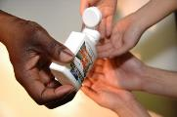
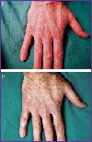
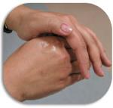
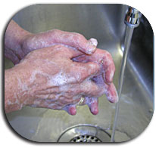
Working Together Is Essential

Slide 4
What are the characteristics of interdisciplinarity?

Slide 5
A continuum of collaboration
Interactions may range from simple communication to the mutual integration of organizing concepts, methodology, procedures, epistemology, terminology, data, and organization of research and education
(OECD [1998] quoted in Morillo, Bordons, and Gomez [2003, p. 1237])

Slide 6
Outcome of the collaboration
Solution to a discreet problem,
A single or group of publications,
Development of a new field and/or language
The process of the interdisciplinary endeavor itself
Synthesis between disciplines

Slide 7
Example of Varying Models
Anthropology
Epidemiology
Numbers
Scientific
Quantitative
Measures of Association
Statistical Models
Logical Positivism
Study what you can measure
Text
Humanistic
Qualitative
Relationships
Cultural Models
Constructivism
Study meaning

Slide 8
Hence, we come to the table with differing perspectives, values, language and expectations
No wonder there is confusion!

Slide 9
It often starts as serendipity
Study to assess impact of an ICU architectural change
Isolation rooms not associated with reduced nosocomial acquisition of organisms or improved hand hygiene
“We conclude that many patient-staff interactions
in an ICU are not followed by handwashing, and that the new unit design had no apparent effect upon the frequency of handwashing or over-all incidence of colonization and infection in
the ICU.”
Preston, Larson, Stamm. Am J Med 1981;70 (3):641‑645.

Slide 10
A Wake-Up Call
Healthcare-associated infections are common. Are they preventable?
Hand hygiene is supposed to be a primary prevention strategy, but
Not everyone believes in hand hygiene
Not everyone does it
Larson, Killien. AJIC 1982; 10:93.

Slide 11
Phase 1: Descriptive/Correlational
What do we need to know?
What’s on the hands of health care professionals?
What are hand hygiene practices of health care professionals?
(Exploratory, Descriptive)
What is evidence of a link between hands and infections?
(Correlational)
What skills are needed?
Clinical, microbiology, epidemiology
What skills do I have?
Clinical only. Get advanced degree, seek collaborators

Slide 12
Collaborative team
Surgeon
Epidemiologist
Nursing staff and administration
Microbiologist
Statistician
Dermatologist

Slide 13
Persistent Carriage
ICU staff persistently carried on hands one or more of 22 species of gram-negative bacteria.
21%of 541 healthcare-associated infections over a 7-month period in the study institution were caused by species found on personnel hands.
Larson, AJIC 1981; 9:112

Slide 14
Handwashing After Contact With Infected Patient (n=372)

Slide 15
Handwashing After Contact with Isolated Patient (n=372)

Slide 16
Handwashing by Discipline (n=372)
Larson. Compliance with isolation technique. Am J Infec Contr 1983;11:221‑225

Slide 17
Larson E, et.al. J Clin Microbiol l986; 23:604‑608.

Slide 18
Differences by Discipline
Physicians had higher counts than nurses
Nurses had higher rates of antimicrobial-resistant flora than physicians
Rank order of antimicrobial resistance:
Bone marrow transplant staff
Patients hospitalized 30+days
Dermatology staff
Normal controls
Horn, Larson , McGinley, Leyden. Infec Control Hosp Epidemiol, 1988; 9:189-93.

Slide 19
Comprehensive Reviews
Larson E. A causal link between handwashing and risk of infection? Examination of the evidence. Infect Control Hosp Epidemiol 1988;9:28-36.
Aiello AE, Larson EL. What is evidence for a causal link between hygiene and infections? Lancet Infec Dis 2002; 2:103-110.

Slide 20
Phase 2. Interventional
What do we need to know?
Does hand hygiene make a difference in infections?
How can we improve hand hygiene practice?
What additional skills are needed to address the question?
Change theory, behavioral sciences, clinical trials, systems theory

Slide 21
Additional Team Members
Psychologist
Industrial Engineer
Sociologist
Infectious disease physician

Slide 22
Intervention Comparison Feb-June and Sept-Dec 98 (8 months)
477,680 handwashes recorded
382,887 handwashes recorded

Slide 23
Intervention Comparison
109,732 patient days monitored
29 VRE, 54 MRSA infections
Larson, Early, Cloonan, Sugrue, Parides. Behav Med 2000; 26:14-22.
236,989 patient days monitored
80 VRE, 55 MRSA infections

Slide 24
Mean handwashes/ patient care day

Slide 25
MRSA Rates/1000 Patient Days

Slide 26
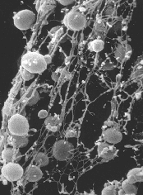
Change from Baseline : MRSA
Intervention Hospital:
33% decrease
Comparison Hospital:
31% increase
p<0.0001

Slide 27
VRE Rates/1000 Patient Days

Slide 28
Effect of Staff Hand Hygiene on Healthcare-Associated Infection in Neonates
Arch Peds Adoles Med 2005; 159:377
1 R01 NR05197

Slide 29
Nurse Staffing
3,155 neonates admitted
Final sample 2,675 (< 48 hrs excluded)
374 neonates with infection
114 with more than one infection

Slide 30
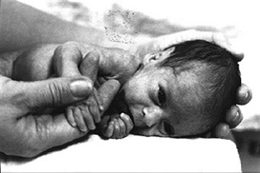
Healthcare-Associated
infection
Low RN hours (HR 1.75)
Conjunct.
(longer)
High total nursing
hours (HR 0.51)
LOS
(shorter)
High RN
skill mix
BSI
Low total nursing hours (HR 2.56)
Low RN hours (HR 3.71)

Slide 31
Summary
New RN graduates acquired a shared clone of methicillin resistant staphylococci within 4-12 weeks
Higher nurse staffing was associated with fewer infections and shorter length of stay among neonates in the NICU
Cimiotti, Wu, Della-Latta, Nesin, Larson. Emergence of resistant staphylococci on the hands of new graduate nurses. Infec Contr Hosp Epidemiol 2004; 25:431-435.

Slide 32
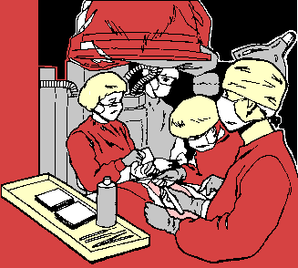
Sequential Trial: ALC or CHG
Two products:
Detergent w/4%CHG
61% ethyl ALC, 1% CHG, and emollients
20 OR staff used each product for 3 weeks sequentially
Larson, et al. AORN J 2001; 73:412

Slide 33
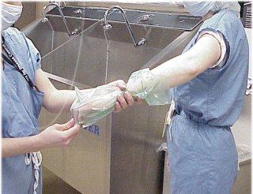
Data Collection
Microbiological Assay

Slide 34
Post-Scrub Microbial Counts

Slide 35
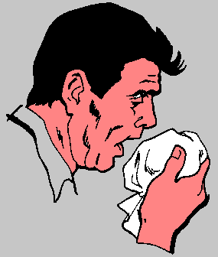
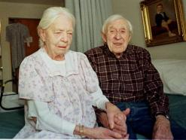
Moving into the Community

Slide 36
Additional Team Members
Sanitarian/health department
Soap manufacturer
Bilingual community health workers

Slide 37
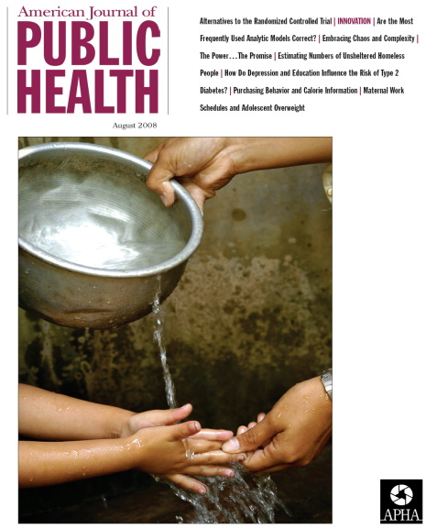
Hand hygiene in the community- is there a significant reduction in infectious illnesses?
Meta-analysis of available studies
Notes:
37

Slide 38
Pooled Efficacy of Hand Hygiene?
Overall, hand hygiene resulted in:
31% reduction in gastrointestinal illness (95% CI, 19% to 42%)
21% reduction in respiratory illness (95% CI, 5% to 34%)
Aiello, Coulborn, Perez, Larson. Effect of hand hygiene on infectious disease risk in the community setting: a meta-analysis. Am J Public Health 2008; 98(8):1372-81
Notes:
38

Slide 39
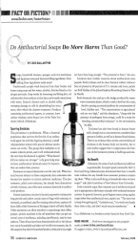
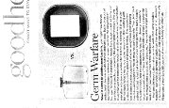
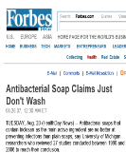
Conclusions
Antibacterial soaps showed no added benefit for reducing illnesses compared to plain soap
Data on alcohol-based hand sanitizers were limited and weak
Notes:
39

Slide 40
Double-Blind, Randomized Clinical Trial of the Effect of Antibacterial Home Products on Infectious Disease Symptoms
Larson E, Gomez Duarte C. Publ Health Nurs 2001; 18:116-127
Larson E, et.al. Ann Intern Med 2004; 140:321-329.
1RO1NR05197

Slide 41
Participants (n=1,178) were….
About 97% Hispanic
About half born outside U.S.
Living in multi-unit apartment buildings in upper Manhattan
99% female heads of households

Slide 42
Rates of at least one symptom/ household month
AB Non Adj RR (95% CI)
Runny nose 26.8 25.6 1.03 (.81-1.32)
Cough 23.2 23.6 .97 (.79-1.18)
Fever 10.2 11.9 .84 (.63-1.12)
Sore throat 10.0 10.3 .95 (.71-1.26)
Diarrhea 2.4 2.9 .90 (.54-1.50)
Vomiting 2.2 3.0 .77 (.47-1.27)
Skin/Eye 0.01 0.01 .46 (.18-1.21)

Slide 43
Log Counts: Baseline and After 1 Year

Slide 44
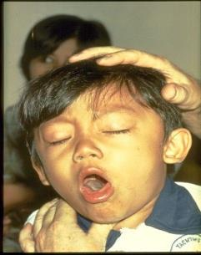
Reducing Influenza

Slide 45
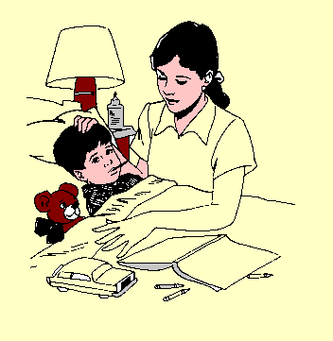
Stopping URIs and Flu in the Family: The Stuffy Trial CDC U01/CI000442
Larson EL, Ferng Y, Wong-McLoughlin J, Wang S, Haber M, Morse SS. Impact of non-pharmaceutical interventions on URIs and influenza in crowded, urban households. Public Health Rep 2010; 125:178-191.
Notes:
45

Slide 46
Enrolled Households
Enrolled Households (Members)
509 (2,788)
Control (education only)
174 (904)
Alcohol Hand Sanitizer
169 (946)
Alcohol + Face Masks
166 (938)

Slide 47
Average Number of Symptoms/Individual/Quarter
1.2
Runny Nose
Sore throat
Cough
1.0
Fever <= 100F
Fever > 100F
Malaise
0.8
Headache
Average number of symptoms
0.6
0.4
0.2
0.0
Winter07
Spring07
Summer07
Fall07
Winter08
Spring08
Quarter
Households with at least one symptom reported: 83.3% (424/509)
Notes:
47

Slide 48
Influenza-like Illness (ILI)
REPORTED ILI EPISODES
669
Samples Collected
234
Missed/Refused
93
Unable to Reach
29
Did Not Meet
ILI Definition (URI)
313
Positive for Influenza
78
Negative for Influenza
156†
Inaccurate report
167
ABX prescribed
146*
Flu A:
34
Flu B:
44
† Among the 156 negatives for influenza, there were seven RSV, one paraflu type 1, three paraflu type 2, five paraflu type 3, eleven enterovirus, ten rhinovirus, six adenovirus and five human metapneumo-virus.
*46.6% were diagnosed to have a bacterial infection and prescribed an antibiotic
Notes:
48
48

Slide 49
Influenza-like Illness (ILI)
p-value: 0.61*
Notes:
Last updated: 08.20.2008

Slide 50
Lab Confirmed Influenza
p-value: 0.57
Notes:
Last udpated 08.20.2008

Slide 51
Secondary Cases of Flu/ILI/URI
INTERVENTION GROUP | Relative Risk (95% Confidence Limits) | P VALUE
Education Group | Ref | p-value: 0.02*
Hand Sanitizer Group | 1.01 (.85, 1.21)
Hand Sanitizer + Mask Group | 0.82 (.7, .97)
*Regression controlling for gender, age group, whether or not born in the U.S., number of hours/week spent outside of the home, whether or not he/she had a chronic respiratory illness such as asthma, and influenza vaccination status, household crowding
Notes:
51

Slide 52
Conclusions
No significant difference between intervention groups in terms of numbers of URI or flu, but secondary attack rates lower in mask group
Increased knowledge and attitude scores and vaccination rates in all households
Low compliance with mask wearing
Need for improved rapid influenza tests

Slide 53
Team Members
Stephen S. Morse, PhD
Left to right: Maria Alvarez-Cid, Maria Jose Gonzales, Jennifer Wong-McLoughlin, Elaine Larson, Angela Barrett, Yu-hui Ferng
Shuang Wang, PhD

Slide 54
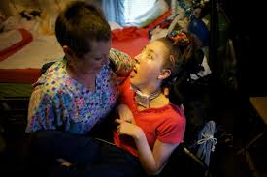
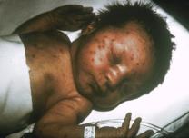
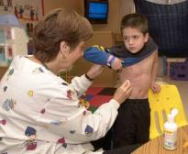
Next…Pediatric Longterm Care

Slide 55
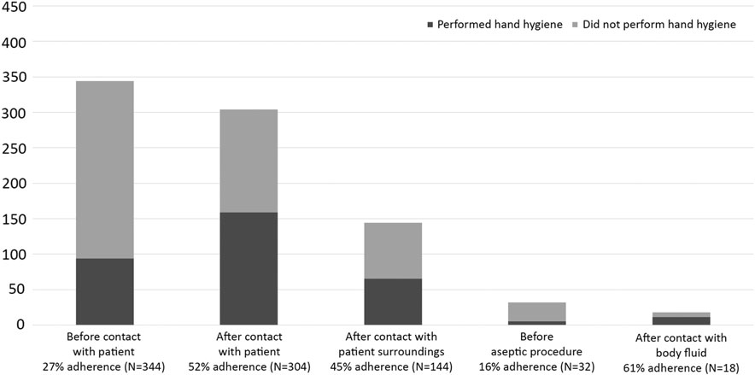
Staff Observations

Slide 56
Qualitative Work Needed!
Despite a multifaceted intervention in three pediatric longterm care hospitals, hand hygiene practices were unchanged
We wanted to understand why

Slide 57
Staff Interviews
Themes | Subthemes
Hand Hygiene Products | Perceptions/preferences Availability/access
Knowledge, Attitudes, Perceptions, Beliefs | Internal/external motivation “Us” vs. “Them” Applicability of ‘5 Moments’
Barriers to IP practice | Patient characteristics Access to/timeliness of data Workflow/setting Low priority
Suggested Improvements | Fun Firm | Feedback Fine

Slide 58
Family Interviews
Themes | Subthemes
Everyone Follows the Rules | Staff is competent Visitors are vigilant
Infections are Inevitable | Germs are everywhere Children are susceptible

Slide 59
Larson EL, et al. Behavioral interventions to reduce infections in pediatric longterm care facilities: The Keep It Clean for Kids Trial. Behav Med 2017; Mar 3:1-10.
Saiman L, et al. Incidence, risks, and types of infections in pediatric long-term care facilities. JAMA Pediatr 2017; 171:872-878.
Loyland B, et al. Staff knowledge, awareness, perceptions and beliefs about infection prevention in pediatric long-term care facilities. Nurs Res 2016; 65:132-141.
Wilmont S, et al. Family experiences and perspectives on infection prevention in pediatric long-term care. Rehab Nurs J 2017, Jun 19.

Slide 60
Phase 3: Impact on Clinical Practice and Policy
What do we need to know?
How can standards for testing products and performing hand hygiene be changed?
What additional skills are needed to address the question?
Political process, rules and regulations of regulatory and professional organizations, grantsmanship (from the grantor’s perspective)

Slide 61
Additional Team Members
CDC, WHO
FDA, EPA
Economists
News media (through University Public Affairs and professional organizations)
Professional organization leadership
Lobbying groups
The Joint Commission, CMS

Slide 62
Practice Guidelines Are Not Enough
Site visits at 40 US NNIS hospitals to assess impact of CDC Hand Hygiene Guideline
89.8% of 1359 ICU staff members were familiar with the Guideline
Alcohol products readily available in all hospitals
Hand hygiene rates remained low (mean, 56.6%)
Catheter-associated bloodstream infection rates significantly lower in hospitals with higher rates of hand hygiene (p<.001)
Larson, et al. AJIC 2007; 35:666 (1 RO1 NR008242)

Slide 63
Staff Hand Hygiene For Contact with Isolated Patients (n=1,001): Does 27 years make a difference?
Larson, AJIC 1983; 11:221. Clock, AJIC 2010; 38:105
U50 CD300860-21 (TS-1431)

Slide 64
Mean Additional Costs
 | Healthcare-Associated | Community-Associated
Charges | $18,990 | $32,400
Length of stay | 2.2 days | 4.2 days
Deaths | 4% | 3%
5R01NR10822
Neidell MJ, Cohen B, Furuya Y, Hill J, Jeon CY, Glied S, Larson EL. Costs of healthcare- and community-associated infections with antimicrobial-resistant versus antimicrobial-susceptible organisms. J Clin Infect Dis 2012; 55:807-815

Slide 65
Impact on Clinical Practice and Policy
Standard setting for evidence-based practice
Testing and product regulation
National research agenda
Public practice
Professional organizations, CDC, WHO, Joint Commission, CMS
FDA, EPA
NIH, other funders, IOM Report
Media

Slide 66
So, where are we? What next? Where do you fit in?
Behavioral and systems interventions—make it easier to do the right thing and difficult to do it wrong (electronic monitoring of practice, sanitizers, align incentives)
More flexible and efficient research methods: comparative effectiveness research, practice-based evidence, modeling and simulation

Slide 67
Common Elements for Success
Clearly articulated purpose
Strong leadership
Contributions by all partners
Funding
Work products
Minimal waste of time and resources

Slide 68
A Final Challenge
Evaluate (formative and summative) the outcomes of your collaboration!!
Is the research collaborative effective and cost effective?
Are results sustainable?
How can it be more effective?
Qual Saf Health Care 2002; 11:345-351

Slide 69
Centuries of scientific observation and of prophets wise have shown us what we know defines what we know not, and there is where our future lies.
Hall. J Infect Dis 2013:207: 1028.

Slide 70
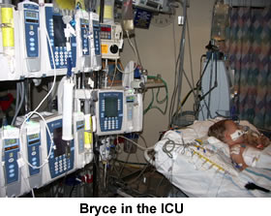
Here’s Why We Do It
Stella
Simon
Carlos
Nils
Evelyn, Nathan

Slide 71
Sincerest Gratitude
To a legion of colleagues and collaborators

Slide 72
