Slide 1
CONTROL OF CARBAPENEMASE-PRODUCING ENTEROBACTERIACEA IN AN ENDEMIC SETTING: DO CLASSICAL IPC METHODS WORK FOR NEW AGE BUGS?
Adj. Asst. Prof. Kalisvar Marimuthu
Department of Infectious Diseases, Tan Tock Seng Hospital, Singapore
HAI surveillance unit, National Centre for Infectious Diseases, Singapore
Division of Medicine, National University of Singapore
e-mail: Kalisvar_Marimuthu@ttsh.com : kalisvar Marimuthu (@Kalisvar)
Hosted by Jane Barnett jane@webbertraining.com
www.webbertraining.com
December 12, 2018

Slide 2
Content
Mechanism of carbapenem resistance
Mechanism of resistance and epidemic potential
Mechanism of resistance and risk factors
Elements of CPE control strategies (WHO multimodal Infection prevention and control strategy)
Identifying asymptomatic CPE carriers
Implementing high-risk screening
Implementing contact precaution
Geographical separation of and contact precaution for CPE carriers
Environmental hygiene
2

Slide 3
Singapore is endemic for major CPEs
Kalisvar et al; CID 2017:64 (Suppl 2)
3

Slide 4
Mechanisms of carbapenem resistance in Enterobacteriaceae
Carbapenem-resistant Enterobacteriaceae
(CRE)
Carbapenemase production: KPC, NDM, OXA-type
(CPE)
Mixed mechanisms:
Extended-spectrum beta-lactamases (ESBL) or AmpC production +
porin mutation or
upregulation of efflux pumps
(NCPCRE)
4

Slide 5
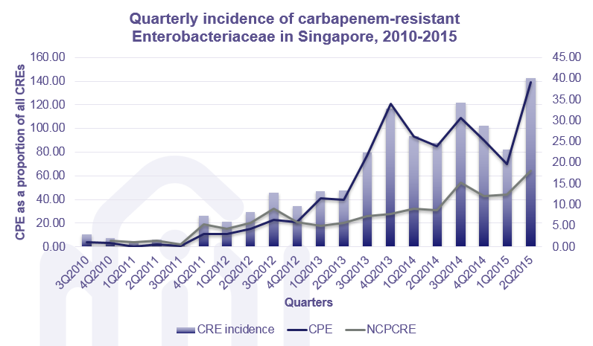
Mechanism of resistance and epidemic potential
Since the introduction, CPE had easily taken over NCPCRE
Kalisvar et al; CID 2017:64 (Suppl 2)
5

Slide 6
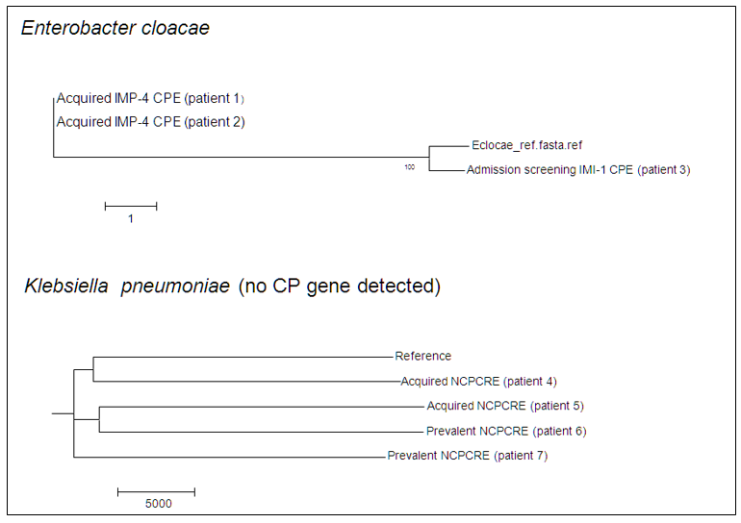
Mechanism of resistance and epidemic potential
In a prospective ICU screening study, none of the ICU acquired NCPCREs were clonally related.
Two IMP-4 CPEs acquired in ICU were clonally related.
Chia, P.Y. et al. Manuscript under review
6

Slide 7
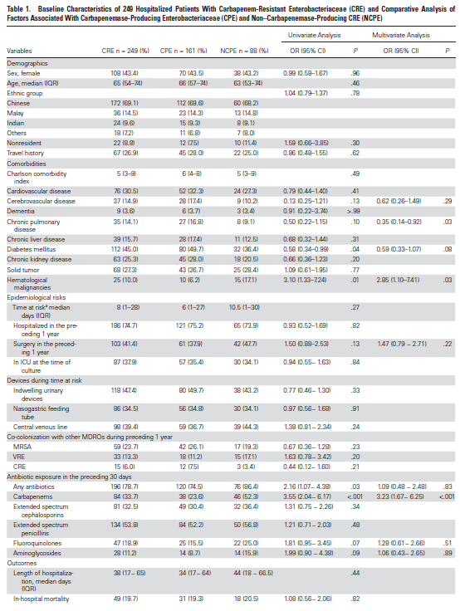
Mechanisms of resistance and risk factors
7

Slide 8
Mechanisms of resistance and risk factors
Authors’ discussion:
The main finding of our study was that, when considering independent risk factors, Porin-ER-Kp isolation,more than KPC-CR-Kp, was associated with the number of prior antibiotics, specifically carbapenems, second- and
third-generation cephalosporins.
Also, in the univariate analysis, the number of antibiotics, types of antibiotics and days of preceding exposure were more strictly related to Porin-ER-Kp strains than KPC-CR-Kp strains.
Orsi, G.B. et al. Infection (2013) 41:61–67
8

Slide 9
General classification of control strategies for multidrug-resistant organisms
Horizontal vs Vertical strategies
Horizontal: Hand hygiene, decolonization
Vertical: Active surveillance and contact precautions
Reactive vs Proactive strategies
Reactive: Contact tracing
Proactive: Active surveillance of high risk patients
Endemic vs outbreak setting
Coordinated vs individual approach
Endemic: Containment will usually be the aim
Outbreak: Eradication can be the aim
Coordinated: Planning, implementation, monitoring and feedback for all units
Decentralised: Planning, implementation and monitoring by individual units
9

Slide 10
Elements of multimodal IPC strategy: Ground-level
Admission screening: High risk patients
Screen before transfer to high risk units
Screen linked contacts
CPE from screening cultures
CPE from clinical cultures
Vertical measures
Horizontal measures
10

Slide 11
Elements of multimodal IPC strategy: Ground-level
Admission screening: High risk patients
Screen before transfer to high risk units
Screen linked contacts
CPE from screening cultures
CPE from clinical cultures
CPE status: life-long
Single room Isolation or cohort
CPE status: life-long
Electronic tagging of CPE carriers
Electronic tagging of CPE carriers
Vertical measures
Horizontal measures
11

Slide 12
Elements of multimodal IPC strategy: Ground-level
Admission screening: High risk patients
Move to vertical?
Enhancement of hand hygiene compliance
Enhancement of environmental hygiene
Antimicrobial stewardship program
Screen before transfer to high risk units
Screen linked contacts
CPE from screening cultures
CPE from clinical cultures
CPE status: life-long
Single room Isolation or cohort
CPE status: life-long
Electronic tagging of CPE carriers
Electronic tagging of CPE carriers
Vertical measures
Horizontal measures
12

Slide 13
Asymptomatic CPE carriers: sources
High-risk screening
Asymptomatic carriers
Others:
Prevalence screening
Contact screening
13

Slide 14
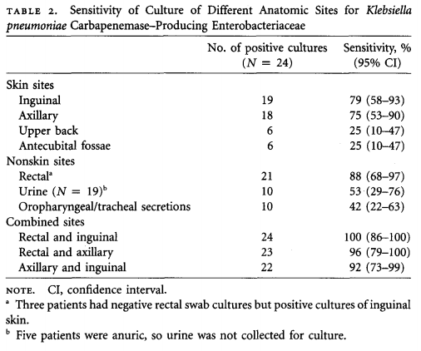
Anatomical site and sampling frequency
Which anatomical site(s) to screen?
No systematic comparative study to identify the most efficacious site(s) to screen
Rectum is the commonest anatomical site to be screened
If rectal swab cannot be done, then stool can be sent for screening
A cross sectional microbiological survey on CRE identification, showed that as a single site, rectum is the best
How many samples are needed?
No systematic studies
Most guidelines suggest repeated sampling
Most centres do convenience sampling
Repeated sampling is probably appropriate for centres
Thurlow, C. J. et. al. ICHE 2013
14

Slide 15
Implementing high-risk screening
AUDIT is a MUST!
15

Slide 16
Screening of high-risk patients
Implementing high-risk screening
Implementing screening of epidemiologically-linked patients (contact screening)
Effectiveness of high-risk screening
16

Slide 17
Issues to consider in implementing high-risk screening
Definition of high-risk patients
Based on local epidemiology
Responsibilities must be clearly defined
Who will identify high-risk patients?
How will they identify high-risk patients?
Who will order the test for rectal screening cultures?
Who will collect the rectal screening cultures?
Who will review the results?
Who will take actions on the results?
Audit the compliance to high-risk screening
17

Slide 18
High-risk patients: definition
Guided by local epidemiology
Hospitalization in the preceding 1 year (all hospitals)
Overseas hospitals
Hospitals other than primary institution
All hospitals
Before and/or transfer to stepdown wards*
Before and/or after transfer to intensive care units (ICUs)*
Before and/or after transfer to haematology/oncology units*
18

Slide 19
Who will identify high-risk patients
Epidemiologically linked contact screening (ELCS)
High-risk screening (HRS) (Doctor lead)
(Hospitalization in endemic countries) + ELCS
HRS- doctor led
(Hospitalization other than own) + ELCS
HRS (Nurse and doctor lead) + ELCS
NDM-1 (NDM-1 SG January 2010)
Oct 2010
IMP in TTSH (IMP SG 1996)
IMI-1 in (IMI-1 SG 2012)
2011
OXA
(SG Jan 2013)
KPC (KPC SG 2011)
2012
2013
2014
2010
2010
2011
2012
2013
2014
2015
2016
Today
Infection control nurses identified and ensured screening for high-risk patients from January 2018.
Compliance to high-risk screening increased to 95%
19

Slide 20
Who will identify high-risk patients
Compliance audits
Epidemiologically linked contact screening (ELCS)
High-risk screening (HRS) (Doctor lead)
(Hospitalization in endemic countries) + ELCS
Compliance<10%
HRS- doctor led
(Hospitalization other than own) + ELCS
Compliance<15%
HRS (Nurse and doctor lead) + ELCS
NDM-1 (NDM-1 SG January 2010)
Compliance 40-50%
Oct 2010
IMP in TTSH (IMP SG 1996)
IMI-1 in (IMI-1 SG 2012)
2011
OXA
(SG Jan 2013)
KPC (KPC SG 2011)
2012
2013
2014
2010
2010
2011
2012
2013
2014
2015
2016
Today
Infection control nurses identified and ensured screening for high-risk patients from January 2018.
Compliance to high-risk screening increased to 95%
20

Slide 21
Identifying high-risk patients
During phase 1 (July 2013–March 2014), surveillance cultures were obtained following physician orders.
During phase 2 (April 2014–December 2014), surveillance culture orders were ordered at the discretion of the nursing staff. Finding: Significantly more high-risk patients were screened following the intervention in phase 2 than following the intervention in phase 1. The number of CREs identified also increased during phase 2 compared with phase 1, but these numbers were not significantly different.
Chia, G. et al. Infection control & hospital epidemiology 37.2 (2016): 238-239.
21

Slide 22
Keeping KPCs away with high risk screening!
HRS hospital is endemic for NDM, OXA, IMI, and IMP
>90% of KPCs identified at HRS hospital are from high-risk screening (HRS)
HRS hospitals remain free from active circulation of KPC, most probably due to HRS (needs to be scientifically evaluated)
Unpublished data
22

Slide 23
Implementing screening of epidemiologically-linked contacts (Contact screening)
AUDIT is a MUST!
23

Slide 24
Contact screening: Main strategy
Epidemiologically linked contact screening (ELCS)
Active surveillance cultures (ASC)
(Hospitalization in endemic countries) + ELCS
ASC- doctor led
(Hospitalization other than TTSH) + ELCS
ASC (Nurse and doctor lead) + ELCS
NDM-1 (NDM-1 SG January 2010)
10/10
IMP (IMP SG 1996)
IMI-1 (IMI-1 SG 2012)
1/11
OXA
(SG Jan 2013)
Watching for VIM, GES etc.
KPC (KPC SG 2011)
1/12
10/13
10/14
11/15
2010
2010
2011
2012
2013
2014
2015
2015
Today
Contact tracing has been part of strategy for CPE control since 2010
24

Slide 25
Issues to consider in implementing contact screening
Definition of epidemiologically-linked contacts
Usually based on outbreak experience and expert opinion
Ease of implementation
Risk assessment
Involved unit
Patient profile
Genotype?
Bacterial species?
Available fund and manpower
Responsibilities must be clearly defined
Who will identify contacts?
How will they identify contacts?
Who will order the test for rectal screening cultures?
Who will collect the rectal screening cultures?
Who will review the results?
Who will take actions on the results?
Audit the compliance to high-risk screening
25

Slide 26
Epidemiologically-linked patients (contacts): definition
Definition is not widely available
Revolves around spatial and temporal overlap
Options for spatial overlap:
Patients sharing the hospital
Patients sharing the same ward
Patients sharing the same room/cubicle
Options for temporal overlap:
Any duration of overlap in the defined space
Duration of overlap for X number of days
Example:
Who: All patients who overlapped in the same ward with the index patient
Risk duration: Date of admission (or date of last negative CPE screen) to date of CPE culture of Index patients
Duration of overlap: any duration
26

Slide 27
Contact screening implementation flow
Identification of index patients
Generation of list of contacts
Ordering of tests
ICNs
Ward nurses (prompted by ICNs)
Ward nurses
ICN
(in-house electronic system)
Collection of samples
Review of results
IPC action and dissemination of information
ICNs
ICNs
Compliance audit
Internal (ICNs) and external (HAI surveillance team)
Compliance ranges from 75-90%
27

Slide 28
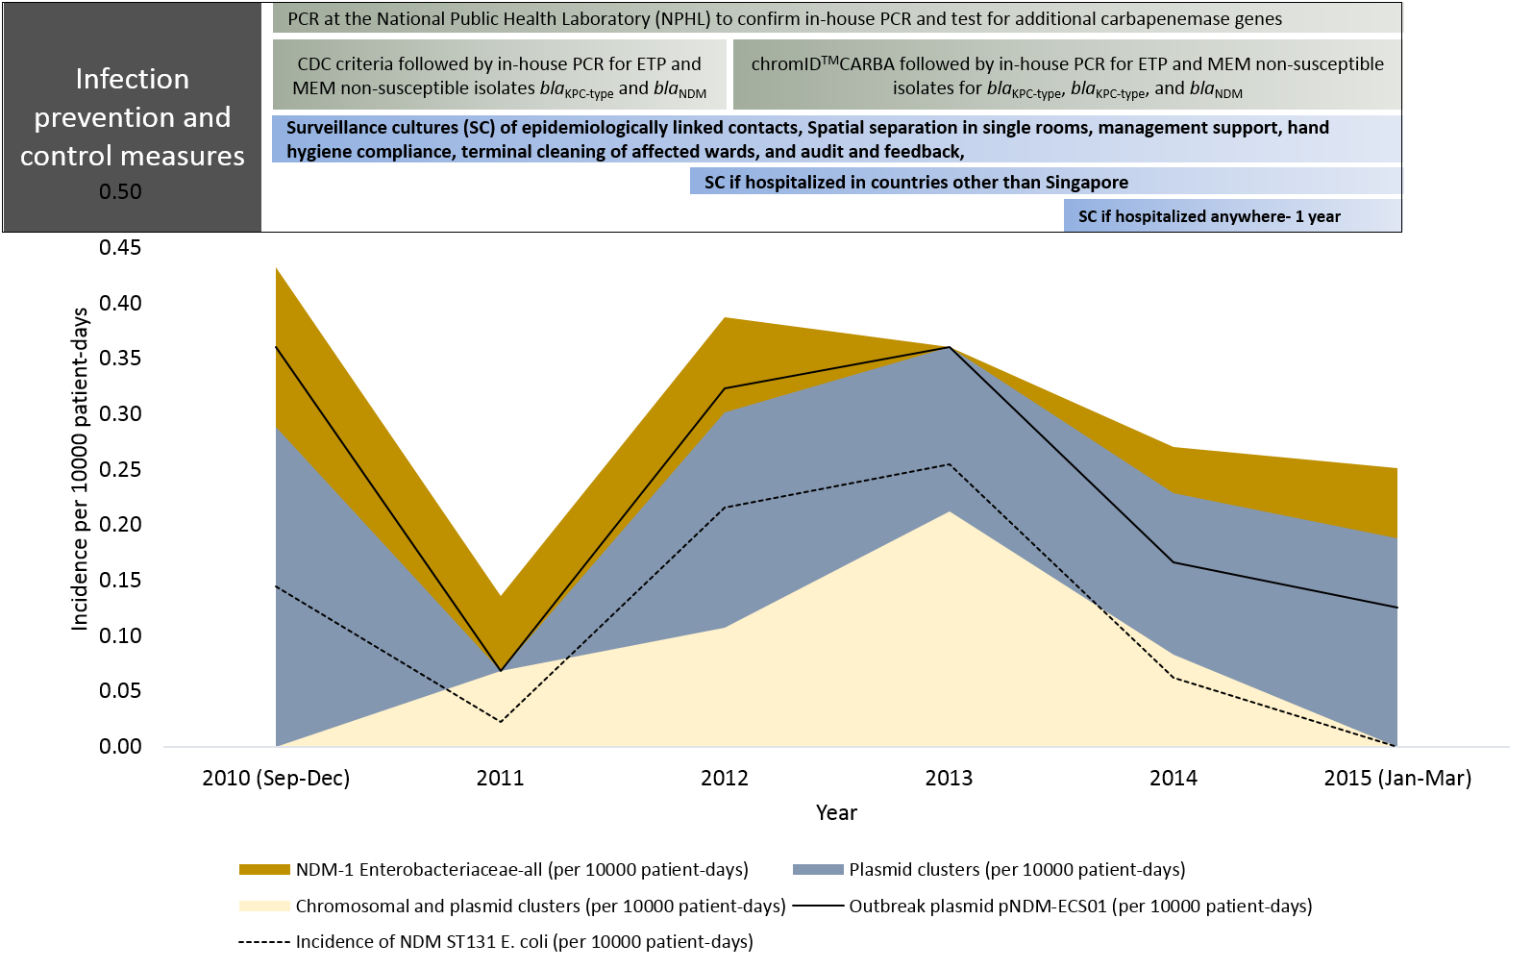
Effectiveness of CPE control strategies for NDM
Clonal transmission of NDM-1 Enterobacteriaceae was controlled with classical IPC methods
Plasmid mediated transmission is still ongoing
28
P0783: ECCMID 2018

Slide 29
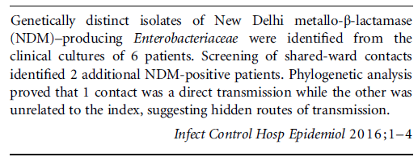
Downside of reactive infection control strategy
29

Slide 30
Dissemination of information
30

Slide 31
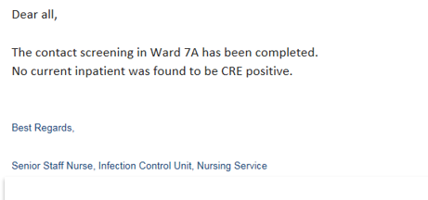
Information dissemination to the healthcare team
At the point of identification
Follow-up
31

Slide 32
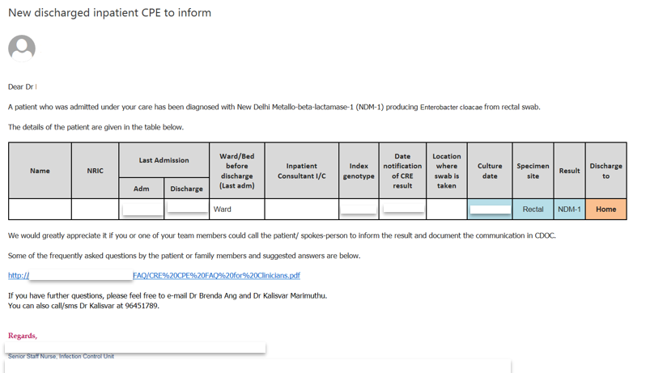
Informing affected patients
32

Slide 33
Effectiveness of identifying asymptomatic carriers
With increasing detection and physical separation of asymptomatic carriers, a decrease in CPE clinical cultures was noted
Kalisvar et al; CID 2017:64 (Suppl 2)
33

Slide 34
Downstream impact of CPE identification
Transfer to rehabilitation facilities
Transfer to nursing homes
Discharge to own homes (concerns from families)
Lack of isolation rooms and problems with cohorting
34

Slide 35
Geographical separation of and contact precaution for CPE carriers
Geographical separation
Contact precaution
35

Slide 36
Geographical separation
Support from hospital management, nursing team, and medical team is critical
Usually affected by:
Bed occupancy rate
Availability of single rooms
Various methods of geographical separation
Single room isolation
Lack of single rooms
Whole ward cohorting
Lack of sufficient patients to fill the wards at
Nested cohorting within a “clean” ward
Risk of transmission to “clean” patients
36

Slide 37
Contact precaution
Contact precaution
Most international guidelines recommend contact precaution when managing patients with CPE
The evidence for benefit is inferred from outbreak control bundles
Generally should include:
Gown
Gloves
± masks
Compliance audit is a must but there is a lack of standard audit protocol
More studies are needed
37

Slide 38
Environmental hygiene
Environmental contamination and CPE
Evidence for environment
Problematic surfaces
Cleaning methods
Sinks and CPE
Burden of proof
How to handle sinks?
38

Slide 39
Hidden transmission of CPE: role of hospital environment
Methods:
Over a 5-year period (2010 to March 2015) all NDM-1-producing Enterobacteriaceae (NDM-E) from a 1700-bed teaching hospital were whole-genome sequenced
Genomically-linked plasmid-mediated NDM horizontal transmission was defined based on inter-isolate shared plasmids
Hidden transmission was defined as genomically-linked NDM-positive subjects detected only by clinical cultures and not by surveillance cultures
Spatiotemporal ward overlap was defined as the contact patient sharing a ward with a known CPE-carrier for at least 24 hours
Spatial-only ward overlap was defined as the contact patient sharing a ward with a CPE carrier regardless of time overlap
Results:
P1102: ECCMID 2018
39

Slide 40
These pathogens are survivors
Stephanie J Dancer. Clinical Microbiology Review 2014.
40

Slide 41
20 studies were included in the final review
13 studies on UVL system and 7 studies on HPV system
41

Slide 42
Summary of the two systems
Criteria | UVL system | HPV system
Number of studies | 13 | 7
Specifics | Pulsed Xenon UVL (n=8) UV-C radiation (n=4) Unspecified (n=1) | Not mentioned
Countries | US (n=13) | US (n=4) UK (n=2) Australia (n=1)
After terminal cleaning | All studies | All studies
Study years | 2011-2014 | 2005-2012
Outcome measures
CDI rates | 11 (6 high baseline rates) | 6 (2 high baseline rate)
MRSA rates | 4 | 3
VRE rates | 4 | 2
MDR Gram-negatives | 2 | 0
HAI rates | 1 | 0
SSI rates | 1 | 0
42

Slide 43
HPV for everything…
Average down time 4-7 hours
And…
43

Slide 44
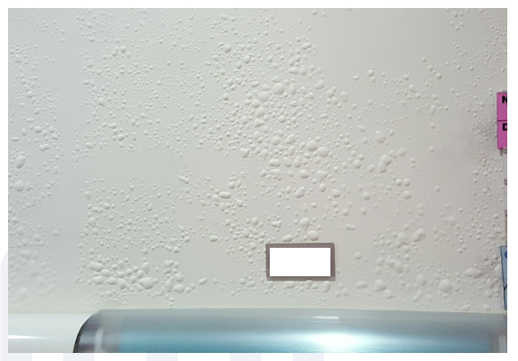
Walls were allergic to H2O2!
Beware of the type of paint!
44

Slide 45
Sinks: Can’t live without them?
Hand hygiene sinks are more commonly implicated than other water sources in healthcare facilities
Commonly implicated pathogens:
Pseudomonas sp.
Enterobacteriaceae
Escherichia coli, Klebsiella pneumoniae, Klebsiella oxytoca, Serratia marcescens, Enterobacter species, Citrobacter species, and Pantoea agglomerans
Non-fermenters
Stenotrophomonas maltophilia, Acinetobacter baumanii, Elizabethkingia meningoseptica
Parkes and Hota. Curr Infect Dis Rep (2018) 20: 42
45

Slide 46
Unfavorable design features
Promotes biofilm formation
Subsequent disruption of biofilm resulting in spread
Parkes and Hota. Curr Infect Dis Rep (2018) 20: 42
46

Slide 47
IPC strategies: still in the works
Cleaning and disinfection/ scaling and disinfection
Effectiveness appears temporary
Interrupts outbreaks but effect seems to be temporary
Disinfectant resistance is a significant problem
Pressurized steam
Short lasting effect for OXA-48
Self-disinfecting traps
Use vibration unit coupled with ultraviolet radiation/heaters
Effects were non-sustained in some studies
Replacement of the sinks and plumbing system
Effects were non-sustained
47

Slide 48
Section summary
There are two distinct (major) mechanisms of resistance of Enterobacteriaceae to carbapenems: CPEs and NCPCREs
NCPCRE is associated more with carbapenem exposure than CPE (case for antimicrobial stewardship)
Acquisition of CPE is probably related more with horizontal transmission (case for infection prevention and control)
High-risk screening and contact screening coupled with geographical separation is effective in controlling CPEs however, strategized implementation is vital
Environmental contamination and subsequent onward clonal transmission plays an important role in CPE transmission during outbreaks and non-outbreak setting
Sink colonization play an important role in CPE transmission to patients
48

Slide 49
Thank you
49

