Slide 1
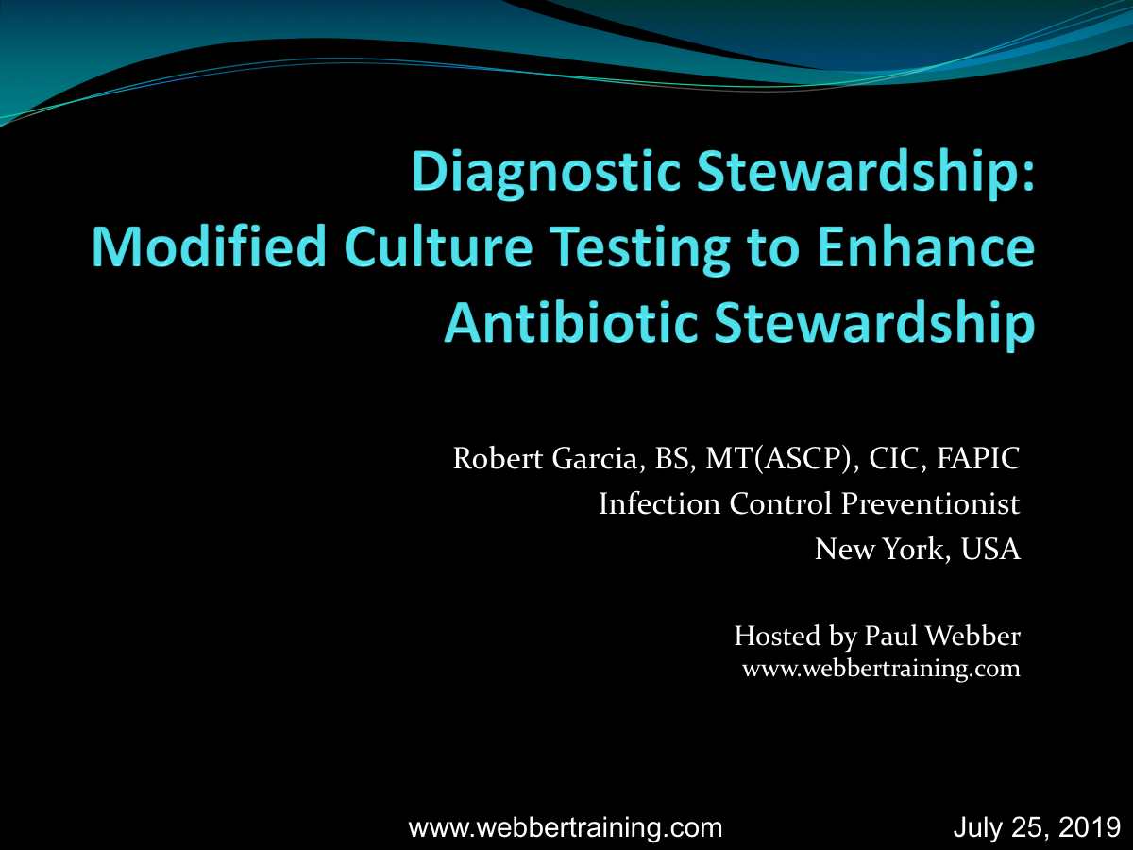

Slide 2
Disclosures
The speaker has provided consultative services to the following:
  The CASPR Group
  BD
  Nanosonics

Slide 3
Lecture Objectives
Describe the impacts of blood and urine cultures have on healthcare outcomes
Describe the potential entry points for contaminant organisms in current collection and handling practices
Review studies that indicate control of urine and blood cultures leads to reduced antibiotic use and negative outcomes

Slide 4
The Effects on Healthcare When Proper
Culture Management is Not Implemented
Clinician
Improper ordering
Systematic review on costs (BC Contamination):
Pharmacy:
  $210-$12,611
Labs:
  $2397-$11,151
Hospital costs:
  $16,200-$111,627
LOS: 1-22 days
Dempsey C, et al. Economic health care costs of BC contamination, AJIC 2018
Nursing
Improper collection
Laboratory
False-positive results, workloads
Pharmacy
Increased costs
ID
Ineffective antibiotic stewardship
IP
Inaccurate analysis
Finance
Increased costs
Patient
Adverse effects including C. difficile

Slide 5
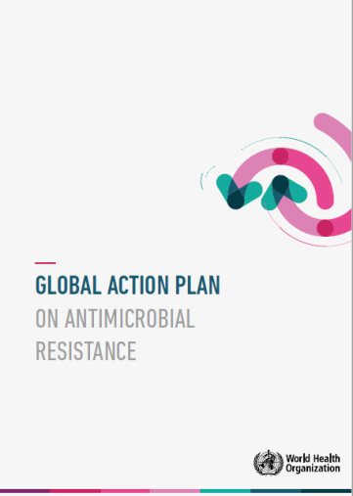


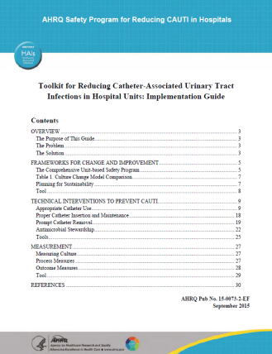
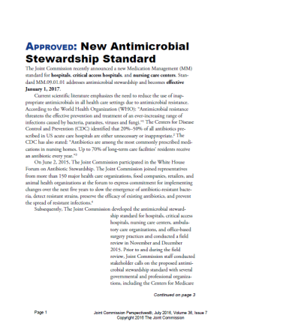
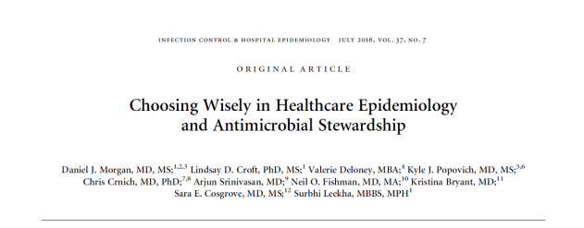
“…don’t perform urinalysis [or] urine culture….unless patients have signs and symptoms of infection….tests can be falsely positive leading to overdiagnosis and overtreatment.”

Slide 6

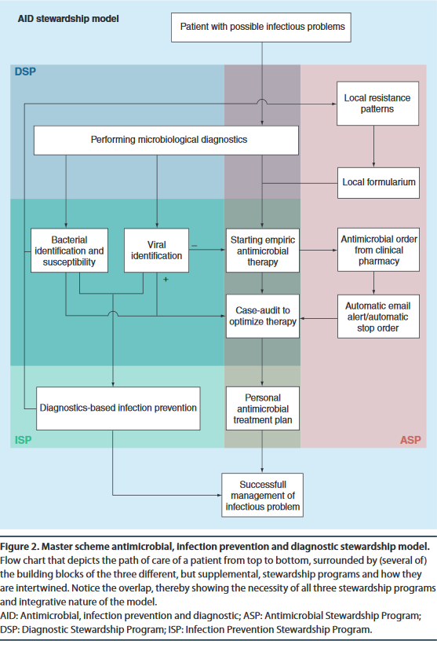
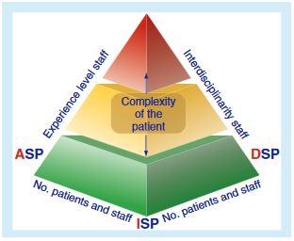
An Integrated Stewardship Model
2015

Slide 7

Antibiotic Stewardship & IP Facts
AS and IP are bound by a common goal: to keep patients safe and improve outcomes, regardless of where care is rendered
A significant world-wide concern are the development of MDROs
Clinicians often order tests for patients without symptoms specific for the disease process, e.g., urine cultures among patients without symptoms of a UTI
AS programs along with IP interventions such as hand hygiene are more effective than AS alone

Slide 8
Goals of AS & IP Programs
Antimicrobial stewardship refers to a collaborative, multidisciplinary program designed to improve (conserve) antimicrobial prescribing to optimize clinical outcomes while minimizing unintended consequences of antimicrobial use
Infection Prevention programs aim to identify significant pathogens, reduce the transmission of organisms and MDROs by emphasizing aseptic technique, hand hygiene, environmental decontamination, and establishing prevention bundles to reduce the occurrence of HAIs
Antimicrobial Resistance: An antimicrobial/diagnostic stewardship and infection prevention approach. Med Clin N Am 2018;102:819-29.

Slide 9
What is Diagnostic Stewardship?
Diagnostic Stewardship is a coordinated system or user-based interventions designed to promote evidence-based utilization of diagnostic tests, with the primary goals of improving value and care quality and safely reducing costs
DS involves modifying the process of ordering, performing, and reporting diagnostic tests in order to direct appropriate antimicrobial therapy
The Microbiology laboratory provides information that identifies if a patient is infected, what the pathogen is, and which antibiotics may be effective in treatment of true infection
Septimus EL. Antimicrobial Resistance: An antimicrobial/diagnostic stewardship and infection prevention approach. Med Clin N Am 2018;102:819-29.
Morgan DJ, et al. Diagnostic Stewardship – Leveraging the laboratory to improve antimicrobial use. JAMA 2017;318:607-8.

Slide 10
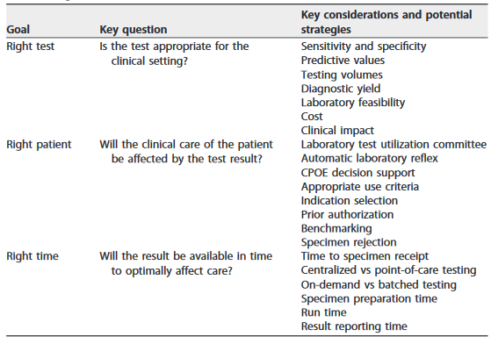
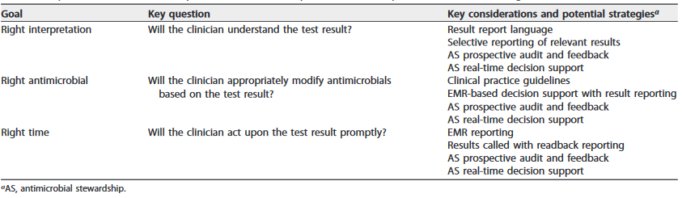
Key Considerations
DS
AS
Messacar K, et al. Implementation of rapid molecular infectious disease diagnostics: the role of diagnostic and antimicrobial stewardship. J Clin Micro 2017;55:715-23.

Slide 11
The 4 Moments for Improving Antibiotic Use
Moment 1: “Does the patient have an infection that requires infection?”
Moment 2: “Have I ordered appropriate cultures before starting antibiotics? What empirical antibiotic therapy should I initiate?”
Moment 3: “A day or more has passed. Can I stop antibiotics? Can I narrow therapy? Can I change from intravenous to oral therapy?”
Moment 4: “What duration of antibiotic therapy is needed for this patient’s diagnosis?”
Tamma PD, et al. Rethinking how antibiotics are prescribed incorporating the 4 moments of antibiotic decision making into clinical practice. JAMA 2018;12/27/18.

Slide 12
Diagnostic Stewardship
DS practices are increasingly common among hospitals, often classified as quality improvement or under the umbrella of AS
DS has a potentially important role in HAI surveillance: HAI surveillance based on current surveillance definitions may over-diagnose HAIs (e.g., CAUTI, CLABSI) by including colonized rather than clinically infected patients or by including organisms that are contaminants rather than true pathogens.
Within the Micro community, the three stages of DS include:
  Pre-analytic – test-related decision making and specimen collection
  Analytic – relating to lab practices including reflex test algorithms
  Post-analytic – includes selective reporting of results
Madden GR, et al. Diagnostic Stewardship for healthcare-associated infections opportunities and challenges to safely reduce test use. ICHE 2018;39:214-18.

Slide 13
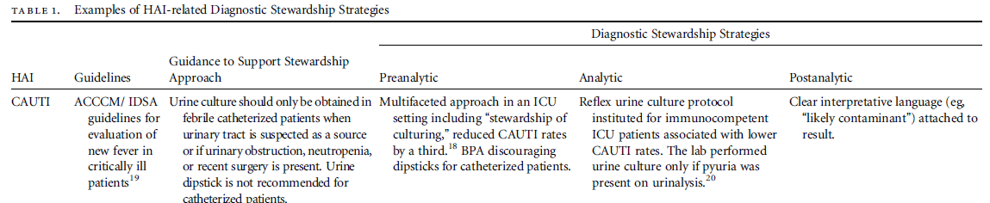
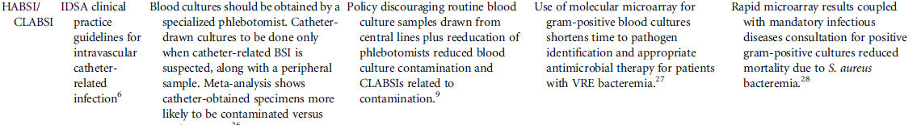
Examples of HAI-Related DS Strategies
Madden GR, et al. Diagnostic Stewardship for healthcare-associated infections opportunities and challenges to safely reduce test use. ICHE 2018;39:214-18.

Slide 14
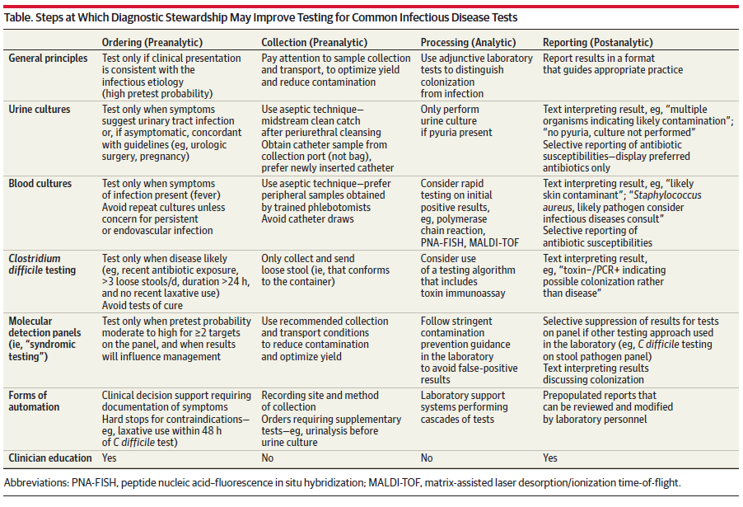
Examples of HAI-Related DS Strategies
Morgan DJ, et al. Diagnostic Stewardship – Leveraging the laboratory to improve antimicrobial use. JAMA 2017;318:607-8.

Slide 15
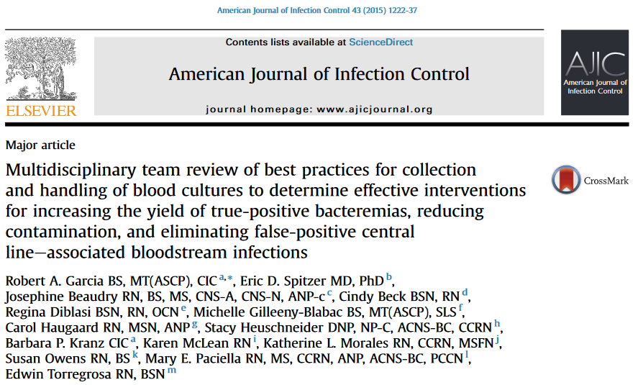
Review Article on Blood Culture Collection and Handling

Slide 16
Reasons for Optimizing Blood Culture Collection & Handling
Identifying true pathogens
Avoidance of blood culture contamination
Avoiding false positive CLABSIs

Slide 17
Need for Maximizing True Pathogens
Septicemia is the 11th leading cause of death in the U.S. accounting for more than 41,000+ lives per year
Sepsis is currently the most expensive hospital condition ($23.6 billion) among inpatients
….has accounted for a 32 percent increase in hospitalizations in recent years
…and is the leading cause of admission to a hospital for adults aged 45 to 84 years after an Emergency Department (ED) visit
Guidelines recommend blood cultures to be obtained within three hours of presentation and prior to administration of antibiotics
CDC, Leading causes of death, US, 2016. available at: https://www.cdc.gov/nchs/data/nvsr/nvsr67/nvsr67_05.pdf
Agency for Healthcare Research and Quality. Healthcare Cost and Utilization Project. Statistical Brief #204. National Inpatient Hospital Costs: The Most Expensive Conditions by Payer, 2013. Available at: https://hcup-us.ahrq.gov/reports/statbriefs/sb204-Most-Expensive-Hospital-Conditions.jsp.
Agency for Healthcare Research and Quality. Healthcare Cost and Utilization Project. Statistical Brief #161. Trends in Septicemia Hospitalizations in Selected HCUP States, 2005 1nd 2010. Available at: http://www.hcup-us.ahrq.gov/reports/statbriefs/sb161.pdf.
Agency for Healthcare Research and Quality. Healthcare Cost and Utilization Project. Statistical Brief #174. Overview of Emergency Department Visits in the United States, 2011. Available at: http://www.hcup-us.ahrq.gov/reports/statbriefs/sb174-Emergency-Department-Visits-Overview.pdf.
Surviving Sepsis Campaign. Updated Bundles in Response to New Evidence. Available at: http://www.survivingsepsis.org/SiteCollectionDocuments/SSC_Bundle.pdf

Slide 18
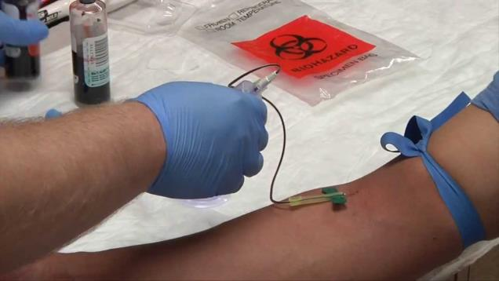
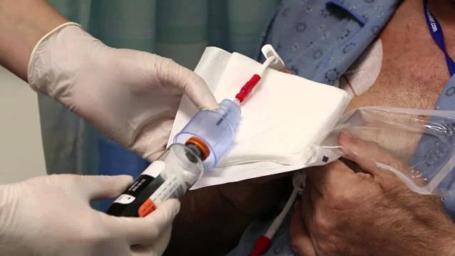
Blood Culture Collection Methods
“Drawing blood for culture may be performed by obtaining the blood peripherally of from an existing intravascular device…..however, both methods have substantial risk of introducing microorganisms that are not present in the blood into the blood specimen”
Hughes, JA, et al. The effectiveness of interventions to reduce peripheral blood culture contamination in acute care: a systematic review protocol. Systematic Rev 2018;7:126.

Slide 19
Blood Culture Contamination
Contaminated BCs are associated with severe financial and clinical consequences
Landmark study by the College of American Pathologists (CAP) of 497,134 BCs obtained in 640 hospitals reported mean contamination rate of 2.5% among all BCs drawn
Approximately 50% of positive BCs represent contamination
Most U.S. hospitals use a BCC benchmark of ≤3.0% as derived from CAP Q-Tracks Monitor data, although this is not a validated benchmark
BCs are considered contaminated if one or more of the following organisms are found in only one bottle in a series of BC sets (e.g., 1 of 1; 1 of 2, etc.):
  CoNS, Micrococcus, alpha-hemolytic viridens strep, Propionibacterium acnes, Corynebacterium sp., Bacillus sp.
Bates DW, Goldman L, Lee TH. Contaminant blood cultures and resource utilization: the true consequences of false-positive results. JAMA 1991;265(3):365-69.
Schifman RB, Strand CL, Meier FA, Howanitz PJ. Blood culture contamination: a College of American Pathologists Q-Probes study involving 640 institutions and 497,134 specimens from adult patients. Arch Pathol Lab Med 1998;122:216-21.
Bekeris LG, Tworek JA, Walsh MK, Valenstein PN. Trends in blood culture contamination: a College of American Pathologists Q-Tracks Study of 356 institutions. Arch Pathol Lab Med 2005;129:1222-25.

Slide 20
BC Utilization Study
Study intended to describe pattern of BC utilization in an academic medical center
In total 38,939 BC sets were drawn over a one-year period (diversion discard tube used)
  No growth – 35,823 (92.0%)
  Pathogens – 2755 (7.1%)
  Contamination – 358 (0.91%)
In 2.5% of BC draws, catheter-related infections were principle diagnosis
Chen AI, et al. Blood culture utilization at an academic hospital: addressing a gap in benchmarking. ICHE 2018:39:1353-59.

Slide 21
Define & Measure (Surveillance): NHSN CLABSI Definitions, 2019
NHSN Footnote: Blood Specimen Collection
In LCBI criteria 2 and 3, the phrase “two or more blood specimens drawn on separate occasions” means:
a. blood from at least two separate blood draws was collected on the same or consecutive
calendar days, and
b. two separate site preparations (decontamination steps) were performed during specimen
collection.
This will reduce misidentification of contaminated blood specimens as LCBIs. For example, aseptic technique indicates that separate site decontaminations would be performed for blood specimens drawn from different sites (in other words; different venipunctures, a combination of venipuncture and lumen withdrawal, or different lumens of the same central line), or at different times. Specimens collected in this manner would therefore be considered “separate occasions”.
Specimen Collection Considerations: Blood specimens drawn through central lines can have a higher rate of contamination than blood specimens collected through peripheral venipuncture. 3, 4 However, all positive blood specimens, regardless of the site from which they are drawn or the purpose for which they are collected, must be included when conducting in-plan CLABSI surveillance (for example, weekly blood cultures performed in hematology and oncology locations).
NHSN, Bloodstream Infection Event (Central Line-Associated Bloodstream Infection and Non-central line-associated Bloodstream Infection), available at: http://www.cdc.gov/nhsn/PDFs/pscManual/4PSC_CLABScurrent.pdf

Slide 22
BCC Effect on CLABSIs
LCBI 1: so called NHSN “recognized pathogens” such as S. aureus or Enterococcus have been identified as contaminants (6.4% and 16.1% respectively) in major study; when a “pathogen” is not related to an infection at another site, as occurs when a contaminant is identified, then the event is a CLABSI
LCBI 2: clinical situations, e.g., patient’s venous condition, limited CVAD lumen access, clinician’s workload may restrict “ideal” blood draws from separate sites or at different times.
There exists no “gold standard” for determining true infection vs. contamination of BCs….this limitation may impact the variability in identifying reportable CLABIs
Freeman JT, et al. Blood culture contamination with Enterococci and skin organisms: implications for surveillance definitions of primary blood stream infections. Am J Infect Control 2011;39:436-48.
Steinberg JP, et al. Distribution of pathogens in central line-associated bloodstream infections among patients with or without neutropenia following chemotherapy: evidence for a proposed modification to the current surveillance definition. Infect Control Hosp Epidemiol 2013;34:171-75.
Backman LA, et al. Validation of the surveillance and reporting of central line-associated bloodstream infection data to a state health department. Am J Infect Control 2010;38:832-38.

Slide 23
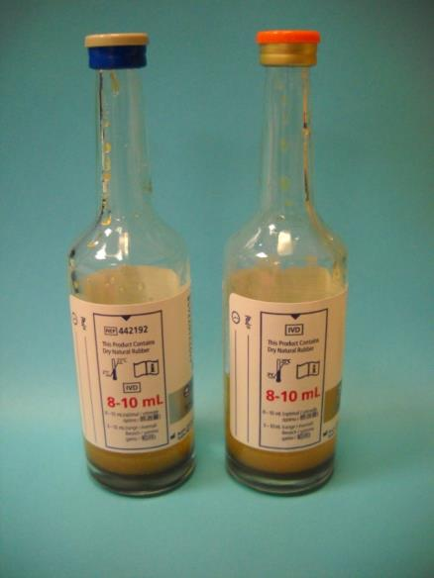
BC Issues Affecting Optimal Outcome
Clinical indications
Site draws: venipuncture vs. intravascular lines
Handling of needleless connectors
Use of pre-packaged kits for BC Drawing
Use of sterile gloves
Use of masks
Skin antisepsis
Disinfection of BC bottle septums
Discarding of initial volume of blood
Recommended volumes of blood
Order of draw
Inoculation of aerobic and anaerobic bottles
Labeling (site of draw)
Transport
Garcia R, Spitzer E. Multidisciplinary team review of best practices for collection and handling of blood cultures to determine effective interventions for increasing the yield of true-positive bacteremias, reducing contamination, and eliminating false-positive central line-associated bloodstream infections. AJIC 2015;43:1222-37.

Slide 24
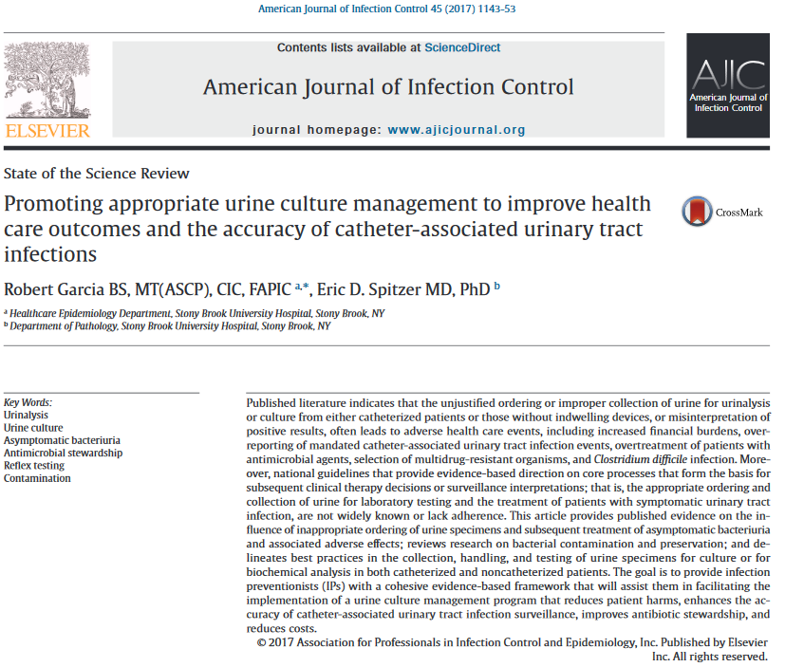
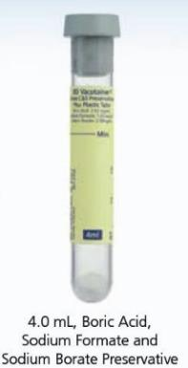
Review Article on Urine Culture Collection and Handling

Slide 25
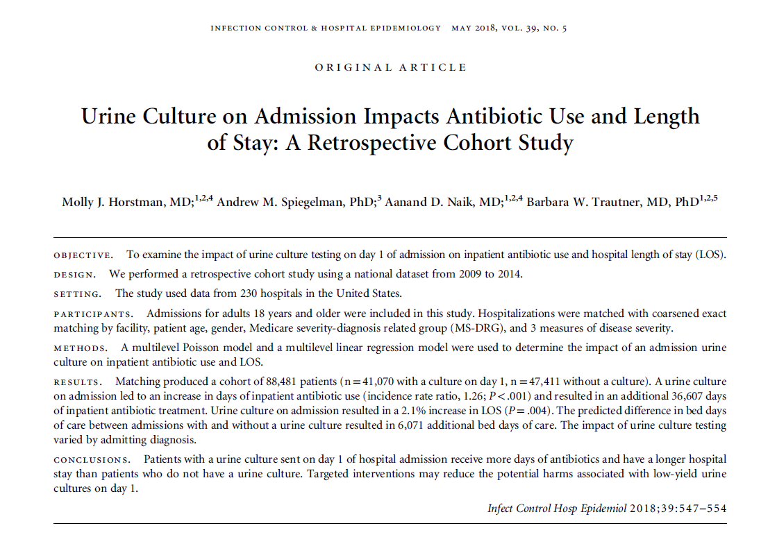
Effects of UC on Admission

Slide 26
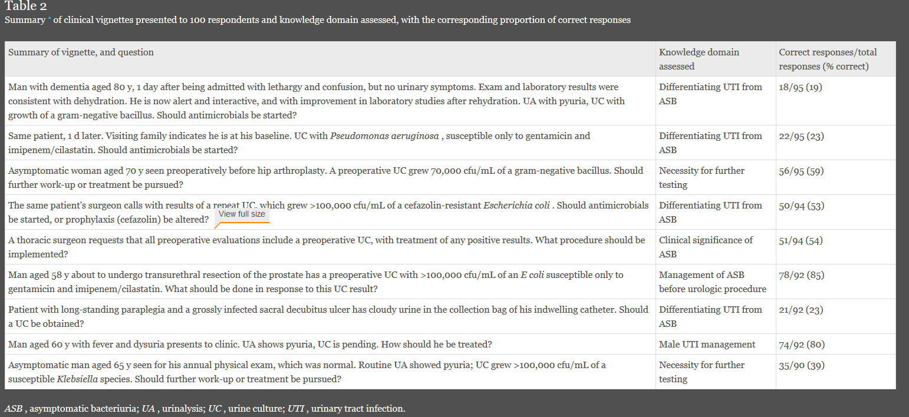
Reasons for Inappropriate UC and UA Ordering
Multi-hospital survey of internal medicine resident physicians designed by 6 board-certified ID physicians
100 total responses, overall knowledge 48%
Drekonja DM, Abbo LM, Kuskowski MA, Gnadt C, Shulka MD, Johnson JR. A survey of resident physicians’ knowledge regarding urine testing and subsequent antimicrobial treatment. Am J Infect Control 2013;41:892-6.

Slide 27
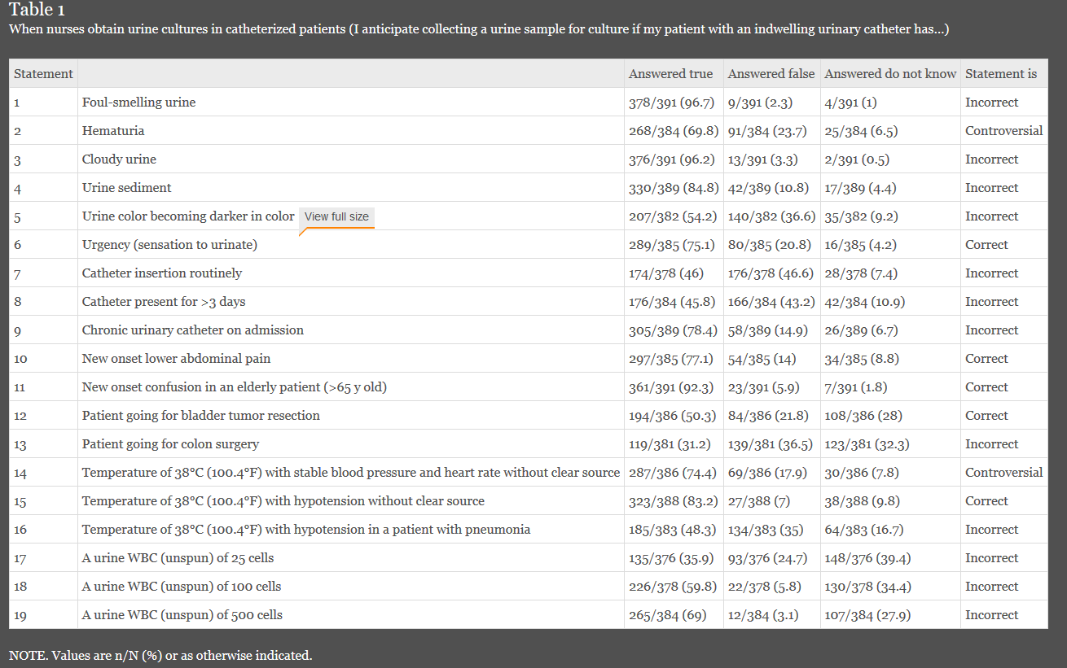
Reasons for Inappropriate UC and UA Ordering
Survey of 354 nurses at 5 hospitals
Sample of incorrect responses: 58.4% observed others compliant with not obtaining specimen for culture from drainage bag; 78.4% would obtain sample in patients with chronic urinary catheter on admission; 3.1%-24.7% agreed with taking culture when patient has pyuria
Jones K, Sibai J, Battjes R, Fakih MG. How and when nurses collect urine cultures on catheterized patients: a survey of 5 hospitals. Am J Infect Control 2016; 44:173-6.

Slide 28
Evidence for Inappropriate Ordering of UC/UA Testing
Randomized study of 208 newly admitted patients over 1 year at the University of Michigan Health System
  120 (57.7%) did not meet guideline-based criteria for a urine culture
  Of these, 75 patients (62.5%) had a reason documented that was inconsistent with current guidelines, including for bacteriuria before an orthopedic procedure and altered mental status
  No documented reason for ordering a UC was found in 37.5% of patients
  Fever was the sole indication for obtaining a UC in nearly three-quarters
Hartley S, Valley S, Kuhn L, Washer LL, Gandhi T, Meddings J, et al. Inappropriate testing for urinary tract infection in hospitalized patients: an opportunity for improvement. Infect Control Hosp Epidemiol 2013;34:1204-7.

Slide 29
Asymptomatic Bacteriuria
IDSA defines ASB as “isolation of a specified quantitative count of bacteria in an appropriately collected urine specimen obtained from a person without symptoms or signs referable to urinary infection”
ASB occurs in more than 30% of nursing home patients and 100% of those who are chronically catheterized
23% to 50% of antibiotic days for UTI are unnecessary treatment of ASB
ASB is a benign condition that generally does not require treatment
When patient symptoms are not considered or when non-urinary symptoms are attributed to bacteriuria, “…unwarranted events may occur including unnecessary urine testing….leading to false-positive results…followed by over-treatment with antibiotics”
Nicole LE, et al. Infectious Diseases Society of America. Guidelines for the diagnosis and treatment of asymptomatic
bacteriuria in adults. Clin Infect Dis 2005;40:643-54.
Lin K. Screening for asymptomatic bacteriuria in adults: evidence for the U.S. Preventive Services Task Force reaffirmation recommendation statement. Ann Intern Med 2008;149:W20-4.
Trautner BW. Asymptomatic bacteriuria: when the treatment is worse than the disease. Not Rev Urol 2012;9:85-93
Garcia R, Spitzer E. Promoting appropriate urine culture management to improve health care outcomes and the accuracy of catheter-associated urinary tract infections. AJIC 2017 (pending publication)

Slide 30
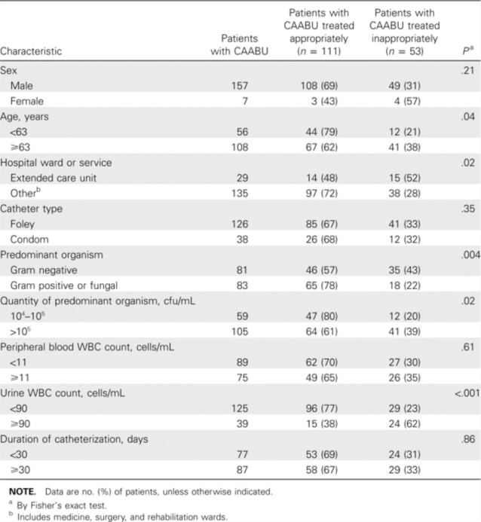
Inappropriate Treatment of Catheter-Associated ASB
Veterans Affairs Hospital, all UC over 3-months, patients with indwelling urinary catheter
Determined Catheter-associated Asymptomatic Bacteriuria (CAABU) vs. CAUTI
Results: 164 CAABU vs. 116 CAUTI
Of 164 CAABU, 32% inappropriate Rx w/antibiotics
10 additional studies: inappropriate Rx range of 17%-83% [Trautner BW, Grigoryan L. Approach to a positive urine culture in a patient without urinary symptoms. Infect Dis Clin North Am 2014;28:15-31]
Cope M, Cevallos ME, Cadle RM, Darouiche RO, Musher DM, Trautner BW. Inappropriate treatment of catheter-associated asymptomatic bacteriuria in a tertiary care hospital. Clin Infect Dis 2009;48:1182-8.

Slide 31


Slide 32
Redefining the
Antibiotic Stewardship Team
2017 American Nurses Association/Centers for Disease Control and Prevention (ANA/CDC) White Paper
  Purpose: inform RNs regarding the issue of antibiotic resistance and facilitate engagement in AS activities
  Jan 2017 – TJC requiring inter-professional of hospital AS programs
  Workgroup convened: 30 nurses from around the United States
Recommendations for Education
  Microbiology
    How specimens for microbiology testing should be obtained
    How to interpret microbiology test results, especially susceptibility reports
    How to interpret the hospital antibiogram
    Basics of distinguishing asymptomatic bacteriuria from urinary tract infection and colonization from active infection.

Slide 33
Redefining the Antibiotic Stewardship Team
Recommendations for Education
  Pharmacology
    Considerations for IV-to-PO conversion: what antibiotics and patients are good candidates
    General information on antimicrobial spectra for various classes of antibiotics
    Antibiotic interactions and incompatibilities
    Common adverse reactions to antibiotics, with a special emphasis on recognizing and responding to suspected C. difficile infections
    Information on therapeutic drug monitoring
    How to assess a patient for a potential allergy to penicillin

Slide 34
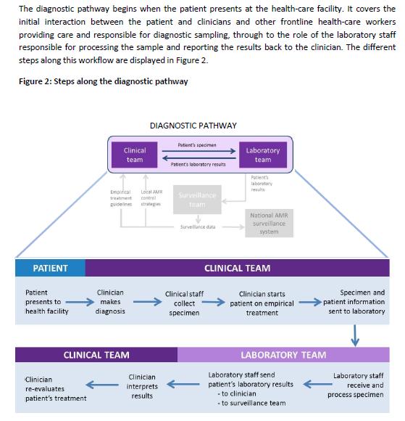
The Diagnostic Pathway
WHO. Diagnostic stewardship. A Guide to implementation in antimicrobial resistance surveillance sites. https://apps.who.int/iris/bitstream/handle/10665/251553/WHO-DGO-AMR-2016.3-eng.pdf?sequence=1

Slide 35
The Diagnostic Pathway
“Have I ordered appropriate cultures before starting antibiotics?”
Have they been obtained properly ?
WHO. Diagnostic stewardship. A Guide to implementation in antimicrobial resistance surveillance sites. https://apps.who.int/iris/bitstream/handle/10665/251553/WHO-DGO-AMR-2016.3-eng.pdf?sequence=1

Slide 36
The Diagnostic Pathway
Has the specimen been preserved properly and transported in a timely manner?
WHO. Diagnostic stewardship. A Guide to implementation in antimicrobial resistance surveillance sites. https://apps.who.int/iris/bitstream/handle/10665/251553/WHO-DGO-AMR-2016.3-eng.pdf?sequence=1

Slide 37
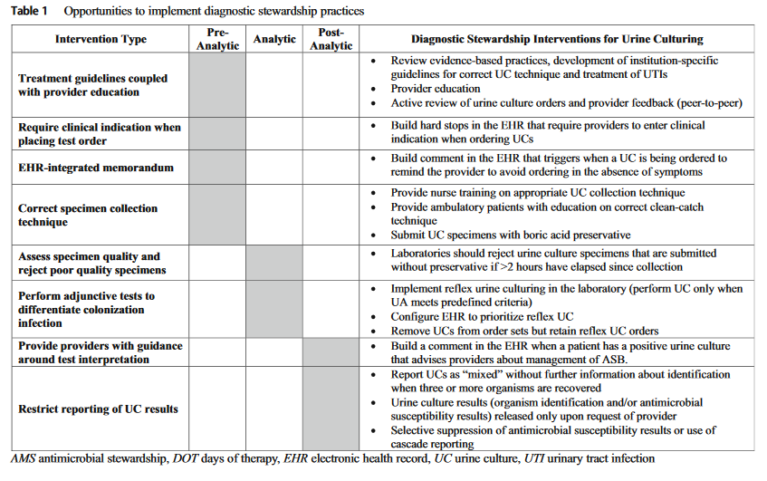
Implementing Diagnostic Stewardship
Claeys KC, et al. Advances and challenges in the diagnosis and treatment of urinary tract infections: the need for diagnostic stewardship. Curr Infec Dis Rpt 2019;21:1-9.

Slide 38
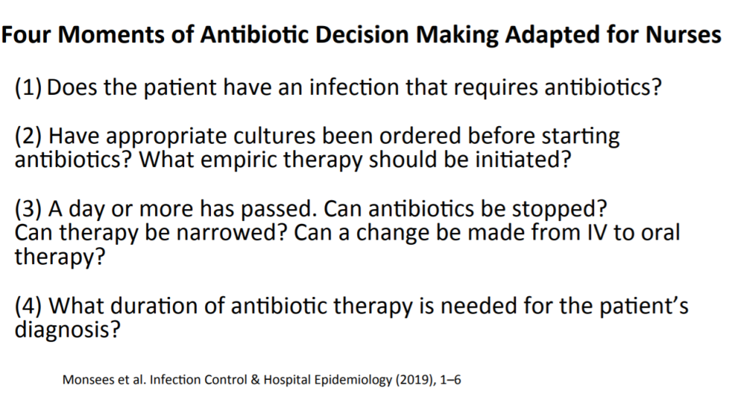
Antibiotic Decision Making

Slide 39
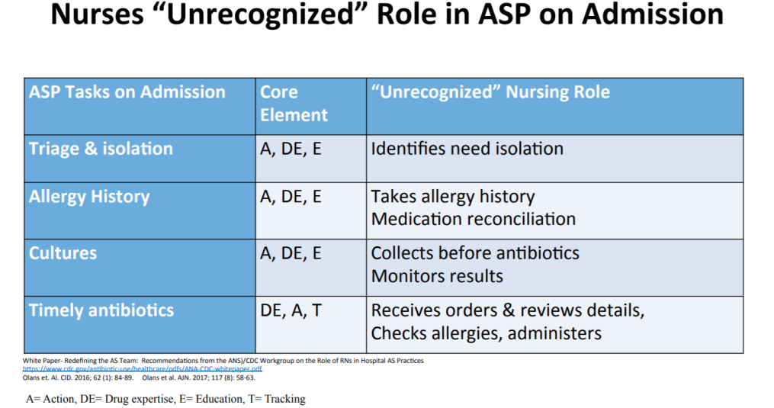
The Role of Nursing in AS Programs

Slide 40
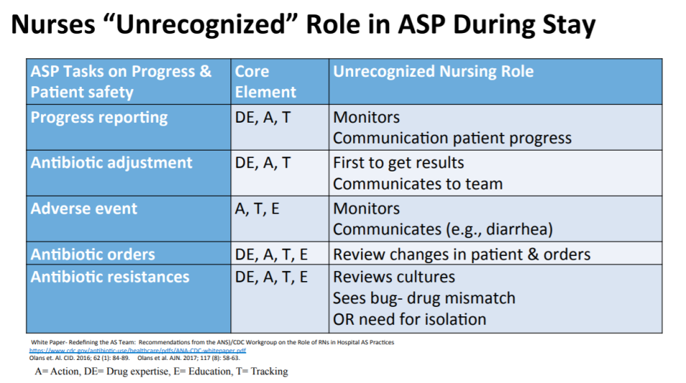
The Role of Nursing in AS Programs

Slide 41
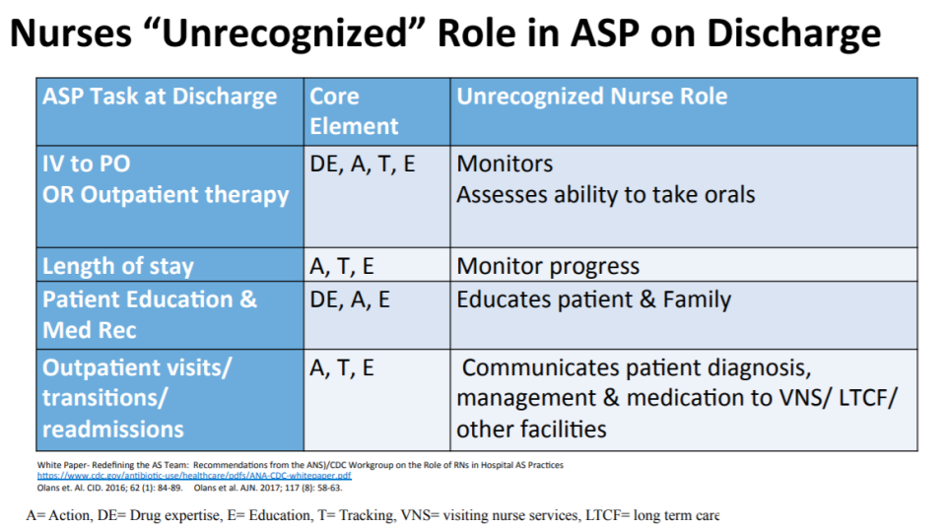
The Role of Nursing in AS Programs

Slide 42
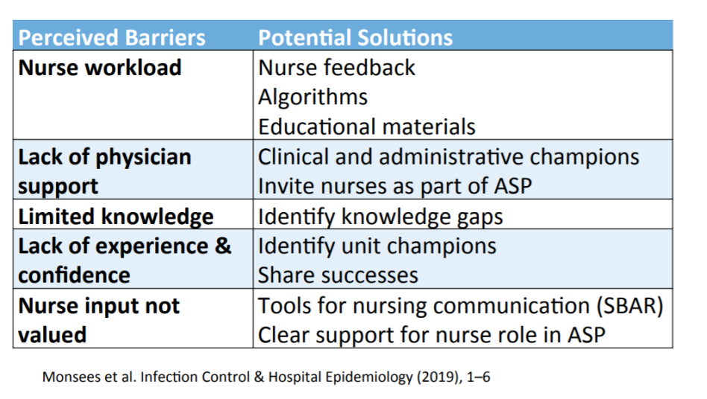
Perceived Barriers for Nursing

Slide 43
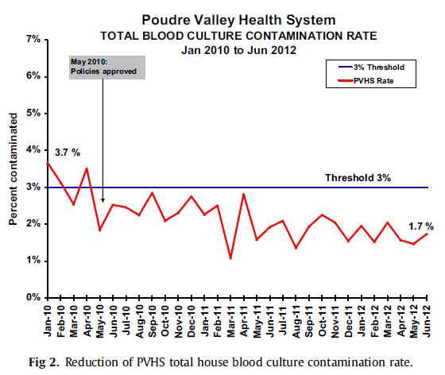
What the Nursing Staff Didn’t Know…
Reducing blood culture contamination rates: A systematic approach to improving quality of care
  Formation of a system-wide interdisciplinary group – nursing, IP and lab – to develop 3 evidence-based nursing protocols for blood culture collection: from CVC, from new PIV, with peripheral blood draw.
  Lessons learned: lack of knowledge regarding
    Proper use of CHG for skin prep
    Need to disinfect bottle tops
    Removal and change of needleless connector
    Scrub the hub of CVC
Hopkins K, et al. Am J Infect Control 2013;41:1272-4

Slide 44
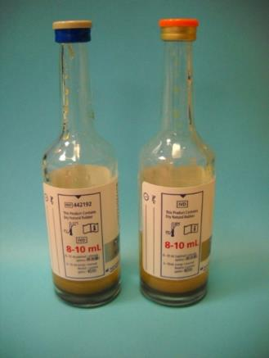
BC Issues Affecting Optimal Outcome
Clinical indications
Site draws: venipuncture vs. intravascular lines
Handling of needleless connectors
Use of pre-packaged kits for BC Drawing
Use of sterile gloves
Use of masks
Skin antisepsis
Disinfection of BC bottle septums
Discarding of initial volume of blood
Recommended volumes of blood
Order of draw
Inoculation of aerobic and anaerobic bottles
Labeling (site of draw)
Transport
Garcia R, Spitzer E. Multidisciplinary team review of best practices for collection and handling of blood cultures to determine effective interventions for increasing the yield of true-positive bacteremias, reducing contamination, and eliminating false-positive central line-associated bloodstream infections. AJIC 2015;43:1222-37.

Slide 45
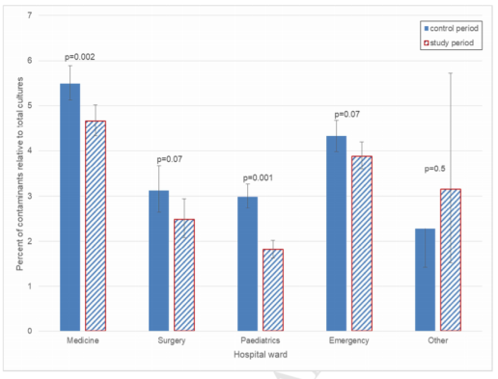
Use of Departmental Report Cards
Prospective, controlled, before-and-after, 18-month study conducted at a 1000-bed university-affiliated hospital
Hospital issued a monthly departmental blood culture report card on contamination rate
  Control period- 49,403 cultures: 9.3% had growth; true positive 5.6%; contaminants 4.0%
  Study period – 53,287 cultures: 8.3% had growth; true positive 5.2% (p = <0.02); contaminants 3.3% (p = <0.001)
Analysis by division showed either a significant contamination reduction or a trend to reduction in all major divisions
Zimmerman FS, et al. J Hosp Infect 2018;99:236-237.

Slide 46


Slide 47
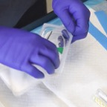

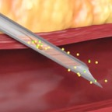
Blood Culturing Technology
.
1.
2.
3.
Human Factor(s): Risk of contamination during assembly and preparation of supplies, and skin prep
Skin Flora: You can disinfect but not sterilize the skin; Up to 20% of skin flora remains viable in the keratin layer of the skin even after skin prep¹
Skin Plug and Fragments: when present, will ALWAYS enter the culture specimen bottle, and commonly will contain viable microorganisms
Mechanical diversion of the initial 1.5-2.0 mL of blood using a closed system has been clinically proven to virtually eliminate blood culture contamination^{2,3}
¹Anjanappa T. et al; Preparative Skin Preparation and Surgical Wound Infection. Journal of Evidence based Medicine and Healthcare;. (January 2015)
^{2.}M. Rupp, et al; Reduction in Blood Culture Contamination Through Use of Initial Specimen Diversion Device. Clinical Infectious Diseases (August 2017)
³Data on file

Slide 48
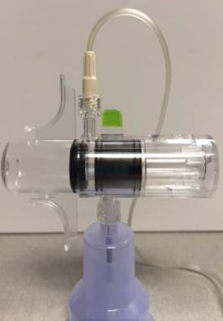
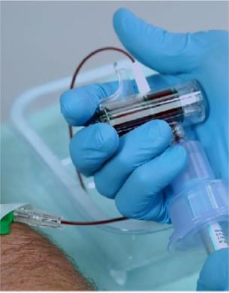
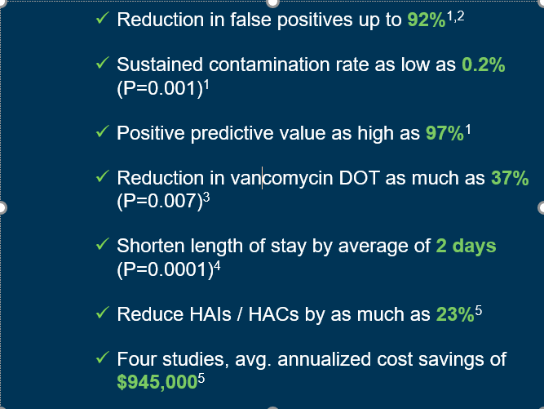
Specimen Diversion Devices for Blood Culturing
Prior to use
Initial 1.5-2.0ml of blood diverted and sequestered prior to culture bottle inoculation

Slide 49
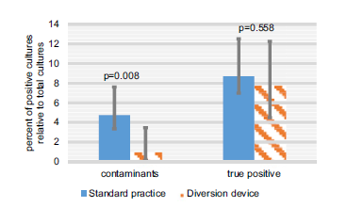
Specimen Diversion Devices for Blood Culturing
Reducing blood culture contamination using an initial specimen diversion device
  6-month prospective controlled pragmatic study on a medical ward ; historical contamination rate of 4%
  Intervention: initial specimen diversion device (integrated needle or attachment to a newly placed IV); controls – standard method. 671 BCs included
  464 cultures taken without device: 5.2% contamination rate; 207 cultures taken with the device: 1.0% contamination rate p = 0.008
  No significant difference in true-positive rates
Zimmerman FS, et al. Am J Infect Control 2019 Jan. doi: 10.1016/j.ajic.2018.12.004.

Slide 50
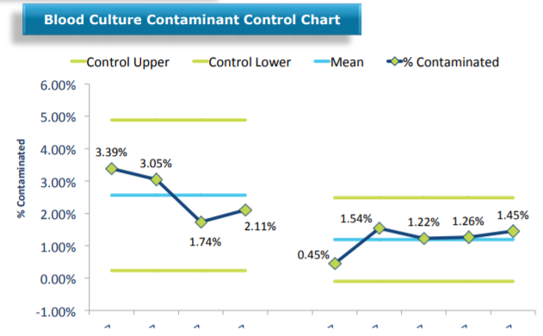
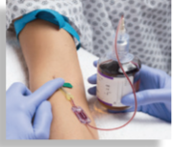
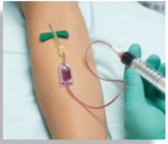
Specimen Diversion Devices for Blood Culturing
Preventing Blood Culture Contamination using a Novel Engineered Passive Blood Diversion Device
  Pre-post intervention design conducted in the ED with phlebotomy and ED staff: outcome metric -total blood culture contaminants
  Pre-intervention – 1953 cultures; contamination rate of 0.025, 95% CI [0.019, 0.033]
  Post-intervention - 2267 cultures; contamination rate of 0.012, 95% CI [0.008, 0.017] p <.05
    Intervention was utilized in only 50% of blood draws during the post intervention period; first 3 months the device was only designed for vacutainer use; redesign allowed for use with newly placed lines
Sutton J, et al. Bayfront Health, St. Petersburg, FL. Presented APIC 2018: Minneapolis, MN

Slide 51
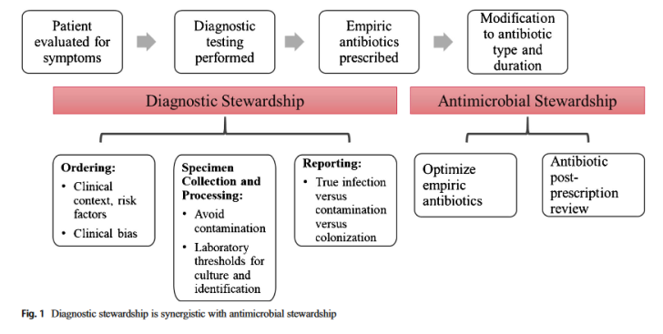
Optimizing the Ordering of Urine Cultures
Strategies used by AS programs generally focus on modulating antimicrobial use after their initiation
By contrast, DS aims to reduce unnecessary detection of ASB
Claeys KC, et al. Advances and challenges in the diagnosis and treatment of urinary tract infections: the need for diagnostic stewardship. Curr Infec Dis Rpt 2019;21:1-9.

Slide 52
Optimizing the Ordering of Urine Cultures
Study conducted on admitted patients, 1250-bed academic medical center
Interventions: notification to providers, changes to order sets, inclusion of new urine culture reflex tests to CPOE
Results:
  45.1% decrease in rate of inpatient UCs
  Reduction of $103,845 in lab charges to patients
 | Pre-intervention | Post-intervention
Pos UCs (%) | 4021 (25.5) | 2621 (29.7)
UCs per 1000 PDs | 38.1 | 20.9
Catherized UCs per 1000 PDs | 7.8 | 1.9
CAUTI per 1000 CDs | 1.25 | 1.27
Munigala S, et al. Effect of changing urine testing orderables and clinician order sets on inpatient urine culture testing: analysis from a large academic medical center. ICHE 2019;1-6.

Slide 53
Summary
Inter-disciplinary development of evidence-based culturing procedures, which address collection and handling, is necessary to ensure standardized practices.
IPs can play a major role in educating nursing staff on the patient safety implications of improper culturing techniques and unnecessary antibiotic use.
Technology has a role in optimizing the ordering and accuracy of culturing techniques.

Slide 54
Thank you!
Robert Garcia, BS, MT(ASCP), CIC
robert.garcia@sbumed.org
Cell 516.810.3093

Slide 55



Slide 56


