Slide 1
EXPLORING THE ROLE OF ENVIRONMENTAL SURFACES IN OCCUPATIONAL INFECTION PREVENTION
Barbara DeBaun, RN, MSN, CIC
Amber Hogan Mitchell, DrPH, MPH, CPH
Hosted by Dr. Lynne Sehulster
Centers for Disease Control and Prevention, Atlanta
www.webbertraining.com
June 23, 2016

Slide 2
Disclosures
Both speakers consult for
Vestagen Protective Technologies, Inc.

Slide 3
Objectives
Describe current landscape and occupational exposure incident data
Discuss the role textiles, apparel, and other soft surfaces play in the transmission of pathogens
Describe the science and evidence driving new guidelines that are changing the way we think about textiles in the healthcare environment
Identify current gaps in occupational protection from blood and body fluid exposure that have led to development of innovative solution

Slide 4
Current Landscape

Slide 5
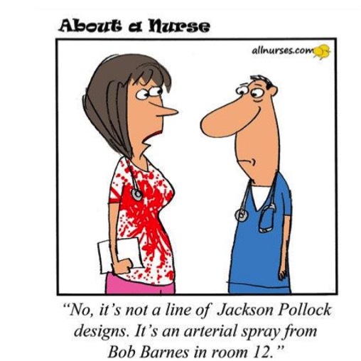

Slide 6
“Protecting Our Healthcare Workers Now”
“From the first moment a patient comes through a hospital's doors to the time that healthcare staff identify the need for exposure protection, a large window is left open—leaving a sizable gap in safety. As any healthcare worker can attest, body fluid splashes and splatters of blood, urine, vomit and so on can occur when least expected. These are not only unpleasant events; these body fluid splashes can carry pathogenic organisms.”
Modern Healthcare, Nov 2014

Slide 7
“A catalytic event like the Ebola outbreak can draw our attention to a longtime problem. If nothing else, the Ebola crisis has shown us that healthcare workers have not hesitated to care for patients under the most dire of circumstances—they have given their all to meet the responsibility of their profession.”
http://www.modernhealthcare.com/article/20141121/NEWS/141129998

Slide 8
APHA Policy Statement
“The cases of Ebola virus disease (EVD) in the United States remind us that infectious disease threats continue to challenge our public health’s, health system’s and communities’ capacities to adequately protect the population from exposure to microorganisms (bacteria, viruses, and spores) that may cause illness or infection and generate stigma and fear.”

Slide 9
APHA Recommendation
“…development of innovative new technologies… and to the certification of personal protective equipment (PPE) and other protective apparel used to eliminate or minimize exposures to microorganisms that cause illness and infection.”
https://www.apha.org/policies-and-advocacy/public-health-policy-statements/policy-database/2015/12/08/15/22/preventing-occupational-transmission-of-globally-emerging-infectious-disease-threats

Slide 10
Infectious & Biological Threats are More Prevalent than Ever… and More People are Accessing Healthcare Systems Around the World

Slide 11
PATHOGENS TRANSMITTED THROUGH OCCUPATIONAL EXPOSURE
Blastomycosis dermatitidis
Brucellosis abortus
Corynebacterium diphteriae
Creutzfeldt-Jakob disease
Cryptococcosis neoformans
Dengue virus
Ebola
Hepatitis B
Hepatitis C
Hepatitis G
Herpes Simplex virus
Herpes Zoster virus
HIV
Leptospira icterohaemorrhaglae
Malaria
Mycobacterioum marinum
Mycobacterium tuberculosis
Mycoplasma caviae
Necrotizing casciitis
Plasmodium falciparum
Rickettsia rickettsii
Sporotrichum schenkii
Streptococcus pyogenes
Staphylococcus aureus
Syphilis
Treponema pallidum
Toxoplasma gondii
Tuberculosis

Slide 12
Hepatitis B
Globally:
2 BILLION People
3 MILLION Refugees
Thanks for Slides from Elise Handelman & Elayne Phillips. BD & McKesson

Slide 13
Hepatitis C
“CDC Warns on Rising Cases of Hepatitis C”
WSJ, May 8, 2015

Slide 14
“Hepatitis C killed almost 20,000 Americans in 2013. More of us died from hepatitis C than from 60 other infectious diseases combined, including HIV and TB, with ‘baby boomers’ at greatest risk.”
Summary source: Preidt, R. Hepatitis C Now Leading Infectious Disease Killer in U.S. HealthDay; 2016 May 4
Available from: https://www.nlm.nih.gov/medlineplus/news/fullstory_158651.html

Slide 15
HIV
Today, 1.2 Million People in the US are living with HIV.
1 in 5 don’t know they are infected and can pass the virus to others.
CDC 2011

Slide 16
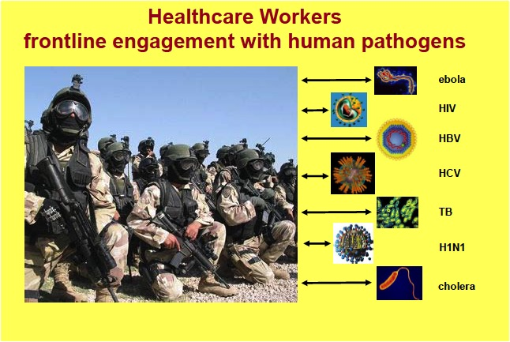

Slide 17

Emerging and Re-emerging Pathogens
Ebola
Zika
Diseases in Conflict Countries
Measles
  New occupational cases depending on level of immunity
Co-Morbidities with Multidrug Resistant Organisms like MRSA
  Patients with now chronic disease like HCV, HIV with increased prevalence of MRSA
  Healthcare worker colonization

Slide 18
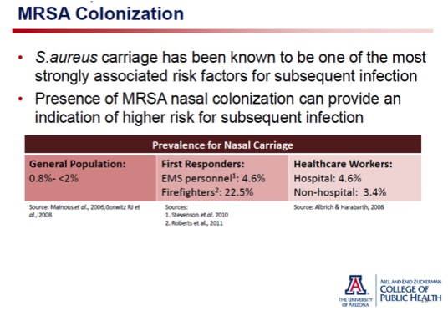
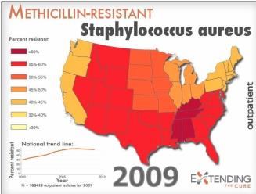
Thank you, Dr. K Reynolds

Slide 19
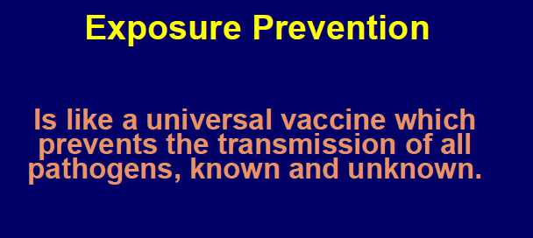
Courtesy Dr. J Jagger

Slide 20
Occupational Incident Data
2014

Slide 21
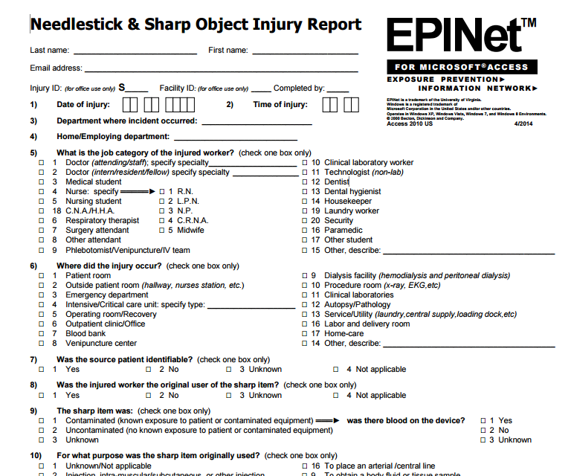
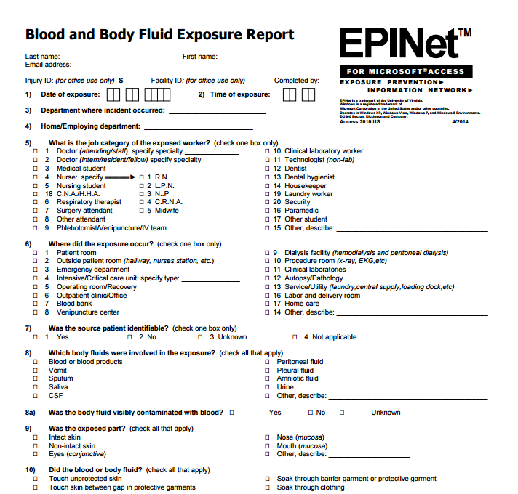
Since 1992, acquired for 1,500 U.S. Hospitals and 96 countries!

Slide 22
2014 EPINet Summary Data:
Splashes and Splatters; Blood and Body Fluid Exposures

Slide 23
2014 Exposure Rate / Ratios
8.9 incidents reported per 100 Average Daily Census
9.4 / 100 ADC Teaching Facilities
8.1 / 100 ADC Non-Teaching Facilities

Slide 24
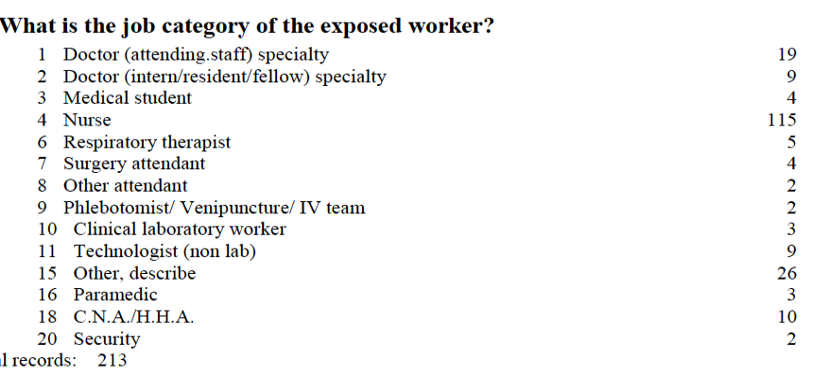


Job Category

Slide 25
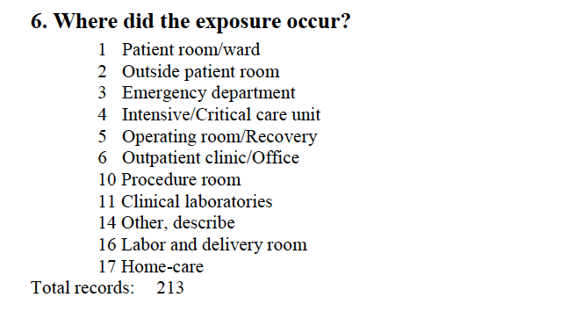
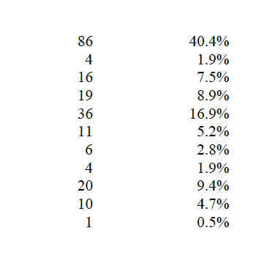
Location of Incident
52.6% from Direct Patient Contact
22.4% “Other”
  wound irrigation, vent tube, trach tube, syringe / blood collection splash

Slide 26
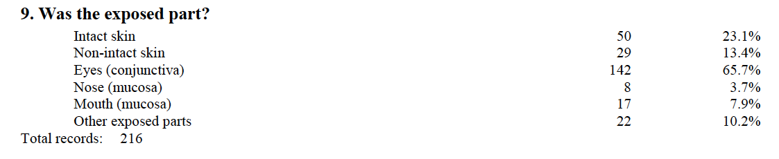
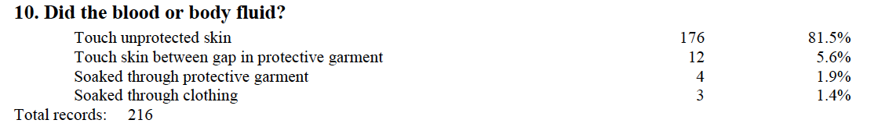
Exposed Part

Slide 27
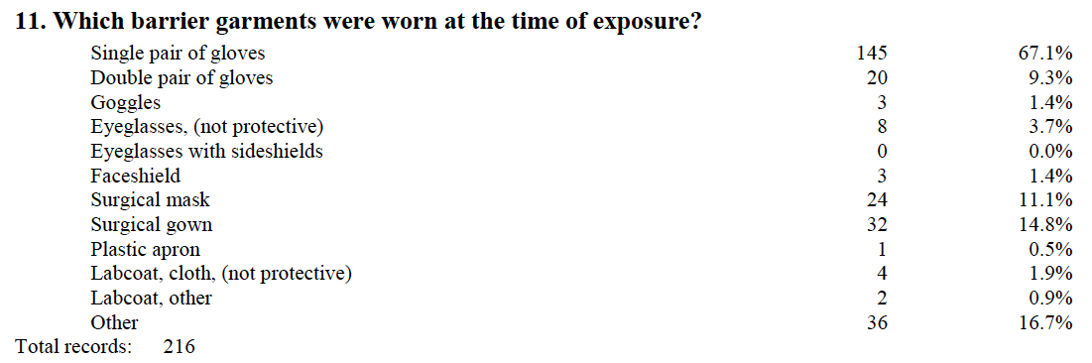

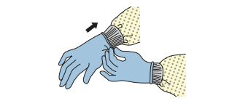
Total PPE & Barrier Garment Worn
47% indicated only wearing uniform / scrubs

Slide 28
Splash/Splatter Year Comparison
 | 2012 | 2013 | 2014
Total Incidents | 174 | 141 | 213
Doctor | 13.8% | 14.9% | 13.1%
Nurse | 47.7 | 49.6 | 54
Eyes (Conjunctiva) | 60.0 | 64.5 | 65.7
Goggles/Faceshield | 7.4 | 8.5 | 2.8
Touched Skin | 93.1 | 90.8 | 87.1
Wore Gown | 14.9 | 18.4 | 14.8
Patient Room | 33.7 | 28.1 | 40.4
OR | 20.0 | 20.9 | 16.9
ED | 18.3 | 14.4 | 7.5
Increasing Risk for Nurses at Bedside?

Slide 29
This isn’t just bedside care…

Slide 30
Clinical Lab
Blood & Body Fluid Splash / Splatter Incident Data

Slide 31
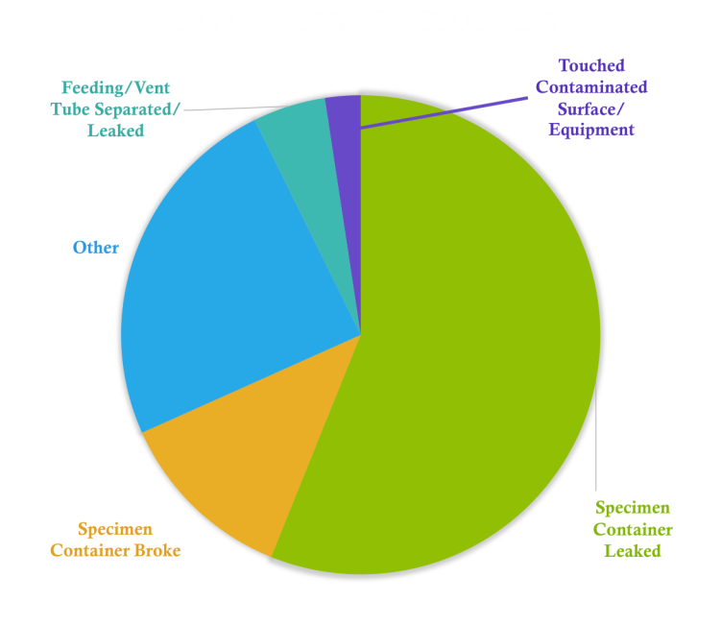

Slide 32
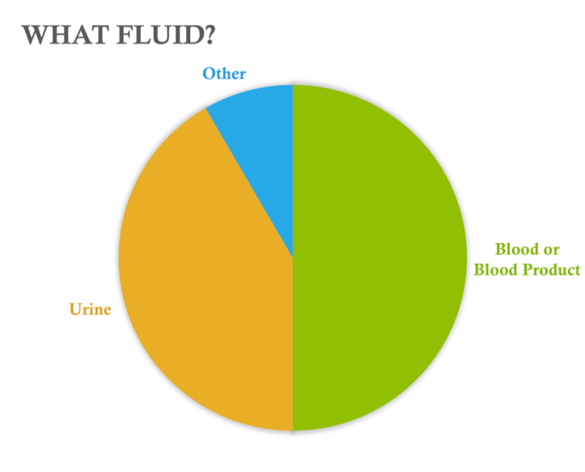
Bacterial Solution
HIV Viral Load Specimen
Plasma
Serum
Vaginal Secretions
Fetal Fibronectin

Slide 33
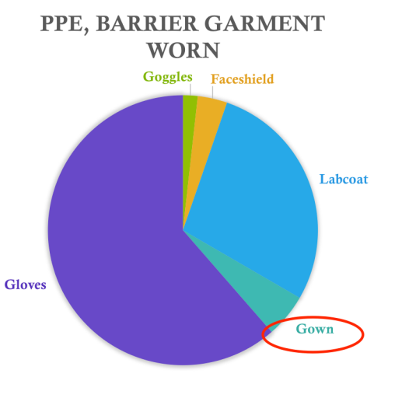
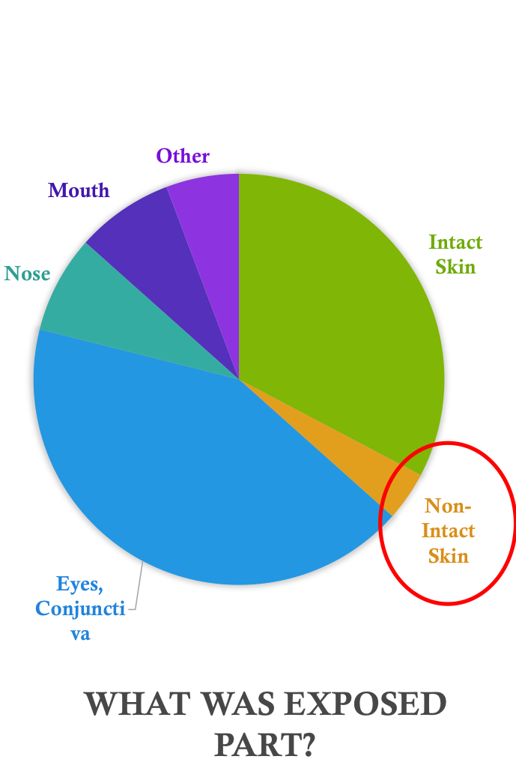

Slide 34
What is contributing to this increased risk and risky behavior over time?

Slide 35
Exploring Environmental Surfaces

Slide 36
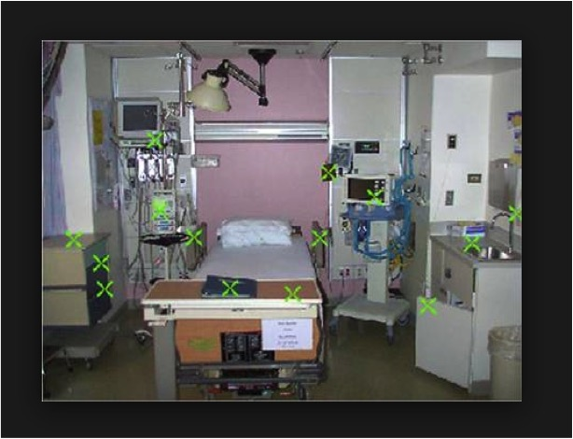
Contaminated surfaces increase cross-transmission. Hayden M, ICAAC, 2001

Slide 37
Types of Environmental Surfaces
Non-Porous, Hard Surfaces
Porous, Soft Surfaces
FIXED | I. TYPICAL HIGH TOUCH: SINKS, COUNTERS, LIGHTSWITCHES, FLOORS | IV. FLOOR AND WALL COVERING UPHOLSTERY, COUCHES
PORTABLE | II. TABLES, CHARTS, CARTS, HARD CHAIRS/FURNITURE | V. UPHOLSTERY, CHAIRS, CURTAINS, LINEN
MOBILE | III. STETHOSCOPE, IV, RESP, DIAG | VI. BP CUFF, PT GOWNS, APPAREL, SCRUBS, LAB COATS

Slide 38
Rich Body of Literature

Slide 39
Literature: Environmental Soft Surface Type
Fixed
  Furniture
Portable
  Privacy Curtains
  Textiles
Laundering
Mobile
  HCW Attire
Creamer 2008, Gould 1993, Langford 2006, Malik 2006, Ndawula 1991, Noskin 2000
Das 2002, Klakus 2008, Ohl 2012, Palmer 1999, Schweizer 2012, Trillis 2008
Barrie 1994, Boyce 1997, Hochmuth 2002, Fijan 2012, Kniehl 2005, Neely 2000, Neely 2001, Nicas 2006, Sasahara 2011, Shiomori 2002, Thomas 1987
Blaser 1984, Jacob 2007, Lakdawala 2011, Patel 2006, Scott 2011, Wright 2012
Babb 1983, Bearman 2012, Burden 2011, Burden 2013, Butler 2010, Callaghan 1998, Ditchburne 2006, Gaspard 2009, Hsieh 1986, Krueger 2012, Loh 2000, Lopez 2009, Loveday 2014, Morgan 2012, Munoz-Price 2012, Osawa 2003, Pandey 2010, Perry 2001, Pilonetto 2004, Sattar 2001, Snyder 2008, Speers 1969, Steinlechner 2002, Treakle 2009, Uneke 2010, Weiner-Wall 2011, Wong 1991
6
6
11
6
27

Slide 40
Recent Published Studies:
Uniforms Can Play a Role in Transmission
Clothing can play a significant role in the spread of infectious materials.
Contamination of Clothing with MRSA and C.difficile
Survival of Bacteria on Clothing
Transfer of Bacteria to Hands
Clothing as Possible Cause of Cases / Outbreaks
Transmission via clothing plays an important part in the spread of S. aureus (and MRSA) infections.

Slide 41
Healthcare Worker Uniforms
At the end of a work shift, C. difficile and MRSA were recovered from the surface of nurses’ uniforms at counts exceeding 500 CFU
23% of lab coats were contaminated with MSSA and 18% with MRSA
60% of hospital staff uniforms were culture positive for MDROs based on samples taken from the sleeves, waists, and pockets of over 100 physicians’ and nurses’ work apparel
Healthcare-associated pathogens were isolated from 63% of the uniforms
Laundered and unworn scrubs harbored normal skin flora on Residents’ uniforms

Slide 42
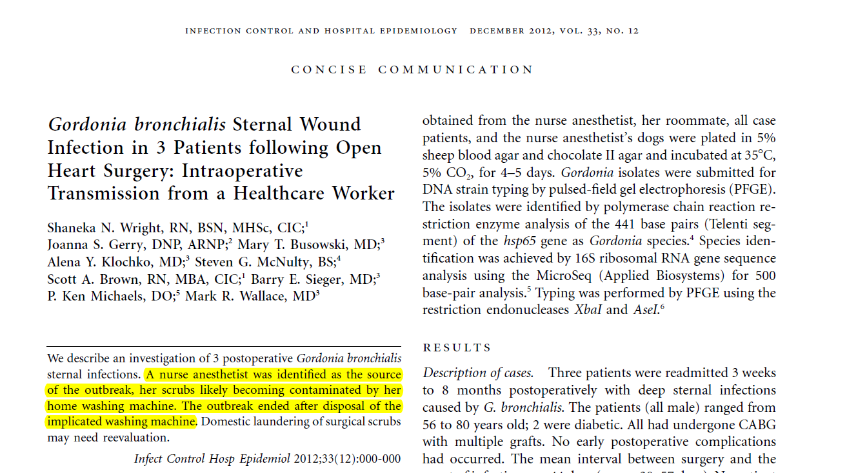

Slide 43
Contaminated Textiles: Microbes and Outbreaks

Slide 44
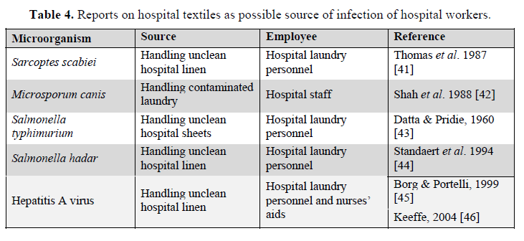

Slide 45
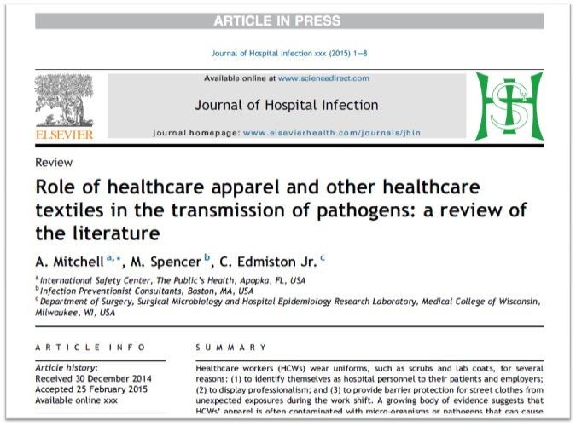

Slide 46
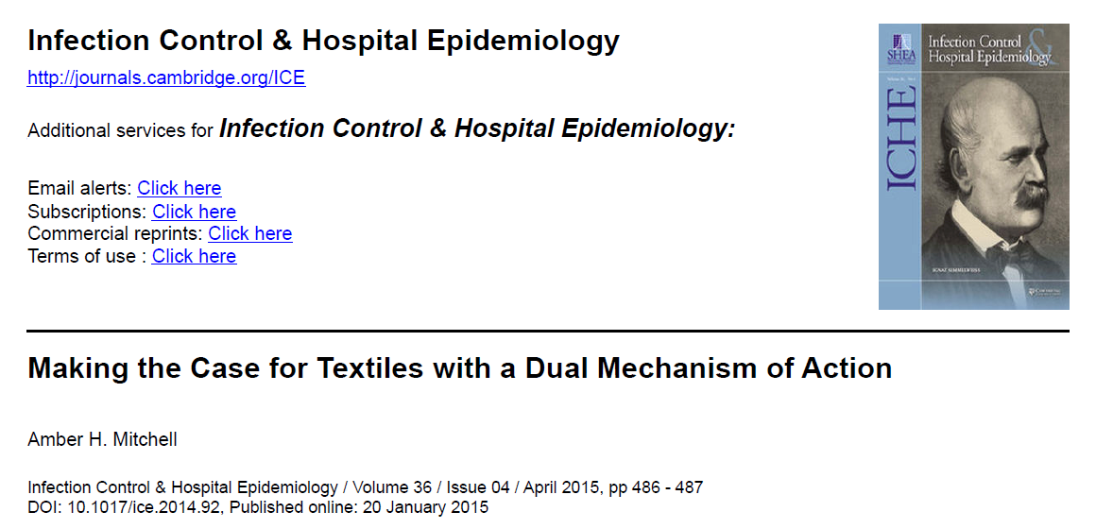

Slide 47
National Landscape

Slide 48

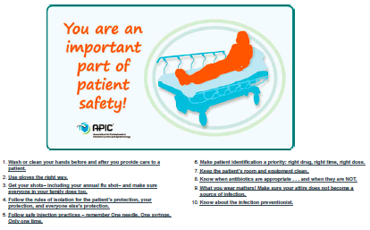
APIC 10 Ways to Protect your Patients from Infection
9. What you wear matters
Make sure your attire does not become a source of infection.
Clothing can be a virtual conveyor belt for infections. Studies have shown that when doctors and nurses lean over a patient with MRSA, their coats and uniforms pick up bacteria 65 percent of the time. Additional studies have shown that ties worn by doctors and other medical staff had bacteria that could cause illness.
What’s more, improper use and removal of personal protective equipment (for example—gowns, gloves, masks) can have negative health consequences to the healthcare worker.

Slide 49
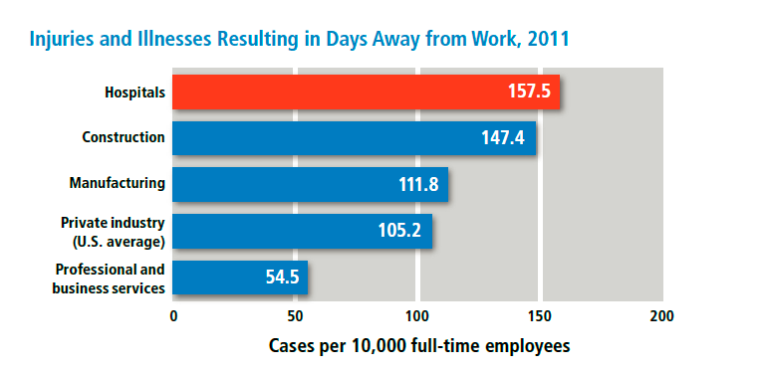
OSHA Worker Safety in Hospitals

Slide 50
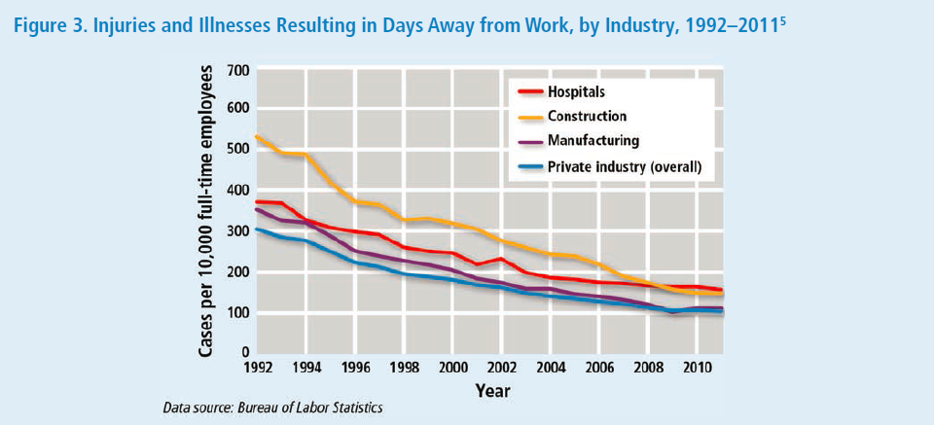
OSHA Worker Safety in Hospitals

Slide 51
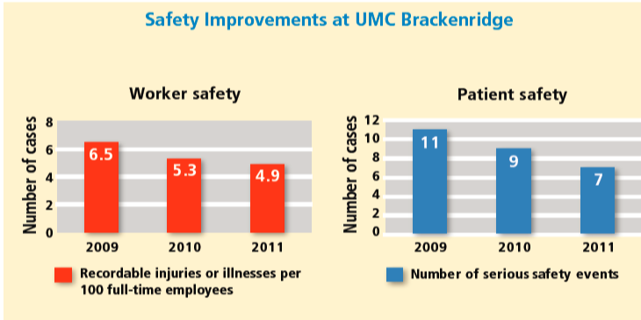
OSHA Worker Safety in Hospitals

Slide 52
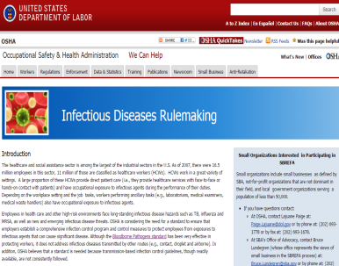
OSHA Infectious Disease Standard
For non-Bloodborne Pathogens
CalOSHA Aerosol Transmissible Disease Standard
Occupational exposure during “direct patient care”
Worker Infection Control Plan
  Infectious Agent Hazard Analysis

Slide 53
Comparing the Whole Healthcare Environment to the OR

Slide 54
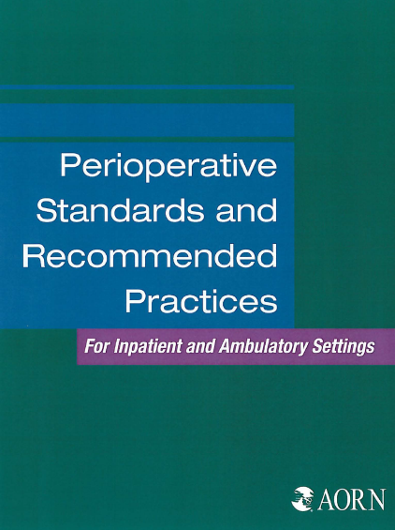
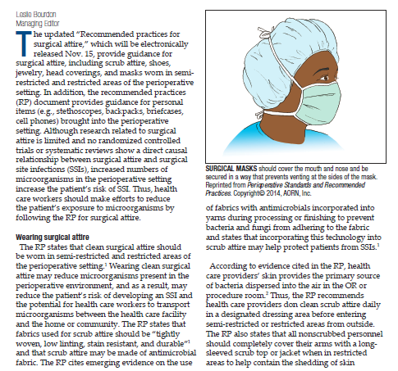
AORN Recommended Practices for Surgical Attire

Slide 55
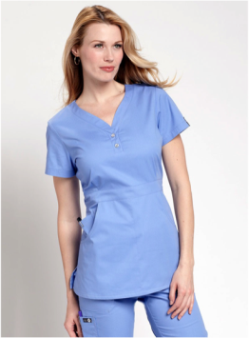
Recommendation I: Clean surgical attire should be worn in the semi-restricted and restricted areas of the perioperative setting
Attire has been laundered in a healthcare accredited laundry facility
Has not been previously worn

Slide 56

Fabrics used for scrub attire (Moderate Evidence)
Tightly woven
Low linting
Stain resistant
Durable

Slide 57
Tightly woven material
Superior to other types of scrub attire in decreasing bacterial contamination of the air (AORN ref 6-9)
Significant reduction of >50% of bacterial load in the air (AORN)
Median CFUs dropped significantly when peri-op team wore tightly woven scrub attire (AOR ref 5, 8-10)

Slide 58
Lint-free, stain-resistant and durable
Prevent lint particles from disseminating into environment where bacteria may attach to them and settle into surgical sites
Promoting professional appearance
Able to withstand rigorous laundering necessary to maintain a high level of cleanliness

Slide 59
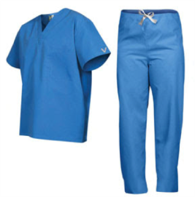
Pathogens can live from hours to months
Gram-positive
  MRSA survived 20 days on cotton; 40 days on polyester (1)
  VRE survived more than 80 days on both cotton and polyester (1)
Viruses
  Influenza A and B survived 12 hours on cloth, paper and tissue (2)
Deeley et al 2001
Baker et al 2001

Slide 60


Changing to street clothes (Moderate Evidence)

Slide 61
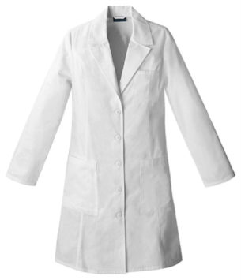
Cover apparel
(Moderate Evidence)
Should be clean/single use
Evidence does not support wearing of cover apparel to protect scrub attire from contamination
Evidence that cover apparel can be contaminated with large numbers of pathogens (AORN ref 30-34)
Current laundering practices are questionable

Slide 62
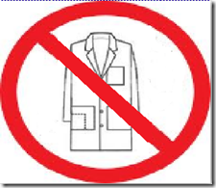
Cover apparel
(Moderate Evidence)
Lab coats worn by 100 physicians
S. aureus isolated from 25
Cuffs and pockets of coats most contaminated (AORN ref 36)
Other study (AORN ref 32) showed Staph and Acinetobacter
Laundering practices poor (AORN ref 31)

Slide 63
Scrub attire may be made of antimicrobial fabric
(Moderate Evidence)
Emerging evidence that fabric with antimicrobials incorporated into yarns during processing or during finishing to prevent pathogens from adhering to the fabric Incorporating this technology into the material used for scrub attire may help to protect the patient from the risk of SSIs | AORN ref 13-19 AORN ref 13-19

Slide 64
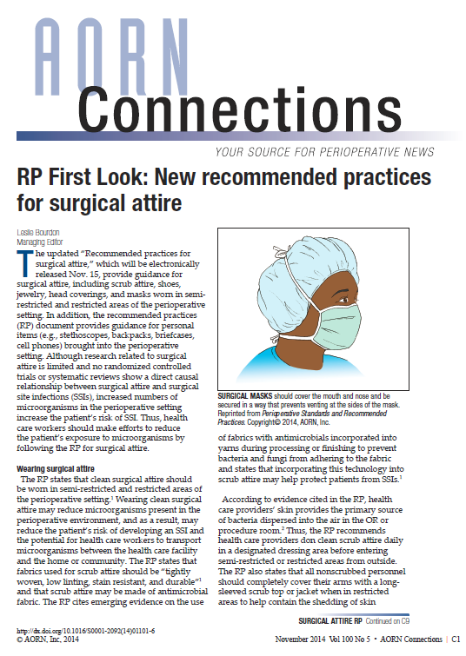
“…scrub attire may be made of antimicrobial fabric…incorporating this technology into scrub attire may help protect patients from SSIs.”
Standards including textile technologies being considered by OSHA and ASTM

Slide 65
Textile Technologies
Fluid Barrier: Repellent / Resistant
Particle Barrier: Weave, Fabric Type
Microbial Barrier: Antimicrobial / Antibacterial
  Metal Ions; e.g. silver, copper
  Quats
Post Market: Sprays, Treatments

Slide 66
Can we make policies for whole healthcare facility based on what we know from the OR?

Slide 67
When collaborating on best path forward, remember to consider…

Slide 68
Industrial Hygiene: Hierarchy of Controls
Best
Worst
Institutional
Departmental
Individual
Elimination
Substitution
Engineering Controls (CSTD)
Administrative Controls
Work Practices
Personal Protective Equipment

Slide 69
Critical Reflections

Slide 70
Healthcare is Unprepared
No nationalized surveillance system in place, therefore EPINet may serve as only benchmark
When skin exposures occur, PPE is being worn in small % of incidents
Rich body of literature related to environmental contamination of surfaces
Small, yet growing literature on impact of patient outbreaks and occupational illness
Standards specific to uniform type already exist in OR
Textile technologies may offer additional degree of protection for unexpected exposures

Slide 71
Recommendations

Slide 72
Recommendations
Since environmental surfaces play a role in transmission of microbes, include it as a focus area along with hand hygiene and other infection prevention initiatives
Do not ignore soft surfaces, uniforms, bedding
Improve State-Wide Surveillance of Worker Incidence & Patient Outbreaks Related to Contaminated Textiles
Improve PPE and Barrier Garment Access, Use, and Compliance
Consider Textile Technologies to Bridge the Gap
Take Models from other Departments or Countries
Stay informed, Read the Literature
Decreasing Incidence = Worker + Patient Safety

Slide 73
THANK YOU!

Slide 74
Additional References
Bloomfield, S. et al. International Scientific Forum on Home Hygiene, Infection Risks Associated with Clothing and Household Linens in Home and Everyday Life Settings, and the Role of Laundry, April 2011.
Fijan S, Poljsak-Prijatelj M, Steyer A et al. Rotaviral RNA found in wastewaters from hospital laundry. Int J Hyg Environ-Health 2006; 209:97-102.
Fijan S, Steyer A, Poljsak-Prijatelj M et al. Rotaviral RNA found on various surfaces in a hospital laundry. J Virological Methods. 2008; 148:66-73.
Wiener-Well Y, Galuty M, Rudensky B, et al. Nursing and physician attire as possible source of nosocomial infections. Am J Inf Cont. Vol 39, Issue 7, pp. 555-559.
Burden M, Cervantes L, Weed D, Keniston A, Price C, Albert R. Newly cleaned physician uniforms and infrequently washed white coats have similar rates of bacterial contamination after an 8-hour workday: a randomized control trial. J Hosp Med 2011:6:177–182.
Treakle AM, Thom KA, Furuno JP, Strauss SM, Harris AD and Perencevich EN. Bacterial contamination of health careworkers' whitecoats. Am J Inf Cont. 2009; 37:101–5.
Krueger CA, Murray CK, Mende K, Guymon CH, Gerlinger TL; The bacterial contamination of surgical scrubs. Am J Orthop 2012; 41(5):E69-73.

Slide 75

June 29 (South Pacific Teleclass)
SHARPS INJURY PREVENTION
Dr. Terry Grimmond, Grimmond & Associates Ltd., New Zealand
July 14 RESULTS OF QUALITATIVE RESEARCH ON IMPLEMENTATION OF
INFECTION CONTROL BEST PRACTICES IN EUROPEAN HOSPITALS
Dr. Hugo Sax, University Hospital Zurich, Switzerland
July 21 BEHAVIOURAL AND ORGANIZATIONAL DETERMINANTS OF
SUCCESSFUL INFECTION PREVENTION AND CONTROL INTERVENTIONS
Dr. Enrique Castro-Sánchez, Imperial College London, England
August 18 (Free Teleclass)
USE OF HYPOCHLORITE (BLEACH) IN HEALTHCARE FACILITIES
Prof. William Rutala, University of North Carolina Hospitals
August 25 APPLICATIONS AND LIMITATIONS OF DIPSLIDES AND PCR FOR
REAL-TIME ENVIRONMENTAL CONTAMINATION EVALUATION

Slide 76


Slide 77


