Slide 1
Critical Appraisal – Where Do I Start?
An Introduction to the New PHAC Toolkit
Joanne Archer RN Btech MA CIC
Education and Practice Coordinator, PICNet

Slide 2
Why is Critical Appraisal of Studies Important?
Decisions are made based upon recommendations stemming from the studies
These decisions often have huge far reaching implications
Unintended consequences for patients and staff
Costs and resources – finite amount available
Reallocation of resources away from something important to something not so important
Notes:
Important to understand the actual strength of the evidence we are using to make individual recommendations

Slide 3
Key Message
Often an appraisal of a study is based on reading the discussion and conclusions.
Your conclusions about a study should be based on your appraisal of the methods and results – NOT on the authors conclusions.
Authors discussion and conclusions can help identify biases , other explanations, provide context etc.
Notes:
Especially when you are not used to reading research studies or when the analysis is really complicated.
Need to make your own interpretation of the results:
Eg. 56% in my mind is NOT a VAST MAJORITY
Sometimes the basis of disagreements is lack of understanding of what the actual evidence is and the strength of it – can lead to a great deal of frustration and heated discussions

Slide 4
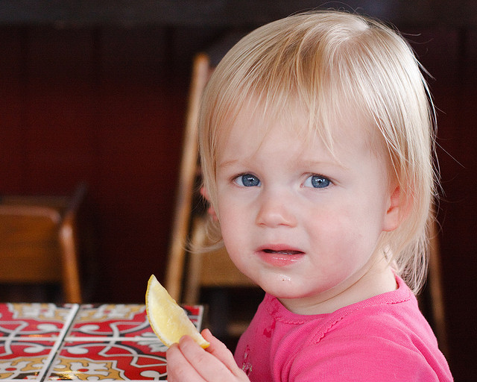
Frustration – it’s like a booger you can’t flick off your finger !!!

Slide 5
A New Tool
A critical appraisal toolkit has been developed by PHAC to promote consistency in the appraisal of a body of evidence, grading the evidence and developing recommendations.
Pilot of this toolkit occurred in 2009 and recently the final version has been realesed.
Notes:
I was lucky enough to be involved in the pilot project and will share some of my thoughts on that experience a little later in this presentation

Slide 6
PHAC Critical Appraisal Toolkit
Guides one through the process of appraising a study’s design and quality and there by the strength of the evidence.
Ideally appraisals are done by a group of people who discuss and reach consensus on conclusions
There is no perfect study
Critical appraisal is NOT an exact science
Notes:
Try to have at least 3 people review the study and be prepared for a variety of perspectives.

Slide 7
The Critical Appraisal Tool
Will guide you through a series of steps to help you determine if the evidence reviewed sufficiently demonstrates an association between the exposure and the outcome while ruling out other explanations.
Notes:
In other words – does the study truly answer or provide some explanation for the key question

Slide 8
Critical Appraisal Tool Contents
Evidence Grading System and definitions
Tools for naming the study design (algorithms with legends)
Critical Appraisal Tool Dictionary and Critical Appraisal Tools for analytical & descriptive studies and literature Reviews
Instructions for writing evidence summary tables and recommendations
Sample of an evidence summary table with recommendations
Notes:
This tool uses a multi-layered or multi-dimensional approach, the sections and steps are not exactly linear

Slide 9
The Steps:
Identify why you are reviewing the article
Focus on the methods and outcomes relevant to your Key Question
Read the methods section
Name the study design
Refer to the methods used for the study
Do not accept the authors identification of the study design unless you agree
Notes:
Key question: A question focusing on a fundamental issue to be addressed by the critical appraisal.
These key questions will guide the literature search and criteria for inclusion – REALLY IMPORTANT TO BE ABLE TO SIFT THRU STUDIES
Examples:
Is alcohol-based hand rub (ABHR) effective for hand hygiene in healthcare settings?
What is the clinical evidence on the impact of isolation on the patient?
What is the clinical evidence for harms for workers bathing individuals with antibiotic-resistant organisms in acute and continuing care?

Slide 10
The Steps:
Describe the study’s content related to the Key Question
Critically appraise the study using the appropriate tool (quality of study)
Document (using the Evidence Summary Table) for each study under the Key Question
Summarize the studies and conclusions on the summary table to form the basis of the recommendation
Notes:
“Quality of Study” – is in NO WAY is a judgement statement on the researchers intentions or integrity.
It is simply a reflection of the error in the design of the study, or in the collection, analysis, interpretation, reporting, publication or review of the data – leading to erroneous conclusions.

Slide 11
Definitions of the Terms Used to Evaluate Evidence
Strength of Study Design
Strong, moderate, weak
Quality of the Study
High, medium, low
Number of Studies
Multiple (4 or more), Few (3 or less)
Consistency of results
Consistent, inconsistent, contradictory
Directness of evidence
Direct, extrapolation

Slide 12
Strength of Study Design
RCT (randomized controlled study)
CCT (controlled clinical trial) = controlled before-after = lab experiment
Meta-analysis (depending upon strength of studies pooled)
Cohort
Case-control
Interrupted time series with adequate baseline
Cohort with non equivalent comparison group
Uncontrolled before-after
Interrupted time series with inadequate baseline
Descriptive (cross-sectional > ecological)
Strength of study design

Slide 13
Evidence Summary Table Key Question: Is ABHR effective for hand hygiene in health care settings?
Author, Year, Source | Participants, Intervention, Methods and Outcome Measures | Results | Conclusions and Comments: Strength of Design, Quality and Directness of Evidence
Larson (2001) AJIC | 1 group: 2% CHG wash 2nd group: ABHR (61% ethanol) Measured skin condition and skin microbiology. 2 ICUs 50 volunteers (different types of HCWs) 10 working days, recorded HH and pt contact, validated diaries and HH techniques Cultures at baseline, day 1, end of weeks 2 and 4 | No significant differences in log reduction between two groups but bacterial counts did decrease significantly from baseline in both groups ABHR took significantly less time than CHG Skin improvements in skin condition in ABHR group 50% reduction in material costs for ABHR group | RCT Strong design High quality Conclusion is that ABHR is not better than HW with antiseptic soap for CFU count but has other advantages They did not compare ABHR to HW with plain soap
Notes:
Once you have gone through all the steps it is really helpful to summarize your thoughts and findings on an Evidence Summary Table

Slide 14
Text Summary For Key Question:
Recommendation:
ABHR is the preferred method of hand hygiene
Evidence Grade: A1
Rationale for evidence grade rating:
Multiple studies of strong design and high quality, consistent results, all directly relevant to effectiveness of ABHR in reducing hand bacterial count in clinical setting, with support from additional studies of lesser design/quality but consistency of results. Studies also support that ABHR increases HH compliance.
Notes:
The toolkit provides a table that defines what the various evidence grades mean

Slide 15
About Outbreak Reports
Some that investigate epidemiological links include group comparison. These would be considered analytic studies.
The majority are descriptive studies
Case series and case reports
ORION Checklist for Outbreak Reports
2009 ORION statement
Notes:
We often have to use outbreak reports to inform our decisions. Just keep in mind that they are usually not designed in a way that would be considered “strong” study design.
Can be useful to include in the “body” of evidence but NOT as stand alone evidence.

Slide 16
In The IPAC World
We frequently are obliged to provide a recommendation by combining the information that is known about the organism/process/outcome along with a few weak/moderate design studies and outbreak or case reports.
Notes:
Very rare to find a RCT. Most of the evidence is indirect.
We have to use whatever is available to us and just be transparent about how and why we have made the recommendation.
Weigh the implications of the recommendation, the benefits they bring, and strength of evidence with the costs, unintended consequences and affect on patients and families
New evidence surfaces and we need to be prepared to re-evaluate recommendations.

Slide 17
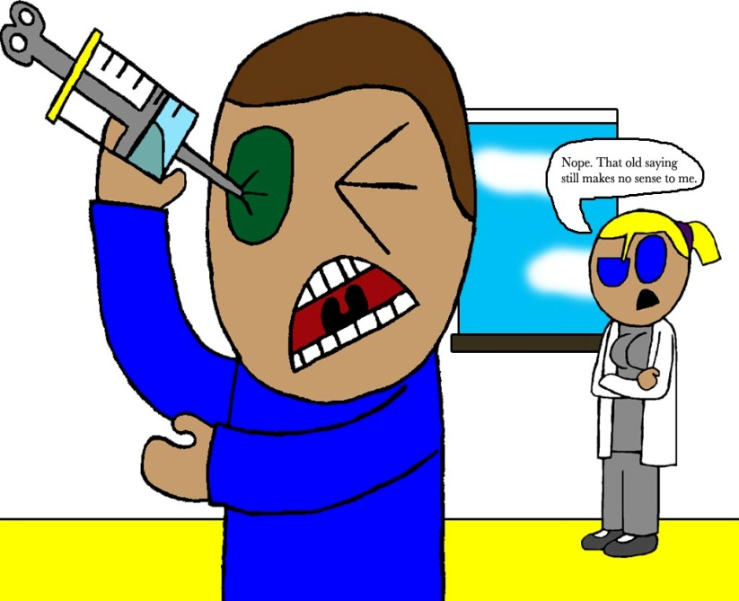
My Experience with the Toolkit
Took a lot of brain power and concentration
Frequent looking back and forth when appraising a study
Length of time to go thru all the steps initially almost an hour per study
By the end of the afternoon I wanted to poke myself in the eye with a sharp stick

Slide 18
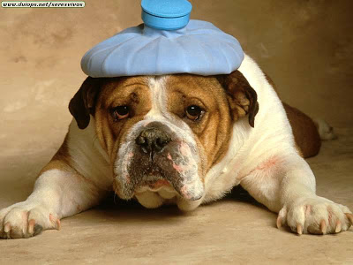
Things I Said to Myself
You’re just dumb
This is too hard
My brain hurts
Notes:
I had used a large data base and done a quantitative analysis for my thesis, so I was fairly familiar with the terms and processes used.
Still it would take me a good hour to use this process for each study

Slide 19
BUT…..
The more I used it, the quicker it went
I felt growing confidence with my decisions and conclusions
This really is a very good tool!

Slide 20
A Very Useful Tool BUT……
Assumed a graduate student level of knowledge
Very time consuming to learn and develop skill using it.
Concerns that this would prevent folks from discovering and using it
YET
Thirst for knowledge and skills surrounding evaluating evidence
What can I develop to assist this process?
Notes:
Some of you may have limited experience with critical appraisal or your experience may have taken place years ago

Slide 21
Introduction to Critical Appraisal Toolkit
A module to review some of the terms used in the toolkit
Go in to further explanations about the elements of various study designs
Expand on the information in the toolkit and fill in the pieces where knowledge was assumed
First experiences using the toolkit will be less frustrating, more gratifying
Notes:
Include information to fill in some of the gaps where knowledge has been assumed

Slide 22
Introduction to Critical Appraisal Toolkit
Using IC examples:
Research and Key questions
Study Designs
Quality of Study (bias, confounding, generalizability, reliability, validity, ethics, statistical or clinical significance, retention and follow-up).
Looking for folks for pilot group
Notes:
Goal is to have it ready for May to trial

Slide 23
Future Dreams
Journal Club
Once a month teleclass that chooses 2 or 3 studies
Provides opportunity to discuss the study methods and key learnings/conclusions
IPCs use their clinical experiences to influence research
active in developing research questions
It all starts with a Question
Notes:
I believe that the biggest mistake we make is when we assume that someone else already knows the answer to our question rather finding out whether anyone has ever even asked the question before.
I also believe that we will find better solutions when we become the people who ask whether we have asked enough questions rather than the people who are the keepers of all the answers.

Slide 24
WARNING !!
This process will still take time, practice and patience.
Your skills will require continual nurturing

