Slide 1
Catheter-Associated UTIs:
Prevention Strategies and Areas for improvement
A Lecture for the PICNET Conference,
Richmond, British Columbia, Canada
March 5, 2015
Robert Garcia, BS, MMT(ASCP), CIC
Infection Control Preventionist
New York, United States

Slide 2
Disclosure Statement
Robert Garcia is a member of the Clinical Advisory Group for Sage Products, LLC.

Slide 3
Today’s Objectives
Describe the prevalence and impact of CAUTI events in the United States
Review UTI definitions and provide new insights on surveillance
Review regulatory and quality initiatives associated with the prevention of CAUTI
Describe the life cycle of the urinary catheter and areas for prevention improvement

Slide 4
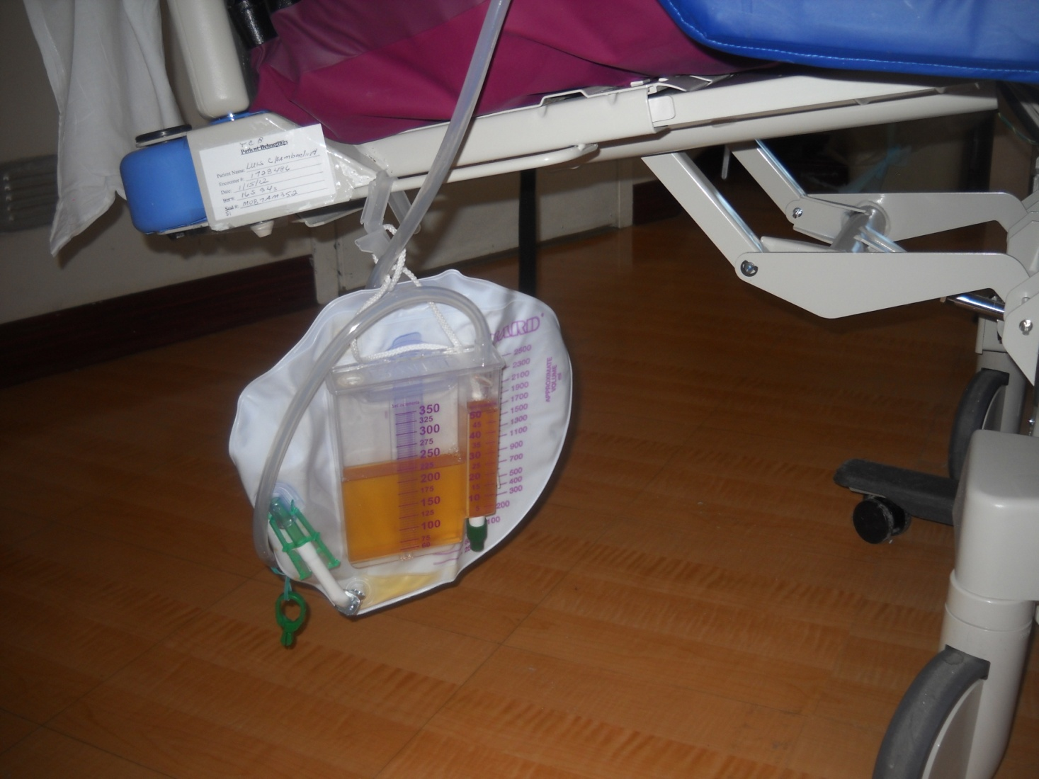
The Source of Troubles

Slide 5
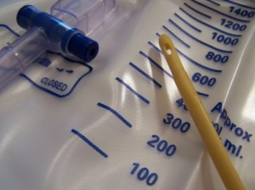
Background on CAUTIs

Slide 6
Epidemiology
4 million Americans per year undergo urinary catheterization¹
>500,000 remain indwelling for some time¹
About 25% of patients in hospitals² and 4.5 % of LTC patients³ will be managed by an indwelling catheter
CAUTI occurs at a rate of 3% to 10% per day⁴
Incidence approaches 100% within 30 days.⁵
CAUTI is the leading cause of secondary hospital-acquired bloodstream infection ⁶
Annual CAUTIs are estimated to be 561,677 with 8,250 associated deaths per year ⁷
Doyle B. Decreasing nosocomial urinary tract infection in a large academic community hospital. Lippincotts Case Manag 2001;6:127-136.
Saint S. The potential clinical and economic benefits of silver allow urinary catheters in preventing urinary tract infection. Arch Intern med 2000;160:2670-75.
Junkin J. Prevalence of incontinence and associated skin injury in the acute care inpatient. J Wound Ostomy Continence Nurs 2007;34:260-69.
Trautner BW. Prevention of catheter-associated urinary tract infection. Curr Opin Infect Dis 2005;18:37-41.
Warren JW. A prospective microbiologic study of bacteruria in patients with chronic indwelling urinary catheters. J Infect Dis 1982;146:719-23.
Gould C. Guideline for prevention of CAUTI 2009.
Department of Health and Human Services, Action Plan To Prevent Healthcare-Associated
Infection, 2009,US Department of Health and Human Services.

Slide 7
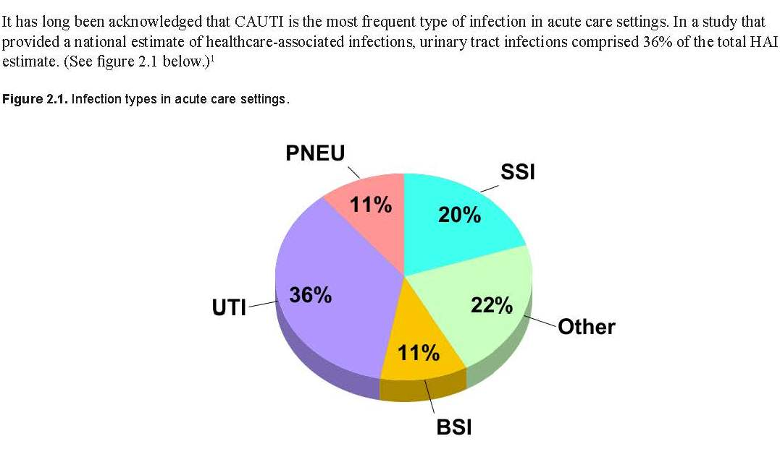

Healthcare Associated Infections
80% of all UTIs are catheter related
*An APIC Guide 2008: Guide to the Elimination of Catheter-Associated Urinary Tract Infections (CAUTIs)
¹ Klevens RM, Edwards JR, Richards CL, et al. Estimating healthcare-associated infections and deaths in U.S. hospitals, 2002. Public Health Rep. 2007; 122:160-167. http://www.cdc.gov/ncidod/dhqp/pdf/hicpac/infections_deaths.pdf

Slide 8
CAUTI Rates, NHSN, 2012
Type of location | No. of locations | No. of CAUTI | Catheter days | Pooled Mean
CRITICAL CARE
Medical-Major teaching | 230 | 2181 | 741,268 | 2.9
Medical-All others | 460 | 1438 | 852,627 | 1.7
Medical cardiac | 405 | 1517 | 703,734 | 2.2
Medical/surgical – major teaching | 328 | 2280 | 935,001 | 2.4
Neurosurgical | 173 | 2464 | 489,391 | 5.0
Pediatric medical/surgical | 297 | 452 | 166,710 | 2.7
Surgical – major teaching | 176 | 1800 | 558,102 | 3.2
Surgical – cardiothoracic | 456 | 1657 | 939,044 | 1.8
INPATIENT WARDS
Medical | 813 | 1334 | 882,392 | 1.5
Medical/surgical | 1825 | 2752 | 2,038,073 | 1.4
Neurosurgical | 48 | 175 | 61,879 | 2.8
Surgical | 458 | 1099 | 647,041 | 1.7
Dudeck MA. National Healthcare Safety Network (NHSN) Report, data summary for 2012, device-associated module. AJIC 2013;41:1148-66.

Slide 9
Urinary Catheter Utilization Ratios, NHSN, 2012
Type of location | No. of locations | Catheter days | Patient days | Pooled Mean
CRITICAL CARE
Medical-Major teaching | 230 | 741,268 | 1,061,826 | 0.70
Medical-All others | 460 | 852,627 | 1,401,026 | 0.61
Medical cardiac | 405 | 703,734 | 1,393,767 | 0.50
Medical/surgical – major teaching | 328 | 935,001 | 1,371,681 | 0.68
Neurosurgical | 173 | 489,391 | 713,836 | 0.69
Pediatric medical/surgical | 297 | 166,710 | 775,828 | 0.21
Surgical – major teaching | 176 | 558,102 | 745,658 | 0.75
Surgical – cardiothoracic | 456 | 939,044 | 1,417,609 | 0.66
INPATIENT WARDS
Medical | 813 | 882,392 | 5,552,794 | 0.16
Medical/surgical | 1825 | 2,038,073 | 11,501,523 | 0.18
Neurosurgical | 48 | 61,879 | 315,157 | 0.20
Surgical | 458 | 647,041 | 2,887,968 | 0.22
Dudeck MA. National Healthcare Safety Network (NHSN) Report, data summary for 2012, device-associated module. AJIC 2013;41:1148-66.

Slide 10
Cost of CAUTI
The CDC has estimated that up to 139,000 hospital onset, symptomatic CAUTIs occurred in 2007,¹ resulting in as much as $131 million in excess direct medical costs ²
Each episode of UTI costs btwn. $600-$3803 ³⁻⁴
UT-related bacteremia, $2800 ⁵
Wise M. Burden of major hospital-onset device-associated infection types among adults and children in the United States, 2007. 21st Annual Scientific Meeting of the Society of Healthcare Epidemiology of America, April 2, 2011; dallas, Tx. Abstract 3703.
Scott R. Economic burden of major device-associated, acute-care hospital-onset infections among adults and children in the United States, 2007. 21st Annual Scientific Meeting of the Society of Healthcare Epidemiology of America, April 2, 2011; dallas, Tx. Abstract 4552.
Saint S. Clinical and economic consequences of nosocomial catheter-related bacteriuria. Am J Infect Cont 2000;28:68-75.
McConnel E. New catheters decrease nosocomial infections. Nurs Manag 2000;31:52,55.
Tambyah PA. The direct costs of nosocomial catheter-related urinary tract infection in the era of managed care. Infect Cont Hosp Epidemiol 2002;23:27-31.

Slide 11
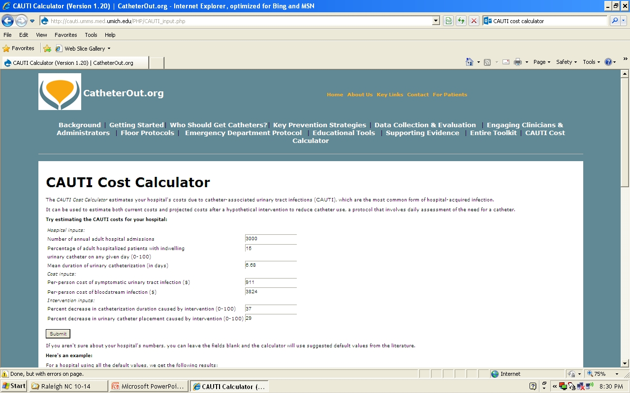
CAUTI Cost Calculator
Available at: http://cauti.umms.med.umich.edu/PHP/CAUTI_input.php
Kennedy EH, et al. Estimating hospital costs of CAUTI. J Hosp med 2013;8:519-22.

Slide 12
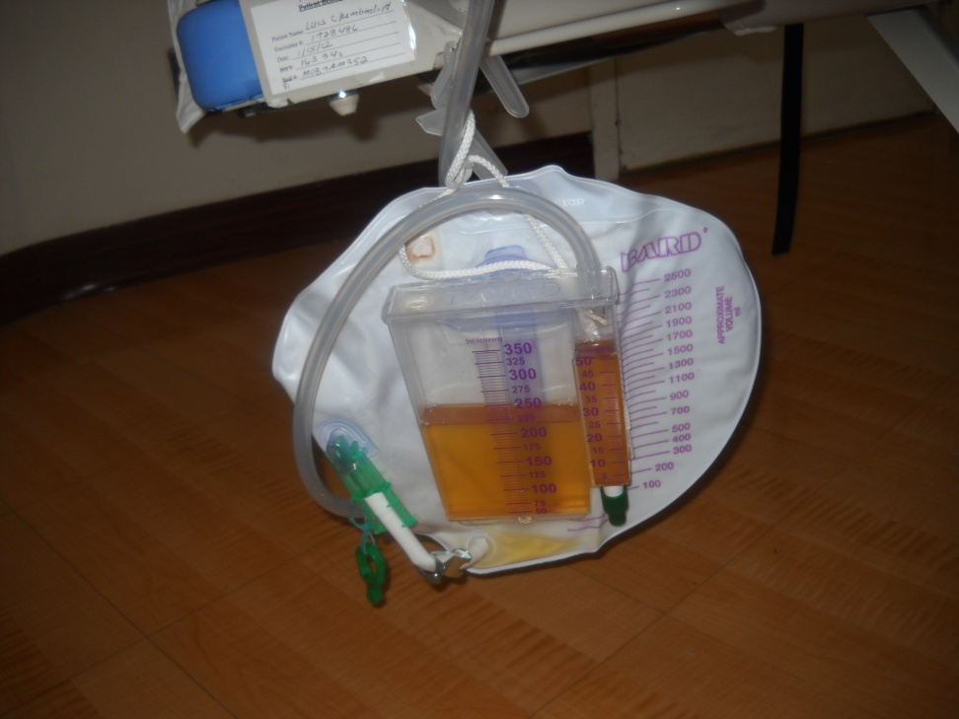
National & Regulatory CAUTI Prevention Initiatives

Slide 13
Financial: CMS - Show Me the Money!
Starting October 1, 2008, the Centers for Medicare and Medicaid Services (CMS) under a revised Acute Care Hospital Inpatient Prospective Payment System (IPPS), would no longer reimburse hospitals for costs attributable to CAUTIs
Starting in 2014, CMS began publically reporting rates of CAUTI for hospitals participating in the Hospital Inpatient Quality Reporting Program
Starting in 2015, required reporting of CAUTIs in all settings, including adult and pediatric medical, surgical wards
CMS will base penalties on NHSN CAUTI data
CMS. Medicare Program: hospital inpatient propsepctive payment systems for acute care hospitals and long-term care hospital prospective payment system and proposed fiscal year 2014 rates. Fed Regist 2013;78:27622-35.

Slide 14

Safer Healthcare Now
Available at: http://www.saferhealthcarenow.ca/EN/Pages/default.aspx

Slide 15
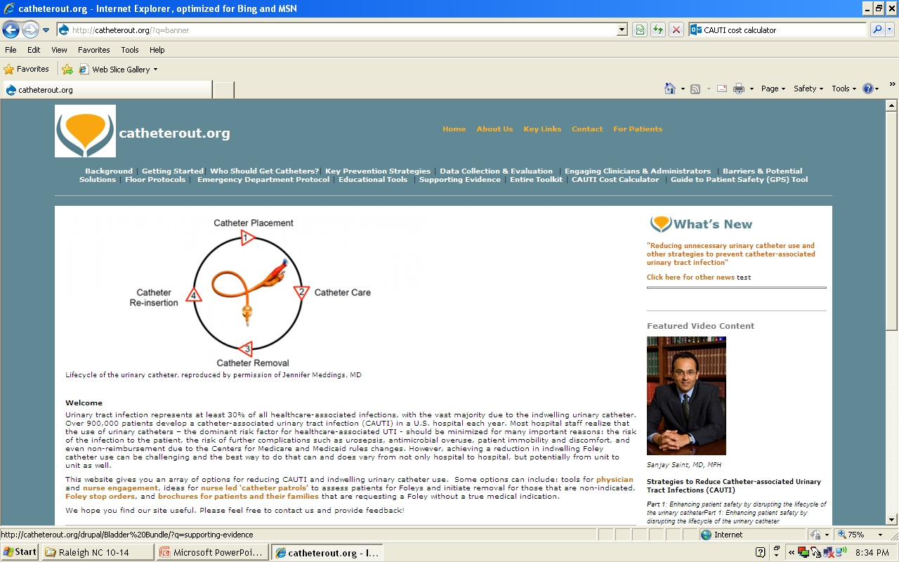
Catheter Out Program
Available at: http://catheterout.org/?q=banner

Slide 16
NHSN Definitions of CAUTI: Preventing the Preventable

Slide 17
NHSN CAUTI Definition Revisions 2015
Effective January 2015
  The Urinary Tract Infections (UTI) definitions will no longer include:
    Symptomatic UTI (SUTI) criteria 2 and 4 due to removal of the following elements:
      Colony counts of less than 100,000 CFU/ml
      Urinalysis results
    Urine cultures that are positive only for yeast, mold, dimorphic fungi, or parasites
    Uropathogen list for Asymptomatic Bacteremic UTI (ABUTI) – ABUTI criteria will use the same pathogen list as SUTI
NHSN Newsletter, Vol. 9, Issue 3, September 2014

Slide 18
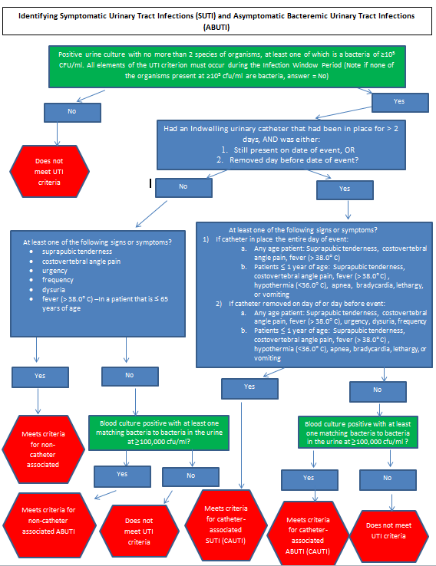
NHSN, SUTI and ABUTI, 2015

Slide 19
Area of Improvement:
NHSN Clarification on CAUTI & POA
NHSN clarified the issue of patients having an infection present on admission (POA)
Simply having a urine culture positive for an organism on the date of admission does not make it POA
The NHSN manual states that an infection that is POA must have all of the required infection criteria during the POA time period. The POA time period includes the 2 days prior before admission, the day of admission, and the day after admission.
Not in your favor: Infection can develop from colonization on day of admission (positive urine culture with no other criteria) to CAUTI (pos urine culture plus other criteria)
In your favor: suspect CAUTI can actually be POA if on POA it is an infection
NHSN Newsletter, March 2014

Slide 20
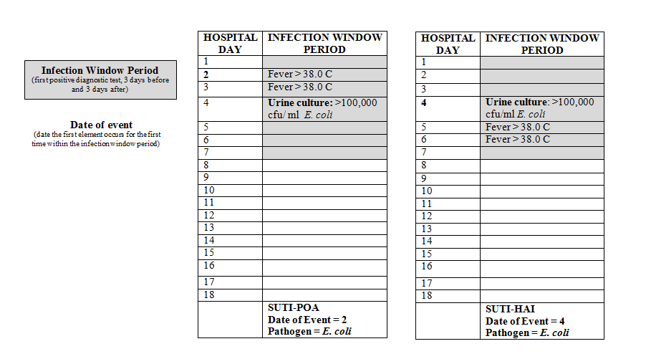
Present on Admission and HAI

Slide 21
Area of Improvement:
Documentation of Symptoms and Catheter Status (1)
Study conducted to examine if pts. with UTI diagnosis in claims data had a catheter, documented symptoms, or met the NHSN criteria for CAUTI (Univ. of Michigan)
Retrospective medical record review of a random sample of 295 adult hospitalized patients with a secondary diagnosis of UTI
Results:
  126/294 (43%) had an indwelling urinary catheter
  113/294 (38%) had NHSN symptoms
  62/294 (21%) had symptoms other than fever
  Of 136 pts. meeting urine criteria, only 17 (5.8%) met NHSN CAUTI criteria
Conclusion:
  “NHSN symptoms beyond fever (e.g., suprapubic or CVA tenderness) were documented for a minority (21%) of hospitalizations and not commonly mentioned outside of investigations for causes of fever…whether these NHSN symptoms were not present or simply were not documented is unclear.”
Meddings J, et al. Challenges and proposed improvements for reviewing symptoms and catheter use to identify NHSN CAUTIs. AJIC 2014;42:S236-S241.

Slide 22
Area of Improvement:
Documentation of Symptoms and Catheter Status (2)
Retrospective study conducted to examine whether clinician practice reflected NHSN definitions (Univ. of Michigan)
Medical record review of 387 adult hospitalized patients with a catheter and positive urine culture
Results:
  Only 4.7% of patients had documented symptoms
  Clinician CAUTI diagnosis: 216/387 (55.8%)
  ID Consultants CAUTI diagnosis: 63/211 (29.9%)
  NHSN CAUTI diagnosis: 119/387 (30.7%)
Conclusion:
  “We found that local signs of infection are rarely reported in patients with a urinary catheter and positive urine cultures….we found that clinicians treated more than half of the patients with positive urine cultures with antibiotics, and their decision was related to signs of sepsis but was based on age and type of organism.”
Fadi AH, et al. Clinician practice and the NHSN definition for the diagnosis of CAUTI. AJIC 2013;41:1173-7.

Slide 23
Example of Amended Urine Culture Order Query
  ∗
    With no other recognized cause besides suspected UTI.
Table 3.
Example text for a urine culture order to query and document catheter status and symptoms at the time of urine culture sample collection
Urine culture request: Please provide the following information regarding the patient
Urinary catheter status
☐ Indwelling Foley urinary catheter in place. Reason:______________. Placed on: date. ☐ Indwelling Foley urinary catheter removed today or yesterday. ☐ No current or recent indwelling Foley urinary catheter. ☐ Other urinary catheter type used today or yesterday:__________________.
Symptoms today or yesterday
☐ None: please avoid ordering urine culture in patients without symptoms.
☐ Fever >38 °C | ☐ CVA pain, tenderness∗ | ☐ Urgency∗
☐ Suprapubic tenderness∗ | ☐ Frequency∗ | ☐ Dysuria∗
☐ Other symptoms/reasons for ordering urine culture:____________________ _____________________________________________________________________
Meddings J, et al. Challenges and proposed improvements for reviewing symptoms and catheter use to identify NHSN CAUTIs. AJIC 2014;42:S236-S241.

Slide 24
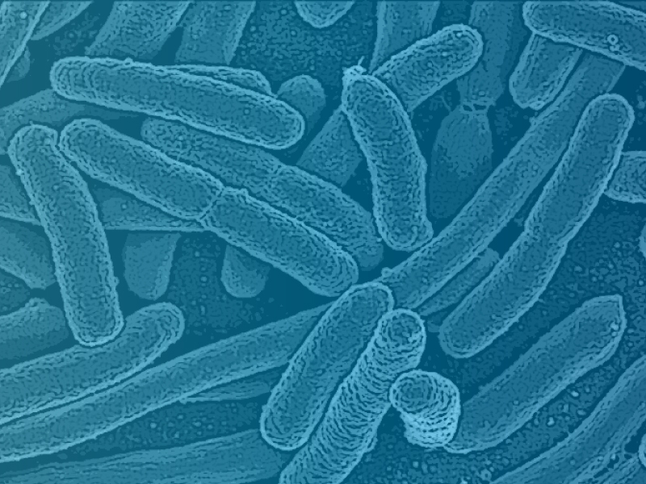
Pathogenesis of CAUTI

Slide 25
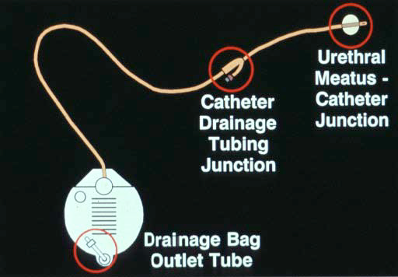
Pathogenesis
66% of CAUTI acquired by the extraluminal route: Staph, Enterococcus, yeast
34% acquired by intraluminal route: Gram negatives
Tambyah PA. A prospective study of pathogenesis of catheter-associated urinary tract infections. Mayo Clin Proc 1999;74:131-6.

Slide 26
Pathogenesis
Extraluminal acquisition of organisms is usually associated with endogenous organisms, i.e., bacteria that colonize the patient’s own perineum
Intraluminal acquisition is most often associated with exogenous organisms and result from cross-contamination from the hands of healthcare workers
Approx. 15% of episodes of healthcare-associated bacteruria occur in clusters from intrahospital transmission
Maki DG. Engineering out the risk of infection with urinary catheters. Emerg Infect Dis 2001;7:1-6.

Slide 27
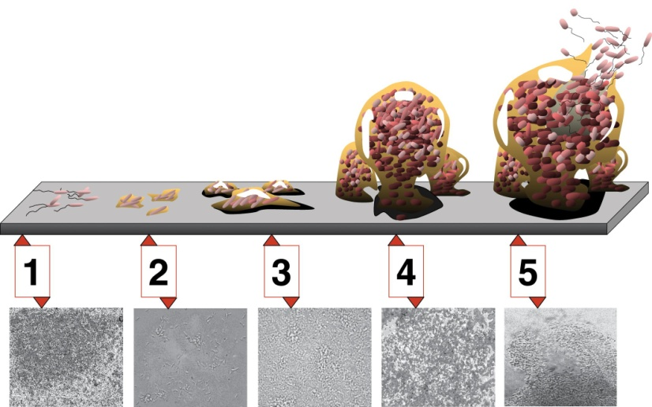
Catheter Biofilms
Biofilms are composed of clusters of mircoorganisms in a polysaccharide matrix
They form on intraluminal and extraluminal surfaces
Organisms in biofilms may ascend the catheter in 1-3 days
Biofilms form a protective environment for organisms with poor penetration by antimicrobials
Saint S. Biofilms and catheter-associated urinary tract infections. Infectious Dis Clin North America 2003;17:411-32.

Slide 28
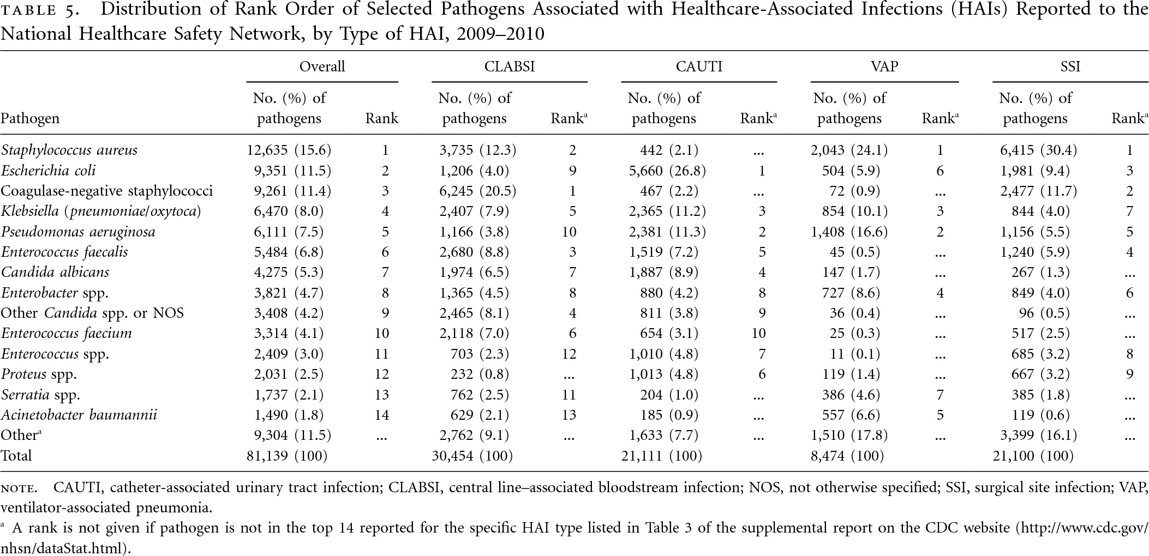
Pathogens Associated with CAUTIs
Sivert DM. Antimicrobial-resistant associated with HAIs: Summary of data reported to the NHSN a the CDC, 2009-2010. ICHE 2013;34;1-14.

Slide 29
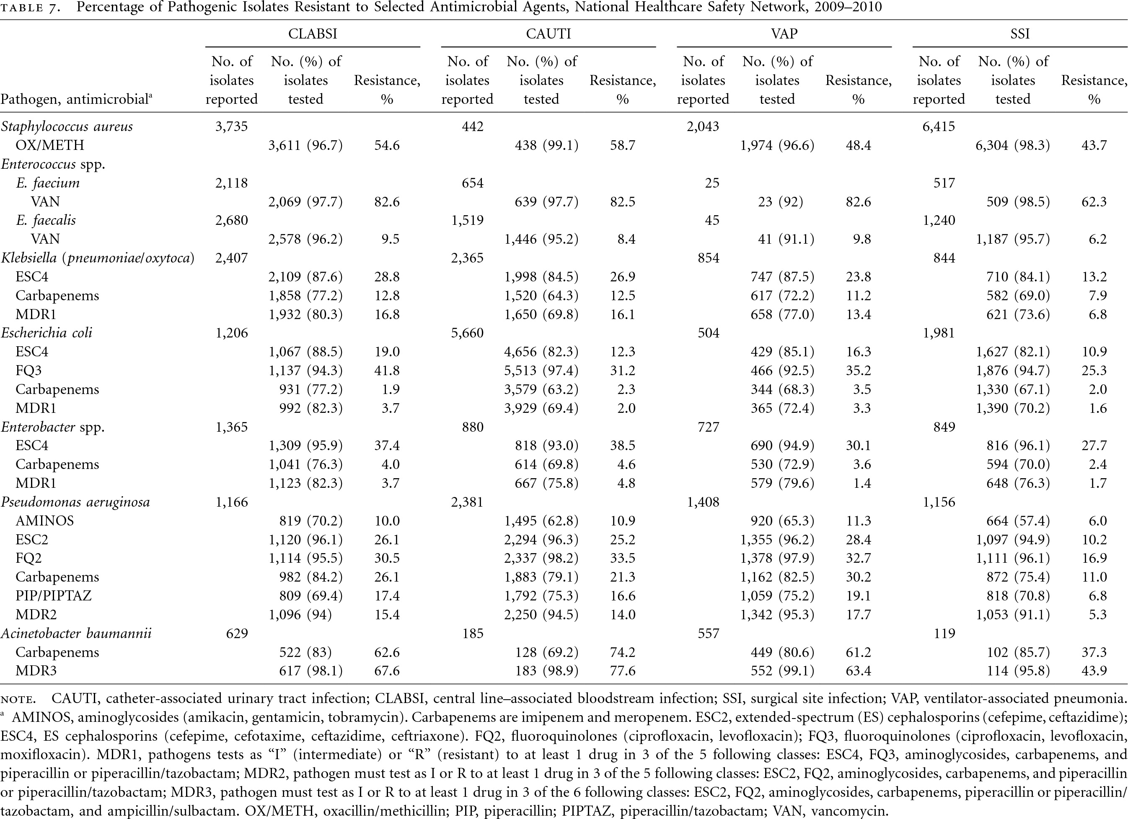
Antibiotic Resistant Organisms & CAUTIs
Sivert DM. Antimicrobial-resistant associated with HAIs: Summary of data reported to the NHSN a the CDC, 2009-2010. ICHE 2013;34;1-14.

Slide 30
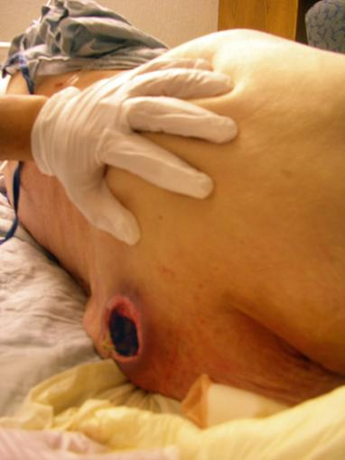
The Danger Next Door

Slide 31
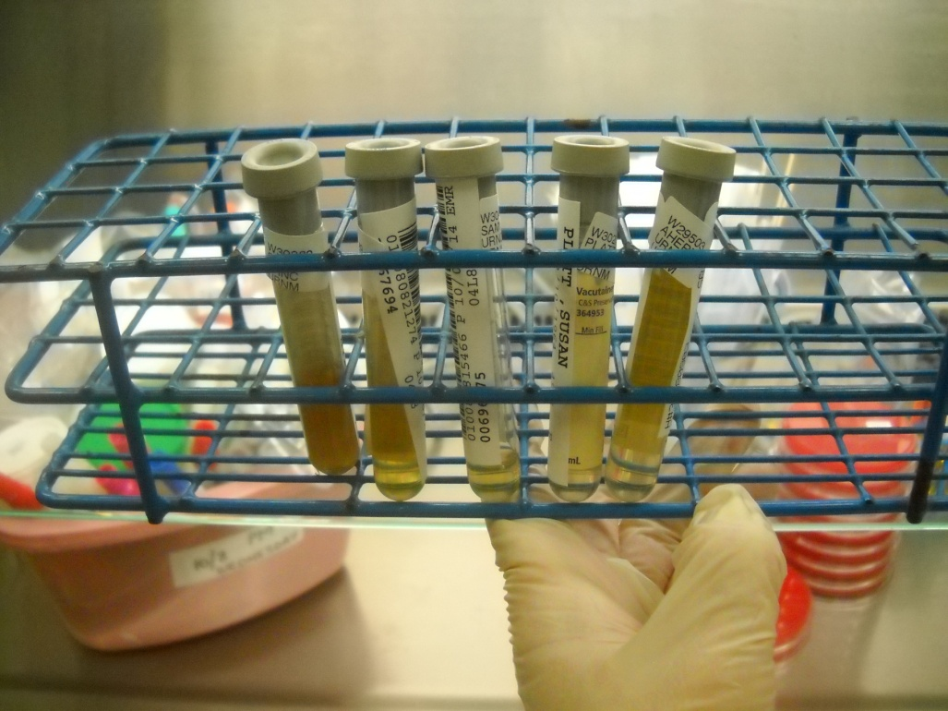
Urine Specimen Collection

Slide 32
Area of Improvement:
Collection of Urine for Microbiology Culture
Protocol is nearly universally overlooked in improvement plans
Major points to address when obtaining urine cultures from urinary catheters:
  In a patient who is symptomatic, replace the catheter and obtain specimen from the new catheter
  Collect sample in an aseptic manner (wash hands, wear gloves)
  Use a disinfectant to wipe the collection port (scrub the hub?)
  Use a 20ml syringe to collect urine from the sampling port
  If facility method is to place the sample in a sterile container, then transport to lab: analysis should take place within 2 hours of collection; if not, place in refrigerator (2-8◦C), max 24 hrs.
  There is a preferred method of collection!
Educate all staff who collect samples for urine culture

Slide 33
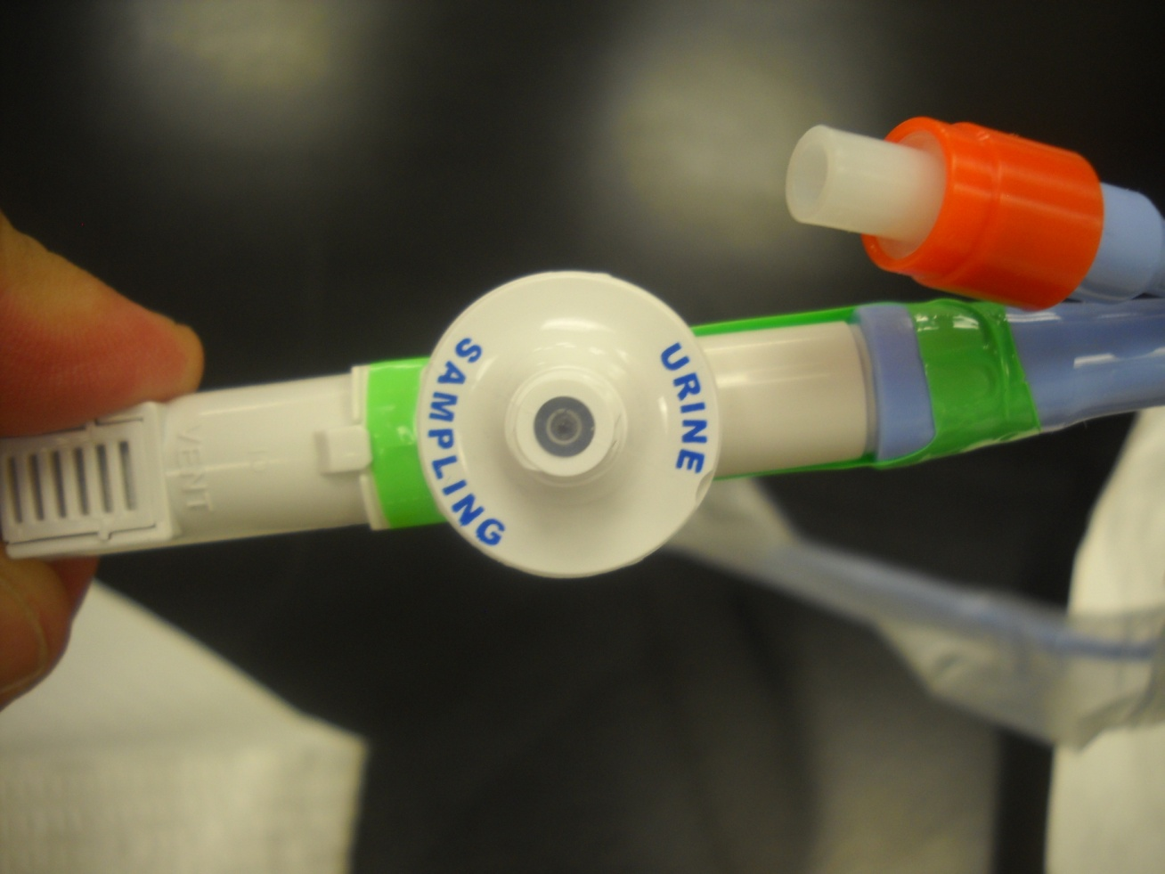
How should we collect urine specimens?
“If a small volume of fresh urine is needed for examination (i.e. urinalysis or culture), aspirate the urine from the needleless sampling port with a sterile syringe/cannula adaptor after cleansing the port with a disinfectant.” (Category IB)
Unlike intravascular catheters, there is no replaceable connector
Gould CV, et al. HICPAC. Centers for Disease Control & Prevention . Guideline for Prevention of CAUTI, 2009.

Slide 34
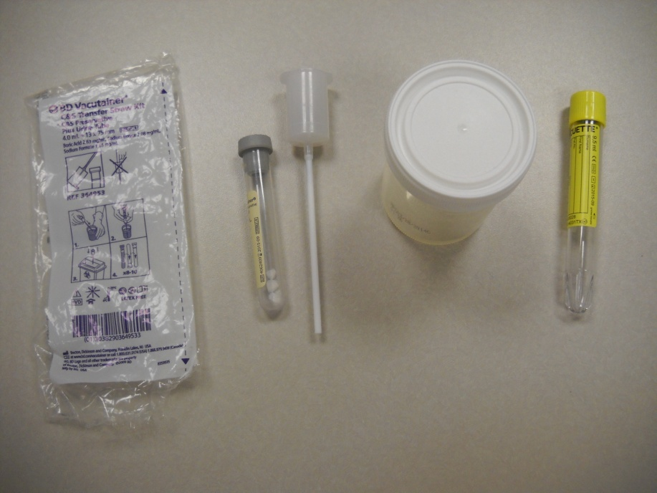
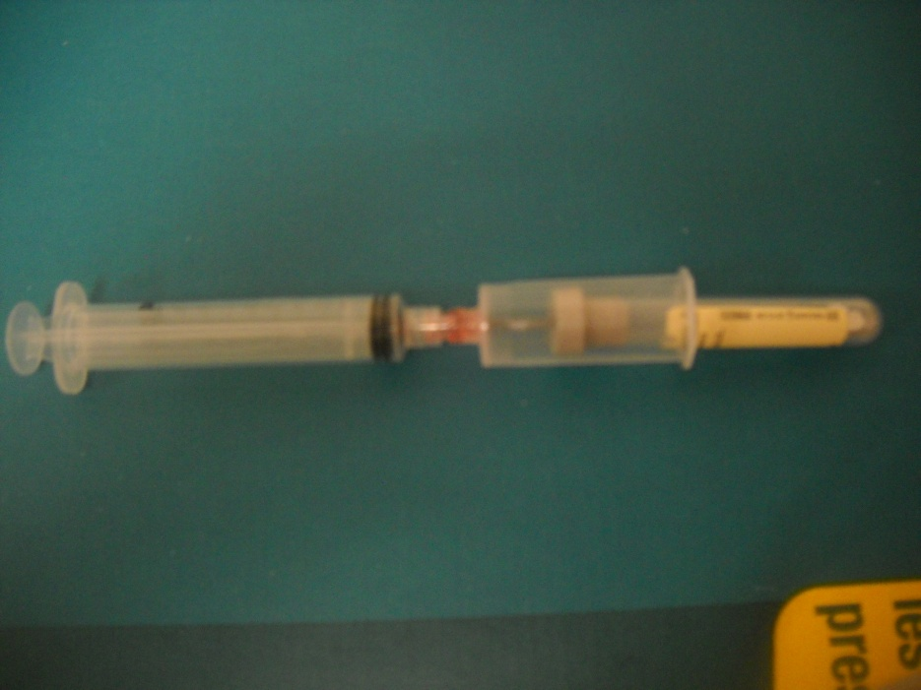
Optimal Urine Collection System
“Straw” method:
“Transfer Device” method:

Slide 35
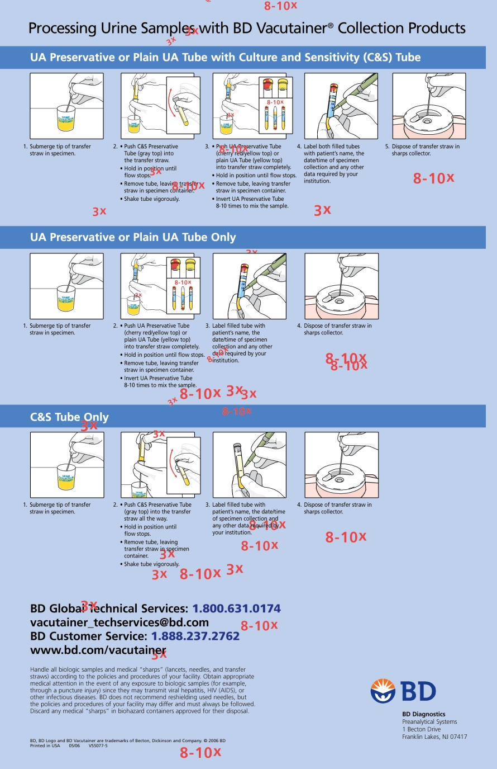
Education on Proper Urine Collection
Available at: http://www.bd.com/vacutainer/pdfs/urine_wallchart_processingsamples_VS5991.pdf

Slide 36
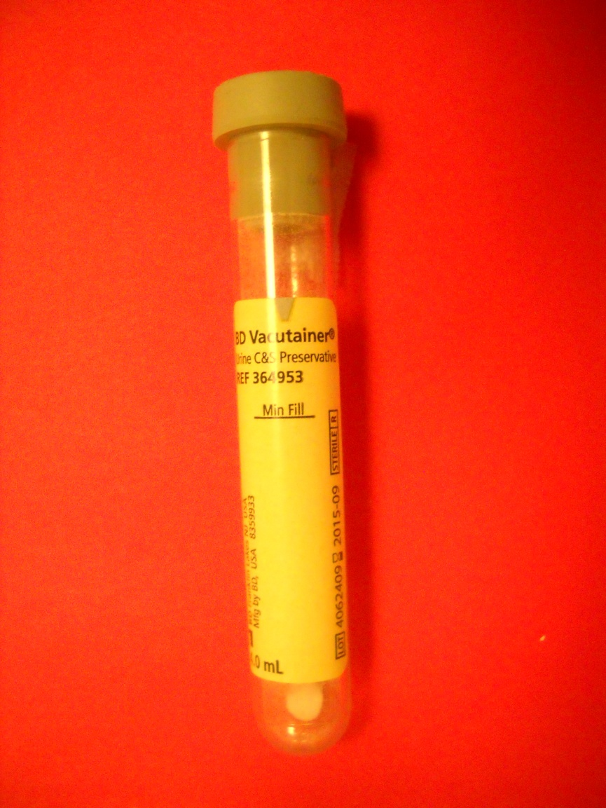
Preferred Method of Urine Collection
Use a kit containing a vacutainer tube with preservative (buffered boric acid)
viable at room temp up to 48 hrs.
In order to optimize the yield of bacteria, collect approx. 15ml of urine (to “Min Fill”)
Fill line
Preservative
Urinalysis: Approved Guideline, 3rd Ed. Clinical and Laboratory Standards Institute, 2009.

Slide 37
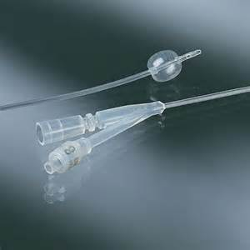
Prevention Recommendations

Slide 38
Is Old New Again?
“….once a catheter is put in place, one must keep two important concepts in mind: (1) keep the catheter system closed in order to postpone the onset of bacteriuria, and (2) remove the catheter as soon as possible. If the catheter can be removed before bacteriuria develops, postponement becomes prevention. However, the best prevention is not to use a urethral catheter at all.”
1991:
JW Warren, The Catheter and Urinary Tract Infection.
Med Clin North Am.75:481-93

Slide 39
National Survey on Prevention of UTIs
Random sample of hospitals with ICUs and >50 beds to determine the extent of prevention practices
119 VA hospitals, 2671 Non-VA hospitals
Results:
  ~56% of hospitals did not have system for monitoring which patients had urinary catheters
  ~74% did not monitor catheter duration
  ~70% did not have established system for monitoring UTI rates
  Only ~10% used either catheter reminders or stop orders.
Conclusion: no single strategy was widely used for the prevention of nosocomial UTI
2008:
Saint S. Preventing hospital-acquired urinary tract infection in the United States: A National Survey. CID 46:243-50.

Slide 40
What Can We Prevent?
An estimated 17% to 69% of CAUTI may be preventable with recommended infection control measures, which means that up to 380,000 infections and 9000 deaths related to CAUTI per year could be prevented ¹
[The best quality studies] suggest that as many as 70% of all CAUTIs are preventable with current evidence-based strategies. CAUTI may be the most preventable HAI; the number of avoidable infections ranges from 95,483 to 387,550 per year. ²
CDC Guideline for the Prevention of CAUTI 2009.
Umscheid CA, et al. Estimating the proportion of HAIs that are reasonably preventable and the related mortality and cost. ICHE 2011;32:101-114.

Slide 41
Published Guidelines on Prevention of CAUTI
CDC: Gould CV, et al. Guideline for prevention of catheter-associated urinary tract infections 2009. Healthcare Infection Control Practices Advisory Committee, CDC, Atlanta, GA, 2009.
SHEA: Lo E, et al. Strategies to prevent catheter-associated urinary tract infections in acute care hospitals:2014 Update. Infect Control Hosp Epidemiol 2014;35:464-479.
IDSA: Hooton TM, et al. Diagnosis, prevention, and treatment of catheter-associated urinary tract infection in adults: 2009 International clinical practice guidelines from the Infectious Diseases Society of America. CID 2010;50:625-663.
APIC: Greene L, et al. Guide to Preventing Catheter-Associated Urinary Tract Infections. Association of Professionals in Infection Control. Washington, DC, 2014.

Slide 42
Published Guidelines on Prevention of CAUTI
European Assoc. of Urology: Tenke P, et al. European and Asian guidelines on management and prevention of catheter-associated urinary tract infections. International J Antimicrobial Agents 2008;31S:S68-S78.
DOH of England: Pratt RJ, et al. EPIC 2: national evidence-based guidelines for preventing healthcare-associated infections in NHS hospitals in England. J Hosp Infect 2007;65(Supp. 1):S1-64.
WOCN: Nursing interventions to reduce the risk of catheter-associated urinary tract infections. Parts 1-3, 2009, J Wound Ostomy Continence Nurs;36, 23-34, 137-54, 156-9.

Slide 43
CDC-HICPAC Guideline Categories
Category | Recommendation
IA | A strong recommendation supported by high to moderate quality evidence suggesting net clinical benefits or harms
IB | A strong recommendation supported by low quality evidence suggesting net clinical benefits or harms or an accepted practice (e.g., aseptic technique) supported by low to very low quality evidence
IC | A strong recommendation required by state or federal regulation.
II | A weak recommendation supported by any quality evidence suggesting a trade off between clinical benefits and harms
No recommendation/Unresolved issue | Unresolved issue for which there is low to very low quality evidence with uncertain trade offs between benefits and harms
Gould CV, et al. HICPAC. Centers for Disease Control & Prevention . Guideline for Prevention of CAUTI, 2009.

Slide 44
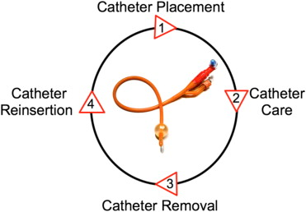
Lifecycle of the Urinary Catheter
Meddings J, et al. Disrupting the life cycle of the urinary catheter. Clin Inf Dis 2011;52:1291-3.

Slide 45
Lifecycle 1: Catheter Placement
Use the smallest bore catheter possible
Assure that all staff understand the indications for appropriate insertion
Only trained personnel to insert catheters
Use alternate devices if possible (condom catheters, intermittent catheterization)

Slide 46
When is Urinary Catheterization Appropriate?
Patient has acute urinary retention or bladder outlet obstruction
Need for accurate measurements of urinary output in critically ill patients
Perioperative use for selected surgical procedures:
  Patients undergoing urologic surgery or other surgery on contiguous structures of the genitourinary tract
  Anticipated prolonged duration of surgery (catheters inserted for this reason should be removed in PACU)
  Patients anticipated to receive large-volume infusions or diuretics during surgery
  Need for intraoperative monitoring of urinary output
To assist in healing of open sacral or perineal wounds in incontinent patients
Patient requires prolonged immobilization (e.g., potentially unstable thoracic or lumbar spine, multiple traumatic injuries such as pelvic fractures)
To improve comfort for end of life care if needed
Gould CV, et al. HICPAC. Centers for Disease Control & Prevention . Guideline for Prevention of CAUTI, 2009.

Slide 47
When is Urinary Catheterization Inappropriate?
As a substitute for nursing care of the patient or resident with incontinence
As a means of obtaining urine for culture or other diagnostic tests when the patient can voluntarily void
For prolonged postoperative duration without appropriate indications (e.g., structural repair of urethra or contiguous structures, prolonged effect of epidural anesthesia, etc.)
Gould CV, et al. HICPAC. Centers for Disease Control & Prevention . Guideline for Prevention of CAUTI, 2009.

Slide 48
Area of Improvement:
Urinary Catheter Use in the Emergency Dept.
Analysis of National Hospital Ambulatory Medical Care Survey (NHAMCS) data, ED visits, 1995-2010
Examined use of urinary catheters and appropriateness of use based on CDC criteria
Results:
  Urinary catheter use: 2.2 to 3.3 per 100 ED visits
  Among admitted patients, 8.5% received urinary catheters
  64.9% of catheters were potentially avoidable
    Reasons:
      Catheters sometimes placed to collect specimens
      To monitor output
      Determine residual bladder volume
      Patient or staff convenience
Schuur JD, et al. Urinary catheter use and appropriateness in U.S. Emergency Departments, 1995-2010. Acad Emer Med 2014;21:292-300.

Slide 49
Recommendations on Insertion
“Perform hand hygiene immediately before and after insertion or any manipulation of the catheter device or site” (Category IB)
“Ensure that properly trained persons (e.g., hospital personnel, family members, or patients themselves) who know the correct technique of aseptic catheter insertion and maintenance are given this responsibility” (Category IB)
“In the acute care hospital setting, insert urinary catheters using aseptic technique and sterile equipment” (Category IB)
  “Use sterile gloves, drape, sponges, an appropriate antiseptic or sterile solution for periurethral cleaning, and a single-use packet of lubricant jelly for insertion” (Category IB)
  “Routine use of antiseptic lubricants is not necessary” (Category II)
  “Further research is needed on the use of antiseptic solutions vs. sterile water or saline for periurethral cleaning prior to catheter insertion” (No recomm.)
Gould CV, et al. HICPAC. Centers for Disease Control & Prevention . Guideline for Prevention of CAUTI, 2009.

Slide 50
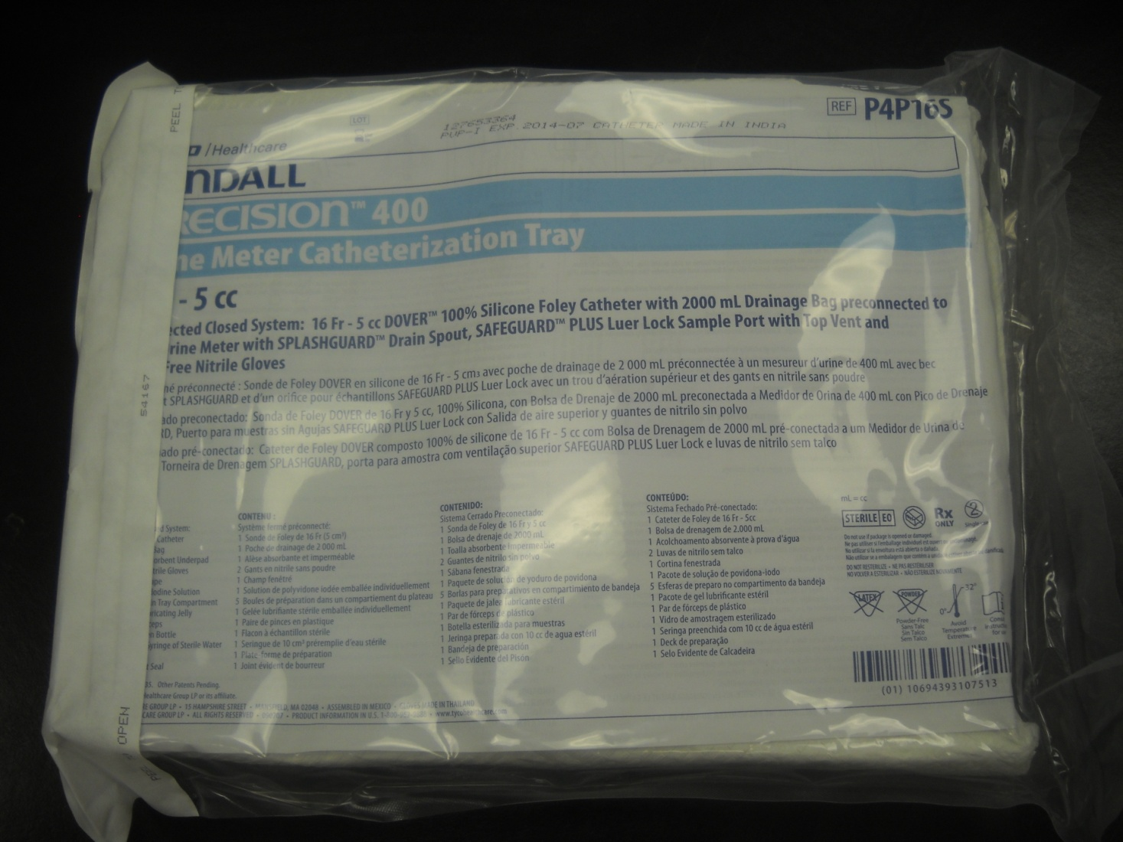
Clinicians Should Choose Products

Slide 51
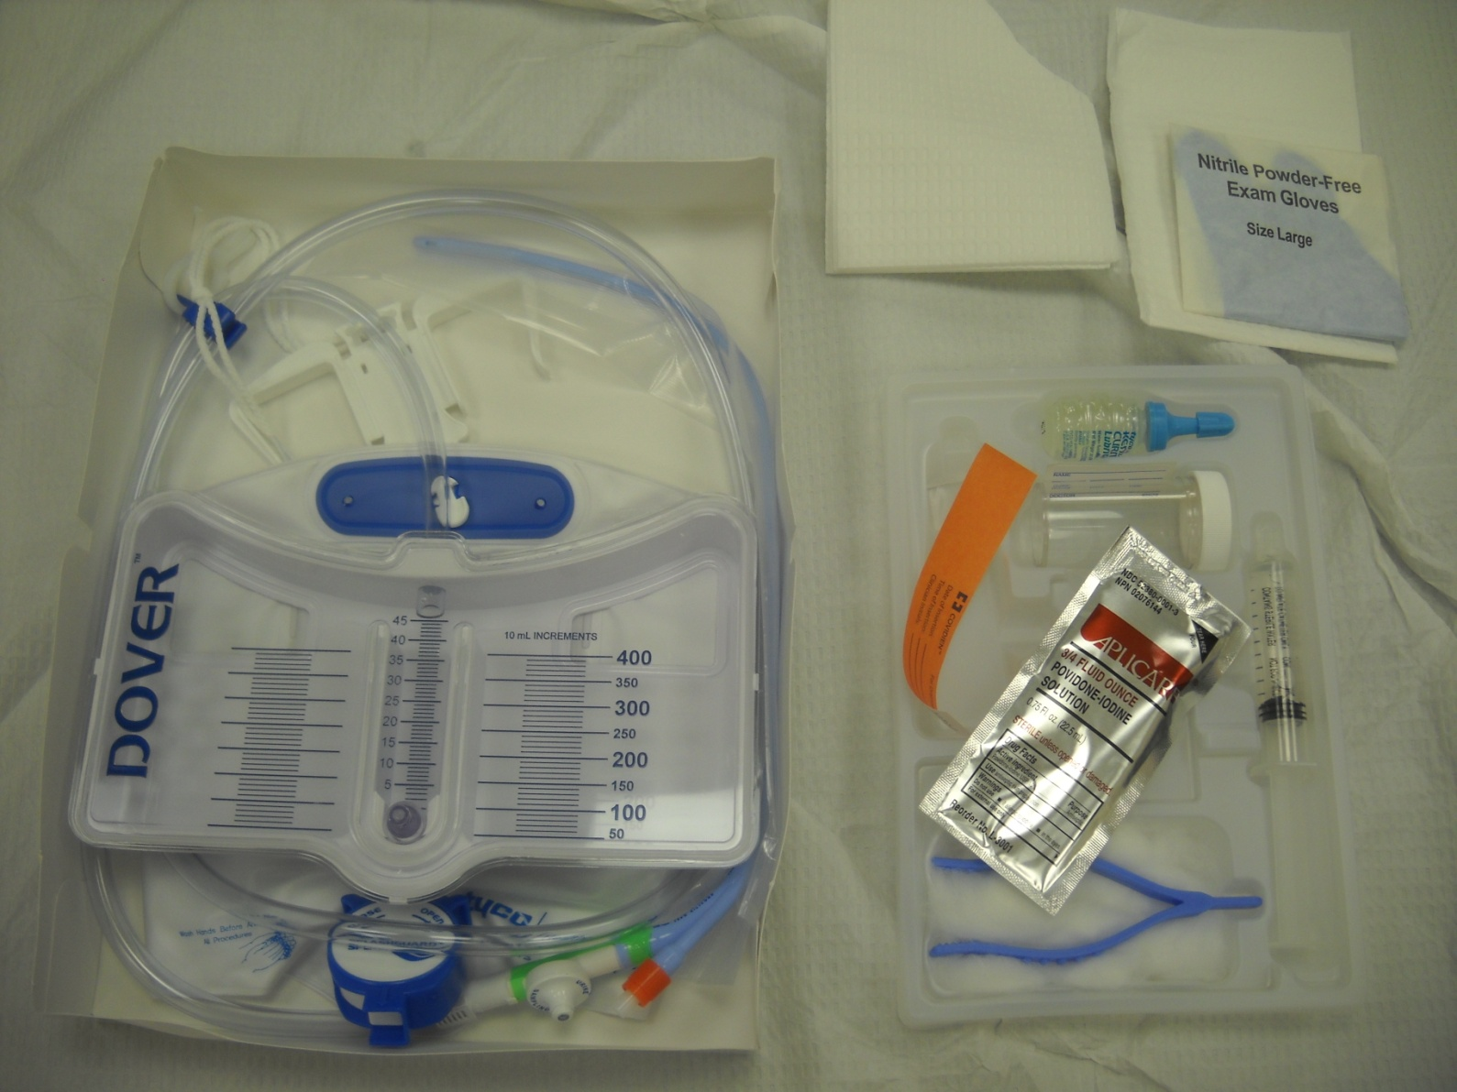
Sample Urinary Catheter Insertion Kit

Slide 52
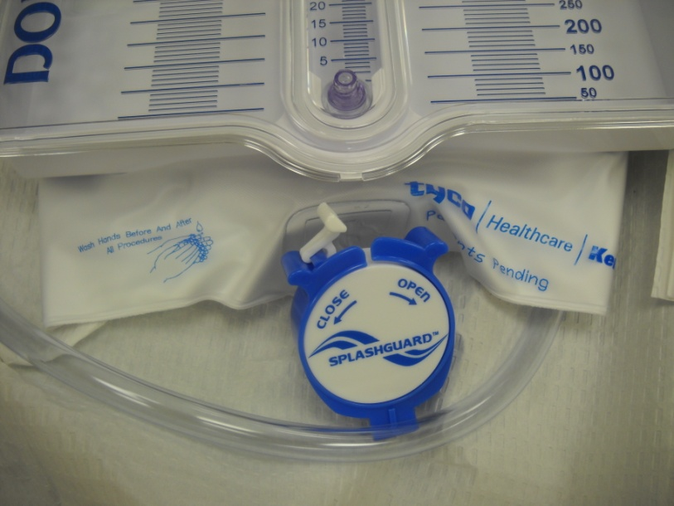
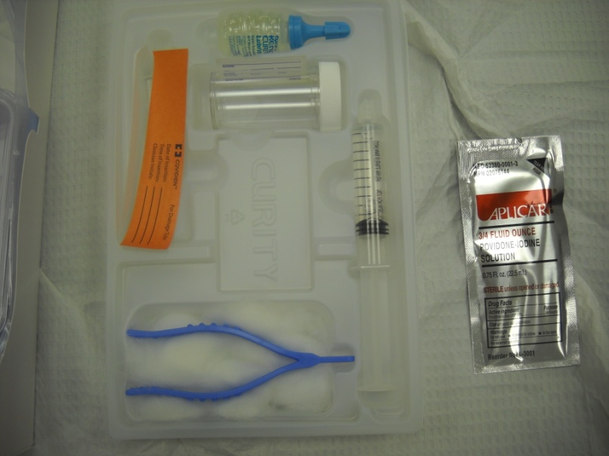
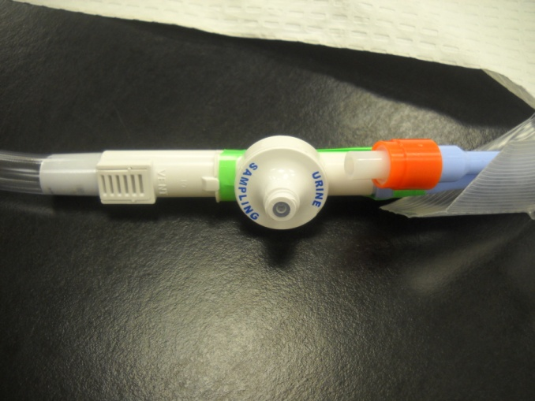
What to Look For in Catheter Products

Slide 53
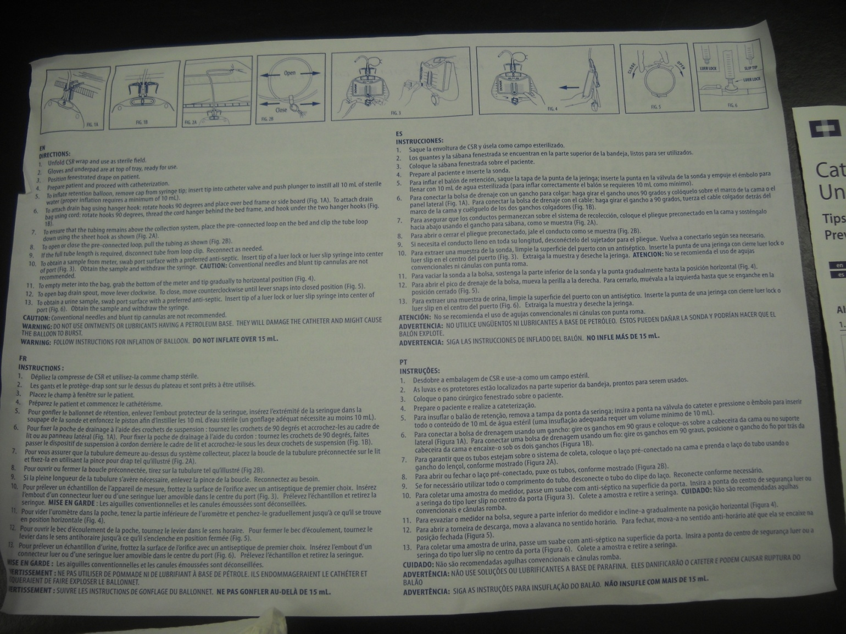
Package Inserts (Instructions on Aseptic Techniques)

Slide 54
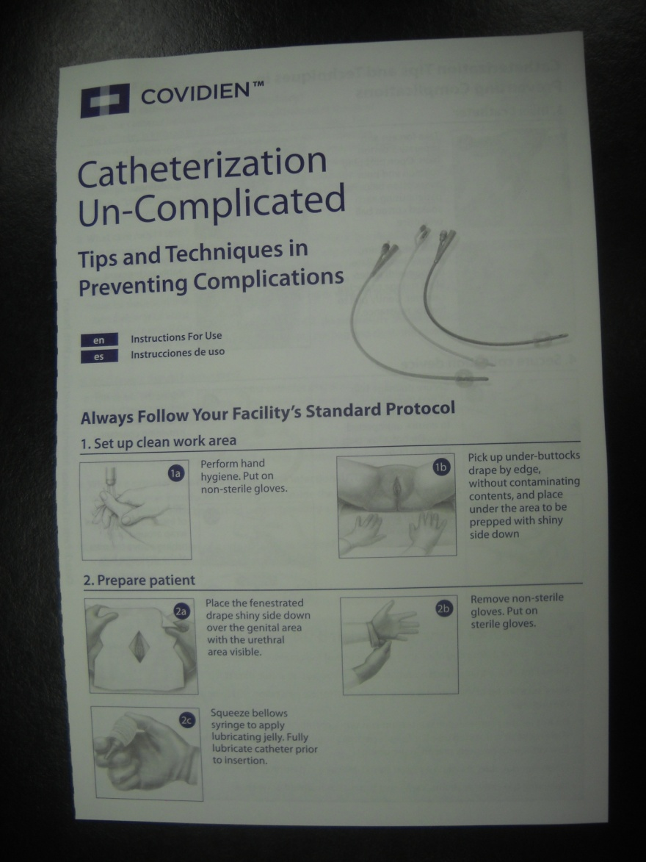
Package Inserts (Instructions on Aseptic Techniques)

Slide 55
Sample Manufacturer Procedure Statements
“Tips to reduce catheter-associated urinary tract infection”
  “Cleanse hands before and after any manipulation of the catheter or site.
  Do Not touch anything which is non-sterile once you put on sterile gloves.
  Make sure the tip of the catheter is well lubricated for easy insertion and to help prevent damage to the urethra.
  Do not reinsert catheter if first insertion was unsuccessful.
    If the catheter is inserted into the female patient’s vagina by mistake, leave it there as a marker until a new catheter is properly placed in the urethra.
  Whenever possible, maintain a closed sterile drainage system after insertion.
  Make sure the catheter drains. Verify that tubing is not kinked or twisted.”
Catheterization Un-complicated. Tips and techniques in preventing complications. Package insert. Kendall Precision 400. urine Meter Catheterization Tray. Covidien, Mansfiled, MA

Slide 56
Education
“Instruction should never be the endpoint,
Competency in practice is what matters”

Slide 57
Antimicrobial/Antiseptic Catheters
“If the CAUTI rate is not decreasing after implementing a comprehensive strategy to reduce rates of CAUTI, consider using antimicrobial/antiseptic-impregnated catheters. The comprehensive strategy should include, at a minimum, the high priority recommendations for urinary catheter use, aseptic insertion, and maintenance.” (Category IB)
  “Further research is needed on the effect of antimicrobial/antiseptic-impregnated catheters in reducing rates the risk of symptomatic UTI, their inclusion among the primary interventions, and the patient population most likely to benefit from these catheters.” (No recommendation/unresolved issue)

Slide 58
Results of 2 Meta-Analysis of Antimicrobial Urinary Catheters
Review of 12 trials; 13,392 patients
No trials addressed symptomatic UTIs
Studies limited by number, size, quality of studies
These catheters may delay or prevent UTIs in select populations with short-term catheterization
  Johnson JR. Systematic review: antimicrobial urinary catheters to prevent catheter-associated urinary tract infection in hospitalized patients. Ann Intern Med 2006;144:116-27.
Review of 23 trials; 5,236 patients in 22 parallel group trials and 27,878 patients in one large cluster-randomized cross-over trial
Silver oxide catheters were of no benefit
Silver alloy catheters were found to significantly reduce asymptomatic bacteriuria in short-term catheterized patients (<7d)
Data was insufficient to determine effect on patients catheterized for longer periods
  Schumm K. Types of urethral catheters for management of short-term voiding problems in hospitalized adults: a short version cochrane review. Neuro Urodynamics 2008;27:738-46.

Slide 59
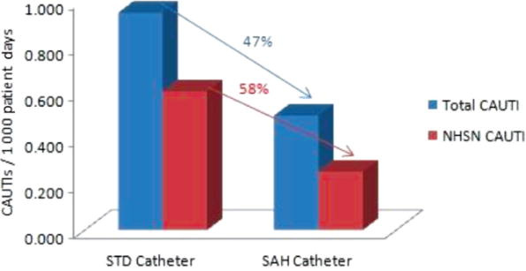
Multicenter Study on Impact of Silver Catheters
Before/After study on effect of standard non-silver urinary catheters (STD) vs. Silver-alloy hydrogel catheters (SAH) on clinical and NHSN CAUTI
7 acute care hospitals
453 pre- vs. 450 post-intervention patients
No significant changes in indwelling catheter practices or overall catheter usage in the two study time periods
1st study to compare outcomes of Clinical CAUTI and NHSN-defined CAUTI
Study conducted after NHSN definition revisions
Results:
Lederer JW, Jarvis WR, et al. Multicenter cohort study to assess the impact of a silver-alloy and hydrogel-coated urinary tract catheter on symptomatic CAUTIs. J WOCN 2014;41:473-80.

Slide 60
Lifecycle 2: Catheter Care
Practice routine hygiene of the meatal surface during daily bathing or showering; use of antiseptics is not necessary.
Properly secure indwelling catheters after insertion to prevent movement and urethral traction
If breaks in aseptic technique, disconnection, or leakage occur, replace the catheter and collecting system
Maintain unobstructed urine flow: Keep the bag below the level of the bladder, avoid kinking, empty bag regularly

Slide 61
Meatal Cleansing
Emphasis should be to ensure separation of bathing or incontinence cleanup from meatal hygiene, i.e., change gloves and perform hand hygiene
Joint Commission:
  “The HCW should take care to wash his or her hands and don a fresh pair of gloves before moving to cleanse the urinary catheter and periurethral area.”
CDC:
  “Do not clean the periurethral area with antiseptics to prevent CAUTI while the catheter is in place. Routine hygiene (e.g., cleansing of the meatal surface during daily bathing or showering) is appropriate.”
APIC:
  “Provide routine hygiene for meatal care.”
SHEA:
  “Employ routine hygiene; cleaning the meatal area with antiseptic solutions is unnecessary.”
AHRQ:
  “Routine urethral meatus cleansing with soap and water during bath and after bowel movement.”
WOCN:
  “Routine perineal care is recommended.”

Slide 62
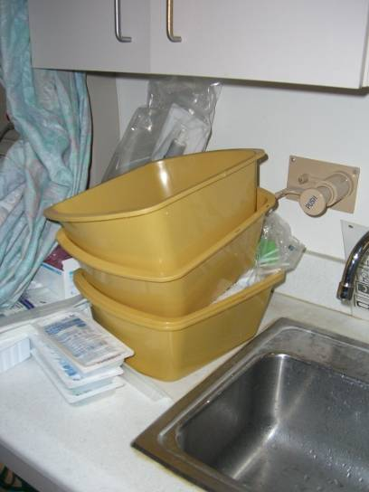
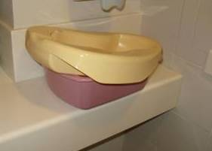
Is a Bath Basin a Source of Pathogens Implicated in Causing HAI’s?

Slide 63
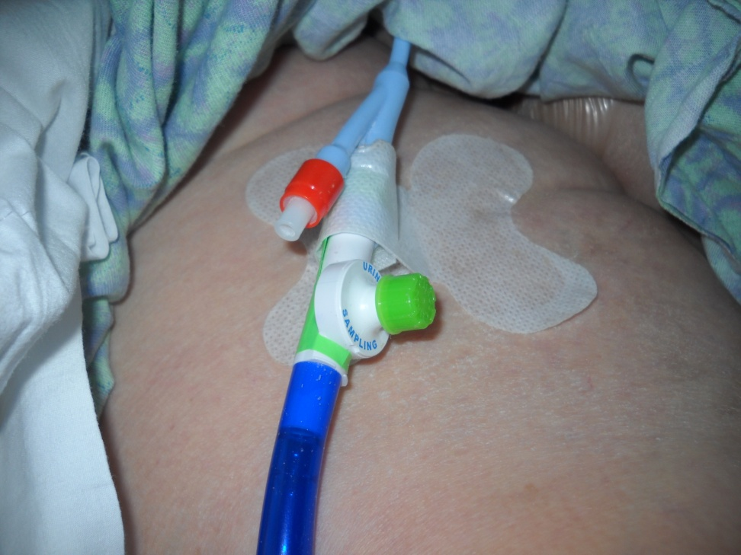
Secure the Catheter
“Properly secure indwelling catheters after insertion to prevent movement and urethral traction” - CDC
Consider using an alcohol impregnated cap on sampling port

Slide 64

Maintain Unobstructed Urine Flow
“Keep the collecting bag below the level of the bladder at all times; do not place the bag on the floor” – CDC
What do transporters do in you facility when transporting patients with urinary catheters?

Slide 65
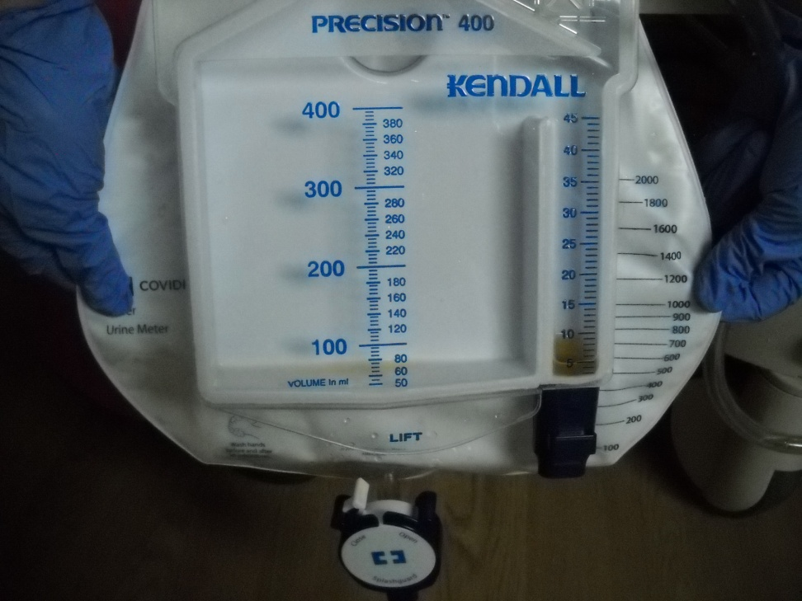
Emptying the Collection Bag
Some institutions are using mostly kits with urimeters to avoid breaking seal
When do you empty a urine collection bag?
What is used to empty the urine collection bag?

Slide 66
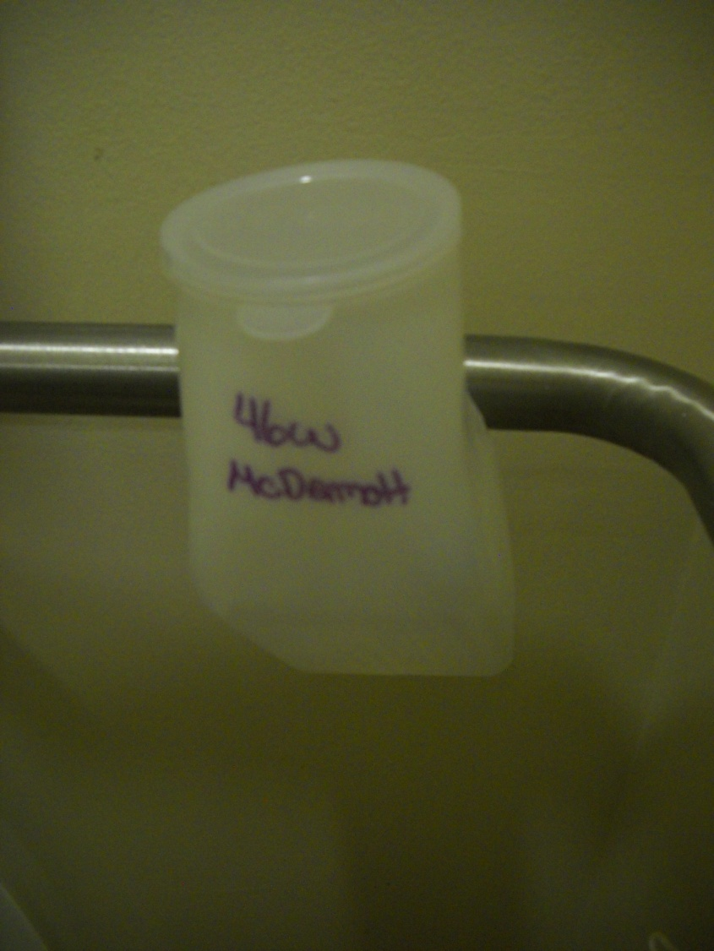
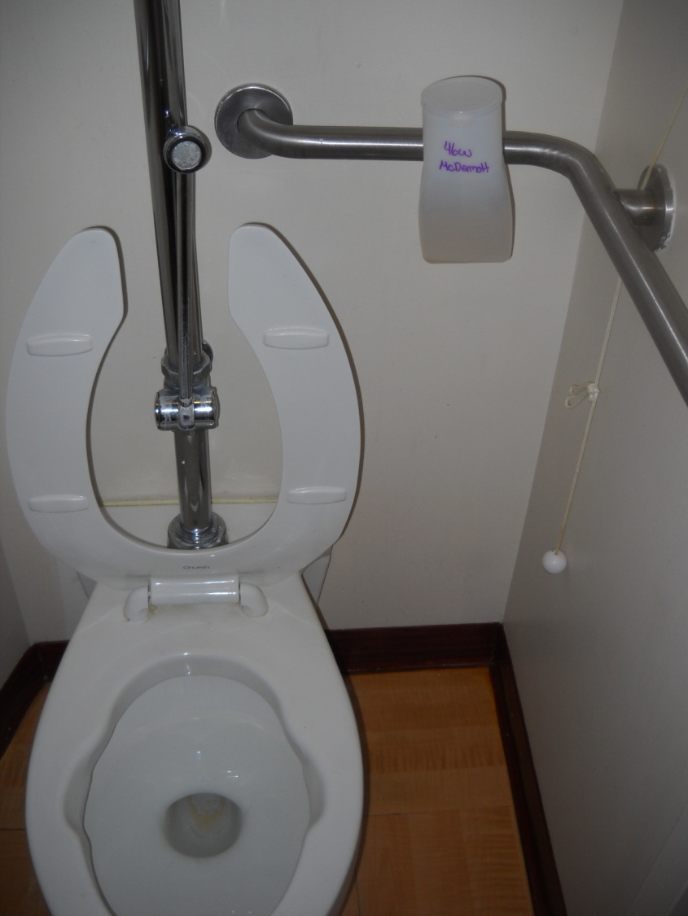
Emptying the Collection Bag

Slide 67
Lifecycle 3: Catheter Removal
Implement quality improvement programs or strategies to enhance appropriate use of indwelling catheters and to reduce risk of CAUTI; examples of programs:
  Daily reviews of patients with indwelling catheters
  Alerts or reminders to identify patients with catheters and assess need for continued catheterization
  Stop orders
  Guidelines and protocols for nurse-directed removal of unnecessary catheters
Replacement of urinary catheters

Slide 68
Example of Intervention Using Daily Reviews (1)
Study Unit: Med-Surg-Trauma ICU
Objective: reduce CAUTI by decreasing use of urinary catheters
Intervention period: 12 mos
Team: Multidisciplinary including staff nurses
Methods: Use of criteria-based urinary catheter guidelines, a decision-making algorithm, and a daily checklist
Results:
  Usage – decreased from a mean cath device days of 4.72 vs. 2.98
  Decrease of 408 catheter days
  CAUTI rates – decreased 33%
Reilly LR. Reducing foley catheter device days in an intensive care unit. AACN Adv Crit Care 2008;17:272-83.

Slide 69
Example of Intervention Using Daily Reviews (2)
Study Unit: MICU
Objective: reduce CAUTI by decreasing use of urinary catheters
Intervention period: 11 mo vs. 6 mo
Methods: daily evaluation using criteria for appropriate use
Results:
  Usage – decreased from 311.7 d/mo to 238.6 d/mo
  CAUTI rates – decreased from 4.7/1000 CD to zero
  32% of device days were considered inappropriate
Elpern EH. Reducing use of indwelling urinary catheters and associated urinary tract infections. AJCC 2009;18:535-41.

Slide 70
Example of Intervention Using Weekly Reviews (3)
Study Unit: 228-bed hospital
Objective: reduce CAUTI by decreasing use of urinary catheters
Intervention period: 6 mo
Team: infection control, education, nursing, performance, improvement , risk management, and pharmacy
Methods: weekly catheter patrols to identify patients with catheters and appropriateness of use
Results:
  CAUTI rates – decreased from 4 CAUTI/mo to zero
McLaughlin A. Catheter patrols: a unique way to reduce the use of convenience urinary catheters. Ger Nurs 1996;17:240-43.

Slide 71
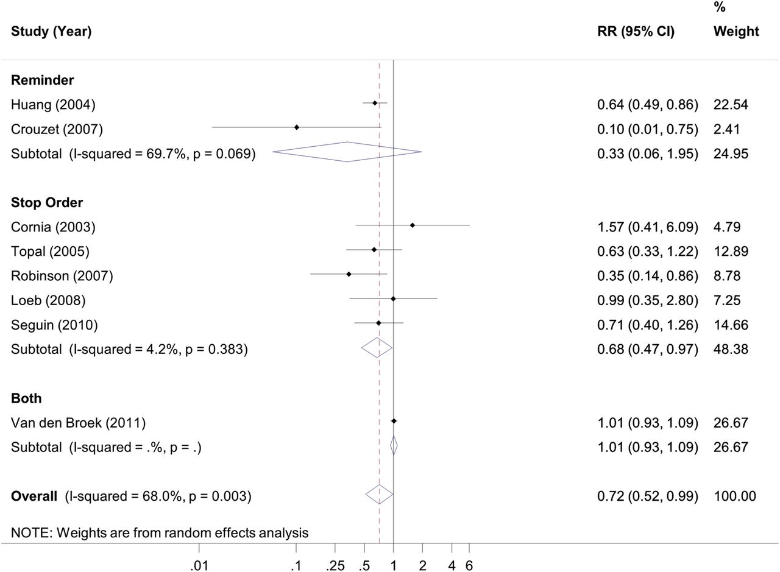
Examples of Interventions Using
Reminders and/or Stop Orders (1)
11 published studies (with online supp. figure), indicate that the rate of CAUTI was reduced by 53% with the use of a reminder or a stop order
Meddings J, et al. Reducing unnecessary urinary catheter use and other strategies to prevent CAUTI: an integrative review. BMJ Qual Saf 2014;23:277-89.

Slide 72
Example of Interventions Using a Reminder (2)
Study Unit: 4 hospital wards (2 control, 2 intervention)
Objective: decrease use of urinary catheters
Methods: A simple written reminder provided to the patient’s clinical team that the patient has a urinary catheter
Results:
  5,678 patients evaluated
  Control group – avg. proportion of time pts. catheterized increased by 15.1%
  Intervention group - avg. proportion of time pts. catheterized decreased by 7.6%
McLaughlin A. Catheter patrols: a unique way to reduce the use of convenience urinary catheters. Ger Nurs 1996;17:240-43.

Slide 73
Examples of Intervention Using a Reminder (3)
Study Unit: Adult ICUs, Large hospital, Taiwan
Objective: reduce CAUTIs and decrease use of urinary catheters
Study period: Nov 2000-Dec 2002
Methods: Nurse-generated daily reminders provided to the physicians to remove unnecessary urinary catheters 5 days after insertion
Results:
  6,297 patients evaluated
  Avg. duration of catheterization decreased from 7.0d to 4.6d
  CAUTI rate – decreased from 11.5/1000 CD to 8.3/1000 CD
  Monthly cost of antibiotics was reduced by 69%
Huang W-C. Catheter-associated urinary tract infections in intensive care units can be reduced by prompting physicians to remove unnecessary catheters. ICHE 2004;25:974-78.

Slide 74
Example of Intervention Using a Reminder (4)
Study Unit: 2 units, medical-cardiology (VA med ctr)
Objective: decrease use of urinary catheters
Intervention period: 8 weeks each unit; cross-over study
Methods: computer-based order for insertion, computer-generated reminders to remove catheters
Results:
  29% of patients on control ward had orders vs. 92% in study group
  Catheter days – Control - 8 vs. Study group - 3
  Not enough study power to detect CAUTI difference
Cornia PB. Computer-based order entry decreases duration of indwelling urinary catheterization in hospitalized patients. Am J Med 2003;114:404-7.

Slide 75
Example of Intervention Using a Stop Order (1)
Study Unit: 3 hospitals, Ontario, Canada
Objective: reduce CAUTIs and decrease use of urinary catheters
Design: patients with urinary catheters randomized to stop orders for removal of catheters if specified criteria were not present or to usual care
Results:
  692 patients in the study
  Inappropriate catheter days: Control – 3.89 vs. Study group – 2.20
  Total catheter days: Control – 5.04 vs. Study group – 3.70
  CAUTI rate: Control – 19%, Study – 20%
Loeb M. Stop orders to reduce inappropriate urinary catheterization in hospitalized patients: a randomized controlled trial. J Gen Intern Med 2008;23:816-20.

Slide 76
Example of a Nurse-Directed Protocol (1)
Study Unit: 4 general medical units
Objective: reduce CAUTIs and decrease use of urinary catheters
Intervention period: 2 periods, one year each
Methods: CPOE system updating physician of urinary catheter insertion and prompting options for minimizing duration; nurse-directed protocol for removal; use of bladder scanners
Results:
  81% of caths inserted in ED; only 22% had physician orders
  Catheter days – decrease from 892 to 521 to 184
  CAUTI rate (per 1000 CD) – decreased from 36 to 19 to 11
  CAUTI reduced by 81%
Topal J. Prevention of nosocomial catheter-associated urinary tract infections through computerized feedback to physicians and a nurse-directed protocol. Am J Med Qual 2005;20:121-26.

Slide 77
Example of Intervention Using a Bundle (1)
Study Unit: 28-bed medical-surgical ICU
Objective: reduce CAUTIs
Intervention Period: one year
Methods: physician-led multidisciplinary rounds, use of prevention bundles, culture changes with focus on team decision making process
UTI bundle: regular assessment of continued need, sterile insertion technique, daily perineal care, drainage bag lower than patient’s bladder, secure all catheters, use silver-coated catheters in selected cases
Results:
  Urinary catheter days: Baseline – 7,691 vs. Study – 5,780
  CAUTI rate (per 1000 CD) Baseline – 3.8, Study – 2.4
Jain M. Decline in ICU adverse events, nosocomial infections and cost through a quality improvement initiative focusing on teamwork and culture change. Qual Saf Health Care 2006;15:235-39.

Slide 78
Example of Intervention Using a Bundle (2)
Study Hospital: 123-bed Veterans Affairs hospital
Objective: decrease unnecessary catheter use
Intervention Period: one year
Methods: Soliciting leadership, physicians, and key players to address known intervention processes
UTI bundle: staff education, system redesign, feedback, dedicated urinary catheter nurse
Results:
  Urinary catheter usage: Baseline – 15% vs. Study – 12%
  Non-ordered UCs: Baseline – 17.0%, Study – 5.1%
  Non-indicated UCs: Baseline – 15.0%, Study – 1.2%
Knoll BM, et al. Reduction of inappropriate urinary tract catheter use at a Veterans Affairs hospital through a multifaceted quality improvement program. Clin Infec Dis 2011;52:1283-90.

Slide 79
Example of Intervention Using a Bundle (3)
Study Hospital: 30-bed Neurosurgery ICU
Objective: decrease CAUTI
Intervention Period: 32 months
Methods: Multidisciplinary team using FADE2
UTI bundle: avoidance of insertion, product standardization, maintenance of catheter sterility, timely removal of catheters, education
Results:
  Urinary catheter usage: Baseline – 100% vs. Study – 73%
  CAUTI rate: Baseline – 13.3%, Study – 4.0%
Titsworth WL, et al. Reduction of CAUTI among patients in a neurological intensive care unit: a single institution’s success. J Neurosurg 2012;116:911-20 .

Slide 80
Area of Improvement:
When Should Urinary Catheters be Replaced?
CDC: changing indwelling catheters or drainage bags at routine, fixed intervals is not recommended. Rather, it is suggested to change catheters and drainage bags based on clinical indications such as infection, obstruction, or when the closed system is compromised (Cat II)
IDSA: If an indwelling catheter has been in place for >2 weeks at the onset of CAUTI and is still indicated, the catheter should be replaced to hasten resolution of symptoms and to reduce the risk of subsequent CA-bacteremia and CAUTI (A-1)
Reasoning: a mature biofilm has usually formed once the catheter has been in situ for longer than 2 weeks. Urine collected through these catheters are contaminated by organisms present in biofilm.
Gould CV, Guideline for Prevention of CAUTI. CDC, 2009
Hooten TM, et al. Diagnosis, prevention and treatment of CAUTI. Clin Infect Dis 2010;50:625-63.
Nicolle LE. Catheter associated urinary tract infections. Antimicrobial Res and Infect Cont 2014;3:1-8.

Slide 81
Area of Improvement: What Should be Done for the Patient Admitted with a Urinary Catheter?
Ascertain when the patient was catheterized
If symptomatic, remove catheter and assess clinically (alternate catheter?)
If indwelling catheterization is deemed necessary, then replace the catheter , obtain urine for culture on symptomatic patients (in ED preferably or on admission to unit, i.e., Day 1)
Reasoning: patients who are chronically catheterized and symptomatic on admission may mistakenly be identified with a CAUTI if the urine culture is taken on Day 3 or later.

Slide 82
Lifecycle 4: Catheter Reinsertion
Consider using a portable ultrasound device in patients undergoing intermittent catheterization to assess urine volume and reduce unnecessary catheter insertions
If ultrasound bladder scanners are used, ensure that indications for use are clearly stated, nursing staff are trained in their use, and equipment is adequately cleaned and disinfected in between patients

Slide 83
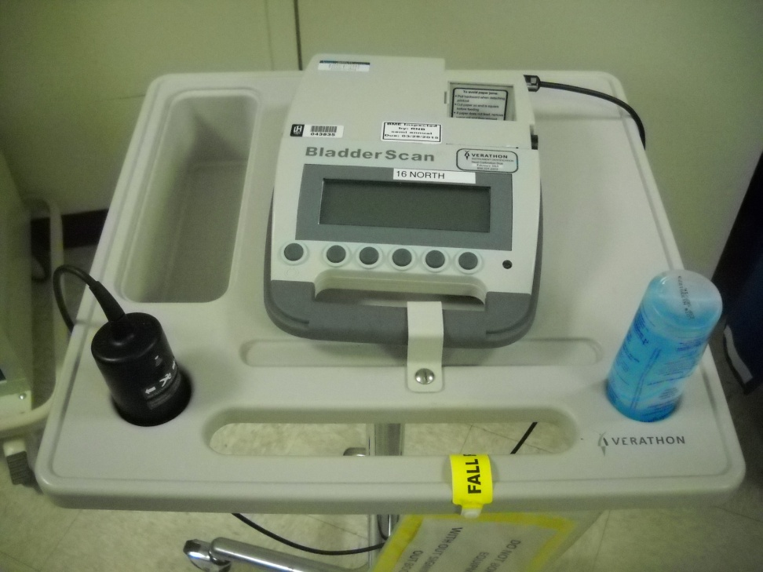
Bladder Scanner for Avoiding Reinsertion
“Consider using a portable ultrasound device to assess urine volume in patients undergoing intermittent catheterization to assess urine volume and reduce unnecessary catheter insertions” (Category II)
When do you use the device as an integral part of a CAUTI reduction program?

Slide 84
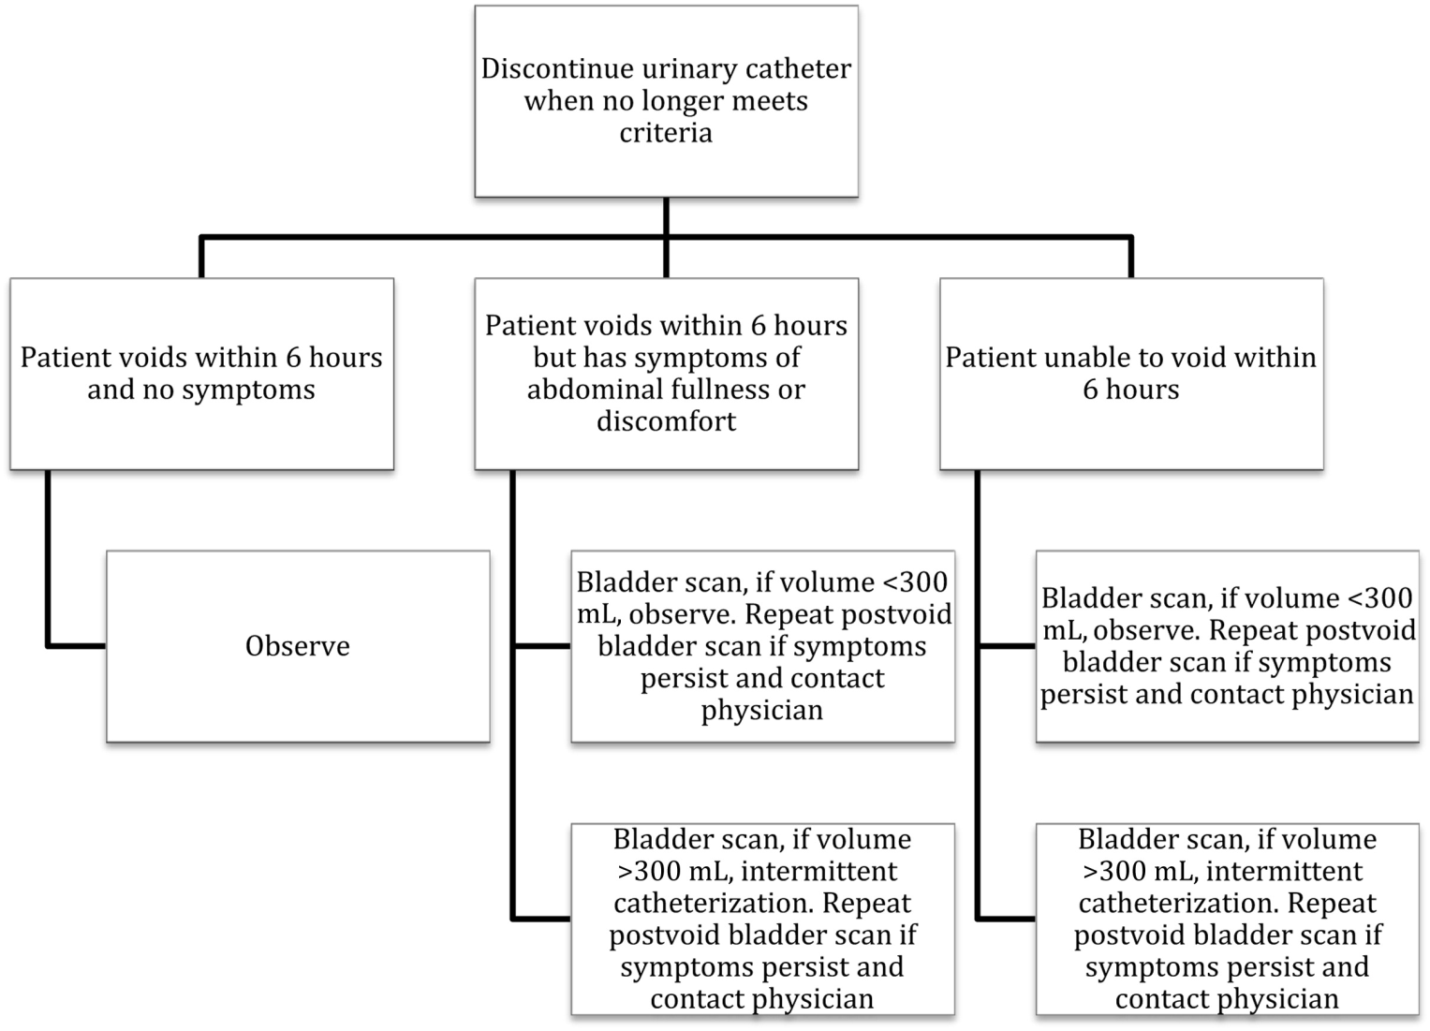
Integration of Bladder Scanning in Nurse-Driven Protocol
Fakih MG, et al. Engaging healthcare workers to prevent CAUTI and avert patient harm. Am J Infect Control 2014;42:S223-S229.

Slide 85
A CAUTI Reduction Program with Integral
Bladder Scanning Protocols
Study conducted in an SICU
Pre-study CAUTI rates:
  Trauma: 10 CAUTIs per 1000 device days
  Neurosurgery: 32 CAUTIs per 1000 device days
  SICU device utilization rate: 89th percentile
Intervention: Algorithm incorporating a scoring tool for insertion, daily assessment guide, and…
  bladder scanner use to assess volume 4 hours after removal
  use of intermittent catheterization if volume >300 cc
  if <300cc, scan again in 2 hrs
  Re-insert if needed to be intermittently cath 2 times
Results:
  Utilization rate: decreased from 0.89 to 0.81
  CAUTI rate: 10 to 5.4 per 1000 device days
Phillips JK. Integrating bladder ultrasound into a UTI-reduction program. AJN March 2000.

Slide 86
What is the Physician’s Role in the CAUTI Prevention Program?
Consider alternate catheterization
Write an order for indwelling catheterization and document appropriate use
Question on a daily basis the need for the catheter
Document the daily need
  IPOC/Daily Goal sheet
Consider delaying culture if patient may become comfort care
Listen to Carol and Denise!

Slide 87
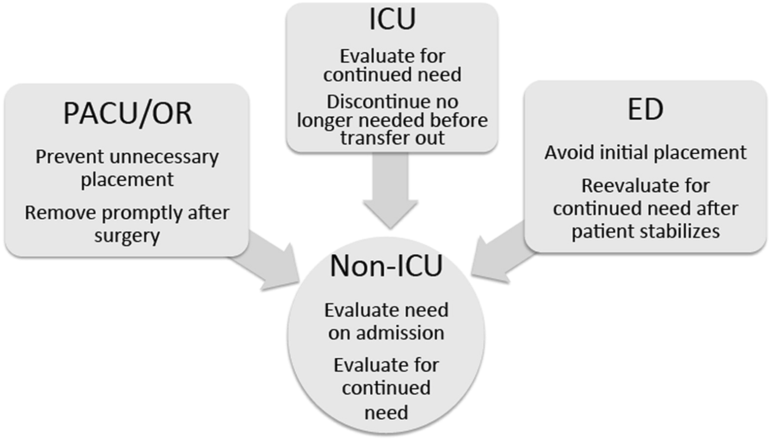
Different Settings and Effect on Non-ICUs
Fakih MG, et al. Engaging healthcare workers to prevent CAUTI and avert patient harm. AJIC 2014;42:S223-S229.

Slide 88
Disciplines & Incentives
Discipline or specialty | Urinary catheter harm
Hospital epidemiology, infection prevention, and infectious diseases | Infectious complications: CAUTI, multidrug resistance, C difficile infection, and improve antimicrobial stewardship
Urology | Mechanical complications: hematuria, meatal and urethral injury
Geriatric medicine | Infectious and noninfectious complications: significant proportion of inappropriate catheterization in older adults, leading to increased immobility and deconditioning risk, in addition to infection and trauma
Hospital medicine | Infectious and noninfectious complications: hospitalists care for a large number of patients; their support may significantly improve the appropriate use of urinary catheters resulting also in shorter length of stay
Rehabilitation medicine and physical therapy | Urinary catheter impedes mobility (1-point restraint), and may be associated with an increased risk of falls
Wound ostomy services | Urinary catheter use increases immobility, which in turn results in an increased risk of pressure ulcers; wound care nurses may help in advising the bedside nurse on methods to reduce skin breakdown in patients with incontinence without using urinary catheters
Surgery | Avoid postoperative complications: the surgeons need to comply with the Surgical Care Improvement Project recommendations to remove catheters by postoperative day 1 or 2; inappropriate urinary catheter use postoperatively will negatively affect the surgeon's profile
Intensive care nurses and physicians | CAUTI is publicly reported in the ICUs; the ICU has the highest prevalence of urinary catheter use compared with other hospital units; opportunities to reduce urinary catheter use exist through daily evaluation of need and on transfer from the ICU to floor
Emergency medicine nurses and physicians | ED represents the point of entry to more than half of the patients admitted to the hospital; unnecessary urinary catheter placement is common in the ED, and promoting appropriate placement will affect use hospital-wide
Administrative leaders | Inappropriate urinary catheter use subjects the patient to preventable safety risk; in addition, the Centers for Medicare and Medicaid Services have stopped compensation for hospital-acquired conditions; moreover, CAUTIs are publicly reported and are tied to value-based purchasing and hospital-acquired condition payment penalty
Fakih MG, et al. Engaging healthcare workers to prevent CAUTI and avert patient harm. AJIC 2014;42:S223-S229.

Slide 89
Consensus Across all Guidelines
Catheterize only when necessary and only for as long as necessary
Insert catheters using aseptic techniques and sterile equipment
Maintain closed, sterile drainage system
Conway LJ. Guidelines to prevent catheter-associated urinary tract infection: 1980-2010. Heart and Lung, 2011; in press.

Slide 90
Implementation Strategies

Slide 91
CAUTI Prevention Program Guide to Patient Safety
Question | Yes | No
1. Do you currently have a well-functioning team (or work group) focusing on CAUTI prevention? | 67% | 33%
2. Do you have a dedicated project manager to coordinate your CAUTI prevention activities?† | 56% | 44%
3. Do you have a committed‡ nurse champion for your CAUTI prevention activities? | 68% | 32%
4. Do bedside nurses assess, at least daily, if their catheterized patients still need a urinary catheter? | 68% | 32%
5. Do bedside nurses take initiative to ensure the indwelling urinary catheter is removed when the catheter is no longer needed (eg, by contacting the physician or removing the catheter per protocol)? | 76% | 24%
6. Do you have a committed‡ physician champion for your CAUTI prevention activities? | 44% | 56%
7. Have physicians fully embraced CAUTI prevention activities? | 49% | 51%
8. Has senior leadership fully supported§ CAUTI prevention activities? | 87% | 13%
9. Do you currently collect CAUTI-related data (eg, urinary catheter prevalence, urinary catheter appropriateness) in the unit(s) in which you are intervening? | 82% | 18%
10. Do you routinely feedback CAUTI related data to frontline staff (eg, urinary catheter prevalence, urinary catheter appropriateness, and infection rates)?‖ | 48% | 52%
11. Have you experienced any of the following barriers?
Substantial nursing resistance | 43% | 57%
Substantial physician resistance | 46% | 54%
Patient and family requests for an indwelling urinary catheter | 28% | 72%
Excessive burden of collecting data¶ | 43% | 57%
Indwelling urinary catheters commonly being inserted in the emergency department without an appropriate indication | 67% | 33%
Saint S, et al. Introducing a CAUTI prevention guide to patient safety (GPS). AJIC 2014:548-50.

Slide 92
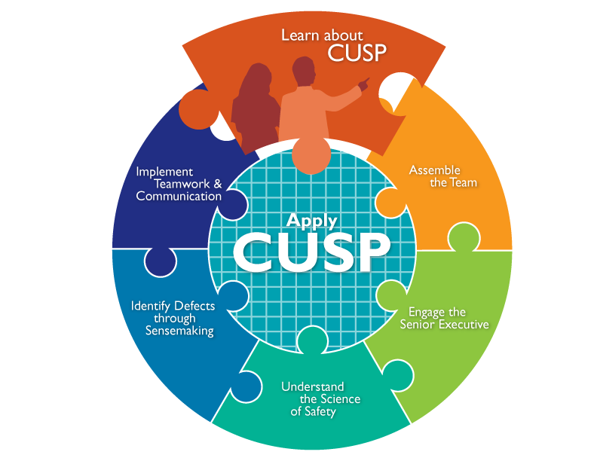
CUSP Improvement Model

Slide 93
Key Toolkit Questions
Engage: How will this make the world a better place?
Educate: How will we accomplish this?
Execute: What do I need to do?
Evaluate: How will we know we made a difference?
Endure: How do I know it will last?
Expand: Who else needs to know this?

Slide 94


Is Your Hospital Safe?
Would you want a loved one to be a patient at your hospital? Your unit?
Would you want to be a patient in the unit where you work?
Can you say with 100 percent certainty that you believe that your hospital does everything it can to protect its patients?

Slide 95
The CUSP Model
Created through a collaborative effort of the Agency for Healthcare Research and Quality and state and national-level innovators in patient safety
Dovetails with, and supports, a range of quality and safety improvement models
Encompasses a wide range of safety tools and approaches
Based on the understanding that all culture is local, and that work to improve culture must be owned at the unit level
Believes that harm is not an acceptable “cost of doing business”
Can be applied by anyone, anywhere

Slide 96
Toolkit Users
Senior executives
Help leaders prioritize improvement efforts
Provide resources for interventions to alleviate defects
Patient safety officers
Work with senior executives and managers to maintain an ongoing infrastructure for improvement activities
Nurse managers
Educate staff on the science of safety
Provide opportunities for staff to learn and practice using teamwork and communication tools
Work with senior executives and managers to maintain an ongoing infrastructure for improvement activities

Slide 97
Toolkit Users
Frontline staff
Engage with Stakeholders in safety improvement
Physician champions
Share knowledge on the immediate and long-term benefits of teamwork and communication tools

Slide 98
Understanding Barriers to Implementation
Barriers | Potential solutions
Engage
Nurses are not on board | Obtain buy-in prior to implementation; address concerns to the nurses’ satisfaction
Physicians do not want to adopt new practice | Provide physicians with data on urinary catheter use, with monthly feedback on use and CAUTI; identify a physician champion who will act as a liaison with colleagues to support the work
Leadership does not see CAUTI as a priority | Present the business case to obtain leadership support; address the external factors (Centers for Medicare and Medicaid Services nonpayment rule, public reporting of CAUTI); provide data to leadership regularly
Educate
Healthcare workers have gaps in knowledge of infectious and noninfectious consequences related to the urinary catheter | Create tailored educational materials; use different venues for education, including bedside and electronic; incorporate education into annual competency testing for nurses; use multiple venues for physicians (formal presentations, meetings, one-to-one discussions for high utilizers)
Execute
Unnecessary catheters are placed frequently | Develop a policy on appropriate catheter placement indications (obtain endorsement from both physician and nurse leaderships); identify areas where catheters are frequently placed (emergency department, operating room)
No longer needed catheters are not discontinued in a timely manner | Address workload concerns by providing alternatives to the catheter (assistance with toileting, bundling changes for the incontinent with regular skin care management); incorporate daily catheter evaluation into the work flow (may be supported by multidisciplinary or nursing rounds); identify a nurse champion on each unit to promote appropriate catheter use (or catheter patrol); identify areas with a significant potential for improvement (intensive care to non–intensive care transition, operating room, or post-anesthesia care unit)
Proper insertion technique is not followed | Develop or update the catheter insertion policy to include all the proper steps; develop competencies for healthcare workers placing the catheter; consider periodic audits of catheter placement
Healthcare workers complain of limited resources to help them “do the right thing” | Build capacity to increase support, identify stakeholders with interest in supporting the work (eg, falls and wound care champions, infection prevention, urologists, and infectious diseases physicians), and national or regional initiatives that the hospital participates in (eg, surgical care improvement project); investigate the potential of using electronic medical records to either prompt the evaluation or the removal of the catheter
Evaluate
Urinary catheter use does not significantly change with the effort, although compliance with appropriate indications significantly increase | Assess for any changes occurring to the patient population (ie, type of admissions to unit involved); if there were no changes in the type of patients admitted to the unit, then scrutinize the data related to labeled indications for accuracy
National Healthcare Safety Network CAUTI rate does not drop, although the efforts lead to a significant reduction in catheter placement | Examine the urinary catheter utilization ratio; if there is a reduction in catheter use, then the population-based CAUTI measure will be a better predictor to evaluate improvement
Fakih MG, et al. Implementing a National Program to Reduce CAUTI: A Quality Improvement Collaboration of State Hospital Associations, Academic Medical Centers, Professional Scieties, and Governmental Agencies. ICHE 2013;34:1048-54.

Slide 99
CUSP Results
Heightened engagement of staff and senior leaders
Improved communication among care team members
Expanded knowledge of potential
hazards and barriers to safety
Collaborative focus on systems of care

Slide 100
The “ABCDE Bladder Bundle”
Adherence to general infection control principles (e.g., hand hygiene, surveillance and feedback, aseptic insertion, proper maintenance, education) is important
Bladder ultrasound may avoid indwelling catheterization
Condom catheters or alternatives to indwelling catheter such as intermittent catheterization should be considered
Do not use the indwelling catheter unless absolutely necessary
Early removal of the catheter using a reminder or nurse-initiated removal protocol appears to warranted
Saint S. Translating health care-associated urinary tract infection prevention research into practice via the bladder bundle. Jt Comm J Qual Patient saf 2009;35:449-55.

Slide 101
Effectiveness of Bundles (1)
28-bed Med/Surg ICU
2 year study
Implemented UTI Bundle:
  Regular assessment of continued need for catheter
  Sterile technique at insertion
  Perineal care daily and after bowel movement
  Drainage bag lower than patient’s bladder at all times, including transport
  Secure all catheters
  Use silver coated catheter in selected cases
Result:
  Decrease CAUTI rate from 3.8 to 2.4 per 1000 CD
Jain M, et al. Decline in ICU adverse events, nosocomial infections and cost through a quality improvement initiative focusing on teamwork and culture change. Qual Saf Health Care 2006;15:235-39.

Slide 102
Effectiveness of Bundles (2)
Minneapolis Veterans Admin. Medical Center
123-bed acute care bed facility
8 year study
Implemented UTI Bundle:
  Staff education including list of appropriate use of catheters
  Regular assessment of continued need for catheter
  System redesign including documentation and notices on EMR
  72-hr. stop date
  Maintenance practices
  Feedback
Result:
  Decrease in nonordered FCs from 17.0% to 5.1%
  Decrease in nonindicated FCs from 15% to 1.2%
Knoll BM, et al. Reduction of inappropriate urinary catheter use at a Veterans Affairs Hospital through a multifaceted quality improvement project. Clin Infect Dis 2011;52:1283-90.

Slide 103
Effectiveness of Bundles (3)
Rochester Veterans Admin. Medical Center
8 month study
Implemented UTI Bundle:
  Obtain provider order for insertion
  Use appropriate size catheter
  Strict hand hygiene
  Secure catheter
  Assess daily need for continued catheterization; consider alternatives
  Perform pericare daily and after bowel movements
  Keep drainage bag and tubing below level of bladder
  When sending C&S sample, cleanse the port vigorously with alcohol and allow to air dry
Result:
  Decrease of 71% in catheter days
  Decrease of 56% in catheter use
Andreessen L, et al. Preventing CAUTI in acute care. J Nurs Care Qual 2012;27:209-17.

Slide 104
Effectiveness of Bundles (4)
Shands Hospital, Univ of Florida
Neuro ICU, 32 month study
Implemented UTI Bundle:
  Avoidance of catheter insertion
  Maintenance of sterility
  Product standardization
  Early catheter removal
Result:
  Decrease in catheter utilization from 100% to 73.3%
  Decrease in CAUTI rate from 13.3 to 4.0 per 1000 CD
Titsworth WL, et al. reduction of CAUTI among patients in a neurological ICU: a single institution’s success. J Neurosurg 2012;116:911-20.

Slide 107
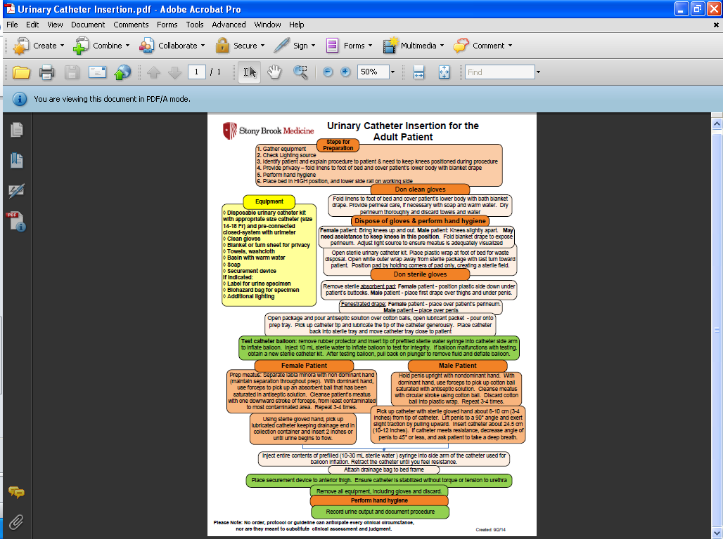

Slide 108
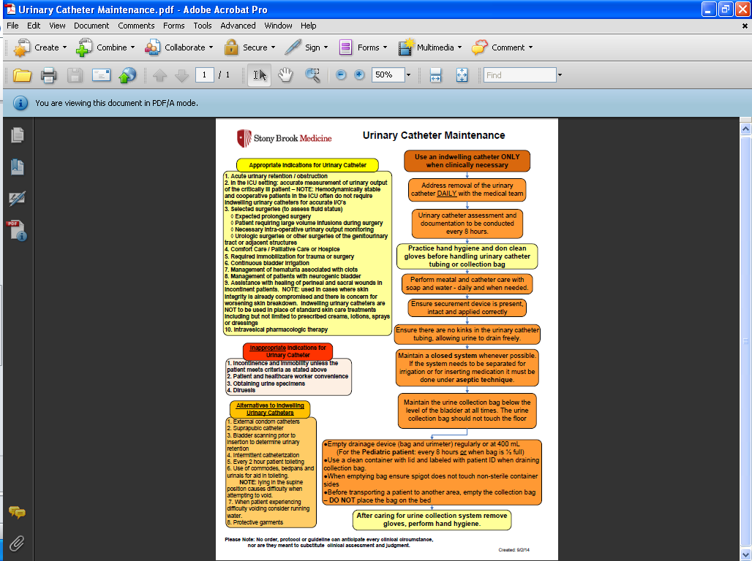

Slide 109
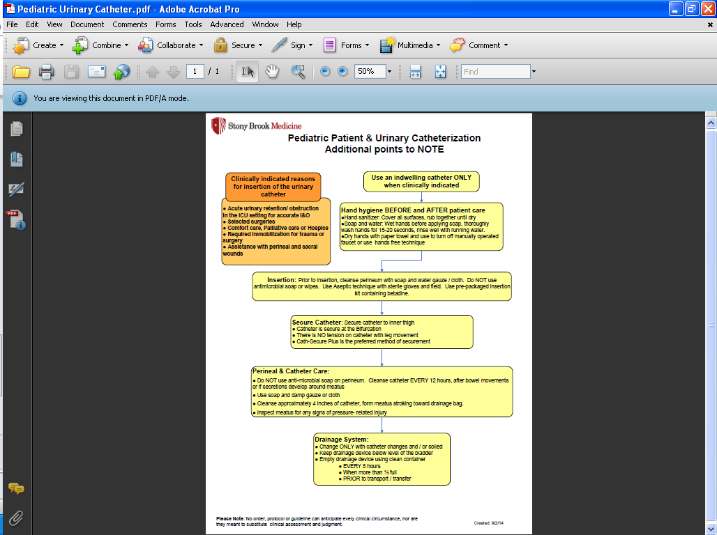

Slide 110
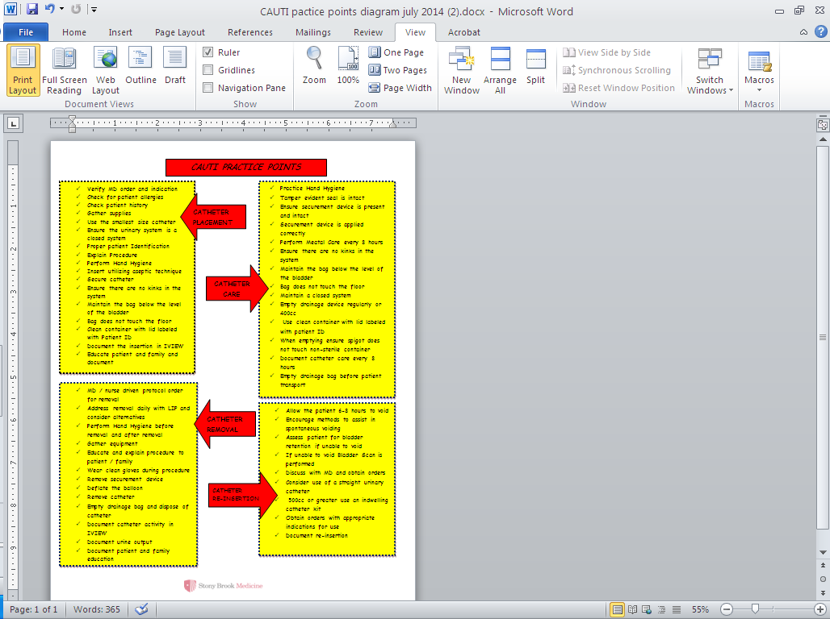

Slide 111
Conclusion
“The bulk of the evidence is consistent with the view that multimodal strategies could prevent between 25% and 75% of catheter-associated urinary tract infections”
Saint S. Catheter-associated urinary tract infection and the Medicare Rule changes. Ann Intern Med 2009;150:877-84.

Slide 112
Summary of Strategies
Ensure surveillance is accurate
Standardize urine collection products and educate staff on proper urine collection
Insert catheters only when necessary
Consider alternate type catheters
Standardize urinary catheter products
Educate all relevant staff on proper insertion/maintenance
Practice clean procedures for meatal care
Conduct competency to ensure staff are implementing policy components
Implement daily reminders/alerts/stop orders/nurse protocols to initiate catheter removal
Provide feedback to staff on all units

Slide 113
Thank you!
Robert Garcia, bs, mmt(ASCP), cic
Infection control preventionist
rgarciaicp@aol.com
Cell 516.810.3093

