Slide 1
HCV infection in prison. From individual care to viral eradication strategy: a benefit for the community
R. Ranieri MD
R. Giuliani MD
Infectious Diseases Service
Penitenciary Regional Health Unit
San Paolo University Hospital
Milano, Italy
Hosted by Jim Gauthier
Senior Clinical Advisor, Diversey
www.webbertraining.com
November 15, 2019

Slide 2
Key points of the talk
HCV in community and prisons
What about Italian and Milano prisons?
What is the state of art of HCV treatment in prisons?
Real life experience of our group
What about reinfection?

Slide 3
HCV in community and prisons

Slide 4
WHO Vision: Eliminate Viral Hepatitis as a Major Health Threat by 2030
“A world where viral hepatitis transmission is halted and everyone living with hepatitis has access to safe, affordable and effective care and treatment services”
Treatment of 80% of eligible persons with chronic HCV infection
90% reduction in new chronic HCV infections
65% reduction in mortality rates
4

Slide 5
The Changing Paradigm of HCV Treatment Has Led to a Significant Increase in the Number of Patients Being Treated
Total Number of Patients Treated in EU¹
Cumulative number treated for HCV globally in 2015:
5.5 million (only 0.5 million received DAAs)²
Introduction of all-oral DAAs³
Treated Patients
5
1. Adapted from the Polaris Observatory. Available at: http://cdafound.org/polaris-hepC-graphs/;
2. WHO Global Hepatitis Report, 2017. Available at: http://www.who.int/hepatitis/publications/global-hepatitis-report2017/en/;
3. CDC Hepatitis C: 25 years since discovery. Available at: https://www.cdc.gov/knowmorehepatitis/media/pdfs/hepc-timeline.pdf.
Notes:
5

Slide 6
All Patients Are Now Prioritized for Treatment
WHO¹
Last updated April 2016
AASLD²
Last updated September 2017
EASL³
Last updated April 2018
Treatment is indicated for:
All adults and children with chronic HCV infection, including PWID
All patients with chronic HCV infection, except those with short life expectancies that cannot be remediated
All patients with HCV infection must be considered for therapy, including TN patients and individuals that failed to achieve SVR after prior treatment
1. WHO guidelines for the screening, care and treatment of persons with chronic HCV infection.
Available at: http://apps.who.int/iris/bitstream/10665/205035/1/9789241549615_eng.pdf?ua=1;
2. AASLD recommendations for testing, managing and treating hepatitis C. Available at: http://www.hcvguidelines.org/full-report-view;
3. European Association for the Study of the Liver. J Hepatol 2018; in press. Available at: https://doi.org/10.1016/j.jhep.2018.03.026.
PWID, people who inject drugs; TN, treatment naive.
6

Slide 7
Overview of the WHO Care Continuum for Viral Hepatitis and the Associated Challenges Encountered When Aiming toward WHO Elimination Targets
Reached by prevention services
Tested
Aware of status
Populations within the care
continuum for viral hepatitis
Treatment completed (HCV) or maintained (HBV)
Enrolled in care
Initiated treatment
Achieved cure (HCV) or viral suppression (HBV)
Care continuum
for viral hepatitis
Prevention
Screening and Linkage to Care
Treatments
Provision of HBV birth-dose vaccination within 24 hours of birth to prevent mother-to-child transmission
Expansion of hemovigilance schemes and safe injection practices to reduce iatrogenic transmission
Adoption of point-of-care testing to expand diagnostic coverage and strengthen linkage to care
Integration of screening into existing care delivery models for at-risk populations to increase their access to and engagement with viral hepatitis care
Maintenance of treatment for all cirrhotic HBV-infected patients indefinitely to minimize risk of disease progression
Procurement of affordable DAAs to enable universal access to treatment for HCV
Current challenges within the care continuum for viral hepatitis with reference to achieving WHO elimination targets
7
Heffernan A., et al. Open Forum Infect Dis 2018; 5:ofx252.

Slide 8
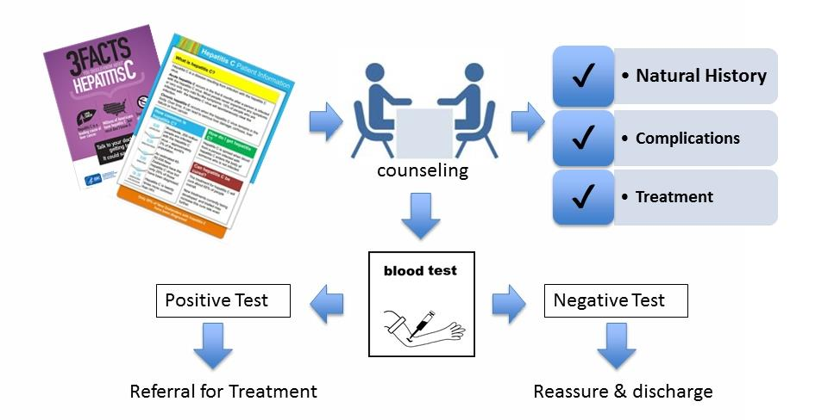
Screening Must Be Linked to Care
CDC. Testing for HCV infection: An update of guidance for clinicians and laboratorians. MMWR 2013; 62.
Available at: https://www.cdc.gov/hepatitis/hcv/pdfs/hcv_flow.pdf.
8

Slide 9
High-Risk Populations Face Unique Challenges with Linkage to Care…
Stigma and discrimination^{1–3}
Prisoners
PWID
MSM
Lack of HCV awareness in patients and HCPs^{1–3}
Substance abuse^{1,2}
Lack of additional support, i.e. harm-reduction services²
Lack of specialists/
coverage of services^{1,2}
Socioeconomic factors^{1,2}
MSM, men who have sex with men; PWID, people who inject drugs.
9
1. Yap L, et al. PLoS One 2014; 9:e87564; 2. Grebely J, et al. J Int AIDS Soc 2017; 20:22146;
3. Sacks-Davis R, et al. J Int AIDS Soc 2018; 21(Suppl 2):e25051.

Slide 10
Benefits of Targeting HCV in Prisons
Prison System
Decreased risk of HCV transmission within the prison
Improved health of inmates
Deceased ‘risk’ to custodial staff
Incarcerated Individual
Cured of HCV
Decreased risk of liver failure and liver cancer
Community
Decreased risk of HCV transmission by prisoners following release
Long-term cost savings
BENEFITS OF HCV TREATMENT
10

Slide 11
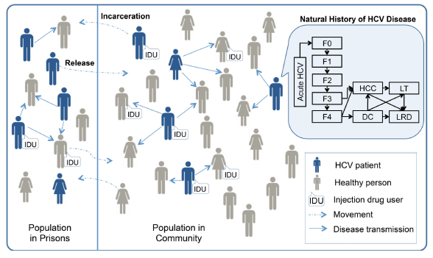
Benefits of Treatment in Prison
Risk-based and opt-out screening and treatment
Prevent new infections – 90% in the community!
Highly cost-effective
But would require increase in healthcare budget
  Potential to decrease HCV in prison
  And in the community!!
F0, no fibrosis; F1, portal fibrosis without septa; F2, portal fibrosis with few septa; F3, numerous septa without cirrhosis; F4, compensated cirrhosis.
DC, decompensated cirrhosis; HCC, hepatocellular carcinoma; LT, liver transplants; LRD, liver-related deaths.
11
He T, et al. Ann Intern Med 2016; 164:84–92.

Slide 12
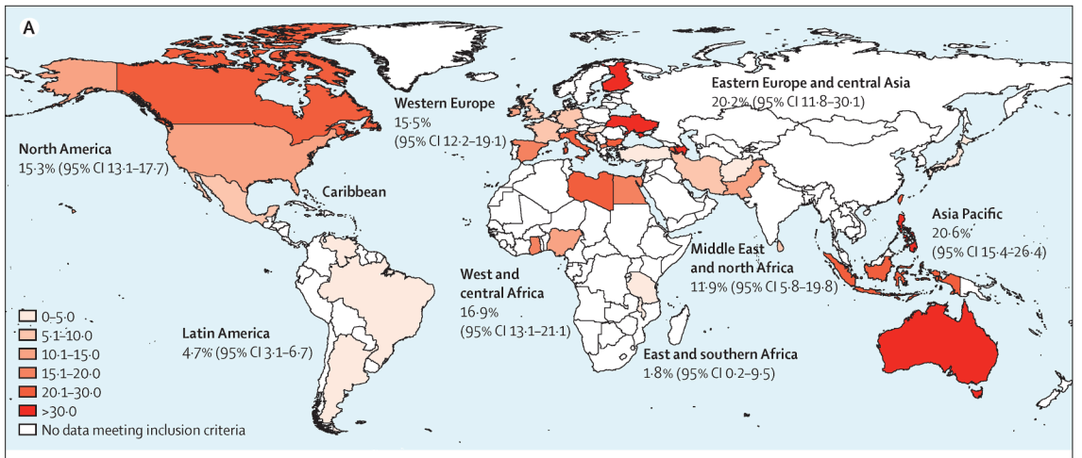
Global and Regional Prevalence of Hepatitis C in Prison Inmates Published Between 2005 and 2015
Percentage unware of HCV infection :25% to 35%
12
Dolan K, et al. Lancet 2016; 388:1089–1102 .

Slide 13
Anti-HCV Prevalence among People in Prison across the EU/EEA
Luxembourg 86.3% (79.0‒91.8) N=122
Finland 45.8% (40.8‒51.0) N=383
Italy 38.0% (35.0‒41.2) N=973
Portugal 34.4% (26.9‒42.6) N=151
Bulgaria (pooled) 26.3% (23.5‒29.3) N=1156
Spain 25.3% (no CI available) N=N/R
Spain 22.7% (18.3‒27.1) N=N/R
  All but 4 estimates (Germany, France, Hungary, Croatia) were above 10% prevalence
Country, prevalence estimate (95% CI),
sample size (N)
Bulgarian (juvenile) 20.5% (15.8‒26.0) N=258
Spain (pooled) 20.3% (18.9‒21.7) N=3062
UK (pooled) 17.4% (16.4‒18.4) N=5450
Croatia (pooled) 13.3% (12.5‒14.2) N=6696
Ireland 12.9% (10.6‒15.4) N=777
Germany (juvenile) 8.6% (7.0‒10.4) N=1125
France (pooled) 6.3% (6.1‒6.5) N=68797
Hungary 4.9% (4.3‒5.6) N=4894
Croatia (juvenile) 4.3% (1.6‒9.1) N=140
0%
10%
20%
30%
40%
50%
60%
70%
80%
90%
100%
Anti-HCV prevalence
13
EU/EEA, European Union/European Economic Area.
Falla AM, et al. BMC Infect Dis 2018; 18:79.

Slide 14


14

Slide 15
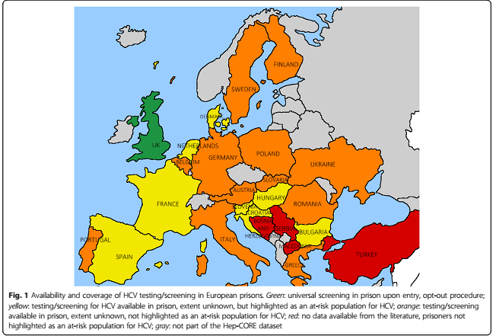
15

Slide 16
What about Italian and Milano prisons?

Slide 17
Italian Penitenciary System september 2018
[www.giustizia.it]
N. of correctional houses→ 190
Total capacity → 50.544 p/l
Total presents → 58.087 p/l
Overcrowding → +15%
Foreigners → 19.818 = 34%
Women → 2.441 = 4,2%
PWUD → 19.752 = 34,1%
Pris. in Lombardia → 8.527 = 14.3%

Slide 18
New comers in 2017 (47.342)
High turnover and short stay
[www.giustizia.it]
55,4%
44,6%
Italians Foreigners

Slide 19
In 2008 penitenciary health management was transferred from Ministry of Justice to Ministry of Health.
Every region adopted its own way: most have choosen territorial management through Local Health Authorities.
Lombardia has attributed health care activities to local hospitals.
19

Slide 20



Distribution of the 19 correctional houses in Lombardia
20

Slide 21
PRISON HEALTH SYSTEM
.
Region Lombardia
Health Department
Local Hospital Health Department
Penitenciary Health Unit: regional supervision
Penitenciary Health System
21

Slide 22

PRISON HEALTH SYSTEM
.
San Paolo Hospital
Health Department
Model of Milano
San Paolo Hospital Penitenciary Unit (24 beds)
San Paolo Hospital
Pharmacy
Prison Health System
4 Correctional houses: Opera, San Vittore, Bollate, Beccaria average 3500 prisoners daily
22
Notes:
Sistema sanitario
Multidisciplinary team

Slide 23
There is a attenuate surveillance section dedicated to mothers and children
23

Slide 24
24

Slide 25
CR Bollate, is similar to Opera, has a capacity of 1100 beds, hosts both males and females, generally at the end of their sentences and on the way of social rehabilitation (programs for jobs, study, ecc)
Istituto Beccaria is a juvenile prison for male adolescents and young adults (until 26 years ), has a capacity of 50 beds.
Cesare Lari
25

Slide 26
Based on the characteristic of each facility there are different levels of health assistance:
Milano Opera, San Vittore, Bollate provide a multispecialistic integrated assistance:
General physicians 24 h/daily
Nurses 24 h/daily
Radiology (daily): chest, skeleton , abdomen, ultrasound (visceral and vascular)
Laboratory for analysis (daily)
New comers service (24 h/daily)
First aid service (24 h/daily)
Digestive Endoscopy service
Drug addiction Service
Pharmacy (depending on Central Pharmacy)
Multispecialistic service: psychiatrics, psycologists, infectious diseases consultants, otolaryngologists, ophthalmologists, pneumologists, orthopaedics, endocrinologists, dentists, surgeons, dermatologists, pediatricians, gynecologists, neurologist, cardiologists, physioterapists
Outside services: es. CT, NMR, hospital admissions are provided by San Paolo Hospital
26

Slide 27
Opera and San Vittore host a Clinical Center for admissions of patients affected by serious diseases (i.e. decompensated diabetes, cardiomiopathy, COPD, AIDS, cirrhosis).
Overall 120 beds with 24 h/daily assistance
4 beds for infectious isolation (i.e. TB)
Opera is considered an italian hub for complex pathologies and particularly for infectious diseases monitoring and treatment.
27

Slide 28
What is the state of art of the HCV treatment in prisons?
28

Slide 29
HCV Treatment in Prisons in the Interferon era
Study site | N | Male, % | Mean age | Treatment | Completed Rx, % | Overall SVR, %
Rhode Island | 90 | 96 | 38 | IFN/RBV | 46 | 29
Virginia | 59 | 83 | 41 | IFN/RBV | NR | 36
Canada | 114 | 100 | 38 | IFN/RBV | NR | 52
Italy | 39 | 98 | 36 | PegIFN/RBV | 26 | 13
Connecticut | 68 | 85 | 41 | PegIFN/RBV | 69 | 47
Rhode Island | 71 | 100 | 41 | PegIFN/RBV | 46 | 28
Chew KW, et al. J Clin Gastrenterol. 2009;43:686-691.
29
Notes:
29

Slide 30
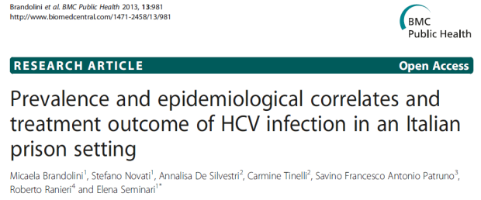
What’s our experience
RESULTS:
2012 HCV + prevalence: 22%
HCV-RNA positivity: 86%
Eligible for treatment: 26%
Overall SVR 48: 43%
Main causes for ineligibility or treatment discontinuation: judiciary concerns
1. Brandolini M, et al. BMC Public Health 2013; 13:981.
30

Slide 31
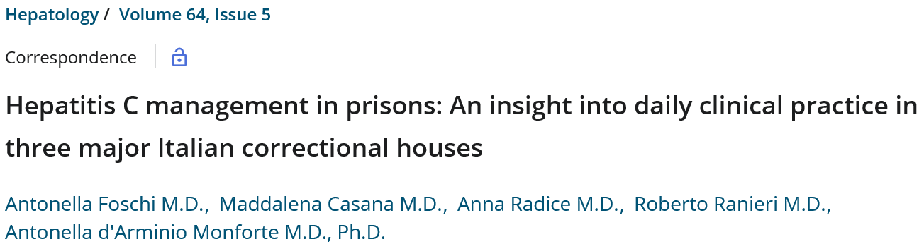
Hepatitis C Management in Prisons in the era of DAAs
DAA regimens are a safe, short duration treatment strategy in prisons. We need to dedicate further efforts to strengthen the continuity of care
and improve HCV management in prisons for both
individual and public health.
Foschi A, et al. Hepatology 2016; 64(5)).
31

Slide 32
32
Notes:
32

Slide 33
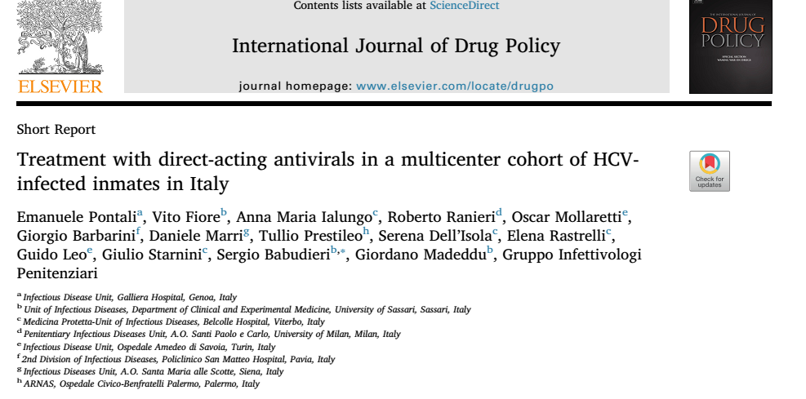
33

Slide 34
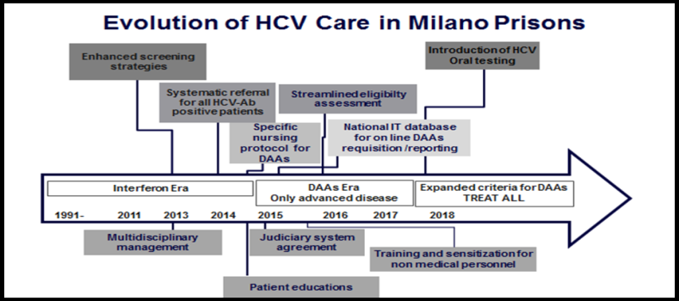
34

Slide 35
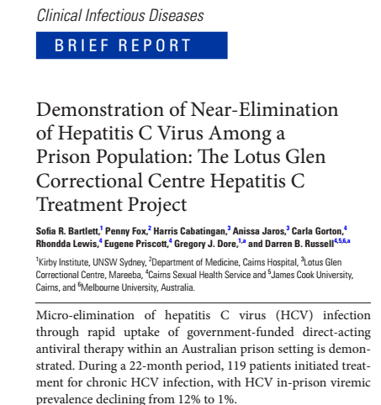
35

Slide 36


in
36

Slide 37
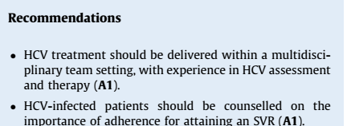
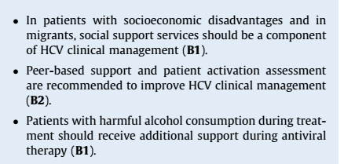
37

Slide 38

Increasing Involvement of Non-specialists
Gastroenterologists
ID
Other specialists
GP
Other
Individuals Initiating DAA Treatment (%)
100%
90%
80%
70%
60%
50%
40%
30%
20%
10%
0%
GP, general practitioners; ID, infectious diseases physicians.
38
1. Hajarizadeh B, et al. J Viral Hepat 2018; 25;
2. Dore GJ & Hajarizadeh B. Infect Dis Clin North Am 2018; 32:269–279.

Slide 39
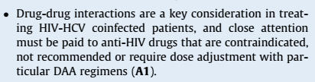
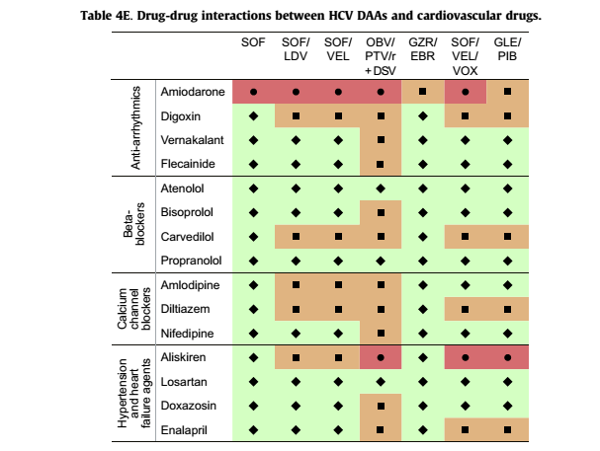
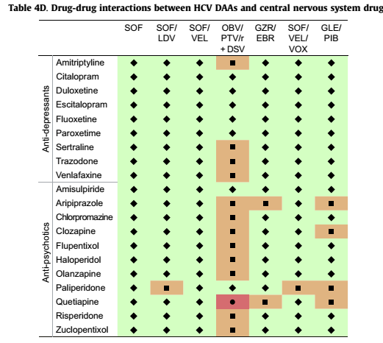
39

Slide 40
The real life experience of our group
40

Slide 41
HCV-free prisons : Real life experience towards micro-elimination in Milano penitentiary services.
Ruggero Giuliani¹, Teresa Sebastiani¹, Francesca Iannuzzi¹, Elisabetta Freo¹, Cesare Lari², Cinzia D’Angelo³, Francesca Bai4, Katarina Kranzer5, Antonella D’Arminio Monforte4, Roberto Ranieri¹
¹Infectious Diseases Service, Penitentiary Health System, San Paolo University Hospital, Milano, Italy
²Penitentiary Health Unit, San Paolo University Hospital, Milano, Italy
³Pharmacy, San Paolo University Hospital, Milano, Italy
4Clinical of Infectious Diseases, San Paolo University Hospital, Milano, Italy
5 Department of Clinical Research, London School of Hygiene and Tropical Medicine, London, UK.
6 National Tuberculosis Reference Laboratory, Research Centre Borstel, Borstel, Germany
Submitted to Journal of Hepatology

Slide 42
We present our experience of almost eradicating HCV infections in Milano prisons and coming close to the 2030 WHO targets of diagnosis and treatment.

Slide 43
Intervention to scale up HCV care in prison
In 2014 San Paolo University Hospital decided to strengthen the Hepatology services offered in the prisons with the objective to reach and maintain high coverage of HCV screening among newly admitted prisoners and to allow fast HCV treatment with DAA in HCV infected inmates. The program included i) strategies to achieve universal HCV screening, ii) broadened treatment eligibility criteria, iii) provision of continuous treatment across and outside prison and iv) information and education for inmates and health care staff.
HCV Screening. In VIT all newly admitted inmates were offered opt out HCV screening along with other STI tests. HCV antibody testing was performed on venous blood with a turn-around time of 48 hours. From March 2017 onwards, prisoners opting-out screening at admission were counseled by Infectious Disease (I.D.) specialists and offered rapid oral test. All positive oral tests were confirmed by HCV serology testing. In OPE availability of previous screening results were checked at the time of transfer from other prisons; if results were not accessible or older than 2 years old, counseling and testing was offered by health professionals within a month of transfer. Regular HCV testing catch-up campaigns were conducted to increase coverage targeting patients who had previously refused the test.
43

Slide 44
Eligibility
During the pre-DAAS era (until 2013) less than one third of inmates were eligible for treatment with depression being on the main reason for ineligibility. For this reason, integration of infectious diseases and psychiatric services with joint clinical consultation and strengthened psychiatric support was offered to patients in need. In 2014, when the first generation DAAs (telapravir) became available, nurses underwent intensive training on administration of directly observed therapy, early identification and management of side effects together with motivational counseling. Initially DAAs were only available for individuals with advanced disease (liver fibrosis staged F3 F4 with metavir score). The national health care system changed the eligibility criteria in April 2017. All HCV viremic individuals regardless of the stage of disease and co-morbidities became eligible for DAAs resulting in a massive increase of eligible individuals. To cope with the new demand eligibility assessment was streamlined . All inmates with HCV antibodies underwent HCV RNA and HCV genotype testing as well as ultrasounds and elastometry to study severity of the liver disease. Regular multidisciplinary case discussions were implemented to optimize treatment for HCV infected inmates with co-morbidities taking into account potential drug interactions and switching concomitant treatment towards safer regimens. Staff from the justice system was invited to attend these meetings to discuss judicial aspects that could hamper the treatment, like duration of sentence, possibility of transfer to other prisons or allocation in correctional regimes alternative to detention)
44

Slide 45
Information and education
OPE introduced specific informative session for newly admitted prisoners on risk of transmission of HCV and prevention, HCV diagnosis and treatment options, as well as more general information about infectious diseases and risk of transmission during detention, perception of risk and consequences on mental health Training and sensitization sessions were also offered to the detention officers and non-medical staff at risk for infection at work.
Provision of continuous treatment. In 2014 a national IT database was introduced to monitor and guide prescription of DAAs.The database strengthened the link between correctional facilities, hospitals and prison pharmacy guarantying prompt supply and delivery of medications. The judiciary system agreed to postpone when possible transfer of HCV infected inmates to correctional facilities where treatment was not available once treatment was completed. A list of inmates on HCV treatment was thus regularly shared between medical and administrative staff within prisons. In case of unexpected release, proper written referral to specific ID clinic in town was ensured and individuals were counselled about the following steps to be taken by the patient. Collaboration with the local centers for treatment of substance and ID clinics in town was strengthened.
45

Slide 46
A cross-sectional survey based on chart reviews was performed among all inmates on the in October-November 2017. Information was collected regarding HCV screening, prevalence of HCV antibody positivity, HCV RNA prevalence, HCV treatment history and outcome. The following variables were recorded: demographic data (sex, country of origin, pre-incarceration drug use, duration of detention), HCV testing offered, HCV virological testing (HCV RNA and Genotype), HBV or HIV co-morbidities, eligibility data. For inmates who initiated HCV treatment pre-treatment fibrosis, previous treatment history, type of regimen (DAAs vs IFN based regimens), location (prison vs community) and date of treatment initiation were recorded. For HCV-infected inmates who did not start treatment reasons for ineligibility were reported. Data was extracted and entered into an access database.
The survey was performed on request of Ministry of Health at local level. Ministry of Justice approved the study and granted a waiver on informed consent. Data were collected in accordance with the national ethical standards. No specific consent was required since data were collected in anonymous and aggregate form.
Statistical analysis
All analysis was performed using Stata version 14 (Stata-Corp, TX, USA). Proportions were calculated for categorical variables and median and interquartile ranges for continuous variable. Associations between not undergoing HCV testing and HCV antibody positivity and explanatory variable such as age, gender, pre-incarceration drug use, country of origin and duration of detention were investigated using univariate and multivariate logistic regression.
46

Slide 47
Characteristics of Inmates tested and not for HCV Antibodies
 | Total | HCV -Ab tested | HCV - Ab Not tested | Univariate Odds Ratio (95% CI) | Multivariate Odds ratio (95% CI)
 |  | N (%) | N (%)
PRISON (OPE) | 1335 | 1234 (92.4%) | 101 (7.6%) | 1 | 1
JAIL (VIT) | 1031 | 861 (83.5%) | 170 (16.5%) | 2.41 (1.86-3.13) | 2.05 (1.53-2.74)
Men | 2261 | 1996 (88.3%) | 265 (11.7%) | 1 | 1
Women | 105 | 99 (94.3%) | 6 (5.7%) | 0.46 (0.20-1.05) | 0.27 (0.12-0.63)
Non Italian | 1017 | 856 (84.2%) | 161 (15.8%) | 1 | 1
Italian | 1349 | 1239 (91.9%) | 110 (8.2%) | 0.47 (0.36-0.61) | 0.73 (0.54-0.99)
<35 years | 772 | 640 (82,9%) | 132 (17,1%) | 1 | 1
>35 years | 1594 | 1455 (91,3%) | 139 (8,7%) | 0.46 (0.36-0.60) | 0.62 (0.46-0.83)
No Drug Users | 1266 | 1098 (86.7%) | 168 (13.3%) | 1 | 1
Drug Users | 1100 | 997 (90.6%) | 103 (9.4%) | 0.68 (0.52-0.88) | 0.62 (0.47-0.80)
47

Slide 48
b
Association between HCV-Ab positivity and risk factors
 | Total | HCV antibody negative | HCV antibody positive | Univariate Odds Ratio (95% CI) | Multivariate Odds Ratio (95% CI)
 |  | N (%) | N (%)
PRISON (OPE) | 1234 | 1104 (89.5%) | 130 (10.5%) | 1
JAIL (VIT) | 861 | 779 (90.5%) | 82 (9.5%) | 0.89 (0.67-1.20)
Men | 1996 | 1794 (89.9%) | 202 (10.1%) | 1
Women | 99 | 89 (89.9%) | 10 (10.1%) | 1.00 (0.51-1.95)
Non Italian | 856 | 820 (95.8%) | 36 (4.2%) | 1 | 1
Italian | 1239 | 1063 (85.8%) | 176 (14.2%) | 3.77 (2.61-5.46) | 2.19 (1.46-3.28)
Age group
<35 years | 640 | 628 (98.1%) | 3 (1.9%) | 1 | 1
>35 years | 1455 | 1255 (86.3%) | 200 (13.8%) | 8.34 (4.62-15.05) | 7.40 (4.03-13.59)
No Drug users | 1098 | 1047 (95.4%) | 51 (4.6%) | 1 | 1
Drug users | 997 | 836 (83.9%) | 161 (16.2%) | 3.95 (2.85-5.49) | 4.92 (3.52-6.89)
HIV-Ab negative | 1941 | 1781 (91.8%) | 160 (8.2%) | 1
HIV-Ab positive | 66 | 22 (33.3%) | 44 (66.7%) | 22.26 (13.02-38.08)
HIV not done | 88 | 80 (90.9%) | 8 (9.0%) | 1.11 (0.53-2.34)
48

Slide 49
Characteristics of patients with HCV RNA available
 | N (%) | N
HCV RNA NEGATIVE pts | 151
Treated with DAAs | 77 (51%) | 15 | Treatment on going
 |  | 22 | Reached EOTR
 |  | 40 | Reached SVR12
Previously treated with IFN | 36 (24%)
No treatment history | 38 (29%)
HCV RNA POSITIVE pts | 41 (21%)
Eligibility on going | 8 (20%)
Eligible for DAAs | 21(51%) | 14 | DAAs Treatment initiated
 |  | 7 | DAAs Treatment requested
Relapse to DAAs | 1 (2%)
No treatment (relevant co-morbidities, refusals) | 11 (27%)
49

Slide 50
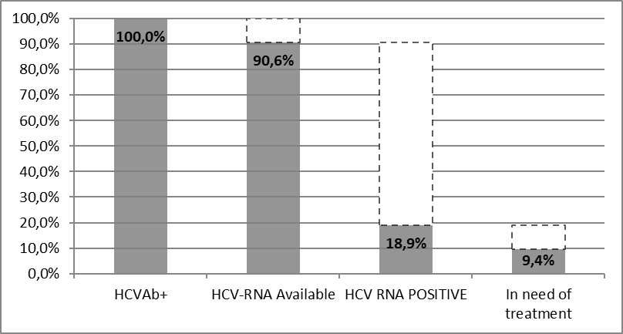
Milano prisons HCV cascade of care
HCV Treatment Cascade in Milano Penitentiary Facilities
50

Slide 51
Discussion
This survey was conducted to evaluate the impact of a bundle of interventions aimed at enhancing and expanding HCV care in prison considering it a strategic venue for treatment of affected individuals otherwise neglected with overall benefits for the general community. As shown by Martin N.K. et al. elimination of HCV in PWID could be very effective to reduce HCV in the general community.
High HCV testing coverage (88%) was achieved by using a combined approach of offering opt-out HCV testing, either blood or oral tests , repeat individual counseling for those who did not want to test and education and information to increase awareness both among inmates as well as staff. Opt-out testing HCV testing in prison has been proven to be a cost-effective strategy to reduce transmission in the community, nevertheless special care must be taken when running universal program within a community of individuals whose liberty has been restricted often with stressing effects on mental condition that might lead to refusal to test at first entrance. In our experience additional strategies were needed to ensure also “difficult” and marginalized patients would adhere to the screening offer and overcome distrust towards medical personnel, e.g. young offenders with behavioral disorders, long course drug users with concomitant psychiatric problems and homeless. A tailored approach around the patients who opt out need to be developed to ensure to reach high coverage and included one to one counseling, repeat contact with the same person along the detention period and counselling from different providers, as well as less invasive methods. In our experience oral tests were found to be more acceptable among illegal immigrants of African origin and young offenders and led to identification of new cases.
51

Slide 52
The prevalence of HCV infection in our cohort was 10,1%, slightly lower than previously reported in a similar cohort in Italy and Spain [18,19], that might be explained by improved access to rehabilitation program in the community for offenders with substance abuse problems that are sentenced for minor crimes. Over 90% of HCV positive inmates underwent further evaluation to determine their eligibility, with very few that missed this opportunity due to judicial issues, like unexpected transfer or quick release. Such high proportion of onward referral and linkage to HCV care was possible because all HCV positive inmates were referred to ID specialist by the general practitioners or straight by the laboratory in case of new infections. This in turn enabled post-test counseling, rapid eligibility assessment, prompt start of treatment and completion within a short period of time.
Among the patients with undetectable viral load the majority was as such as a result of a previous treatment received while in prison. DAAs, that were used in our experience in 75% of the cases, are indeed particularly suitable to the prison setting due to easy administration, lack of side effects and short duration of treatment that overcome the possibility of interrupt treatment due to unexpected transfers and release Besides, several trials had shown similar efficacy among active drug users receiving DAAs who were on substitution therapy and who had admit concomitant substance abuse .Up to date in our experience, till now over 200 only one patient had relapsed, that was started on treatment while in the community before entering the prison. Results were similar in short and long-stay facilities because of the prompt treatment of all eligible individuals as soon as identified.
52

Slide 53
Comparing our experience to a recently published HCV test and treat trial conducted in a Spanish prison (18) that were able to reach 0 prevalence of viremic infection, the main practical challenges were the continuous new admission from the community of new HCV positive inmates often unaware of their condition and the refusal to treat especially in case of asymptomatic infections or due to their mental condition or psychological/emotional situation.
In relation to our experience the main limitation in term of exportability to other Italian prisons and other countries is the availability of specialists within the prison, as well as ultrasounds service, while pharmacy orders and laboratory results are easily available by web from inside the prison. Treatment as prevention program in the prison have been already found to be cost [23] effective: despite the extra cost for having specialist care inside the prison might not have been considered in such calculation, it is unlikely to change the overall benefit and such availability appears more linked to political endorsement of a HCV elimination program. Regarding the survey main limitations concern the method: data were extracted retrospectively from clinical files so that some variables, in particularly the counseling approach was not properly recorded and the concomitant psychiatric condition and diagnosis was not always clear, when present. Also variable such as substance abuse was self-reported and didn’t always differentiate between endo-venous or oral abuse. Lastly, it was not possible to compare the intervention with a baselines assessment, in particular the prevalence of viremic infection before the treatment thus it is difficult to assess how much of the effect was due to the intervention bundle.
53

Slide 54
Conclusions
Implementation in prison of test and treat program offer an unique possibility of detection and cure of HCV
in a special at risk population that is often suffering from reduced access to care once free in the community, with benefits that go beyond the individual and reach the overall community.
Our program based on systematic screening of all new inmates followed by fast track and prompt treatment of eligible cases is the result of an elimination strategy that has been tailored to respond to the specific characteristic and challenges of our setting and that has been built over the time with a multidisciplinary approach and strong coordination between health and non-health professionals, including patients and judiciary system .
Despite the positive impact of this strategy, still it remains a small group of persons difficult to engage in care due to important co-morbidities, especially psychiatric conditions or diseases, that require a dedicated individual strategy.
54

Slide 55
Case Study – 1
DM, 49 years old italian male
IDU (heroin & cocaine). Followed by a Drug Addiction Service since 1987 and taking opioid substitution treatment (methadone)
Alcohol abuser (daily alcohol intake 3lts)
Heavy cigarette smoker (40 c. a day)
Never submitted to blood borne diseases screening
1989: Admitted in hospital for pneumonia. Diagnosis of PCP AIDS (C3 Atlanta) : CD4 cell count nadir 1/mmc
Referred to Infectious Disease Unit of San Paolo Hospital
Started on dual and then triple drug regimen therapy according to guidelines. Throughout the years an optimal virological status was achieved (January 2018 CD4 1248/mmc, 24% HIV-RNA undetectable)
1991: Diagnosis of HCV genotype 1b infection
1992: Liver biopsy Chronic HCV Hepatitis Ishak score: 7
Comorbidities: COPD, arterial hypertension, ischemic heart disease (MI due to cocaine abuse with PTCA), epilepsy treated with phenobarbital
DM, demographic; IDU, injection drug use; PCP, pneumocystis pneumonia;
COPD, chronic obstructive pulmonary disease; MI, myocardial infarction;
PTCA, percutaneous transluminal coronary angioplasty.
Data presented here are the speaker’s own.
There are no references published for these. Data presented are internal only and no distribution is allowed
55

Slide 56
Case Study – 2
2001: first detention in Milano prison due to a three year sentence
ALT 96 IU, AST 88 IU, HCV-RNA 1,288,000 IU, PT INR 0.97, albumin 4.5 g/dl, total bilirubin 0.7 mg/dl CD4 count 720/mmc HIV RNA undetectable
Liver biopsy: Ishak 7 (same as before)
Liver ultrasound: fatty liver, neither signs of portal hypertension or hepatic nodules
Treatment started in March 2003
2004 NEJM increased treatment efficacy in coinfected people is shown
Remaining data presented here are the speaker’s own.
There are no references published for these. Data presented are internal only and no distribution is allowed
ALT, alanine transferase; IU PT INR, international units prothrombin time international normalized ratio;
RVR, rapid virologic response; EVR, early virologic response
55

Slide 57
Case Study – 3
July 2003 - unexpected release in freedom, without being referred in time to Service for Drug Addiction and Infectious Disease Unit
Relapsed in drug and alcohol abuse
August 2003 therapy was discontinued with HCV breakthrough
In spite of drug abuse, the patient keeps the link with the Infectious Disease Unit and goes on taking antiretroviral therapy. HIV-RNA always suppressed. No further treatment for HCV is started.
July 2017: new detention with a two-year sentence
August 2017: ALT 91 UI, AST 68 UI, tot bilirubin 1.1 mgs/dl, PT INR 0.95, albumin 4.7 g/dl, HCV-RNA genotype 1b, HCV-RNA 1801568, CD4 1248/mmc, 24% HIV-RNA undetectable
Current ART: Elvitegravir + cobicistat + TAF + emtricitabine
Liver elastography (fibroscan): grade 2 fibrosis
Liver ultrasonography: fatty liver, no signs of portal hypertension or hepatic nodules
Patient eligible for treatment with DAAs
ALT, alanine aminotransferase; ; ART, antiretroviral therapy;
PT INR, prothrombin time international normalized ratio;
TAF, tenofovir alafenamide; DAA, direct acting antiviral
Data presented here are the speaker’s own.
There are no references published for these. Data presented are internal only and no distribution is allowed
57

Slide 58
Case Study – 4
What issues should be considered? What is your opinion?
Issues to be considered:
Duration of treatment
Duration of sentence
Other judiciary concerns: transfer to other prison, unexpected release
Drug‒drug interactions (antiretroviral, cardiovascular, anti-epyleptic, psichiatric)
Linkage to care after release
Data presented here are the speaker’s own.
There are no references published for these. Data presented are internal only and no distribution is allowed
58

Slide 59
Case Study – 5
What did we do? Short-duration HCV treatment
An agreement with judiciary system was achieved to ensure treatment completion avoiding transfer before end of the schedule
Treatment started in early December 2017 and ended in early February 2018
Both EOTR and SVR 12 were reached
At the end of treatment a document including diagnosis, drug regimen, outcome and indication for medical facility was given to the patient aiming to ensure linkage to care when released
Data presented here are the speaker’s own.
There are no references published for these. Data presented are internal only and no distribution is allowed
59

Slide 60
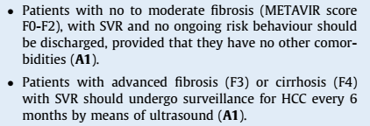
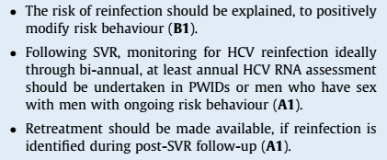
EASL recommendations
60

Slide 61
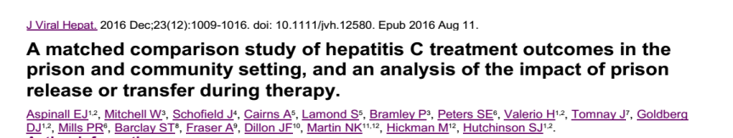
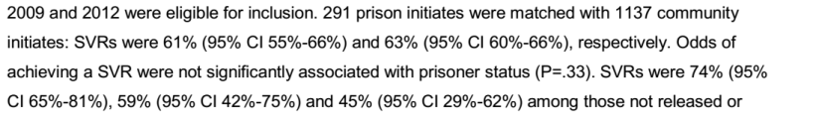
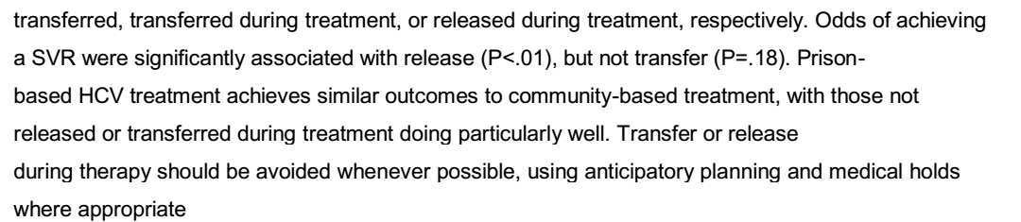
A Matched Comparison Study of Hepatitis C Treatment Outcomes in the Prison and Community Setting, and an Analysis of the Impact of Prison Release or Transfer During Therapy
61
Aspinall E J, et al. J Viral Hepatology 2016;23(12):1009–1016.

Slide 62
62

Slide 63
Conclusions and Recommendations
Detention is an opportunity for testing, diagnosis and care for HCV infected inmates, mainly if unaware of this infection
Extensive blood borne disease screening is strongly recommended in high risk populations
Eligibility path and treatment could be entirely performed inside prison by a multi-specialist team with a nurse protocol
An agreement with judiciary system has to be reached in order to keep the patients in the same institution for the whole duration of treatment
A document including diagnosis, drug regimen, outcome and indication for medical facility has to be given to the patient aiming to ensure linkage to care after release
Inmates have to be referred to Infectious Diseases/Gastroenterology Unit for follow-up and to prevent liver complications or reinfections
Data presented here are the speaker’s own.
There are no references published for these. Data presented are internal only and no distribution is allowed
63

Slide 64
Acknowledgements
Infectious diseases specialist:
  Ruggero Giuliani, Teresa Sebastiani, Elisabetta Freo, Francesca Iannuzzi
  Francesca Baj, Antonella D’Arminio Monforte
Psychologists and psychiatrists
Pharmacists
Nurses
Prison officers
Magistrates
San Paolo Hospital Health Department
54

Slide 65

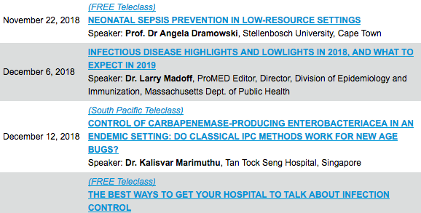

Slide 66


