Slide 1


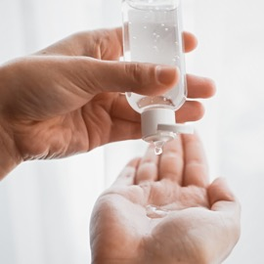
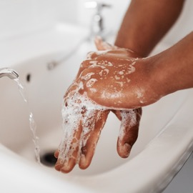
Jeopardy!
Hand hygiene Game

Slide 2
Instructions for use
Download the PowerPoint ® slide deck.
You will need a computer with a monitor that your participants can all see. Alternatively, a hard copy of the game can be adapted using a poster board.
Divide participants into three or more contestant teams .
Play the game in Slide Show mode.
  Instruct each contestant/team to select the category, and points value. The host should select/click on the correspoding area of the Points Board.
  The contestant/team will be shown trivia clues phrased as answers, to which they must respond in the form ofa quesiton that identfies whatever it is the clue describes. The answers are available to the host in the notes section of the slide deck.
  When the response is correct, the contestant/team is awarded the corresponding points. If the response is incorrect, the contestant/team points are demeritted.
  Return back to the points panel after each trivia clue slide without advancing the slide deck.
  Continue playing the game with all contestant/teams until all the categories and triva clues are completed.
  The contestant/team with the most points will be awarded as the winner(s).
Have fun!

Slide 3
Hand Hygiene Game Points Panel
General
Hand Care
Technique
Moments
Supplies
Facilitators & Barriers
200
200
200
200
200
200
400
400
400
400
400
400
600
600
600
600
600
600
800
800
800
800
800
800
1000
1000
1000
1000
1000
1000

Slide 4
Most effective way of preventing the spread of infections in health care settings.
CATEGORY 1/General · 200
Notes:
Correct response: What is hand hygiene or cleaning your hands?

Slide 5
The hand hygiene method for sanitizing (killing microorganisms/germs) on hands.
CATEGORY 1/General · 400
Notes:
Correct response: What is alcohol-based hand rub (ABHR)?

Slide 6
In health care settings, infections are most commonly spread through these.
CATEGORY 1/General · 600
Notes:
Correct response: What are hands (of health care workers)?

Slide 7
The one practice that breaks the most links in the chain of infection.
CATEGORY 1/General · 800
Notes:
Correct response: What is hand hygiene?

Slide 8
Persons responsible for doing hand hygiene.
CATEGORY 1/General · 1000
Notes:
Correct response: Who is everyone?

Slide 9
Method of hand hygiene that is least irritating/drying to skin.
CATEGORY 2/hand care · 200
Notes:
Correct response: What is alcohol-based hand rub (ABHR)?

Slide 10
Frequent application of this prevents skin dryness and irritation.
CATEGORY 2/Hand care · 400
Notes:
Correct response: What is hand lotion or cream?

Slide 11
Washing hands with this type of water/temperature range can dry and irritate skin.
CATEGORY 2/hand care · 600
Notes:
Correct response: What is hot water?

Slide 12
Drying your hands with paper towel using this technique reduces skin irritation and dryness.
CATEGORY 2/hand care · 800
Notes:
Correct response: What is gently patting hands dry and/or avoiding vigorous rubbing?

Slide 13
To prevent hand skin irritation or dryness, this should be done before applying soap.
CATEGORY 2/Hand care · 1000
Notes:
Correct response: What is wet your hands?

Slide 14
Optimal time frame for rubbing alcohol–based hand rub (ABHR) or soap and water on your hands.
CATEGORY 3/Technique · 200
Notes:
Correct response: What is 15 to 20 seconds?

Slide 15
Use these to prevent hand contamination when manually turning off water taps/faucets after hand washing.
CATEGORY 3/technique · 400
Notes:
Correct response: What are paper towels?

Slide 16
Recommended method of hand hygiene when hands are visibly soiled.
CATEGORY 3/technique · 600
Notes:
Correct response: What is hand washing (with plain soap and water)?

Slide 17
Items that impede effective hand hygiene and should not be worn when cleaning your hands.
CATEGORY 3/technique · 800
Notes:
Correct response: What are hand jewelry/rings/bracelets?

Slide 18
This practice is done before putting on and after removing gloves.
CATEGORY 3/Technique · 1000
Notes:
Correct response: What is hand hygiene?

Slide 19
The first moment of hand hygiene within the moments for hand hygiene.
CATEGORY 4/Moments · 200
Notes:
Correct response: What is before contact with patient or patient’s environment?

Slide 20
The second moment of hand hygiene within the moments for hand hygiene.
CATEGORY 4/Moments · 400
Notes:
Correct response: What is before aseptic procedure(s)?

Slide 21
The third moment of hand hygiene within the moments for hand hygiene.
CATEGORY 4/moments · 600
Notes:
Correct response: What is after blood and body fluid exposures?

Slide 22
The fourth moment of hand hygiene within the moments for hand hygiene.
CATEGORY 4/moments · 800
Notes:
Correct response: What is after contact with the patient/patient’s environment? or What is after contact with the patient?

Slide 23
Procedure to be done before accessing clean supplies and devices.
CATEGORY 4/moments · 1000
Notes:
Correct response: What is hand hygiene?

Slide 24
Hand hygiene option that is quicker, effective, and usually more convenient to access than soap and water?
CATEGORY 5/supplies · 200
Notes:
Correct response: What is alcohol-based hand rub (ABHR)?

Slide 25
Essential equipment for hand washing.
CATEGORY 5/supplies · 400
Notes:
Correct response: What is a (dedicated) hand hygiene sink?

Slide 26
Used for drying hands in health care settings.
CATEGORY 5/supplies · 600
Notes:
Correct response: What are disposable paper towels?

Slide 27
Minimum concentration of alcohol-based hand rub (ABHR) in health care setting.
CATEGORY 5/Supplies · 800
Notes:
Correct response: What is 70%?

Slide 28
Alcohol-based hand rub (ABHR) should not be used past this date.
CATEGORY 5/supplies · 1000
Notes:
Correct response: What is the expiry date?

Slide 29
Optimal placement of alcohol-based hand rub to prevent spread of infection.
CATEGORY 6/facilitators & Barriers · 200
Notes:
Correct response: What is at point-of-care/bed-side?

Slide 30
Personal Protective Equipment (PPE) that is used to prevent hand contamination but is not a substitute for hand hygiene.
CATEGORY 6/Facilitators & barriers · 400
Notes:
Correct response: What are gloves?

Slide 31
Hand adornments that prevent effective hand hygiene.
CATEGORY 6/Facilitators & barriers · 600
Notes:
Correct response: What are artificial fingernails/extenders, chipped nail polish, or hand jewelry?

Slide 32
Disposal of these in hand hygiene sinks can lead to contamination and transmission of multi-drug resistant organisms (e.g., carbapenemase producing organisms).
CATEGORY 6/facilitators & barriers · 800
Notes:
Correct response: What are body fluids or other fluids?

Slide 33
A type of assessment that provides timely feedback to health care workers and administrators on hand hygiene practices and identifies areas of improvement.
CATEGORY 6/Facilitators & barriers · 1000
Notes:
Correct response: What are hand hygiene (compliance) audits?

Slide 34
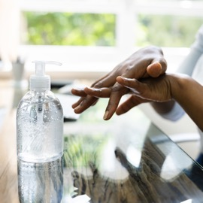
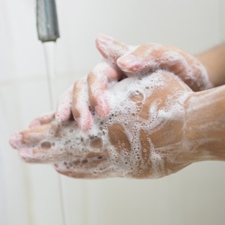
Winner!

Slide 35
Credits & Acknowledgements
PowerPoint template credit: SlidesCarnival
Special thank you to:
Ben Shaw, IPC Consultant, Island Health, for his review and feedback in the development of this game.

