Slide 1


Screening for Staphylococcus aureus before surgery. Why bother?
Hilary Humphreys
Royal College of Surgeons in Ireland (RCSI)
& Beaumont Hospital, Dublin, Ireland
Hosted by Paul Webber
paul@webbertraining.com
www.webbertraining.com
March 30, 2017

Slide 2
Declaration
The views expressed are of a professional but personal nature and not necessarily those of the RCSI & Beaumont Hospital, Dublin.
I have recently received research funding from Pfizer & Astellas. I have also provided professional advice or education for Cepheid

Slide 3
Outline
Surgical site infections (SSI); prevalence, impact & costs
Staph. aureus as a pathogen, evolution of resistance & virulence determinants
Strategies to reduce post-operative SSI
Selective screening & decolonisation or universal decolonisation – the evidence
Conclusions

Slide 4
Key Publications
Humphreys H, Becker K, Dolmen PM, et al. Staphylococcus aureus and surgical site infections: benefits of screening & decolinisation before surgery. J Hosp Infect 2016; 295-304.
Septimus EJ, Schweizer ML. Decolonisation in prevention of healthcare-associated infection. Clin Microbiol Review 2016; 29: 201-222.
Poovikunnel T, Gethin G, Humphreys H. Mupirocin resistance; Clinical implications & potential alternatives for the eradication of MRSA. J. Antimicrobial Chemother 2015; 70: 2681-2692

Slide 5
Surgical Site Infection;
Prevalence, Impact & Costs

Slide 6
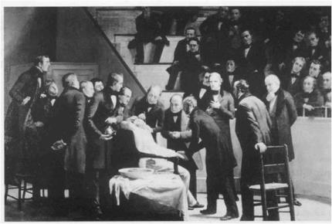
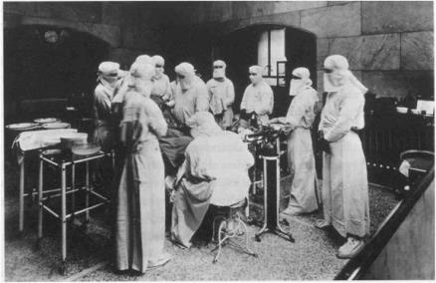
SSI-Worldwide
USA & Europe - 4.5 -7.1/100 hospitalised patients
- 1.7- 41 x 10⁶ patients
- 3rd most common HCAI
Resource-poor countries - 15.4/100 hospitalised patients
- Commonest HCAI
Wellcome Trust

Slide 7

Public Reporting & Performance Indicators
HICPAC
SSI associated with cost, morbidity & mortality Prevention guidelines exist
100,000 Lives Campaign/Surgical Care Improvement Project
SSI amenable to interventions
Am J Infect Control 2005; 217-26
JAMA 2000; 295: 324-327
Clin Microbiol Infect 2008; 14: 892-894

Slide 8
ECDC Point Prevalence Survey of HCAI & Antimicrobial Use, 2011-2012
2800 healthcare workers from 1200 hospitals were trained
231,459 patient in 947 hospitals, with a single ward surveyed on a single day
Prevalence of HCAI was 6% (2.3 – 10.%); 4.8% in primary & 7.2% in tertiary hospitals
RTI (23.5%), SSI (19.6%), UTI (19%), bloodstream infection (10.7%) & GI infection (7.7%) – 48% due to Clostridium difficile

Slide 9
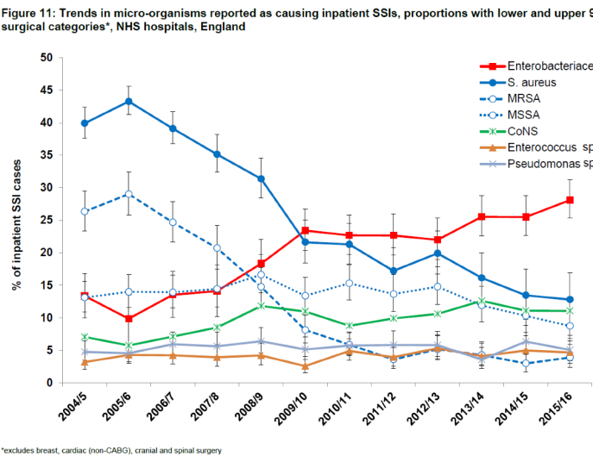
SSI in England, 2015-16
Public Health, England

Slide 10
SSI Variation
Varies according to procedure ‘clean’, ‘contaminated’, patient risk factors (e.g. age, diabetes mellitus), duration, technical competence, etc.
11% for cardiac surgery, 7% for vascular surgery & 2.4% for orthopaedic surgery
Highest, usually > 20%, for emergency, colo-rectal surgery with perforation
SSI rate increases x 2.9 if nasal colonisation for Staph. aureus

Slide 11
SSI Impact & Costs
Length of stay – 10 additional days
Costs - €19 billion in Europe
Numbers – 70,000 SSIs out of 80 million procedures in US
Also, more hospital visits
need for home help
more equipment
? societal costs, e.g. loss of income
tax, disability payments, etc.

Slide 12
What About After Hospital Discharge?
Data from existing IT systems, e.g. pharmacy
Direct observation by healthcare professional
Telephone interviews
Patient questionnaire

Slide 13
In-Patient versus Post-Discharge Diagnosis
 | Superficial | Deep | Organ/ space | Total
During hospitalisation Post discharge | 149 122 | 14 57 | 5 32 | 168 216
Re-admission | 28 | 39 | 26 | 93
Follow-up | 19 | 2 | 2 | 23
OPD + questionnaire | 64 | 7 | 2 | 73
Infect Control Hosp Epidemiol 2006; 27: 1324-1329

Slide 14
Surgical Site (Wound) Infection
Uninfected MSSA MRSA
Death 2% 7% 21%
Mean hospital stay 5d 14d 23d
after surgery
Hospital charges $29,000 $53,000 $92,000
Clin Infect Dis 2003;36:592-98

Slide 15
Staph. aureus as a pathogen;
Evolution of Resistance & Virulence Determinants

Slide 16
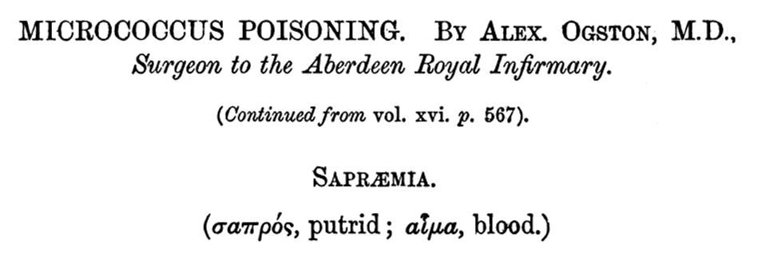
A Scottish surgeon in Aberdeen first showed that many pyogenic lesions were associated with cluster-forming micro-organisms
Also described bloodstream infection or septicaemia
J Anat Physiol 1882; 17 part 1: 24-58

Slide 17
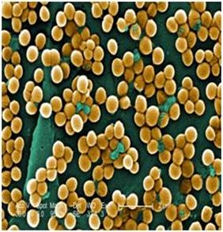
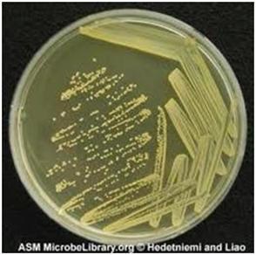
Colonisation & Infection
Colonisation
The bacteria are carried by the individual/patient, but he/she is well
Infection
The bacteria causes illness, with symptoms & possible adverse consequences

Slide 18
Pathogenesis
Bacterium e.g. peptidoglycan,
Panton-Valentine,
leucocidin
Circumstances
e.g. IV line,
surgery,
trauma
Patient/Host
e.g. elderly,
diabetes mellitus,
cancer

Slide 19
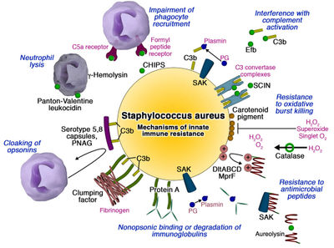
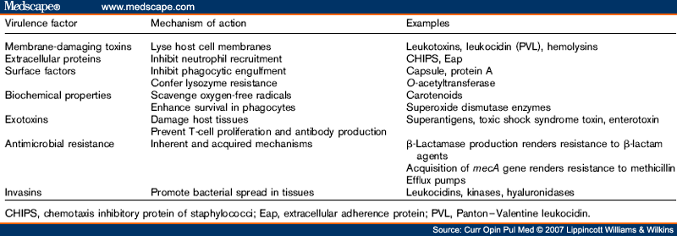
S. aureus Virulence Factors
Pathogen of humans & animals
Expresses many potential virulence factors
Pathogenesis is multifactorial
David Coleman

Slide 20
Recent Changes in S. aureus Epidemiology
Increase followed by decrease in MRSA in many hospitals such as BSI (EARS-Net)
Emergence & spread of CA-MRSA with presentations in acute hospitals
Livestock-associated MRSA, often in low prevalence countries
New clonal lineages, e.g. SCCmec XI with the divergent mecC

Slide 21

Community-Acquired MRSA in the Netherlands
> 29% of pig farmers & 39% of pigs MRSA+ve
Sequence Type (ST) 398, unusual in humans
Overuse of antibiotics in pigs, e.g. tetracyclines, or international trade in pigs
Clin Microbiol Infect 2008; 14: 519-521

Slide 22

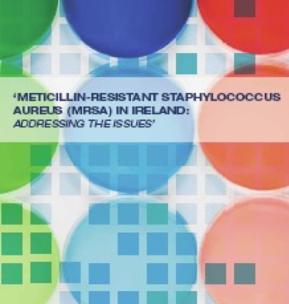
Costs of MRSA in Ireland
25,000 patients get HCAI annually
€850/day leads to €233.75m
MRSA accounts for 10% of HCAI
MRSA costs the healthcare
system €23m; does not
allow for additional costs
of MRSA
MRSA in Ireland: Addressing the Issues (2010)

Slide 23
Strategies to Reduce Post-Operative SSI

Slide 24
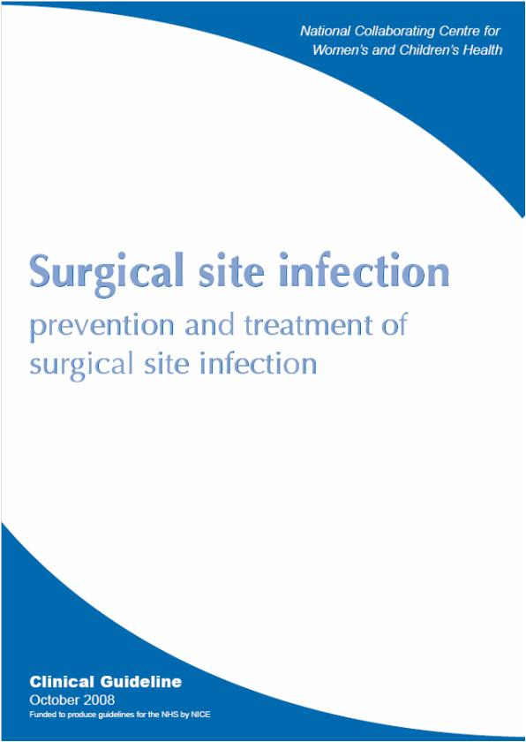
Healthcare Bundle for SSIs
Derived from NICE
Pre-Operative
e.g. hair removal,
staff theatre wear
antibiotic prophylaxis
Intra-Operative
e.g. hand decontamination
antiseptic skin preparation
wound irrigation
Post-Operative
e.g. changing dressings
topical antimicrobial agents
debridement

Slide 25
New WHO Recommendations to Prevent SSI
Meta-analyses, Cochrane methods & Guideline Development Group
Pre-operative measures, e.g. preoperative bathing, antibiotic prophylaxis, etc.
Intra-operative measures, e.g. body temperature, category of drapes, etc.
Post-operative measures, e.g. ward dressings, etc.
Lancet Infect Dis 2016; 16: e276-87 & e288-303

Slide 26
WHO & Decolonisation of S. aureus
Surgery | Recommendation | Strength | Quality of Evidence
Cardiothoracic & orthopaedic | Decolonise known carriers with mupirocin & CHG | Strong | Moderate
Other surgery | Decolonisation is suggested | Conditional | Moderate
CHG = chlorhexidine
Lancet Infect Dis 2016; 16: e27-87

Slide 27
Selective Screening &
Decolonisation or Universal Decolonisation- the Evidence

Slide 28
Decolonisation to Prevent S. aureus SSI-1
Studies vary in quality & category of surgery
Some limited to MRSA
Often combined with other interventions
Methods of testing vary; culture & molecular

Slide 29
Decolonisation to Prevent S. aureus SSI-2
Best evidence for cardio-thoracic & orthopaedics
Elective more than emergency unless PCR
Plausible that there might be benefits for neurosurgery & plastic surgery
SSI after GI, liver & gall bladder surgery caused by enteric bacteria

Slide 30
Nasal Decolonisation of S. aureus
Conventional | Unconventional
Mupirocin | Tea tree oil
Bacitracin | Photodynamic therapy
Retapamulin | Omiganan pentahydrochloride
Povidone - iodine | Lysostaphin
Alcohol | Honey

Slide 31
Skin Decolonisation of S. aureus
Selective | Digestive Tract Decontamination
Chlorhexidine (CHG) | Tobramycin, polymixin & amphothericin B
Hexachlorophane
Povidone-iodine | Directed mainly against GNBs & in ICU
Triclosan
Bleach | Has been combined with CHG

Slide 32
Dutch Study of SSI & S. aureus
PCR screening at admission, multi-centre
No MRSA detected
+ve received a 5 day course of mupirocin/CHG
SSI rate lower in treatment group (3.4% vs 7.7%)
Mean hospital stay less by 2 days
N Engl J Med 2010; 362: 9-17

Slide 33
Point-of-Care Universal Screening
Cluster randomised cross-over trial on four admission wards in London with wash-out periods
Admission & discharge screening by culture or/& PCR (XpertTM MRSA, Cepheid)
PCR was 69% sensitive, 97% specific, PPV 29%, NPV 99%
Total days not isolated higher if culture
J Hosp Infect 2017;95: 245-52

Slide 34
Point-of-Care Universal Screening
Variables | Culture | PCR
No. screened | 4978 (75%) | 5039 (72%)
MRSA +ve | 113 (1.8%) | 109 (1.6%)
MRSA acquisition by discharge | 23 (0.46%) | 24 (0.48%)
Acquisition/1,000 patient days | 5.39 | 4.6
J Hosp Infect 2017; 95: 245-52

Slide 35
Rapid Screening for MRSA
Beaumont Hospital study of 462 (ward, ED) & 27 ICU patients during 3 periods
22-33% MRSA +ve
27% not screened if culture used & 11% if PCR used (p<0.01)
24% of patients pre-emptively isolated without PCR compared to 7% with PCR (p>0.001)
Infect Control Hospital Epidem 2010; 31: 374-381

Slide 36
Rapid Screening for MRSA Using PCR- Does It Make a Difference?
Interval from admission to
MRSA +ve result
PCR
Culture
Infect Control Hosp Epidemiol 2010; 31: 374-381

Slide 37
Logistical Issues
Decolonisation with prior screening requires planning, education, etc

Slide 38
Universal Decolonisation - 1
Why screen as ~ 30% are carriers and adds to delay & expense
A. Unnecessary use of mupirocin & CHG with emergence of resistance

Slide 39
Universal Decolonisation - 2
Represents a horizontal intervention, i.e. measures for all patients
Largely used in critical care but –
  very ill patients
  not directed at preventing SSI
  possible benefits in preventing BSI
Economic models target short-term benefits
Well planned non-emergency surgery should allow for screening

Slide 40
Targeted versus Universal Decolonisation to Prevent ICU Infection
N Engl J Med 2013; 368: 2255-65

Slide 41
Clin Infect Dis 2016; 62: 631-6
“The current evidence on the occurrence of high-level mupirocin resistance in CoNS does not constitute an important risk for high-level mupirocin resistance in Staph. aureus.”

Slide 42
S. aureus & Mupirocin Resistance - 1
Low level - MICs 8 – 128/256 mg/l
Amino acid substitutions
Clinical significance uncertain
High level - MICs ≥ 512 mg/l
Plasmid – localised mup A gene
Can transfer to Staph. epidermidis

Slide 43
S. aureus & Mupirocin Resistance -2
Mupirocin resistance associated with resistance to other antimicrobial agents such as clindamycin & levofloxacin
Resistance to antiseptics/biocides such as CHG (qacA & qacB) amongst coagulase negative staphylococci
Increased use of mupirocin associated with increased resistance

Slide 44

Literature Review of Mupirocin Resistance
Mupirocin resistance (MR). Clinical implications and potential alternatives for the eradication of MRSA, was published in the Journal of Antimicrobial Chemotherapy, October 2015.
Key findings
Resistance ranges from 1-81%
Chlorhexidine resistance genes among MRSA isolates, 65-91%
High level mupirocin resistance (HLMR) linked with multi-drug resistance
  clindamycin, tetracycline, erythromycin & levofloxacin

Slide 45
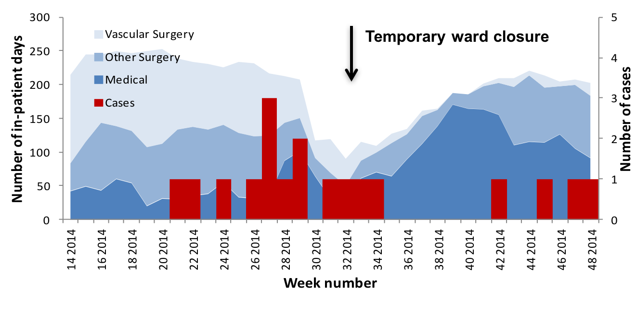
Mup. Res MRSA (spa type t127 or t922) Outbreak
Median age 73 years, 78% male
31 colonised, 8 infections
42%, vascular, 37% medical & 20% other surgical patients
Patricia Garvey et al

Slide 46
REDUCE MRSA Trial & Mup/Chlor Resistance
7/12 baseline & 18/12 intervention periods
Most isolates collected from nose on 1st day of hospitalisation; 3,173 (43%) tested
No difference in MIC₅₀ /MIC₉₀ for chlorhexidine resistance
7.1% LLMR & 7.5% HLMR but no difference between phases & introduction
0.6% had gac gene
J Clin Microbiol 2016; 54: 2735-42

Slide 47
Preliminary Results from RCT of Mupirocin versus Natural Honey
Patient recruitment
  March 2014 to March 2016
Outcome of ~100 patients enrolled & completed the study
Natural honey non-inferior & multi-site MRSA a risk factor for decolonisation failure
Toney Poovelikunnel, et al.

Slide 48
Conclusions

Slide 49
SSI are amongst the most important HCAIs & S. aureus the commonest cause
Horizontal measures are important pre- intra- & post operatively
Evidence & plausibility are strong to screen & selectively decolonise before cardio-thoracic & orthopaedic surgery

Slide 50
Molecular testing can preclude the need for universal decolonisation before surgery
Studies are required outside of orthopaedic & cardio-thoracic surgery
Unnecessary & widespread use of topical antibiotics & biocides should not occur

Slide 51


Slide 52

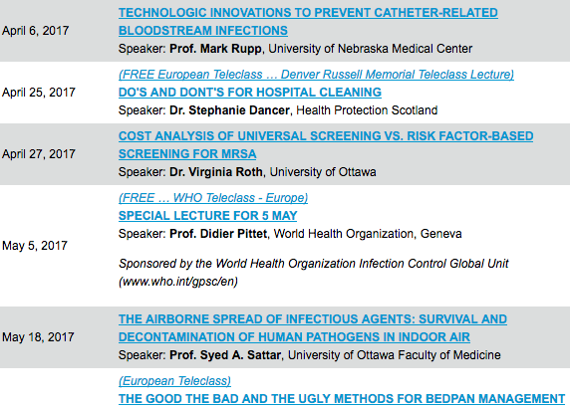

Slide 53


