Slide 1
SSI Surveillance Strategies in Under-Resourced Settings
Joseph S. Solomkin, MD, FACS, FIDSA On behalf of the World Surgical Infection Society
Hosted by Claire Kilpatrick
Sponsored by the World Surgical Infection Society (www. worldsis.org)
www.webbertraining.com
June 13, 2019

Slide 2
Objectives
- Explain the need for SSI surveillance in order to support infection prevention and safe surgery - Outline the approaches taken to conduct SSI surveillance - Describe the challenges and some of the proposed solutions for undertaking SSI surveillance in under-resourced settings - Summarize the role of the World Surgical Infection Society (WSIS) in supporting surveillance and improvement in under resourced setting

Slide 3
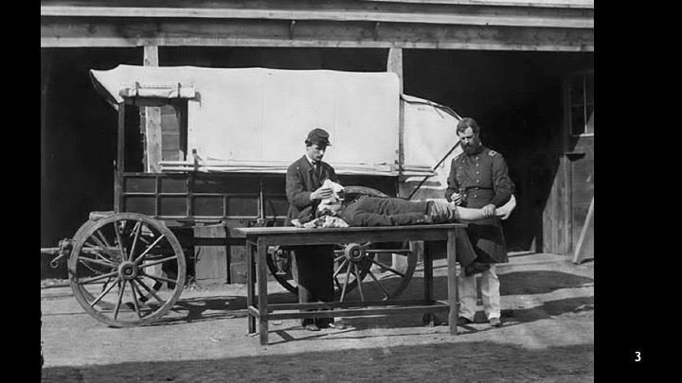
Notes:
Surgical site infections (SSIs) have been an adverse outcome from surgery over the ages. In a time when knowledge of sterility and antibiotics did not exist, this could be expected. Why do SSIs occur in healthcare of the 21st century?

Slide 4
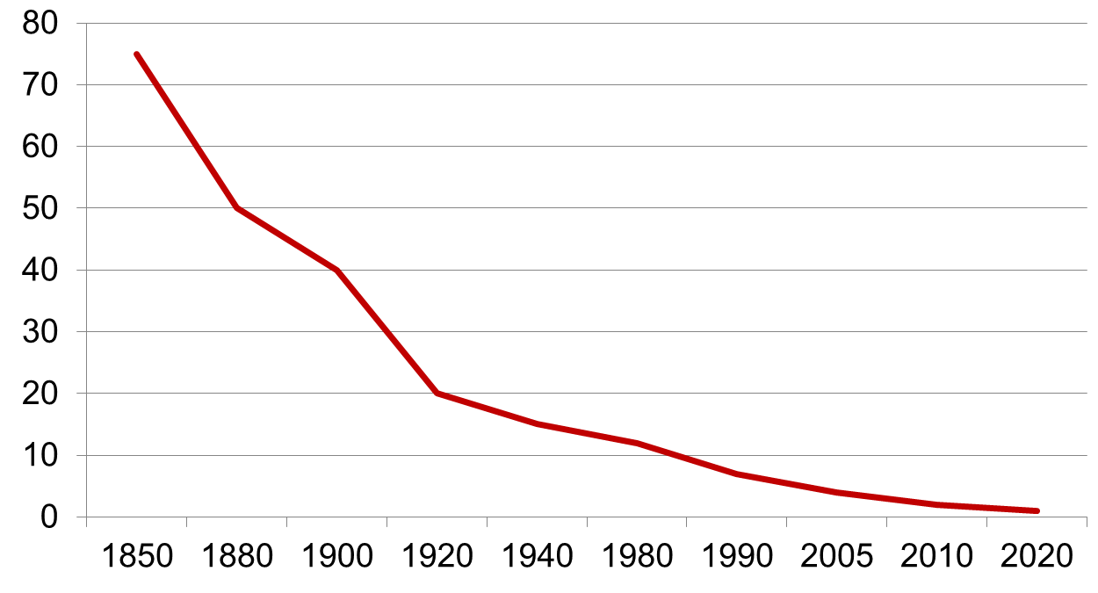
Surgical Site Infection Rates Through Time
Hand hygiene
Site preparation
Delicate technique
Antibiotic prophylaxis
ICP training
Surveillance
SCIP
SUSP
Surgical Site Infection Rate
Notes:
Organization and operation of the hospital-infection-control program of the University of Iowa Hospitals and Clinics.
Rasley D, Wenzel RP, Massanari RM, Streed S, Hierholzer WJ Jr.
Infection. 1988;16(6):373-8.
http://en.wikipedia.org/wiki/Ignaz_Semmelweis; http://www.historylearningsite.co.uk/joseph_lister.htm; http://en.wikipedia.org/wiki/William_Stewart_Halsted (websites accessed on 18/6/13); Polk HC Jr, Lopez-Mayor JF. Surgery. 1969;66(1):97-103; Wenzel RP et al. Am J Epidemiol. 1976;104(6):645-51; Cruse P. Rev Infect Dis. 1981;3(4):734-7; Bratzler DW. Clin Infect Dis. 2013;56(3):428-9; Rasley D et al. Infection 1988;16(6):373-8.
ICP: infection control and prevention
SCIP: surgical care improvement project
SUSP:Surgical Unit-Based Safety Program

Slide 5
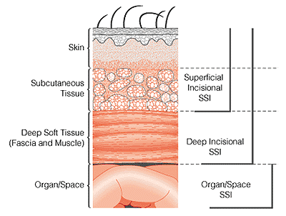
What is a Surgical Site Infection (SSI)?
CDC/NHSN definition of SSI: “Infection occurring at the operation site within 30 days of the procedure.”
ref: Horan TC, Am J Inf Cont 2008
Less severe, but harder to reliably diagnose
COMPLEX SSI: More severe, straightforward diagnosis

Slide 6
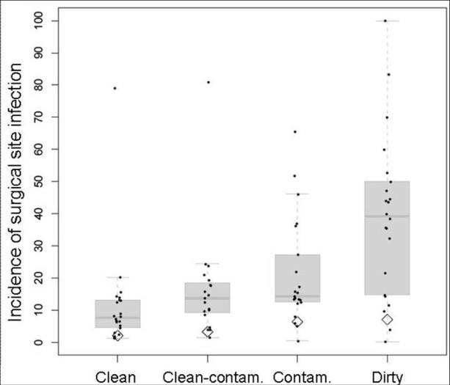
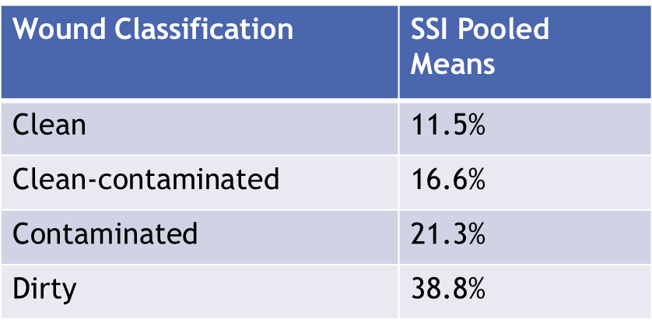
SSI Rates in Low- and Middle-Income Countries According to Wound Classification

Slide 7
Surgical site infection after gastrointestinal surgery in high-income, middle-income, and low-income countries
The Lancet Infectious diseases 2018;18:516-25

Slide 8
Background: Impact
Length of Hospital Stay
~7-10 additional postoperative hospital days
Cost
$3000-$29,000/SSI depending on procedure & pathogen
Up to $10 billion annually
Most estimates are based on inpatient costs at time of index operation and do not account for the additional costs of rehospitalization, post-discharge outpatient expenses, and long term disabilities
Anderson DJ, etal. Strategies to prevent surgical site infections in acute care hospitals.
Infect Control Hosp Epidemiol 2008;29:S51-S61 for individual references

Slide 9
Value of Cesarean Section (CS) as a Model Operation for SSI Prevention Research
50-80% of surgery in Sub-Saharan Africa is CS
CS is a highly standardized operation
Young, typically healthy patients

Slide 10
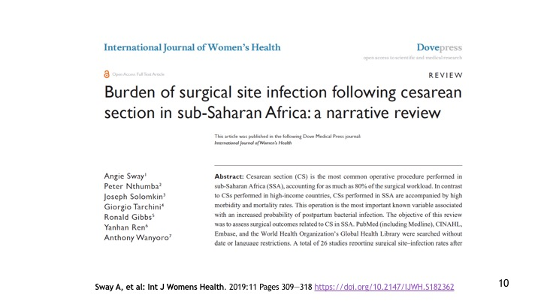

Slide 11
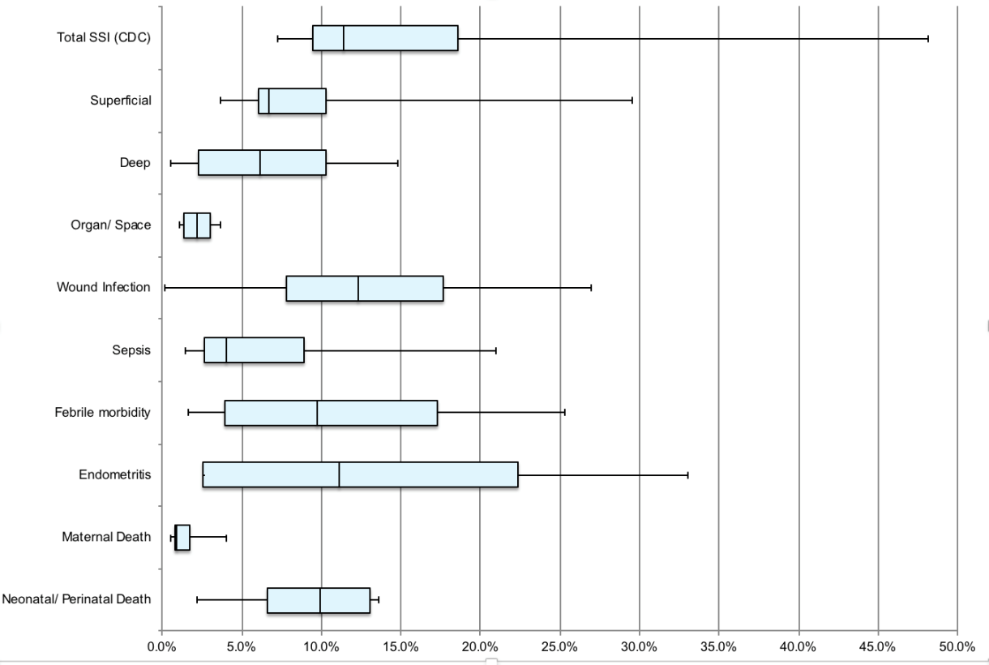
Infection Rates in Cesarean Section in Sub-Saharan Africa – A Systematic Review
CDC classification
Ad hoc
Sway A, et al: Int J Womens Health. 2019:11 Pages 309—318

Slide 12
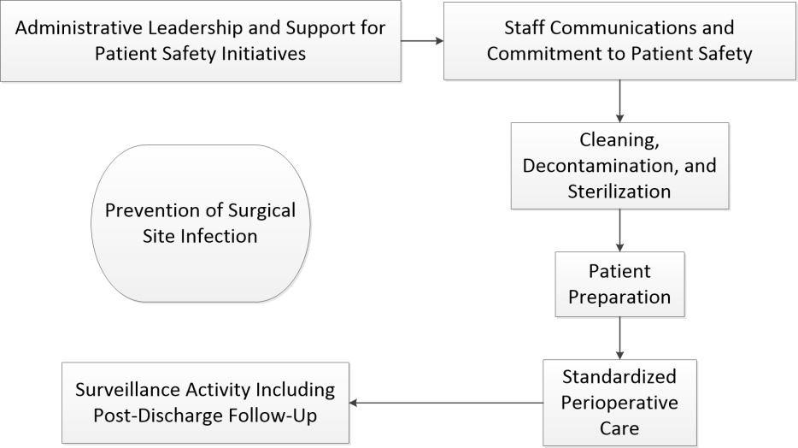
Key Elements in Reducing SSI
12

Slide 13
Challenges for SSI Surveillance and Prevention in LMIC Setting
Excluding the highest level, national referral hospitals, many facilities in LMIC are understaffed and short on resources
When there is already a struggle to handle the patient load, programs such as HAI/SSI Surveillance and IPC are considered optional “extras”

Slide 14
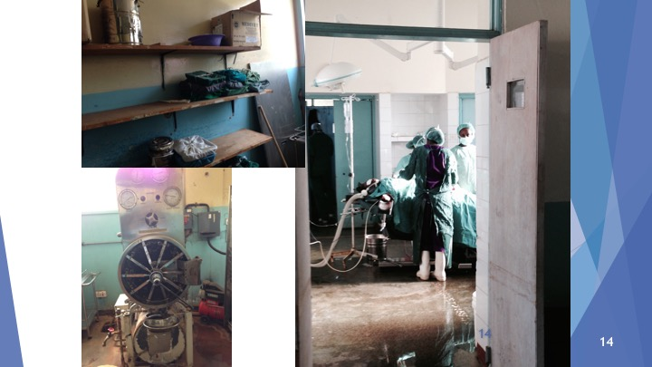

Slide 15
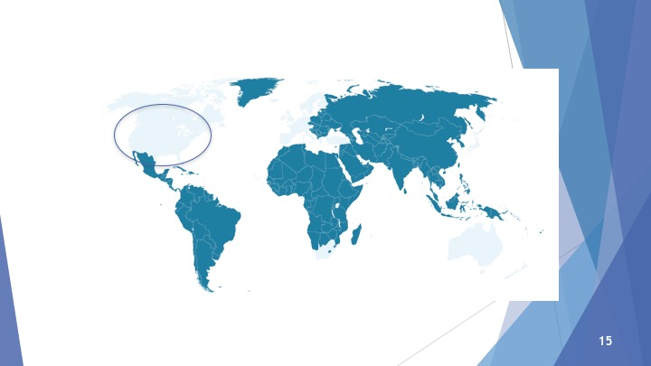
Notes:
72% of the surgeries performed in the developing world are emergency surgeries.Emergency surgeries are riskier and procedures are often skipped.There is a huge need for our solution.

Slide 17
Why Bother with New Guidelines in Infection Control?
The broad goal of health care is to safely improve the quality of life for our community
This is now phrased as creating a culture of safety
Guidelines are intended to establish “best practices” to achieve this
Appropriate topics include:
The structure for administered services (Core Components)
The communication skills of health care workers
The details of technical care (this guideline)

Slide 18
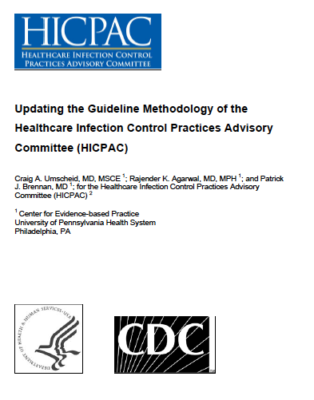
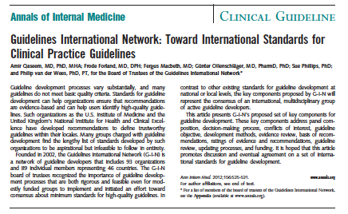
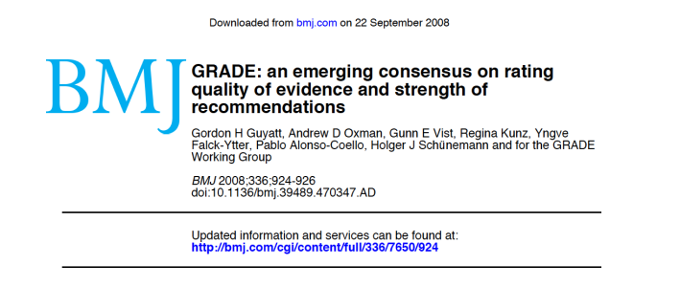
Notes:
http://www.iom.edu/~/media/Files/Report%20Files/2011/Clinical-Practice-Guidelines-We-Can-Trust/Clinical%20Practice%20Guidelines%202011%20Insert.pdf

Slide 22
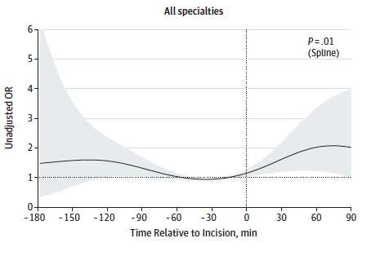
ANTIBIOTIC PROPHYLAXIS | When indicated (depending on the type of operation), surgical antibiotic prophylaxis should be administered prior to the surgical incision, and within 120 minutes before incision, while considering the half-life of the agent. Strong recommendation Moderate quality of evidence Surgical antibiotic prophylaxis administration should not be prolonged after completion of the operation for the purpose of preventing SSI Strong recommendation Moderate quality of evidence
Hawn MT, Richman JS, Vick CC, et al. Timing of surgical antibiotic prophylaxis and the risk of surgical site infection. JAMA surgery 2013;148:649-57.

Slide 26
Other Recommendation Areas
Triclosan-coated sutures
Antimicrobial dressings
Laminar flow ventilation systems
Prophylactic negative pressure wound therapy
Wound protector devices
Drapes and gowns
Maintenance of adequate circulating volume control/ normovolemia
Drains

Slide 34
Notes:
Say: ‘we have already talked about recognising SSIs based on the definitions but reliable steps are required to record them - the WHO tools allow you to do this.’ READ SLIDE and say you can see here the initial information that you must collect for each patient having surgery in agreed categories of surgery for surveillance. READ FIELDS. You will understand from reading these the importance of the surgical team being in charge and owning this process of collecting data.’

Slide 36
WHO Implementation Project in Sub-Saharan Africa
A before–after cohort study, between July 1, 2013, and Dec 31, 2015, at four African hospitals
The multimodal intervention consisted of:
Implementation or strengthening of multiple SSI prevention measures
An adaptive approach aimed at the improvement of teamwork and the safety climate.

Slide 37
SUSP in Sub-Saharan Africa
From 2013 to 2015 the WHO Clean Care is Safer Care programme supported the implementation of an SSI prevention and quality improvement intervention in Surgical Departments in five African hospitals:
AIC Kijabe Hospital, Kenya: Level 5 tertiary referral hospital
Mulago Hospital, Uganda: Teaching, national referral hospital
Church of Uganda Kisiizi Hospital, Uganda: Private non-profit hospital
Ndola General Hospital, Zambia: Referral hospital
This program was successful in reducing SSI rates at participating facilities

Slide 38
Allegranzi B, Aiken AM, Zeynep Kubilay N, et al. A multimodal infection control and patient safety intervention to reduce surgical site infections in Africa: a multicentre, before-after, cohort study. The Lancet Infectious diseases 2018;18:507-15.

Slide 39
global health gaps that we seek to address
Surgical infections are now widely recognized as a public health issue in high income countries. They are an even more widespread problem in low- and middle-income countries. Some healthcare workers view SSI’s as an inevitability rather than a problem that can be fixed. WSIS plans to change that attitude.
Surgical infections are not the sole responsibility of a single healthcare department. WSIS is the first organization to join together surgeons, infection control experts, nurses, and other healthcare workers to target SSI reduction.

Slide 40
MISSION
Vision
We are an inter-professional collaboration that aims to improve patient safety where the need is greatest by bringing together regional surgical infection interest groups, creating education initiatives, and developing actionable data
We are aiming to fill the gaps between safe surgery and infection prevention and control programs, focusing on the reduction of surgical site infection through research into best practices and implementation and working with local and regional hospitals and health care workers

Slide 41
The Case for a Focus on Smaller District Hospitals
A large majority of the operations performed in low/middle income countries are performed in smaller district-level facilities
There is little availability of trained infection control practitioners and little infection control infrastructure

Slide 42
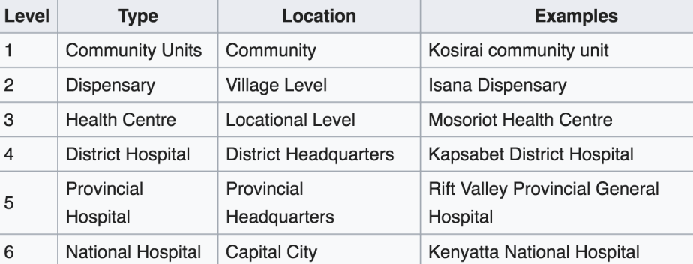
Hospital Levels in Kenya
https://en.wikipedia.org/wiki/Healthcare_in_Kenya
42

Slide 44
WSIS Lucina Project (2017)
Thika Hospital
Kiambu Hospital
300 women enrolled
Single shot prophylaxis antibiotic given ½ - 2 hours pre-incision.
300 women enrolled
5-7 days antibiotics was routinely administered to ALL women following CS
Equivalent surgical credentials, patient demographics, indications for operation, and anesthesia, and skin preparation
Surgical sites examined by surveyor Days 3, with clinical or cell phone contact follow up at 14 and 30 days

Slide 45
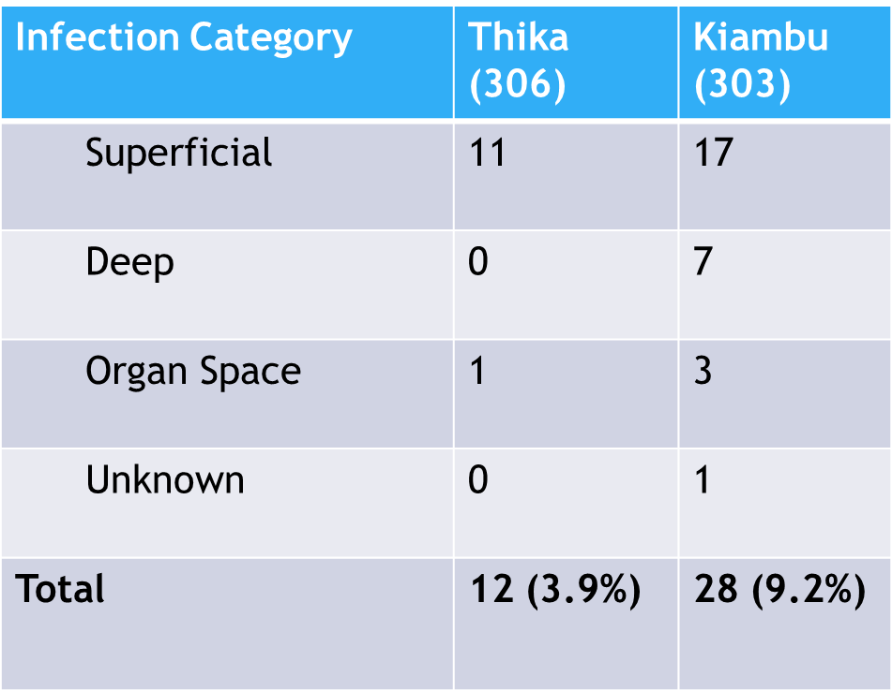
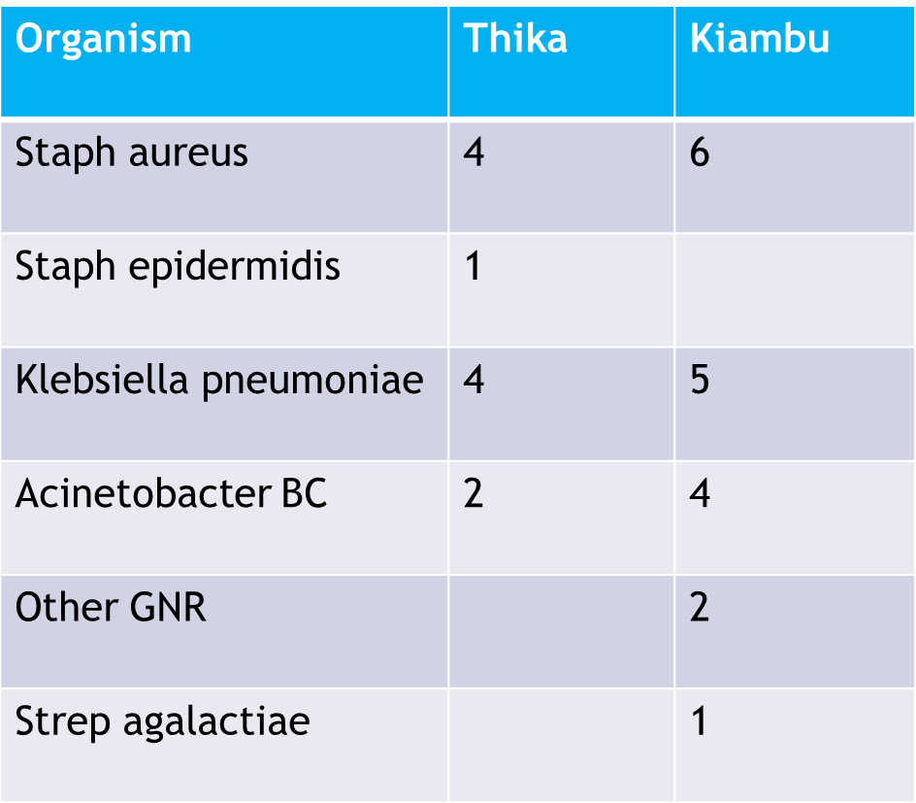
WSIS Lucina Project (2017)

Slide 46
Complex Surgical Site Infections and the Devilish Details of Risk Adjustment Anderson DJ, Chen LF, Sexton DJ, Kaye Infection control and hospital epidemiology 2008;29:941-6.
Complex SSIs are serious infections that typically require rehospitalization, return to the operating room, and intravenous antibiotic therapy.
Such infections are difficult to ignore or miss when they do occur, and they are of undoubted significance to patients and their surgeons.
Notes:
This is the problem. 2 incision sites. Both incisions made by the same team on the same day, under the same conditions. One has a debilitating, preventable infection.

Slide 47
What is a Surgical Site Infection (SSI)?
CDC/NHSN definition of SSI: “Infection occurring at the operation site within 30 days of the procedure.”
ref: Horan TC, Am J Inf Cont 2008
Less severe, but harder to reliably diagnose
COMPLEX SSI: More severe, straightforward diagnosis

Slide 49
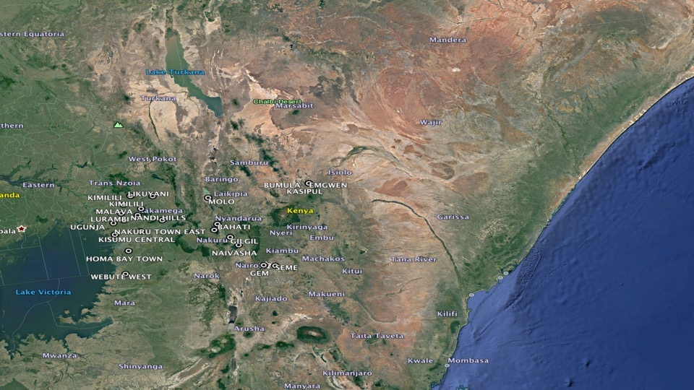
LUCINA II: First Phase of an Implementation Intervention
Aimed at District Hospitals
49

Slide 50
WSIS Survey (Unpublished Data) of Level 4 and 5 Facilities in Kenya
Level 4 (District and Sub-district) and Level 5 (Provincial Referral) hospitals provide much of the non-specialized surgical care, including cesarean sections, for Kenyan citizens
Survey of 27 facilities reported an estimated population served of over 3 million
Unlike national referral facilities, many of these hospitals have no more than one or two surgeons on staff, if any, and no anesthesiologists
Much of the surgical burden is handled by Medical Officers
At least one half of the surveyed hospitals did not have a functioning infection control activity

Slide 51
Conclusions
There is compelling information that application of key guideline recommendations results in a substantial decrease in SSI rates in patients s.
Poor sterilization practices, unit cleansing, and other recognized patient- and status-dependent factors that are difficult to change without significant infrastructure and financial investment may have been overcome by appropriate antibiotic prophylaxis.
Given the significant difference in settings, separate but parallel implementation work should be carried out at Level 4 and 5 hospitals in Kenya, and facilities of a similar type in other LMIC, in order to take into account the differences in workforce dynamics and resources
The implementation of these recommendations through tested methods will reduce the burden of SSIs and likely other healthcare associated infections

Slide 52
