Slide 1
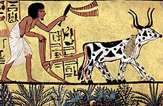
A One Health Perspective on Food Security
Laura H. Kahn, MD, MPH, MPP
Center for Health and Wellbeing Princeton University
www.webbertraining.com
January 23, 2020

Slide 2
Food Security Challenges in the 21st Century
What impact will climate change have on food production?
What policies can governments implement to maximize food security? (And food safety?)
Governments have an incentive to ensure food security to minimize risk of civil unrest or possibly even revolution.
How can everyone be fed without destroying the planet’s biosphere (global sum of all ecosystems)?

Slide 3
Threats to Agriculture and Food Security
Climate Change
Crop Threats
Diseases and Pests
Pollinator Threats
Food Animal Threats
Diseases
Antimicrobial Resistance

Slide 4
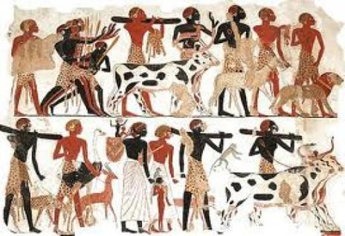
Domestication of Plants and Animals
Agriculture began about 10,000 years ago.
Agriculture is foundation of civilization.
Towns, cities, and nations flourished with secure food supplies..
http://www.nature.com/nature/journal/v447/n7142/full/nature05775.html

Slide 5
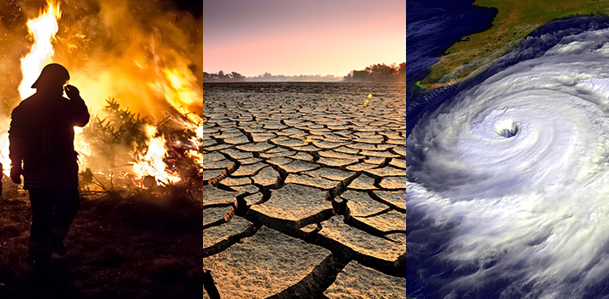
Climate Change
https://climate.nasa.gov/effects/

Slide 6
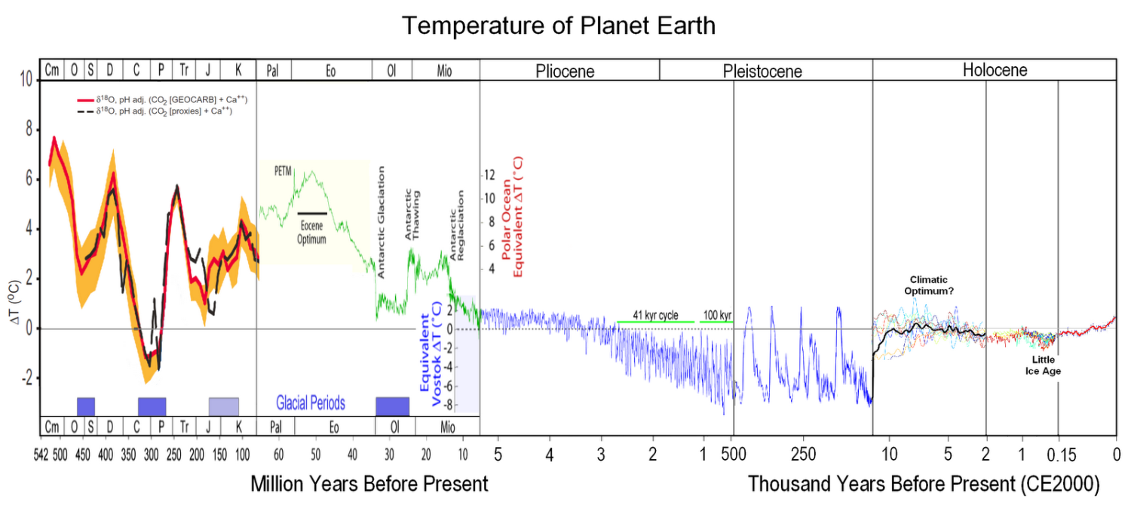
Time of Complex Life on Earth
Paleozoic Era
Early hominids
Permian-Triassic Extinction
Cambrian Explosion: Thriving life in seas but barren land
Earth is 4.5 Billion Years Old
https://commons.wikimedia.org/wiki/File:All_palaeotemps.png
http://gergs.net/2015/06/updating-the-geological-temperature-plot/all_palaeotemps/

Slide 7
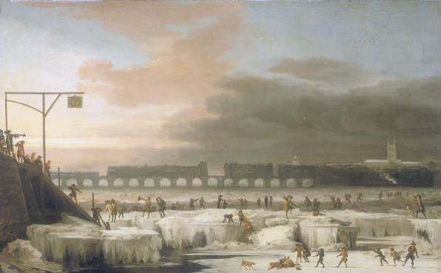
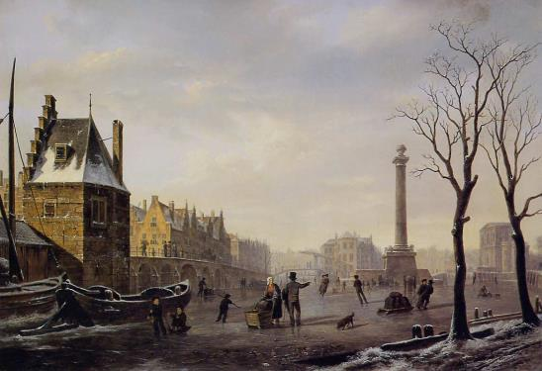
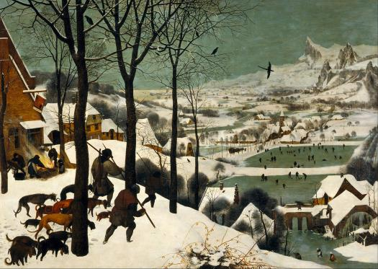
Little Ice Age from 1300 to 1850
The Frozen Thames, Britain, 1677
Frost fairs lasted from 1607 to 1814
Ice skating on main canal of Pompenburg,
Rotterdam, 1825.
Little Ice Age noted for crop
failures, bread riots, famine, wars.
Details outlined in ”Global Crisis,”
by Geoffrey Parker and “Nature’s Mutiny”
by Philipp Blom.
The hunters in the snow, Pieter Brueghel the Elder, 1565

Slide 8
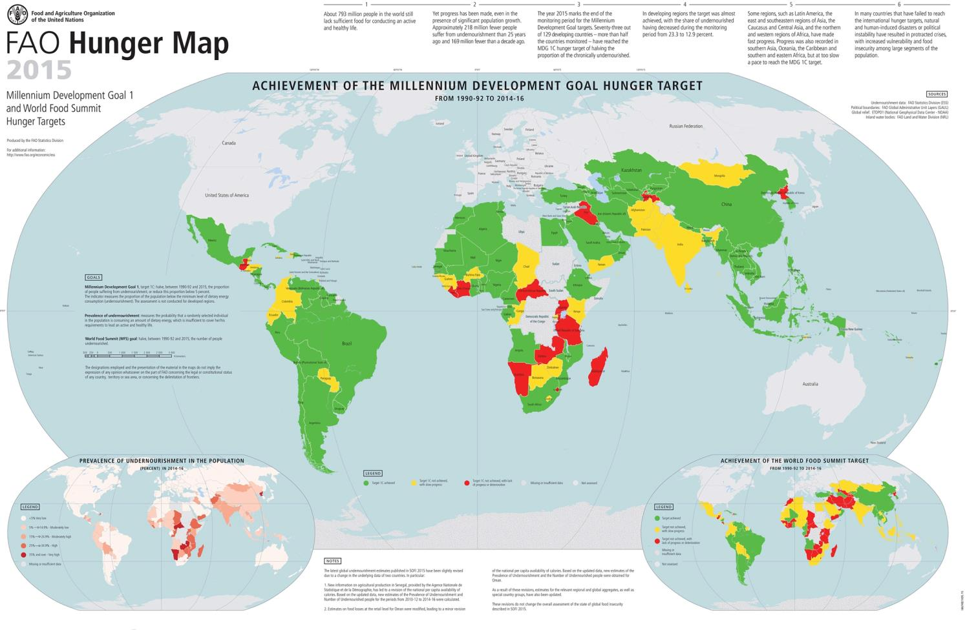
http://www.fao.org/hunger/en/

Slide 9
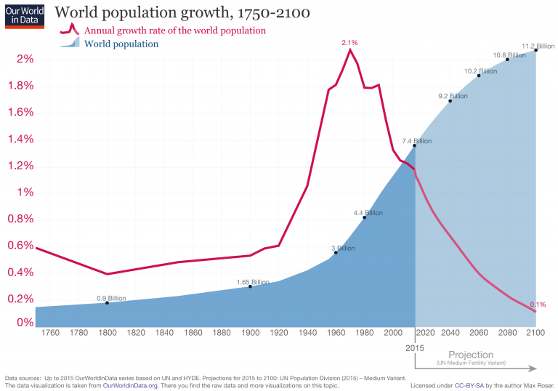
https://ourworldindata.org/world-population-growth

Slide 10
USDA: Percent of consumer expenditures spent on food consumed at home by selected countries, 2016
Percent
Our entire consumer economy depends on relatively inexpensive food
http://www.ers.usda.gov/data-products/food-expenditures.aspx

Slide 12
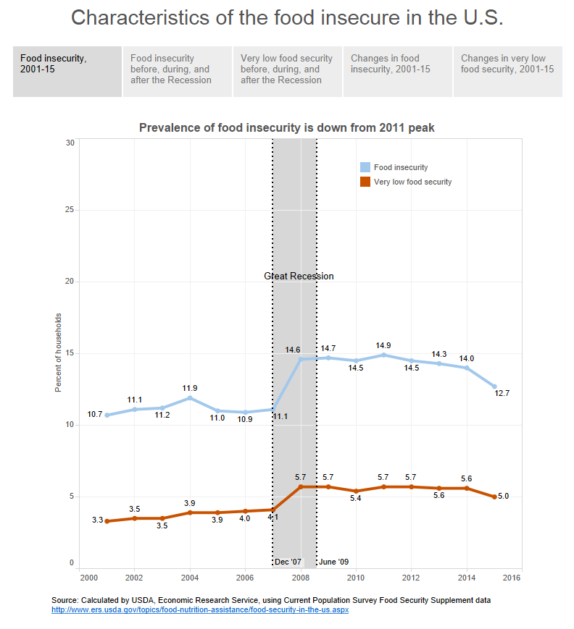
Food insecure: Reduced food
quality. Little reduction of
food intake.
Very low food security: Disrupted
eating patterns. Reduced
food intake.

Slide 13
Estimated agricultural yields in 2050 due to climate change effects,
assuming current agricultural practices and crop varieties.
https://siteresources.worldbank.org/INTWDR2010/Resources/5287678-1255547194560/WDR2010_BG_Note_Mueller.pdf
http://www.wri.org/sites/default/files/wri13_report_4c_wrr_online.pdf
https://openknowledge.worldbank.org/handle/10986/4387

Slide 14
Crop Vulnerabilities
According to FAO, 3 grains provide 60% of the world’s food: rice, maize, and wheat.
Almost half of humanity relies on rice as a food staple.
Roots and tubers (e.g. potatoes and cassava) feed over 1 billion people in developing nations.
Crops feed food animals as well.
Naturally-occurring or bioengineered disease pathogens could devastate the world’s food supply.
FAO. Dimensions of Need. An Atlas of Food and Agriculture. http://www.fao.org/docrep/U8480E/U8480E01.htm#Contents

Slide 15
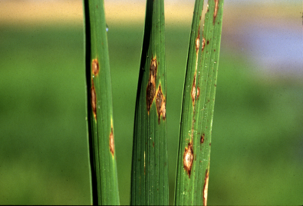
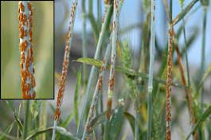
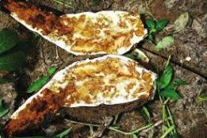
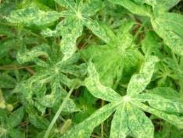
Disease Threats to Crops
Rice blast caused by
fungus Magnaporthe oryzae
Best strategy is
developing disease
and drought
resistant crops.
The problem?
They are
labeled GMO.
Wheat rust caused by fungus genus Puccinia, three
different species.
Cassava brown streak virus transmitted likely by
a whitefly species.
African cassava mosaic virus transmitted by
whiteflies.
https://www.agric.wa.gov.au/rice/rice-blast-disease
http://news.cornell.edu/stories/2008/04/gates-foundation-awards-268m-cu-fight-deadly-wheat-plague

Slide 16
FAO Estimates
http://www.fao.org/coag/en/

Slide 17
Let’s turn to insects: the good, the bad, and the ugly
https://www.mybeeline.co/en/p/how-the-honey-bees-navigate
http://www.pan-uk.org/about_neonicotinoids/
http://wlrn.org/post/mosquitoes-battling-zika-released-south-miami-neighborhood

Slide 18
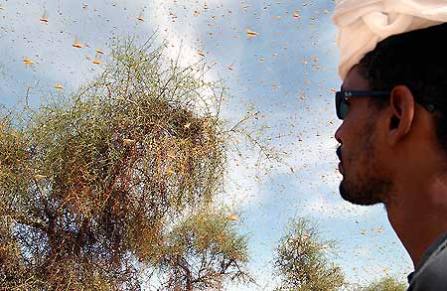
Insect Threats to Crops
Swarms of millions of locusts can consume over 100,000 tons
of crops per day, enough to supply food to tens of thousands
of people for a year.
http://www.fao.org/english/newsroom/field/locust_photo_gallery/locust1.htm
http://www.fao.org/emergencies/emergency-types/plant-pests-and-diseases/en/

Slide 19
Pests and Pesticides
Farmers have been battling pests (insects, fungi, weeds) since the dawn of agriculture.
4500 years ago, Sumerians used sulphur compounds to control pests.
Pyrethrum, botanically derived from the dried flowers of Chrysanthemum cinerariaefolium, used as an insecticide for over 2000 years, deteriorated in sunlight.
Naturally-derived inorganic (e.g. copper sulfate, lime sulfur, lead arsenate) and organic (i.e. pyrethrins, nicotine, rotenone)compounds were used until 1940’s.
Development of synthetic pesticides began during WW II.
https://agrochemicals.iupac.org/index.php?option=com_sobi2&sobi2Task=sobi2Details&catid=3&sobi2Id=31
Matthews, Graham. Pesticides: Health, Safety and the Environment. John Waley & Sons, Inc. 2016.

Slide 20
DDT’s deleterious effects in the environment
https://pops-science30.weebly.com/history-of-pops.html

Slide 21
Neonicotinoids
Neonicotinoids are a class of neuroactive insecticides chemically similar to nicotine. Less toxic than the organophosphate pesticides but have been implicated in Colony Collapse Disorder that has been devastating bee populations essential for pollination services.
EU banned 3 of them in 2018.
https://www.epa.gov/ingredients-used-pesticide-products/chlorpyrifos
https://www.nytimes.com/interactive/2017/10/21/us/document-EPA-Chlorpyrifos-FOIA-Emails-to-NYT.html

Slide 22
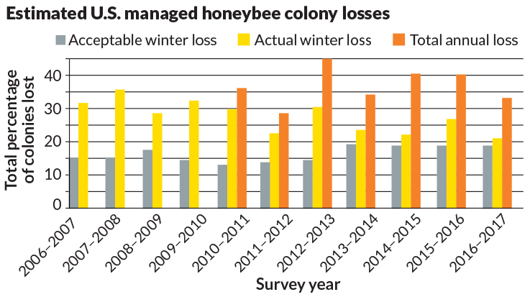
Honeybee Health
Colony Collapse Disorder:
A seemingly healthy bee colony
loses most of its workforce.
Theories: stressors such as poor nutrition and pesticide exposure made bees vulnerable to diseases.
Honey bee colony losses are higher than acceptable.
Poor nutrition, pesticides, pathogens, and
parasites continue to threaten bees, increase
pollination costs, and affect food prices.
What impact will a hotter, drier climate have on bees?
https://www.sciencenews.org/article/mystery-vanishing-honeybees-still-not-definitively-solved

Slide 23
Apiary Medicine for Veterinarians
FDA’s Veterinary Feed Directive (VFD) final rule placed
apiary medicine into the purview of veterinarians
https://www.avma.org/KB/Resources/Pages/Honey-Bees-101-Veterinarians.aspx

Slide 24
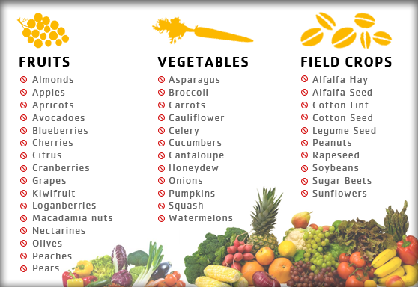
Foods Dependent on Bees’ Pollination Services
https://nohoneymoproblems.wordpress.com/why-should-we-care/

Slide 25
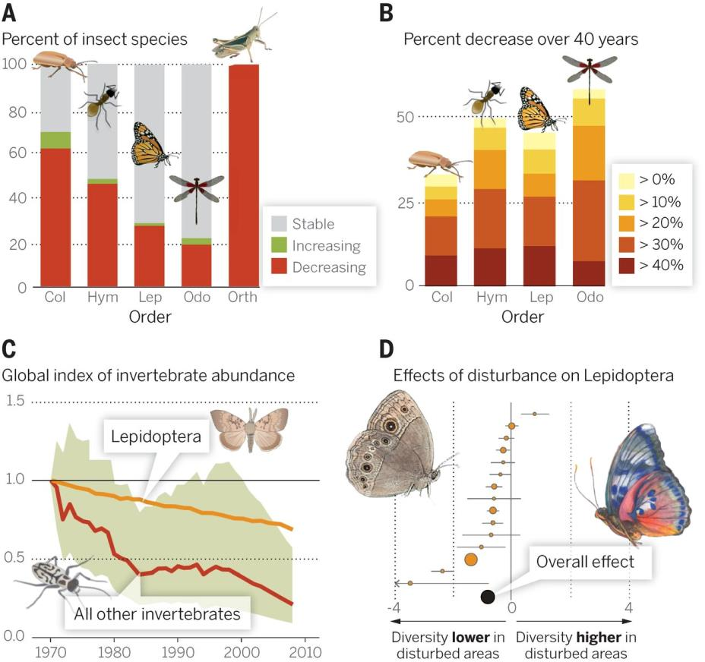
Fig. 1 Evidence of declines in invertebrate abundance.
Rodolfo Dirzo et al. Science 2014;345:401-406
Published by AAAS
Notes:
Evidence of declines in invertebrate abundance. (A) Of all insects with IUCN-documented population trends, 33% are declining, with strong variation among orders (19). (B) Trends among UK insects (with colors indicating percent decrease over 40 years) show 30 to 60% of species per order have declining ranges (19). (C) Globally, a compiled index of all invertebrate population declines over the past 40 years shows an overall 45% decline, although decline for Lepidoptera is less severe than for other taxa (19). (D) A meta-analysis of effects of anthropogenic disturbance on Lepidoptera, the best-studied invertebrate taxon, shows considerable overall declines in diversity (19).

Slide 26
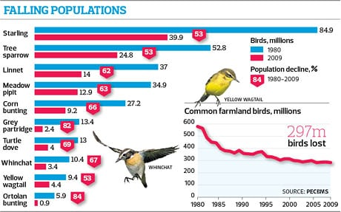
Farming policies in Europe over 30 past years has led to decline of bird populations
Widespread pesticide use and destruction of ecosystems.
https://www.theguardian.com/environment/2012/may/26/eu-farming-policies-bird-population

Slide 27
Sustainability of Pesticide Use
Pesticides are analogous to antibiotics—they kill off the good bugs along with the bad bugs.
Pesticides harm ecosystem and environmental health.
We need to work with Nature, not against it, when growing crops.
Harnessing the natural foes of pests should be a priority.

Slide 28
Food Animal Vulnerabilities
Severe livestock diseases could severely affect the world’s food supply and economies, particularly in developing countries where farmers rely on livestock for food and livelihoods.
In 2011, Rinderpest was 2nd disease (after smallpox) to be eradicated. A member of the Paramyxoviridae family, the virus causes disease in cloven-hoofed animals. Historically, outbreaks of it devastated the food supply. What would happen if it were re-introduced?
Foot and Mouth Disease (FMD) is a severe, highly-infectious disease of livestock. US eradicated it in 1929. FMD remains a major problem in many countries. Moving National Bio and Agro-Defense Facility from Plum Island, New York to Manhattan, Kansas raises concerns about lab accidents/breaches in the middle of livestock country.
Arthropod-borne animal diseases—The midge (Culicoides imicola and other culicoids) transmits Bluetongue disease & Epizootic hemorrhagic disease; Culex tritaeniorhynchus and Aedes vexans mosquitoes transmit Rift Valley fever virus. How will climate change affect the spread of these diseases?
http://www.oie.int/fileadmin/Home/eng/Media_Center/docs/pdf/Disease_cards/RINDERPEST-EN.pdf

Slide 29
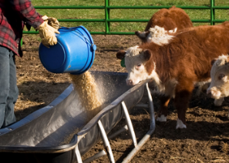
Vaccines, Medications, and Genetically Diverse and Robust Food Animals That Tolerate Heat and Drought Will Be Essential for Food Security in the 21st Century
MERS Vaccine needed for camels &
for people who work with camels
http://www.nationalhogfarmer.com/animal-health/each-farm-needs-right-vaccination-program-pigs-and-profits
https://www.fda.gov/ForConsumers/ConsumerUpdates/ucm378100.htm
http://www.pnas.org/content/113/13/3410
https://www.timeoutabudhabi.com/restaurants/features/42057-camel-milk-in-abu-dhabi

Slide 30
Public Opposition to Science
Widespread mistrust of science, vaccines, and genetically modified organisms will hinder the ability to feed people in the 21st century.
Vaccines have been a victim of their own success. People have forgotten the severity of the diseases that vaccines prevent.
The affluent have the luxury to refuse food they deem “unacceptable.”
Opposition is not necessarily a matter of education (or the lack thereof).
Market research, public outreach, and communication will be important strategies to counter public mistrust and misperceptions.

Slide 31
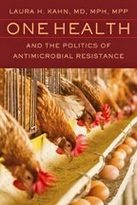
Antimicrobial resistance threatens veterinary medicine and agriculture
https://jhupbooks.press.jhu.edu/content/one-health-and-politics-antimicrobial-resistance

Slide 32
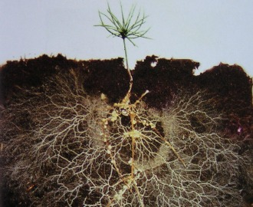
Microbial Ecology We need to understand our microbial world better
http://www.theatlantic.com/health/archive/2013/06/healthy-soil-microbes-healthy-people/276710/

Slide 33
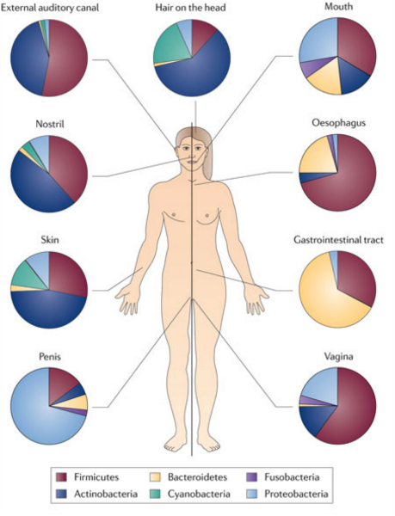
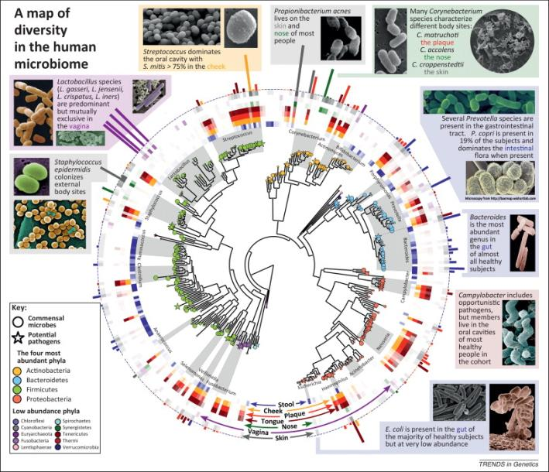
Our bodies are microbial ecosystems
http://fullspectrumbiology.blogspot.com/2013/06/a-healthy-microbiome-is-healthy-you.html
https://www.sciencedirect.com/science/article/pii/S016895251200145X

Slide 34
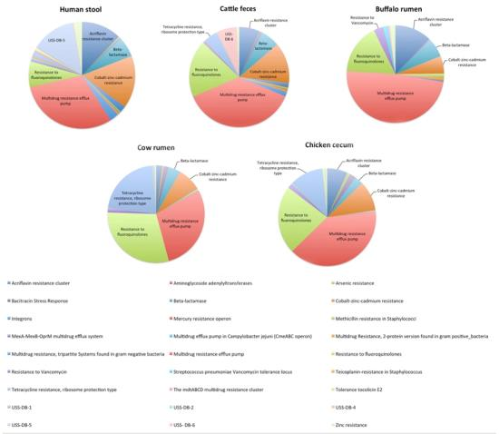
Animals have microbial ecosystems too.
http://journal.frontiersin.org/article/10.3389/fmicb.2013.00087/full
https://www.nature.com/articles/496400c
http://blogs.plos.org/everyone/2015/03/30/let-microbes-paw-print-doggy-skin-bacteria/
https://www.progressivedairy.com/topics/feed-nutrition/don-t-upset-the-digestive-microbiome-utilize-direct-fed-microbials

Slide 35
Metagenomics has shed light on microbial ecosystems in the environment
DNA extracted directly from environment.
Low doses of antibiotics in environment seem to serve as signaling agents for bacteria.
Induce them to change behavior such as increase movement, produce biofilms, or synthesize chemicals.
Antibiotic resistance genes are everywhere including places with no anthropogenic antibiotic exposure.
Linares J.F., Gustafsson I, Baquero F. et al. Antibiotics as intermicrobial signaling agents instead of weapons. PNAS 2006; 103: 19484-19489 (http://www.pnas.org/content/103/51/19484.full)
Martinez J.L. Antibiotics and Antibiotic Resistance Genes in Natural Environments. Science. 2008; 321: 365-367.

Slide 36
The Global Resistome
Evidence suggests that antibiotic resistance genes are ancient and predate the selective pressures of modern antibiotic use.
DNA sequences from Alaskan permafrost dating back to Late Pleistocene were highly diverse and showed resistance to tetracycline, penicillin, vancomycin, and other antibiotics.
But not clear if microbes in permafrost have been dormant or metabolically active—potentially influencing when they evolved and acquired resistance genes.
D’Costa V.M., King C.E., Kalan L., et al. Antibiotic resistance is ancient. Nature. 2011; 477: 457-461.
Steven B, Leveille R, Pollard W.H. et al. Microbial ecology and biodiversity in permafrost. Extremophiles. 2006; 10: 259-267.

Slide 37
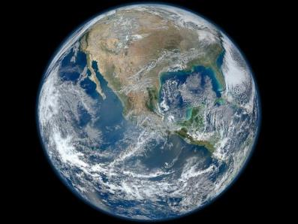
How are humans adversely impacting the Global Resistome?
Poor sanitation
Indiscriminate antibiotic use
Widespread human and animal waste applications
Land and water contamination
Wildlife spread resistant microbes and resistant genes far and wide

Slide 38
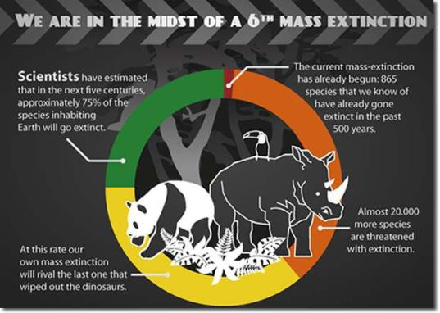
Humans and Domesticated Animals Make Up Approximately 97% of Total Mammalian Zoomass on Earth. Together, they make a lot of manure, contaminating food and the environment, and increasing antibiotic use.
https://www.ecowatch.com/earth-is-facing-most-severe-extinction-crisis-in-65-million-years-1882085041.html
https://howwegettonext.com/pandemic-proofing-the-world-98222a38782#.fwwutac03
https://www.theodysseyonline.com/quick-facts-sixth-mass-extinction
Notes:
Q14: 97% of total mammalian biomass

Slide 39
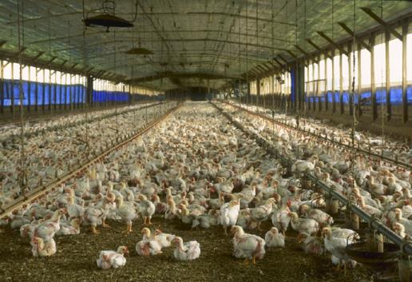
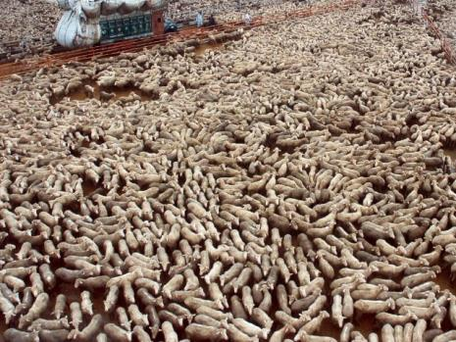
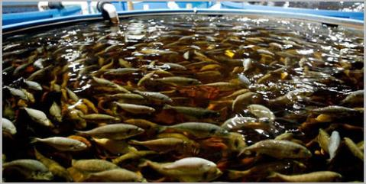
Is large scale
animal agriculture
ecologically
sustainable?
https://en.wikipedia.org/wiki/Intensive_animal_farming
http://www.stoptac.org/index.php?mact=News,cntnt01,detail,0&cntnt01articleid=273&cntnt01origid=93&cntnt01returnid=93
http://www.fis.com/fis/techno/printable.asp?id=55672&l=e&ndb=1&print=yes

Slide 40
Estimation of global recoverable human and animal fecal biomass
In 2014, global population of humans (7.2 billion) and livestock animals (29.7 billion) produced an estimated 3.9 trillion kilograms of fecal matter.
Animal fecal matter made up almost 80% of the total fecal biomass.
Chickens, cattle, and sheep constituted the largest animal populations and produced the most fecal matter.
Since 2003, total fecal matter production has been increasing by over 52 billion kilograms per year.
By 2030, total fecal mass is estimated to be 4.6 trillion kilograms per year.
Berendes DM, Yang PJ, Lai A, et al. Nature Sustainability 2018; 1: 679-685.

Slide 41
Total fecal matter produced by humans and livestock in 2014 would fill…
over 1.6 million Olympic-sized swimming pools,
and by 2030, over 1.8 million Olympic-sized swimming pools.
Notes:
Approximately 2.3 X 10^10 tons (or 2.1 X 10^13 kgs) of manure

Slide 42
Flooded Manure Lagoon After Hurricane Matthew, 2016
Flood waters partially submerged 14 manure lagoons. The waters carried large amounts of animal waste downstream and out to sea putting waterways and public health at risk.
Hurricane Florence’s impact in North Carolina?
https://www.npr.org/sections/thesalt/2016/11/04/500701098/manure-happens-especially-when-hog-farms-flood

Slide 43
Manure’s role in spread of disease and antibiotic resistance genes
Application of manure to soil as fertilizer is widespread in many countries.
In US, large concentrated animal feeding operations (CAFOs) produce massive amounts of manure.
CAFOs alter microbial ecosystems and promote transfer to resistant genes through manure, air-borne drift of contaminated dust, animal waste run-off into water systems leading to water contamination.
GAO. Concentrated Animal Feeding Operations.
EPA Needs More Information and a Clearly Defined Strategy to Protect Air and Water Quality from Pollutants of Concern.
September 2008. GAO-08-944. Page 5. (http://www.gao.gov/assets/290/280229.pdf)

Slide 44
1 Billion People (14% World’s Population) Openly Defecate
Source: Unicef data http://data.unicef.org/water-sanitation/sanitation

Slide 45
Open Defecation and Childhood Stunting
Harris G. Poor Sanitation in India May Afflict Well-Fed Children with Malnutrition. New York Times. July 13, 2014.
http://www.nytimes.com/2014/07/15/world/asia/poor-sanitation-in-india-may-afflict-well-fed-children-with-malnutrition.html

Slide 46
Why is Open Defecation linked to antibiotic resistance?
Because countries with poor sanitation rely on antibiotics to treat the high disease burden.
According to Unicef, open defecation costs world’s poorest countries $260 Billion/year.
In India, open defecation is not a matter of poverty. Govt. has built latrines, but people prefer to defecate outside. Problem is cultural preference.
Coffey D, Gupta A, Hathi P., et al. Revealed preference for open defecation: Evidence from a new survey in rural north India.
SQUAT Working Paper No. 1. Rice Institute. June 26, 2014. http://squatreport.in/wp-content/uploads/2014/06/SQUAT-research-paper.pdf

Slide 47
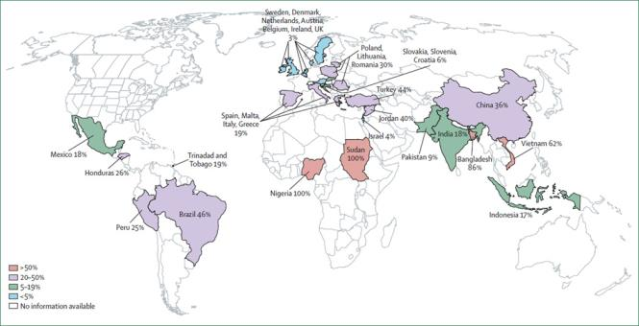
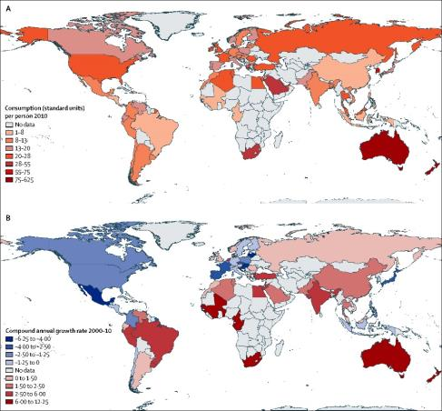
Consumption of Antibiotics in Humans
Frequency of Non-Prescription Antibiotic Use in General Population
Country | Total Units | Units per Person
India | 12.9 X 10⁹ | 10.7
China | 10.0 X 10⁹ | 7.5
USA | 6.8 X 10⁹ | 22.0
Antibiotic Consumption per Person Lancet Infectious Diseases 2014; 14: 742-50.
Countries with high antibiotic consumption rates per person in 2010:
Australia 87 units per person and New Zealand 70 units per person.
But not all high-income countries had high consumption rates:
The Netherlands 7.89 compared to France 23.12.
Morgan DJ, Okeke IN, Laxminarayan R, et al. Non-prescription antimicrobial use worldwide: a systematic review.
Lancet Infect. Dis. Sept. 2011; 11: 692-701. http://www.sciencedirect.com/science/article/pii/S1473309911700548
Van Boeckel T. P., Gandra S., Ashok A., et al. Global antibiotic consumption 2000 to 2010:
an analysis of national pharmaceutical sales data. Lancet Infectious Diseases 2014; 14: 742-50.
http://www.thelancet.com/journals/laninf/article/PIIS1473-3099(14)70780-7/fulltext#article_upsell

Slide 48
Climactic conditions, such as storms, might be affecting microbial ecosystems
The relationship between Vibrio cholerae (i.e. cholera outbreaks) and vibrio phages in Dhaka, Bangladesh
http://weloveourbangladesh.blogspot.com/2012/08/jahaj-bari-or-boat-housechistia.html

Slide 49
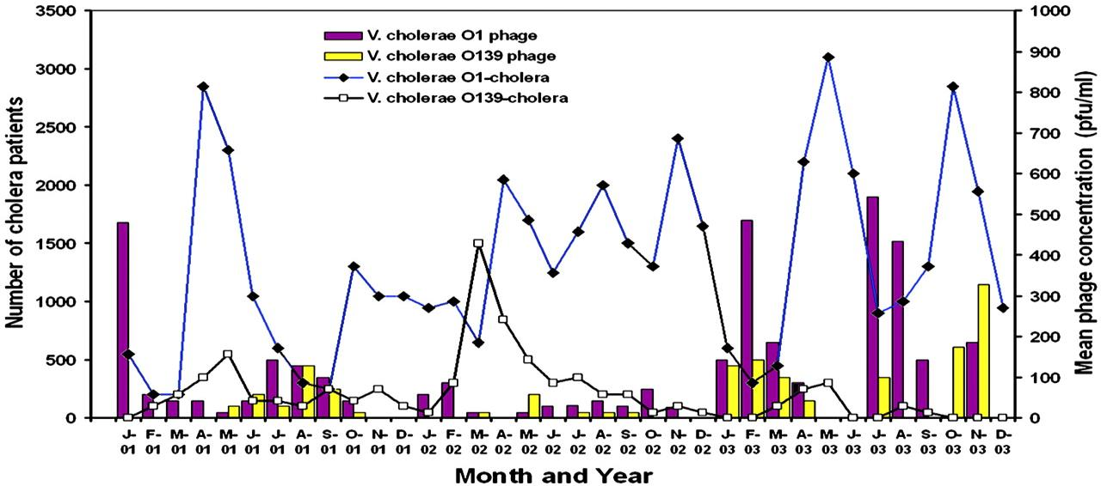
Mean concentration of lytic vibriophages in the aquatic environment of Dhaka, Bangladesh, and the estimated number of cholera cases reporting to the International Centre for Diarrhoeal Disease Research hospital in Dhaka from 2001 to 2003.
Shah M. Faruque et al. PNAS 2005;102:5:1702-1707
©2005 by National Academy of Sciences
Notes:
Mean concentration of lytic vibriophages in the aquatic environment of Dhaka, Bangladesh, and the estimated number of cholera cases reporting to the International Centre for Diarrhoeal Disease Research hospital in Dhaka from 2001 to 2003. Number of cholera cases is extrapolated from a 2% surveillance sample of all patients presenting for treatment. pfu, plaque-forming units.

Slide 50
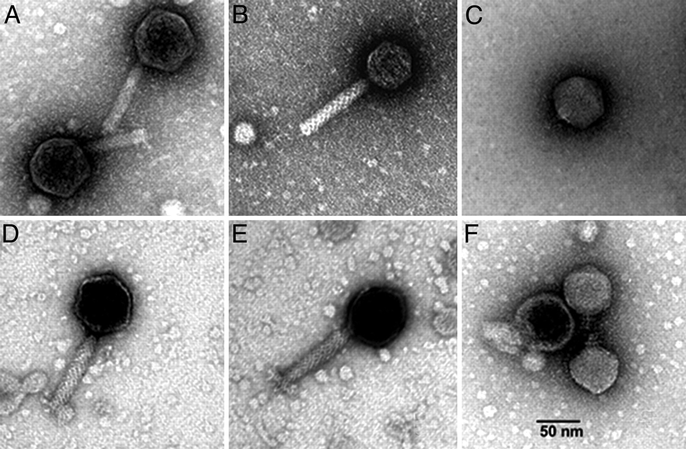
Electron micrograph of vibriophages isolated from environmental waters in Bangladesh.
Shah M. Faruque et al. PNAS 2005;102:5:1702-1707
©2005 by National Academy of Sciences
Notes:
Electron micrograph of vibriophages isolated from environmental waters in Bangladesh. (A–F) Morphology of phages JSF1–JSF6. (Scale bar: 50 nm.)‏

Slide 51
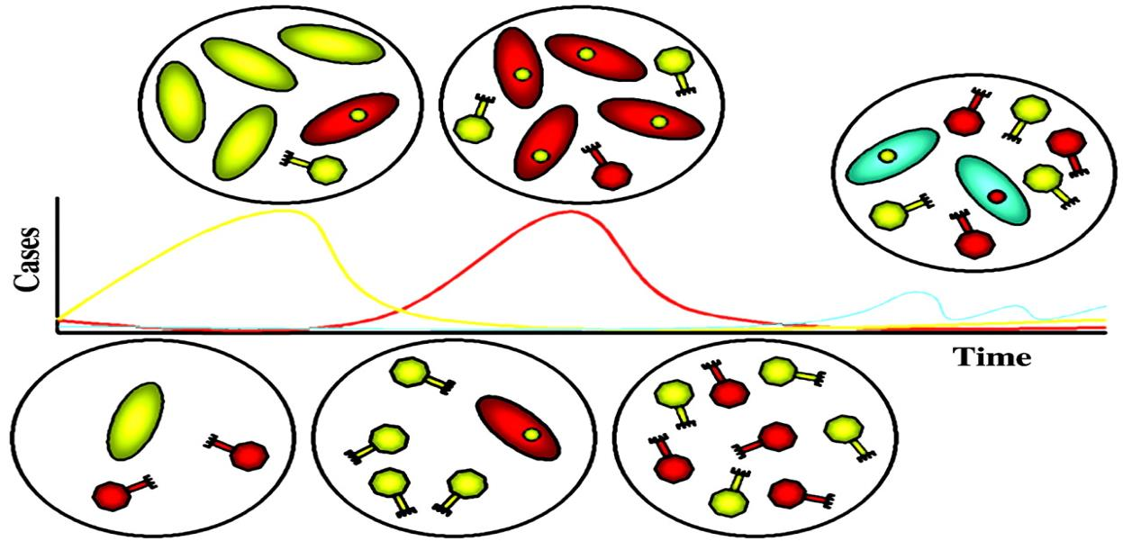
Schematic model for the influence of phage on cholera seasonality and serogroup emergence.
Shah M. Faruque et al. PNAS 2005;102:5:1702-1707
©2005 by National Academy of Sciences
Notes:
Schematic model for the influence of phage on cholera seasonality and serogroup emergence. Seasonal cholera epidemics (increased cases over time) occur in waves, with different serogroups (e.g., O1 or O139) dominating. Corresponding conditions that exist in the aquatic environment are diagramed in the circles shown. The absence of yellow phage specific for yellow oval cells provides an opportunity for that serogroup to begin the seasonal epidemic and transmit efficiently. However, yellow phages eventually amplify in the environment and attack this serogroup, ending that epidemic. A different serogroup (red oval cells) is resistant to the yellow phage. In the case shown, red cells actually carry a prophage (yellow intracellular circle) and thus shed yellow phage. A second epidemic wave due to the red serogroup follows and runs its course until red phages bloom and prevent environmental transmission of this serogroup. The interepidemic period is dominated by sporadic disease due to other serogroups (blue cells) resistant to both phages. These strains usually lack typical virulence factors but are more environmentally adapted than virulent strains. However, blue cells may harbor prophages that kill virulent serogroups and may acquire virulence determinants by horizontal gene transfer. Thus, blue cells may eventually emerge to become a new epidemic serogroup.

Slide 52
Bacteriophages (“Phages”)
Natural foes against bacteria
Resistance is less of an issue than with antibiotics.
CRISPR-Cas9 is bacterial immune system against phages.
Phages evolve along with the bacteria
Most prevalent bioform on the planet, “the Virosphere.”
They might be a viable strategy against antibiotic-resistant bacteria.
FDA approved phage products for food safety on the market.
A potential strategy in addressing environmental bacterial contamination on farms and other settings with high microbial burdens.
https://www.nytimes.com/2018/04/13/science/virosphere-evolution.html
https://www.nature.com/articles/s41396-017-0042-4

Slide 53
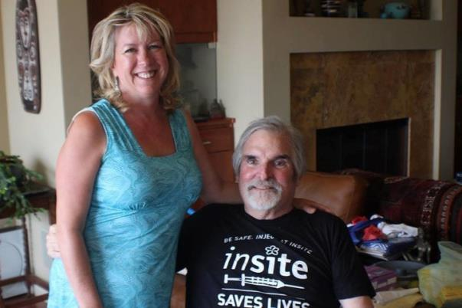
TED Talk: How Sewage Saved My Husband’s Life
Dr. Stephanie Strathdee and her husband Dr. Tom Patterson at UC San Diego
https://www.youtube.com/watch?v=AbAZU8FqzX4
Multidrug-resistant Acinetobacter baumanii infection cured with phage therapy.
UC San Diego is now establishing a Center for Innovative Phage Applications and Therapeutics
https://health.ucsd.edu/news/releases/Pages/2017-04-25-novel-phage-therapy-saves-patient-with-multidrug-resistant-bacterial-infection.aspx
https://medschool.ucsd.edu/som/medicine/divisions/infectious-diseases/research/center-innovative-phage-applications-and-therapeutics/Pages/default.aspx

Slide 54
Phage Therapy Research in Food Animals
Poultry
Salmonella, pathogenic E. coli, C. perfringens, C. jejuni
Swine
Salmonella, pathogenic E. coli
Cattle/ruminants
ETEC (carriage), S. aureus, Staphylococcus spp. (mastitis)
Aquaculture
P. plecoglossicida
Recent Reviews
Carvalho et al. Crit Rev Micro 2017, v. 43
Wernicki et al. Virology J 2017, v. 14
Slide courtesy of Jason Gill, Assist. Prof, Bacteriophage Biology & Microbiology, Texas A & M

Slide 55
Food Security Challenges in the 21st Century
Climate change will have a deleterious impact on food production around much of the world.
Governments must implement scientifically sound policies to maximize food security—and food safety.
We need to ensure healthy crops to feed both people and animals.
We need to reduce losses from pests without harming the health of pollinators, other beneficial animals, ecosystems, or the environment.
Vaccines, medications, and genetically diverse and robust food animals that can tolerate heat and drought are essential strategies for food security.
Getting people to accept scientific advances will require market research and effective public outreach and communication to counter mistrust and misperceptions.
Research on the role of bacteriophages in addressing antimicrobial resistance and in promoting healthy farm ecosystems should be a priority.

Slide 56
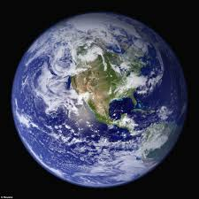
We must figure out how to feed ourselves sustainably to maintain our civilization on a hotter, drier planet
We need to integrate our efforts to benefit
humans, animals, and the environment (One Health)

Slide 57
One last thought...
About 2 billion people eat insects. Insects are extremely
efficient at converting feed to food. High quality protein. Use
minimal water. Feed on bio-waste. Less land-dependent. Can
also supplement animal feed.
Major obstacle: The ick factor.
http://www.fao.org/edible-insects/en/
http://www.fao.org/docrep/018/i3264e/i3264e00.pdf

Slide 58
Acknowledgements
Collaborators:
Bruce Kaplan DVM, Dipl. AVES (Hon)
Tom Monath MD, Dipl. AVES (Hon)
Lisa Conti, DVM, MPH, Dip. AVES (Hon)
http://www.onehealthinitiative.com

Slide 59
Thank you!

Slide 60
