Slide 1
A Pragmatic Approach to Infection Prevention and Control Guidelines in an Ambulatory Care Setting
Jessica Ng, MSc., CIC
Manager, Infection Prevention and Control (IP&C)
Women’s College Hospital
Hosted by Paul Webber
paul@webbertraining.com
www.webbertraining.com
April 16, 2015

Slide 2
Objectives
Provide an overview of infection prevention and control (IP&C) in ambulatory care
Identify and describe the four key areas where a more pragmatic ambulatory approach was applied
Discuss future opportunities for IP&C growth and development in ambulatory care

Slide 3
Definition: Ambulatory Care
Any care service provided to patients who are not admitted as inpatients to a hospital (WHO)
Care provided in facilities where patients do not remain overnight (CDC)

Slide 4
Examples of Ambulatory Care Settings
Hospital-based outpatient clinics
Non-hospital based clinics
Physician offices
Urgent care centres
Ambulatory surgical centres
Public health clinics
Imaging centers
Oncology clinics
Ambulatory behaviour health and substance abuse clinics
Physical therapy and rehabilitation centres

Slide 5
Transmission and Infection Risk
Risk of infection is commonly considered to be low
Fewer patient encounters
Shorter contact times with healthcare workers and the environment
Exposures to smaller numbers of microorganisms (viruses, bacteria)
Little is known about transmission and infection risk
Lack of data due to:
Difficulty with attributing causation and track infection rates due to short duration of patient’s stay
Difficulty with distinguishing between infections that are community-associated vs. healthcare associated

Slide 6
Literature Review
Literature review from 1960 – 1990 identified 53 reports documenting transmission of healthcare-associated infections (HAIs) in various ambulatory care settings
Most common transmission routes: common source, person-to-person and airborne/droplet
Most frequent agents: Mycobacterium species. Hepatitis B (HBV), measles, rubella, and adenovirus
Reported outbreaks mainly due to invasive medical procedures

Slide 8
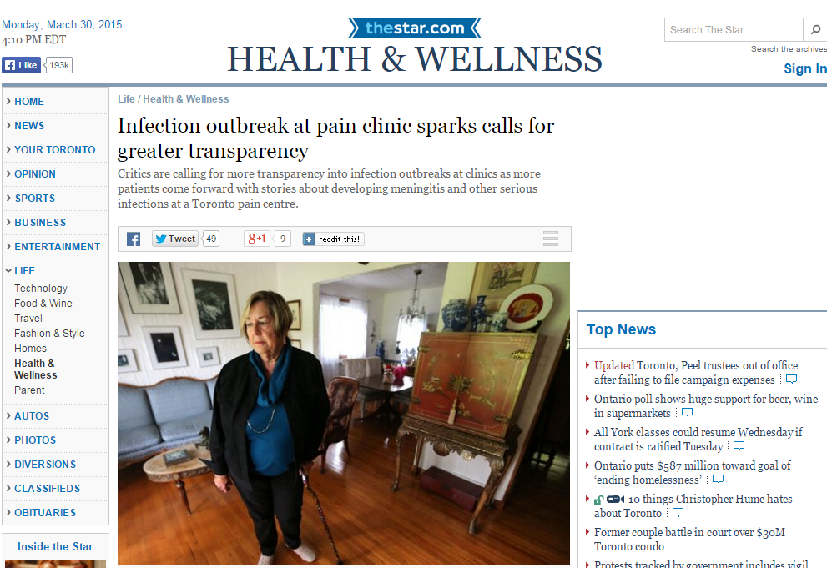

Slide 9
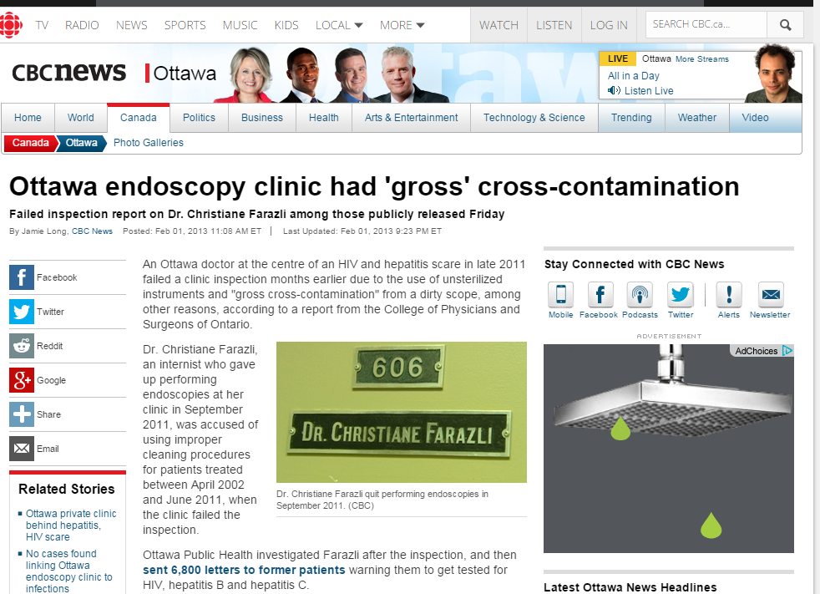

Slide 10
IP&C Guidelines in Ambulatory Care
Centers for Disease Control (CDC) – Guide to Infection Prevention in Outpatient Settings: Minimum Expectations for Safe Car, 2011
World Health Organization – Hand hygiene in outpatient care, home-based care and long-term care facilities, 2012
Public Health Agency of Canada – Infection prevention and control best practices for long term care, home and community care including health care offices and ambulatory clinics, 2007
Provincial Infectious Diseases Advisory Committee (PIDAC) – Infection Prevention and Control for Clinical Office Practice, 2012

Slide 11
Women’s College Hospital (WCH)
Ambulatory care hospital with a primary focus on the health of women.
275 000 visits per year

Slide 12
Our Story
Women’s College Hospital (WCH) began operating as an independent ambulatory care hospital in 2006
IP&C practices were not clearly defined
IP&C program review conducted in 2011
Moved to a more pragmatic ambulatory approach to applying IP&C guidelines in our setting:
Screening and surveillance
Isolation practices and personal protective equipment (PPE) use
Environmental cleaning
Hand hygiene

Slide 13
Screening and Surveillance – Before
Some patients were screened upon admission
Immediate phone calls to IP&C upon receiving lab results
Patients with an antibiotic resistant organism (ARO) were flagged
Larger focus on outcome surveillance
infection rates for AROs were tracked

Slide 14
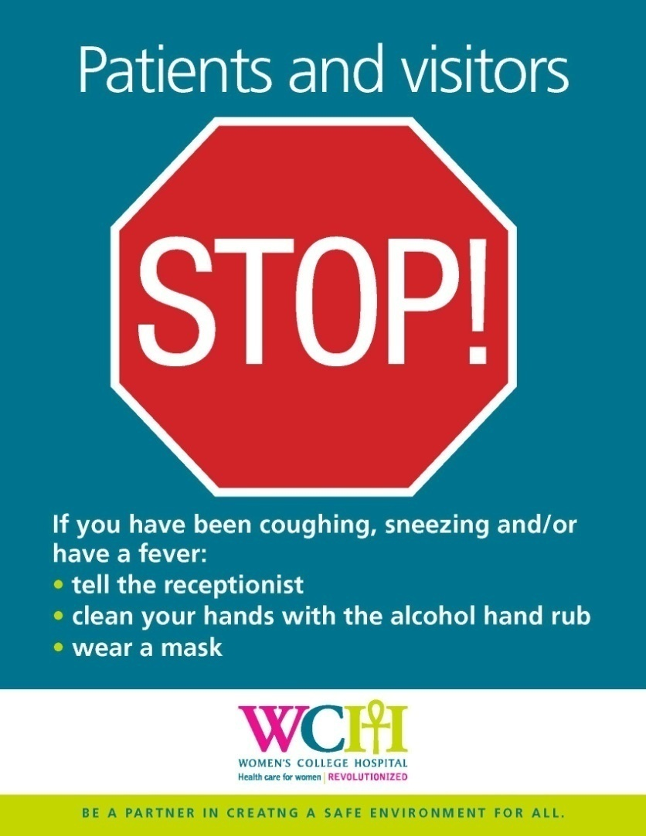
Screening and Surveillance – After
ARO status of patients is largely unknown in standalone ambulatory care settings
Difficult to attribute causation and track infection rates
Patients are not screened for IP&C purposes
Focus on process surveillance

Slide 15
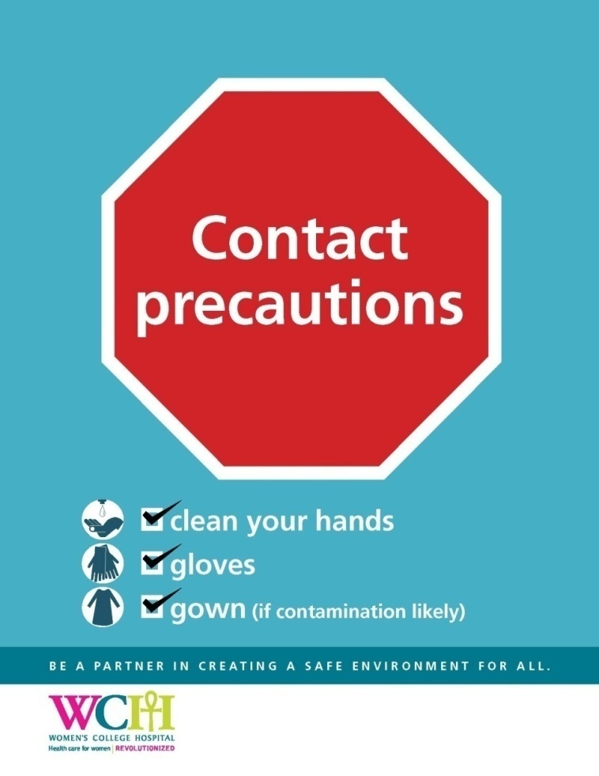
Isolation Practices and PPE Use – Before
Patients with AROs were flagged on their record
Additional precautions were implemented for anyone with an ARO
patient placement
use of personal protective equipment (PPE)
environmental cleaning
Heightened attention to routine practices with patients flagged with an ARO

Slide 16
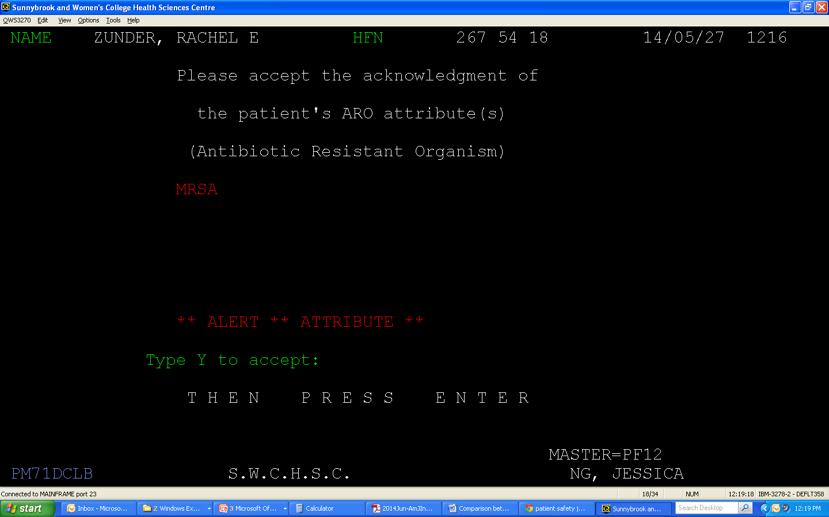

Slide 17
Isolation Practices and PPE Use – Before
Patients with AROs were flagged on their record
Additional precautions were implemented for anyone with an ARO
patient placement
use of personal protective equipment (PPE)
environmental cleaning
Heightened attention to routine practices with patients flagged with an ARO

Slide 18
Isolation Practices and PPE Use – After
Revised policy on management of ARO patients in ambulatory setting
Use additional precautions based on risk assessment
Apply routine practices to all patients at all times
ARO status of patients to be documented in clinical notes

Slide 19
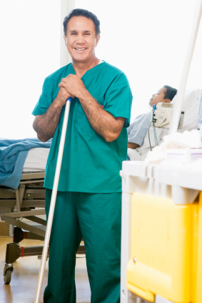
Environmental Cleaning – Before
Patients with ARO were scheduled at end of day
Heightened attention to cleaning practices when patients identified with an ARO
EVS often called for “terminal cleaning”

Slide 20
Environmental Cleaning – After
Focus on cleaning patient equipment between use and a thorough end-of-day room cleaning for all patients
Patients can be scheduled at any time of the day

Slide 21
Hand Hygiene – Before
Few resources on hand hygiene in outpatient setting
Four Moments of Hand Hygiene based on inpatient settings
Monitored hand hygiene practices using a direct observation
Data collection challenges:
Physical environment
Type of care provided
Use of resources
Hawthorne effect
Observer
Healthcare Provider
Patient

Slide 22
Hand Hygiene – After
Redefined Four Moments for Hand Hygiene for an ambulatory care setting
Transitioned to engaging patients as observer for hand hygiene practices
Patient observer
Healthcare Provider

Slide 23
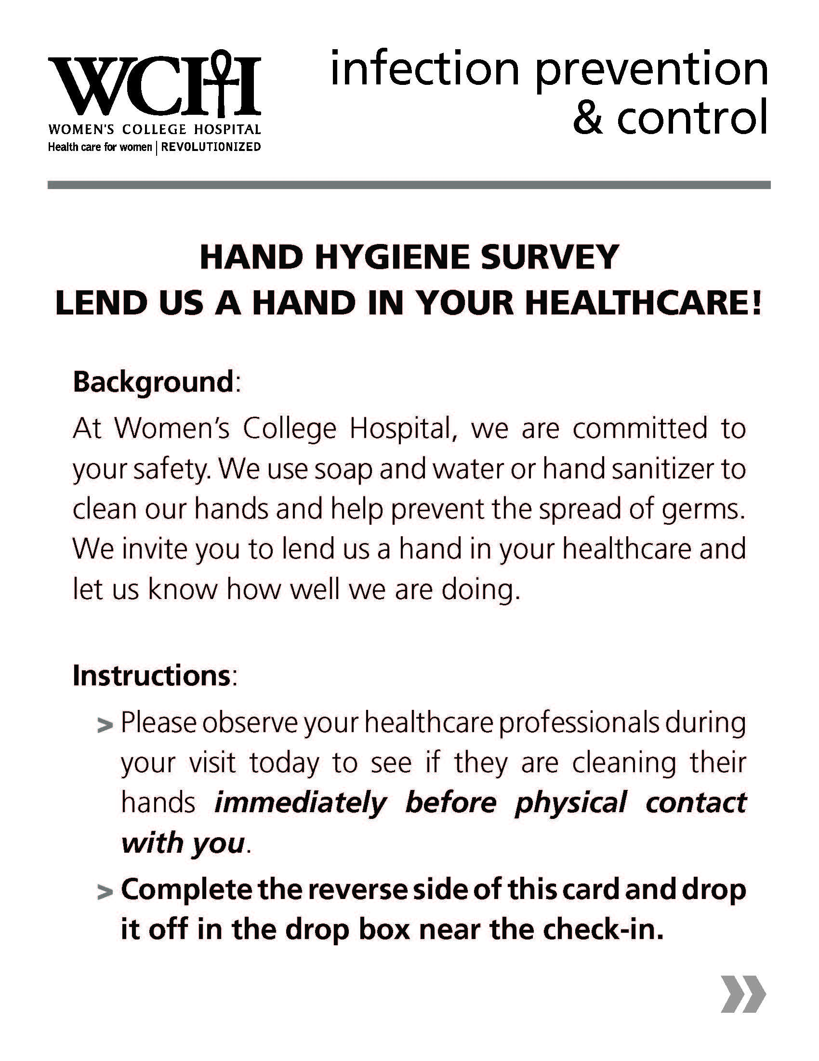
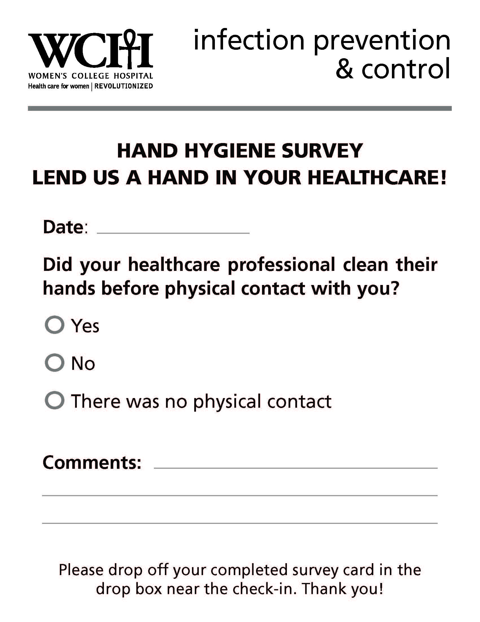
Patient as Observer Method
Alternative hand hygiene auditing method to address challenges unique to ambulatory setting
Patient acts as an observer for HH compliance of healthcare providers

Slide 24
Patient as Observer Pilot
Pilot conducted in Family Practice setting
% of healthcare provider hand hygiene compliance: 97%
% of survey cards returned: 75%
Enhanced patient experience
Strengthens hand hygiene awareness for all

Slide 25
Future Opportunities
Increasing patient education in IP&C through patient engagement activities
Informing guidelines on the important differences between acute and ambulatory care
Continue to work on making IP&C guidelines relevant to the ambulatory care setting

Slide 26
For More Information
Ng J, Le-Abuyen S, Mosley J, Gardam M. A Pragmatic Approach to Infection Prevention and Control Guidelines in an Ambulatory Care Setting. American Journal of Infection Control. 2014; 42:671-3.
Le-Abuyen S, Ng J, Kim S, De La Franier, A, Khan B, Mosley J, Gardam M. Patient-as observer approach: an alternative method for hand hygiene auditing in an ambulatory care setting. American Journal of Infection Control. 2014; 42:439-42.

Slide 27
Acknowledgements
Barbara Catt, Sunnybrook Health Sciences Centre, Toronto, Ontario

Slide 28
Questions?
Contact:
Jessica Ng, MSc., CIC
Manager, Infection Prevention and Control
Women’s College Hospital, Toronto, Ontario, Canada
Email: jessica.ng@wchospital.ca

Slide 29
April 22 (South Pacific Teleclass) COMING UP ROSES – A SUSTAINABLE SOLUTION TO CONTINENCE PRODUCT DISPOSAL Julianne Munro, Christchurch Women’s Hospital, New Zealand
April 30 ARE WIPES (TOWELETTES) EFFECTIVE FOR SURFACE DECONTAMINATION IN HEALTHCARE SETTINGS? Prof. Jean-Yves Maillard, Cardiff University, Wales May 5 (FREE WHO Teleclass – Europe) 10 YEARS OF WHO CLEAN CARE IS SAFER CARE: WHY YOU SHOULD BE A PART OF THE SOCIAL PANDEMIC THAT IS SAVE LIVES: CLEAN YOUR HANDS Prof. Didier Pittet, World Health Organization Sponsored by the World Health Organization May 7 VACCINATION OF HEALTHCARE PROVIDERS: A CRITICAL STEP TOWARD PATIENT SAFETY

