Slide 1
Infection Prevention and Control with
Accreditation Canada Qmentum Program
Chingiz Amirov MSc-QIPS, MPH, CIC
Director, Infection Prevention and Control, Baycrest Health Sciences
Sponsored by
Hosted by Julie Langlois Accreditation Canada
www.gojo.com
www.webbertraining.com
April 28, 2017

Slide 2
Outline
Accreditation in CCC/Rehab/LTC
The study of “Getting Ready”
Evidence beyond the guidelines
Tips & pointers

Slide 3
What is accreditation?
“An ongoing process of assessing your organization against standards to identify what you do well, where you can make improvements, and how to make them happen.” (Accreditation Canada)
Voluntary exercise
~100% of facilities go through it

Slide 4
Accreditation / certification landscape

Slide 5
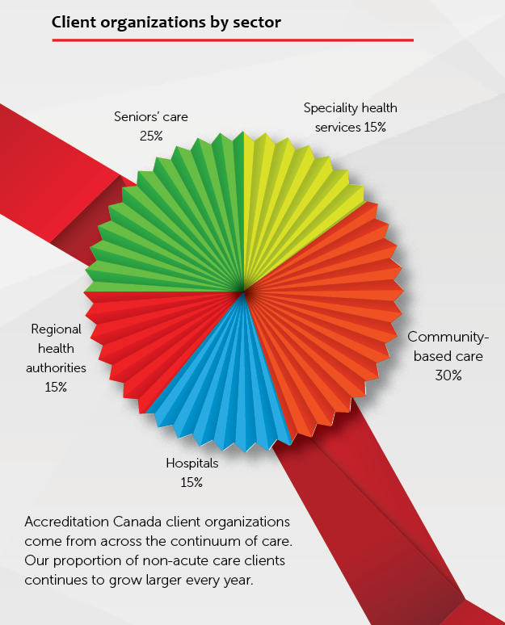
H
Accreditation Canada
Annual Report 2014

Slide 6
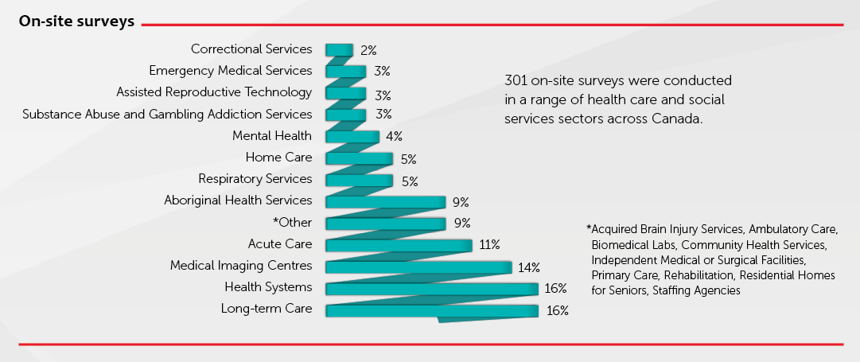
Accreditation Canada
Annual Report 2014

Slide 7
4 main mechanisms
Engagement of staff in QI (e.g. self-assessment)
Promotion of quality systems of care;
Documentation, collation and use of data for internal and external benchmarking; and
Implementation of best-practice guidelines

Slide 9
Core program
Leadership
Governance
Medication Management
Infection Prevention and Control

Slide 10
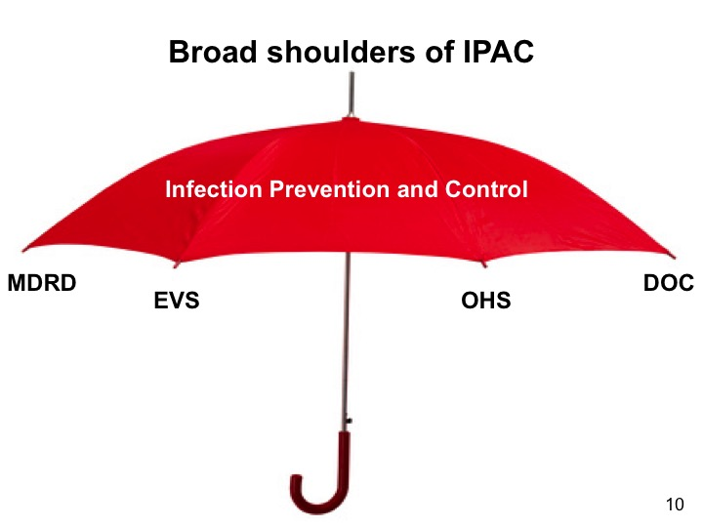

Slide 11
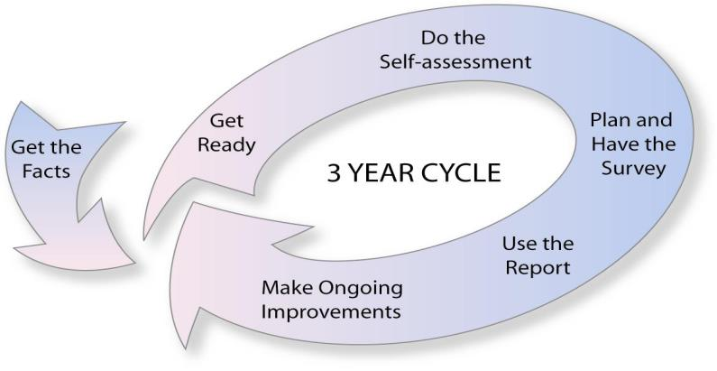
What’s special about Qmentum?
4 YEAR CYCLE

Slide 12
4 YEAR CYCLE

Slide 13
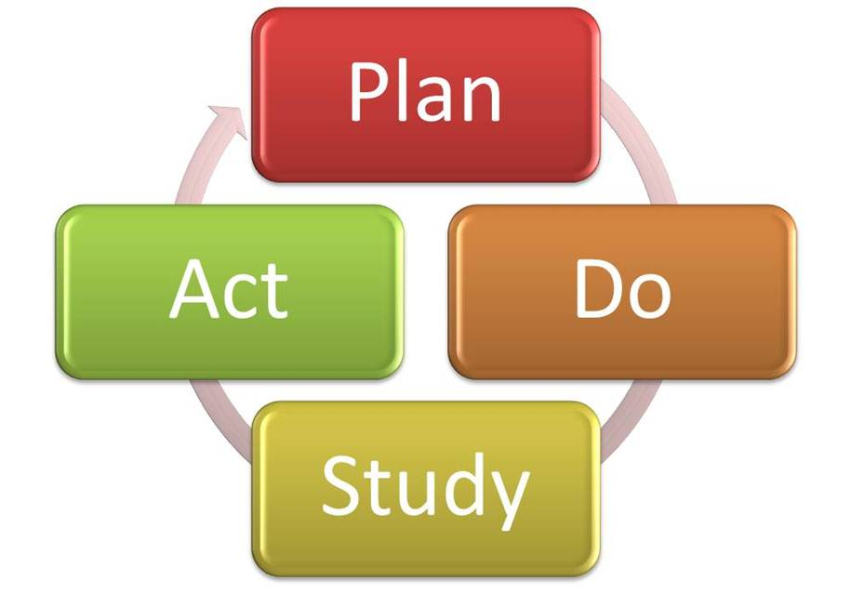

Slide 14
What’s special about Qmentum?
4 YEAR CYCLE

Slide 15
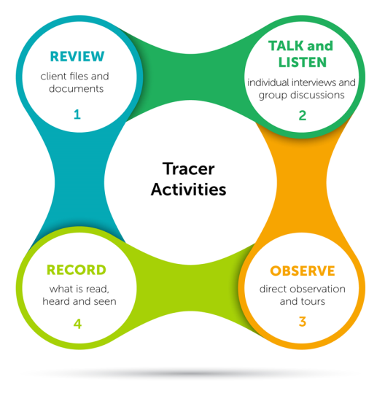
Tracer activities

Slide 16
Tracers
Compliance with standards alone not enough
Preparation two-pronged:
demonstrate compliance with IPAC standards
ensure POC staff convey their understanding of & adherence to these standards
+

Slide 17
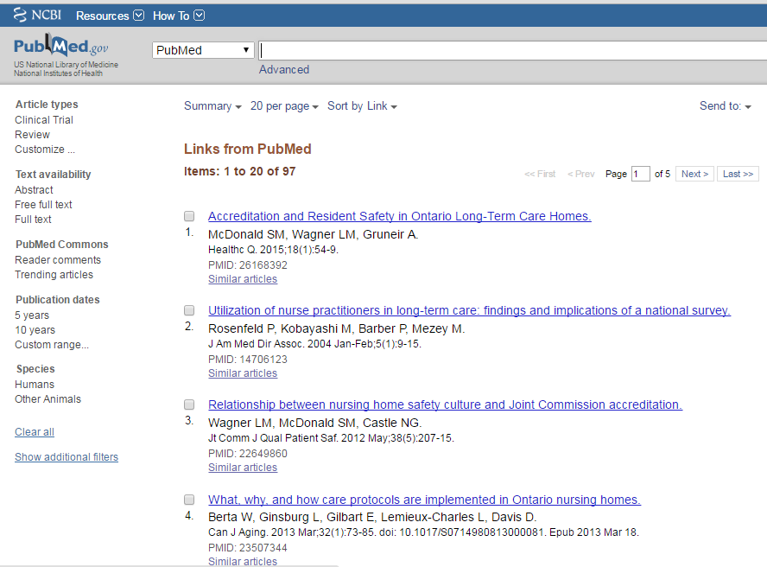

Slide 18
300-bed CCC/Rehab
472-bed LTC
220-bed Assisted Living
262-bed CCC/Rehab
288-bed LTC
275-bed CCC/Rehab
404-bed CCC/Rehab

Slide 19
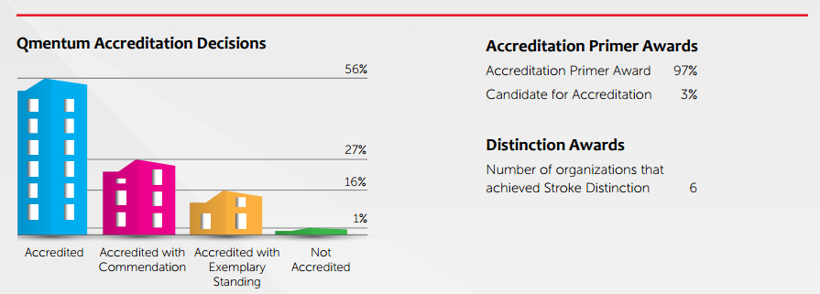
16% of organizations are accredited with Exemplary Standing
Accreditation Canada
Annual Report 2014

Slide 20
H

Slide 21
Study design & methods
Qualitative
case studies
applied and action research
Questionnaire
Analysis of common patterns
Identify themes
Retrieve concrete tips and actions

Slide 22
Questionnaire
29 open- & close-ended questions
Required Organizational Practices (ROPs)
Leading Practices
Overall experience
Response of 4 teams collated in a single document for data analysis
The following key themes emerged…

Slide 23
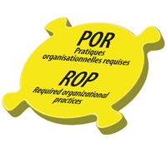
Ace your ROPs
Generate ROP-specific roadmaps,
Develop ROP-specific information sheets
Conduct ROP-specific mock surveys

Slide 24
Create unit-specific reports
No formal requirement to have unit-specific stratification of the infection rates.
But…
Emphasis on unit-specific reports of:
Infection rates;
Hand hygiene compliance;
Immunizations
2E
3E
4E
5E

Slide 25
Use ‘tip sheets’
Heavy use of ‘tip sheets’ for accreditation standards
Particularly for ROPs with specific tests of compliance
Questions, answers, where to find them

Slide 26
Conduct mock surveys
Extensive use of mock surveys
Layered mocks:
tabletop within IPAC team;
mock tracer with the IPAC committee;
full mock with POC staff on the units;
Mock tracer on-site session

Slide 27
Conduct mock surveys (contd.)
Emphasis not on memorizing what to say, but on where to find the information
Help staff to get into the ‘survey mode’, boost comfort level of engaging with surveyors

Slide 28
Disseminate widely
Use multiple venues to disseminate your messages

Slide 29
Don’t say “I don’t know”
POC staff may not be used to being questioned by ‘strangers’
Overcome the inertia of defaulting to the ‘easy answer’
Offer more suitable alternatives

Slide 30
Don’t say “I don’t know” - Provide alternatives
“I don’t know”
“Let me show you!”
“Let me refer you to someone”

Slide 31
Surveyors by discipline
Administrator | 68
Biochemist | 7
Counselor | 4
Diagnostic Imaging Technologist | 9
Lab Scientist/Technologist | 4
Lab Technologist | 23
Medical Doctor | 60
Medical Microbiologist | 2
Occupational Therapist | 5
Paramedic | 7
Pharmacist | 15
Physical Therapist | 11
Psychiatrist | 3
Psychologist | 2
Registered Nurse | 198
Respiratory Therapist | 12
RPN | 17
Social Worker | 17

Slide 32
Competencies
Surveyor
Analytical thinking
Client focus
Communications
Planning and Organizing
Teamwork
Team Lead
Issues Management
Team Leadership

Slide 33
Make it stick
‘Accreditation overdrive’
Attention deficit, competing priorities
Think outside the box
Make it memorable, make it stick

Slide 34
Submit Leading Practice(s)
No evidence Leading Practice awards correlate with high accreditation mark
But…
Accreditation Canada actively seeks and recognizes them for their contributions

Slide 35
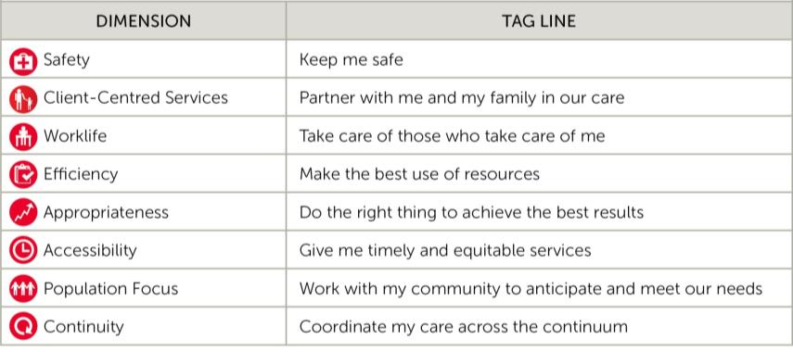
Accreditation Canada Quality Framework
Accreditation Canada Quality Dimensions: Changing the philosophy from doing to or doing for clients, to doing with the client.
35

Slide 36
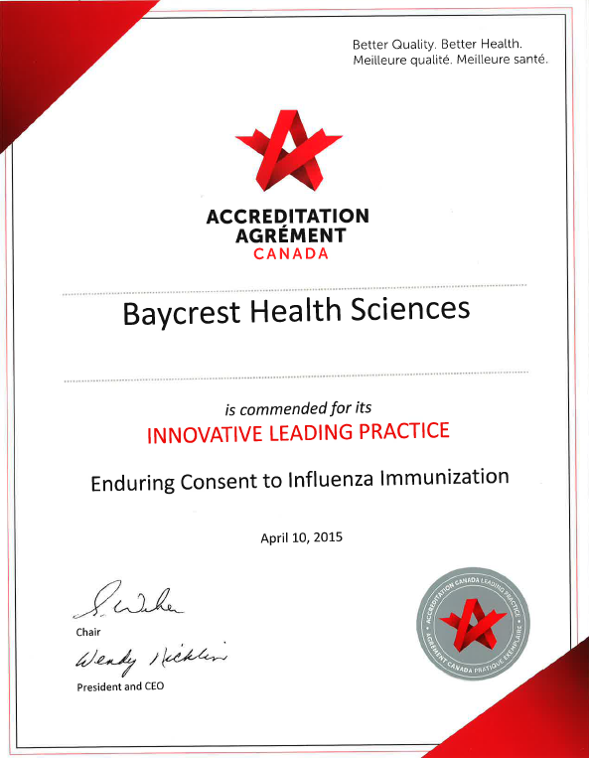

Slide 37
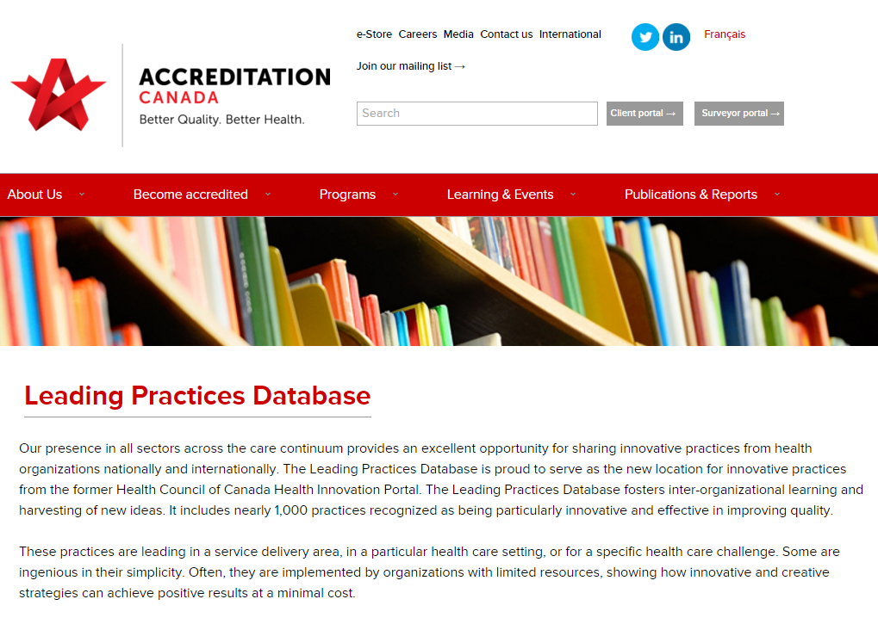

Slide 38
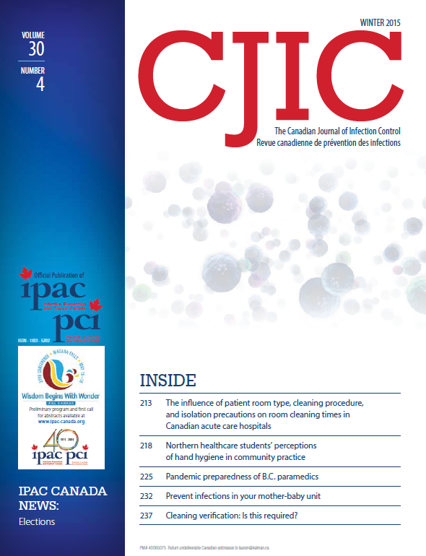

Slide 39
Fast peer review
Short time submission-to-publication
Designated section: QI in IPAC
Submission is easy. Email me at:
editor-in-chief@ipac-canada.org

Slide 41
Phone call from Accreditation Canada

Slide 42
In conclusion…
Ace your ROPs
Create unit-specific reports
Use ‘tip sheets’
Conduct mock surveys
Disseminate widely
Don’t say ‘I don’t know’
Make it stick
Submit Leading Practice(s)

Slide 43
May 4 (FREE … WHO Teleclass - Europe) SPECIAL LECTURE FOR 5 MAY Prof. Didier Pittet, University of Geneva Hospitals Sponsored by the World Health Organization May 12 INFECTION PREVENTION RESOURCES: TOO FEW? TOO MANY? A DISCUSSION OF STRATEGIES TO CALCULATE APPROPRIATE IP PERSONNEL RESOURCES Kate Gase, BJC Learning Institute, St. Louis May 16 (FREE Teleclass - Broadcast live from the 2016 IPAC-Canada conference) PHYSICIANS, FARMERS, AND THE POLITICS OF ANTIBIOTIC RESISTANCE Dr. Laura H. Kahn, Woodrow Wilson School of Public and International Affairs, Princeton University Sponsored by Virox Technologies Inc. (www.virox.com) May 17 (FREE Teleclass - Broadcast live from the 2016 IPAC-Canada conference WHAT’S NEW IN NUMBER 2? UPDATE ON DIARRHEAL DISEASE

