Slide 1

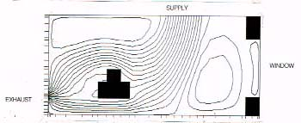
Airborne transmission and precaution – facts and myths
WH Seto,
HK, China
www.webbertraining.com
November 17, 2014

Slide 2

Edward Joseph Lister Lowbury (1913 - 2007)
A pioneering and innovative English medical bacteriologist and pathologist and also a published poet.

Slide 3
Acknowledgements:
Prof. Ben Cowling, School of Public Health,
University of Hong Kong
Prof. Yugio Li, Dept. of Mechanical Engineering,
University of Hong Kong

Slide 4
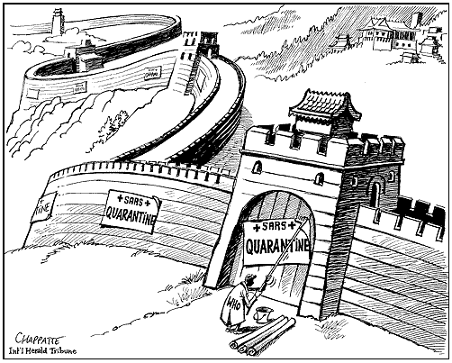

Slide 5


Slide 6
Bacteria That Cause Airborne Nosocomial Infections
Group A Streptococcus
Staph. aureus
Neisseria meningitidis
Bordetella pertusis
MTB
Acinetobacter
Legionellae
Clostridia
Pseudomonas
Nocardia
Viruses Implicated in Airborne Nosocomial Infections
Rinoviruses
Influenza and
Parainfluenza viruses
Respiratory Syncytial Virus
Adenovirus
Varicella Zoster Virus
Measles
Rubella
Smallpox
Certain enteroviruses
Adapted from Schaal, 1985

Slide 7
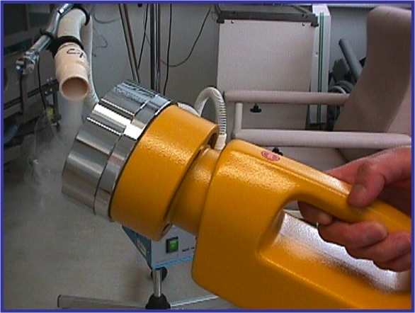
aerosol

Slide 8
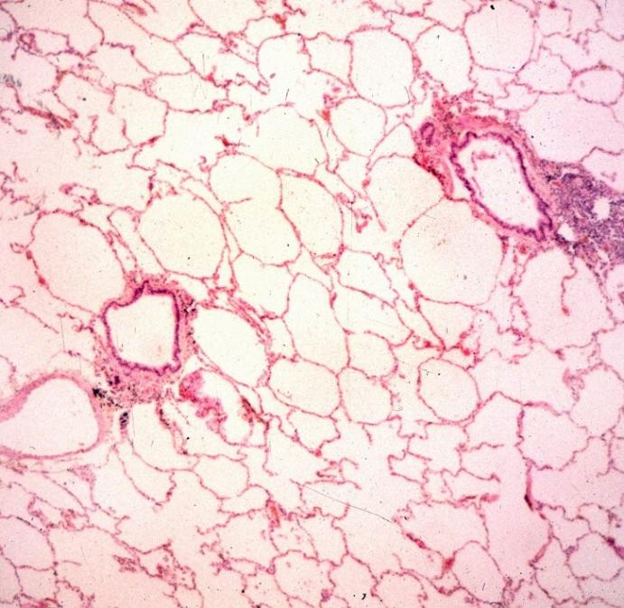
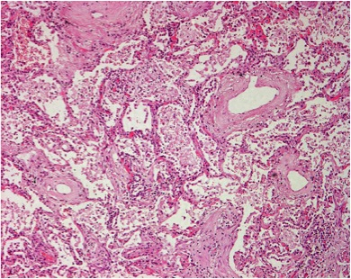
Normal alveolar
Pneumonia
Courtesy: Dr Gavin Chan, Department of Pathology
Queen Mary Hospital

Slide 9


Slide 10
Recent classification for airborne transmission
Obligate airborne: initiate solely through aerosols: TB
Preferential airborne: initiate through multiple routes but predominately by aerosols: Chicken pox and measles
Opportunistic airborne: typically through other routes but by aerosols in favorable conditions (as high-risk procedures such as intubation): Influenza and SARS

Slide 11
2014
WHO ARI Guideline

Slide 13

Transmission Based Precaution

Slide 14
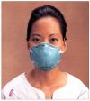
Airborne Precaution
Isolation Room
Single room - Negative Pressure
Keep doors closed
N95

Slide 15
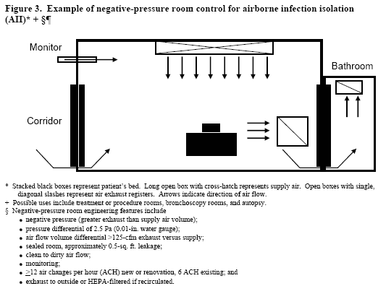

Slide 16
Airborne infection isolation room (AII):
Single room or cohorting
Negative pressure (-2.5 Pa)
12 air changes per hour for new renovations
Exhaust air outside or recirculated by
HEPA filters

Slide 17
General consensus on the N95 Respirator to prevent airborne transmission
A tightly sealed respirator blocked 99.8% of total virus and 99.6% of infectious virus (n = 3).
A tightly fitted (surgical) mask block 94.5% of the total virus and 94.8% of the total infectious virus.
Noti JD, Lindsley WG, Blachere FM. et al: Detection of influenza virus in cough aerosol generated in a simulated patient examination room. Clin Infect Dis 2012; 54 (1 June) 1569-1577

Slide 18
A. Are Most Respiratory Viral Infections Airborne?
Most studies done – Influenza and SARS

Slide 19
Is Influenza Airborne?
Reviews
Clinical Trials Comparing N95 and Medical Masks
New Experimental Studies

Slide 20
Two major reviews

Slide 21
Transmission of influenza A in human beings
Brankston et al. Lancet ID 2007(7):257-65
More a systemic review
Search of 2012 citations

Slide 22
Artificial generated aerosol can infect man and animals
Artificial aerosols: <10% are larger 8 μm
Natural coughing: 99.9% are larger then 8 μm
“We question whether these studies are relevant to natural route of human transmission”
“No published evidence of human infection resulting from the ambient air”

Slide 23
Alaskan Airline: Non functional ventilation system 72% infected
(Am J Epidemiol 1979:110:1-6) Free movement of passengers
Naval base aircraft (Am J Epidemiol 1989:129:341-48)
Klontz reported outbreaks (56%) in functional ventilation planes
Influenza lower with UV lights in VA hospital (Am Rev Resp Dis 1961:83:36)
Infection related to ventilation systems in 4 buildings
(J Am Ger 1996:18:811)
Many confounders not accounted:
eg. number of index patients, bed layout, length of stay, hand hygiene,
immunization status.
One study even confirmed that lowest rate has more space allocated
Air exchange rate is not reported
2nd study even reported equal rates in next season.

Slide 24
Clinical Trials Comparing N95 and Medical Masks.

Slide 25
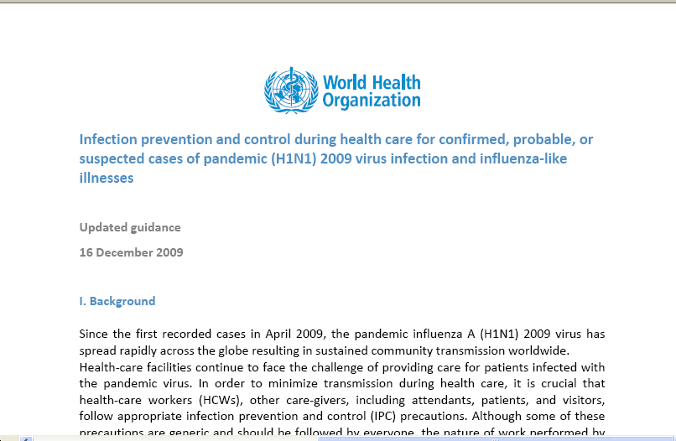
http://www.who.int/csr/resources/publications/cp150_2009_1612_ipc_interim_guidance_h1n1.pdf
This guidance replaces guidance documents issued on 29 April and 25 June 2009
and remains valid until 30 June 2010,

Slide 26
WHO guidance for infection prevention and control for H1N1
III, 1.1 - Standard & Droplet Precautions should always be applied
III,1.2 - performing aerosol-generating procedures
wear a particulate respirator
III, 4. Collection of laboratory specimens
Upper respiratory tract (above larynx)
Standard and Droplet Precaution
Lower respiratory tract specimens
Aerosol-generating procedures IPC measures

Slide 27
Recommendation for 2009 H1N1 Pandemic
“At the start of the 2009 outbreak, there was uncertainty regarding the transmission dynamics of the novel H1N1 virus. While seasonal influenza is spread by large respiratory droplets, a concern at the onset of any potential influenza pandemic is whether the pathogen will have a different dynamics or methods of spread.”
13th May – CDC recommends N95 to be used in all situations

Slide 28
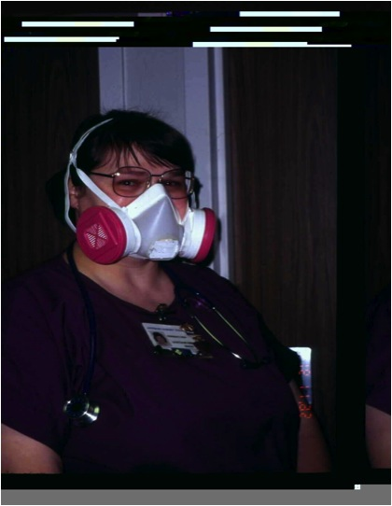

Slide 29
But there is a study not considered by IOM showing that surgical masks is as effective as N95………….
Surgical Mask vs N95 Respirator for Preventing Influenza Among Health Care Workers: A Randomized Trail.
Mark Loeb et al, JAMA,, 2009;302(17), October 1 online
A randomized controlled trail of 446 nurses in 8 tertiary care hospitals – Ontario
Surgical
masks N95
n = 225 221
Influenza infected = 50 (23.6%) 48 (22.9%)
p = 0.086 (meet criteria for non-inferiority)

Slide 30
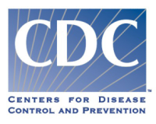
HICPIC advisory committee
23rd July 2009 to vote on the latest recommendation
(http://www.cdc.gov/ncidod/dhqp/hicpac_transcript-07-23.html).
“endorse the use of surgical masks for the routine care of patients with confirmed or suspected, novel influenza A (H1N1)”
“it is appropriate at this time to recommend the use of N95 or higher respiratory protection for procedures that are likely to generate small particle aerosols.” The procedures are then listed to include
“bronchoscopy, intubation under controlled or emergent situations, cardiopulmonary resuscitation, open airway suctioning and airway induction.”
Comment on Blachere et al: PCR positive is not the same as culture positive

Slide 31
1st September 2009
Institute of Medicine
HCWs (including non-hospital settings) in close contact with individuals with nH1N1 or ILIs should use fit-tested N95 respirators.
Endorse current CDC guidelines.
Page 17 : “confirm the presence of airborne influenza virus in various clinic locations”
Blachere et al (CID 2009 48 (4):438)
Also based on the Macinthyre study done in China

Slide 32
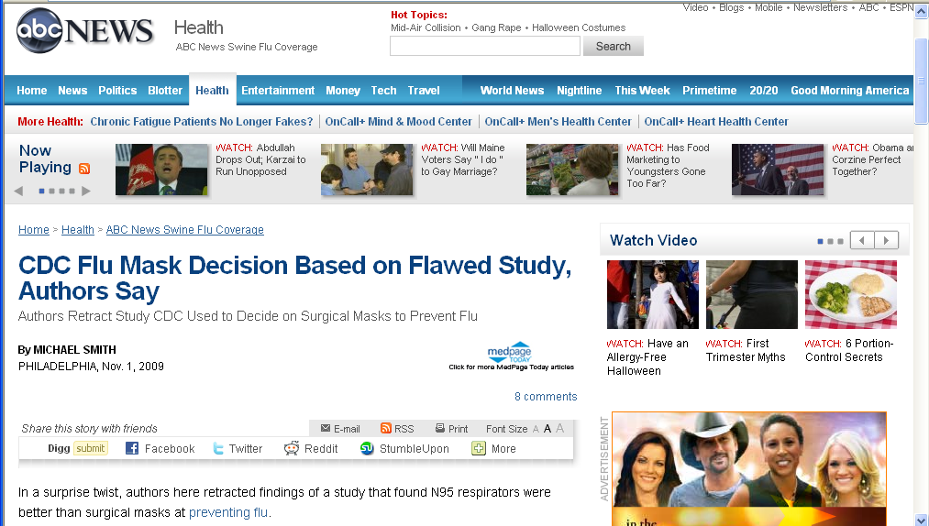
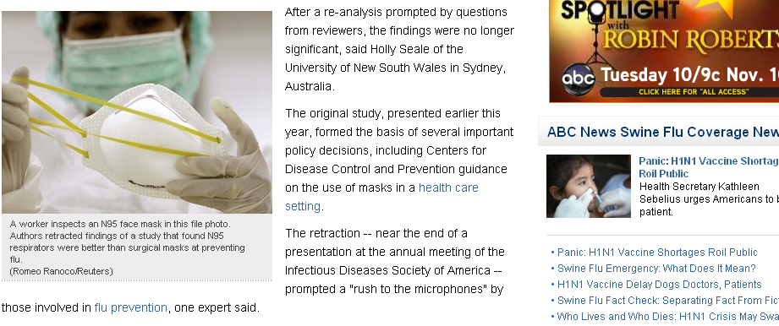
But Macintyre group retracted their study
http://abcnews.go.com/Health/SwineFluNews/cdc-flu-mask-decision-based-flawed-study-authors/Story?id=8966585&page=1

Slide 35
Large ongoing trial however conducted by John Hopkins which is yet to be published
(http://clinicaltrials.gov/ct2/show/NCT01249625).

Slide 36
Comparison of Non-clinical and Clinical Staff Infected by pH1N1
 | Non-clinical |  |  | Clinical | Statistical significance (p)
Total number of staff (n) |  | 18759 | 40511
Number infected
A. During mandatory reporting for all staff |  | 119 (0.63%) | 249 (0.62%) |  | 0.82 RR: 0.98 (95% CI 0.78-1.2)
B. Data during the entire pandemic period |  | NA | 1039 (2.6%)

Slide 37
New Experimental Studies.
Experimental studies in which only PCR was used in diagnosis could not be considered conclusive because it would not be possible to ascertain whether such particles had viable virus that could result in transmission.
Must demonstrate both production of infectious virus and inoculation of live viruses on to patients

Slide 38
Presence of viable viral aerosols in the exhaled breathe
Milton KD, Fabian P, Cowling JB. et al: Influenza virus aerosols in human exhaled breath: particle size, culturability and effect of surgical mask. PLOS Pathogen March 2013 Vol 9, Iss 3 e1003205
Fabian P, McDevitt, DeHaan HW. et al: Influenza virus in human exhaled breath: an observational study. PLOS ONE July 2008, Vol 3, Iss 7 e2691

Slide 40
There were at least two studies showing that viable virus may be transmitted to the host
Noti JD, Lindsley WG, Blachere FM. et al: Detection of influenza virus in cough aerosol generated in a simulated patient examination room. Clin Infect Dis 2012; 54 (1 June) 1569-1577
Bischoff EW, Reid T, Russell BG, Peters T: Transocular entry of seasonal influenza-attenuated virus aerosol and the efficacy of N95 respirators, surgical masks and eye protection in human. JID 2011:204 (15 July) 193-199
Sources were by artificially generated aerosols by simulators - difficult to be certain whether the situation was similar in real life.

Slide 41
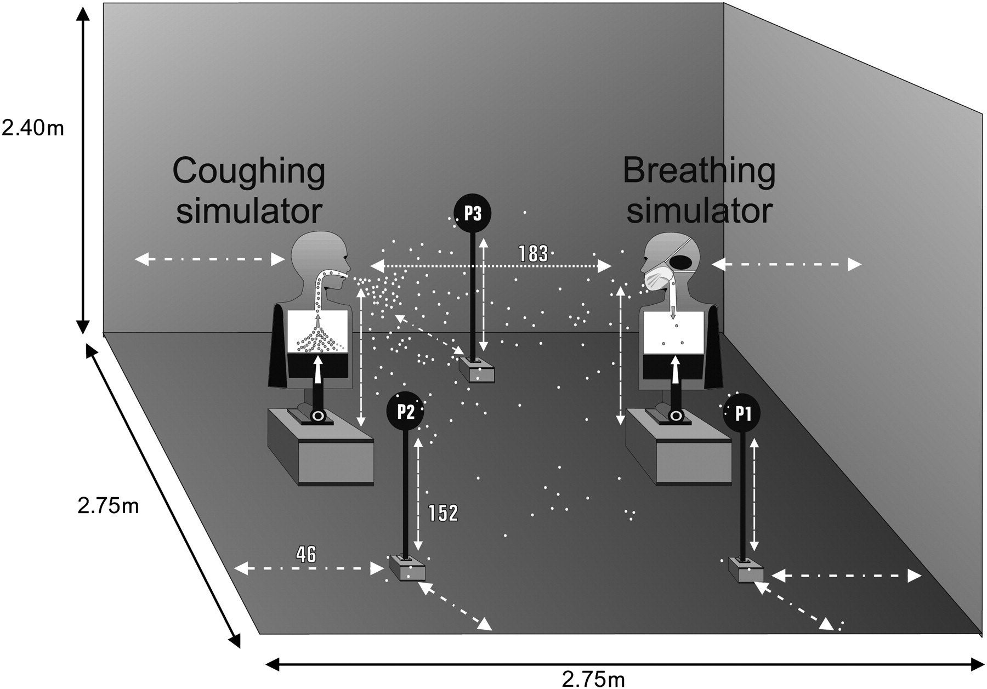

Three-dimensional view of the aerosol exposure chamber.
Noti J D et al. Clin Infect Dis. 2012;54:1569-1577
Published by Oxford University Press on behalf of the Infectious Diseases Society of America 2012
Notes:
Three-dimensional view of the aerosol exposure chamber. National Institute for Occupational Safety and Health samplers collected aerosols through the mouth (depicted as black oval in breathing mannequin’s head), 10 cm beside the mouth of the breathing simulator, and in 3 other positions (P1, P2, P3), as shown. The mouths of the coughing and breathing simulators and sampler inlets at P1, P2, and P3 were located 152 cm above the floor (approximate height of a sitting patient and healthcare worker). For 3 experiments, fingertips from medical gloves were also placed on the manikin’s forehead and alongside 3 of the aerosol samplers. All dimensions adjacent to white arrows within chamber are in centimeters.

Slide 42
Finally a study - the sources were naturally infected influenza volunteers. Claims to be the first “end-point host-exposure and sampling study” where special manikins were exposed to these volunteers.
Tang J, Gao CX, Cowling BJ, et al: Absence of detectable influenza RNA transmitted via aerosol during various human respiratory activities – experiments from Singapore and Hong kong.
PLOS ONE September 2014 Vol 9, Iss 9 e107338 1-9
Methods
The two studies had an identical aim, to test ….transmission of influenza from a naturally influenza-infected human to a life-like human manikin ‘recipient’ through real-life respiratory activities.
The HK study used a shop display manikin, customized for ‘mouth-inhaling’, to examine the quantity of influenza virus inhaled ….This study only examined the inhalation phase of a potential recipient.
The Singapore study used a commercial thermal, breathing manikin with a full breathing cycle to quantify the amount of influenza virus landing on facial skin sites.

Slide 43
Finally a study - the sources were naturally infected influenza volunteers. Claims to be the first “end-point host-exposure and sampling study” where special manikins were exposed to these volunteers.
Tang J, Gao CX, Cowling BJ, et al: Absence of detectable influenza RNA transmitted via aerosol during various human respiratory activities – experiments from Singapore and Hong kong.
PLOS ONE September 2014 Vol 9, Iss 9 e107338 1-9
Results
No influenza RNA was detected from any of these swabs with either team’s in-house diagnostic influenza assays.

Slide 44
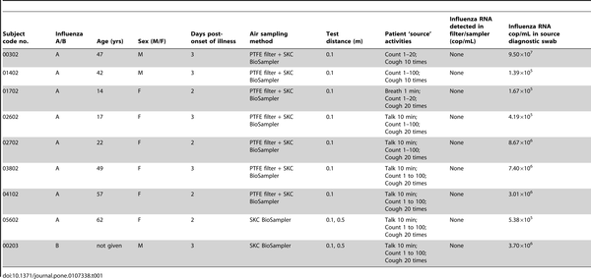

Table 1. Results for the Hong Kong experiments (n = 9).
Tang JW, Gao CX, Cowling BJ, Koh GC, et al. (2014) Absence of Detectable Influenza RNA Transmitted via Aerosol during Various Human Respiratory Activities – Experiments from Singapore and Hong Kong. PLoS ONE 9(9): e107338. doi:10.1371/journal.pone.0107338
http://www.plosone.org/article/info:doi/10.1371/journal.pone.0107338

Slide 45
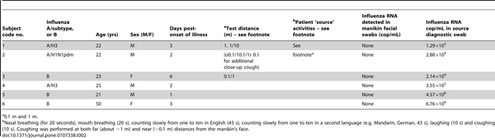
Table 2. Results for Singaporean experiments (n = 6).
“The outcomes of these two studies are presented together due to the similar and largely unexpected results”
Tang JW, Gao CX, Cowling BJ, Koh GC, et al. (2014) Absence of Detectable Influenza RNA Transmitted via Aerosol during Various Human Respiratory Activities – Experiments from Singapore and Hong Kong. PLoS ONE 9(9): e107338. doi:10.1371/journal.pone.0107338
http://www.plosone.org/article/info:doi/10.1371/journal.pone.0107338

Slide 47
Majority of droplets are from 10-100 µm.
N = Nicas et al (2005), D = Morawska (2006), Duguid (1946), L&R = Louden and Rpberts (1967)

Slide 51
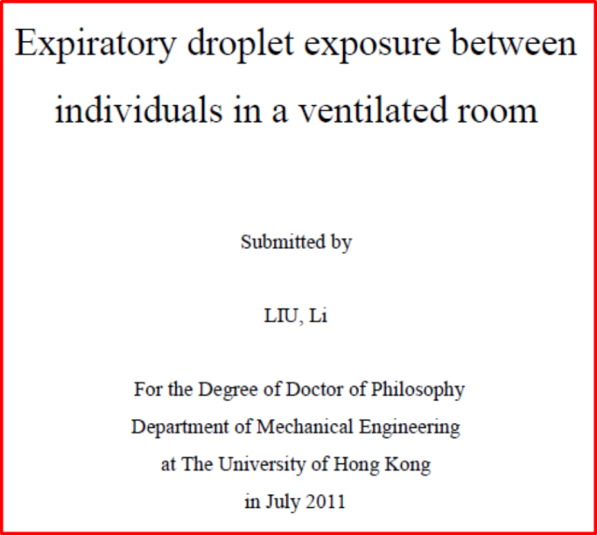
Factors affecting droplets evaporation:
initial size, composition, humidity, temperature velocity, exhalation airflow, turbulence and ambience airflow.

Slide 52
Factors affecting droplets evaporation: initial size, composition, humidity, temperature, velocity, exhalation airflow, turbulence and ambience airflow.
pp 152

Slide 53
Can Influenza be transmitted by air?
……the risk is probably low

Slide 54
A. Are Most Respiratory Viral Infections Airborne?
Most studies done – Influenza and SARS

Slide 55
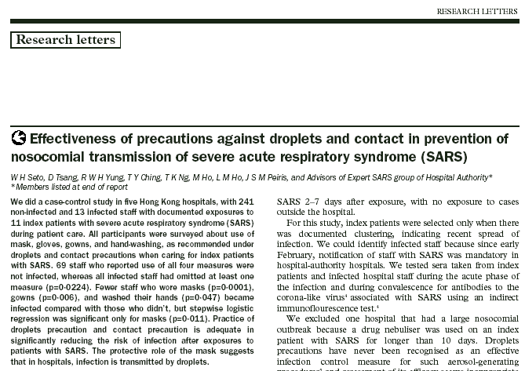
Is SARS airborne?

Slide 56
2014
WHO ARI Guideline

Slide 58
Recommendations | Ranking
1. Use clinical triage for early identification of patients with ARIs to prevent the transmission of ARI pathogens to HCWs and other patients | Strong
2. Respiratory hygiene (i.e. covering the mouth and nose during coughing or sneezing with a medical mask, tissue, or a sleeve or flexed elbow followed by hand hygiene) should be used in persons with ARIs to reduce the dispersal of respiratory secretions containing potentially infectious particles. | Strong
3. Spatial separation (distance of at least 1 metre) between beds should be maintained to reduce the transmission of ARI pathogens from one patient to another. Spatial separation (distance of at least 1 metre) between the patient and the HCW without the use of PPE should be maintained to reduce the transmission of ARI pathogens to the HCW | Strong
4. Cohorting, the placement of patients infected or colonized with the same pathogens in the same designated unit, zone or ward (with or without the same staff), or special measures, the placement of patients with the same suspected diagnosis (similar epidemiological and clinical information) in the same designated unit, zone or ward (with or without the same staff) within a health care setting, could be used in certain settings for the implementation of isolation precautions for patients with ARIs to reduce transmission of ARI pathogens to HCWs and other patients. | Conditional
5. According to the risk assessment (according to the procedure and suspected pathogen), PPE may be needed when providing care to patients presenting with ARI syndromes and may include an appropriate combination of the following: medical mask (surgical or procedure mask), gloves, long-sleeved gowns, and eye protection (goggles /face shields) | Strong
6. Personal protective equipment (PPE) including the use of gloves, long-sleeved gowns, eye protection (goggles or face shields) and facial mask (surgical/procedure mask or particulate respirators) should be used by HCWs during aerosol generating procedures that have been consistently associated with an increased risk of transmission of ARI pathogens¹. The available evidence suggests performing or being exposed to endotracheal intubation either by itself or combined with other procedures (e.g. cardiopulmonary resuscitation, bronchoscopy) was consistently associated with increased risk of transmission. | Conditional
7. Adequately ventilated single rooms should be used when performing aerosol generating procedures that have been consistently associated with increased risk of ARI transmission. | Conditional
8. Vaccination for influenza should be used for HCWs caring for patients at higher risk of severe or complicated illness from influenza to reduce influenza illness & mortality among these patients | Strong
9. Considerations for Ultraviolet Germicidal Irradiation – no recommendations possible. | -
10. Additional IPC precautions in health care settings for patients with ARIs should be based on the duration of symptomatic illness (according to the pathogen and patient information1) to reduce the transmission of ARI pathogens to HCWs and other patients. Note that Standard Precautions should always be used. There is no evidence to support the routine application of laboratory tests for the determination of duration of IPC precautions. | Conditional
Ten WHO Recommendations for Infection control and Prevention of Acute Respiratory Viral Infections
Seto WH, Conly JM, et al:
Infection prevention and control measures for acute respiratory infections in healthcare settings: an update.
East Mediterr Health J. 2013;19 Suppl 1:S39-47. Review.

Slide 59
B. Can we define the aerosols generating procedures?

Slide 60
Recommendations | Overall Ranking
6. Personal protective equipment (PPE) including the use of gloves, long-sleeved gowns, eye protection (goggles or face shields) and facial mask (surgical/procedure mask or particulate respirators) should be used by HCWs during aerosol generating procedures that have been consistently associated with an increased risk of transmission of ARI pathogens¹. The available evidence suggests performing or being exposed to endotracheal intubation either by itself or combined with other procedures (e.g. cardiopulmonary resuscitation, bronchoscopy) was consistently associated with increased risk of transmission. | Conditional

Slide 63
WHO meta-analysis
3 studies all together
One NIV and manual ventilation before intubation is the same study
One study on NIV with OR > 1
One study on tracheostomy

Slide 64
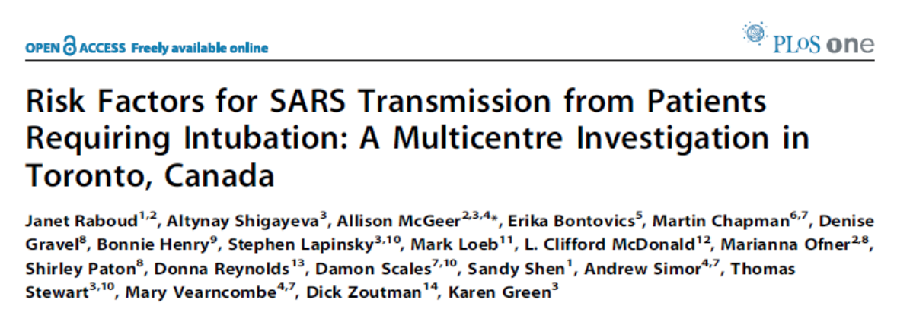



Slide 65
Poor infection control practices

Slide 66
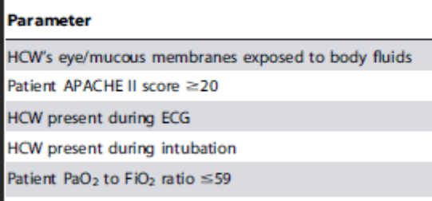
HCW present during intubation is a factor but no factor related to NIV or manual ventilation

Slide 67
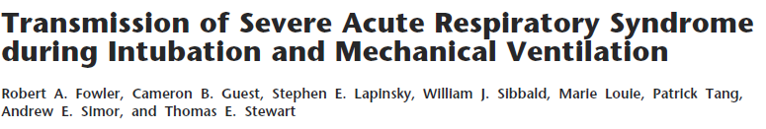
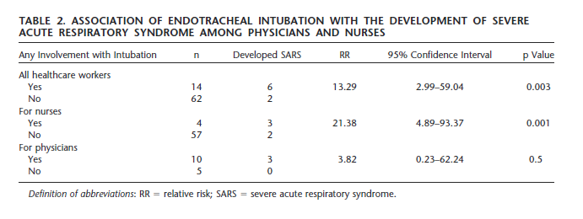
NIVs OR>1

Slide 68
Tracheostomy

Slide 69
Aerosol-generating procedures
Some procedures performed on patients are more likely to generate higher concentrations of respiratory aerosols than coughing, sneezing, talking, or breathing, presenting healthcare personnel with an increased risk of exposure to infectious agents present in the aerosol. Although there are limited objective data available on disease transmission related to such aerosols, many authorities view the following procedures as being very high exposure risk aerosol-generating procedures for which special precautions should be used:
Bronchoscopy
Sputum induction
Endotracheal intubation and extubation
Open suctioning of airways
Cardiopulmonary resuscitation
Autopsies

Slide 70
Aerosol-generating high risk procedures.
Both WHO/CDC: Intubation, bronchoscopy, autopsies, cardiopulmonary resuscitation, open suction of airways.
CDC only: extubation, sputum induction;
WHO only: collection of lower respiratory tract specimens.

Slide 71
About Sputum Induction
Sputum induction is used to obtain sputum for diagnostic purposes when patients are unable to spontaneously expectorate a specimen. The procedure uses sterile water or hypertonic saline to irritate the airway, increase secretions, promote coughing, and produce a specimen. The CDC and OSHA both classify sputum induction as a high-risk procedure when performed on a person with suspected or known infectious TB

Slide 72


Slide 73
Nebulizers

Slide 74
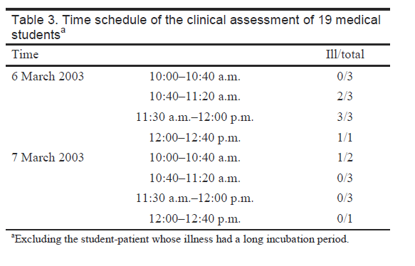

Slide 75
C. Is N95 Fit Testing Necessary?

Slide 76
Is N95 Fit Testing Required?
Most elements of the NIOSH respirator program (i.e., fit factor, protection estimates, etc.) are theoretical using mathematical models and have not been confirmed in practical work situations.
In one NIOSH study, fit testing respirator assignment errors were as high as 20%.
From Bill Jarvis, CDC

Slide 77
Quantitative Fit Testing Does Not Ensure Health Care Worker Respiratory Protection
M Lee, S Takaya, R Long, M Joffe
SHEA Abstract - Apr 2005
58 HCW never fit-tested
25/58 (43%) passed initial fit-test
  19 passed with instruction = 76% total passes
3 months later, 49/58 re-tested
  47% recalled respirator type and passed fit-test
  Passing at 3 months did not correlated with passing at initial fit-test or receipt of instruction

Slide 78
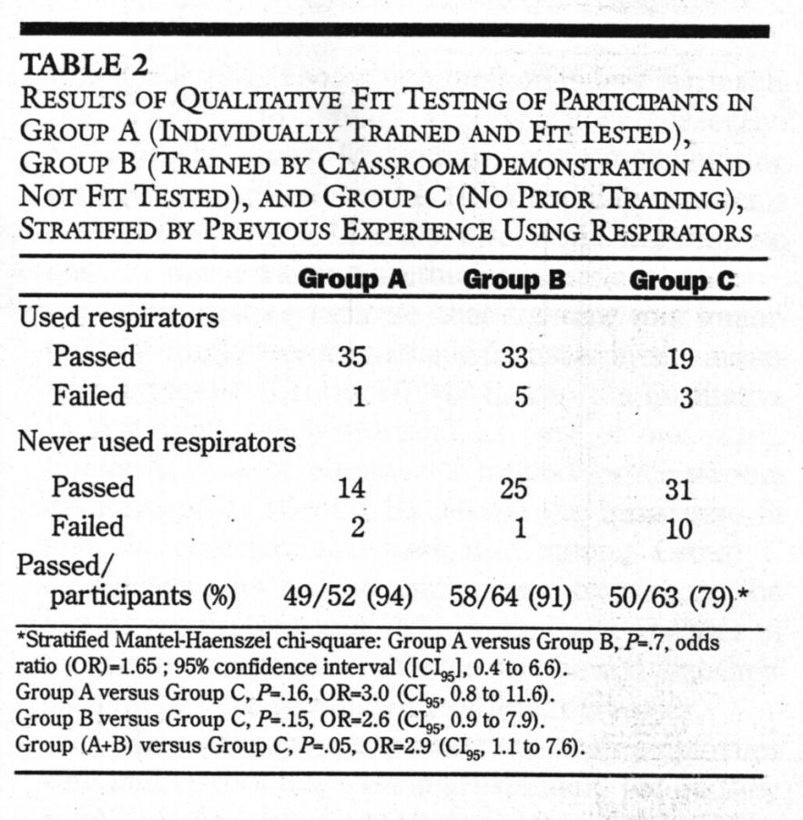
No, fit testing is not needed.
No added value to adequate training:
Hannum D, et al. The effect of respirator training on the ability of healthcare workers to pass a qualitative fit test. Infect Control Hosp Epidemiol 1996;17:636-40

Slide 80
Seal check
  A method for determining whether a respirator has been put on and adjusted to fit properly
  Perform every time when a respirator is worn

Slide 81
Seal check

Slide 82

However, we disagree with the next sentence, which is inherently contradictory, “However, HCWs should undergo initial and periodic fit testing.” There is no sound evidence to support initial and periodic fit testing.
Infectious Diseases Society of America (IDSA) letter to CDC February 4, 2005

Slide 83
D. Is negative-pressure room an absolute necessity?

Slide 84
“The most important part of
tuberculosis infection control
is getting the patient into the
isolation room.”
Wurtz, 1996, ICHE

Slide 86
Airborne transmission isolation room:
Single room or cohorting
Negative pressure (2.5 Pa or .01 in water)
6 - 12 air changes per hour - now it is > 12
Exhaust air outside or recirculated
HEPA filters
Anteroom may enhance effects
Upper-room UVGI only as adjunct
Avoid within room circulation (eg. fans)

Slide 87
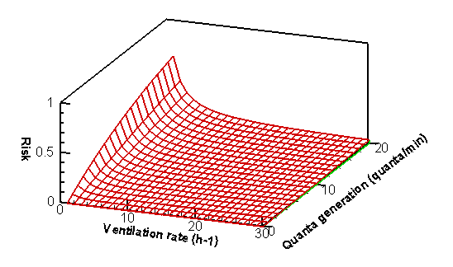
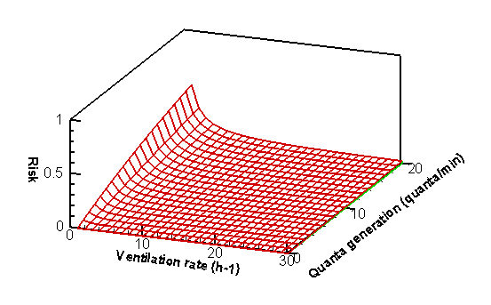
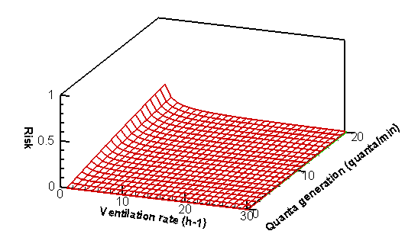
(a) 15 minutes exposure time
(b) 10 minutes exposure time
Graphs constructed by Wells-Riley equation to express the relationship between infection risk over ventilation rate, quanta generation rate and exposure time.
(c) 5 minutes exposure time

Slide 88
Journal of TB and Lung Diseases; Oct 2005
AR Escombe et al:
Supervise by Imperial College and John Hopkins
65 rooms in 8 hospitals in Lima, Peru
Old Facilities: Median 37 ACH
Modern Facilities: Median 18 ACH

Slide 89
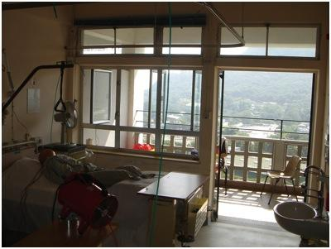
Measurements in Grantham Chest Hospital Hong Kong (tests in 4 rooms)
Windows open (100%), Doors open (100%) = 45.4 ACH
Windows open (100%), doors close = 20.2 ACH
Windows open (50%), doors close = 15.5 ACH
Windows close , doors close = 0.6 ACH
Windows close, doors open = 3 .4 ACH

Slide 90
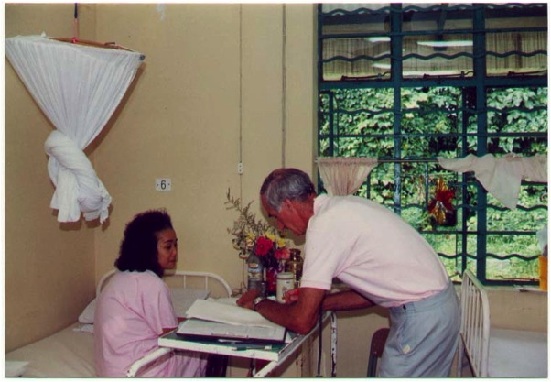

Slide 92
http://www.who.int/water_sanitation_health/publications/natural_ventilation.pdf

Slide 93
What is natural ventilation?

Slide 95
TB incidence in Grantham and HA hospitals
1996-2005
Mean Incidence (per 100,000 pat year)
HA hospitals: (257 cases) 60.4
GH: (5 cases) 65.2
p = 0.9

Slide 96
Marion A. Kainer MD, MPH, FRACP
Medical Epidemiologist/ Infectious Diseases Physician Director, Hospital Infections and Antimicrobial Resistance Program Tennessee Dept. of Health
Dr Seto,
I really enjoyed your insightful presentation yesterday... I am sorry you had to skip through so many of the slides in the interests of time.
I did my infectious disease training in Australia at Fairfield hospital... a stand-alone infectious diseases hospital that saw/treated most of the TB patients in Victoria-- we had single rooms, ]all of which opened up to a private balcony... we used lots of open air ventilation, high ACH and none of our staff converted their TSTs.

Slide 98
Opening your windows,
The key to natural ventilation..

Slide 99

Thank You
Microsoft Windows
I mean...to open your room windows!

