Slide 1


Norovirus Understanding diversity in relation to detection, healthcare impact, control and prevention
Marion Koopmans
m.koopmans@erasmusmc.nl
@MarionKoopmans
www.webbertraining.com
November 17, 2014

Slide 2
Norovirus background
Most common etiology of acute gastro-enteritis
Transmission person-to-person, environmental, foodborne, waterborne, zoonotic?
Mostly mild illness, self limiting
More severe disease in persons with co-morbidities
Cardiovascular patients (OR 17.1, 2.2-403)
Renal transplant recipients (OR 13,1.7-281)
Age >65 (OR 11.6, 1.9-204)
Immunosuppression (OR 5.7, 1.8-20.1)
Sporadic cases and outbreaks
Short-lived immunity

Slide 3
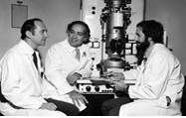
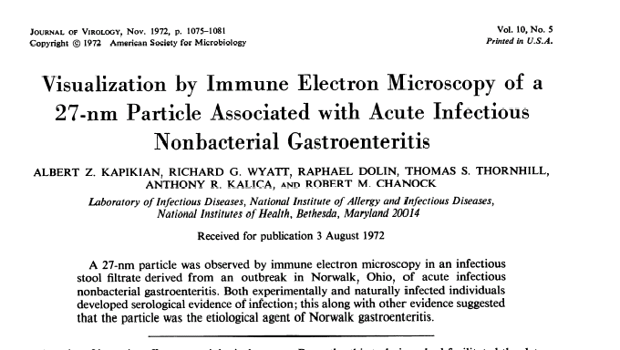
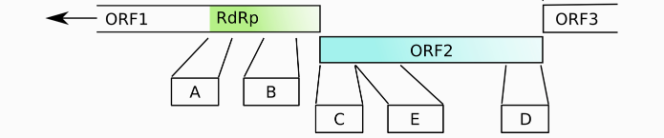
1990: Jiang et al; sequence of the Norwalk virus genome

Slide 4
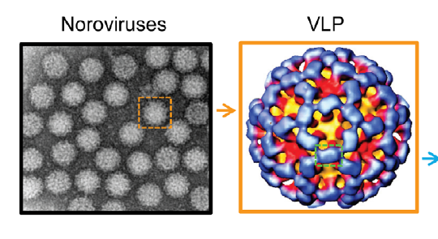
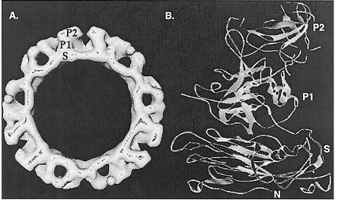
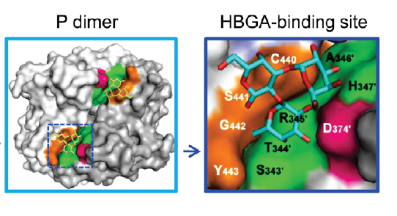
Jiang and Tan, 2010

Slide 5
Norovirus diagnostics
No cell culture model (?)
RT-PCR based for individual patients
  Conserved genome targets
  Note genetic diversity > validation of PCR assays is difficult (GII4 and GII3 most commonly detected in patients)
  QCMD quality control panels
ELISA for outbreak diagnostics (insufficient sensitivity for case-based diagnostics)
Genotyping
  May be used in outbreak investigations
  Capsid and polymerase gene based

Slide 6
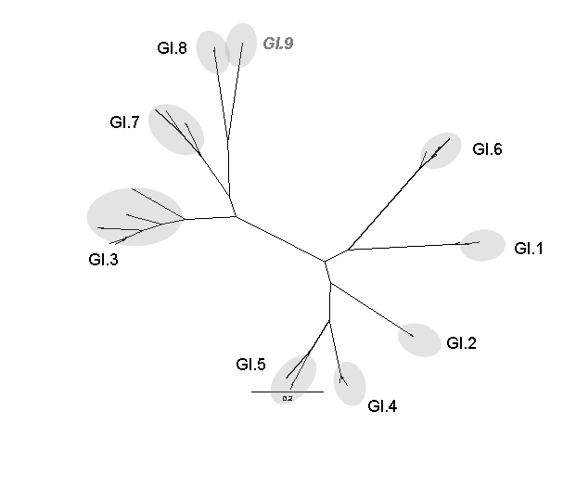
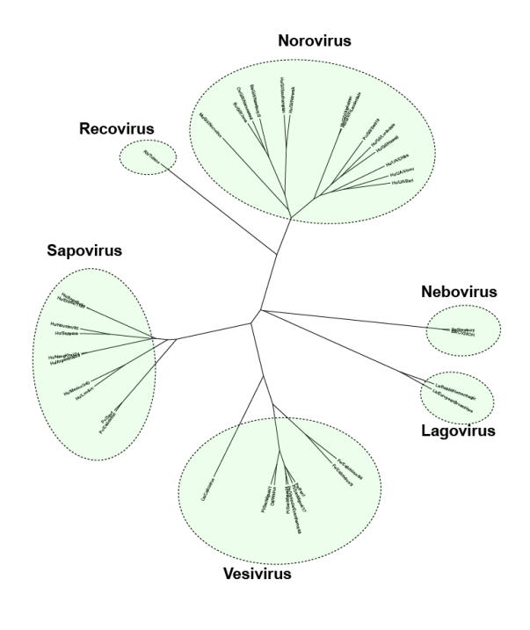
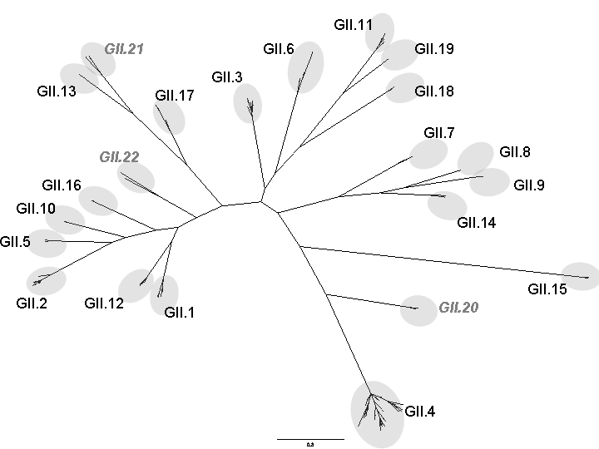
Family, genus, genogroups, genotypes, variants
Genotype (I.1, I.2, II.4 etc)
GGI
~20%
More varied
Food
Genogroup (I, II, IV)
GGII
~80%
Seasonal
HCAI
Clarke et al, 2010; Verhoef et al., 2011; Kroneman et al., 2013
Dominant Variant (GII.4)

Slide 7
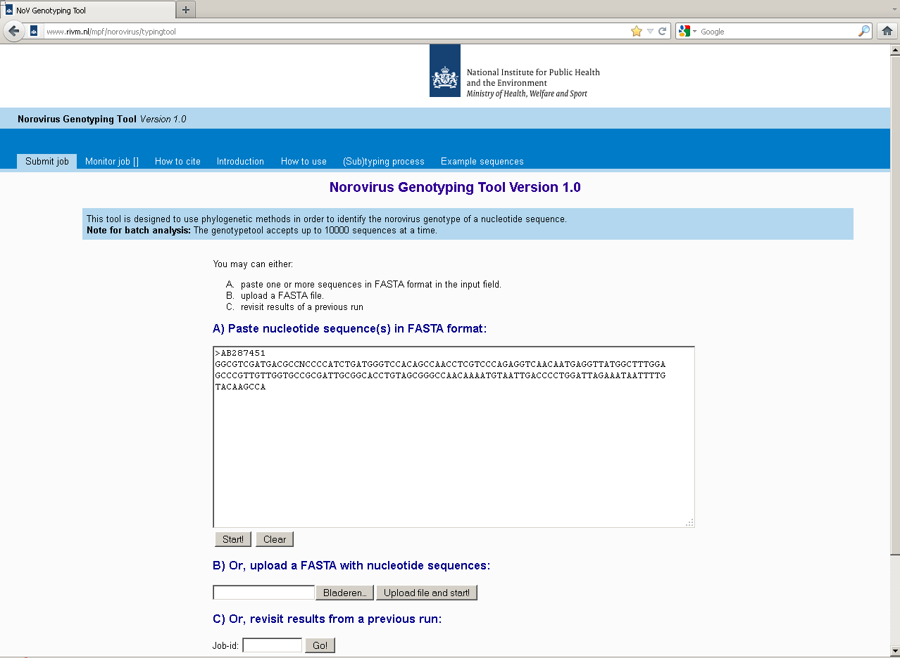
Typing tool and nomenclature; www.noronet.nl

Slide 8
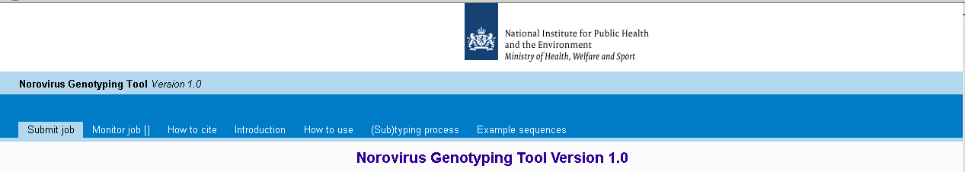
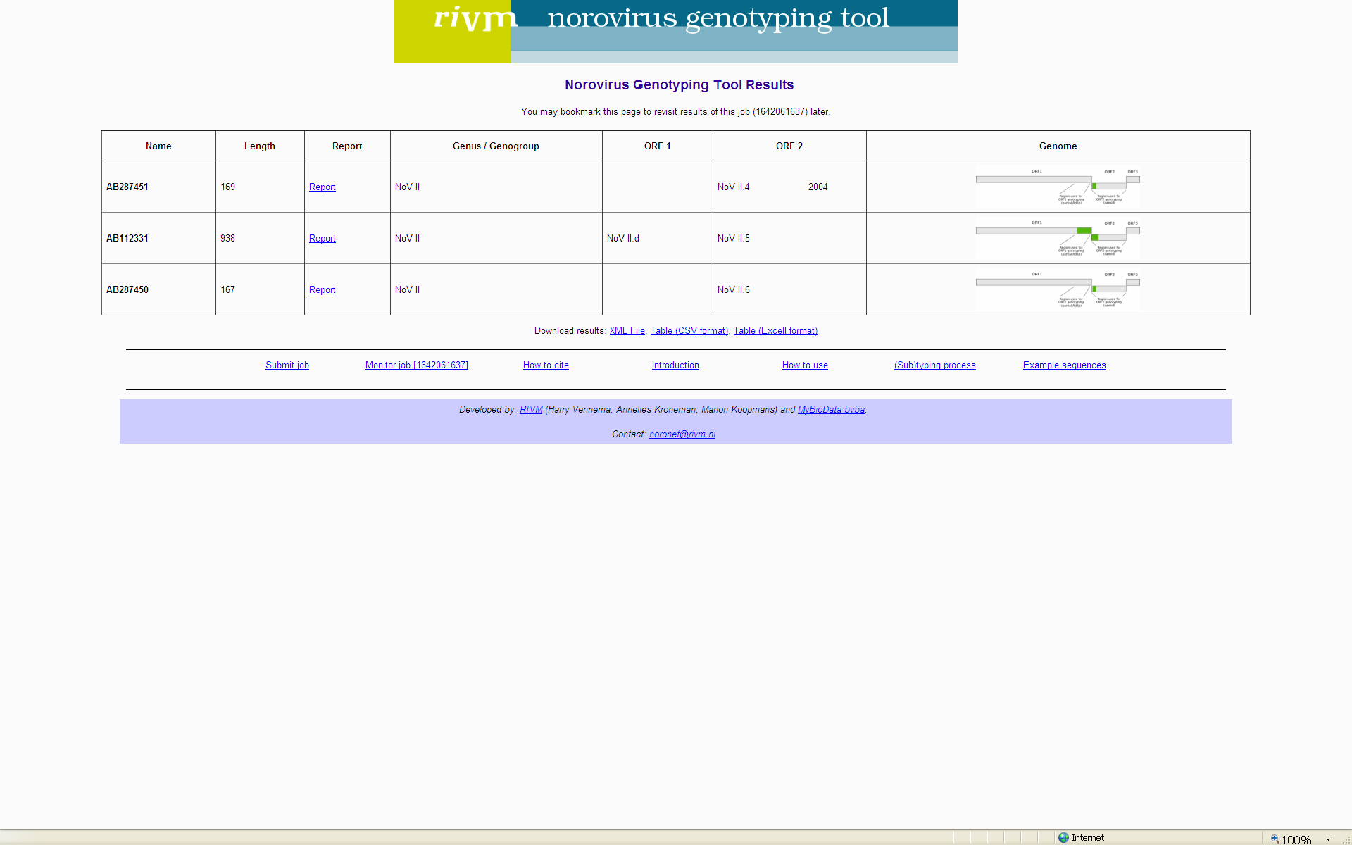
Based on outcome of nomenclature discussion
Batch job option
(e.g. retyping of up to 10.000 sequences to adapt to standardized nomenclature)
Tutorial
Report:
Genotype and subtype assignment
Downloadable:
Phylogenetic tree against reference strains
Alignment
PAUP log file
Details of method
Tables of the reference sequences for each taxonomic level
Downloadable results + reference sequences in multiple file formats
http://www.rivm.nl/en/Topics/N/NoroNet

Slide 9
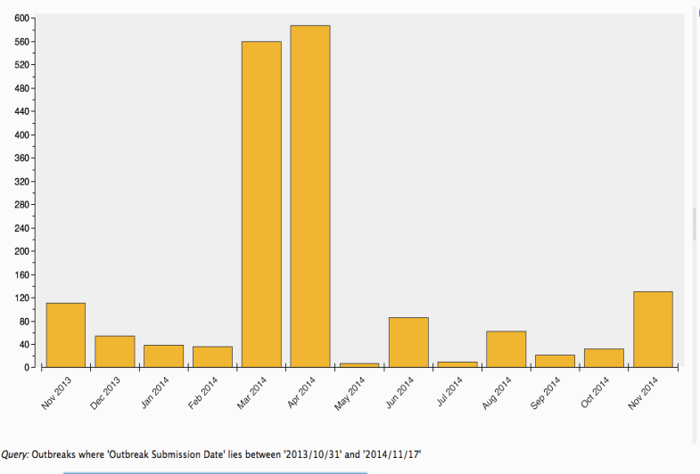
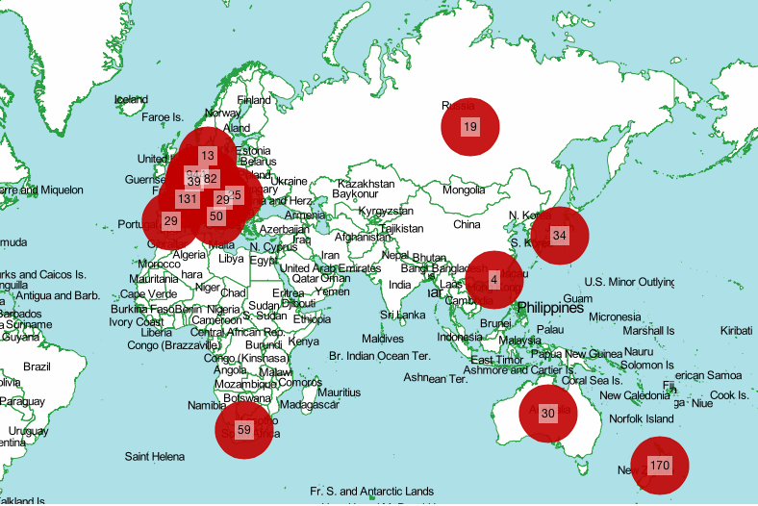
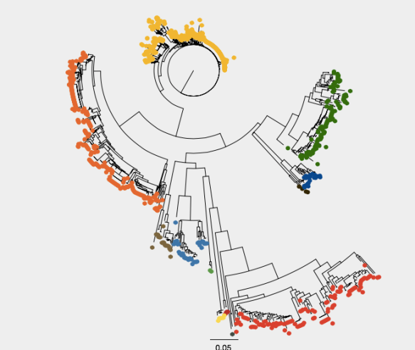
Noronet entries, 16 November 2013-16 November 2014
N = 1700
Features from the noronet website

Slide 10
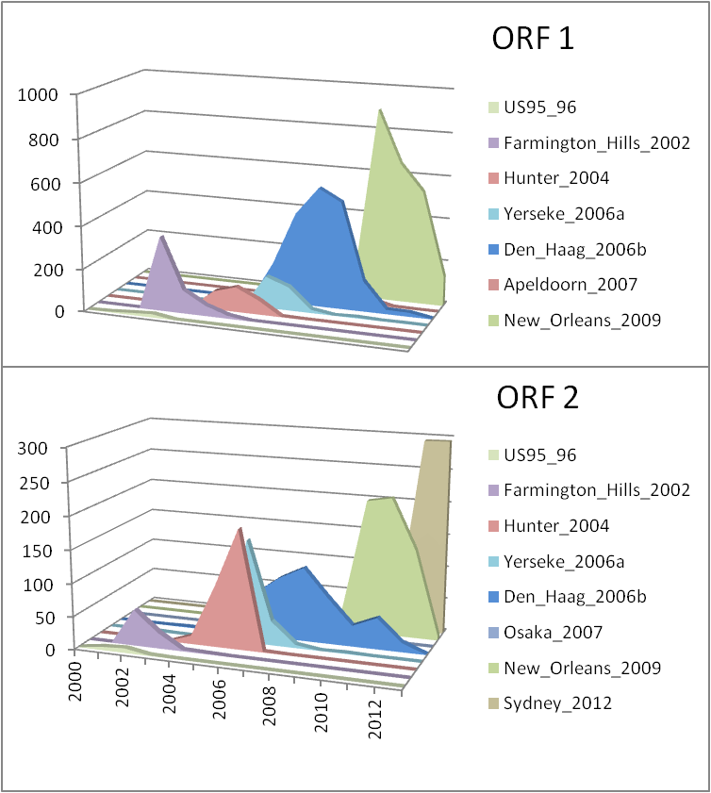
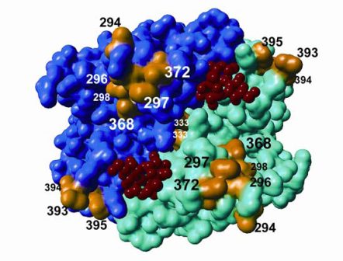
GII4 noroviruses persist through evolution
Effects of mutations:
Escape mutants (drift)
No protective immunity
Differences in host cell binding
> New host range
Siebenga et al., 2008; Allen et al., 2008; Parra et al., 2012; Tan et al., 2003
Lindesmith et al., 2008; Bok et al., 2009; Siebenga et al. 2010

Slide 11
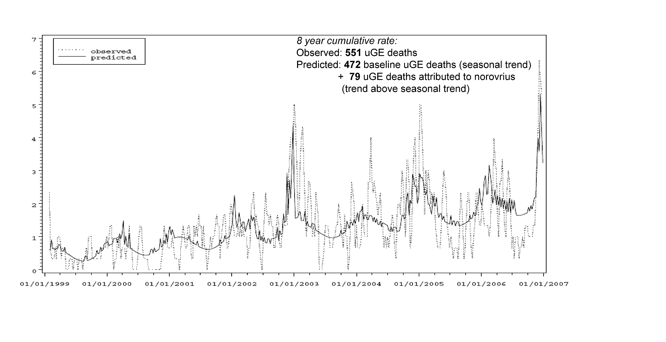
Increased severity risk groups (age, comorbidity, immunocompromised)
Increase in hospitalisations
Mortality
Chronic infections
Van Asten et al., 2011; Lopman et al., 2004; Mattner et al., 2006; Rondy et al., 2010; Siebenga et al., 2008

Slide 12
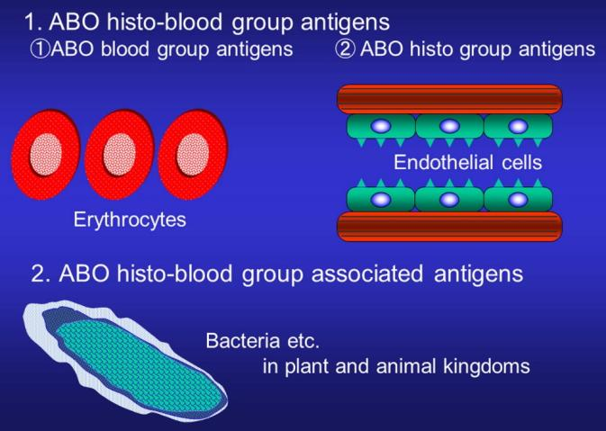
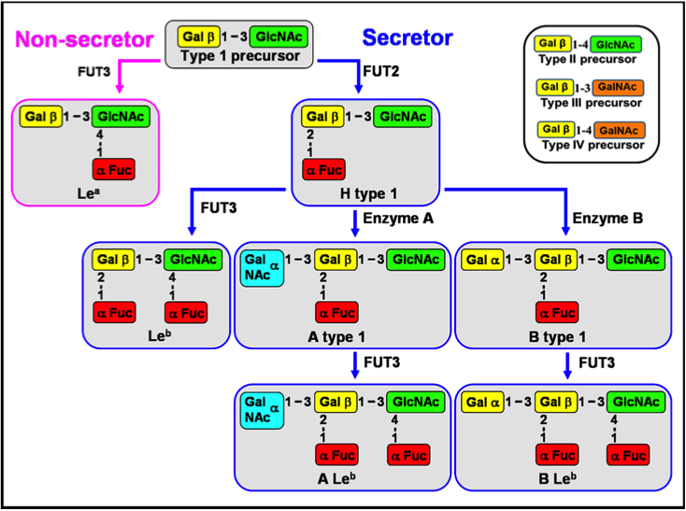
Genetic susceptibility: wide range of options
Takahashi et al. Transplantation Reviews, 2013; Shanker et al. J Virol, 2011

Slide 13
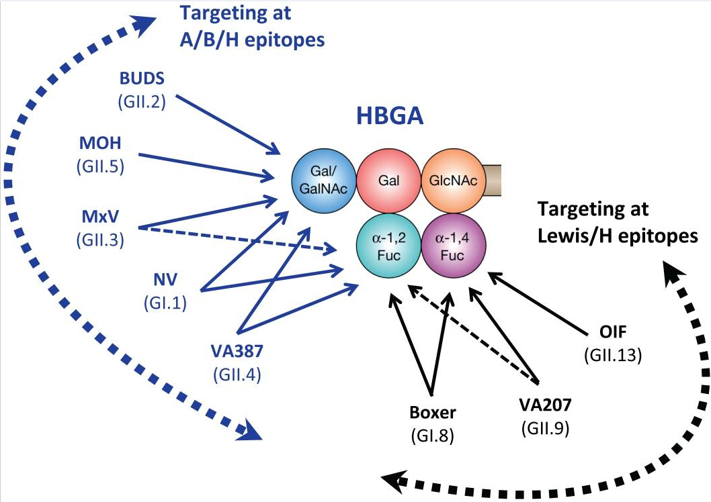
Genotypes differ in host binding
May become relevant when looking into antivirals

Slide 14

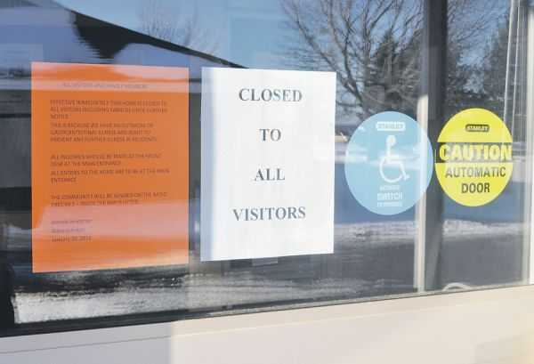

Slide 15
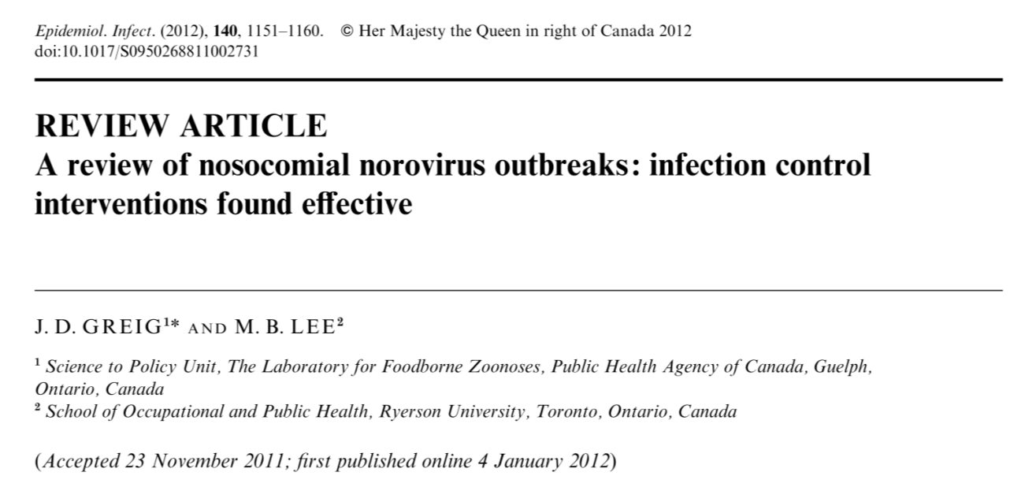
Rapid identification
Immediate implementation of infection control measures
Debate on alcohol based desinfectants *(no model)
Experimental evidence for decontamination with H₂O₂
Preclinical evidence for post exposure prophylaxis

Slide 16
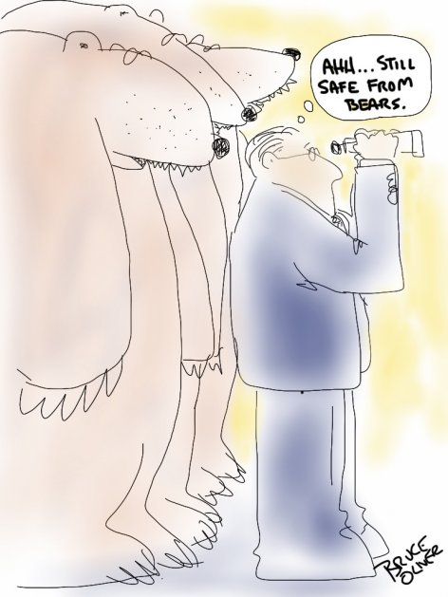

Slide 17
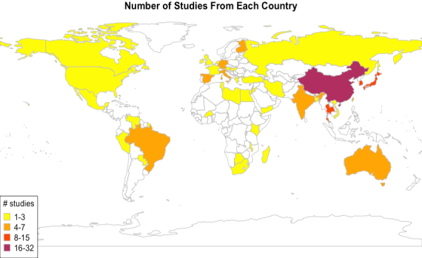
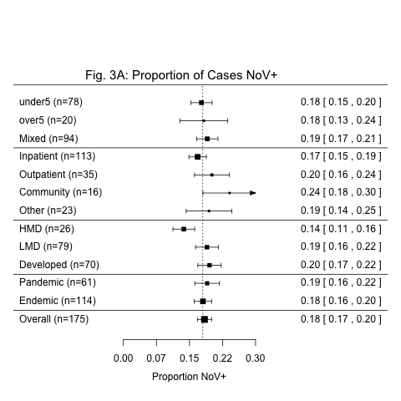
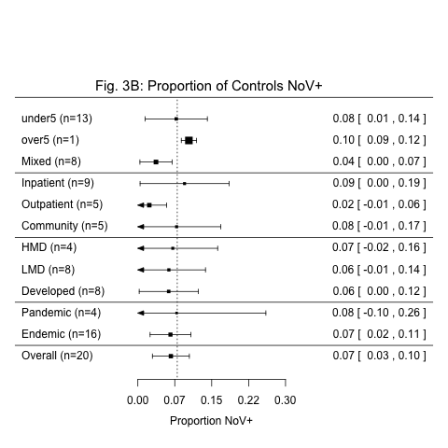
Outbreaks reflect high prevalence of NoV in community
17%
7%
Ahmed et al., Lancet, 2014

Slide 18
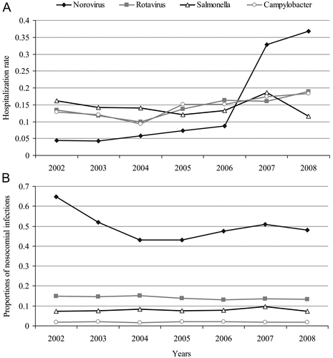
Notifications for infectious gastro-enteritis from hospitals, Germany
Most by children. (Beersma et al., 2009)
increase Dx missed patients (X ray, coloscopy, biopsies)(Beersma et al.., 2012)
Mainly GII3 and GII4 (Sukhrie et al., 2011)
1:1 ratio of infected HCW to (recognized) patients (Sukhrie et al., 2012)
Virus evolution in chronic shedders (Siebenga et al., 2008)
Transmission from chronic shedders (Sukhrie et al., 2010)
.
Proportion nosocomial
(based on date of onset)
Spackova et al., 2010, Beersma et al., 2009; Petrignani et al., in press
Notes:
18

Slide 19
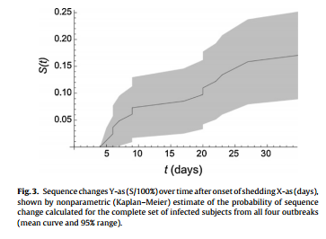
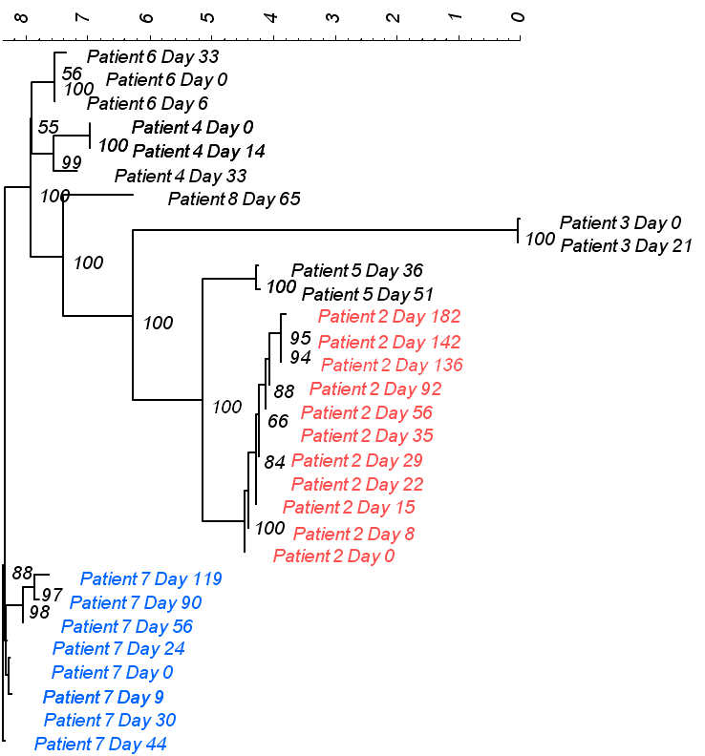
Chronic norovirus (>90days) patients in the
Erasmus Mc, Netherlands, 2006 - 2013
All patients have severe underlying illness: 21 of 26 (81%) patients have undergone a solid organ or stam cell transplatation.

Slide 20
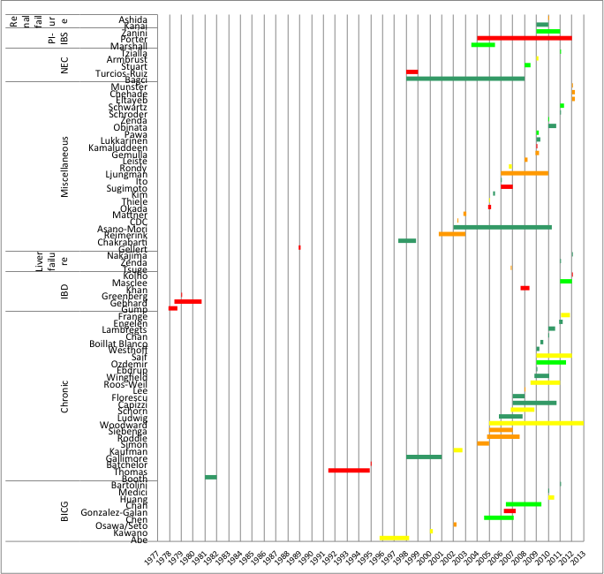
Petrignani et al., su
Renal failure
NEC
Review of studies showing
Evidence for complications and /or sequellae
Petrignani et al, in preparation
Chronic diarrhea
Infantile convulsions

Slide 21
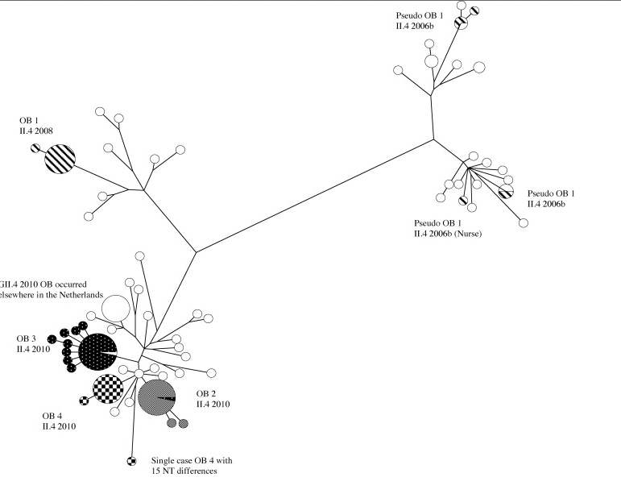
Use of strain typing for hospital epidemiology
Strain typing on partial genome sequence against background
Assignment of clusters
Ruling out clusters
Resolution depends on genotype
Sukhrie et al., 2013

Slide 22
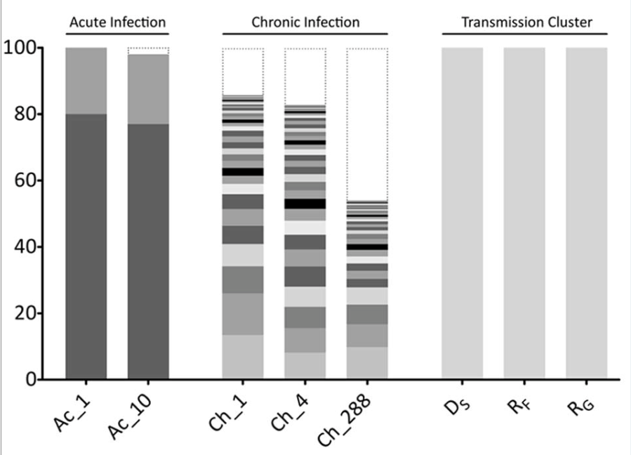
Transmission chain analysis (who infected whom?)
1
1
0
7
0
7
4
8
4
8
6
6
5
5
3
3
2
2
Patient 6 Day 33
56
Patient 6 Day 33
56
Patient 6 Day 0
100
Patient 6 Day 0
100
Patient 6 Day 6
55
Patient 6 Day 6
55
Patient 4 Day 0
Patient 4 Day 0
Patient 4 Day 0
100
Patient 4 Day 0
100
100
100
Patient 4 Day 14
Patient 4 Day 14
Patient 4 Day 14
99
Patient 4 Day 14
99
Patient 4 Day 33
100
Patient 4 Day 33
100
Patient 8 Day 65
Patient 8 Day 65
Patient 3 Day 0
100
Patient 3 Day 0
100
Patient 3 Day 21
100
Patient 3 Day 21
100
Patient 5 Day 36
100
Patient 5 Day 36
100
100
100
Patient
Patient
5 Day 51
5 Day 51
Patient 2 Day 182
100
Patient 2 Day 182
100
95
95
Patient 2 Day 142
94
Patient 2 Day 142
94
Patient 2 Day 136
Patient 2 Day 92
88
Patient 2 Day 92
100
88
Patient 2 Day 56
66
Patient 2 Day 56
66
Patient 2 Day 35
Patient 2 Day 35
Patient 2 Day 29
84
Patient 2 Day 29
84
Patient 2 Day 22
Patient 2 Day 22
Patient 2 Day 15
100
Patient 2 Day 15
100
Patient 2 Day 8
Patient 2 Day 8
Patient 2 Day 0
88
Patient 2 Day 0
88
Patient 7 Day 119
97
Patient 7 Day 119
97
Patient 7 Day 90
98
Patient 7 Day 90
98
Patient 7 Day 56
Patient 7 Day 56
Patient 7 Day 24
Patient 7 Day 24
Patient 7 Day 0
Patient 7 Day 0
Patient 7 Day 9
Patient 7 Day 9
Patient 7 Day 9
Patient 7 Day 9
Patient 7 Day 30
Patient 7 Day 30
Patient 7 Day 44
Patient 7 Day 44
Beersma et al, 2009, 2012; Siebenga et al., 2010; Bull et al., 2011; Sukhrie et al., 2011;

Slide 23
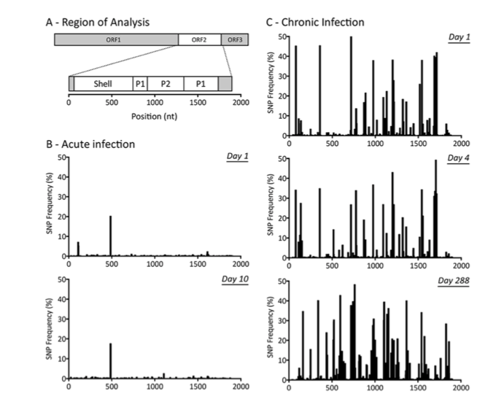
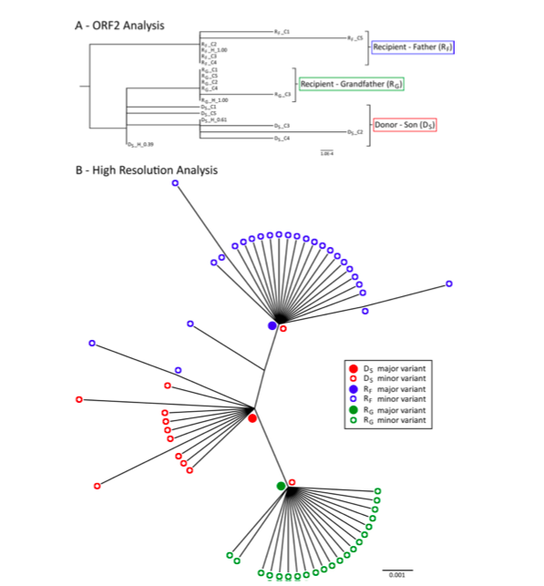
Hospital epidemiology using NGS
Kundu et al., 2013; Bull et al., 2011

Slide 24
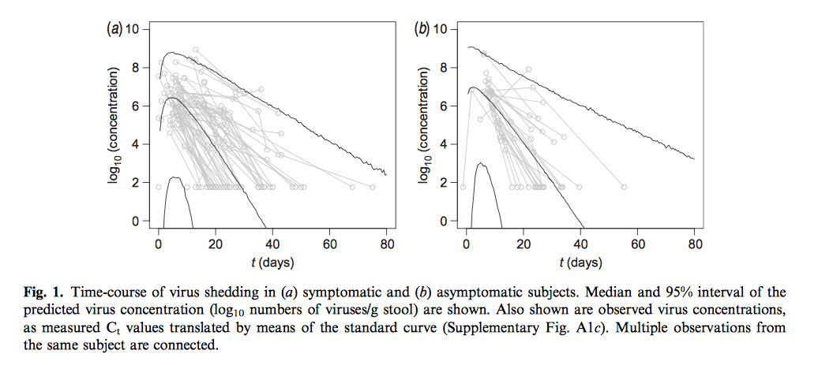
Symptomatic
Asymptomatic
Teunis et al., 2014

Slide 25
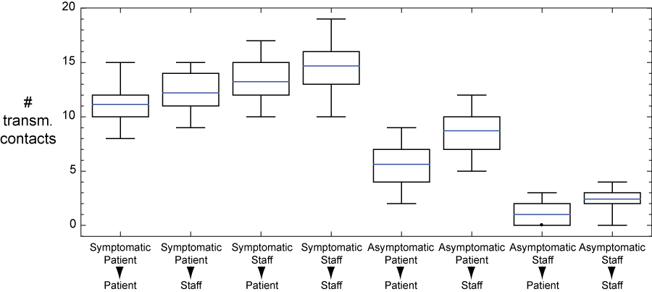
HCW without symptoms marginally contribute to spread of infection
HCW with symptoms do
Sukhrie et al., 2012

Slide 26


Slide 27
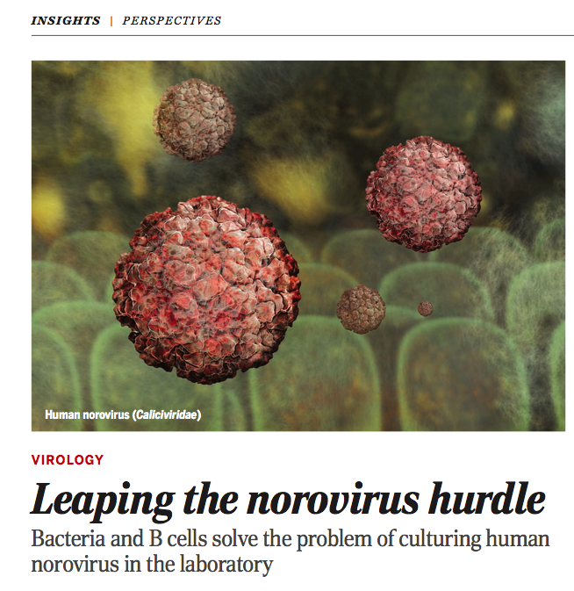
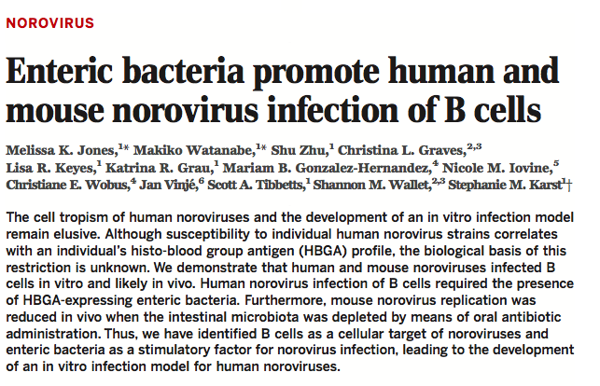
Human norovirus culture in B cells, with bacterial extract containing HBGA

Slide 28
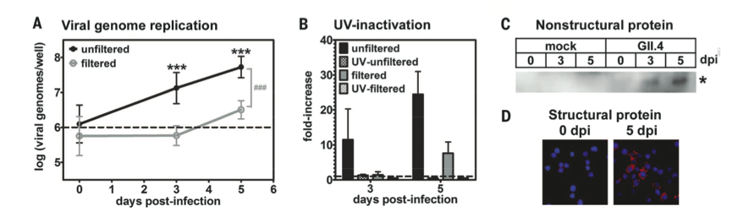
If confirmed:
Immunological studies
Infectivity studies
Inactivation studies
Jones et al., science, 2014

Slide 29
Take home messages
NoV infection is widely underdiagnosed
NoV diagnostics should be routine, as part of hospital infection prevention policy
Check product information for validation against uncommon genotypes
Be aware of chronic norovirus in immunocompromised patients
Strain typing / sequencing may inform hospital epidemiology or source tracking
29

Slide 30

Ackowledgements
RIVM
Dr Harry Vennema
Annelies Kroneman
Bas van der Veer
Prof Peter Teunis
Dr Erwin Duizer
FSA
Dr Ingeborg Boxman
Erasmus University
Dr Thijs Beersma
Jolanda Bogerman
Dr Pieter Fraaij
Susan Pas
Dr Martin Schutten
Prof Jan Henrik Richardus
PhD students
Dr Joukje Siebenga
Dr Faizel Sukhrie
Mariska Petrignani
Janko van Beek
www.noronet.nl
Noronet partners
Calicinet – Jan Vinje CDC US
Episurv – Joanna Hewitt, NZ
Global noronet and FBVE network
30
24 november 2014
Notes:
30

Slide 31
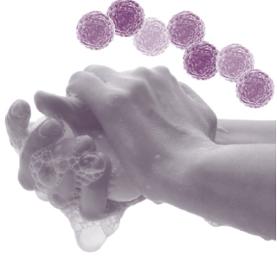
?

Slide 32

www.his.org.uk

