Slide 1
Antibiotic Stewardship in nursing homes
Pat W. Stone, PhD, MPH, FAAN
Columbia University School of Nursing
Hosted by Prof. Jingjing Shang
Columbia University
www.webbertraining.com
February 27, 2020

Slide 2



Disclosures
No financial conflicts of interest
Funding over the last 6 months:
  Study of the Integration of Infection Management and Palliative Care at End of Life (SIMP-EL) R01 NR13687, role: PI
    Alzheimer's Supplement
  Infection Prevention in Home Health Care (InHOME) R01 NR016865, role: MPI
    Alzheimer's Supplement
  Comparative and Cost Effectiveness Research Training for Nurse Scientists (CER2) T32 NR014205, role: contact MPI
  Quality Care Initiatives in Home Heath Care, role: MPI
  Respiratory Syncytical Virus, role: cost expert

Slide 3
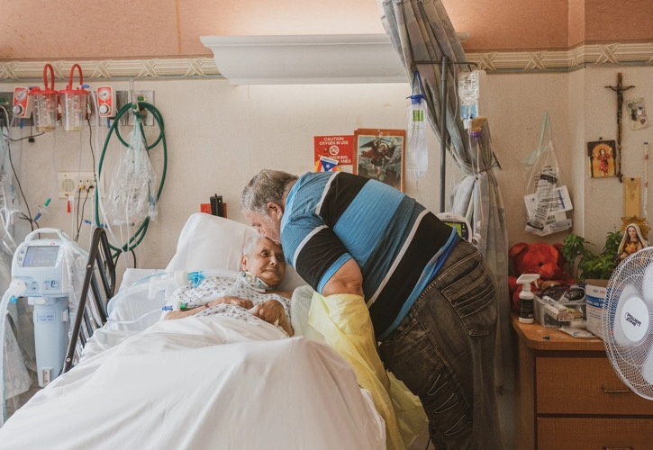

September 11, 2019
DEADLY GERMS, LOST CURES
Nursing Homes Are a Breeding Ground for a Fatal Fungus

Slide 4

Background
Over 1.3 million elderly living in 15,700 nursing homes (NHs)
1.6-3.8 million infections annually in NHs (estimates old)
1 out of 3 NH residents are colonized with a Multiple Drug Resistant Organism (MDRO)
380,000 people die of infections in long term care facilities every year
Sources: CDC. Long Term Care Providers & Services Users, 2013-2014. 2016
Tsan et al. Prevalence of nursing home-associated infections in the Department of Veterans Affairs nursing home care units. American journal of infection control. 2008

Slide 5

Background
Antibiotics are overused in NHs and account for approximately 40% of all medications administered
Between 47-79% of NH residents receive antibiotics at least once per year
Over- and mis-use of antibiotics cause MDROs and C. difficile (which is a contagious diarrhea)
  20% patients with healthcare-associated C. difficile experience a recurrence
  9% patients aged 65+ with healthcare-associated C. difficile died within 30 days of diagnosis
Sources: CDC. Antibiotic Stewardship in Nursing Homes Infographic. Accessed 2018.
Daneman et al. Variability in antibiotic use across nursing homes and the risk of antibiotic-related adverse outcomes for individual residents. JAMA internal medicine. 2015
Hunter, et al. Burden of nursing home-onset Clostridium difficile infection in the United States: estimates of incidence and patient outcomes." Open forum infectious diseases. 2016
Lessa, et al.. Burden of Clostridium difficile infection in the United States. New England Journal of Medicine. 2015

Slide 6
Pathogen Resistance
These cases point to the rising global threat of emerging pathogen resistance
More than 23,000 Americans die each year from infections caused by resistant pathogens
Spread of Resistant Organisms

Slide 7


Pathogen Resistance
These cases point to the rising global threat of emerging pathogen resistance
More than 23,000 Americans die each year from infections caused by resistant pathogens
Spread of Resistant Organisms
Between People
With and Without
Symptoms of Infection

Slide 8


Pathogen Resistance
These cases point to the rising global threat of emerging pathogen resistance
More than 23,000 Americans die each year from infections caused by resistant pathogens
Spread of Resistant Organisms
Between People
With and Without
Symptoms of Infection
Between
Facilities

Slide 9

Pathogen Resistance
These cases point to the rising global threat of emerging pathogen resistance
More than 23,000 Americans die each year from infections caused by resistant pathogens
Spread of Resistant Organisms
Between People
With and Without
Symptoms of Infection
Between
Facilities
Between Pathogens

Slide 10
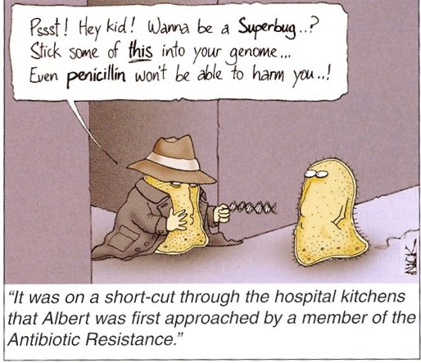

Slide 11

National Efforts
42 CFR RULE (§483.80) UPDATES NH INFECTION PREVENTION AND CONTROL PROGRAMS
System for preventing, identifying, reporting, investigating and controlling infections
Antibiotic stewardship program
Designated IP with specialized training
IP participates on quality assurance committee
NATIONAL ACTION PLAN
CMS restructures QIN-QIO program
SURVEILLANCE
CDC’s NHSN Long-term care module
HAI NATIONAL ACTION PLAN Phase I
State HAI Prevention
HAI NATIONAL ACTION PLAN
Phase III
Include LTC
NATIONAL ACTION PLAN
Combating Antibiotic-Resistant Bacteria
NATIONAL ACTION PLAN
Improvement of NH Quality
CDC BROAD AGENCY AGREEMENT
Antibiotic Resistance Solutions Initiative
2009
2012
2013
2014
2015
2016
2017

Slide 12
CMS Final Rule Phases
Phases
Phase 1 (November 28, 2016) | Implementation of existing requirements Participation in Quality Assurance and Performance Committees Infection Control Program
Phase 2 (November 28, 2017) | Quality Assurance and Performance Improvements (QAPI Plan Only) Infection Control Program with Antibiotic Stewardship
Phase 3 (November 28, 2019) | Full Implementation of QAPI plan Infection Preventionist with specialized training

Slide 13

CMS Quality Improvement Organizations
Quality of care concerns/appeals
Improve knowledge and processes
Mission: Improve the effectiveness, efficiency, economy, and quality of services delivered to Medicare beneficiaries and to make sure that those services are reasonable and necessary

Slide 14
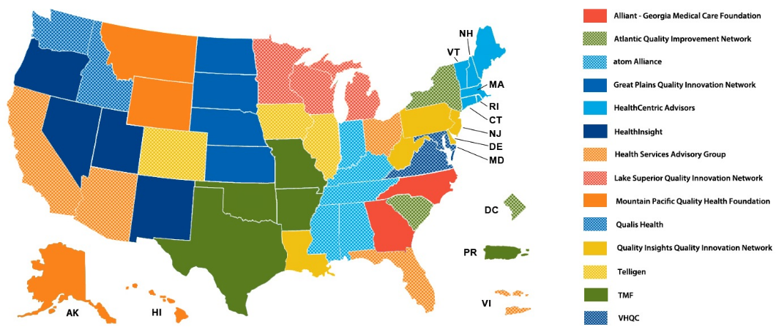
QIN-QIOs
Required as part of the Social Security Act
Each QIN-QIO serves a region of 2-6 states and territories

Slide 15
Infection Surveillance in Nursing Homes
Growth of NH Enrollment in NHSN
Number of Enrolled NHs
3,269 facilities currently enrolled
(March 2018)
CMS funds the
QIN-QIO C. Diff Infection Reporting & Reduction Project begins
Creation of
NHSN Long-term care component
Source: Quarterly CDC NHSN Newsletters March 2012-March 2018

Slide 16
CDC Core Elements for ASP in NH
Leadership Support
written statement
job description
reviewed in quality assurance meetings
Accountability
Identifying leads
Drug Expertise
Partnering as needed
Actions to Improve Use
Policies
Tracking
Monitoring antibiotic use
Reporting Information to Staff
Reports on antibiotic use, C. diff
Education
Clinical prescribers
Nursing staff
Residents/family

Slide 17
Study of the Integration of Infection Management and Palliative Care at End-of-Life in Nursing Homes: SIMP-EL
R01 NR013687 (years 5 - 10: 2017-2021)
Pat Stone RN MPH PhD FAAN, PI
Andy Dick, PhD, PI, RAND subcontract
Susan Mitchell, PhD, PI Harvard subcontract
17

Slide 18
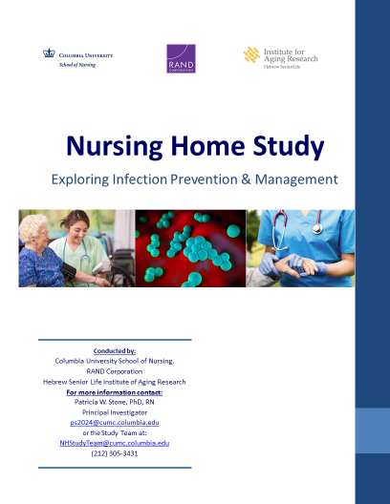
Survey
Characteristics of the infection control program in the facility
Demographics and training of the person in charge of the program (i.e., the infection preventionist), workforce stability and staffing
Antibiotic stewardship
Outbreak control
UTI prevention

Slide 19
Nursing Home Characteristics
 | All n = 1807 | Respondents n = 879 | Non-Respondents n = 928 | p
Ownership, n (%)
For profit | 1223 (67.68) | 551 (62.68) | 672 (72.41) | <0.01
Government | 126 (6.97) | 74 (8.42) | 52 (5.60)
Nonprofit | 458 (25.35) | 254 (28.90) | 204 (21.98)
Chain, n (%) | 1047 (57.94) | 487 (55.40) | 560 (60.34) | 0.03
Number of beds, mean (SD) | 115.43 (65.12) | 112.97 (67.46) | 117.77 (62.77) | <0.01
Region, n (%)
Midwest | 549 (30.38) | 288 (32.76) | 261 (28.13) | <0.01
Northeast | 364 (20.14) | 192 (21.84) | 172 (18.53)
South | 533 (29.50) | 236 (26.85) | 297 (32.00)
West | 361 (19.98) | 163 (18.54) | 198 (21.34)
No differences in: 5-star ratings, case-mix, staffing, citations

Slide 20
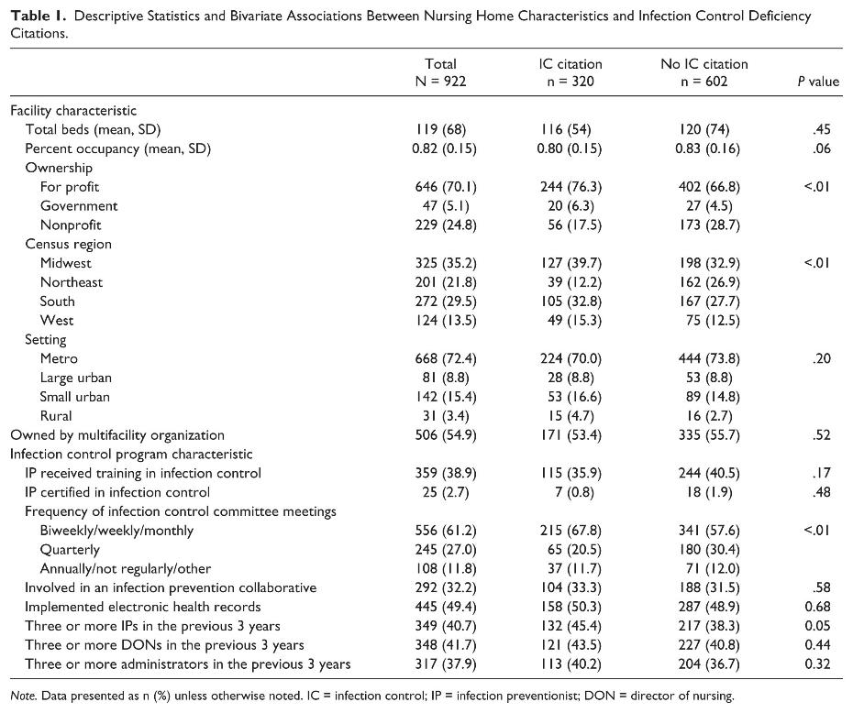
Table 1. Descriptive Statistics and Bivariate Associations Between Nursing Home Characteristics and Infection Control Deficiency Citations.
DOI: (10.1177/0046958018778636)
20

Slide 21
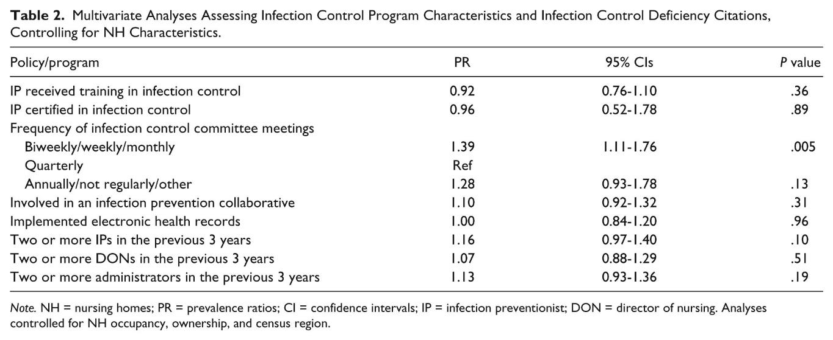
Table 2. Multivariate Analyses Assessing Infection Control Program Characteristics and Infection Control Deficiency Citations, Controlling for NH Characteristics.
DOI: (10.1177/0046958018778636)
21

Slide 22
Associations between Training and Antibiotic Stewardship
Policy/program | Total, N = 922 (%) | Specific training, n = 359 (%) | No specific training, n = 563 (%) | P value
Written guidelines in place for antibiotic use | 422 (46.5) | 161 (45.5) | 261 (47.1) | .63
Collection of data on antibiotic utilization | 467 (51.4) | 197 (55.7) | 270 (48.7) | .04
Antibiotic prescribing guideline/order form | 152 (16.7) | 70 (19.8) | 82 (14.8) | .05
Policies to restrict the use of specific antibiotics | 65 (7.2) | 44 (12.4) | 21 (3.8) | <.01
Providing feedback to clinicians on antibiotic prescribing | 301 (33.2) | 136 (38.4) | 165 (29.8) | .01
Use of therapeutic formularies | 153 (16.9) | 73 (20.6) | 80 (14.4) | .02
Review of cases to assess antibiotic appropriateness | 395 (43.5) | 179 (50.6) | 216 (39.0) | <.01
None of the above policies/programs on antibiotic use | 105 (11.6) | 31 (8.8) | 74 (13.4) | .03

Slide 23
Multivariate Results*
Policy/program | PR | 95% CIs | P value
Written guidelines in place for antibiotic use | 0.99 | 0.86-1.15 | .95
Collection of data on antibiotic utilization | 1.14 | 1.00-1.30 | .04
Antibiotic prescribing guideline/order form | 1.33 | 0.99-1.78 | .05
Policies to restrict the use of specific antibiotics | 3.29 | 1.99-5.44 | <.01
Providing feedback to clinicians on antibiotic prescribing | 1.31 | 1.09-1.57 | <.01
Use of therapeutic formularies | 1.36 | 1.02-1.80 | .04
Review of cases to assess antibiotic appropriateness | 1.29 | 1.11-1.50 | <.01
None of the above policies/programs on antibiotic use | 0.62 | 0.42-0.94 | .02
* Controlled for NH occupancy, ownership and region

Slide 24
Change in Infection Programs Over Time
Questions on ICP program
  Antibiotic Stewardship (5 policies)
  Outbreak Control (7 policies)
  UTI Prevention (7 policies)
  Infection Preventionist Education & Training
Calculated standardized intensity indices for the 3 policy groups
Index | Mean | Std Dev
Antibiotic Stewardship | 47.81 | 29.10
Outbreak Control | 61.50 | 26.19
UTI Prevention | 52.77 | 20.13

Slide 25
Change in Infection Programs Over Time
Significant increased in policies in all categories (p<0.001)

Slide 26
Change in Infection Programs Over Time
Multivariate models showed significant increases over time and impact of IP training, education and responsibilities on ICP program
 | Antibiotic Stewardship Policies |  | Outbreak Control Policies |  | UTI Prevention Policies
 | Estimate | p value | Estimate | p value | Estimate | p value
2018 Survey Indicator | 33.14 | <0.01 | 13.72 | <0.01 | 5.61 | <0.01
IP Characteristics
Education
Licensced Practical Nurse | 0.08 | 0.98 | -14.54 | <0.01 | -0.81 | 0.77
Registered Nurse | 0.52 | 0.86 | -10.93 | <0.01 | -0.30 | 0.90
Other | Ref
Training
Certified in Infection Control (CIC) | 8.67 | <0.01 | 5.33 | 0.06 | 6.53 | <0.01
State of local training course with certificate | 2.61 | 0.16 | 4.31 | 0.02 | 4.19 | 0.01
National or local training course through professional society | 5.16 | 0.01 | 6.48 | <0.01 | 4.58 | 0.01
Other | 4.17 | 0.07 | 5.95 | 0.01 | 0.82 | 0.67
No Specific Infection Control Training | -3.76 | 0.05 | -0.91 | 0.64 | -0.83 | 0.60
Adjusted for staff turnover and facility characteristics

Slide 27
Change in Infection Programs Over Time
Multivariate models showed significant increases over time and impact of IP training, education and responsibilities on ICP program
 | Antibiotic Stewardship Policies |  | Outbreak Control Policies |  | UTI Prevention Policies
 | Estimate | p value | Estimate | p value | Estimate | p value
Responsibilities outside of IC
Director/Assistant Director of Nursing | -3.11 | 0.03 | -5.21 | <0.01 | -0.50 | 0.66
Quality Coordinator/Quality Management | -1.20 | 0.42 | -0.61 | 0.68 | -1.67 | 0.17
Staff Education/Staff Development | -0.76 | 0.57 | 2.28 | 0.09 | 0.73 | 0.51
Staff Nurse | -0.87 | 0.63 | -6.36 | <0.01 | -0.75 | 0.62
Employee Health | 1.79 | 0.23 | 2.70 | 0.07 | 2.17 | 0.07
Other | 0.57 | 0.70 | 1.17 | 0.43 | 0.29 | 0.81
No Other Activities | 2.64 | 0.61 | 4.63 | 0.38 | 12.11 | <0.01
Adjusted for staff turnover and facility characteristics

Slide 28

Change in Infection Programs Over Time
National initiatives to improve ICP are working
Hiring & training dedicated infection preventionists are key for ICP
  Having dedicated IP not part of the final rule
Future work will evaluate if these policy changes have improved infection rates and antibiotic usage

Slide 29
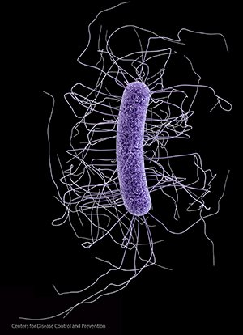
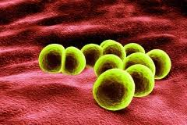
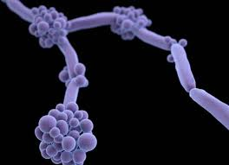
Questions or
Comments
MRSA
C diff
Candida auris

Slide 30

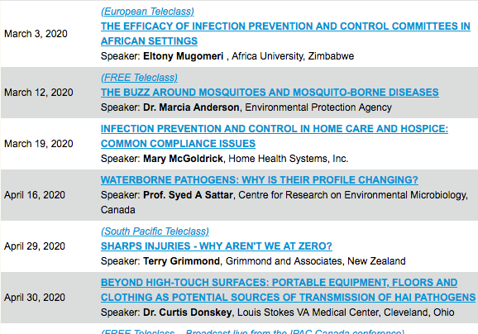

Slide 31


