Slide 1
ANTIMICROBIAL ENVIRONMENTAL SURFACES IN HEALTHCARE SETTINGS
CAN THEY REALLY BE BENEFICIAL?
Jean-Yves Maillard
Cardiff School of Pharmacy and Pharmaceutical Sciences
Cardiff University
Hosted by Bruce Gamage Provincial Infection Control Network of British Columbia
www.webbertraining.com
October 27, 2016

Slide 15
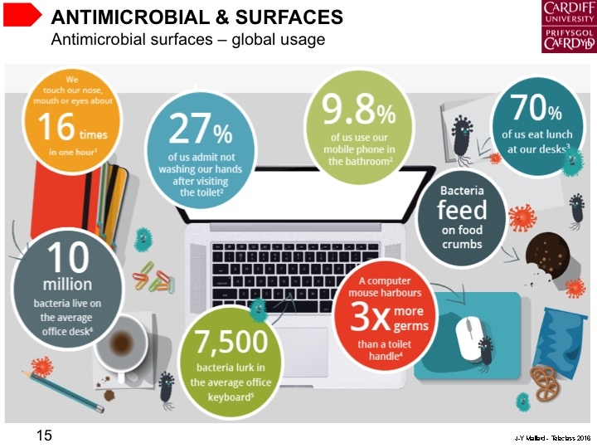

Slide 22
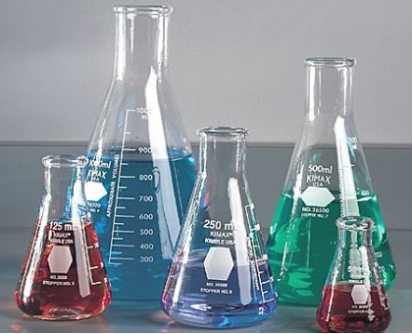
PRINCIPLES FOR ACTIVITY
J-Y Maillard - Teleclass 2016

Slide 26
PRINCIPLES FOR ACTIVITY
Factors affecting antimicrobial efficacy
JIS-Z-2801 standard efficacy test
Temperature: 35°C
Humidity: 100% humidity
Contact time: 24 hours
Factors inherent to the product
concentration
formulation
water activity
pH*
Factors inherent to the application
surface
organic load (soiling)
temperature
contact time
humidity
Factors inherent to the micro-organism
type
number
phenotype
pH*
J-Y Maillard - Teleclass 2016

Slide 27
TESTS FOR ANTIMICROBIAL SURFACES
J-Y Maillard - Teleclass 2016

Slide 43
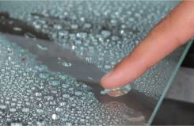
DRY BIOFILMS?
J-Y Maillard - Teleclass 2016

Slide 44
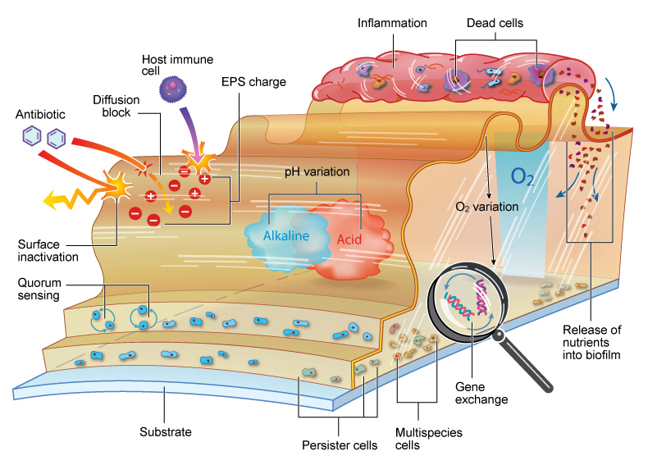
MICROBIAL BIOFILMS
Courtesy of K Vickery, Macquarie University, Sydney, Australia
J-Y Maillard - Teleclass 2016

Slide 45
MICROBIAL BIOFILMS
Biofilm resistance mechanisms | Observation
Establishing a reduced local biocide concentration | Diffusion gradient Non-specific neutralising interaction with cell constituents Lysed bacterial community offering mechanistic inactivation as a result of increased organic load
Enhanced bacterial insusceptibility | Degradation of antimicrobial Efflux (more effective against lower concentrations) Early stress-response
Slow growth/metabolism | A local chemical gradient (reduced nutrients / O₂) can retard growth rate, mitigating against biocide injury
Selection for increased resistance | Formation of pockets of surviving bacteria Dormant cells (which re-grow rapidly in the presence of exudates released from lysed community)
Acquisition of new resistance determinants | Increased genetic exchange
Intrinsic resistance | Nature of micro-organisms (i.e. some being more resistant than others)
Maillard & Denyer. Chemica Oggi 2009; 27:26-8.
J-Y Maillard - Teleclass 2016

Slide 46
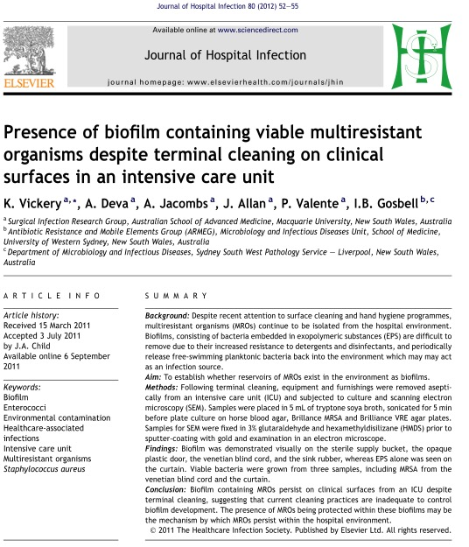
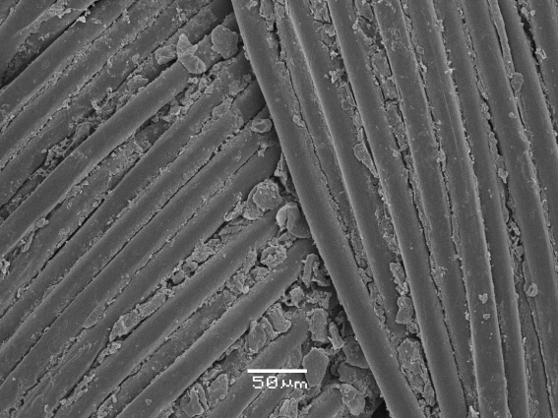
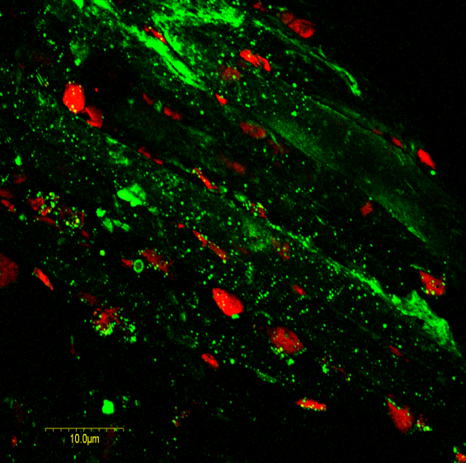
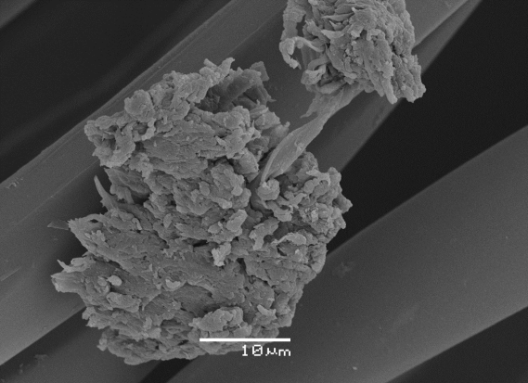
MICROBIAL BIOFILMS
“Dry” biofilm - a new challenge
Curtain – MRSA +ve
Desiccation resistance
Venetian blind cord MRSA +ve
Courtesy of K Vickery, Macquarie University Sydney, Australia
J-Y Maillard - Teleclass 2016

Slide 51
CONSIDERATIONS
J-Y Maillard - Teleclass 2016

Slide 54
November 10 NOROVIRUS AND HEALTHCARE FACILITIES: HOW TO KEEP THE VIRUS OUT AND WHAT TO DO WHEN IT GETS IN Dr. Ben Lopman, CDC, Atlanta Prof. Miren Iturriza-Gomara, University of Liverpool November 23 AIR TRAVEL AND INFECTION TRANSMISSION Dr. Paul Edelson, CDC JFK Airport Quarantine Station, New York Sponsored by GOJO (www.gojo.com) December 1 2017 TELECLASS SCHEDULE RELEASED
December 8 VIABILITY OF BACTERIA ON FABRICS Prof. Jerry H. Kavouras, University of Illinois at Chicago December 15 (FREE Teleclass)
INFECTION CONTROL IN ELDERLY CARE INSTITUTIONS – WHERE SHOULD WE GO? Prof. Andreas Voss, Radboud University Medical Centre, The Netherlands

