Slide 1

Are towelettes effective for surface decontamination in healthcare settings?
Jean-Yves Maillard
Cardiff School of Pharmacy and Pharmaceutical Sciences
Cardiff University
Hosted by Dr. Lynne Sehulster
Prevention and Response Branch
Division of Healthcare Quality Promotion
Centers for Disease Control and Prevention
www.webbertraining.com
April 30, 2015

Slide 2

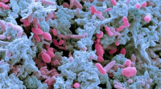
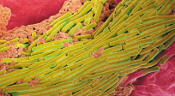
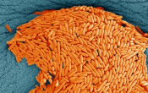
OBJECTIVES
Review the usage of towelettes in healthcare settings, particularly pre-wetted towelettes
Discuss the role of pre-wetted towelettes in healthcare settings
Consider the claims made by pre-wetted towelettes’ manufacturers in relation to the efficacy tests performed
Review the efficacy of antimicrobial and detergent pre-wetted towelettes against bacteria, spores (Clostridium difficile) and viruses
Reflect on the appropriate usage of pre-wetted towelettes and evidence that need to be provided by manufacturers to make an meaningful and practical claim
Discuss potential new practical and regulatory challenges for pre-wetted towelettes
2
Teleclass 2015

Slide 3
SOME NUMBERS…
HCAIs cost the NHS: £1 billion annually (£3,154 per patient)
HPA 2012
Plowman et al. J Hosp Infect 2001;47:198-209.
National Audit Office, The management and control of hospital acquired infection in acute NHS trusts in England., 2009, The Stationary Office: London
IFIC 2011
20-30% of HCAIs could be avoided with better application of existing knowledge and realistic infection control practices
National Audit Office 2009
Enhanced cleaning practices are reported to save hospitals between £30,000–£70,000
Dancer et al. BMC Med 2009;7:28.
3
Teleclass 2015

Slide 4
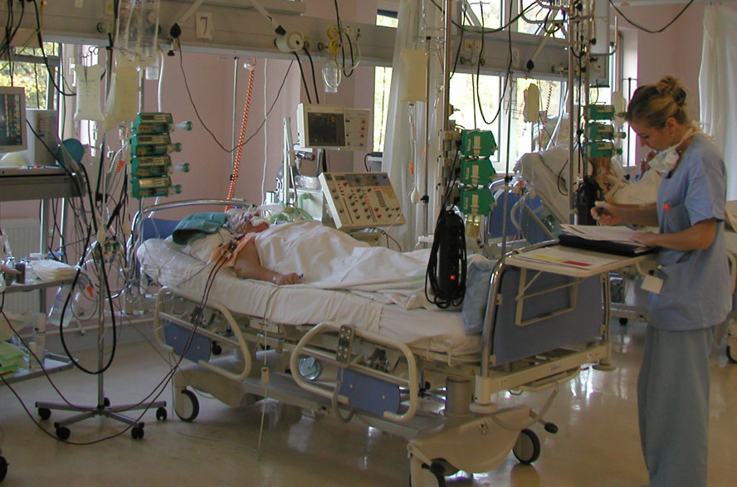
LIMITATIONS OF CURRENT SURFACE INTERVENTIONS
SURFACES AT RISK
*
*
*
*
*
*
*
4
Teleclass 2015

Slide 5
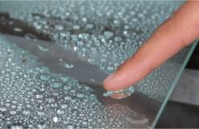
What is the evidence that environmental surface are involved in the transmission of pathogens?
5
Teleclass 2015

Slide 6
ROLE OF SURFACES IN MICROBIAL TRANSMISSION
1970s - 1990s: THE DARK AGES: AN ALMOST COMPLETE DENIAL!
EVIDENCE
Microorganisms survival on surfaces proximal to patients (high-touch surfaces)
Pathogens survival on surfaces at concentrations sufficient for transmission and transference to the hands of healthcare workers (inc. MRSA, C. difficile, norovirus, VRE…)
Low infectious dose for some pathogens
Otter et al. ICHE 2011;32:687-99.
Lawley et al. AEM 2010;76L6895-900.
Teunis et al. J Med Virol 2008;80:1468-76.
Ample evidence of the genotypic link between bacteria isolated from patients and surfaces proximal to patients
6
Teleclass 2015

Slide 7
ROLE OF SURFACES IN MICROBIAL TRANSMISSION
MRSA
Link between inanimate environmental contamination and infected or colonized individuals
65% of nursing staff that had directly treated an infected individual contaminated their gowns/uniforms with MRSA
MRSA contamination of gloves was also observed in 42% of personnel who had no direct contact with the patient, but had touched surfaces in infected patient's rooms
Boyce et al. ICHE1997; 18:622–7.
Hand contamination from surface
Bhalla et al. ICHE 2004; 25:164–7.
7
Teleclass 2015

Slide 8
ROLE OF SURFACES IN MICROBIAL TRANSMISSION
Prevalence of Clostridium difficile
Floors, commodes, toilets, bed pans, bed frames
Vonberg et al. Clin Microbiol Infect 2008; 14: 2-20.
C. difficile spores persistence on surfaces : 5 months
Kramer et al. BMC Infect Dis 2006; 6:130-8.
C. difficile incidence data correlated with the prevalence of environmental spores in 1 ward (out of 2).
Fawley et al. Epidemiol Infect 2001; 126: 343-50.
8
Teleclass 2015

Slide 9
ROLE OF SURFACES IN MICROBIAL TRANSMISSION
Cheeseman et al. J Hosp Infect, 2009; 72: 319-25.
Observations | Hospital 1 | Hospital 2
% observations where staff washed hands | 28 | 20
% observations where staff used alcoholic hand rub | 30 | 9
Of those incidences where no gloves worn, % incidences where staff used alcoholic hand rub | 41 | 14
% staff wearing no gloves and used no AHR, but washed hands | 17 | 19
% staff using no protection/skin sanitisation | 19 | 46
% potential staff to object cross- contamination | 30 | 59
% potential staff to patient cross-contamination | 4 | 0
% potential object to object cross- contamination | 70 | 88
% potential object to patient cross-contamination | 20 | 9
% potential patient to object cross-contamination | 17 | 9
Low frequency of hand sanitisation, particularly with use of AHR lead to high incidence of potential cross contamination
9
Teleclass 2015

Slide 10
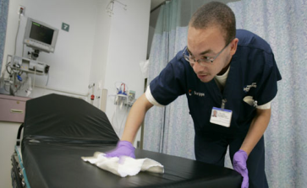
How can decontamination of environmental surfaces be achieved?
10
Teleclass 2015

Slide 11
LIMITATIONS OF CURRENT SURFACE INTERVENTIONS
BREAKING THE CHAIN OF TRANSMISSION
PATIENT
PATIENT
ANTIMICROBIAL SURFACES?
CONTAMINATED SURFACES
HEALTHCARE WORKERS
SURFACE DISINFECTION
- liquid disinfectants
- antimicrobial pre-wetted wipes
- UV irradiation
- gas
11
Teleclass 2015

Slide 12
LIMITATIONS OF CURRENT SURFACE INTERVENTIONS
BREAKING THE CHAIN OF TRANSMISSION
Increasing body of knowledge which highlights improved infection control practices can help break the chain of transmission
Otter et al. ICHE 2011;32:687-99.
Rutala & Weber. J Hosp Infect 2001;48:S64-8.
Boyce. J Hops Infect 2007;65:50-4.
Staff compliance
Product efficacy
Product
usage
Factors affecting efficacy
12
Teleclass 2015

Slide 13

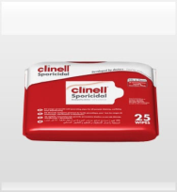
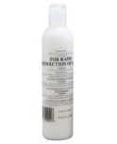
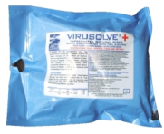


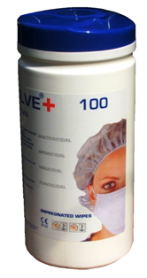
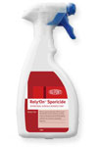

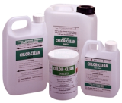
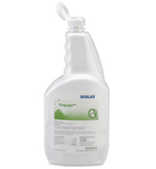
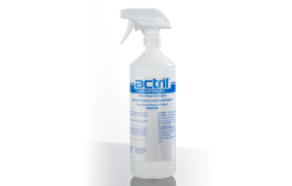
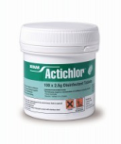

BREAKING THE CHAIN OF TRANSMISSION
USE OF BIOCIDAL PRODUCTS
13
Teleclass 2015

Slide 14
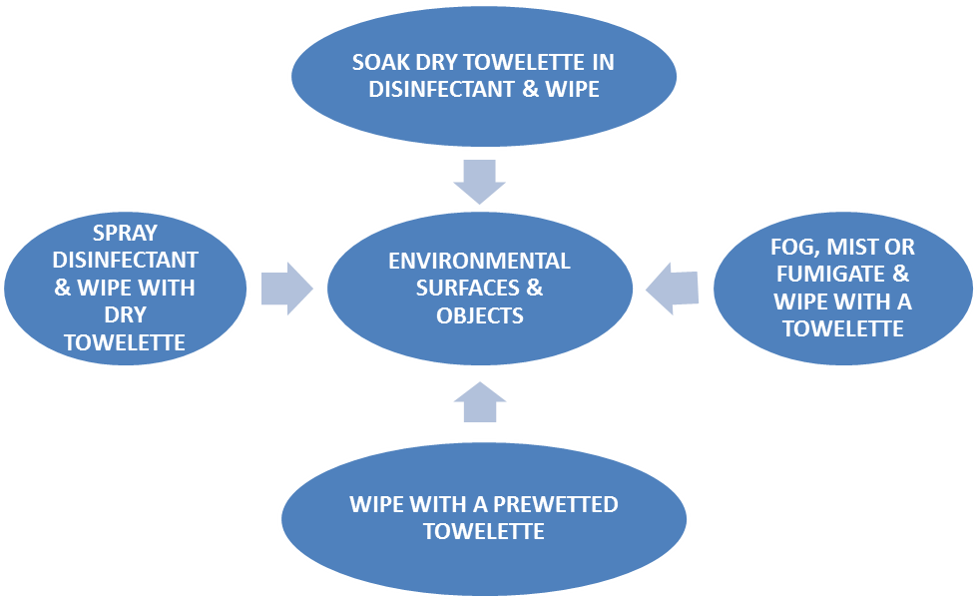
BREAKING THE CHAIN OF TRANSMISSION
Possible scenarios for decontaminating high-touch environmental surfaces by wiping
Sattar and Maillard AJIC 2013;41:S97-S104.
14
Teleclass 2015

Slide 15
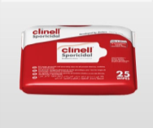
Can manufacturers and end users rely on standard efficacy tests
(product claim)?
15
Teleclass 2015

Slide 16
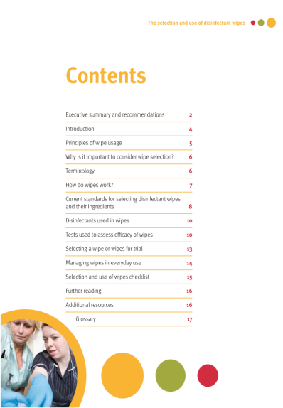
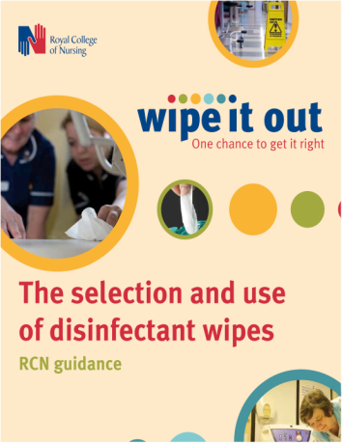
HOW TO DETERMINE WIPE EFFICACY?
16
Teleclass 2015

Slide 17
HOW TO DETERMINE WIPE EFFICACY?
“The main purpose of wipes is to remove contamination from surfaces. Additionally, some wipes may provide some antimicrobial activity by the inclusion of a disinfectant although this activity might be limited based on contact time, type of surface and contamination present.”
“There are currently no accepted standards to support the selection and purchase of disinfectant wipes in health care.”
Support the use of surface test rather than suspension test
17
Teleclass 2015

Slide 18
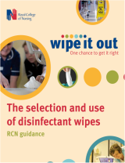
HOW TO DETERMINE WIPE EFFICACY?
Phase 2, step 2 tests: surface tests
Determine bactericidal, fungicidal, virucidal or sporicidal activity under laboratory conditions that simulate practical conditions.
Can be used to make a claim (liquid expressed from wipes)
Application for surface disinfection
e.g. EN14561: Quantitative carrier test for the evaluation of bactericidal activity for instruments used in the medical area
Temperature: 20ºC(4-40ºC); contact time: 5 min (1-60 min) + soiling
18
Teleclass 2015

Slide 19
HOW DO WE KNOW WIPES WORK?
HOW TO DETERMINE WIPE EFFICACY?
Phase 1, step 1 tests: basic activity (suspension test)
Does my product show some antimicrobial activity (yes/no)
Not to be used to make a claim
e.g. (BS)EN14347: Basic sporicidal activity
Temperature: 20ºC; contact time one of the following 30, 60, 120 min; no soiling (no C. difficile)
Phase 2, step 1 tests: suspension test
Determine bactericidal, fungicidal, virucidal or sporicidal activity under laboratory conditions that simulate practical conditions.
e.g. EN 13727: Bactericidal suspension test
Temperature: 20ºC(4-40ºC); contact time:
5 min (1-60 min) + soiling
19
Teleclass 2015

Slide 20
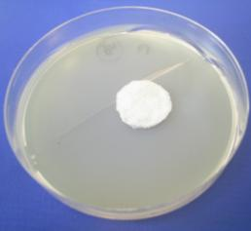
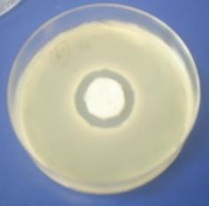
HOW TO DETERMINE WIPE EFFICACY?
Efficacy of “antimicrobial” wipes
  Qualitative –agar diffusion test (ISO 20645)
ISO 20645
CONTROL
TEST
Test interpretation: “good antimicrobial effect”
20
Teleclass 2015

Slide 21
WIPE USAGE IN PRACTICE
Antimicrobial wipe usage
Williams et al. J Hosp Infect 2007; 67: 329-35
Observation of usage in practice –cleaning staff in ITUs
- use of wipes – surface area
- contact
- rotation
Wipe Number | Surface initially wiped | Time applied (seconds) | Number of consecutive surfaces wiped (other surfaces)
1 | Bed Rail | 4 | 5 (bedside table, monitor X2, monitor stand)
2 | Steel Trolley | 6 | 2 (both shelves on the trolley wiped)
1 | Monitor | 4 | 5 (monitors, two keypads, monitor stand)
2 | Bed rail | 7 | 4 (table, monitor, keypad)
3 | Bedside table | 10 | 4 (folder, two bed rails)
21
Teleclass 2015

Slide 22
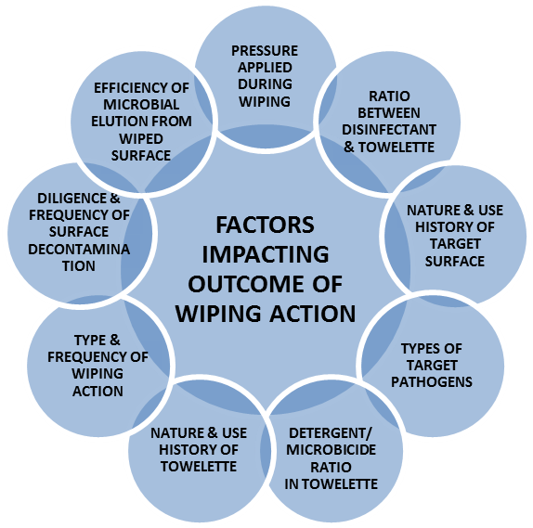
WIPE USAGE IN PRACTICE
Factors impacting on the efficacy of wipes.
Sattar and Maillard AJIC 2013;41:S97-S104.
Usage
Formulation (product)
pathogen
22
Teleclass 2015

Slide 23

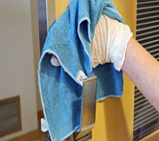
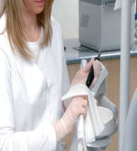
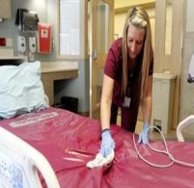
WIPE TESTS
Sattar and Maillard. Am J Infect Control 2013; 41:S97-S104
WIPING NOT CONTROLLED
AOAC International 961.02
EN 4-Field test (phase 2, step 2)
ASTM International E2362
US EPA (virucidal efficacy, mycobactericidal efficacy)
US EPA; Draft Interim Guidance for Non-Residual Sanitization of Hard Inanimate Food Contact Surfaces Using Pre-Saturated Towelettes
US EPA Method for Disinfection Using Pre-Saturated Towelettes
CONTACT TIME INAPPROPRIATE
AOAC International 961.02
US EPA Method for Disinfection Using Pre-Saturated wipes
DO NOT REFLECT PRODUCT USAGE
23
Teleclass 2015

Slide 24
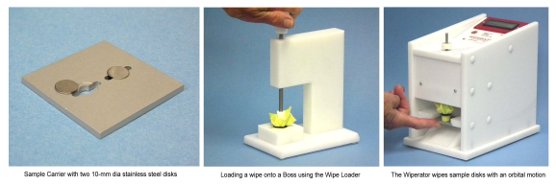
3-STEP TEST – A NEW ASTM Intl. STANDARD (04-15)
Remove bioburden from a surface
Stage 1 – bacterial removal
How good are the wipes in removing microbial contaminants? (not killing effect)
Prevent transfer of bioburden from the wipe to other surfaces
Stage 2 – bacterial transfer “adpression tests”
Can the wipes transfer survivors to other surfaces (i.e. cross-contaminate)?
Where antimicrobial is present – kill the microbial bioburden
Stage 3 – Antimicrobial activity
Can the wipes kill the bacteria they remove?
24
Teleclass 2015

Slide 25

EVIDENCE THAT
PRE-WETTED ANTIMICROBIAL/DETERGENT WIPES WORK
25
Teleclass 2015

Slide 26
LITERATURE USING THE 3-STEP TEST
Williams GJ, Denyer SP, Hosein IK, Hill DW and Maillard J-Y. (2007) The development of a new
three-step protocol to determine the efficacy of disinfectant wipes on surfaces contaminated with Staphylococcus aureus. Journal of Hospital Infection 67(4): 329-335
-S. aureus and methicillin-resistant S. aureus: one wipe
Panousi MN, Williams GJ, Girdlestone S and Maillard J-Y. (2009) Use of alcoholic wipes during aseptic manufacturing. Letters in Applied Microbiology 48, 648-651.
-methicillin-resistant S. aureus, B. subtilis, S. epidermidis : alcohol impregnated vs. alcohol spray on wipe
Williams GJ, Denyer SP, Hosein IK, Hill DW and Maillard J-Y. (2009) Limitations of the efficacy of surface disinfection in the healthcare settings. Infection Control and Hospital Epidemiology, 30(6); 570-573.
-S. aureus and methicillin-resistant S. aureus: multiple wipes
Siani H, Cooper CJ and Maillard J-Y. (2011) Efficacy of ‘sporicidal’ wipes against Clostridium difficile. American Journal of Infection Control, 39(3), 212-218.
- C. difficile: multiple wipes
Sattar S.A. and Maillard J.-Y. (2013) The Crucial Role of Wiping in Decontamination of High-Touch Environmental Surfaces: Review of Current Status and Directions for the Future. American Journal of Infection Control, 41; S97-S104. - review
Ram L, Wesgate R, Siani S and Maillard J-Y (2015) Pathogen transfer and high variability in pathogen removal by detergent wipes. American Journal of Infection Control, in press
-S. aureus, A. baumanii, C. difficile (spores): multiple wipes
26
Teleclass 2015

Slide 27
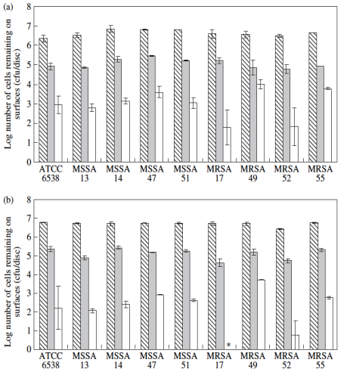
DO ANTIMICROBIAL WIPES WORK?
Williams et al. J Hosp Infect 2007; 67: 329-35
REMOVAL
Log₁₀ number of S. aureus cells remaining on surfaces following 10 s applications of control and test wipes. Striped bars: inocula; grey bars: control wipes; white bars: test wipe
(a) Dirty
1 log₁₀ reduction (90%)
(b) clean
1 log₁₀ reduction (90%)
27
Teleclass 2015

Slide 28
DO ANTIMICROBIAL WIPES WORK?
Williams et al. J Hosp Infect 2007; 67: 329-35
REMOVAL
Log₁₀ number of S. aureus cells remaining on surfaces following 10 s applications of control and test wipes. Striped bars: inocula; grey bars: control wipes; white bars: test wipe
(a) Dirty
3 log₁₀ reduction (99.9%)
(b) clean
4 log₁₀ reduction (99.99%)
28
Teleclass 2015

Slide 29
DO ANTIMICROBIAL WIPES WORK?
Williams et al. J Hosp Infect 2007; 67: 329-35
REMOVAL
Log₁₀ number of S. aureus cells remaining on surfaces following 10 s applications of control and test wipes. Striped bars: inocula; grey bars: control wipes; white bars: test wipe
(a) Dirty
5 log₁₀ reduction (99.999%)
(b) clean
6 log₁₀ reduction (99.9999%)
29
Teleclass 2015

Slide 30
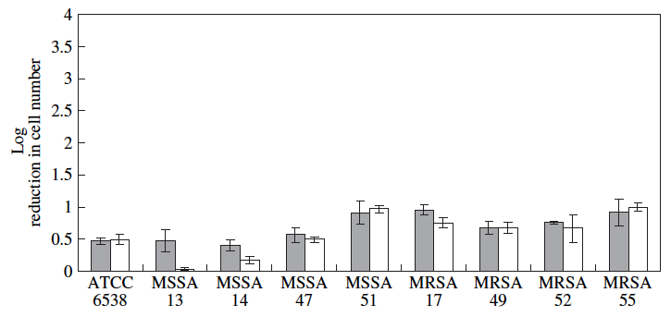
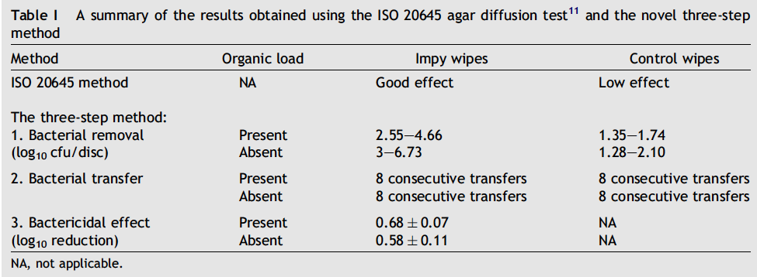
DO ANTIMICROBIAL WIPES WORK?
Williams et al. J Hosp Infect 2007; 67: 329-35
KILLING
The bactericidal effect of 10 s exposures of S. aureus strains to a grapefruit
extract containing wipe.
1 log₁₀ reduction (90%)
Antimicrobial wipes
30
Teleclass 2015

Slide 31
DO ANTIMICROBIAL WIPES WORK?
Williams et al. Infect Control Hosp Epidemiol 2009;30:570-3
REMOVAL
Log₁₀ number of S. aureus cells removed from surfaces following 10 s applications of two disinfectant wipes.
(a) Dirty
99.9-%
90%
(b) clean
99.9-99.99%
90-99%
31
Teleclass 2015

Slide 32
DO ANTIMICROBIAL WIPES WORK?
Williams et al. Infect Control Hosp Epidemiol 2009;30:570-3
KILLING
The bactericidal effect of 10 s exposures of S. aureus to a disinfectant wipe.
Inocula were prepared to simulate dirty (grey bars) and clean (white bars) conditions
32
Teleclass 2015

Slide 33
DO ANTIMICROBIAL WIPES WORK?
Panousi et al. Lett Appl Microbiol 2009; 48:648-51
Comparison of efficacy between an alcohol impregnated wipe and a non-impregnated sprayed with ethanol 70% v/v wipe.
Impregnated wipe
Non-impregnated wipe sprayed with ethanol 70% v/v
33
Teleclass 2015

Slide 34
DO ANTIMICROBIAL WIPES WORK?
Panousi et al. Lett Appl Microbiol 2009; 48:648-51
Comparison of efficacy between an alcohol impregnated wipe and a non-impregnated sprayed with ethanol 70% v/v wipe.
Impregnated wipe
Non-impregnated wipe sprayed with ethanol 70% v/v
34
Teleclass 2015

Slide 35
DO ANTIMICROBIAL WIPES WORK?
REMOVAL
SPORICIDAL CLAIM – efficacy testing against C. difficile NCTC12727
Siani et al. AJIC 2011; 39(3):212-8.
Wipes | Bacterial Removal (log₁₀ cfu/disk ± SD) 500 g surface pressure | Bacterial transfer following 10 s wiping time at 500 g surface pressure
Negative control | 1.13 (± 0.36) | 5 consecutive transfers. TNTC
Hypochlorite soaked wipe | 2.02 (± 0.21) | 5 consecutive transfers. TNTC
Clinell® sporicidal wipe | 4.09 (± 0.79) | No spore transferred
TriGene Advance | 0.22 (± 0.07) | 5 consecutive transfers. From 0 to TNTC
AzoMaxActiveTM | 1.30 (± 0.33) | 5 consecutive transfers. From 0 to TNTC
Sani-Cloth® Rapid | 0.57 (± 0.07) | 5 consecutive transfers. From 1 to TNTC
Activ8TM | +0.08 (± 0.08) | 5 consecutive transfers. TNTC
SuperNova® | 1.14 (± 0.65) | 5 consecutive transfers. From 83 to TNTC
Tuffie | 0.67 (± 0.11) | 5 consecutive transfers of ≤43 bacteria
Enduro Patient wipes | 0.88 (± 0.13) | 5 consecutive transfers. From 2 to TNTC
NewGenn | 0.84 (± 0.66) | 5 consecutive transfers. From 40 to TNTC
35
Teleclass 2015

Slide 36
DO ANTIMICROBIAL WIPES WORK?
KILLING
SPORICIDAL CLAIM – efficacy testing against C. difficile NCTC12727
Siani et al. AJIC 2011; 39(3):212-8.
Wipes | Claim on label | Sporicidal effect (log₁₀ reduction ±SD)
 |  | 10 s contact time | 5 min contact time
Clinell® sporicidal wipe | Sporicidal | 0.11 (± 0.15) | 1.54 (± 0.84)
TriGene Advance | Sporicidal | 0.04 (± 0.05) | +0.84 (± 0.03)
AzoMaxActiveTM | Bactericidal claim and claim against Clostridium difficile on label | 1.41 (± 0.14) | +0.92 (± 0.15)
Sani-Cloth® Rapid | Sporicidal | 1.77 (± 0.27) | 0.01 (± 0.44)
Activ8TM | Sporicidal | 0.99 (± 0.14) | +0.70 (± 0.15)
SuperNova® | Sporicidal | 1.96 (± 0.09) | +0.66 (± 0.13)
Tuffie | Sporicidal | 0.37 (± 0.23) | +0.50 (± 0.19)
Enduro Patient wipes | Sporicidal | 0.41 (± 0.10) | +0.66 (± 0.10)
NewGenn | No sporicidal claim on label | 0.31 (± 0.15) | +0.82 (± 0.14)
Hypochlorite soaked wipe | 5000 ppm | +0.14 (± 0.49) | 5.39 (± 0.00)
36

Slide 37
DO ANTIMICROBIAL WIPES WORK?
EFFICACY OF ANTIMICROBIAL WIPES AGAINST VIRUSES
Remove, transfer and kill MS2 phage, a surrogate virus for small non-enveloped mammalian viruses.
Virucidal activity of expressed wipe solutions (n=3)
Virus removal from disks and virus transfer from wipes to disks. (n=3)
 | Mean removal | Range
‘Universal’ wipes | 1.68 log₁₀ | 1.37‑1.87 log₁₀
Sporicidal wipes | 3.13 log₁₀ | 2.61- 3.65 log₁₀
Detergent wipes | 2.11 log₁₀ | 0.36- 3.85 log₁₀
37

Slide 38
DO DETERGENT WIPES WORK?
REMOVAL
EFFICACY OF DETERGENT WIPES
Wesgate et al. AJIC; in press
Bacterial/spore removal from surface
S. aureus
A. baumannii
C. difficile
38
Teleclass 2015

Slide 39
DO DETERGENT WIPES WORK?
TRANSFER
EFFICACY OF DETERGENT WIPES
Wesgate et al. AJIC; in press
CFU and % transfer in S. aureus, A. baumannii and C. difficile onto three consecutive surfaces.
39
Teleclass 2015

Slide 40
DO ANTIMICROBIAL WIPES WORK?
TESTING WIPES EFFICACY: FIELD TRIAL
Cross-over study in two gastro/surgery wards (1 and 2) with similar patient mix, design and layout (number of bedded-bay and bedded-side room)
Cleaned using the current wipe regimen (detergent and chlorine) or a sporicidal wipe for a period of 9 months.
 | Baseline data | Cross over study
 | Phase 1 | Phase 2 |  |  |  | Phase 3
Ward 1
Ward 2
Month | 1 | 2 | 3 | 4 | 5 | 6 | 7 | 8 | 9
40
Teleclass 2015

Slide 41

DO ANTIMICROBIAL WIPES WORK?
TESTING WIPES EFFICACY: FIELD TRIAL
LRU measurement – bioburden on surfaces
Total aerobic counts
Total anaerobic count
Siani et al. unpublished data.
41
Teleclass 2015

Slide 42
DO ANTIMICROBIAL WIPES WORK?
Gen | Phase -1 |  |  |  |  | Phase-2 |  |  |  |  |  |  |  |  |  |  |  | Phase-3
A
B
C
D
E
F
G
H
I
J
K
L
M
N
O
P
Q
R
S
T
Staphylococci
Ward-2
Siani et al. unpublished data.
42
Teleclass 2015

Slide 43
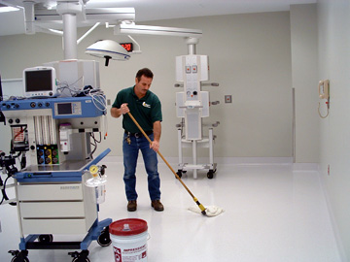
Education & Training
43
Teleclass 2015

Slide 44
LIMITATIONS OF CURRENT SURFACE INTERVENTIONS
EDUCATION AND TRAINING
Integral to infection control and prevention
NHS personnel (medical and non-medical staff) and NHS users (patients and visitors).
Evidence that they can contribute to reductions in HCAIs.
Siani & Maillard. Eur J Clin Microbiol Infect Dis 2015: DOI: 10.1007/s10096-014-2205-9.
Disparity in training
Nurses and healthcare assistants were provided with induction training on infection control in 90% of NHS Trusts, whilst only 16% of senior doctors received training.
National Audit Office, The management and control of hospital acquired infection in acute NHS trusts in England., 2009, The Stationary Office: London
44
Teleclass 2015

Slide 45
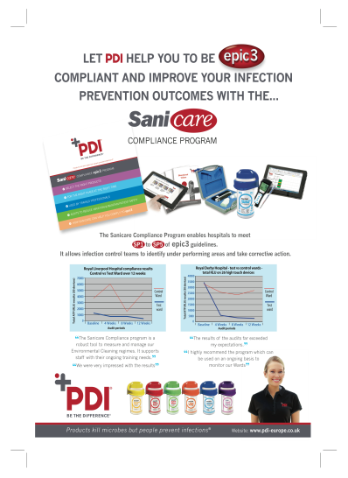
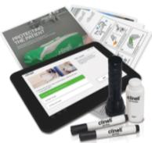
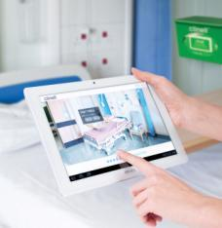
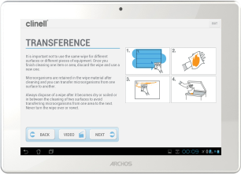
LIMITATIONS OF CURRENT SURFACE INTERVENTIONS
EDUCATION AND TRAINING
From wipe manufacturers – Training tools & Audit
45
Teleclass 2015

Slide 46

A way forward
46
Teleclass 2015

Slide 47
LIMITATIONS OF CURRENT SURFACE INTERVENTIONS
A WAY FORWARD
Auditing product efficacy and usage – manufacturers’ responsibility
The choice of disinfectant will depend on its intended use, thus the manufacturer’s instructions should be followed to ensure correct application
Maillard & McDonald. In Pract 2012;34: 292-9.
Procurement – include auditing as part of product package
Education of end users
Joint manufacturers and NHS provider responsibilities
Procurement - include product training, educational material (poster etc.)
47
Teleclass 2015

Slide 48
A WAY FORWARD
BETTER UNDERSTANDING
WIPE MATERIAL
TARGET ORGANISM
FORMULATION
SURFACES
Key criteria
Mechanical effect
Formulation: correct balance of surfactants
48
Teleclass 2015

Slide 49
A WAY FORWARD
BIOCIDES ARE IMPORTANT!
PREVENTION, PREVENTION PREVENTION
COMPLIANCE (only 30% surface disinfected)
ANTIMICROBIAL WIPES
Removal of bioburden from surfaces
Added value – vegetative bacteria –
kill within the contact time (10 sec)
- spores - ? – wipes safe to dispose of.
49
Teleclass 2015

Slide 50
A WAY FORWARD
BIOCIDES ARE IMPORTANT!
PREVENTION, PREVENTION PREVENTION
COMPLIANCE (only 30% surface disinfected)
BETTER PRODUCTS
Understanding formulation efficacy
APPROPRIATE EFFICACY TEST
Product development
Ensuring efficacy in real conditions
EDUCATION
Better understanding
Better usage
Better information
50
Teleclass 2015

Slide 51

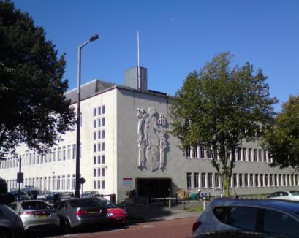
THANK YOU
THANK YOU
51
Teleclass 2015

Slide 52

May 5 (Free WHO Teleclass - Europe)
10 YEARS OF WHO CLEAN CARE IS SAFER CARE: WHY YOU SHOULD BE A PART OF THE SOCIAL PANDEMIC THAT IS SAVE LIVES: CLEAN YOUR HANDS
Prof. Didier Pittet, World Health Organization, Geneva
May 7 VACCINATION OF HEALTHCARE PROVIDERS: A CRITICAL STEP TOWARD PATIENT SAFETY
Dr. Helena Maltezou, Hellenic Center for Disease Control and Prevention, Greece
May 13 (Free WHO Teleclass – Europe)
UNDERSTANDING CONSUMER PERCEPTIONS OF HAI AND HAND HYGIENE THROUGH A GLOBAL SURVEY
Claire Kilpatrick, WHO, and Dr. Maryanne McGuckin, McGuckin Methods International
May 21 (Free Teleclass)
IS YOUR PHONE BUGGED? THE ROLE OF MOBILE TECHNOLOGY IN INFECTION CONTROL

Slide 53


