Slide 1
Clostridium difficile prevention using a human factors and systems engineering approach
Nasia Safdar, MD, PhD
William. S. Middleton Memorial Veterans Hospital and the University of Wisconsin-Madison
Hosted by Paul Webber
paul@webbertraining.com
www.webbertraining.com
January 31, 2019

Slide 2
Objectives of the Session
Identify how to apply a systems engineering approach to C. difficile prevention
Describe the complementary data collection approaches useful in characterizing C. difficile prevention efforts.
Examine the interprofessional aspects of C. difficile prevention

Slide 3
Complexity of C. difficile infection
Challenges to containment
Uncertain incubation period
Multiple reservoirs
Environmental persistence
High rates of recurrence
Need for soap and water for hand hygiene
Multidisciplinary approach to containment
Need for both infection prevention protocols and antibiotic stewardship interventions

Slide 4
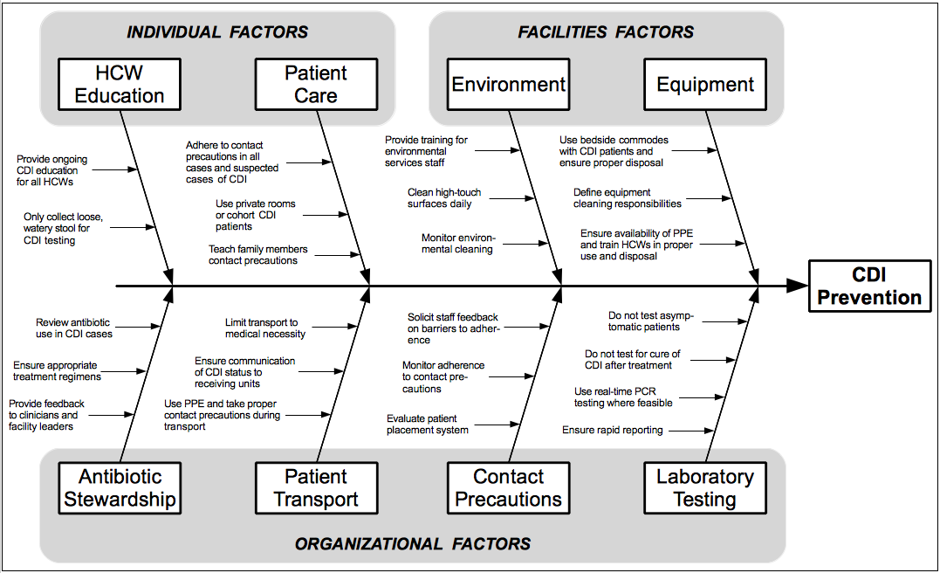
Fishbone diagram showing the complexity of CDI pre
4

Slide 5
Systems Perspective
An individual perspective may be narrow, underestimate the scope of the problem, may not be sufficient to recognize root causes and may make implementation of infection prevention for CDI challenging
A systems perspective takes the whole picture into consideration from all relevant perspectives and stakeholders
Breaks the problem down into its component parts
5

Slide 6
Human Factors
Misperceptions:
Fact #1: Human factors is about designing systems that are resilient to unanticipated events.
Fiction: Human factors is about eliminating human error.
Fact #2: Human factors addresses problems by modifying the design of the system to better aid people.
Fiction: Human factors addresses problems by teaching people to modify their behaviour.
The science of human factors: separating fact from fiction Alissa L Russ et al
https://qualitysafety.bmj.com/content/22/10/802

Slide 7
Fact #3: Human factors work ranges from the individual to the organisational level.
Fiction: Human factors is focused only on individuals.
Fact #4: Human factors is a scientific discipline that requires years of training; most human factors professionals hold relevant graduate degrees.
Fiction: Human factors consists of a limited set of principles that can be learnt during brief training.

Slide 8
Fact #5: Human factors professionals are bound together by the common goal of improving design for human use, but represent different specialty areas and methodological skills sets.
Fiction: Human factors scientists and engineers all have the same expertise.

Slide 9
Human Factors/Ergonomics
HFE mechanisms | Objectives of system design
1. A work system that is not designed according to HFE design principles can create opportunities for errors and hazards (see table 2 for examples of design principles) | The objective of HFE-informed system design is to identify and remove system hazards from the design through maintenance phases.
2. Performance obstacles that exist in the work system can hinder clinicians’ ability to perform their work and deliver safe care | If some obstacles cannot be removed, for instance, because they are intrinsic to the job, then strategies should be designed to mitigate the impact of performance obstacles by enhancing other system elements (ie, balance theory of job design)4142
3. A work system that does not support resilience can produce circumstances where system operators may not be able to detect, adapt to, and/or recover from errors, hazards, disruptions and disturbances | Work systems should be designed to enhance resilience and support adaptability and flexibility in human work,43 such as allowing problem or variance control at the source44
4. Because system components interact to influence care processes and patient safety, HFE system design cannot focus on one element of work in isolation.32 35 | Whenever there is a change in the work system, one needs to consider how the change will affect the entire work system, and the entire system needs to be optimised or balanced41 42
HFE mechanisms between system design and patient safety
HFE, human factors and ergonomics.

Slide 10
Human Factors/Ergonomics
Focus of HFE | Examples of HFE design principles
Physical HFE | To minimise perception time, decision time, and manipulation time
 | To reduce or mitigate need for excessive physical exertion
 | To optimise opportunities for physical movement
Cognitive HFE | To ensure consistency of interface design
 | To match between technology and the user's mental model
 | To minimise cognitive load
 | To allow for error detection and recovery
 | To provide feedback to users
Organisational HFE | To provide opportunities to workers to learn and develop new skills
 | To allow worker control over work system
 | To support worker access to social support
 | To involve users in system design
Examples of HFE design principles
HFE, human factors and ergonomics.
Human factors and ergonomics as a patient safety practice Pascale Carayon, Anping Xie, Sarah Kianfar https://qualitysafety.bmj.com/content/23/3/196#block-system-main

Slide 11
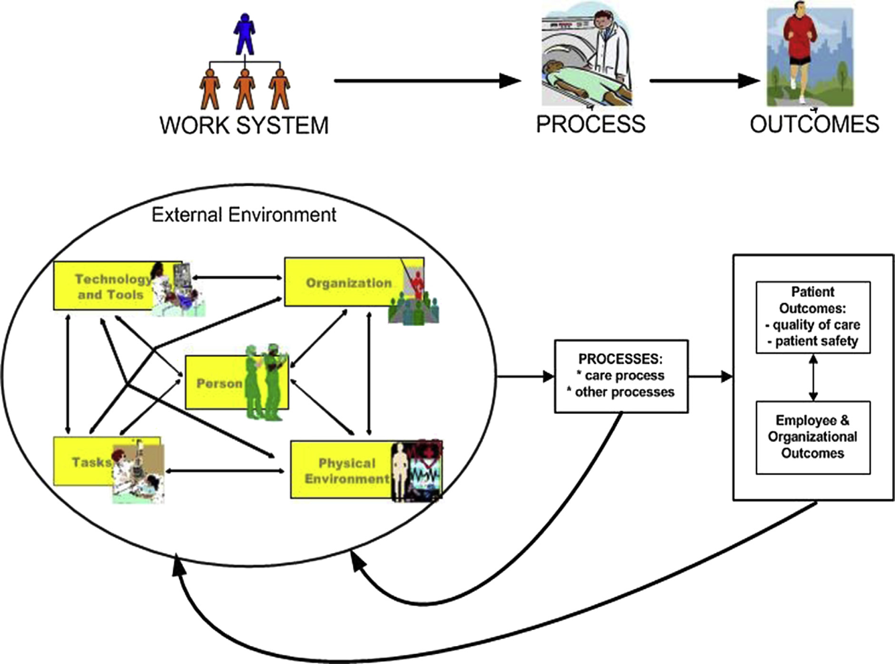

Slide 12
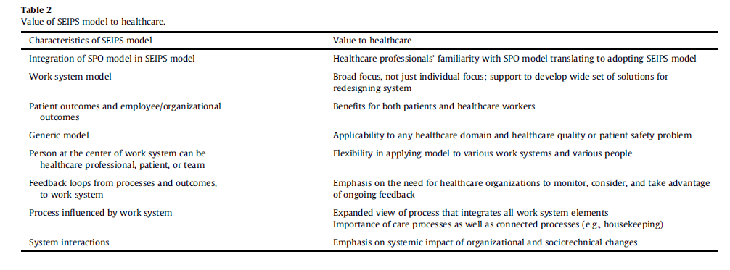

Slide 13
Key interventions for CDI prevention - a CDI bundle
1) rapid, appropriate diagnostic testing for C. difficile
2) empiric isolation for patients with diarrhea and suspected CDI
3) contact isolation for patients with confirmed CDI
4) environmental decontamination of CDI patient rooms
5) full compliance with hand hygiene by all entering and leaving CDI patient rooms.
13

Slide 14
SEIPS model for CDI
Five Components
Tools
Technologies
Environment
People
Organization
Tasks
14

Slide 15
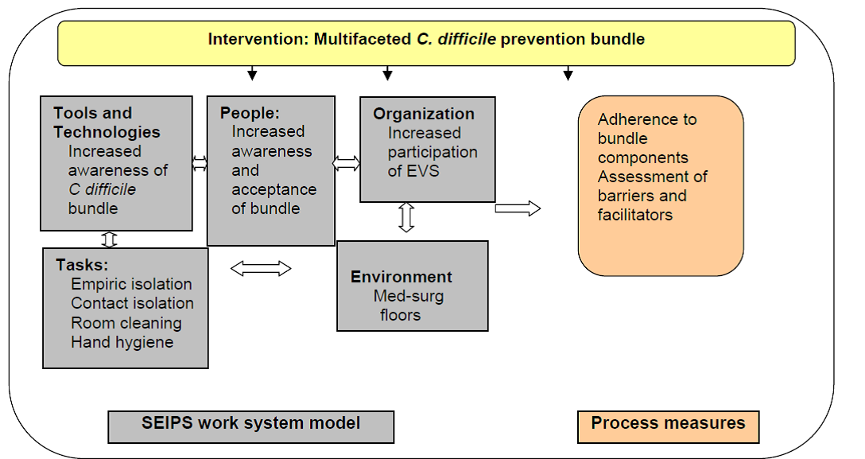
SEIPS for evaluation of C difficile bundle

Slide 16
SEIPS application to CDI
Create a process map to understand current practice and procedures
Review of policies and procedures, signage, diagnostic testing procedure
Supplement this data with focus groups/interviews of relevant groups
Supplement with direct observations of PPE donning and doffing, room layout, PPE supplies.

Slide 17
Data collection
Three homogenous focus groups convened – one each comprised of physicians, nurses and environmental services workers (EVS) – over a 4-week period.
The physician focus group included 7 medicine residents and one attending physician
The nursing focus group included 10 nurses from medical units with varying experience
The EVS group included six participants with 2-30 years of experience from varying types of units (ICU, medical, surgical).

Slide 18
Facilitated by a human factors engineer with significant experience in healthcare group facilitation.
Participants received no financial remuneration for attending.
Discussion was audio recorded for transcription by a professional service and subsequently coded by two researchers
18

Slide 19
Transcripts of the three focus groups were uploaded to Dedoose® web-based qualitative data analysis software.
Each excerpt was coded to three dimensions –
which of the five CDI bundle interventions the excerpt corresponded to
which of the five elements of the work system it related to
and 3) whether it was a work system barrier or facilitator.
An excerpt could be coded to multiple bundle interventions, multiple work system elements and be both a barrier and facilitator.
19

Slide 20
Person. Nurses presented an issue associated with relying on others to inform them that a patient they care for has CDI. This becomes a problem when the expectation is not met. For example, CDI patient rooms must have a sign on the door informing the person entering the room to take additional precautions. If the person responsible for posting the sign forgets or does not post the notice, hand hygiene and other CDI interventions may not appropriately occur. [Nurse focus group: “Or if somebody forgets to put the sign up and it’s your patient … you have no idea they were in isolation. That’s (not) always great.”
20

Slide 21
Tools/technology.
All three groups noted sink interference posed by the excessive amount of equipment (and also people) in the patient room.
Pose sink access issues. [EVS focus group: “(There are) huge chairs and the patient sits in front of the sink. And then we can’t get to the sink to wash our hands. …
Supplies in front of the sink … (cause) interference.”]
EVS staff commented on their positive and consistent use of pagers as a means of informing them that they will be cleaning a CDI patient room.
21

Slide 22
Organization.
The challenge of educating patients’ families regarding their need to comply with the CDI interventions was solely discussed by nurses who noted that changes in hand hygiene practice varied based on family member perceptions.
Physicians admitted the lack of clarity of the hand hygiene policy related to when, where, and how long hand washing should occur.
Other organization issues that were identified frequently related to role-specific policies solely relevant to a particular group. For example, EVS workers discussed significant issues related to training and staff turnover that had an impact on compliance with and understanding of the importance of hand hygiene.
Institutional pressure to turnover room fast

Slide 23
Environment
Eight of the 52 total comments were related to sinks and were made by all three groups.
Consistent issues related to the number and location of the sinks.
[Nurse focus group: “We have to use the sinks in the hallway to wash our hands because you can’t get out of a C. diff room without recontaminating your hands after you’ve washed.”]

Slide 24
Tasks Wet hands make gloving difficult PPE when not anticipating touching patient or environment Inconsistency in where used gowns are disposed Inconsistency in where clean gowns are stored Supply

Slide 25
SEIPS Application to PPE
Person
Type of healthcare worker
Patient/visitor
Knowledge/awareness
Perception of risk given anticipated activity
Tools/technology
PPE cumbersome
Use of phone/iPAD in isolation rooms difficult
Tasks
Bundling of cares
Increases time
Cleaning issues

Slide 26
SEIPS Application to PPE
Environment
Disposal
Supplies
Signage on door
Stethoscope issues
Organization
Policies
Practice variation
Leadership involvement
Facilitators
Leadership engagement
Consistency of messages
Ease of availability and disposal

Slide 27
SEIPS and interventions
Create a list of barriers and select ones that are modifiable and have high impact
Examples
Creation of new sinks
Consistency of messaging- pros and cons
Leadership support for EVS

Slide 28
Acknowledgments
Funding:
AHRQ
VA
PCORI
NIH
CDC
UW-Madison
References:
Barriers and facilitators to Clostridium difficile infection prevention: A nursing perspective.
Ngam C, Schoofs Hundt A, Haun N, Carayon P, Stevens L, Safdar N.
Am J Infect Control. 2017 Dec 1;45(12):1363-1368. doi: 10.1016/j.ajic.2017.07.009. Epub 2017 Sep 19.
What do visitors know and how do they feel about contact precautions?
Seibert G, Ewers T, Barker AK, Slavick A, Wright MO, Stevens L, Safdar N.
Am J Infect Control. 2018 Jan;46(1):115-117. doi: 10.1016/j.ajic.2017.05.011. Epub 2017 Jul 18.
28

Slide 29
