Slide 1



Bridging the Gap
Between Research and Practice in Long-Term Care:
An Innovative Model for Success
Broadcast live from
Sharon Bradley RN, CIC
  Senior Infection Prevention Analyst
  Pennsylvania Patient Safety Authority
  Nothing to disclose
www.webbertraining.com
June 13, 2016

Slide 2
Objectives
Recall multifocal methods of assessment to measure integration of best practices into infection control program and structure
Detect opportunities for improvement to implement infection control best practices at leadership, physician, clinical, and support staff levels
Select approaches to translate assessment results into a structured framework that incorporates infection control strategies into clinical practice

Slide 3
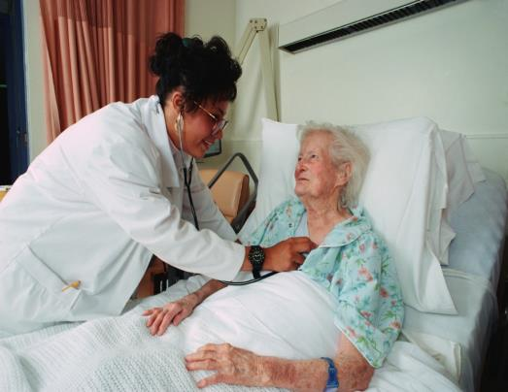
Burden of Healthcare-Associated Infections (HAI) in Long-Term Care Facilities (LTCF)
1.2 - 3.8 million annual HAI
150,000 additional hospitalizations
380,000 additional deaths
( US HHS: “Long-Term”)

Slide 4

What Does the Research Tell Us?
2000-2007: study of infection control deficiency citations
  60,000 LTCFs nationwide
  On average, 15% cited for infection control deficiency
2005: survey of 37 LTCFs
  Significant variability in
  implementation of
infection control methods
(Castle et al.; Mody et al.)

Slide 5
What Does the Research Tell Us?
Few peer-reviewed publications examine infection control in LTCF
No studies have critically evaluated
efficacy of infection control programs in LTCF
Need for increased emphasis and research
Focus on identifying barriers to implementing infection control best practices in LTCF
(Castle et al.; Mody et al.)

Slide 6



Research Questions
In which infection prevention domains do nursing homes perform well or need improvement ?
In which implementation categories are there differences between facilities or units with high or low HAI rates?
What elements of best practice are most lacking in areas of low performance?

Slide 7

Where to Start?
Measure integration of best practices into infection control program and structure
Utilize multifocal methods of assessment

Slide 8
Identify barriers and determine compliance with infection control practices
Assessment Tools
Interview
Simulation
Checklists
Medical record review
Clinical observation
Process measuring worksheets

Slide 9
Assessment Module Design
INTERVIEW
RECORD REVIEW
CLINICAL OBSERVATION
(Bradley et al.)

Slide 10

Assessment Module Design
Standardized measurement tool
  Implementation of evidence-based infection control practices
  Secondary implementation categories
  Scoring system to identify the level of implementation
  Specific targets for improvement

Slide 11
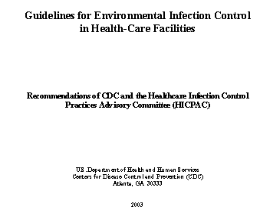
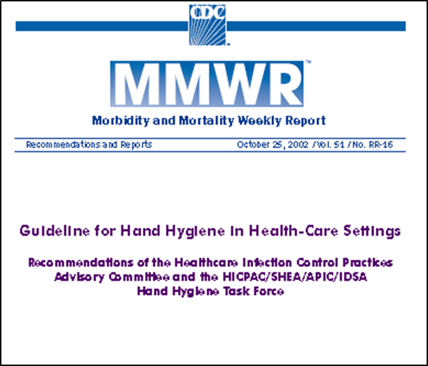
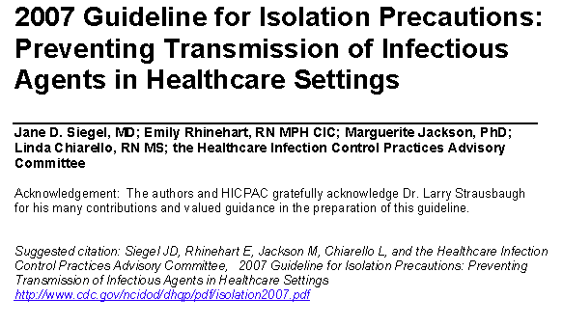
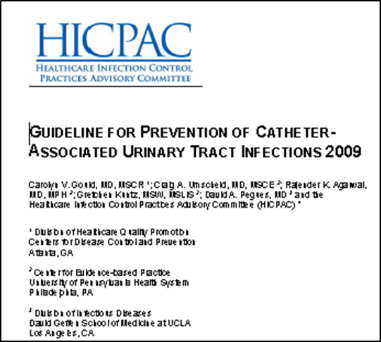
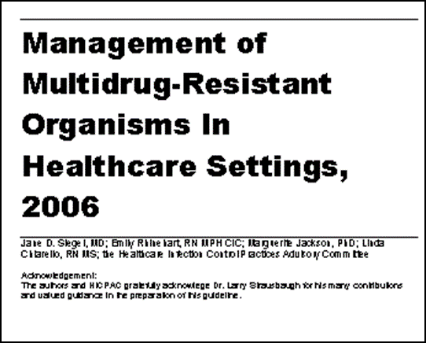
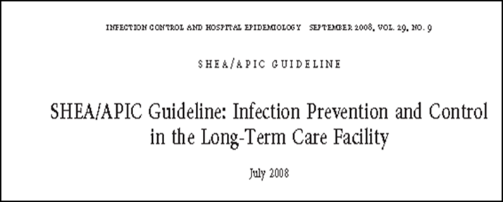
Where Is the Evidence?

Slide 12
Seven Assessment Domains
Hand hygiene compliance
Environmental control
Outbreak control
Prevention of:
  Urinary tract infections (UTIs)
  Respiratory tract infections (RTIs)
  Gastrointestinal (GI) and multidrug-resistant organism infections (MDROs)
  Skin and soft-tissue infections (SSTIs)
(Bradley et al.)

Slide 13
Implementation Category
Infection Control Program Structure
Infection Prevention Plan and Goals
Policies and Procedures
Education
(Bradley et al.)

Slide 14

Implementation Category
Infection Control Program Function
Standard Documentation
Process and Outcome Monitoring
Assigned Accountability

Slide 15




Long Term Care Best Practice Assessment Practice Assessment
4) 100% Implemented 3) Partial implementation 2) Implementation considered 1) Unknown 0) Not implemented N/A) Not applicable
 | Best Practice | IC Plan / Goals | Policy and Procedures | Education process | Standard Documentation | Monitoring of process and outcomes | Accountability assigned
l | HAND HYGIENE ^{1,3}
1 | Clinical staff demonstrates understanding of hand hygiene rationale, indications & methods.
2 | Alcohol-based hand rub and gloves are available at the point of care
3 | Gloves are changed between residents & between clean and dirty activities on the same resident.
4 | Hand washing with soap and water is performed when hands are visibly soiled
5 | Hand hygiene is performed before and after resident care
6 | The facility has an individualized program to monitor hand hygiene compliance
7 | Residents and families are knowledgeable about hand hygiene
Category sub-total
(Bradley et al.)

Slide 16

Long Term Care Best Practice Assessment ( Demonstration)
4) 100% Implemented 3) Partial implementation 2) Implementation considered 1) Unknown 0) Not implemented N/A) Not applicable
 | Best Practice | IC Plan / Goals | Policy and Procedures | Education process | Standard Documentation | Monitoring of process and outcomes | Accountability assigned
l | HAND HYGIENE ^{1,3}
1 | Clinical staff demonstrates understanding of hand hygiene rationale, indications & methods. | 3 | 4 | 4 | 0 | 0 | 4
2 | Alcohol-based hand rub and gloves are available at the point of care | 3 | 4 | 4 | 0 | 0 | 3
3 | Gloves are changed between residents & between clean and dirty activities on the same resident. | 3 | 4 | 4 | 0 | 0 | 3
4 | Hand washing with soap and water is performed when hands are visibly soiled | 3 | 4 | 4 | 0 | 0 | 3
5 | Hand hygiene is performed before and after resident care | 3 | 4 | 4 | 0 | 0 | 3
6 | The facility has an individualized program to monitor hand hygiene compliance
7 | Residents and families are knowledgeable about hand hygiene | 3 | 3 | 3 | 3 | 0 | 4
Category sub-total
2
2
2
2
2
2
20 25 25 5 2 22

Slide 17

Detect Opportunity for Improvement
Clinical observation tool
Pre and post-intervention self-assessment
Overall performance of unit/facility/group
Multidisciplinary-level barriers
(Bradley et al.)

Slide 18
Multi-Functional Use
DOMAIN | Education |  | Documentation |  | Monitoring
* PI: Process Improvement | A WING | B WING | PRE- PI * | POST- PI * | YEAR 2013 | YEAR 2014
Hand hygiene | 73% | 76% | 77% | 85% | 84% | 83%
Environmental control | 88% | 74% | 96% | 98% | 85% | 98%
Urinary tract infection | 75% | 32% | 79% | 86% | 89% | 80%
Respiratory tract infection | 79% | 52% | 85% | 92% | 91% | 89%
Gastrointestinal/multi-drug-resistant organism Infections | 78% | 78% | 90% | 90% | 91% | 90%
Skin and soft-tissue infection | 84% | 30% | 95% | 95% | 98% | 96%
Outbreak control | 71% | 84% | 84% | 84% | 80% | 87%
(Bradley et al.)

Slide 19

Detect Opportunity for Improvement
  Leadership
  Physicians
  Clinicians
  Support staff
(Bradley et al.)

Slide 20

PA Patient Safety Authority
Outreach Project 2010-2012
Comparison of implemented infection prevention best practices
Model and assessment tool utilized
20 nursing homes visited
  10 LTCFs with high HAI rates
  10 LTCFs with low HAI rates

Slide 21
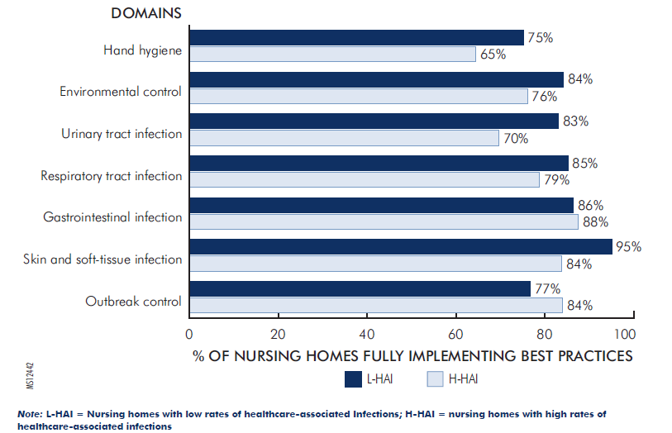
Difference in Percentages of Full Implementation of Nursing Home Best Practices
#3
#1
#2
(Bradley et al.)

Slide 22
Implementation of Structure Categories
DOMAIN | Plan |  | Policy/ goals |  | Education
 | L-HAI | H-HAI | L-HAI | H-HAI | L-HAI | H-HAI
Hand hygiene | 73% | 76% | 84% | 77% | 84% | 83%
Environmental control | 88% | 74% | 98% | 96% | 85% | 98%
Urinary tract infection | 75% | 32% | 86% | 79% | 89% | 80%
Respiratory tract infection | 79% | 52% | 91% | 85% | 91% | 89%
Gastrointestinal/multidrug-resistant organism Infections | 78% | 78% | 91% | 90% | 91% | 90%
Skin and soft-tissue infection | 84% | 30% | 95% | 95% | 98% | 96%
Outbreak control | 71% | 84% | 84% | 84% | 80% | 87%
L-HAI = Nursing homes with low HAI rates H-HAI = Nursing homes with high HAI rates
Yellow cells- higher % of implementation; Bolded cells- 10% higher implementation
(Bradley et al.)

Slide 23
Implementation of Function Categories
DOMAIN | Documentation |  | Monitoring |  | Accountability
 | L-HAI | H-HAI | L-HAI | H-HAI | L-HAI | H-HAI
Hand hygiene | 61% | 37% | 66% | 31% | 84% | 83%
Environmental control | 65% | 28% | 70% | 63% | 100% | 98%
Urinary tract infection | 82% | 72% | 76% | 70% | 90% | 84%
Respiratory tract infection | 84% | 74% | 71% | 79% | 95% | 94%
Gastrointestinal/multidrug-resistant organism Infections | 91% | 88% | 78% | 85% | 91% | 95%
Skin and soft-tissue Infection | 97% | 95% | 97% | 90% | 98% | 96%
Outbreak control | 80% | 86% | 64% | 74% | 80% | 87%
L-HAI = Nursing homes with low HAI rates H-HAI = Nursing homes with high HAI rates
Yellow cells- higher % of implementation; Bolded cells- 10% higher implementation
(Bradley et al.)

Slide 24
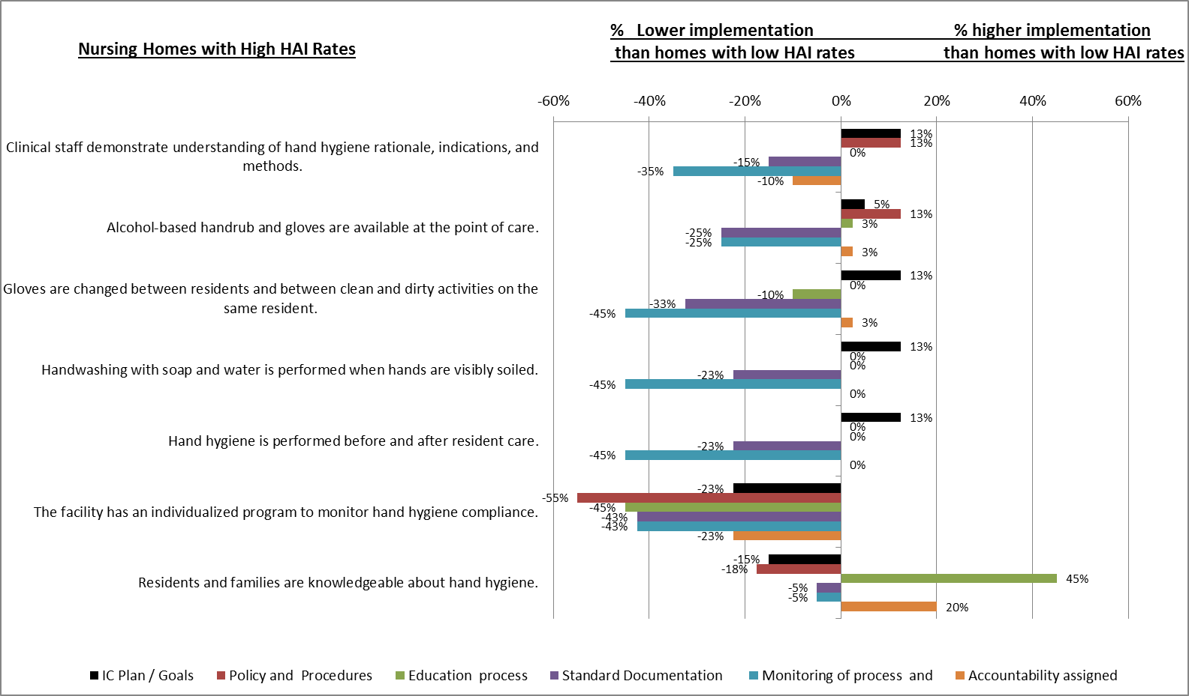

Hand Hygiene Best-Practice Implementation

Slide 25
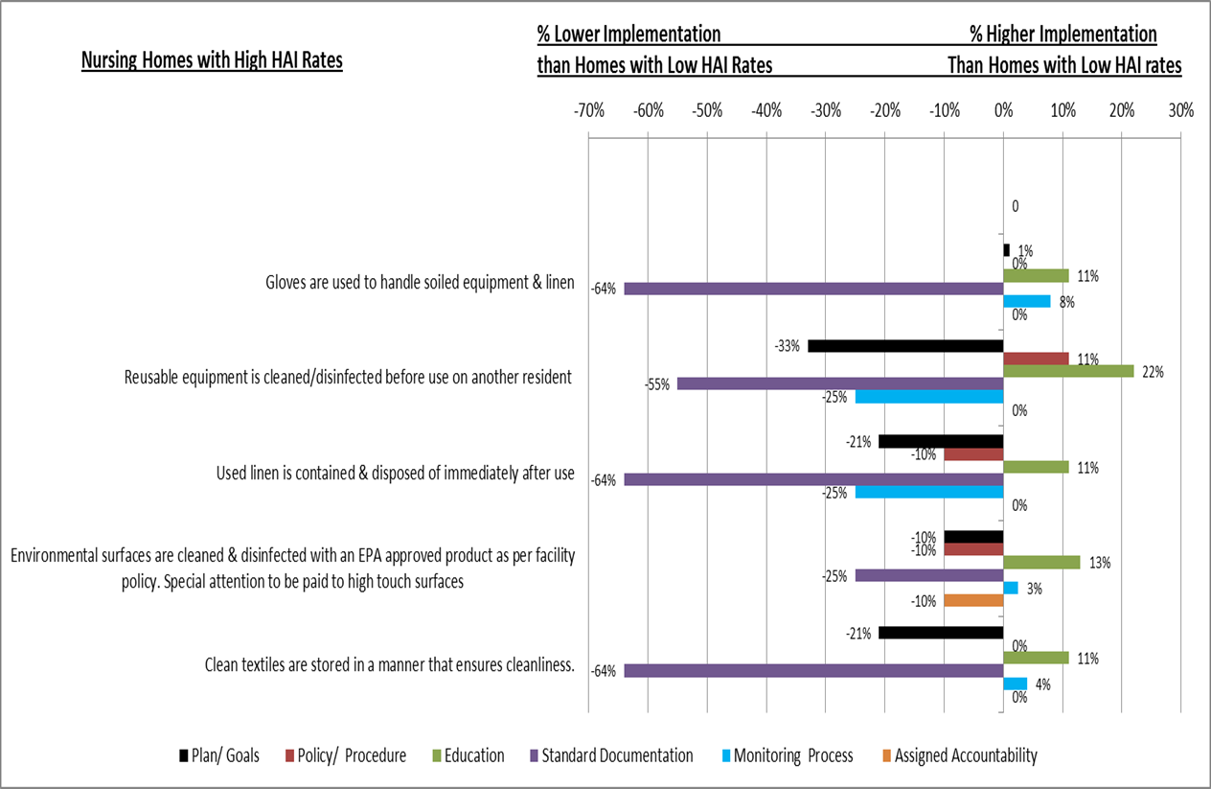
Environmental Control Best-Practice Implementation
  (Bradley et al.)

Slide 26
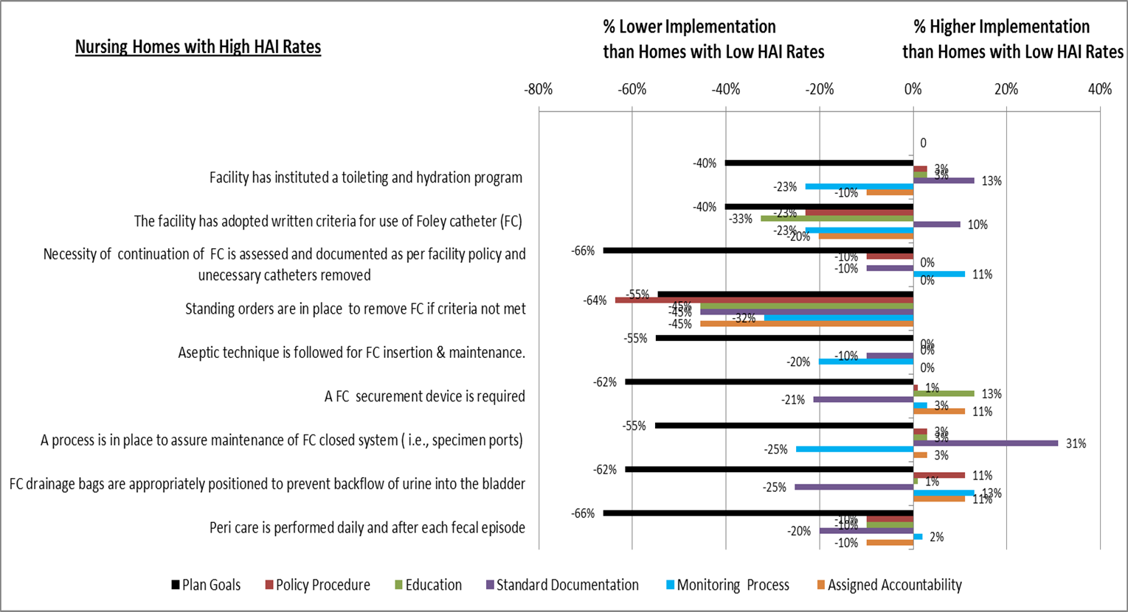

Urinary Tract Infection Prevention
Best-Practice Implementation
(Bradley et al.)

Slide 27
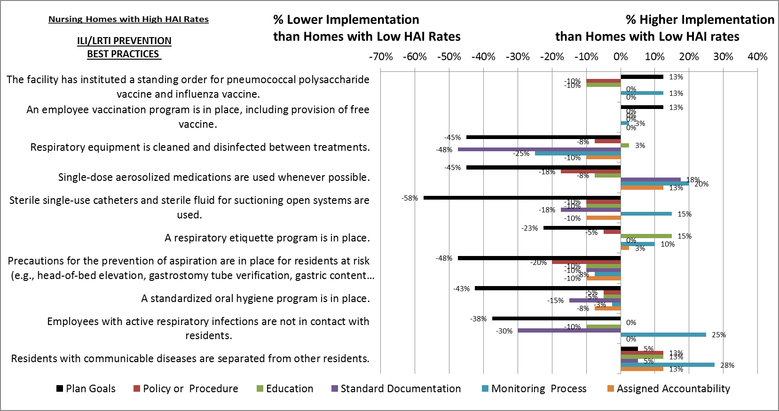

Respiratory Tract Infection Prevention
Best-Practice Implementation
(Bradley et al.)

Slide 28
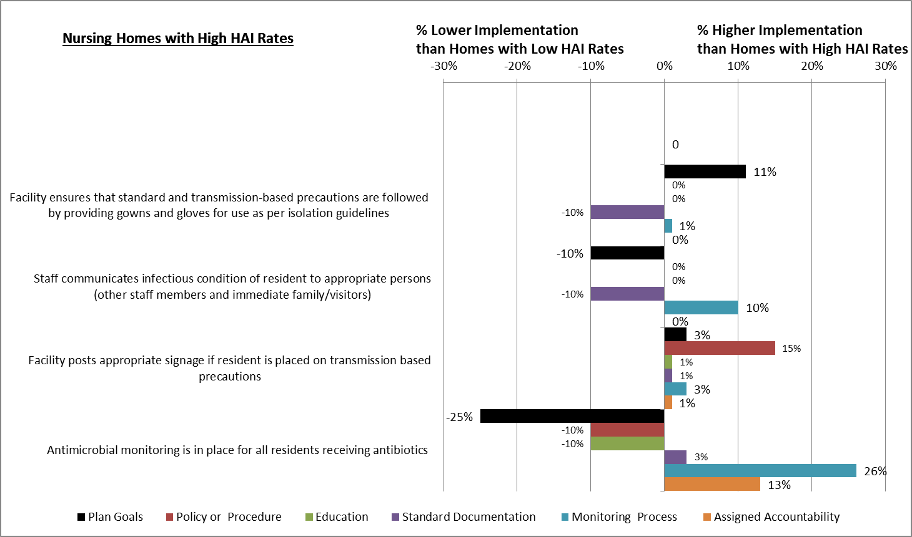
Gastrointestinal and Resistant Organism Infection Prevention Best-Practice Implementation
(Bradley et al.)

Slide 29
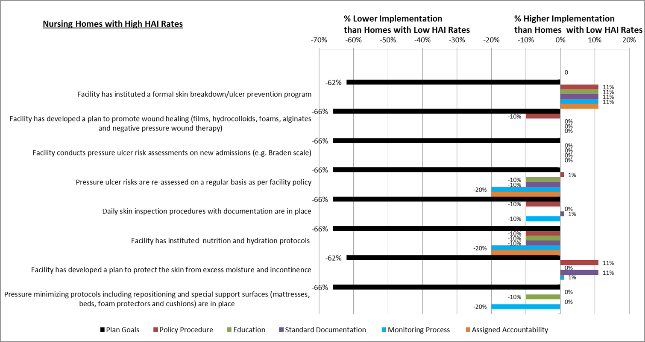
Skin and Soft-Tissue Infection Prevention
Best Practice Implementation
(Bradley et al.)

Slide 30
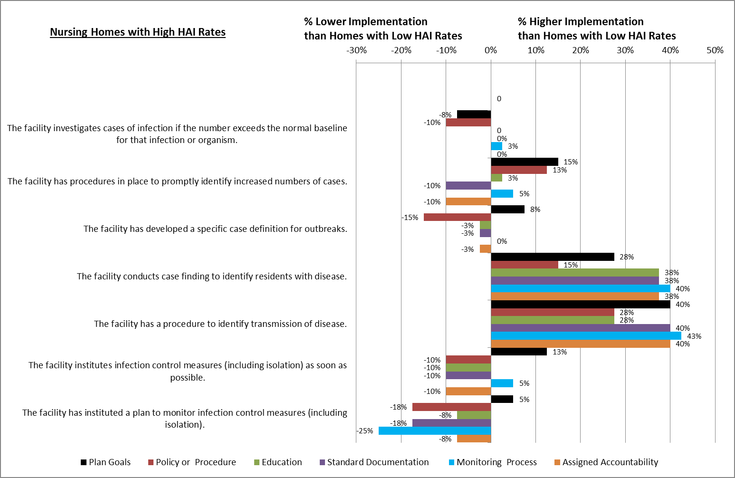
Outbreak Control Best Practice Implementation
(Bradley et al.)

Slide 31
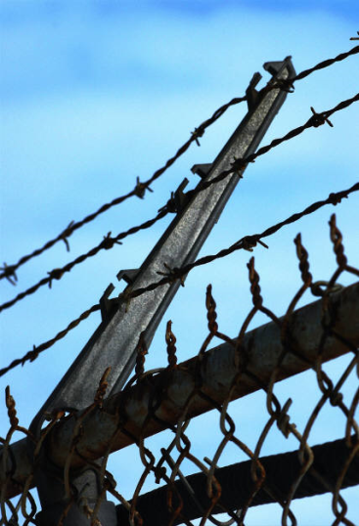
Practice Barriers Identified
Unavailability of hand sanitizers
Antimicrobial monitoring by pharmacy only
Lack of aspiration prevention strategies
Routine Foley changing/irrigation
Physician refusal to remove Foley
Limited separation of clean/dirty workspace
Lack of family/resident education
(Bradley et al.)

Slide 32
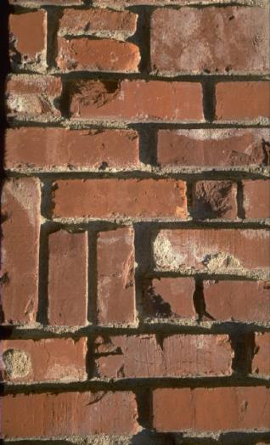
Organizational Barriers Identified
Lack of trained infection preventionist (IP)
IP has multiple roles/campuses
High acuity, low staffing, limited consultation
Reactive versus proactive response
Lack of administrative support
Lack of root-cause analysis (RCA)
Absence of structured documentation process
Inadequate communication protocols
(Bradley et al.)

Slide 33

High-HAI NH Follow-Up
Pre to post intervention quarters:
  Improved in all domains and implementation categories
  16% significant decrease in mean overall HAI rate (P value <0.05
  8:10 improved infection rates
  18.8% combined decrease in number of HAIs
  9% decrease in overall costs for GI infections, RTIs, SSTIs, and symptomatic UTIs
(Feil et al.)

Slide 34
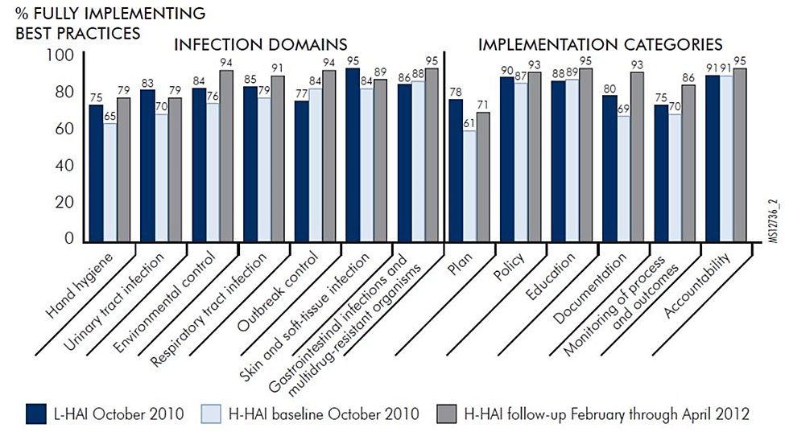
Implementation Improvement
(Feil et al.)

Slide 35

Barriers to Practice Adoption
Awareness of
performance gaps
before practice
adoption
Leadership directly
responsible for
closing gaps
ACCOUNTABILITY
AWARENESS
Resource investment
and capacity to
make changes
ACTION
ABILITY
Define targets to
close performance gaps

Slide 36

Bridging the Gap
Translate assessment
results into a
structured framework
Incorporate infection control strategies into clinical practice

Slide 37

Structured Framework
Provides a snapshot of level of current barriers and defects:
  Domain
  Implementation category
  Implementation level
  Specific best practice
(Bradley et al.)

Slide 38

Structured Framework
Stimulate
conversations
with leadership
Cost-effective and
targeted use
of resources
Supports
administrative
safety rounds
Business
plan
buy-in
Display ready for committee
and administrative review
(Bradley et al.)

Slide 39

Approaches to Integrate Strategies into Clinical Practice
Increase awareness
  Engage
  Educate
Oversee compliance
  Execute
  Evaluate

Slide 40
“Bundled” Infection Practices
IV | INFLUENZA LIKE ILLNESS / LOWER RESPIRATORY TRACT INFECTION
1 | The facility has instituted a standing order process for pneumococcal polysaccharide vaccine and influenza vaccine.
2 | An employee vaccination program is in place, including provision of free vaccine.
3 | Respiratory equipment is cleaned and disinfected between treatments.
4 | Single-dose aerosolized medications are used whenever possible.
5 | Sterile single-use catheters and sterile fluid for suctioning open systems are used.
6 | A respiratory etiquette program is in place.
7 | Precautions for the prevention of aspiration are in place for residents at risk (e.g., head-of-bed elevation, gastrostomy tube verification, gastric content aspiration, feeding protocols).
8 | A standardized oral hygiene program is in place.
9 | Employees with active respiratory infections are not in contact with residents.
10 | Residents with communicable diseases are separated from other residents.
  (Bradley et al.;CDC;CMS)

Slide 41
Complements Quality Assurance Performance Improvement Work
  Fresh perspective on effectiveness of (QAPI) strategies
  Identify and learn from defects
  Data for monitoring or evaluation tools
  Enhance annual infection control risk assessment
  Demonstrate compliance with regulations
  Less time commitment than a failure mode and effects analysis (FMEA)
(Bradley et al.)
44

Slide 42

Facilitators for Success
Supportive/engaged leaders
Education, checklists, monitoring
Multidisciplinary teamwork
Root Cause Analysis for adverse infection events
Administrative partnership with units
Accessibility of supplies at point of care
Sharing process outcome data with staff
(Bradley et al.)

Slide 43
References
Feil M, Bradley S. Infection control challenges: Pennsylvania nursing homes are making a difference through implementation of best practice. Pa Patient Saf Advis [online] 20123 Jun 1 [cited 2013 Jun 3].
Mody L, Langa KM, Saint S, et al. Preventing infections in nursing homes: a survey of infection control practices in southeast Michigan. Am J Infect Control Oct;33(8):489-92.
Pennsylvania Patient Safety Authority. 2013 annual report [online] [cited 2014 Sept 5]. http://patientsafetyauthority.org/PatientSafetyAuthority/Pages/AnnualReports.aspx.
Smith PW, Bennett G, Bradley S, et al. SHEA/APIC guideline: infection prevention and control in the long-term care facility, July 2008. Infect Control Hosp Epidemiol 2008 Sep;29(9):785-814.
US Department of Health and Human Services (HHS):
  Long-term care facilities. Chapter 10. In: National action plan to prevent healthcare-associated infections: roadmap to elimination [online]. [cited 2013 Apr 24]. http://www.hhs.gov/ash/initiatives/hai/actionplan/ltc_facilities508.pdf
  Using the 4 E’s for technical and adaptive work. Slide 4. In: CUSP Toolkit [online]. [cited 2013 Apr 24]. http://www.ahrq.gov/legacy/cusptoolkit/3engagexec/engagexecslides.htm.

Slide 44
References
Bradley S, Segal P, Finley E. Impact of implementation of evidence-based best practices on nursing home infections. Pa Patient Saf Advis [online] 2012 Sep [cited 2013 Apr 24]. http://patientsafetyauthority.org/ADVISORIES/AdvisoryLibrary/2012/Sep;9(3)/Pages/89.aspx.
Castle NG, Wagner LM, Ferguson-Rome JC, et al. Nursing home deficiency citations for infection control. Am J Infect Control 2011 May;39(4):263-9.
Centers for Disease Control and Prevention (CDC): Guideline for preventing health-care--associated pneumonia, 2003 [online]. [cited 2013 Apr 24]. http://www.cdc.gov/mmwr/preview/mmwrhtml/rr5303a1.htm.
Centers for Medicare and Medicaid Services (CMS). Revisions to appendix PP—“Interpretive Guidelines for Long-Term Care Facilities,” Tag F441” [transmittal 55 online]. 2009 Dec 2 [cited 2013 Apr 24]. http://www.cms.hhs.gov/transmittals/downloads/R55SOMA.pdf.
Denham CR. Patient safety practices: leaders can turn barriers into accelerators. J Patient Saf 2005;1:41-55.

Slide 45
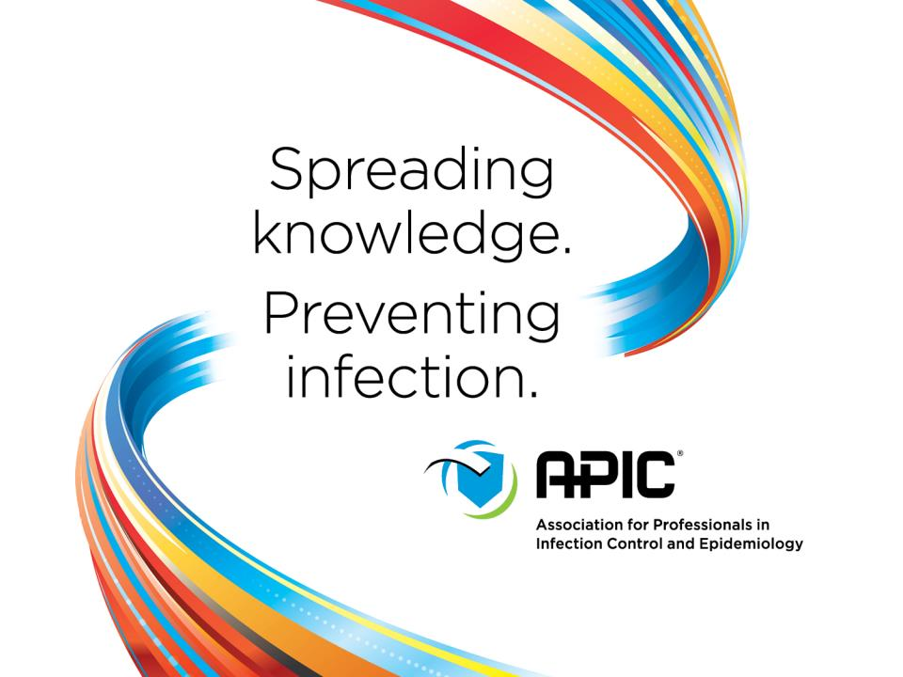


Slide 46

June 16 STRATEGIES TO REDUCE SKIN INJURY IN CRITICALLY ILL PATIENTS
Kathleen M. Vollman, Advanced Nursing LLC
June 23 EXPLORING THE ROLE OF ENVIRONMENTAL SURFACES IN
OCCUPATIONAL INFECTION PREVENTION
Dr. Amber Mitchell, International Safety Center, and Barbara DeBaun, Cynosure Health
June 29 (South Pacific Teleclass)
SHARPS INJURY PREVENTION
Dr. Terry Grimmond, Grimmond & Associates Ltd., New Zealand
July 14 RESULTS OF QUALITATIVE RESEARCH ON IMPLEMENTATION OF
INFECTION CONTROL BEST PRACTICES IN EUROPEAN HOSPITALS
Dr. Hugo Sax, University Hospital Zurich, Switzerland
July 21 BEHAVIOURAL AND ORGANIZATIONAL DETERMINANTS OF
SUCCESSFUL INFECTION PREVENTION AND CONTROL INTERVENTIONS
Dr. Enrique Castro-Sánchez, Imperial College London, England

Slide 47


