Slide 1

Being Heard: The IP and Organizational Structure
Broadcast live from
Janet Glowicz MSN RN, MPH, CIC
Northrop Grumman CIMS
Division of Healthcare Quality Promotion
Centers for Disease Control and Prevention
No financial disclosures
www.webbertraining.com
June 13, 2016

Slide 2
Objectives
Identify attributes of a healthful workplace environment
Discuss collaboration to build infection prevention competency
Identify methods of communication that inspire change

Slide 3
Organizational Culture
There is a need to understand organizational culture and change it when it hinders performance¹
Direct evidence linking leadership to infection rates is limited but consistent themes have been identified²
Leadership traits that may assist in preventing infections³:
Proactive, Positive, Visible
Supportive of Change
Clear Responsibilities
Clear Policies
Leadership traits that may be associated with risk²:
Reactive
Laissez Faire Management Style
Failure to assign responsibility/ maintain accountability
Wide Span of Control
De Bono et al., J Hosp Inf (2014) 86:1-6
Griffiths et al., J Hosp. Inf. (2009) 73, 1e14
Sinkowitz-Cochran et al., AJIC, 2012; 40, 138-143

Slide 4
Barriers to Change:
Capacity
Capacity may be affected by complex management issues
Nurse Staffing Ratios
High Occupancy
Nurse to patient staffing ratios have been inversely associated with healthcare associated infections (UTI and SSI)¹
Feeling Overwhelmed
Stress and chaos may be associated with poorer infection prevention practices³
Inpatient wards with occupancy rates of 80-89.9 % had CDI rates that were 56% higher than baseline occupancy rates (0-69%)²
Strong leadership at the unit level and above is likely a prerequisite to infection prevention improvements⁴
1. Ciomatti et al, AJIC 2012, 40; 486-490 3. Sinkowitz-Cochran et al., AJIC 2012; 40, 138-143
2. Ahyow et al., ICHE, 2013 34 1062-1069 4. Griffiths et al., J Hosp. Inf. (2009) 73, 1e14

Slide 5
Shifting Boundaries and Role Uncertainty
The IP must be able to influence operations regardless of his/her formal title or placement within the hierarchy
Changes in Accountability for HAI
  Personnel at the unit level “own” the data
  Increasing engagement of hospital executives
  Linking reductions in HAI to personnel evaluations and bonuses
IP Departments subsumed by the Quality Department
  Layers between IP and Senior Leaders
  Differing vocabularies
  Differences in formal titles may influence meeting invitations, visibility, and a seat at the decision making table
Conway, et al. Am J Infect Control, 2013; 41: 959-964

Slide 6
Recognizing Inappropriate Roles:
An Infection Prevention Action Plan
Opportunity for Improvement | Risk Reduction Strategies | Responsible Person
Enforce procedures to ensure all who enter the unit are free from symptomatic illness | Re-educate ancillary staff on the importance of maintaining contact isolation at the bedside | Manager Infection Prevention Unit Manager
Ensure ongoing staff competencies specific to the unit | Annual cleaning competence including relocation of the cleaning area | Clinical Educator Unit Manager
Implement evidence based care | Create order set for blood and stool cultures and isolation Restructure nursing care review and revise cleaning practices | Medical Director Care Coordinator Unit Manager Service Line Director
Minimize contamination in environment of care | Add manufacturer recommendations for cleaning to the policy and procedure web site | Manager Environmental Services Risk Management
Ongoing surveillance and reporting | Continue active surveillance | CMO

Slide 7
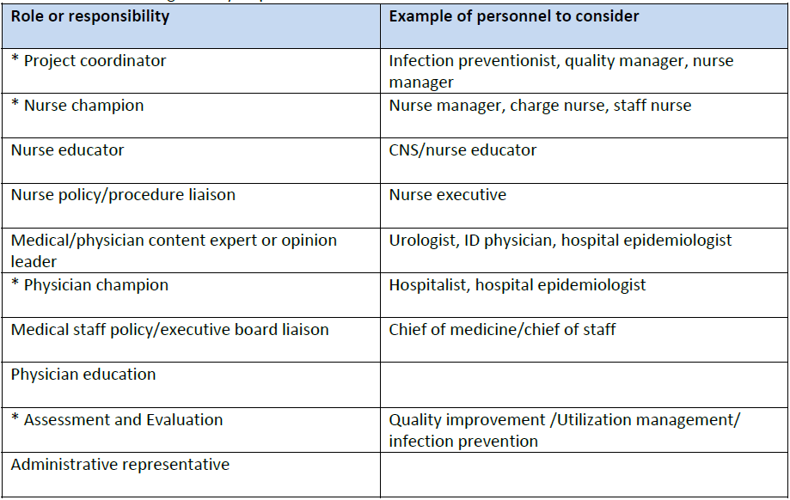
Appropriate Roles and Responsibilities for the Infection Preventionist
Roles with an * are required.
Downloaded from www.catheterout.org

Slide 8
Workplace Incivility, Bullying, and Violence
“It is important first to recognize the existence of harmful actions taken and not taken in the workplace in order to eliminate them”
Mobbing may occur when groups strive to maintain mediocrity and compliance with the status quo
The establishment of positive, respectful relationships is crucial to preventing incivility, bullying and workplace violence
Incivility
Bullying
Violence
ANA Workplace Violence Position Statement, 2015

Slide 9
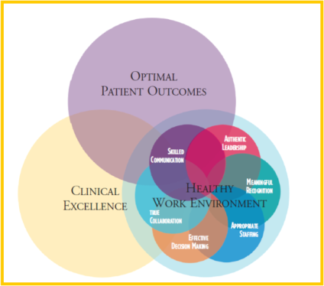
A Healthy Work Environment
American Association of Critical Care Nurses standards for a healthy work environment are interdependent and influence Clinical Excellence and Optimal Patient Outcomes
True Collaboration
Skilled Communication
Authentic Leadership
Meaningful Recognition
Appropriate Staffing
Effective Decision Making
American Association of Critical Care Nurses (AACN), 2004

Slide 10

Collaboration Defined
Main Entry: col·lab·o·rate
Pronunciation: \kə-la-bə-rāt\
Function: intransitive verb
Inflected Form(s): col·lab·o·rat·ed; col·lab·o·rat·ing
Etymology: Late Latin collaboratus, past participle of collaborare to labor together, from Latin com- + laborare to labor
Date: 1871
1 : to work jointly with others or together especially in an intellectual endeavor
2 : to cooperate with an agency or instrumentality with which one is not immediately connected

Slide 11
Characteristics of True Collaboration
Every team member acts with a high level of personal integrity
Team members are competent appropriate to their roles
Nurse Managers and Medical Directors are equal partners in fostering collaboration
“Cooperation is when we get along, collaboration is when we use our uniqueness to make something great.”
A fourth grade student
AACN, 2004
Quote from thetechrabbi.com

Slide 12
Collaborative Prevention Models
Diverse Healthcare Associated Infections in diverse settings have responded to interventions introduced through collaborative models
Initiative | Year Initiative Ended | Effect
National Surgical Infection Prevention Collaborative | 2003 | 27% decrease in SSI¹
Michigan Keystone Project (ICU) | 2005 | 66% Reduction in CLABSI²
IHI 100,0000 Lives Campaign | 2006 | Galvanized Efforts to Prevent Harm³
NY State NICU CLABSI Prevention | 2007 | 25% decrease in CLABSI⁴
Dialysis BSI Prevention Collaborative | 2011 | 32% decrease in BSI⁵ 54% decrease in access infections
Wake Up and Breathe Collaborative | 2013 | Decreased VAE per episodes of ventilation (OR 0.63, CI 0.42-0.97)⁶
Dellinger et al. Am J Surg 2005; 190: 9-15 4. Wirtschafter et al. J Perinatol, 2010; 30:170-181
Pronovost et al. N Eng J Med. 2006; 355:2725-2732 5. Patel et al. Am J Kid Dis, 2013; 62:322-330
Wachther & Pronvost, Jt. Comm J Qual and Safety, 2006; 32: 621-627 6. Klompas et al. Am J Respir Crit Car Med, 2015; 191: 297-307

Slide 13
Collaboration is Additive
Themes identified from 5 Regional Collaboratives include:
  1. Fosters Change
  2. Standardizes Processes, Messages and Metrics
  3. Encourages Local Focused Implementation
  4. Engages Frontline Staff
  5. Assists Organizational Learning
  6. Provides Support, Resources and Accountability
  7. Ensures Feedback and Reinforcement
Welsh et al. Am J Infect Control, 2012; 40 : 29-34

Slide 14
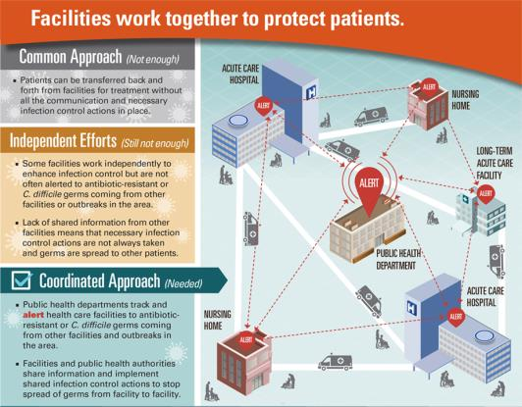
Collaboration Spans the Care Continuum
Public Health led coordinated prevention approaches have the potential to more completely address the emergence and dissemination of antibiotic resistant organisms and CDI than facility based approaches
Slayton et al., MMWR; 64 (30); 826-831

Slide 15
Skilled Communication Inspires Change
Skilled communicators:
focus on finding solutions
protect and advance collaboration
invite and hear all relevant perspectives
call upon good will and mutual respect
demonstrate congruence between words and actions
AACN, 2004

Slide 16
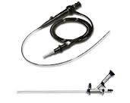
Skilled Communication
Question from the urologist:
  Can I flush the ureteroscope with betadine immediately before a procedure instead of reprocessing it?
The correct response is:
“This facility does not vary from manufacturer’s instructions for use without formal written communication of updated, FDA approved processes.”
This call resulted in the purchase of additional instruments.

Slide 17
Communicating to Inspire Change: SBAR
Improving Ultrasound Probe Disinfection
Situation
Ultrasound probes are currently disinfected in the patient exam room. This room lacks appropriate ventilation per OSHA standards.
Background
Intra-cavity Ultrasound Probes require High Level Disinfection between each use.
Assessment
Patient and Employee safety is compromised by the lack of ventilation and mixing of clean and dirty areas.
Recommendation
Purchasing a system that obtains compliance with regulatory bodies as soon as possible is recommended.
Cost: $21,840 – Construction: Wall Mounting
SBAR Toolkit: http://www.ihi.org/resources/pages/tools/sbartoolkit.aspx

Slide 18
Communicating with Constipators:
When Leaders Don’t Want to Move
Recognizing the role of Active Resistors and Organizational Constipators in hindering performance can help overcome barriers.
Type of Personnel | Source of Barrier | Engagement Strategies
Active Resistors Personnel who are highly invested and resistant to change. | Culture or behavior is entrenched Disregard recommendations from competing authorities | Data feedback of infection rates Data feedback of compliance rates Collaboration in initiatives that align leadership and clinician goals to reduce harm Effective championing by a respected individual
Organizational Constipators Mid to Senior Level managers | Insidious barriers to change Maintain control and create extra work that makes change difficult to accomplish | Engage the individual early in the initiative Work around the individual Provide every opportunity to improve or comply Utilize external partners Termination is sometimes needed to bring change
Saint et al. Jt Comm J Qual Patient Saf 2009; 35: 239-246.

Slide 19
Communicating Routine Bad News
Everyday feedback
Less than optimal
NOT disclosure of an adverse event
May be considered impolite
Necessary to avoid
  Problematic
  Severely negative feedback episodes
Strategic delivery
  Can preserve solidarity and teamwork among personnel
  Can reduce threats to autonomy and competence
    Assists personnel in moderating actions to improve performance
Wagoner & Waldron S Comm Journal, 1999; 64: 199-210

Slide 20
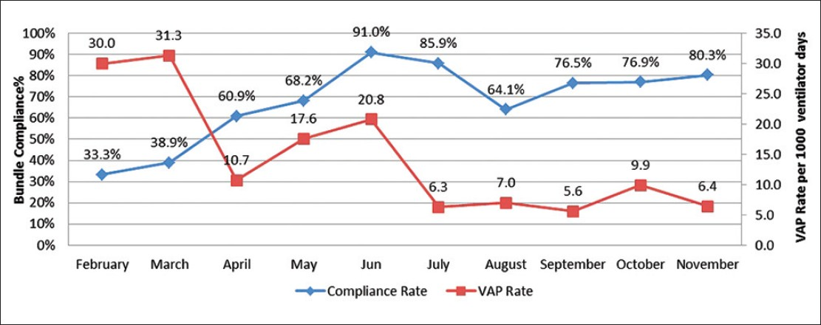
Communicating Routine Feedback
Cochrane Reviewers Findings on Feedback:
  Most effective when performance is less than optimal
  Person responsible for feedback is a supervisor or colleague
  Is provided more than once
  Is provided verbally and in writing
  Includes clear targets and an action plan
Ivers et al. Cochrane Library, 2012;1 Figure from: Asadat et al. Avicenna J Med, 2012:4

Slide 21
Targeted Assessment for Prevention
(TAP) Strategy
Target
Assess
Prevent
Target facilities/units with high burden/excess of HAIs
Assess gaps in infection prevention in targeted facilities/units
Prevent infections by implementing interventions to address the gaps
Linear progression framework for quality improvement
http://www.cdc.gov/hai/prevent/tap.html

Slide 22

Benefits of TAP Strategy
TAP allows you to:
  Take a focused approach to prevention
  Map excess HAIs to targeted locations
  Have a concrete prevention goal (CAD) linked to the SIR
  Identify specific gaps through a standardized assessment
  Customize strategies to address gaps

Slide 23
Appropriate Use of TAP Data
The Standardized Infection Ratio (SIR) is used for comparison
Used to compare performance over time, adjusted for exposure
The Cumulative Attributable Difference (CAD) is used for prioritization
Snapshot of the number of infections which if prevented would result in goal attainment
http://www.cdc.gov/hai/pdfs/prevent/TAP-Guide-for-Individual-Facility-User.pdf

Slide 24
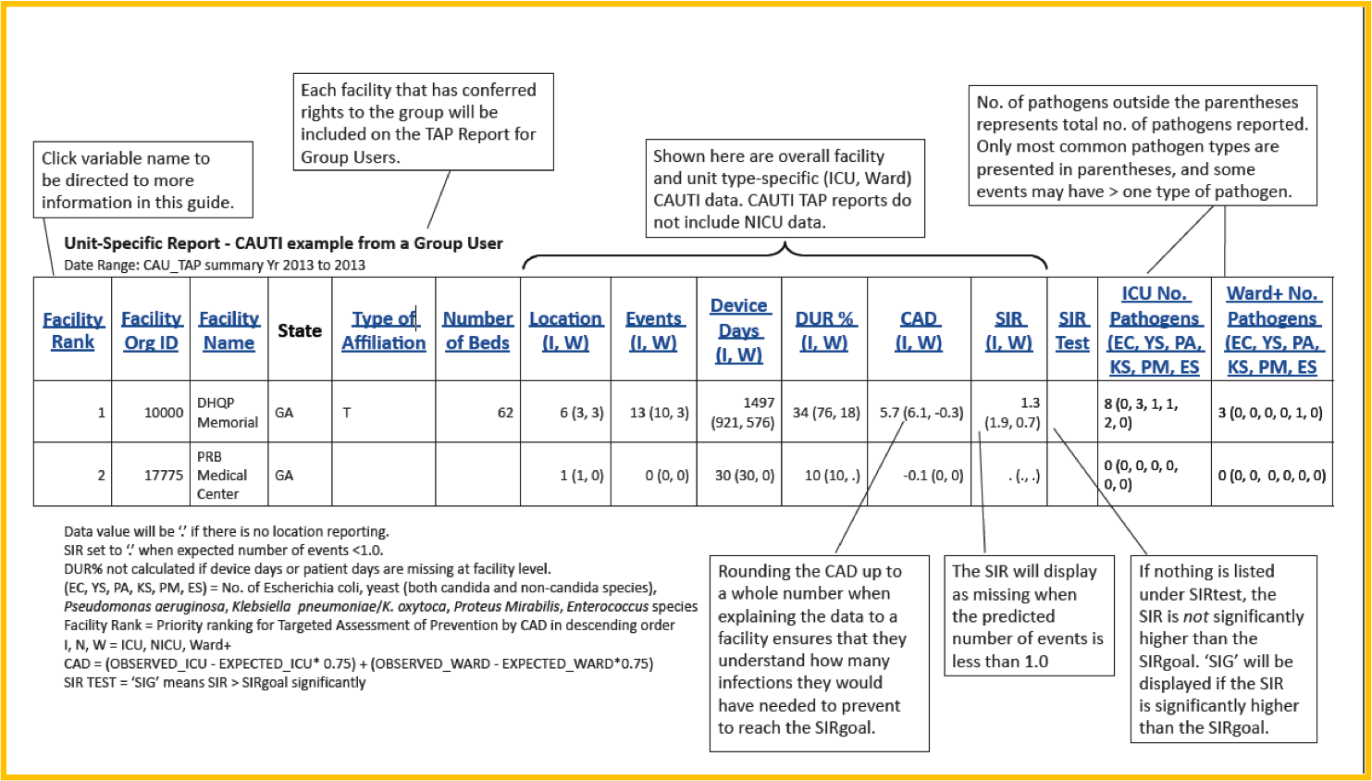
The TAP Report

Slide 25
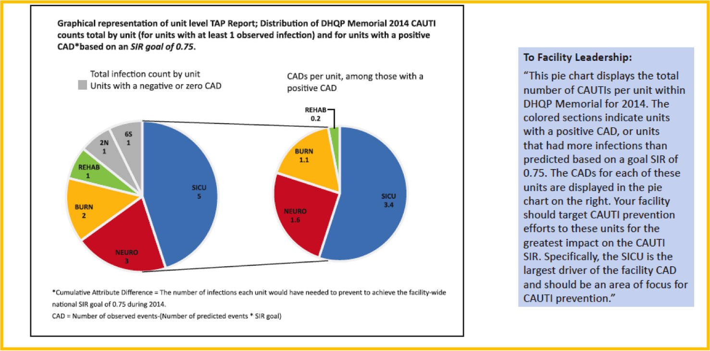
Targeted Communication: Unit Specific

Slide 26
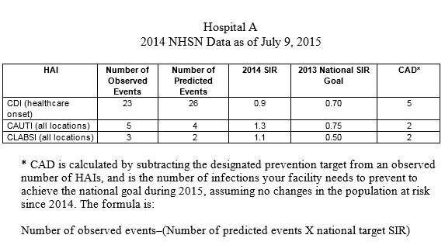
Targeted Communication Facility Specific
“The tradition of collaboration among Wisconsin hospitals is a proven method for improving healthcare quality, and DPH strongly encourages your facility to participate in one of the collaborative HAI reduction groups led by [the hospital association or the quality improvement organization].”
http://www.cdc.gov/hai/pdfs/prevent/TAP-Guide-for-Group-User.pdf

Slide 27
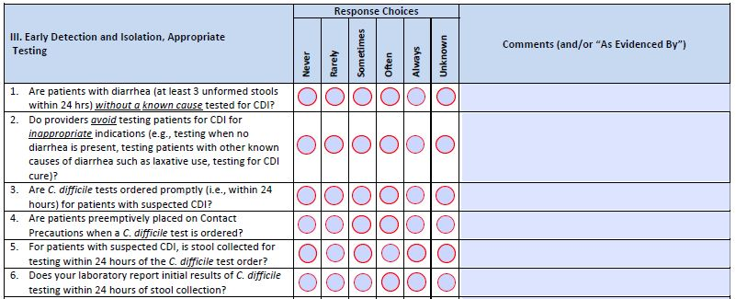
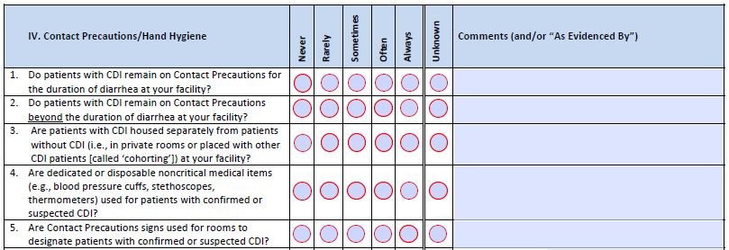
Focused Assessment
TAP Assessments are meant to capture awareness of polices and processes at the facility or unit
Include frontline providers, mid-level staff and senior leadership
The greater number of assessments collected, the greater the ability to identify gaps and target prevention.
Examples of 2 Domains Within the CDI Assessment Tool
http://www.cdc.gov/hai/prevent/tap.html

Slide 28
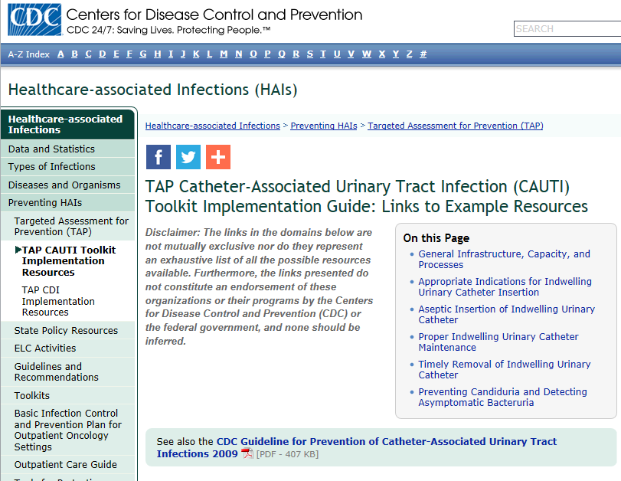
Align Interventions to Needs
CAUTI and CDI Implementation Guides
  Communicate, Collaborate, Coordinate
http://www.cdc.gov/hai/prevent/tap/resources.html

Slide 29

In Summary
Reporting is Required
  Does not teach prevention measures
  Informs need for collaboration and communication
Collaboration and Skilled Communication Build Credibility
  Choose projects carefully and participate fully
    Avoid fatigue by engaging collaborators
      Encourage unit managers to participate in collaboratives
      Create standing Infection Prevention Agenda Items for members of collaboratives
Marstellar et al. Am J Infect Control, 2014; 42: S209-215.

Slide 30
Thank you!
Questions?
National Center for Emerging and Zoonotic Infectious Diseases
Place Descriptor Here

Slide 31


Slide 32

June 16 STRATEGIES TO REDUCE SKIN INJURY IN CRITICALLY ILL PATIENTS
Kathleen M. Vollman, Advanced Nursing LLC
June 23 EXPLORING THE ROLE OF ENVIRONMENTAL SURFACES IN
OCCUPATIONAL INFECTION PREVENTION
Dr. Amber Mitchell, International Safety Center, and Barbara DeBaun, Cynosure Health
June 29 (South Pacific Teleclass)
SHARPS INJURY PREVENTION
Dr. Terry Grimmond, Grimmond & Associates Ltd., New Zealand
July 14 RESULTS OF QUALITATIVE RESEARCH ON IMPLEMENTATION OF
INFECTION CONTROL BEST PRACTICES IN EUROPEAN HOSPITALS
Dr. Hugo Sax, University Hospital Zurich, Switzerland
July 21 BEHAVIOURAL AND ORGANIZATIONAL DETERMINANTS OF
SUCCESSFUL INFECTION PREVENTION AND CONTROL INTERVENTIONS
Dr. Enrique Castro-Sánchez, Imperial College London, England

Slide 33


