Slide 1
Beyond high-touch surfaces: Floors, portable equipment, sinks and other potential sources of healthcare infection transmission
Curtis Donskey, M.D.
Louis Stokes VA Medical Center
Cleveland, Ohio
Hosted by Paul Webber paul@webbertraining.com
www.webbertraining.com
December 7, 2017
Notes:
1

Slide 2
Disclosures
Research support
Merck, Pfizer, 3M, EcoLab, GOJO, Altapure
Consultant
Synthetic Biologics

Slide 3
Objectives
To understand general principles of pathogen transmission
To appreciate the potential for floors and portable equipment to contribute to pathogen transmission
To be aware of recent developments in transmission of pathogens from healthcare facility water systems
Notes:
3

Slide 4
General principles

Slide 5
1. Patients and the environment contribute to transmission
InfectedPatient
Susceptible Patient
Environment

Slide 7
2. Patients shed pathogens before and after they are diagnosed
Preemptive isolation
Extend isolation until discharge
Resolution of diarrhea
Contact Precautions
Test order
CDI Diagnosis
Terminal Cleaning
End of Treatment
3-4 weeks
after Treatment
Sunkesula K, et al. Potential for transmission of spores by patients awaiting testing to confirm suspected CDI. ICHE 2013;34:306-8; Sethi AJ, et al. Persistence of skin contamination and environmental shedding of C. difficile during and after treatment of CDI. ICHE 2010;31:21-7; Kundrapu S, et al. A randomized trial of daily disinfection of high-touch surfaces in isolation rooms to reduce contamination of healthcare workers’ hands. ICHE 2012;33:1039-42.

Slide 8
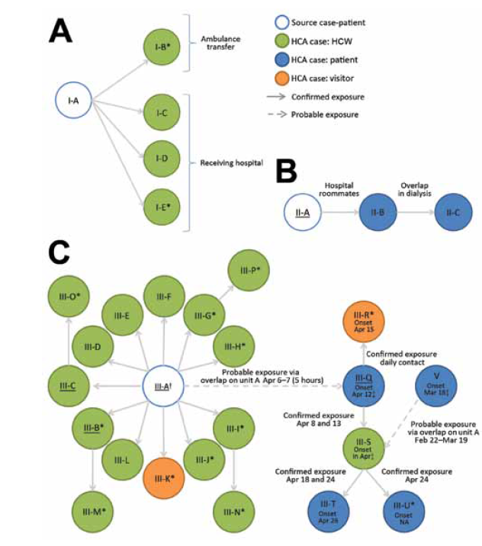
Delays in recognition of infectious patients contribute to transmission
Saudi Arabia outbreak, 2014^{1,2}
27 of 65 (42%) cases healthcare-associated
Most transmission occurred before infection diagnosed
South Korea outbreak, 2015³
173/180 (96%) transmissions occurred prior to isolation
83% of transmissions linked to 5 super-spreaders
3 transmission clusters
1. Hunter JC, et al. Emerg Infect Dis 2016;22:647-655; 2. Assiri A, et al. NEJM 2013;369:407-16; 3. Woo Kim S, et al. Clin Infect Dis 2017;64:551-7

Slide 9
3. Antibiotics promote shedding of pathogens
Effect of antibiotics on density of VRE in stool
Log₁₀ VRE/g
WEEK
Antibiotics with potent activity against anaerobes
Antibiotics with minimal activity against anaerobes
Donskey CJ, et al. N Engl J Med 2000;343:1925-32

Slide 10
Environmental VRE contamination, stratified by burden of VRE in stool
Donskey CJ, et al. N Engl J Med 2000;343:1925-32

Slide 12
5. Contamination transmission

Slide 14
Portable equipment and floors

Slide 15
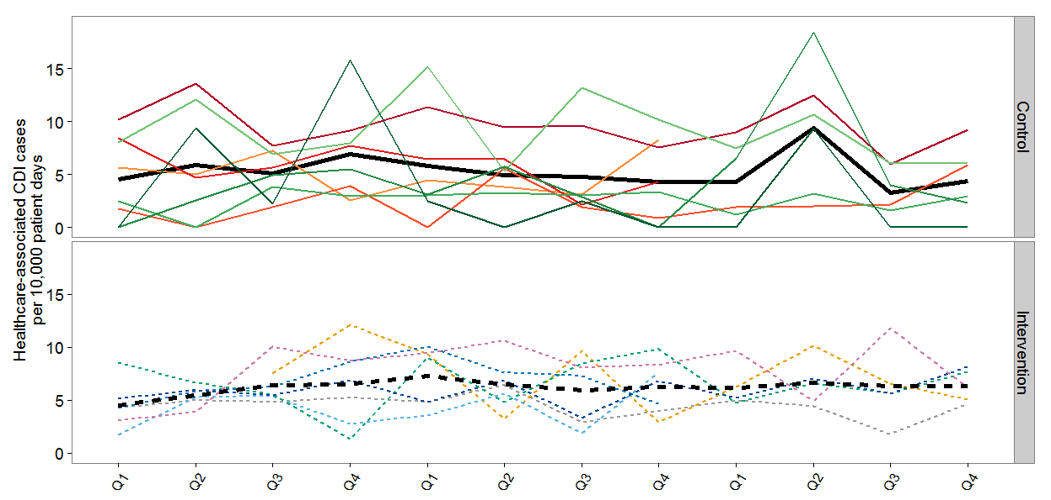
Are we missing important environmental sources of transmission?
Pre-intervention Intervention Post-intervention
Ray AJ. A Multicenter Randomized Trial to Determine the Effect of an Environmental Disinfection Intervention on the Incidence of Healthcare-Associated CDI. ICHE 2017;38:777-83

Slide 16
Shared portable equipment
Hospitalized patients frequently have direct or indirect interactions with shared medical equipment and other fomites ¹
Portable equipment is often contaminated with pathogens, but rarely cleaned ²
Portable equipment has been associated with outbreaks ³
1. Suwantarat N. Quantitative assessment of interactions between hospitalized patients and portable medical equipment and other fomites. AJIC 2017; 2. Havill N. Cleanliness of portable equipment disinfected by nursing staff. Am J Infect Control 2011; 3. Kanamori H. The role of patient care items as a fomite in healthcare-associated outbreaks and infection prevention. Clin Infect Dis 2017

Slide 17
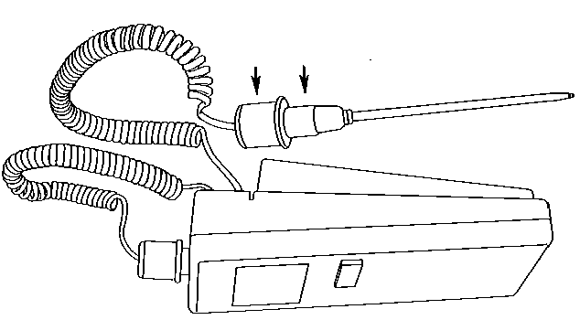
Electronic thermometers
 | Study design | Intervention | Outcome
¹Brooks | Quasi-experimental | Replacement of electronic rectal thermometers with disposables | Significant reduction in CDI in a hospital and skilled nursing facility
²Jernigan | Ward cross-over study | Replacement of electronic thermometers with disposables | Significant reduction in CDI with disposable vs. electronic thermometers (RR 0.44; CI 0.21-0.93)
1). Brooks SE et al. Infect Control Hosp Epidemiol 1992;13:98-103; 2). Jernigan JA, et al. Infect Control Hosp Epidemiol 1998;494-9;
3). Livornese LL, et al. Ann Intern Med 1992;117:112-116

Slide 19
Dissemination of a non-pathogenic virus from portable electronic thermometers in a LTCF
Alhmidi H, et al. Am J Infect Control in press.

Slide 20
SICU: Doppler ultrasounds
Number of swabs 28 13 9 6 38 22 10 6 34 16 11 7 100 51 30 19
1 2 6 All days
Days after inoculation of DNA marker
John A. Contaminated Portable Equipment Is a Potential Vector for Dissemination of Pathogens in the ICU. ICHE 2017;38:1247-9

Slide 21
MICU: ECG machines
*
Number of swabs 43 31 8 4 43 27 10 6 42 28 10 4 128 86 28 14
1 2 6 All days
Days after inoculation of DNA marker

Slide 24
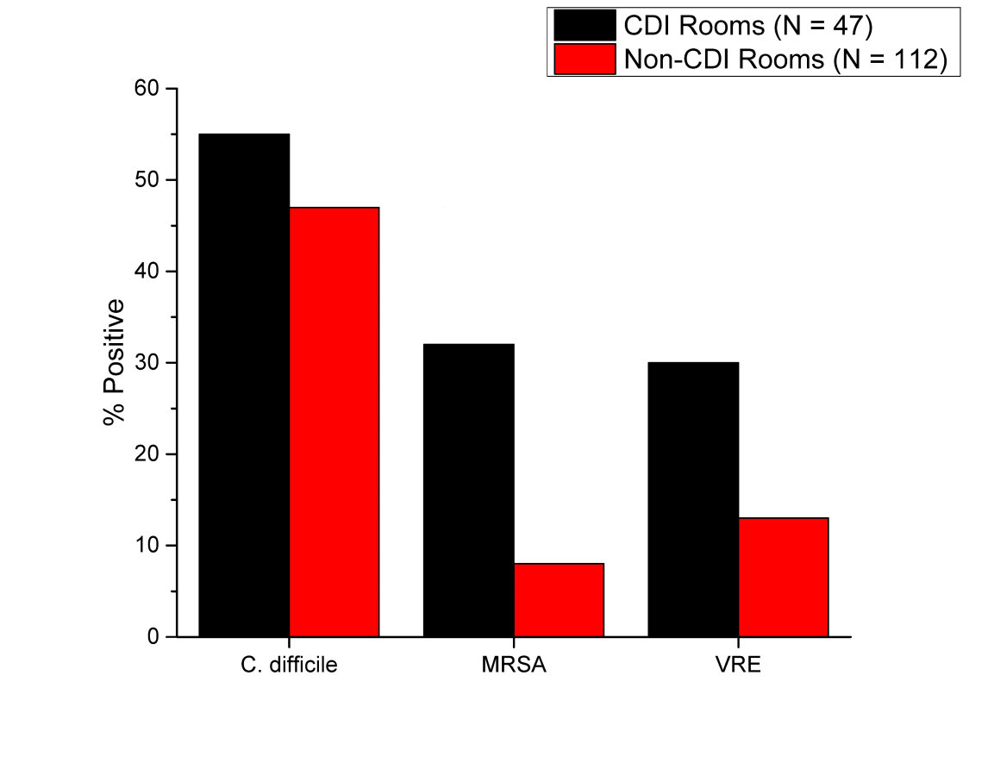
Are floors an under-appreciated source of transmission?
Deshpande A. Are hospital floors an underappreciated reservoir for transmission of health care-associated pathogens? Am J Infect Control 2017;45:336-8; Fekety R. Am J Med 1981;70:906-8 (floors frequently contaminated with C. difficile spores); Mutters R. J Hosp Infect 2009;71:43-8 (floors more heavily contaminated with C. difficile spores than hands of CDI patients or other environmental surfaces); Ali S. J Clin Microbiol 2015;53:2570-4 (floors in room and bathroom more heavily contaminated with C. difficile spores than other environmental sites); Lemmen SW. J Hosp Infect 2004;56:191-7 (floors frequently contaminated with multi-resistant gram-positive and gram-negative pathogens)

Slide 28
Current floor cleaning methods may be ineffective
Floor cleaning: a neutral detergent was used and the solution and mop head was changed after every 3rd room
Wong T, et al. Am J Infect Control 2016; 44:416-20

Slide 29
Cleaning and disinfection of floors can be more effective
Floor cleaning: a cleaner/disinfectant was used with multiple disposable mop heads used per room
Mustapha A, et al. Am J Infect Control in press

Slide 30
Clothing and personal protective equipment

Slide 32
Hand contamination during patient care despite wearing gown and gloves
 | Gloves contaminated before removal, % | Hands contaminated after glove removal, %
MRSA | 11 | 3
VRE | 10 | 2
Acinetobacter baumanii | 29 | 5
C. difficile | ND | 24
C. difficile | ND | 16
Hayden MK, et al. ICHE 2008;29:149-54; Morgan DJ, et al. ICHE 2010;31:716-21; Morgan DJ, et al. Crit Care Med 2012;40:1045-51; Landelle C, et al. ICHE 2014;35:10-5; Tomas M, et al. ICHE 2015.

Slide 34
Skin and clothing contamination during removal of contaminated gloves

Slide 35
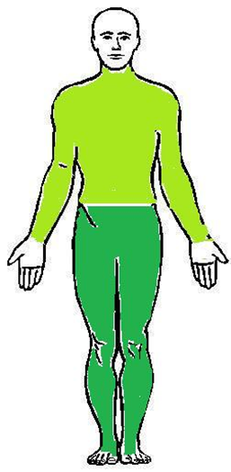
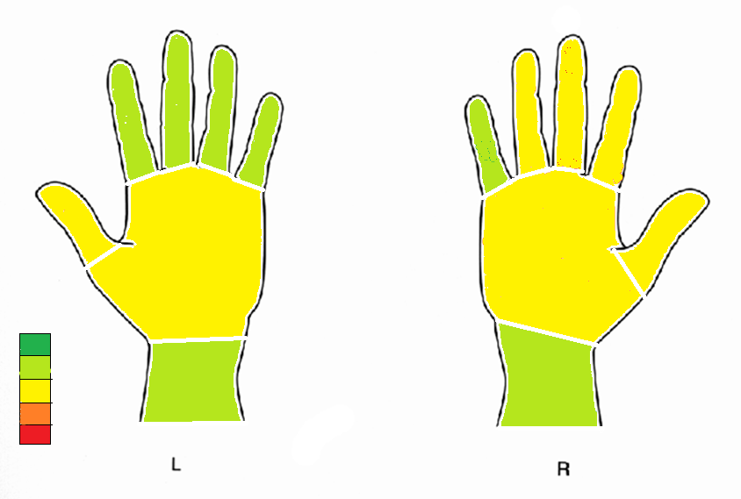
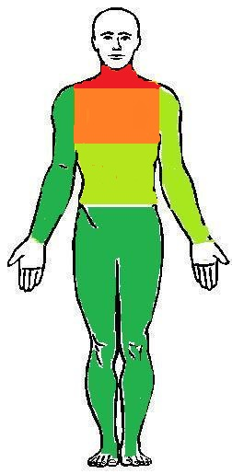
Sites of contamination
Contaminated glove removal
0%
10%
20%
30%
40%
Contaminated gown removal

Slide 40
Contamination with DNA marker while wearing long- versus short-sleeved coats
John A. Infect Control Hosp Epidemiol in press.

Slide 41
Healthcare facility water systems

Slide 42
You have an outbreak of multidrug-resistant Pseudomonas in your ICU. Which would you consider as a potential source?
A. Dirty laundry
B. Contaminated stool softener
C. Physician’s ties
D. Contaminated sinks

Slide 43
You have an outbreak of multidrug-resistant Pseudomonas in your ICU. Which would you consider as a potential source?
A. Dirty laundry (Zygomycosis)
B. Contaminated stool softener (B. cepacia)
C. Physicians’ ties
D. Contaminated sinks
Marquez L, et al An outbreak of Burkholderia cepacia complex infections associated with contaminated liquid docusate. ICHE 2017;1-7; Cheng VCC, et al. Hospital outbreak of pulmonary and cutaneous zygomycosis due to contaminated linen items from substandard laundry. Clin Infect Dis 2016;62:714-20 (Hong Kong); Duffy J, et al. Mucormycosis outbreak associated with hospital linens. Pediatr Infect Dis J 2014;33:472-6 (Louisiana); ID Week 2016. Zygomycosis associated with contaminated laundry (Rhizopus spp. and Lichtheimia (Absidia) corymbifera)

Slide 44
Organisms linked to sinks
Pseudomonas aeruginosa
Klebsiella pneumoniae and K. oxytoca
Enterobacter cloacae
Elizabethkingia meninogoseptica
Acinetobacter baumanii
Stenotrophomonas maltophilia
Kanamori H, et al. Clin Infect Dis 2016;62:1423-35 (review on waterborne transmission in healthcare facilities); Hota S, et al. ICHE 2009;30:25-33; Ambrogi V, et al. J Hosp Infect 2016;92:27-9; Wolf I, et al. J Hosp Infect 2014;87:126-30; Roux D, et al. J Hosp Infect 2013;85:106-11; Zhou Z, et al. J Infect Chemother 2016; Aspelund AS, et al. J Hosp Infect 2016;94:13-20; Leitner E, et al. Antimicrob Agents Chemother 2015;59:714-16; Chapuis A, et al. Frontiers Microbiol 2016;7:1-9; Amoureux L, et al. Emerg Infect Dis 2017;23:304-7; Clarivet B, et al. Euro Surveill 2016;21; Knoester M, et al. Clin Microbiol Infect 2014;20:0207-0215; Vergara-Lopez S, et al. Clin Microbiol Infect 2013;19:E490-8; Fusch C, et al. Acta Paediatrica 2015;104:e344-e349; Lowe C, et al. Emerg Infect Dis 2012;18:1242-7;

Slide 45
Recovery of potential pathogens from hospital surfaces
Piedrahita C, et al. Environmental Surfaces in Healthcare Facilities are a Potential Source for Transmission of Candida auris and other Candida species. ICHE 2017;38:1107-9; Jencson AL, et al. Hospital sinks are a potential nosocomial source of Candida infections. Clin Infect Dis 2017.

Slide 46
From sink to patient
Cold
Hot
Kotay S, et al. Spread from the sink to the patient: in situ study using GFP expressing E. coli to model bacterial dispersion from sink trap reservoirs. Appl Env Microbiol Feb. 2017

Slide 47
Cold
Hot

Slide 48
Cold
Hot

Slide 49
Cold
Hot

Slide 50
Cold
Hot

Slide 51
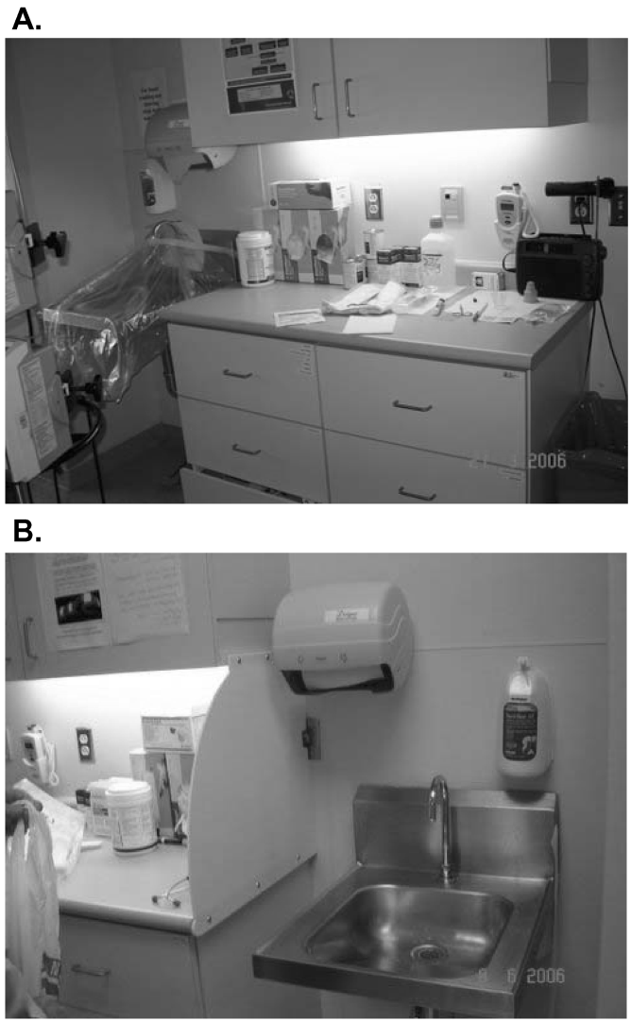
Improving room design to reduce risk for transmission from sinks
Before renovation
After renovation
Hota S, et al. Outbreak of multidrug-resistant P. aeruginosa colonization and infection secondary to imperfect intensive care unit room design. ICHE 2009;30:25-33.

Slide 52
5. How could contaminated ice machines be linked to transmission?
Ice machines have been linked to transmission of Legionella, Mycobacterium chelonae, and Enterobacter cloacae
Genetically related carbapenem-resistant Acinetobacter baumannii recovered from the stool of 3 patients, the hands of a nurse, and an ice machine water outlet spout and drain ¹
Kanwar A. A cold hard menace: A contaminated ice machine as a potential source for transmission of carbapenem-resistant Acinetobacter baumannii. AJIC 2017

Slide 53
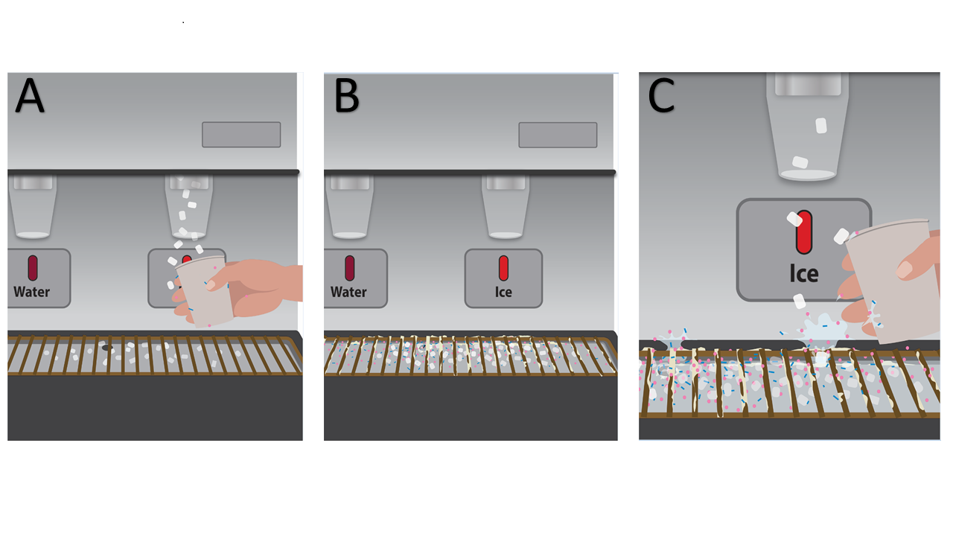
Contaminated ice machines as a source of pathogen transmission
Kanwar A. A cold hard menace: A contaminated ice machine as a potential source for transmission of carbapenem-resistant Acinetobacter baumannii. AJIC 2017; Kanwar A. Hiding in plain sight: Contaminated ice machines as a potential source for dissemination of pathogens. ICHE in revision.

Slide 54
A patient with history of aortic valve replacement presents with fever and fatigue. Blood cx negative.
A. Pseudomonas aeruginosa
B. Legionella species
C. Non-tuberculous mycobacteria

Slide 57
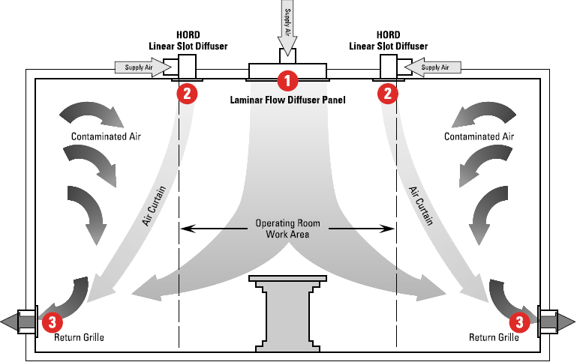
OR Supply Air Distribution Air Curtain System

Slide 60
