Slide 1
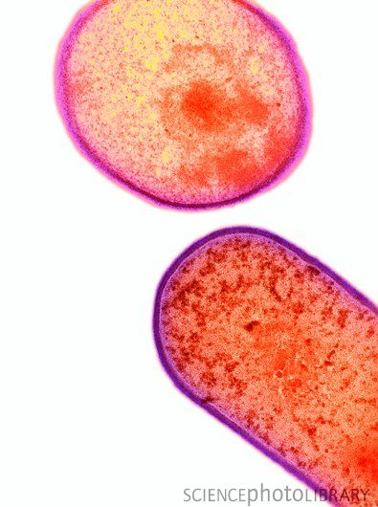
Clostridioides difficile
Asymptomatic Carriers:
Should We Care About Them?
Yves Longtin, MD
Chair, Infection Prevention and Control Unit
Jewish General Hospital
Associate professor of Medicine, McGill University
Yves.Longtin@McGill.ca
Hosted by Paul Webber
paul@webbertraining.com
www.webbertraining.com
May 19, 2022

Slide 2
Disclosures
Research Funding
  Merck Canada, BD Diagnostics, Canadian Institute for Health Research
Salary Support from the Fonds de Recherche en Santé du Québec
2

Slide 3
BACKGROUND
3

Slide 4
Background
C. difficile infections have become the most frequent cause of healthcare-associated infection in the USA¹⁻³
500,000 cases per year²
29,000 deaths²
$4.8 billion in excess medical costs²
One of only 3 microorganisms designated as an “Urgent threat” to the population by CDC³
1. Leffler DA et al. N Engl J Med 2015;372:1539-48.
2. Lessa FC, et al. N Engl J Med 2015;372:825-34.
3. CDC ARO report Sept. 16, 2013.
Notes:
Other urgent threats:
CPE
Drug-resistant Gono

Slide 5
Evolution of CDI
A small victory

Slide 6
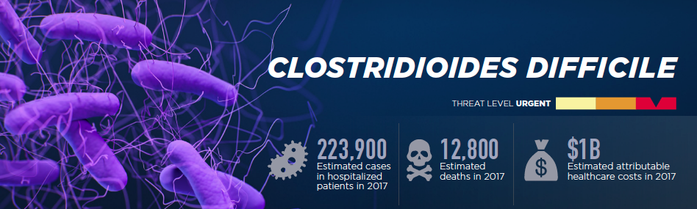
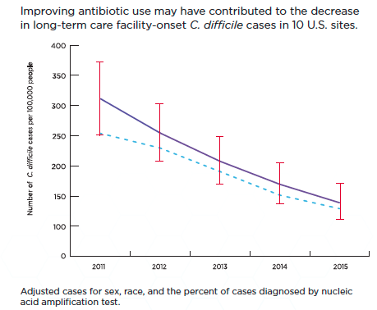
CDC 2019
6

Slide 7
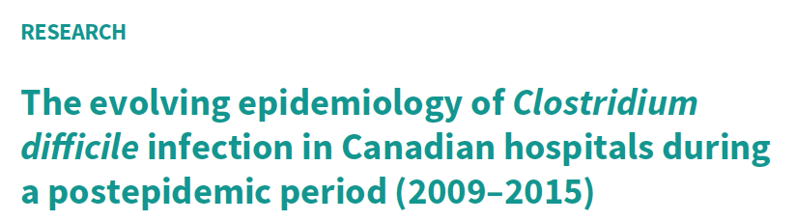
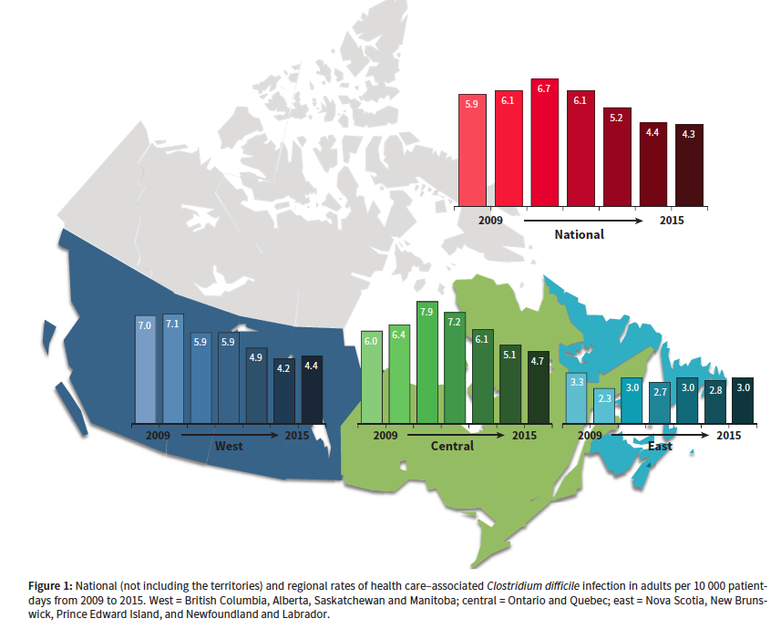
% NAP1
49%
37%
47%
38%
36%
29%
28.5%
7
Katz K et al. CMAJ. 2018 Jun 25;190(25):E758-E765.

Slide 8
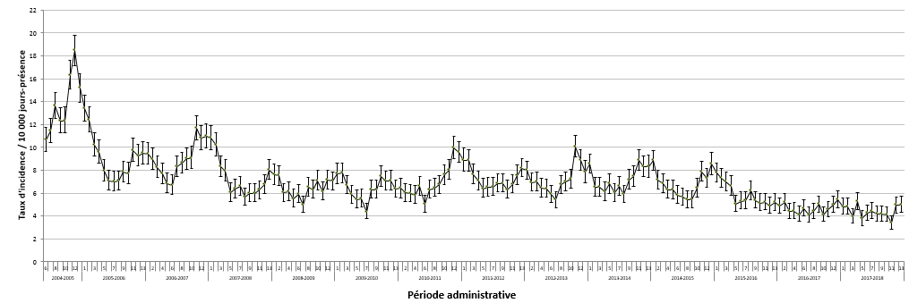
Figure 2 – Évolution des taux d’incidence des DACD nosocomiales (cat. 1a et 1b) pour les installations participantes (N = 94) ¹ selon la période administrative, ensemble du Québec, 2004-2005 à 2017-2018 (taux d’incidence par 10 000 jours-présence [I.C. à 95 %])
>75%
DECREASE
Why embark in a ACDC screening and isolation program?
We already solved CDI!
No need to improve any further…

Slide 9
Did we “solve” the CDI issue?

Slide 10
Because CDI is a problem
1
HUGE
still

Slide 11
Room for improvement
13% of U.S. hospitals have CDI rates significantly above average
Even a decrease of an additional 25%-30% would lead to significant life savings
How long should we go? Try to eliminate CDI
https://gis.cdc.gov/grasp/PSA/HAIreport.html

Slide 12
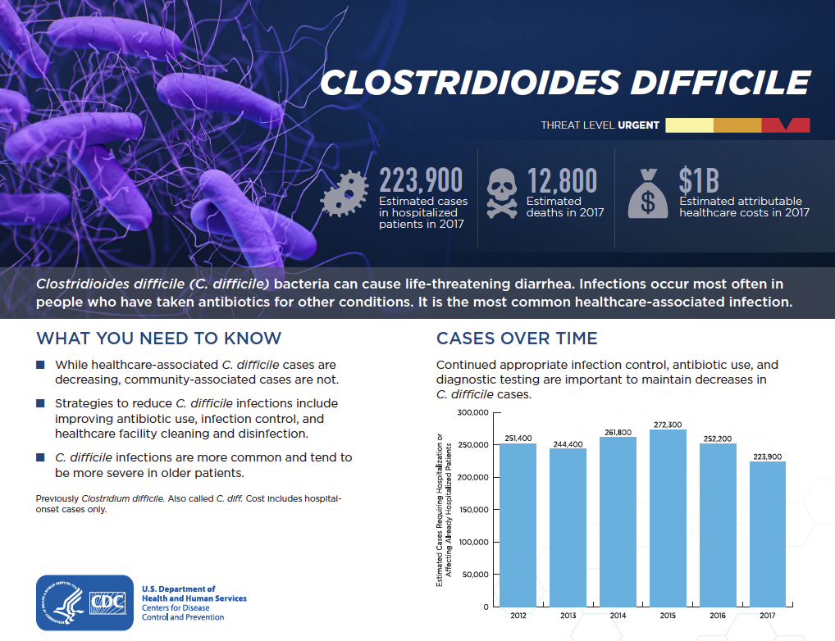
CDC 2019

Slide 13
C. difficile infections burden
500,000 cases per year²
29,000 deaths²
$4.8 billion in excess medical costs²
200,000
12,000
SSI:
157,000 cases;
4700 deaths (3% mortality)
CLABSI:
84,000-203,000 cases;
10,000-25,000 deaths
.
https://www.cdc.gov/nhsn/pdfs/pscmanual/9pscssicurrent.pdf
OntheCUSPStopHAI.org

Slide 14

PREVENTION
Could we go even further?

Slide 15
Prevention of CDI
Current recommendations relatively unchanged for more than 20 years^{1,2}
  i.e. prior to the onset of the NAP1 epidemic
Dubberke ER, et al. Strategies to prevent Clostridium difficile infections: 2014 update. Infect Control Hosp Epidemiol 2014;35 Suppl 2:S48-65.
Vonberg RP, et al. Infection control measures to limit the spread of Clostridium difficile. Clin Microbiol Infect 2008;14 Suppl 5:2-20.
15

Slide 16
Guidelines
Measures recommended to prevent CDI
  Contact Precautions for symptomatic patients
    Only for duration of diarrhea
  Hand hygiene
    Hand washing in outbreak setting
  Environmental cleaning with chlorine-based agent
  Optimization of antimicrobial use
    Minimize duration
    Avoid high-risk drugs
Cohen, S.H., et al., Infect Control Hosp Epidemiol, 2010. 31(5): p. 431-55.

Slide 17
Guidelines
Other Secondary Measures to prevent CDI
  Surveillance and feedback of CDI incidence
  No touch disinfection systems
    As effective as hypochlorite (not more effective)
    May be effective in reducing transmission
  Educate HCWs, patients and visitors on how to prevent CDI
Cohen, S.H., et al., Infect Control Hosp Epidemiol, 2010. 31(5): p. 431-55.
Tschudin-Sutter S et al. Clin Microbiol Infect 2018. 24(10): 1051-1054

Slide 18
Guidelines
Other Secondary Measures to prevent CDI
  Surveillance and feedback of CDI incidence
  No touch disinfection systems
    As effective as hypochlorite (not more effective)
    May be effective in reducing transmission
  Educate HCWs, patients and visitors on how to prevent CDI
Main Issues
Not based on strong evidence
Flawed: Allow for residual cross-transmission
Cohen, S.H., et al., Infect Control Hosp Epidemiol, 2010. 31(5): p. 431-55.
Tschudin-Sutter S et al. Clin Microbiol Infect 2018. 24(10): 1051-1054

Slide 19
Which component is most important?
Could not identify which component of CDI bundle were associated with lower CDI rates
Survey of 126 hospitals in VA system in the US 2017
Musuuza JS et al. Infect Control Hospit Epidemiol 2020 41(1): 52-58

Slide 20
Current recommendations
Current preventive recommendations focus mainly on patients with CDI, but are insufficient to interrupt the dissemination of this microorganism in healthcare settings^{1,2}
Dubberke ER, et al. Strategies to prevent Clostridium difficile infections: 2014 update. Infect Control Hosp Epidemiol 2014;35 Suppl 2:S48-65.
Vonberg RP, et al. Infection control measures to limit the spread of Clostridium difficile. Clin Microbiol Infect 2008;14 Suppl 5:2-20.

Slide 21
Cross-transmission in Acute Care
Asymptomatic colonization is frequent
during hospitalization in acute care settings
    9.4% (54/569) of patients during their hospital stay¹
    17% acquired C.difficile during their hospitalization²
    12% of patients admitted on a geriatric unit³
    8% (6/76) during their hospital stay⁴
    21% (83/399) acquired C. difficile during their stay. A third progressed to CDI⁵
    Approximately 10% after 21 days of hospitalisation⁶
1. Clabots CR. J Infect Dis 1992;166:561-7.
2. Kyne L. N Engl J Med 2000;342:390-7.
3. Rudensky B. Postgrad Med J 1993;69:45-7.
4. Bliss DZ. Ann Intern Med 1998;129:1012-9
5. McFarland LV. N Engl J Med 1989;320:204-10.
6. Loo V et al. N Engl J Med 365;18: 1693-1703

Slide 22
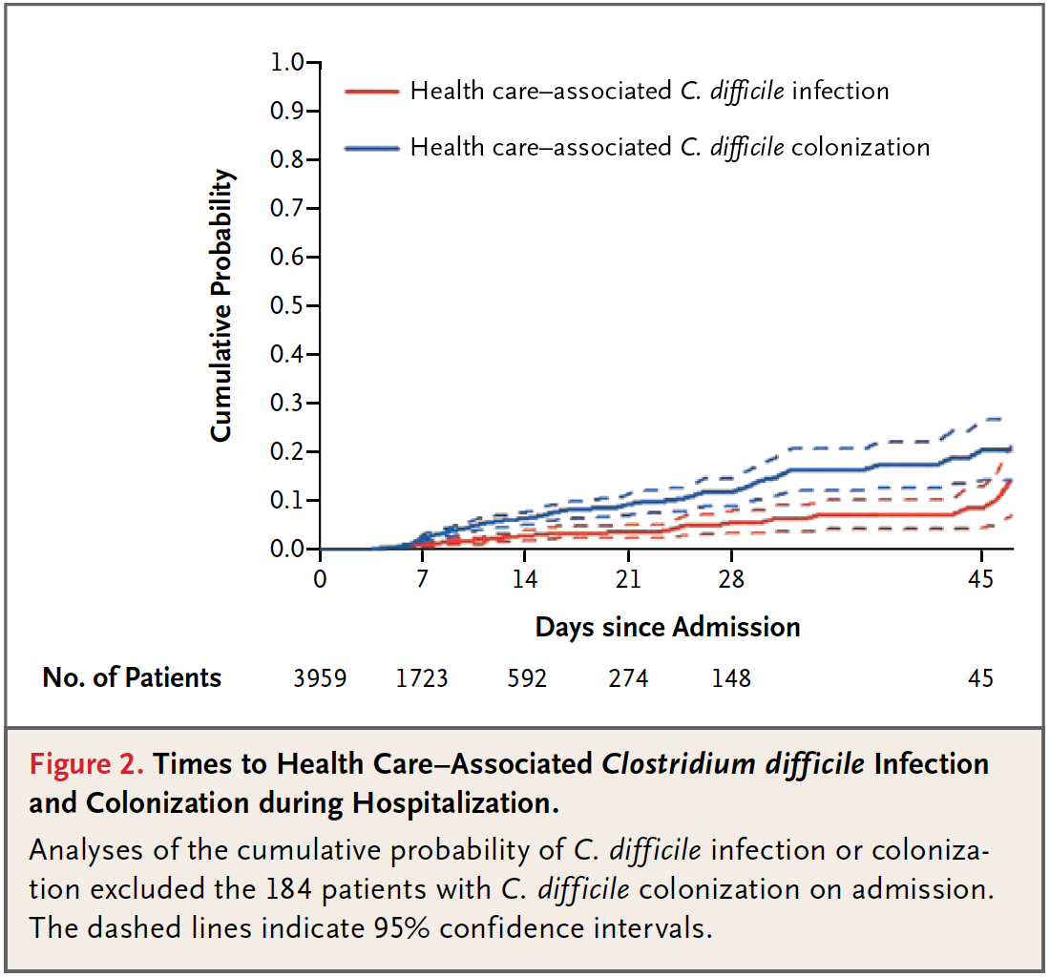
Ongoing Transmission in Quebec Hospitals
Loo V et al. N Engl J Med. 2011 Nov 3;365(18):1693-703.

Slide 23
Ongoing Transmission in Quebec Hospitals
Ongoing transmission DESPITE isolation of patients with CDI as per GL
Source of residual transmission?
CDI “breakthrough” transmission?
Healthcare workers?
Food?
CD carriers?
Loo V et al. N Engl J Med. 2011 Nov 3;365(18):1693-703.

Slide 24
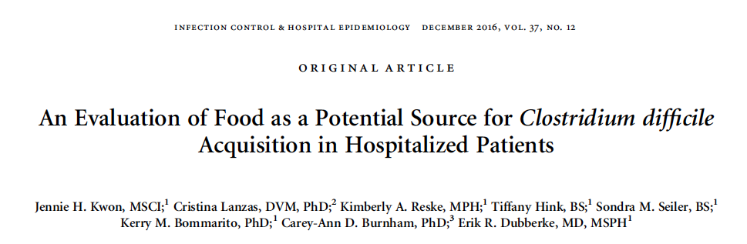
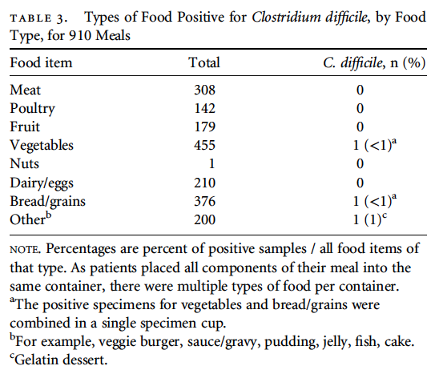

Stochastic modeling: food would be responsible for < 1 newly colonized patient /1,000 adms.
2 patients had food + for CD
1 of 2 patients tested for CD at d/c and found negative
Kwon JH et al. Infect Control Hosp Epidemiol 2016;37:1401–1407

Slide 25

Unrecognized transmission?
Observational study, Switzerland single center
Culture of shoes twice per shift of HCWs caring for patients with C. difficile
Comparison with patient’s C. difficile strain
RESULT: 17% of HCWs’ shoes contaminated with C. difficile
  74% strain matching the patient’s
  A longer duration of care associated with greater odds of matching isolates between shoes and patient strain (100 min vs 70 min, p=0.007)
Buchler AC et al. J Hosp Infect. 2022 May 10;S0195-6701(22)00131-1.

Slide 26
Ongoing Transmission in Quebec Hospitals
Ongoing transmission DESPITE isolation of patients with CDI as per GL
Source of residual transmission?
CDI “breakthrough” transmission?
Healthcare workers?
Food?
CD carriers?
Maybe
Loo V et al. N Engl J Med. 2011 Nov 3;365(18):1693-703.
Unlikely
Unlikely
Possibly

Slide 27
How numerous are CD-AC?
A point-prevalence of patients hospitalized in a LTCF during an epidemic showed a very high prevalence (35/73) of asymptomatic carriers and CDAD patients (5/73) (A:S ratio: 7:1)¹
A prevalence study of patients hospit. for >7days in a gen. hospital 9 were symptomatic and 51 were asymptomatic (A:S ratio 5:1)²
In a large multicentric study in Quebec, there were 192 CDI cases (75 on admission and 117 after admission) and 307 CD-AC (184 on admission and 123 after admission) (A:S ratio: 1.5:1)³
Riggs MM, Clin Infect Dis 2007;45:992-8.
Johnson S et al. Lancet 1990;336:97-100.
Loo V et al. N Engl J Med. 2011 Nov 3;365(18):1693-703

Slide 28
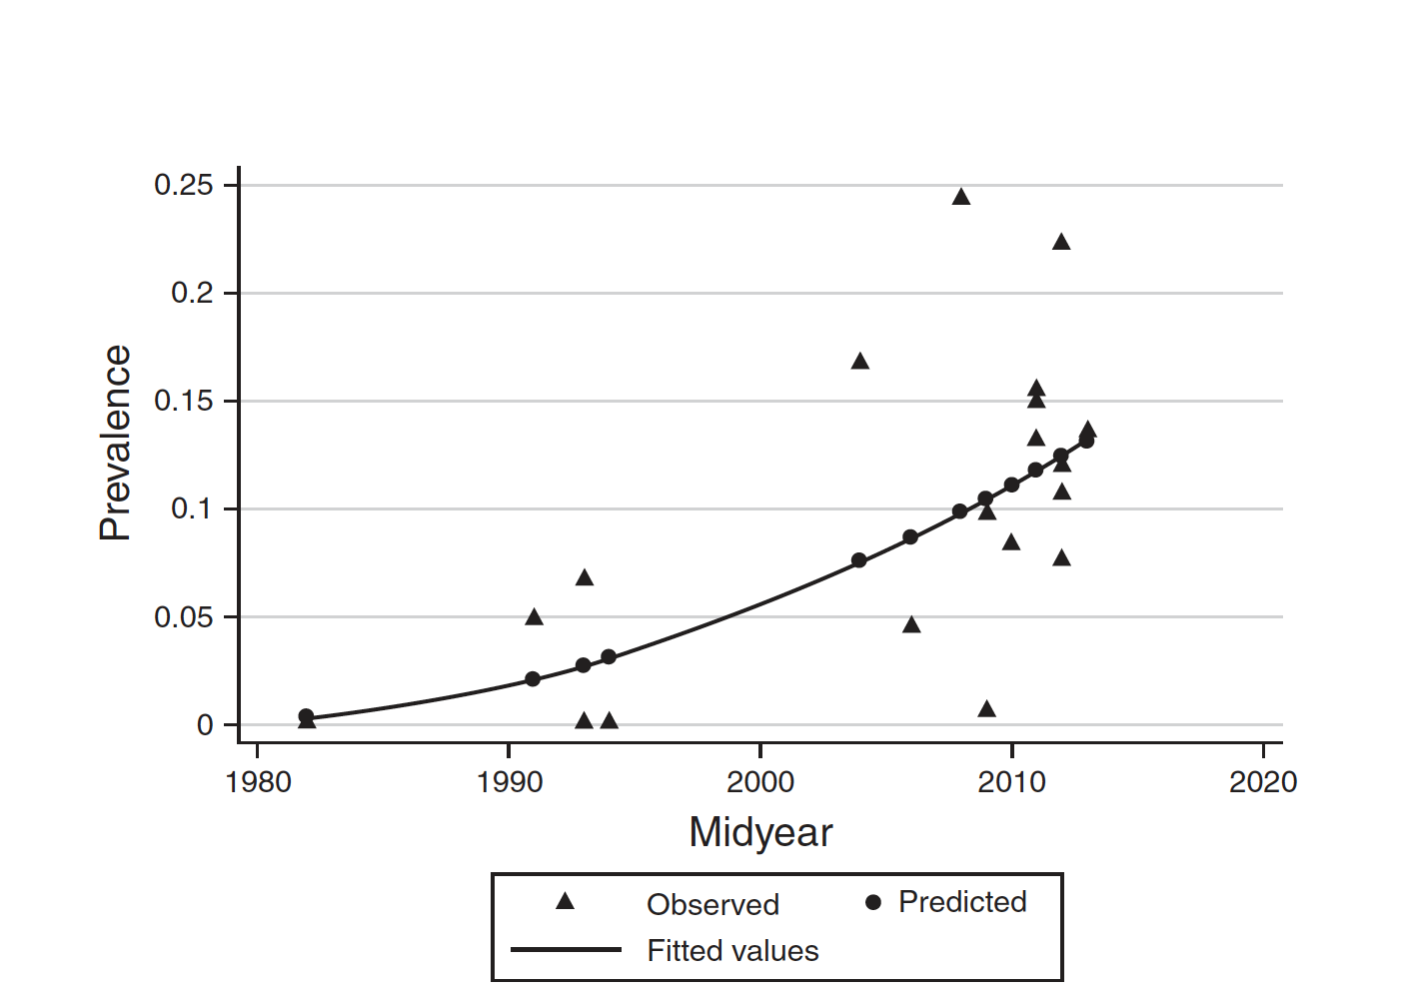
Colonization of patients becoming MORE COMMON
Zacharioudakis IM, et al. Am J Gastroenterol 2015; 110(3): 381-90

Slide 29
Contagiousness of
CDI patients
Just how “contagious” are they?

Slide 30
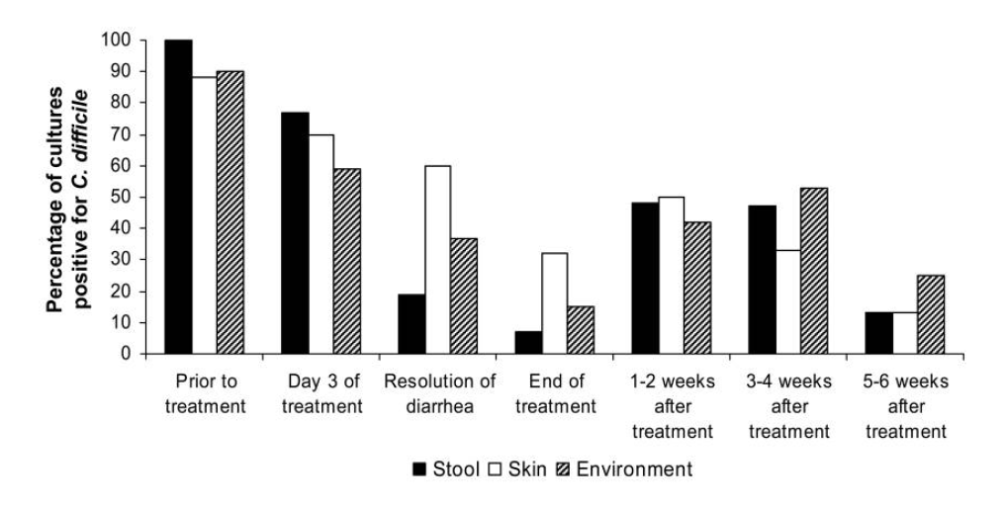
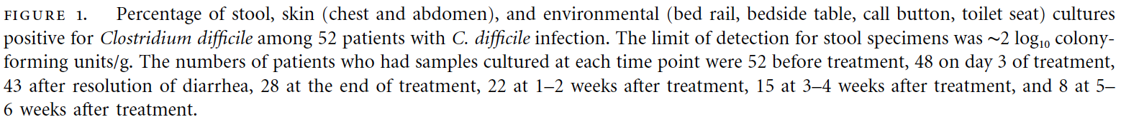
Contagiousness of patients with CDI on the day of diagnosis
Sethi AK at al. Infect Control Hosp Epidemiol. 2010 Jan;31(1):21-7. doi: 10.1086/649016.
30

Slide 31
Contagiousness of CDI patients
Skin colonization of CDI patients
Transfer to gloves
Bobulski GS, Clin Infect Dis 2008
31

Slide 32

CD-AC are not as contagious as CDI patients… but almost!
78%
61%
C. difficile is present on the SKIN of asymptomatic carriers
19%
78%
59%
C. difficile in the IMMEDIATE SURROUNDINGS of asymptomatic carriers
24%
Riggs MM. Clin Infect Dis 2007;45:992-8

Slide 33
C. difficile present on skin of asymptomatic carriers can be transferred to HCWs’ hands
30-60% of time
…And an ABHRS won’t kill them
Bobulsky GS. et al., Clin Infect Dis. 2008; 46(3):447-50
33

Slide 34
Duration isolation precautions
CDI
D/C
CDI treatment
How long should we isolate CDI patients?
Uncertainty highlights doubt over role of carriers
34

Slide 35
Duration isolation precautions
CDI
D/C
CDI treatment
ESCMID 2018: No recommendation can be made, but not until discharge
CDC HICPAC 1996
CDC 2007
Duration illness
IDSA 2018 if rates too high despite implemtnation of basic measures
PHAC – 2012
U.K.
IDSA 2018
48 h normal BM
INSPQ 2005
until 72h asympto
SHEA 2002
Only if incontinent
35

Slide 36
Duration isolation precautions
SHEA 2014
CDI
D/C
CDI treatment
CDC HICPAC 1996
CDC 2007
Duration illness
PHAC - 2012
48 h normal BM
INSPQ 2005
until 72h asympto
SHEA 2002
Only if incontinent
36

Slide 37
D/C precautions
Terminal disinfection
Unknown recontamination of env.
Sethi AK at al. Infect Control Hosp Epidemiol. 2010 Jan;31(1):21-7. doi: 10.1086/649016.
37

Slide 38
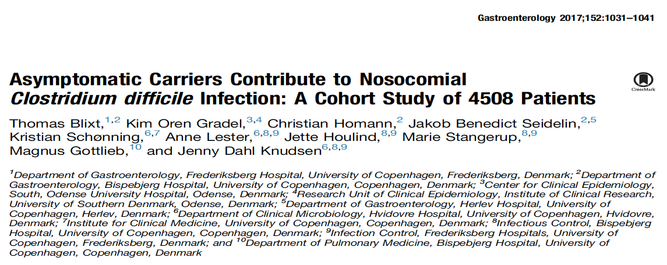
C. difficile carriers can cause CDI in other patients
Blixt T et al. Gastroenterology. 2017 Apr;152(5):1031-1041.

Slide 39
Observational study
8 wards in 2 hospitals in Copenhagen
CDI incidence 2-2.5 per 1,000 patient-days
Private rooms rare
Blixt T et al. Gastroenterology. 2017 Apr;152(5):1031-1041.

Slide 40
Exposure to a CD carrier doubled risk of CDI
  OR 2.10 (95% CI, 0.97-4.53)
Association between level of exposure and risk of CDI
(no. of carriers and/or Length of stay)
NNTH: 71 (ward level) and 50 (room level)
Blixt T et al. Gastroenterology. 2017 Apr;152(5):1031-1041.

Slide 41
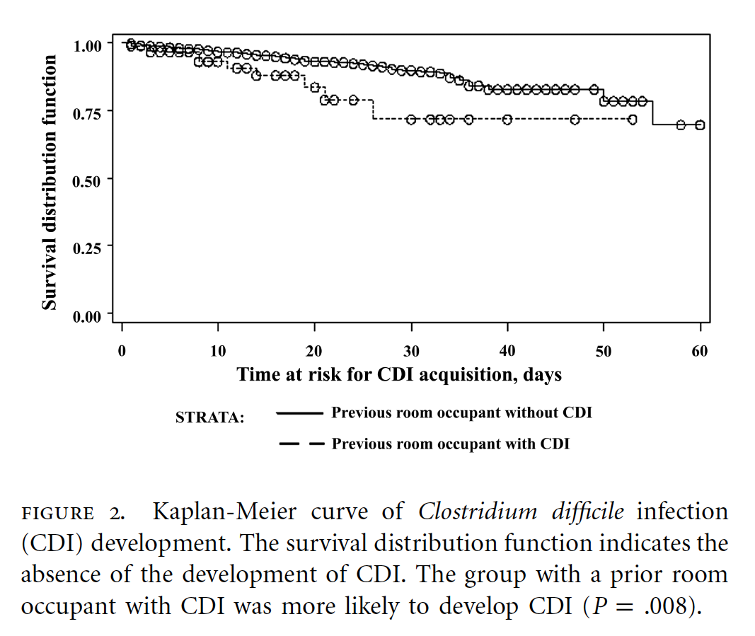
Room attribution and risk of CDI
Overall risk: 4.6%
In ICU, occupying a room of a CDI patient increases risk of CDI two-fold
Still: 90% of CDI could not be linked to previous CDI case
Overall risk: 11%
HR, 2.35 (95% CI, 1.21–4.54) p=0.01
Shaughnessy MK et al. Infect Control Hosp Epidemiol 2011;32(3): 201–206.

Slide 42
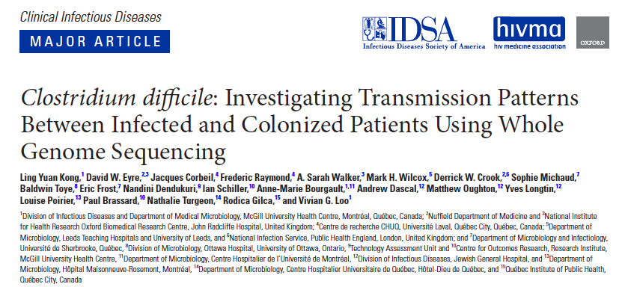
WGS studies confirm the role of ACDC in some HA-CDI
Comparing samples from patients with CDI with prior samples from within the cohort by WGS (threshold <2snp)
  105 cases (52%) cases linked to a prior sample
    65 (62%) linked to both infected and CD carrier
    28 (26%) only linked to CDI Case
    12 (11%) only linked to CD carrier
  96 cases (48%) could not be linked to another patient
    Over-representation of CD carriers in this population? (ratio colonization/infection: 1.3 : 1)

Slide 43

Modeling Studies
Asymptomatic carriers play a role in the dissemination of C. difficile, according to modeling experiments
  Transmission of C. difficile cannot be explained solely by symptomatic patients¹
1. Lanzas C et al. Infect Control Hosp Epidemiol 2011

Slide 44
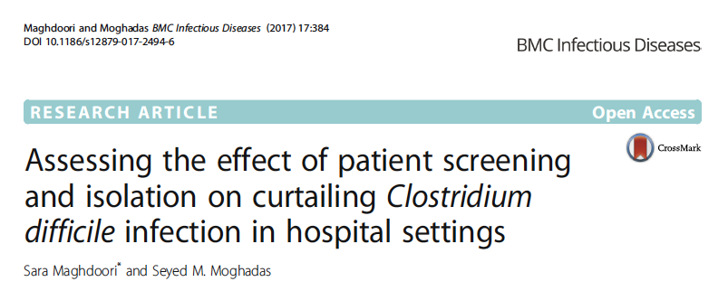
Rapid detection of colonized
patients can significantly affect the prevalence of CDI and its control, especially in the context of asymptomatic
carriers and in-ward transmission.
Maghdoori, Mohandas. BMC Infect Dis. 2017 Jun 2;17(1):384.

Slide 45
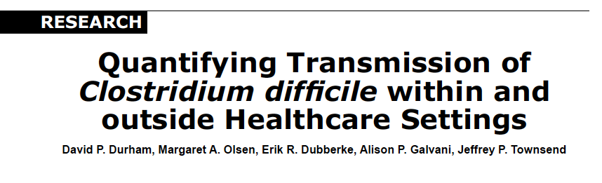
Despite lower transmission rates for asymptomatic carriers, this transmission route has a substantial effect on hospital-onset CDI because of the larger reservoir of hospitalized carriers
Durham DP et al. Emerg Infect Dis. 2016 Apr;22(4):608-16.

Slide 46
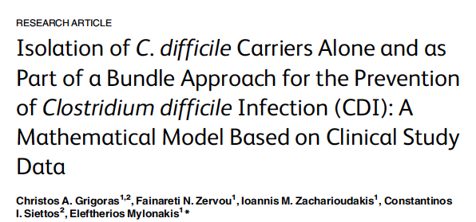
From a baseline CDI incidence of 6.18 per 1,000 admissions, screening of patients at the time of hospital admission with PCR and isolation of those colonized, as a single additive policy to the standard practice, reduced CDI incidence to 4.99 per 1,000 admissions (95% CI, 4.59– 5.42; RR = 19.1%). Applying this policy as part of a bundle approach combined with an antimicrobial stewardship program had effectiveness in reducing CDI incidence. Specifically, CDI incidence reduced to 2.35 per 1,000 admissions (95% CI, 2.07– 2.65; RR = 61.88%) with the addition of an antimicrobial stewardship program.
Grigoras CA. PLoS ONE 11(6): e0156577.

Slide 47
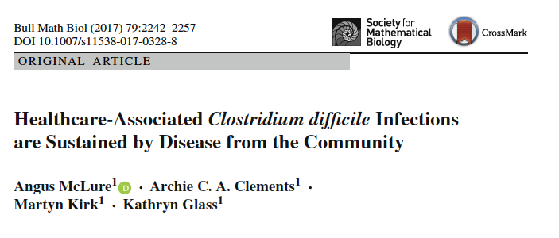
Within-hospital transmission alone is insufficient to sustain endemic conditions in hospitals without the constant importation of colonised individuals. Improved hygiene practices to reduce transmission from symptomatic and asymptomatic individuals and reduced length of stay are most likely to reduce within-hospital transmission and infections;
McLure A. et al. Bull Math Biol. 2017 Aug 3. doi: 10.1007/s11538-017-0328-8.

Slide 48
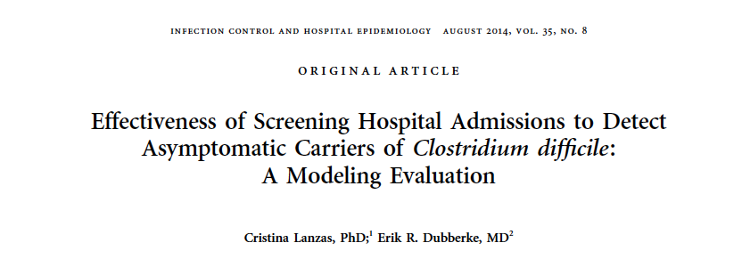
On average, testing for asymptomatic carriers reduced the number of new colonizations and HO-CDI cases by 40%-50% and 10%-25%, respectively, compared with the baseline scenario.
1. Lanzas C et al. Infect Control Hosp Epidemiol 2011

Slide 49

Household transmission?

Slide 50
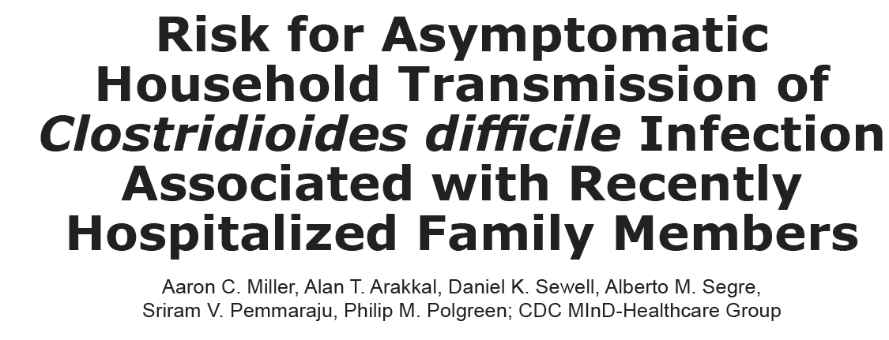
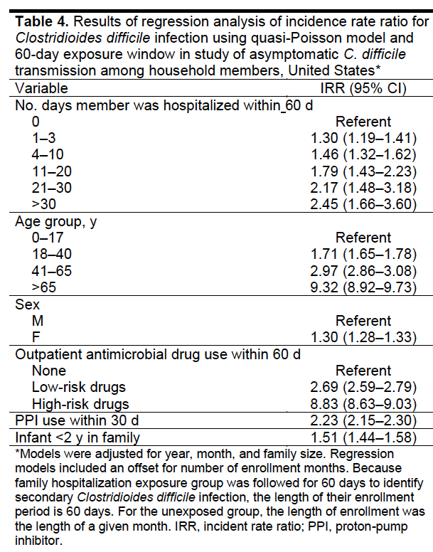
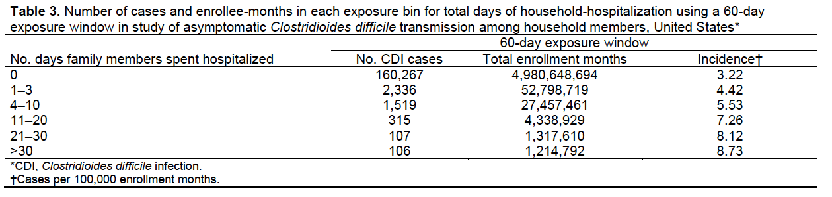
Household members of patients who were hospitalized (but did not develop CDI) are at increased risk of CDI
Miller AC et al. Emerg Infect Dis. 2022 May;28(5):932-939.

Slide 51
Detection of carriers

Slide 52
HIGH
SENSITIVITY
RAPID
TURNAROUND
Toxigenic culture
CCNA
NAAT
EIA
We CAN detect and isolate carriers, not only patients with CDI… and we should seize the opportunity!
REF. Infection Control 101 – control of
MRSA, VRE, CRE, C.auris, etc.
Belanger SD et al J Clin Microbiol. 2003 Feb;41(2):730-4.

Slide 53
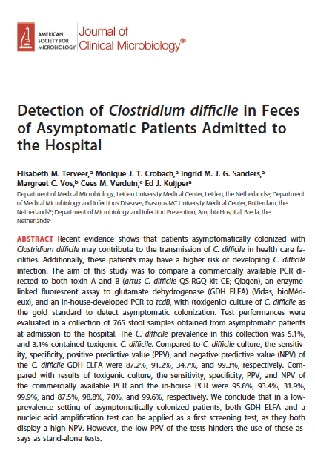
Detection of carriers
Terveer EM et al. J Clin Microbiol. 2017 Feb;55(2):403-411.

Slide 54
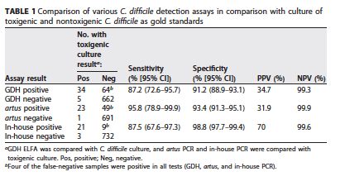

Detection of carriers
GDH
PCR
Nasal swabbing for MRSA detection
80-93% sensitivity
Terveer EM et al. J Clin Microbiol. 2017 Feb;55(2):403-411.

Slide 55

Hand rubbing vs. Hand washing
What is the best way to interrupt dissemination mediated by HCWs’ hands?

Slide 56
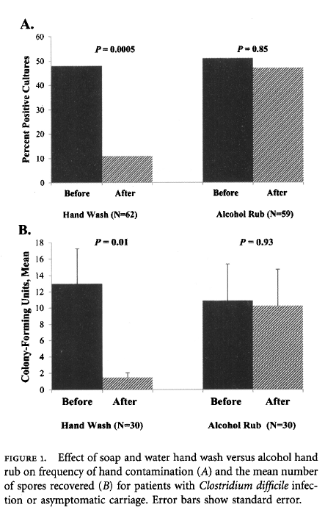
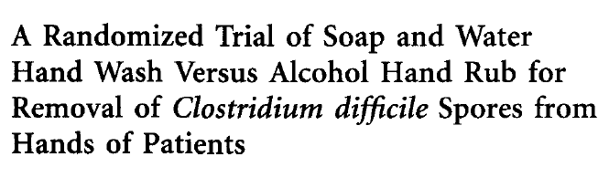
44 patients CDI or CD-AC
HR with ABHRS
HW with triclosan soap
Kundrapu S et al. Infect Control Hosp Epidemiol. 2014 Feb;35(2):204-6.

Slide 57
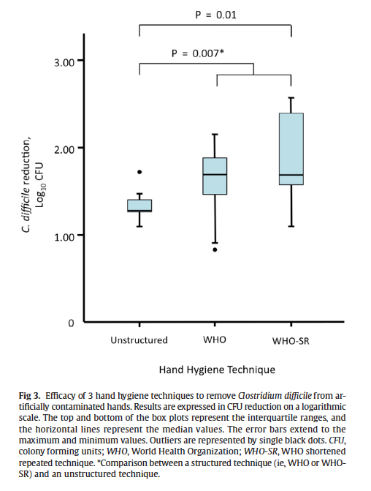
Hand washing vs.
C. difficile
1.70
1.71
1.30
Even the best hand hygiene technique is poorly effective to remove C. difficile
from hands!
e.g. ABHRS against E. coli: 3.5 to 5 log reduction
Deschênes P et al. Am J Infect Control. 2017 May 16.
57

Slide 58

Should we add gloves?
To soap and water or HR ?

Slide 59
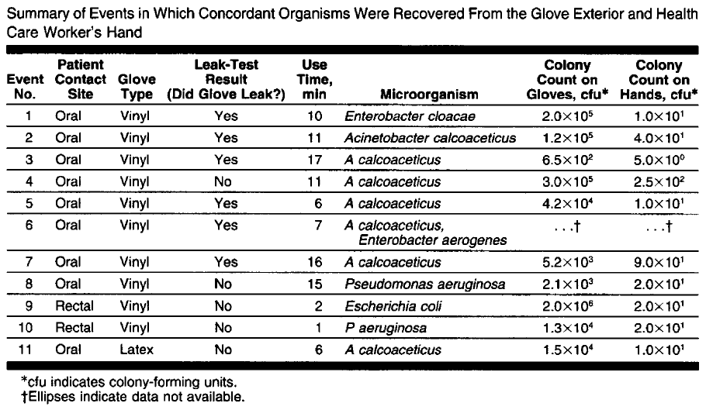
Efficacy of gloves
2-4 log reduction
99% to 99.99%
protective!
Olsen RJ et al. JAMA. 1993 Jul 21;270(3):350-3.

Slide 60
Impact of glove use to protect against C. difficile
Hands of 35 HCWs sampled after caring for C. difficile patient
  20/35 (57%) acquired C. difficile on their hands
Glove use | Hand washing | Presence of C. difficile
no | no | 7/15 (47%)
no | Regular soap | 14/16 (88%)
yes | no | 0/4 (0%)
Gloves: the best “hand hygiene” technique?
McFarland LV et al. N Engl J Med. 1989 Jan 26;320(4):204-10.

Slide 61





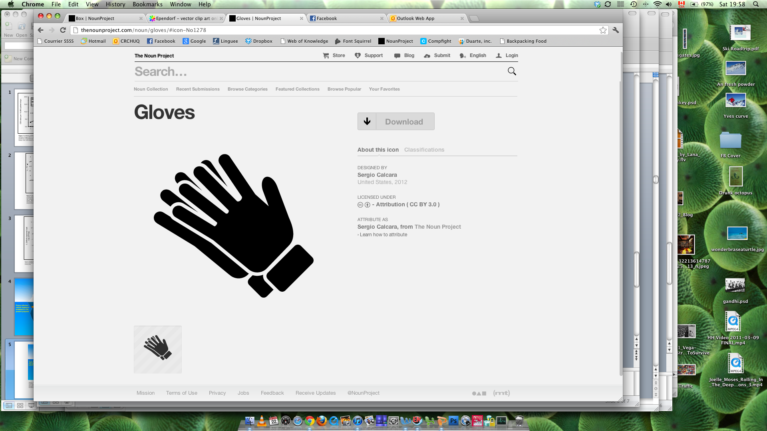

We NEED gloves against C. difficile!
gloving
C. Difficile contaminated
gloves
Glove removal
HR or HW
Total
Hand rubbing with ABHRS only
nil
+
0 Log
=
0 Log
Hand washing only
nil
+
1-2 Log
=
1-2 Log
Hand rubbing with ABHRS + gloves
2-4 log
+
0 Log
=
2-4 Log
Hand washing + gloves
2-4 Log
+
1-2 Log
=
3 – 6 Log
7

Slide 62

Improving environmental cleaning?

Slide 63
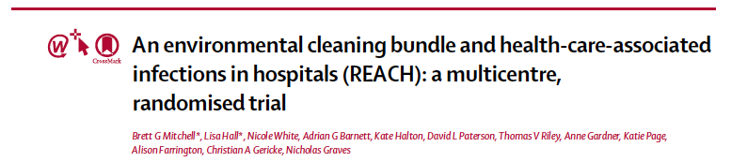
Multimodal intervention to improve routine cleaning
  Better product use
  Improved technique
  Education
  Auditing and feedback
  Communication
Mitchell BG et al. Lancet Infect Dis. 2019 Apr;19(4):410-418.

Slide 64
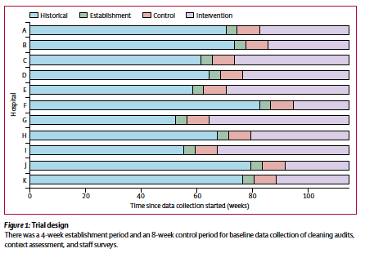
Mitchell BG et al. Lancet Infect Dis. 2019 Apr;19(4):410-418.

Slide 65
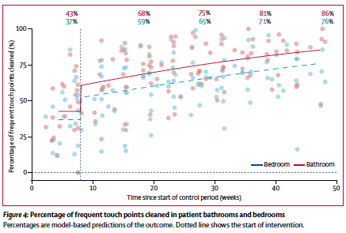
⬆ 50% cleaning high-touch surfaces
Mitchell BG et al. Lancet Infect Dis. 2019 Apr;19(4):410-418.

Slide 66
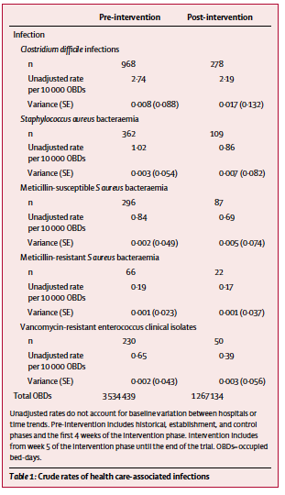
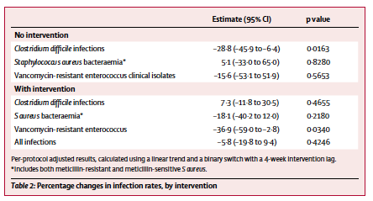
Mitchell BG et al. Lancet Infect Dis. 2019 Apr;19(4):410-418.

Slide 67
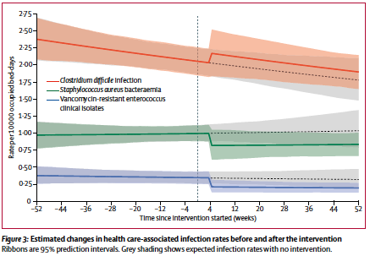
Mitchell BG et al. Lancet Infect Dis. 2019 Apr;19(4):410-418.

Slide 68
Impact of universal bleach routine disinfection on C. difficile contamination of patient rooms (instead of quaternary ammonium)
Ng Wong YK et al. Am J Infect Control. 2019 Jul;47(7):843-845.

Slide 69
Ng Wong YK et al. Am J Infect Control. 2019 Jul;47(7):843-845.

Slide 70
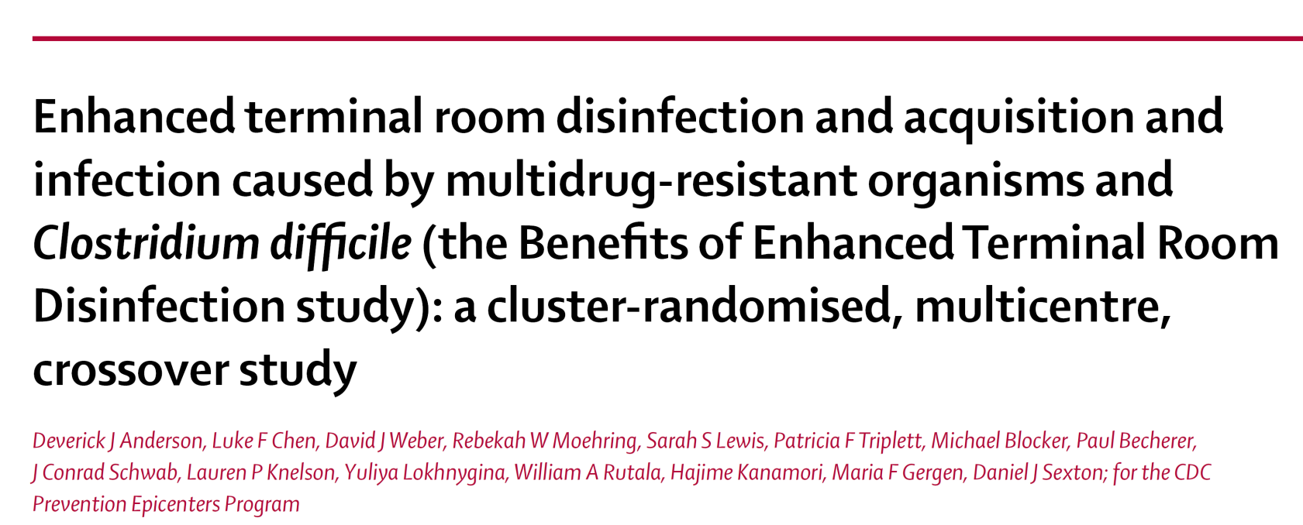
Anderson et al. Lancet 2017; 389: 805-14

Slide 71
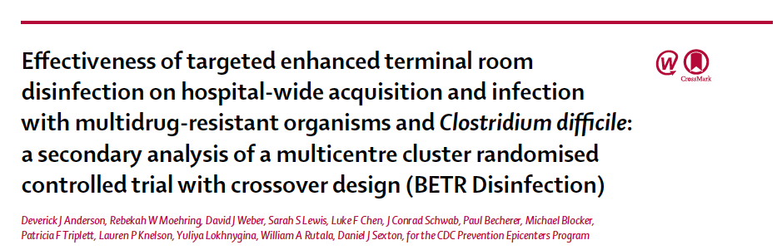
Secondary analysis of main BETR study
Population-level analysis
4 arms of terminal disinfection for carriers of AMR (C.difficile, VRE, MRSA and MDR A. baumannii)
Anderson DJ et al. Lancet Infect Dis. 2018 Aug;18(8):845-853.

Slide 72
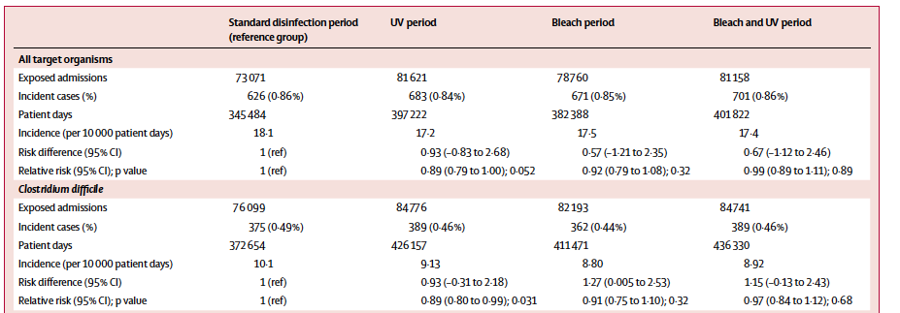

Universal sporicidal for terminal cleaning of AMR room
Significant decrease
Anderson DJ et al. Lancet Infect Dis. 2018 Aug;18(8):845-853.

Slide 73

Universal sporicidal for terminal cleaning of AMR room
NO Significant decrease

Slide 74

Universal sporicidal for terminal cleaning of AMR room
THERE’S MORE THAN P-VALUES TO CONSIDER
Is this difference clinically meaningful?
Anderson DJ et al. Lancet Infect Dis. 2018 Aug;18(8):845-853.

Slide 75
Clinical evidence

Slide 76

Institut Universitaire de Cardiologie et Pneumologie de Québec
  354-beds Canadian tertiary institution
  Endemic for CDI

Slide 77
HA-CDI rates, 2004-2013
  HA-CDI rates > 9.0 per 10,0000 patient-days in a quarter of monthly reports (2007 to 2013)
Government-imposed target
CDI rates per 10,000 patient-days
2004
2005
2006
2007
2008
2009
2010
2011
2012
2013
2014
2015
Surveillance period and year
Incidence of healthcare-associated Clostridium difficile infection (CDI) per 4-week period at the Quebec Heart and Lung Institute and all institutions participating in the provincial CDI surveillance program (n=94).
Longtin Y et al. JAMA Intern Med. 2016 Jun 1;176(6):796-804.

Slide 78

Control of CDI
October 2013
  Review of the literature
  on the potential role of
  CD carriers in CDI
  Request from executive
  committee to
  implement a strategy
  to detect and isolate CD-AC
  Creation of a new set of
  infection control measures for CD carriers

Slide 79
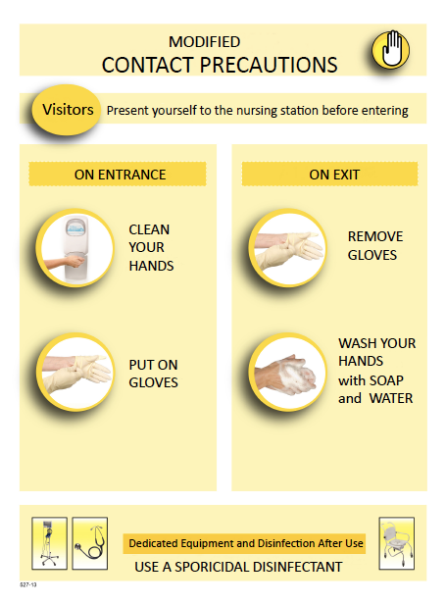

Similar to CDI patients with few exceptions:
  No isolation gowns
  Patients could share a room with non-carriers with the privacy curtains drawn
  Measures discontinued temporarily when
  going on exam
Longtin Y et al. JAMA Intern Med. 2016 Jun 1;176(6):796-804.

Slide 80
RESULTS

Slide 81
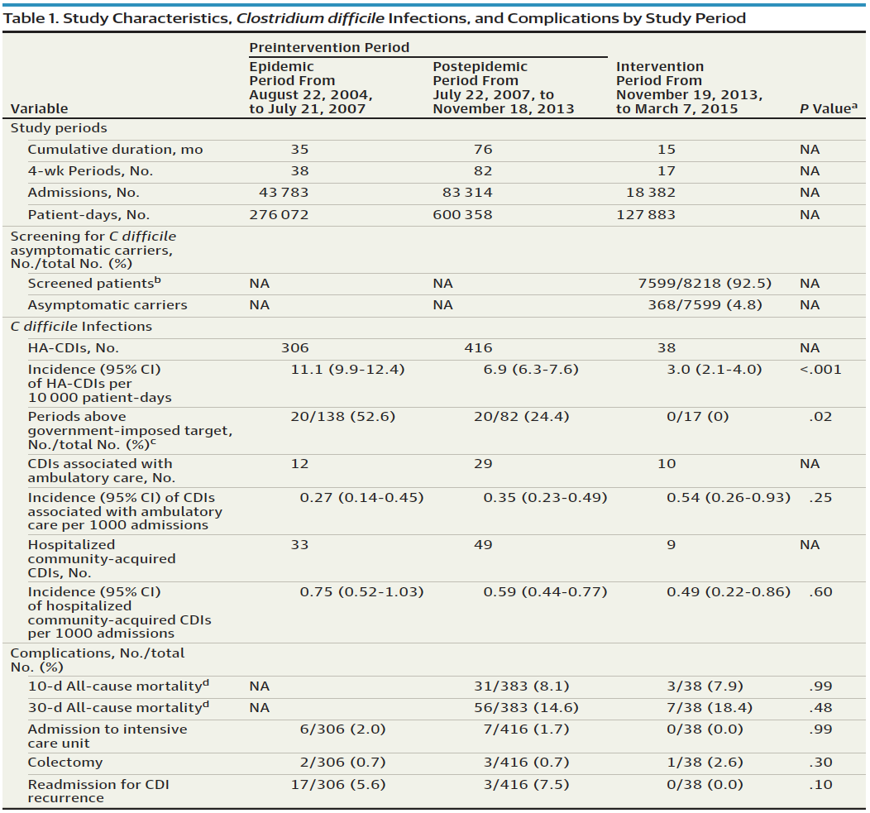

96
Every Year
Approx. 295 carriers admitted
Approx. 96 patients with CDI
Ratio 3:1
295
JAMA Intern Med. 2016 Jun 1;176(6):796-804

Slide 82
Longtin Y et al. JAMA Intern Med. 2016 Jun 1;176(6):796-804.

Slide 84
target
threshold
Expected HA-CDI rates
INTERVENTION
CDI rates per 10,000 patient-days
CHANGE
IN TREND
0.93; p=0.02
2004
2005
2006
2007
2008
2009
2010
2011
2012
2013
2014
2015
Surveillance period and year
Figure 1. Incidence of healthcare-associated Clostridium difficile infection (CDI) per 4-week period according to standardized surveillance definitions, August 2004 - March 2015, Quebec Heart and Lung Institute, Quebec City, Canada. An intervention consisting of screening and isolation of Clostridium difficile asymptomatic carriers was introduced on November 19, 2013. The institution is subjected to a government-imposed threshold of 9.0 per 10 000 patient-days (blue dashed line). The expected HA-CDI rate during the intervention using an ARIMA prediction model is presented (dashed green line).
Longtin Y et al. JAMA Intern Med. 2016 Jun 1;176(6):796-804.

Slide 85
INTERVENTION
CDI rates per 10,000 patient-days
NO CHANGE
IN TREND
0.98; p=0.18
2004
2005
2006
2007
2008
2009
2010
2011
2012
2013
2014
2015
Surveillance period and year
Figure 2. Incidence of healthcare-associated Clostridium difficile infection (CDI) per 4-week period at the Quebec Heart and Lung Institute and in 3 control groups: other institutions in Quebec City (n=6); matching academic institutions (n=15); and all institutions participating in the provincial CDI surveillance program (n=94).
Longtin Y et al. JAMA Intern Med. 2016 Jun 1;176(6):796-804.

Slide 86
ARIMA modeling
64 averted HA-CDI cases over 15 months
target
NNT: 118 admissions to screen and 6 CD-AC to isolate
threshold
Expected HA-CDI rates
INTERVENTION
CDI rates per 10,000 patient-days
2004
2005
2006
2007
2008
2009
2010
2011
2012
2013
2014
2015
Surveillance period and year
Figure 1. Incidence of healthcare-associated Clostridium difficile infection (CDI) per 4-week period according to standardized surveillance definitions, August 2004 - March 2015, Quebec Heart and Lung Institute, Quebec City, Canada. An intervention consisting of screening and isolation of Clostridium difficile asymptomatic carriers was introduced on November 19, 2013. The institution is subjected to a government-imposed threshold of 9.0 per 10 000 patient-days (blue dashed line). The expected HA-CDI rate during the intervention using an ARIMA prediction model is presented (dashed blue line).
Longtin Y et al. JAMA Intern Med. 2016 Jun 1;176(6):796-804.

Slide 87
LONG-TERM Follow-up
…The intervention never stopped

Slide 88
Long-term Impact
INTERVENTION
CDI incidence
per 10,000 patient-days
2004
2005
2006
2007
2008
2009
2010
2011
2012
2013
2014
2015
2016
Figure 1. Healthcare-associated CDI incidence, Quebec Hearth and Lung Institute, 2004-2016

Slide 89
Long-term Impact
INTERVENTION
2012-13 average:
6.1 per 10,000 patient-days
2015-16 average:
2.2 per 10,000 patient-days
CDI incidence
per 10,000 patient-days
2004
2005
2006
2007
2008
2009
2010
2011
2012
2013
2014
2015
2016
Figure 1. Healthcare-associated CDI incidence, Quebec Hearth and Lung Institute, 2004-2016

Slide 90
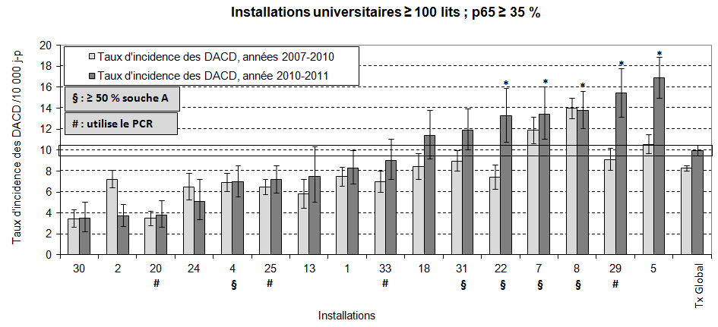
Incidence rate among university hospitals, 2011-2012
QHLI
Institut National de Santé Publique du Québec

Slide 91
Long-term follow-up
QHLI
Figure 3. HA-CDI rates of University Hospitals in Quebec, 2015-2016. Red bar represents the HA-CDI incidence rate at the QHLI. Yellow Bar represents the 95% Confidence Interval for the stratum

Slide 92
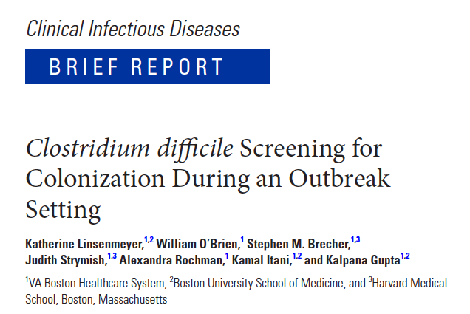
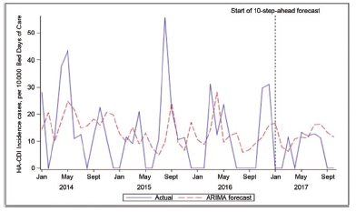
1250 patients screened over 12 months
3.1% asymptomatic carriers (perirectal swabs)
Decrease in HA-CDI from 10.9 to 3.0 per 10kpd
Linsenmeyer K et al. Clin Infect Dis. 2018 May 26. doi: 10.1093/cid/ciy455. [Epub ahead of print]

Slide 93
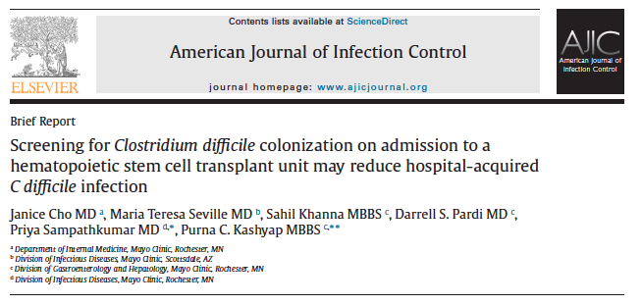
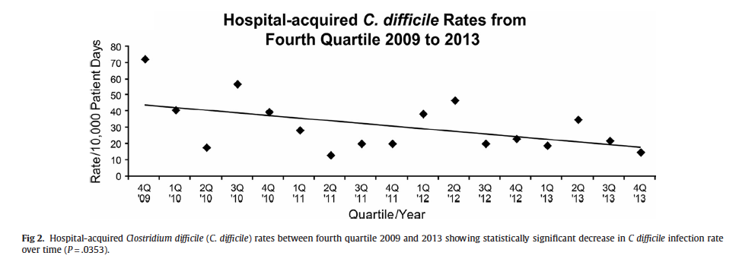
Screening for CD carriage in HSCT unit
Program started in 2010 but analyses 2012-2013 only
14% carriage rate
Decrease in HA-CDI (role of screening uncertain – no data prior to screening)
Cho J et al. Am J Infect Control. 2018 Apr;46(4):459-461.

Slide 94
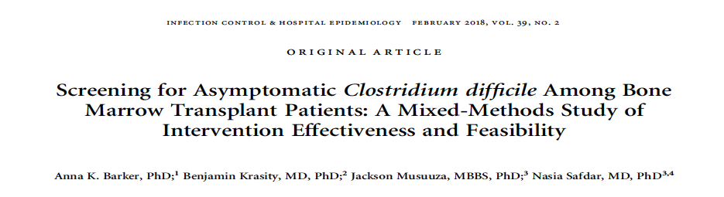
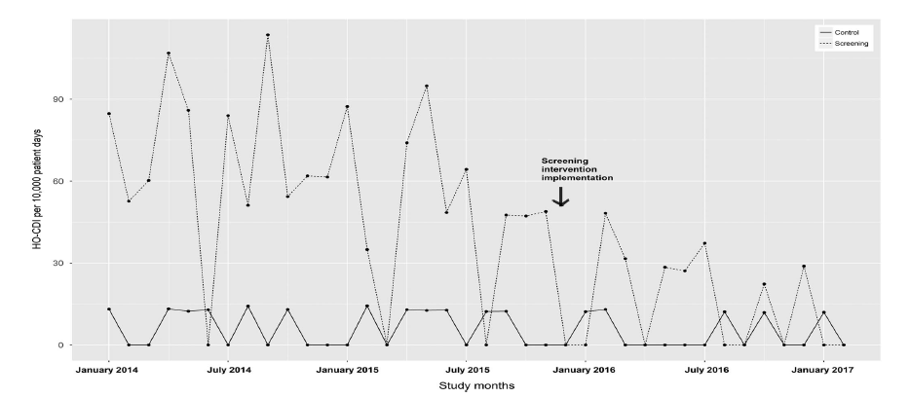
Universal admission screening on BMT unit, 2014-2017 (n=5357)
Rates lower post-intervention ...
but
No signifcant change in trend c/w control arm

Slide 95
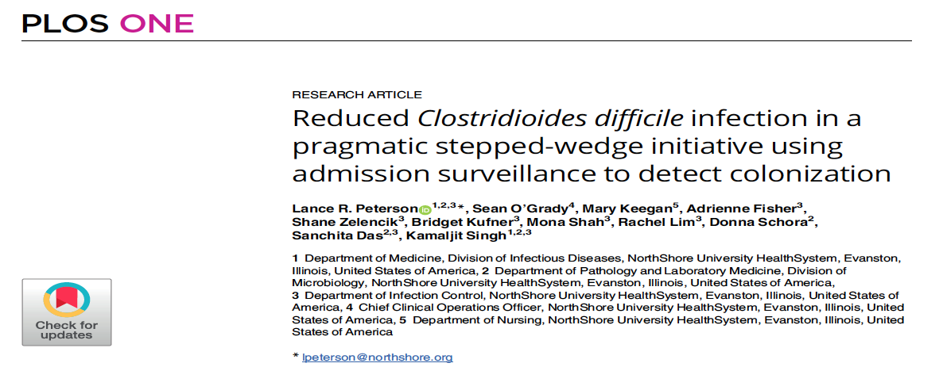
4 hospitals;
Targeted screening (pmx of hospit, LTCF resident, previous CDI)
  30% admissions screened; 8% CD-AC
CDI incidence from 5.96 to 4.23 / 10,000 pd (p=0.02)
Peterson LR et al. PLoS One. 2020 Mar 19;15(3):e0230475

Slide 96

Rolling deployment over many months
Decrease in HA-CDI from 13.3 (12-months pre-intervention) to 5.0 per 10,000 pd (12 month into the intervention)

Slide 97
Limitations
Mostly single center trials
Mostly before-and-after quasi-experimental studies
Other concomitant interventions
Multicenter trials with better study design needed!

Slide 98


Patients with diarrhea who are carriers of toxigenic
C. difficile but without detectable toxin levels :
are they contagious?
GDH + but ToxAB -
Mawer DPC et al Clin Infect Dis. 2017 May 1;64(9):1163-1170.

Slide 99
WGS on all samples of C. difficile detected by GDH
2 centres in U.K. over 9-12 months
Determine the relative contribution of GDH+/ToxAB+ vs. GDH+/ToxAB- in transmission and subsequent CDI
Mawer DPC et al Clin Infect Dis. 2017 May 1;64(9):1163-1170.

Slide 100
Source of new CDI cases
  GDH+/ Tox + : 10%
  GDH+/ Tox - : 3%
But the ratio Tox+:Tox- was approximately 2:1, so the “risk per patient” was almost equivalent
Patients who are GDH+/ Tox- should be isolated
Mawer DPC et al Clin Infect Dis. 2017 May 1;64(9):1163-1170.

Slide 101
Are guidelines changing?

Slide 102


Asymptomatic Carriers
Asymptomatically colonized patients who have not had CDI can shed C. difficile spores, but the number of spores and degree of contamination is not as great as for patients with active CDI
There are insufficient data to recommend screening for asymptomatic carriage and placing asymptomatic carriers on
contact precautions (no recommendation).
Dubberke ER, et al. Strategies to prevent Clostridium difficile infections in acute care hospitals: 2014 update. Infect Control Hosp Epidemiol 2014;35 Suppl 2:S48-65.
McDonald LC et al. Clin Infect Dis. 2018 Feb 15. doi: 10.1093/cid/cix1085.

Slide 103
Asymptomatic Carriers
Routine identification of asymptomatic carriers (patients
or healthcare workers) for infection control purposes
is not recommended (A-III)
2010
There are currently no data to support detection or isolation of these asymptomatic patients (Area of controversy).
2014
There are insufficient data to recommend screening for asymptomatic carriage and placing asymptomatic carriers on
contact precautions (no recommendation).
2018
McDonald LC et al. Clin Infect Dis. 2018 Feb 15. doi: 10.1093/cid/cix1085.

Slide 104

Asymptomatic Carriers
Supplemental intervention if reduction goals are not reached with baseline strategies:
Evaluate and test patients at high risk for CDI to detect asymptomatic carriage;
Isolate patients that test positive, but do not treat in the absence of symptoms
2018
https://www.cdc.gov/hai/prevent/cdi-prevention-strategies.html

Slide 105
Could it allow primary prevention of CDI?

Slide 106
Risk of CDI
Non-carriers:
  QHLI: 6 per 10,000 pd
  Sheeba: 4.6 per 10,000 pd
Carriers:
  QHL I: 67.2 per 10,000 pd (39/5807 hospital-days)
  Sheeba: 76.7 per 10,000 pd
Meltzer E et al. Clin Microbiol Infect. 2019 Feb 14.
Relative risk of CDI, carriers vs non-carriers (ICU): 9.32 (95% CI, 3.25-26.7)
Worley J et al. Clin Infect Dis. 2021 Oct 5;73(7):e1727-e1736.
…But 10-20 times less frequent than non-carriers so roughly equal contributions between CD carriers and non-carriers to global institutional CDI burden?

Slide 107

C. difficile carriers
Identifying carriers could lead to strategies to protect CD carriers from progressing to CDI
  Low hanging fruit: intensive ATB stewardship
  Potential avenues: Primary prophylaxis, probiotics, vaccination…
  Detection of carriers is key to this end

Slide 108
C. difficile carriers
No prospective study performed so far specifically targetting carriers
A warning: Vancomycin and flagyl induce dysbiosis

Slide 109

ATB-induced Dysbiosis

Slide 110
Cross-sectional retrospective study
Cohort of CD carriers identified at QHLI
Identify risk factors for progression to CDI
  Gain insight on pathogenesis
  Identify patients at greater risk of progression

Slide 111
Predictors of CDI among CD carriers
19,112 patients screened
960 CD carriers identified
513 (53.4%) enrolled
39 (7.6%) developed HO-CDI
  Median delay between adm. and CDI: 4 days (range, 0-27 d)
  5/39 (12.8%) admitted to ICU
  1 toxic megacolon, no colectomy
  11 deaths within 30 days (case fatality, 28%)
  Attributable mortality: 7/39 (18%)
An additional 17 patients without HO-CDI had evidence of CDI following discharge, for an overall CDI risk of 10.9% (56/513)

Slide 112
Table 3. Factors associated with CDI among C. difficile colonized patients
(multivariate analysis)
! Risk of acquisition?
Narcotic stewardship?
ATB stewardship?
Risk of CDI
0 ATB: 3.6%
≥ 3 ATB : 13.8%
Note. CI, confidence interval; OR, odds ratio.

Slide 113

Tariq R et al. Therap Adv Gastroenterol. 2021 Feb 23;14:1756284821994046.

Slide 114
Secondary prophylaxis:
10 studies, 9258 patients
CDI: 13.3% vs 21.9%
(OR, 0.34; 95% CI, 0.20–0.59; p < 0.00001)
Tariq R et al. Therap Adv Gastroenterol. 2021 Feb 23;14:1756284821994046.
114

Slide 115
Primary prophylaxis:
4 studies, 1352 patients
CDI: 29/402 (7.4%) vs 99/950 (10.4%)
OR: 0.18, 95% CI, 0.03–1.03; p = 0.06
Prophylaxis not targeting carriers!
Short follow-up period (<=90 days in 3 of 4 studies)
NB Carignan: no primary prophylaxis!
Tariq R et al. Therap Adv Gastroenterol. 2021 Feb 23;14:1756284821994046.

Slide 116
Research Agenda

Slide 117

Unknowns and
Research Agenda
Need high-quality research!
Generalizability of previous studies?
  Very pro-infection control hospital, high endemicity, high prevalence of hypervirulent strain
Best detection methods?
What is the incidence rate at which it becomes cost-effective?
  Which population to target?
Management of C. difficile carriers who must receive ATB?
Where does it fit in relationship with ATB stewardship to control NAP1 ?
117

Slide 118
Conclusions
Optimal approach to prevent CDI remains unknown
Current strategies = flawed
Current recommendations based on limited evidence
Better evidence would be required
  These are hard to obtain!
New strategies should be explored
118

Slide 119
ANY QUESTIONS?
119

Slide 120



