Slide 1
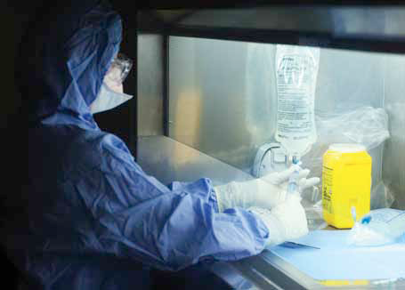

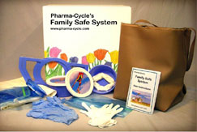
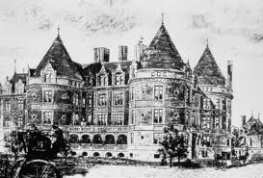
New perspectives on an old nemesis:
Chemotherapy - Health, safety, and waste management issues
Ed Krisiunas
WNWN International Inc.
Hosted by Paul Webber
paul@webbertraining.com
New York Cancer Hospital 1884
www.webbertraining.com
December 4, 2014
Notes:
2

Slide 2
Ed Krisiunas, MT (ASCP), MPH
WNWN International, Inc.
PO Box 1164
Burlington, Connecticut 06013
USA
860-675-1217
860-675-1311(fax)
860-839-3993 (mobile)
ekrisiunas@gmail.com
ekrisiunas@wnwnintl.com
SKYPE: boutiquewaste
Notes:
2

Slide 3
Objectives:
At the completion of the presentation, participants will have:
1. Knowledge of the historical perspective of health and safety standards for chemotherapy (i.e., OSHA Instruction 1986 STD 01-23-001)
2. Knowledge of the current guidance - NIOSH Alerts/WHO Guidance/JCAHO
3. Knowledge of trending issues - management of chemo waste: drugs/PPE/Sharps/patient excretions

Slide 4
Disclaimer:
The mention or photos of any products is strictly for education purposes. While I do consult to a wide range of companies in the areas of waste management, Infection Prevention, and Occupational Health and Safety, I am not employed by any of the vendors of products shown in this PPT

Slide 5
TERMS….
Cancer - The disease caused by an uncontrolled division of abnormal cells in a part of the body…a malignant growth or tumor resulting from the division of abnormal cells.
Chemotherapy ( Attributed to German biochemist Paul Erhlich [1854-1915]
The treatment of cancer using specific chemical agents or drugs that are selectively destructive to malignant cells and tissues.
The treatment of disease using chemical agents or drugs that are selectively toxic to the causative agent of the disease, such as a virus or other microorganism.
Cytotoxic - Of, relating to, or producing a toxic effect on cells.
Cytostatic - Inhibiting or suppressing cellular growth and multiplication.
poptosis - (biology) the programmed death of some of an organism's cells as part of its natural growth and development……Also called programmed cell death
Reference: http://dictionary.reference.com/

Slide 6
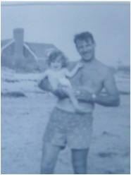

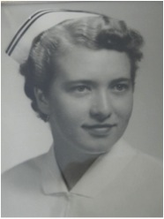

We are all likely to have been touched by cancer….

Slide 7
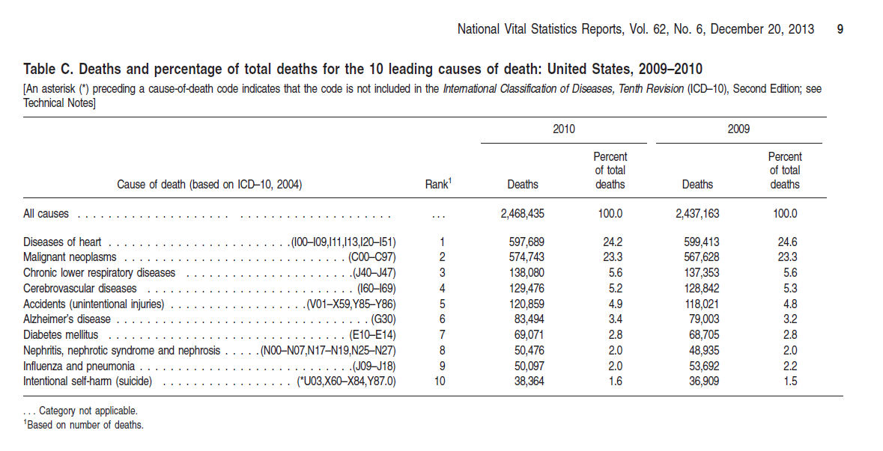
http://www.cdc.gov/nchs/data/nvsr/nvsr62/nvsr62_06.pdf

Slide 8

US Cancer Death Rate
Mark Clanton, MD, MPH,
Chief Medical Officer,
American Cancer Society, High Plains Division
Year
Source: 1900-1970, U.S. Public Health Service; 1971-2001, U.S. National Center for Health Statistics

Slide 9
Risk Factors/Causes of Cancer in the US
Percent Attributable to Cause

Slide 10
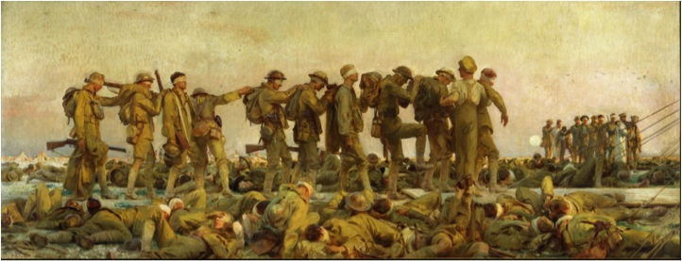
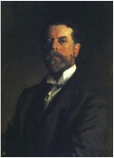
“Gassed”
1919
Mustard gas
John Singer Sargent.
http://en.wikipedia.org/wiki/Gassed_%28painting%29

Slide 11
An Accidental Discovery:
From Warfare to Mainstay: Mustard Derivatives
Play Evolving Role in Cancer Therapy – November 2011
The discovery of nitrogen mustard’s potential in cancer therapy could easily have taken place in 1919. Edward Bell Krumbhaar, MD, PhD, who would go on to become a leading pathologist and cardiac physician in Philadelphia, Pennsylvania, was a medical officer with the American forces in France when he studied the effects of mustard gas on soldiers and noted its tendency to kill bone marrow and suppress white blood cell production.

Slide 12
The breakthrough realization about the potential for using nitrogen mustard in cancer treatment, however, did not come until World War II, when the US government asked researchers at Yale School of Medicine in New Haven, Connecticut, to study potential antidotes to mustard gas as a weapon. They realized the agent’s promise as a treatment for lymphoid malignancies and began developing a mouse model for
testing.
Reference : http://www.onclive.com/print.php?url=/publications/Oncology-live/2011/november-2011/From-Warfare-to-Mainstay-Mustard-Derivatives-Play-Evolving-Role-in-Cancer-Therapy

Slide 13
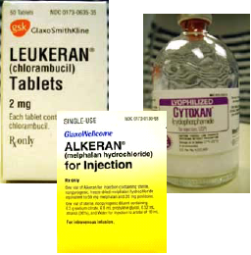
Mustard derivatives (also known as alkylating agents) include the following:
Mustragen – 1949
Chlorambucil ( Leukeran) – 1957
Cyclophosphamide (Cytoxan) – 1959
Melphalan ( Alkeran) – 1964
Ifosfamide (Ifex) – 1988
Treanda – 2008
Reference : http://www.onclive.com/print.php?url=/publications/Oncology-live/2011/november-2011/From-Warfare-to-Mainstay-Mustard-Derivatives-Play-Evolving-Role-in-Cancer-Therapy

Slide 14
Surgery and radiation therapy were the primary treatments for cancer in the 1950s. The National Chemotherapy Program, a federal program funded in 1955, supported the development of new chemotherapy agents. Due to advances in science, chemotherapy is now commonly administered for the treatment of cancer in patients with both solid tumors and hematologic malignancies. The United States Food and Drug Administration (FDA) approved 85 drugs used in the treatment of cancer between the years of 1949 and 1992, 85 drugs in the next eight years (1993-2000), and 34 drugs during the three-year period from 2001 to 2004 (FDA, 2004).

Slide 15
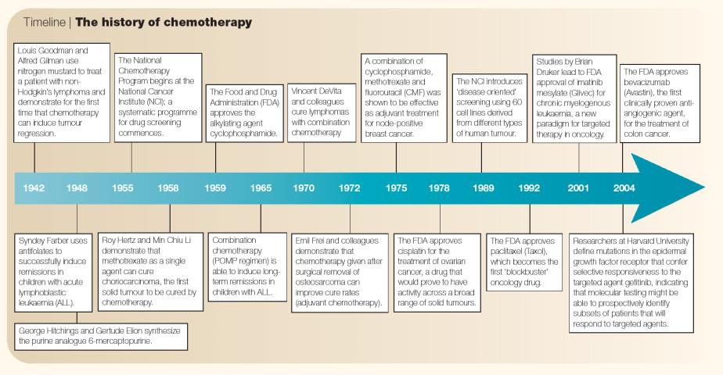
http://www.nature.com/nrc/journal/v5/n1/fig_tab/nrc1529_I1.html

Slide 16
Health and Safety Issues begin to be recognized..
1970’s

Slide 17
In the 1970s, several chemotherapy agents were linked to secondary leukemia and other cancers in treated patients. This information was accompanied by the notion that health risks might extend to persons occupationally exposed to the drugs (Donner, 1978; Ng, 1970). Lancet published the first convincing evidence in a letter to the editor by Falck, et al in 1979.
In a small, but controlled study, mutagenic activity (as measured by the Ames test) was found in the urine of patients who received chemotherapy as well as nurses who administered chemotherapy. The Ames test measures genetic mutations in bacteria after exposure to compounds. Ninety percent of known carcinogens test positive on this test. The test is reliable during drug excretion in the urine, which is usually within 48 hours of exposure. It has neither high sensitivity nor specificity (Polovich 2003). Several other studies followed that demonstrated risks from occupational exposure to chemotherapy.

Slide 18
In the 1970s and 1980s it was common practice for nurses to perform drug preparation activities in medication rooms on nursing units (Stolar 1988).The main route of exposure to hazardous drugs was thought to be inhalation of drug aerosols generated during preparation. To reduce this risk, OSHA guidelines state that cytotoxic drug preparation must be performed in a biological safety cabinet (BSC) in a designated area, usually a pharmacy. A BSC has vertical airflow that moves away from the worker, as opposed to horizontal airflow that moves away from the product toward the worker. Vertical airflow protects the worker, while horizontal airflow is designed to protect the sterile product from contamination. Air leaving a BSC is filtered through a HEPA (high efficiency particulate air) filter.

Slide 19
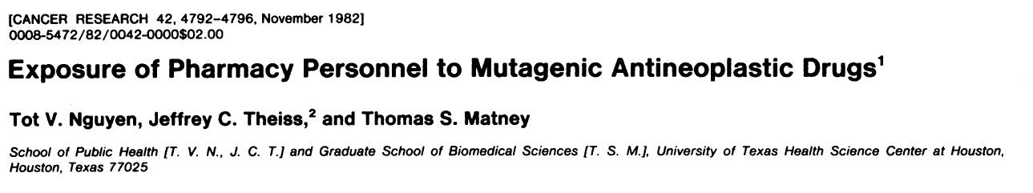
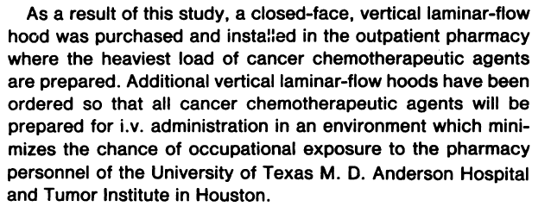

Slide 20
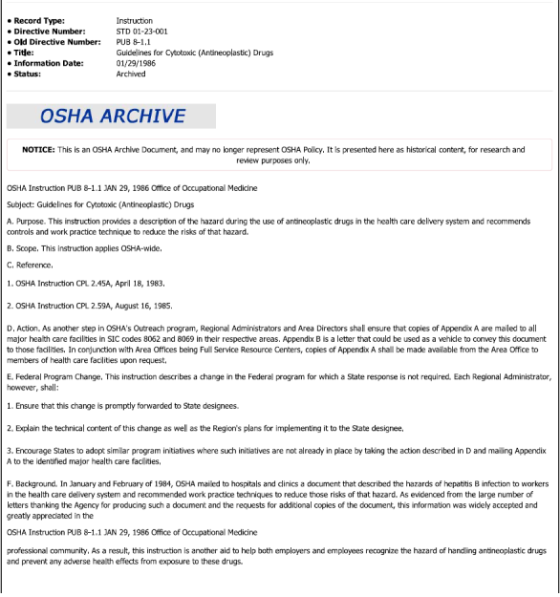
US Dept. of Labor
OSHA
STD 01-23-001
Guidelines for cytotoxic (Antineoplastic) Drugs
January 29, 1986

Slide 21
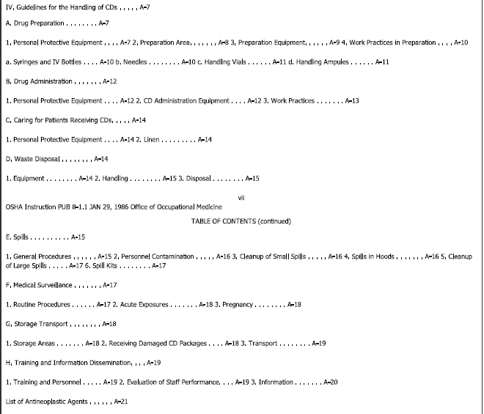
STD 01-23-001
Guidelines for cytotoxic (Antineoplastic) Drugs

Slide 22
Studies in the ‘90s…..
Biological safety cabinets (BSCs) provide imperfect protection against hazardous drug exposure. Other types of ventilated cabinets may provide containment, but are not currently available in pharmacies.
Routine handling activities can result in contamination of the worker and work environment.
There is frequent and persistent contamination of the environment where hazardous drugs are handled.
Dermal absorption of hazardous drugs as a result of contact with contaminated surfaces is another potential route of exposure.
Failure to use personal protective equipment can result in inadvertent contamination of clothing.
Workers who are not directly involved in activities related to hazardous drug handling are at risk for exposure.
Drug exposure can result in drug absorption that can be measured.

Slide 23

DHHS (NIOSH Publication Number 2004-165
September 2004)

Slide 24
Criteria for Defining Hazardous Drugs
Drugs that meet one or more of the following criteria should be handled as hazardous:
Carcinogenicity
Teratogenicity or developmental toxicity
Reproductive toxicity
Organ toxicity at low doses
Genotoxicity
Structure or toxicity similar to drugs classified as hazardous using the above criteria
From Preventing Occupational Exposures To Antineoplastic And Other Hazardous Drugs In Healthcare Settings. (NIOSH, 2004)

Slide 25
The employer responsibilities include:
Developing policies and procedures for the safe storage, transport, administration, and disposal of hazardous agents.
Identifying those hazardous drugs used in the facility and determining methods for updating the list.
Making guidance documents such as Material Safety Data Sheets (MSDS) available to health care workers who handle hazardous drugs.
Requiring that all employees who handle hazardous drugs wear personal protective equipment (PPE) designated for the purpose .

Slide 26
Requiring a BSC for the preparation of hazardous drugs.
Prohibiting eating, drinking, etc. in areas where hazardous drugs are handled.
Providing mandatory training for all employees based on their hazardous drug handling tasks.
Developing a hazardous-drug spill management policy and procedure.
Setting forth a plan for medical surveillance of personnel handling hazardous drugs.
Addressing in a policy workers’ hazardous drug handling during pregnancy. The Oncology Nursing Society recommends that employers provide alternate duty to employees who request other assignments due to pregnancy, the desire to conceive, or breast-feeding
Monitoring compliance with safe-handling policies and procedures.

Slide 27
The health care worker responsibilities include:
Participating in training before handling hazardous drugs and updating knowledge based on new information.
Referring to guidance documents as necessary for information regarding hazardous drugs.
Utilizing BSCs in drug preparation.
Consistently using recommended gloves, gowns, and face and respiratory protection.
Washing hands after drug handling activities and removal of PPE.
Disposing of materials contaminated with hazardous drugs separately from other waste in designated containers.
Cleaning up hazardous drug spills immediately according to recommended procedures.
Following institutional procedures for reporting and following up on accidental exposure to hazardous drugs.

Slide 28
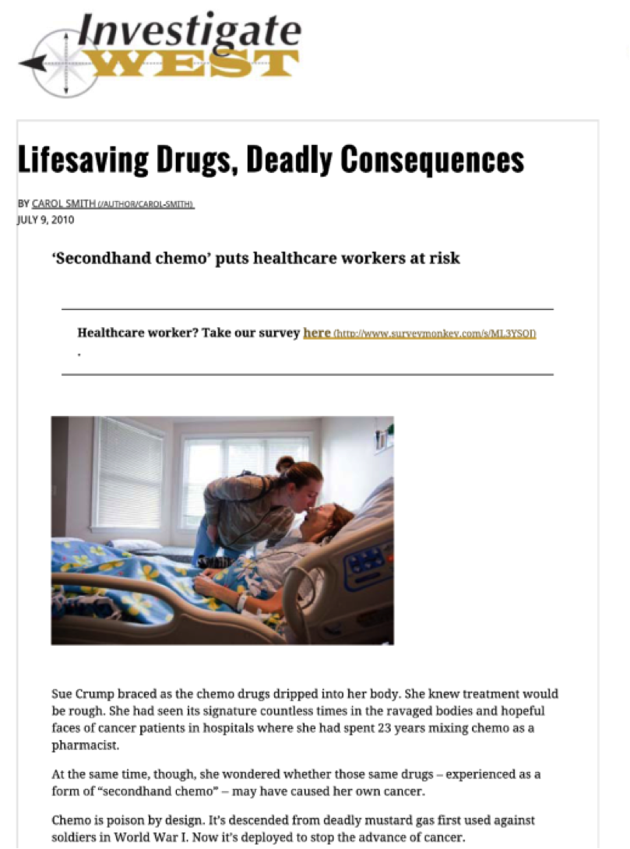
http://www.invw.org/chemo-main

Slide 29
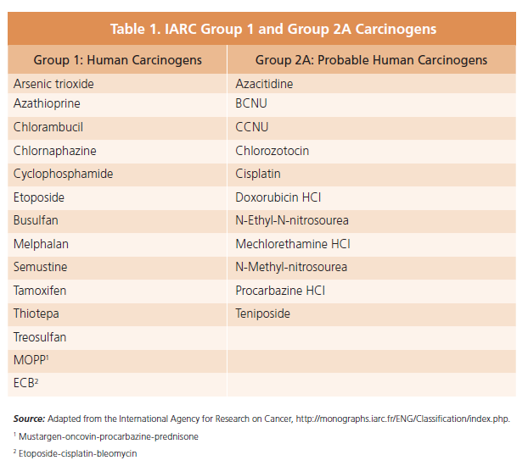

Slide 30
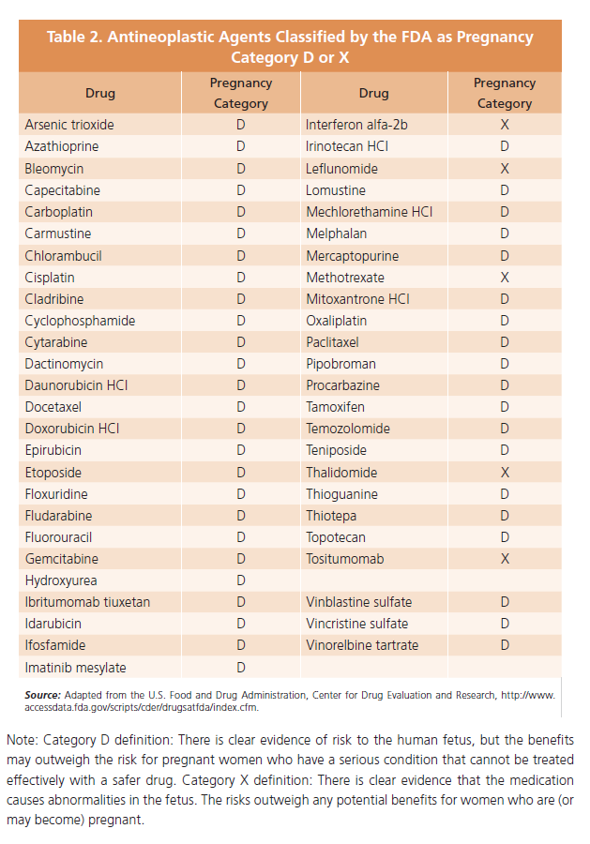

Slide 31
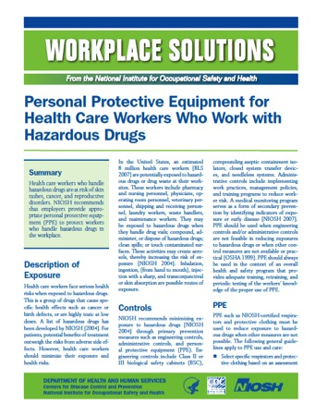
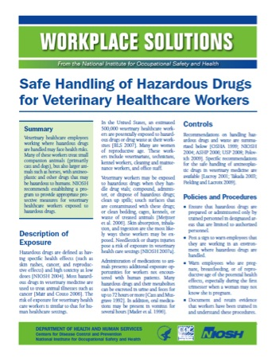

Slide 32
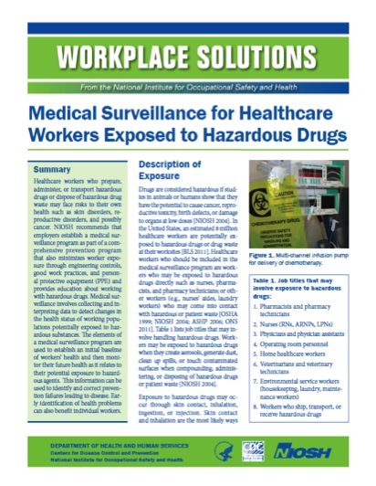

Slide 33
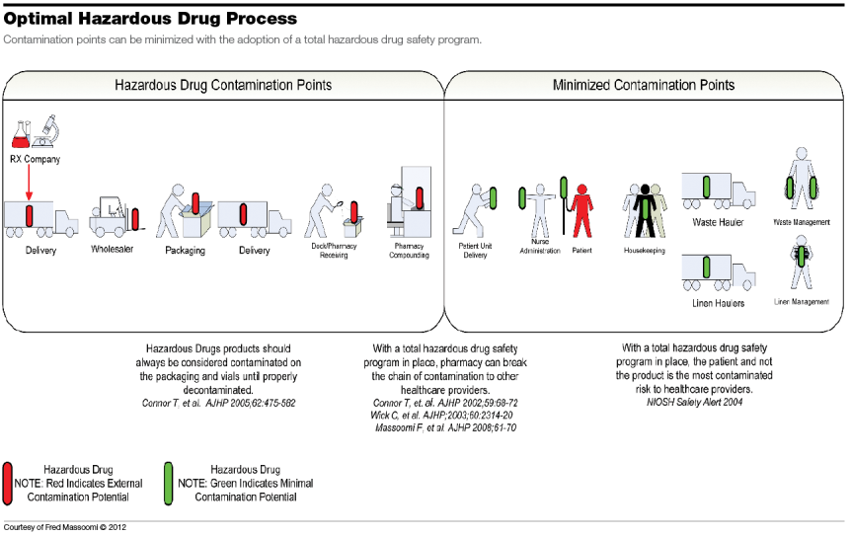

Slide 34
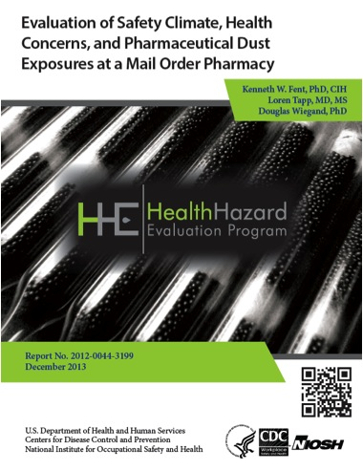

Slide 35
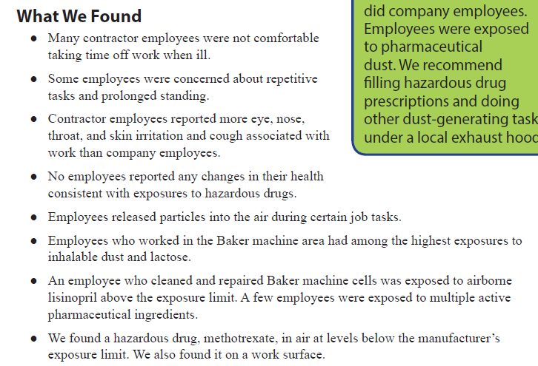

Slide 36


Slide 37
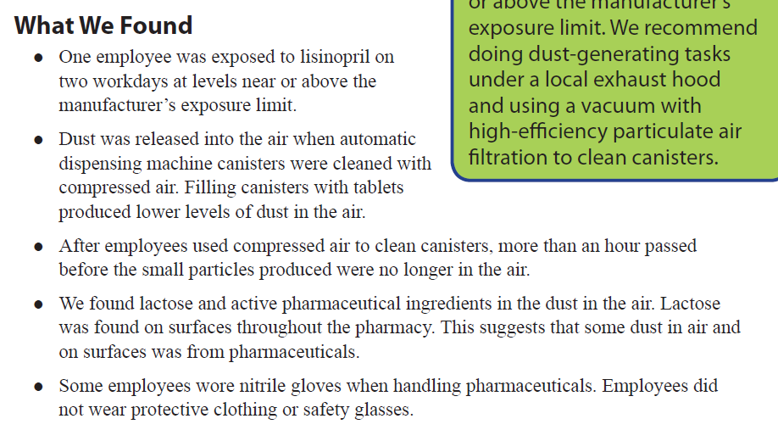

Slide 38
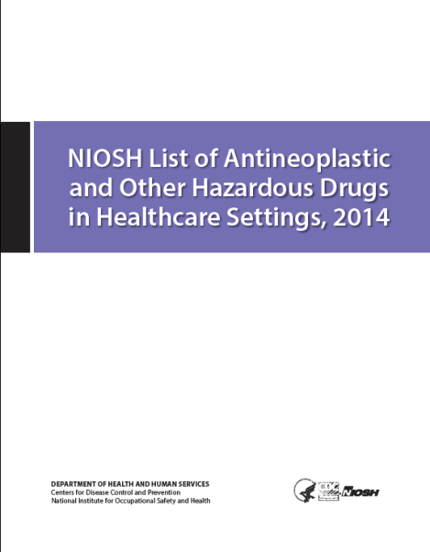
NDHHS (NIOSH) Publication Number 2014-138 (Supersedes 2012-150)
September 2014

Slide 39
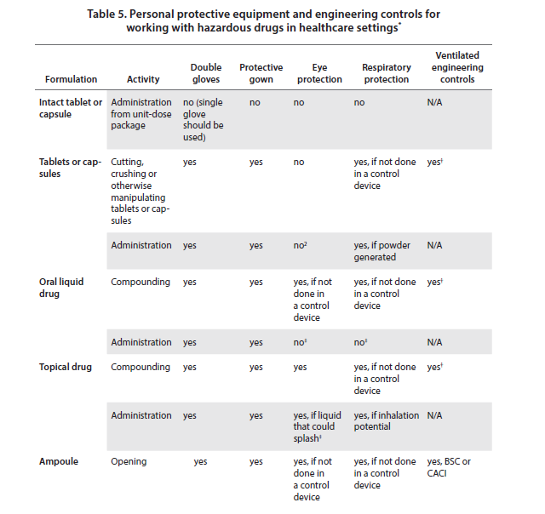

Slide 40
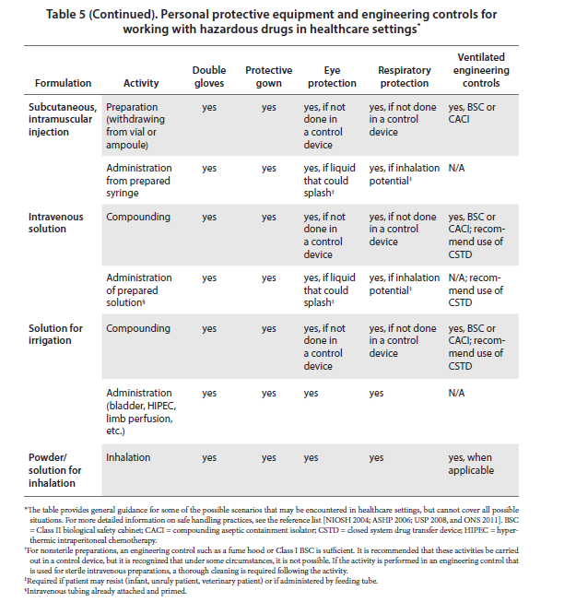

Slide 41
New issues
http://www.nature.com/nrc/journal/v5/n1/fig_tab/nrc1529_I1.html

Slide 42
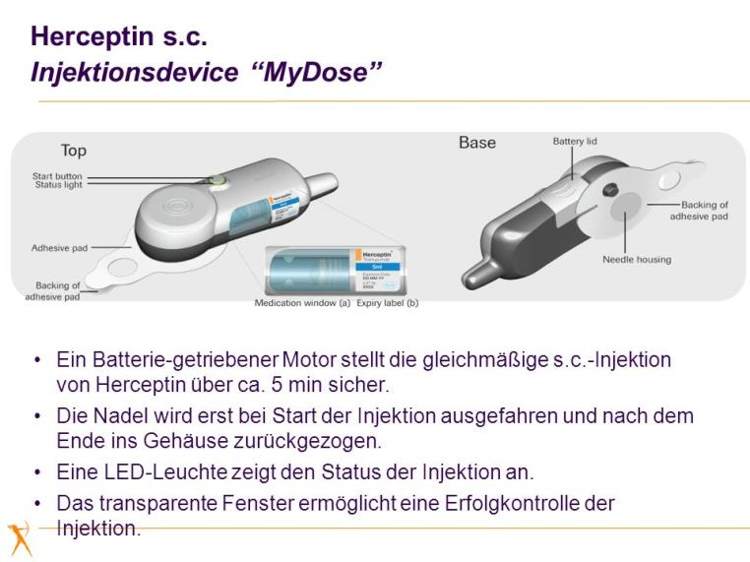
http://images.slideplayer.de/2/864499/slides/slide_17.jpg

Slide 43
Preference for subcutaneous or intravenous administration of trastuzumab in patients with HER2-positive early breast cancer (PrefHer): an open-label randomised study
Prof Xavier Pivot MD et al
The Lancet Oncology, Volume 14, Issue 10, Pages 962 - 970, September 2013
Nine out of 10 (91.5 per cent) HER2-positive breast cancer patients preferred the subcutaneous (SC) injection of Herceptin (trastuzumab) – an injection in the skin – to the current practice of intravenous drip delivery. Patients reported less pain and discomfort and spent up to 80 per cent less time in the hospital chair, as a SC injection around five minutes per visit, compared with 30-90 minutes for IV treatment.
http://www.thelancet.com/journals/lanonc/article/PIIS1470-2045%2813%2970383-8/abstract
http://www.bsms.ac.uk/about/news/herceptin-by-injection-is-quicker-and-preferred-say-breast-cance/

Slide 44
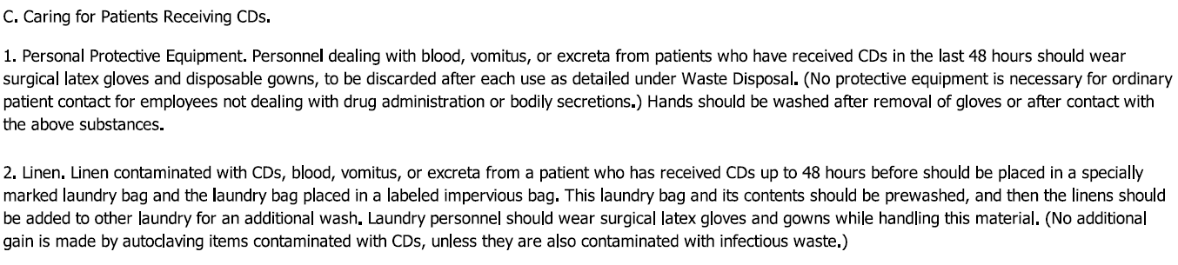
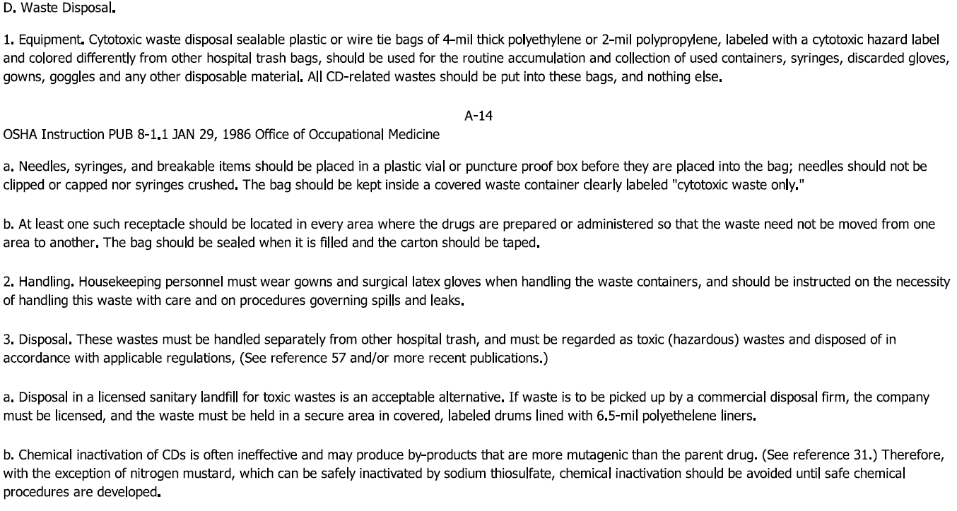

Slide 45
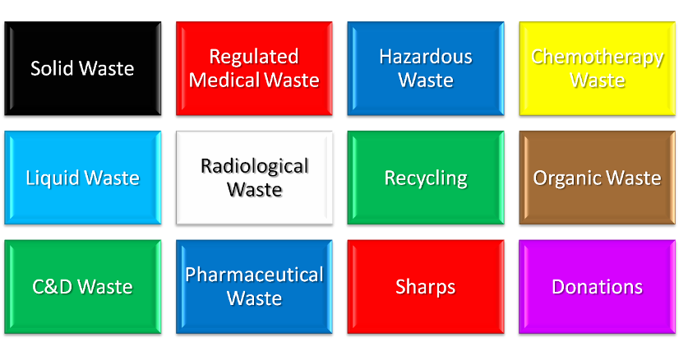
Waste streams……..

Slide 46
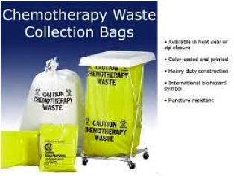
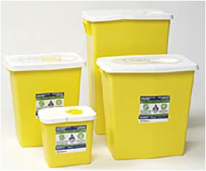

Slide 47
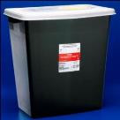
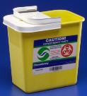
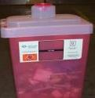
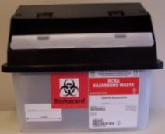
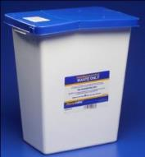

Pharmaceutical Waste and Disposal
Providence Health & Services (Portland Service area) https://practicegreenhealth.org/pubs/sharing/ProvidencePharmaceuticalTrainingPowerpoint.pptx
Hazardous Drugs,
Bulk Chemo,
& empty vials & IV bags that contained Warfarin, Arsenic Trioxide and Physostigmine
Trace Chemo
Used or partly-used syringes and vaccines
UNUSED syringes containing hazardous drugs
Aerosols (inhalers)
All other drugs, & empty containers
Aerosol

Slide 48
Recommended Pharmaceutical Waste Streams
MUNICIPAL
SEWER
SYSTEM
HAZARDOUS WASTE
- TOXIC
HAZARDOUS WASTE
- IGNITABLE
CHEMO
WASTE
- SHARPS
CHEMO
WASTE
- SOFT
NON-HAZARDOUS RX
RED SHARPS
• Packaging
• Empty bottles
• Paper
• Plastic
• Food waste, etc.
Maybe…
• IV’s
- D5W
- NaCl
NO ANTIBIOTICS
• P-listed
• U-listed
• D-listed
• Toxic
(Heavy metals)
• Chemo agents
(residue, bulk)
• Chemo spill clean up
• Hazardous spill clean up
• Risk management:
- Antivirals
- Others
• ≥ 24% alcohol
• Collodion
• Oxidizers
• Ignitable
compressed
gas
• Vials
- Empty
• Syringes/Needles
- Empty
• IV’s
- Empty
• Gowns
• Gloves
• Goggles
• Tubing
• Wipes
All waste
pharmaceuticals
NOT hazardous
including
antibiotics, IV’s
• Non-chemo
vials
- Empty
• Non-chemo
syringes/
needles
- Empty
* Recycle as much paper, glass, plastic
as possible
* Check with
municipal water treatment plant
for limits, recommendations
These may be combined IF
non-infectious and approved by medical waste disposal firm. Should be incinerated, not directly landfilled. The non-hazardous ash may be landfilled.
Federally permitted hazardous waste incinerator
(high temperature, scrubbers)
REGULATED MEDICAL WASTE DISPOSAL
Low temperature incinerator
Lined hazardous waste landfill
Ash
Landfill
Copyright © 2002 by PharmEcology™ Associates, LLC

Slide 49
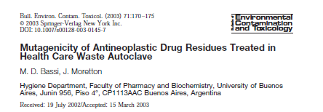
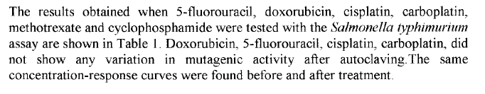

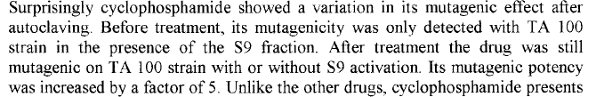

Slide 50
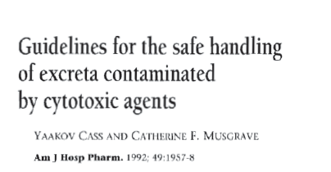
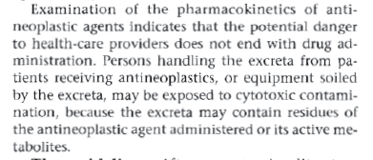

Slide 51
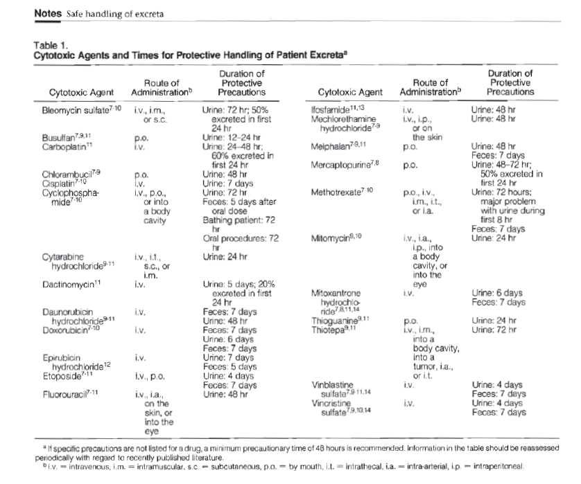

Slide 52
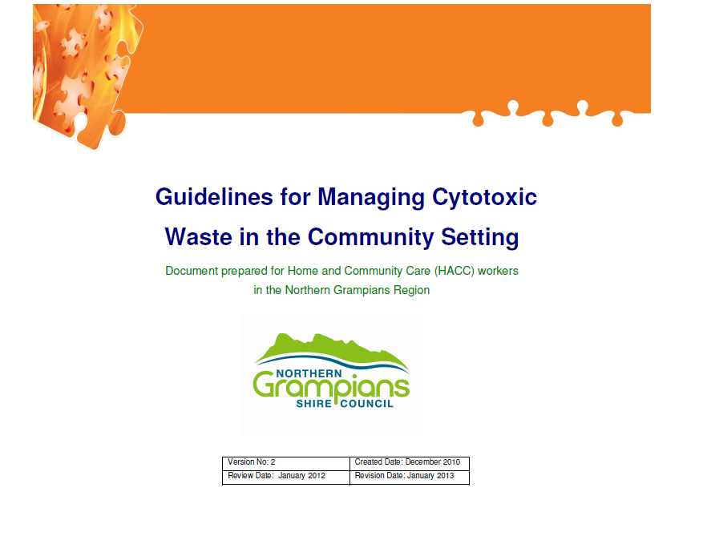

Slide 53
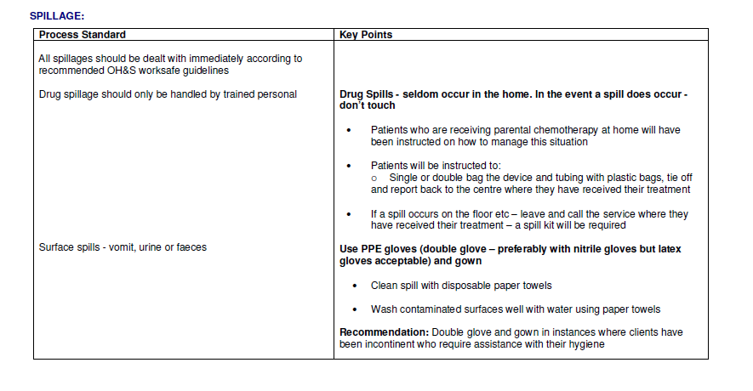

Slide 54
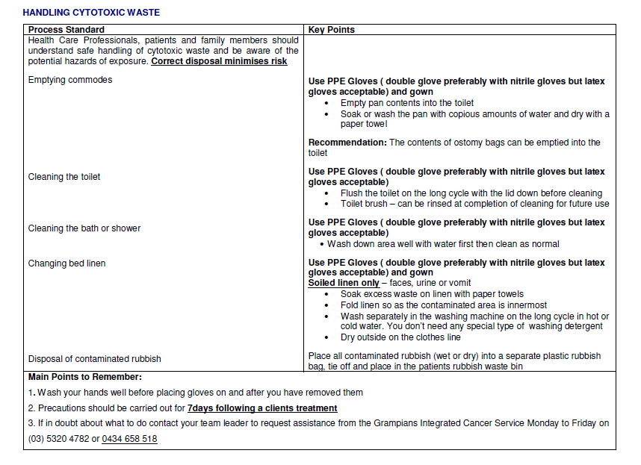

Slide 55
JCHAHO input….
MM.06.06.01 requires safe administration of medication and that the family should be informed regarding other concerns (including proper disposal) when new medications are started.
PC.02.03.01 Requires that a learning needs assessment is completed and that patient education, then, is provided based on this assessment. This would certainly include education related to safe use, disposal, etc. of medications the patient has received during a hospital encounter, and/or medications to be continued after discharge.
MM.05.01.09 Discusses the use of cautionary labels on medications dispensed. There is a cautionary label which says "chemotherapy," and during the education process under PC as stated above, education regarding what one should do when the medication has the "chemotherapy" sticker on the container of medication. Included once again in the information provided should be a referral to this sticker and what that means in terms of proper disposal and danger to others with whom the patient may contact.

Slide 56
NPSG.03.06.01 includes requirements about maintaining accurate medication information, providing patients with a list of medications to continue after their hospital encounter, and educating patients on the importance of managing medication information to the patient when he or she is discharged from the hospital or at the end of an outpatient encounter.
MM.01.01.03 include requirements for safe management of high alert and hazardous medications and also references requirements at EC.02.02.01 which addresses risks associated with disposing of hazardous medications. Lastly, organizations are required to be in compliance with law and regulation regarding proper use, handling and disposal of such medications (see LD.04.01.01).
Each of the accreditation standards referenced above are found in the Comprehensive Accreditation Manual for Hospitals. Each accredited organization's Accreditation Coordinator has a copy of this manual containing these requirements.
Post questions to: https://web.jointcommission.org/sigsubmission/sigonlineform.aspx

Slide 57
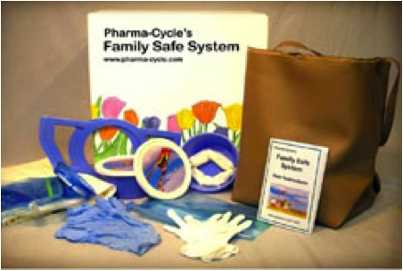
http://www.cytotoxicsafety.org/

Slide 58
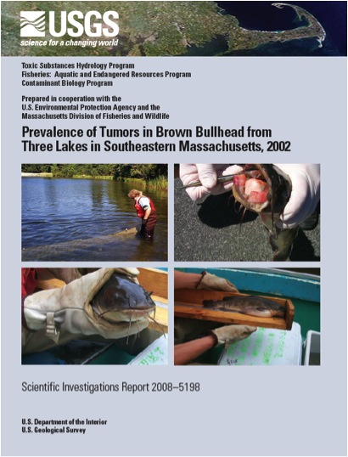

Slide 59
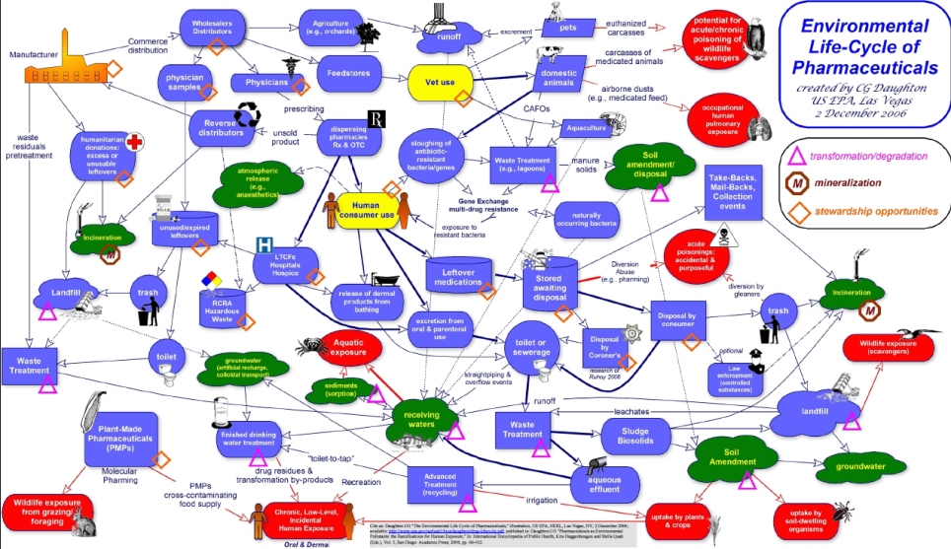
http://www.epa.gov/esd/bios/daughton/drug-lifecycle.pdf

Slide 60




What Happens to the Drugs Post Treatment?
A few Bad Actors are Excreted from Patients in Active Form
Cytotoxic chemotherapeutic drugs remain active Post-Patient (after excretion from patient)
Waste drugs enters watershed, source of our drinking water.
85% of infusion patients are sent home with no equipment to manage toxic chemicals excreted in their urine, feces, sweat and other bodily fluids.
Septic Systems Destroyed and the well poisoned

Slide 61

Recent pharmacovigilance legislation in the EU acknowledges that the pollution of waters and soils with pharmaceutical residues is an emerging environmental issue. The European Commission was asked to deliver a report on the scale of the issue, the causes, and possible policy options to mitigate such impacts. More recently, in the framework of the adoption of the Directive regarding priority substances in the field of water policy, the Commission has been asked to develop, instead of the report, a strategic approach to pollution of water by pharmaceutical substances by the end of 2015.

Slide 62

References:
http://www.cdc.gov/niosh/topics/antineoplastic/nioshpubs.html

Slide 63

http://www.paho.org/hq/index.php?option=com_docman&task=doc_download&gid=24983&Itemid=&lang=en

Slide 64
ON LINE Journal of Nursing Issues
Volume 9 – 2004 No 3: Sept'04
Hazardous Drugs
Safe Handling of Hazardous Drugs
Martha Polovich, MN, RN, AOCN
http://www.nursingworld.org/MainMenuCategories/ANAMarketplace/ANAPeriodicals/OJIN/TableofContents/Volume92004/No3Sept04/HazardousDrugs.aspx#Stolar83

Slide 65

Thank-you!

Slide 66


December 8 TELECLASS EDUCATION 2015 SCHEDULE RELEASE
http://www.webbertraining.com/schedulep1.php
December 11 ENVIRONMENTAL CLEANINGIN HEALTHCARE: IS MONITORING OF CLEANING COMPLIANCE REALLY NEEDED?
Dr. Michelle Alfa, Diagnostic Services of Manitoba

Slide 67


