Slide 1

CBIC 2022 Update
Presented by:
Sandra Callery, RN, MHSc, CIC
Hosted by: Paul Webber
paul@webbertraining.com
www.webbertraining.com
November 3, 2022

Slide 2

CBIC President (2022)
Senior leadership positions in Infection Prevention and Control
  across a variety of health care settings
  Ontario Agency of Health Protection and Promotion (Public Health Ontario).
Assistant professor, McMaster University
FIRST CERTIFIED: 1986
Sandra Callery, RN, MHSc, CIC

Slide 3
Disclaimer
These slides are for informational use only and cannot be used for subsequent presentations without the explicit permission of CBIC.

Slide 4
Learning Objectives
To discuss the value of certification
To differentiate between the current CBIC examinations.
Understand the options available for CIC recertification.
To describe the Long Term Care Certification in Infection Prevention eligibility requirements and content outline.

Slide 5

What certification means for me…
1986

Slide 6
The Value of the CIC®
“CIC supports higher salary compensation, increases job satisfaction through a structured career development framework, improves patient outcome, advances evidence-based infection prevention practices, and is valued by the public and within the health care industry.”
James Marx, et al. Value of certification in infection prevention and control. American Journal of Infection Control 47 (2019) 1265−1269

Slide 7
The Value of the CIC®
Instills professionalism among practitioners in infection prevention and control
A way to formally recognize experienced professionals in infection prevention and control through CIC® certification and recertification.

Slide 8
Impact of Certification
CIC IPs may have a stronger understanding than other practitioners of the evidence for certain IPAC practices
CIC IPs are more likely to recommend implementing them in the hospitals where they work-
and especially when the lead IP is certified.
Hospitals hiring certified infection preventionists were more likely to implement certain infectionprevention practices
Hsu, Yea-Jen et al. Impact of certified infection preventionists in acute care settings: A systematic review. American Journal of Infection Control preprint online June 2022

Slide 9
Purpose of the CIC®
The purpose of the CIC® certification and recertification process is to protect the public by:
Providing standardized measurement of current essential knowledge needed for infection prevention and control practitioners

Slide 10
What is CBIC?
Certification Board of Infection Control and Epidemiology, Inc.
Voluntary, autonomous, multidisciplinary board
Mission: Provide pathways to assess and maintain infection prevention competency.
Vision: Healthcare without infection through verifiable competency.

Slide 11
The CIC®
Certification in Infection Prevention and Control
The only standardized measurement of essential knowledge, skills, and abilities expected of infection prevention and control professionals in North America
Currently over 8,700 CICs in over 40 countries

Slide 12
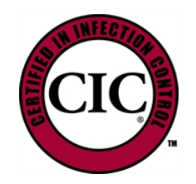
CBIC Examinations
Certification in Infection Control (CIC®) Examination
Certification in Infection Control Recertification Examination

Slide 13
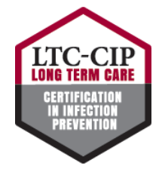
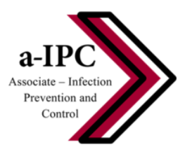
CBIC Examinations
Associate-Infection Prevention and Control (a-IPC™) Examination
Long Term Care Certification in Infection Prevention (LTC-CIP)

Slide 14
Certificate versus Certification
A certificate is awarded following the completion of a course or series of courses that provides education and training around an intended learning outcome.
A certification is awarded following successful completion of a comprehensive examination process and provides an independent assessment of the knowledge, skills, and/or competencies required for competent performance of an occupation or professional role.

Slide 15

CBIC Exam Development Cycle

Slide 16
Conduct the practice analysis
Develop test specifications
Write items to the test specifications
Assemble Test Forms
Conduct the beta test
Ongoing test maintenance
Set the passing score
Exam Cycle

Slide 17
Steps of a Practice Analysis
Conduct a Planning meeting
Develop a survey instrument
Disseminate Survey
Analyze the Survey Data
Develop Test Specifications

Slide 18
CBIC Practice Analysis
A Practice Analysis is foundational
Ensures a valid and reliable exam
Conducted every 4-5 years
Results in exams with new criteria

Slide 19

The CIC®- NCCA accredited
The CIC is accredited by the National Commission for Certifying Agencies (NCCA)
Provides impartial, third-party validation that CBIC’s program has met recognized national and international credentialing industry standards for development, implementation, and maintenance of our certification program.

Slide 20

Candidate Testing Experience
CBIC partners with Prometric to deliver exams in a secure, proctored environment
Prometric is a U.S. based company in the test administration industry and provides test development and delivery services
20

Slide 21
Candidate Testing Experience
Candidates can take the exam at a physical testing center or via Prometric’s live remote proctoring option, Pro Proctor
Testing is available 5-7 days a week depending on location
21

Slide 22
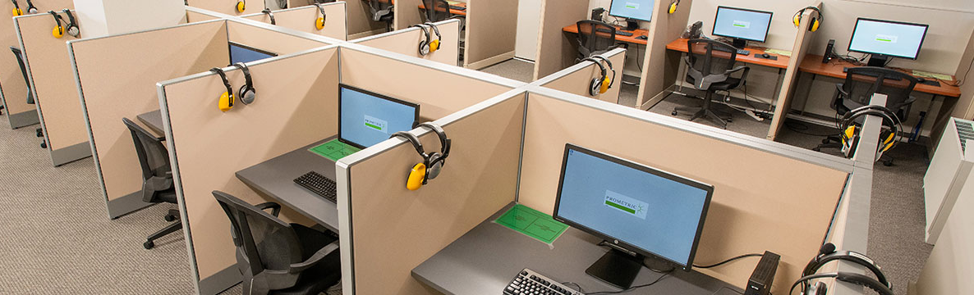
Prometric Testing Centers
  Located worldwide in 40+ countries
  Testing available 5-7 days a week during normal business hours
  Candidates are monitored throughout the exam in a secure environment

Slide 23

Pro Proctor
Candidates can take the exam at home
A live, remote proctor locks down the candidate’s browser
360-degree environment check done of candidate workspace

Slide 24
CIC® Examination

Slide 25
CIC® Eligibility Requirements

Slide 26
CIC® Eligibility Requirements
Completed post-secondary education in a health-related field including but not limited to medicine, nursing, laboratory technology, or public health. Post-secondary includes public or private universities, colleges, community colleges, etc.
Direct responsibility for the infection prevention program activities in a healthcare setting

Slide 27
CIC® Eligibility Requirements
3. Work experience, defined as active engagement in infection prevention, determined by a current job description, for compensation, for a minimum of:
    At least one-year full-time employment OR
    Two (2) years part-time employment OR
    Completed 3,000 hours of infection prevention work experience earned during the previous three (3) years

Slide 28
CIC® Eligibility Requirements
Infection Prevention activities must include…
Identification of infectious disease processes
Surveillance and epidemiologic investigation
Preventing and controlling the transmission of infectious agents
Environment of care
Cleaning, disinfection, sterilization, and asepsis
AND at least two (2) of the remaining three (3) components:
Employee / occupational health
Management and communication
Education and research

Slide 29
CIC® Recertification Options

Slide 30
CIC® Recertification Overview
CIC certification is valid for five years from the year of successful examination.
Recertification takes place every five years
Recertification can be completed via infection prevention units (IPUs) or examination.

Slide 31
CIC® Recertification by IPUs

Slide 32
What is an IPU?
IPU = Infection Prevention Unit (IPU) = continuing education credits
Can be achieved by*:
  Presenting at conferences,
  Authoring publications
  Attending local or national conferences,
  Participating in a professional organization in a position of leadership
  And more! IPU guide available online.
  *must be infection prevention related

Slide 33
Recertification by IPUs
Candidates must submit an IPU portfolio demonstrating completion of a minimum of 40 IPUs
All IPUs are required to be from an accredited organization
Candidates can accumulate IPUs any time after their previous recertification submission date throughout their five-year recertification period
Candidates may access IPU portfolio once certified and must submit by October 31st of their expiration year.

Slide 34
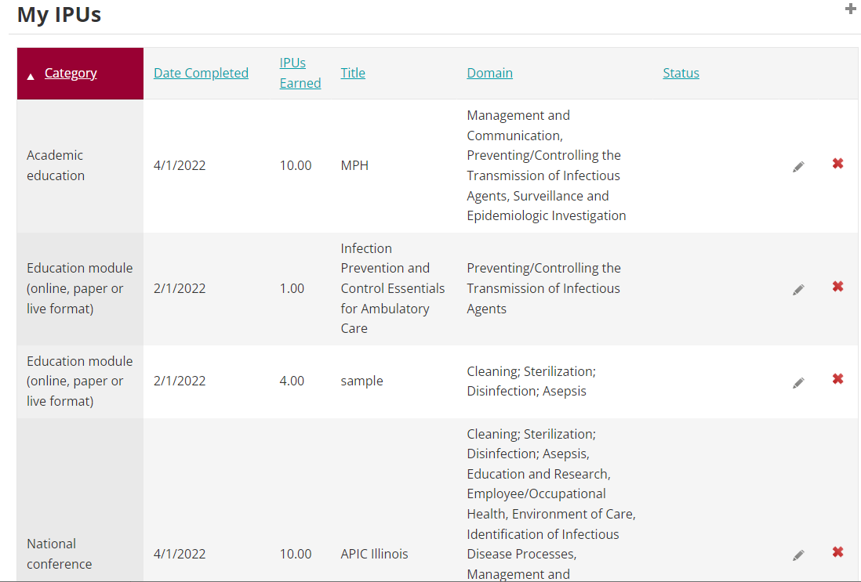
IPU Portfolio

Slide 35
Recertification by IPUs Timeline
Professional portfolio available once certified.
Submit portfolio by October 31st
CBIC reviews all portfolios
If successful, new five-year recertification period begins
Record activities and upload verification documents

Slide 36
Recertification by Infection Prevention Units (IPUs)
$375 fee required with portfolio submission.
Once submitted, average review time is three weeks-if there are questions regarding activities, you will be contacted via email. Two resubmissions are permitted.

Slide 37
Missed deadlines/unsuccessful portfolio
If you do not submit your portfolio by the deadline of October 31, you must take the online recertification exam.
This exam must be purchased by November 30 and completed by December 31

Slide 38
Missed deadlines/unsuccessful portfolio
If upon review and resubmission and your IPUs are not accepted, you must take the proctored CIC exam, which must be purchased by December 17 and completed by December 31. The unproctored recertification exam is not an option if your IPUs are not accepted.

Slide 39
Helpful Hints
Submit your IPUs as you earn them!
Reach out to staff with questions
Don’t wait until October 31 to submit your credits
Once your 40 credits have been approved, you will receive a new five-year certification and can begin submitting new IPUs for your next portfolio, due in five years.

Slide 40
IPUs Categories
Online, paper, or live format education
Local, national or international conferences and workshops
Academic education
Publications
Presentation
Participation in professional organization
Teaching
Research

Slide 41
Domains (6/8 required)
Identification of Infectious Disease Processes
Surveillance and Epidemiologic Investigation
Preventing/Controlling the Transmission of Infectious Agents
Employee/Occupational Health
Management and Communication
Education and Research
Environment of Care
Cleaning, Sterilization, Disinfection, Asepsis

Slide 42
IPUs and Chapter Activities
Does my Chapter activity count towards IPUs?
Subject matter related to infection prevention and control and falls within at least one of the eight exam domains
Able to verify chapter member attendance or participation by providing required documentation
YES!

Slide 43
Examples of IPU Activities*
Attendance at national conferences (e.g. APIC/IPAC Canada)
Online, paper or live format education
  Webinars
  Online educational modules
Participation in a professional organization
  Elected position on an IPAC Chapter Board (Treasurer, Secretary, President, President-Elect)
  *All activities must be provided by or presented through an accredited organization

Slide 44



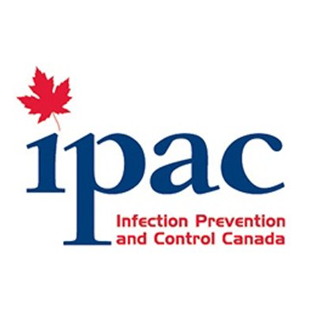



Potential Accredited Providers
…and many more!

Slide 45
CEU – IPU Conversion Chart
For Per Hour IPU Activities
 | Duration of participation/ instruction | CEUs | CMEs | CNEs | IPUs
Activity: -Online, paper, or live format education -Attendance at national conference IP-related sessions -Teaching | 60 minutes of instruction or 1 “contact hour” | .1 | 1 | 1 | 1

Slide 46
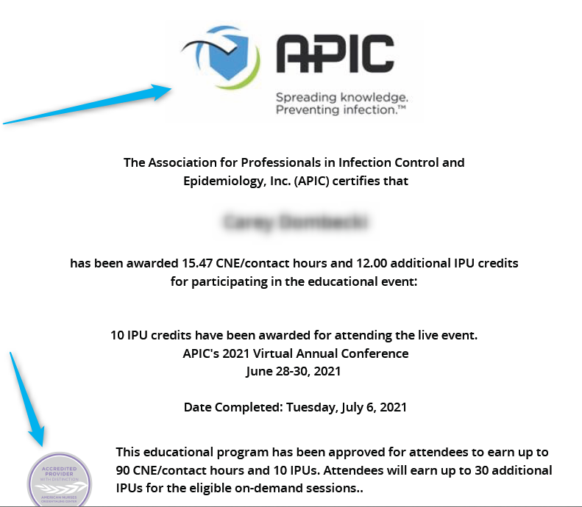
Example Verification Form
Official organization letterhead
Accreditation Information

Slide 47

IPUs Resources
IPUs FAQ page: https://www.cbic.org/CBIC/Certification-FAQs/Recertification.htm#RecertificationIPU
IPUs downloadable Criteria Chart: https://www.cbic.org/CBIC/PDFs/2021IPUsCriteriaChart-WebsiteVersionV5.pdf
IPUs Portfolio Manual: https://www.cbic.org/CBIC/PDFs/2022-Recertification-by-Continuing-Education-for-the-CIC.pdf

Slide 48
Recertification by Examination
Online, web-based examination taken on your home computer and on your own schedule
Must be taken independently
150 multiple-choice questions (135 scored questions and 15 pre-test, unscored items)
Follows same content outline as the CIC

Slide 49
Recertification Examination
$375 exam fee submitted with application
Staff will approve your application and send your details to Prometric – you will receive an approval email within 5-7 business days.
The recertification examination must be purchased on or before November 30, 2022
Exam must be completed by December 31, 2022 at 11:59 pm Greenwich Mean Time / 6:59 pm EST

Slide 50
Recertification Examination
Results available immediately after submitting the examination
A candidate that does not pass the recertification examination must take and pass the initial CIC® examination to maintain certification – recertification by IPUs is not an option after an unsuccessful attempt on the recertification examination

Slide 51
Recertification by Examination Timeline
Examination available for purchase January 1st of recertifying year
Submit Exam by December 31st
If candidate fails recert exam, they must apply for the CIC proctored exam
If successful, new five-year recertification period begins
Exam must be purchased by November 30th

Slide 52
Recertification Examination: Helpful Hints
Apply now!
Do not wait until December 31 to begin taking your exam
DO NOT ACCESS the examination in Internet Explorer or in a remote workplace access
Review the CBIC website for technical requirements and more: https://www.cbic.org/CBIC/Recertification.htm

Slide 53
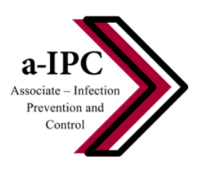
a-IPC™ Certification

Slide 54
a-IPC™ Examination
Entry-level certification examination is a measure of basic infection prevention competency.
Intended for the novice IP and for those interested in pursuing careers in infection prevention and control
Certification valid for three years and non-renewable

Slide 55
a-IPC™ Eligibility Requirements
No job-specific or educational requirements to apply.
Intended for those with formal education but without current work-related duties.
Perfect stepping-stone to prove a candidate’s foundational knowledge, interest and dedication to the field.

Slide 56
New! a-IPC™ Test
Beta testing of new a-IPC exam completed
Results of beta testing in early November
New exam available for prospective candidates after December 15, 2022.

Slide 57
Long-Term Care Certification in Infection Prevention (LTC-CIP)

Slide 58
New! Long-Term Care Certification
Practice analysis completed in 2021
1,700 individuals participated in the long-term care job analysis survey
Survey provided insight into the tasks and knowledge important for Infection Preventionists in long-term care
The survey results guided the creation of the test content outline that all test questions are based on.
Developed with the same rigor as the CIC®

Slide 59
LTC-CIP content outline
1. Long-Term Care Settings
2. Management and Communication of the Infection Prevention Program
3. Identification of Infectious Diseases
4. Surveillance and Epidemiologic Investigation
5. Prevention and Control of Infectious and Communicable Diseases
6. Environment of Care
7. Cleaning, Disinfection, Sterilization of Medical Devices and Equipment
8. Antimicrobial Stewardship
9. Employee/Occupational Health

Slide 60
LTC-CIP Eligibility Requirements
Responsibility for the infection prevention and control programs/activities in a long-term care setting. Candidates will fill out an attestation form confirming this information.
Completed post-secondary education in a health-related field including but not limited to medicine, nursing, laboratory technology, public health, or biology. Post-secondary includes public or private universities, colleges, community colleges etc.

Slide 61
LTC-CIP- available February 2023
Beta testing completed October 15, 2022
Results of beta test will be reviewed in early January 2023
Exam will be fully available beginning February 2023
Exam will consist of 150 multiple-choice questions

Slide 62
CBIC Resources
Exam Prep Materials: https://www.cbic.org/CBIC/Exam-Prep-Resources.htm
CBIC Podcasts (Available on CBIC Multimedia page)
Study Groups: Check with local APIC/IPAC Canada Chapters

Slide 63
Questions?

Slide 64

Contact Information
General Information
info@cbic.org
202-454-2625
Executive Director, Jessica Dangles
jdangles@cbic.org

Slide 65

