Slide 1
: the next frontier in infection prevention
Prof. Didier Pittet
Infection Control Programme and WHO Collaborating Center on Patient Safety,
University of Geneva Hospitals and Faculty of Medicine, Geneva, Switzerland
Dr. Pierre Parneix
Nouvelle Aquitaine Healthcare-Associated Infection Control Centre,
Bordeaux University Hospital, Bordeaux, France
www.webbertraining.com
October 20, 2020

Slide 2
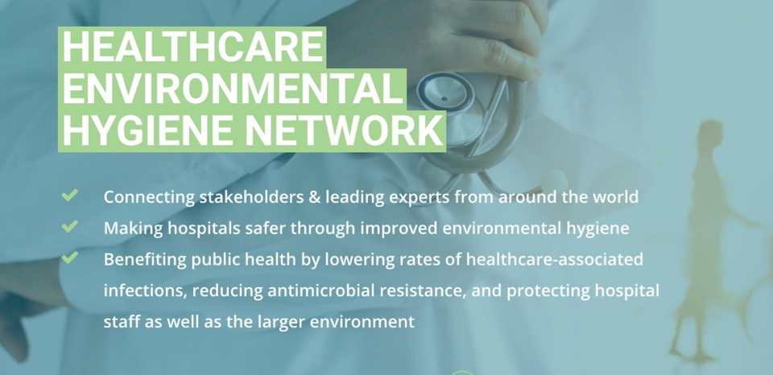
What is Clean Hospitals ?
2
www.CleanHospitals.com

Slide 3
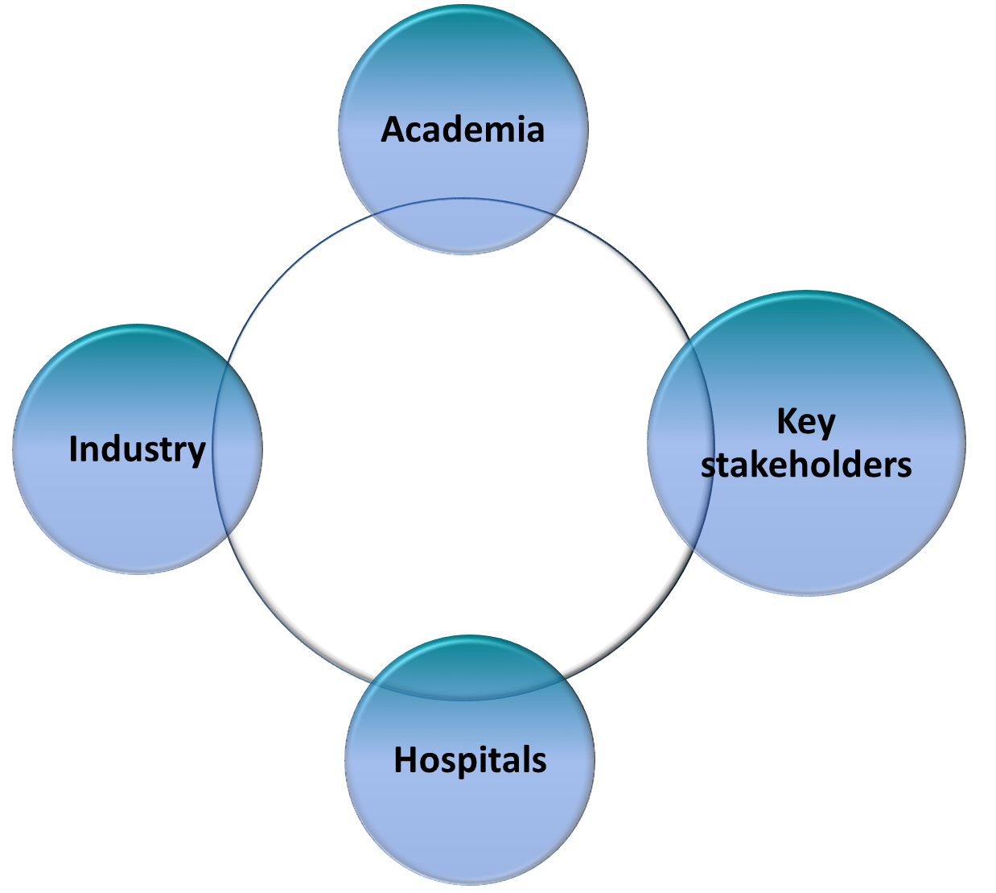
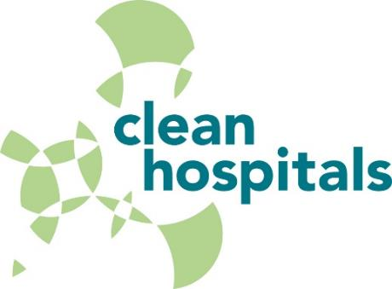
Our Mission:
3

Slide 4
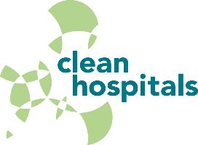
Our activities around HEH
4
Setting the agenda for addressing urgent issues in the field
  Academic Taskforce
  Stakeholder meetings
  Board meetings
Education
  Development of training programs for hospitals
Research projects and studies
  Systematic review of the efficacy of HEH interventions
  A global Environmental Hygiene Self-Assessment Framework
Publications
  White papers & academic papers in peer-reviewed journals

Slide 5
Our activities around HEH (cont.)
5
Specialized industry-led working groups
  Mapping guidelines for HEH
  Transposable model for hospital hygiene
  Fake news and how to respond to it
Participation to conferences
  Interclean and the Healthcare Cleaning Forum
  iClean 2020 Australia
  International Solid Waste Association (ISWA) World Congress
  SVS Hygiene Forum
  International Association for Soaps, Detergents and Maintenance Products (AISE) Healthcare Event

Slide 6

6
Why do we need a day ?
Why do we need to raise awareness ?
What we did with hand hygiene previously, and the impact it had

Slide 7
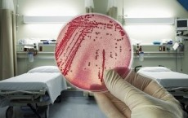
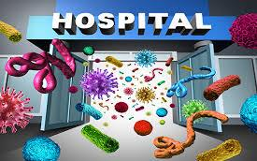
Why do we need to raise awareness:
7
The healthcare environment’s effect on healthcare-associated infections

Slide 8
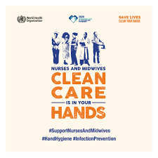
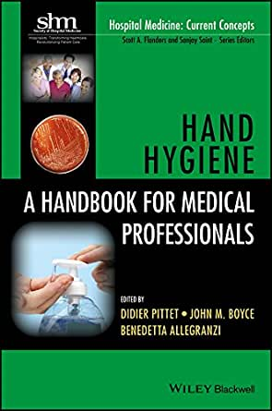
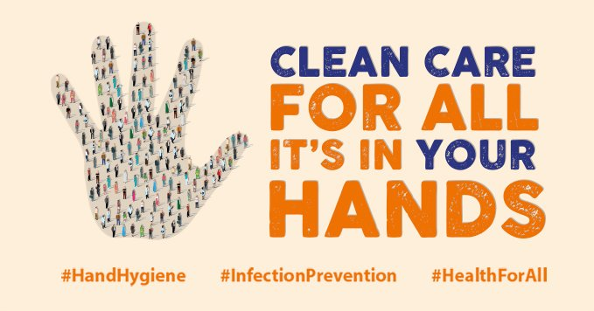
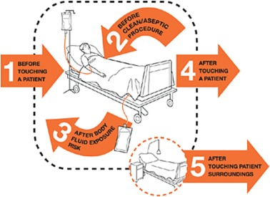

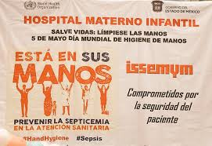
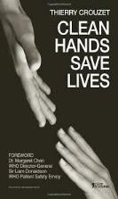
25 Years of Hand Hygiene
8

Slide 9
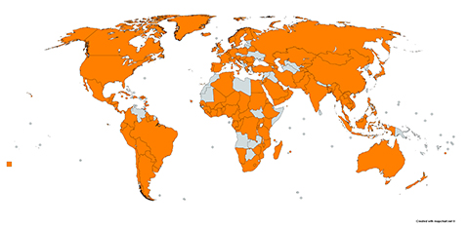
Pledges to combat health care-associated infections:
Saving millions of lives every year
9
https://www.who.int/infection-prevention/countries/hand-hygiene/statements/en/

Slide 10






We asked our stakeholders their most urgent questions about healthcare environmental hygiene
$
?
How can hospitals save costs in environmental hygiene?
Is cleaning a science?
What is the difference between cleaning and disinfecting?
Do cleaner hospitals really mean safer hospitals?

Slide 11
Questions:
11
Q 1: Do cleaner hospitals really mean safer hospitals ?
Q 2: What is the difference between cleaning and disinfecting ?
Q 3: How is cleaning a hospital different than cleaning a hotel ?
Q 4: Does it make economic sense to invest in hospital cleaning programs ?
Q 5: How can cleaning be a science ?
Q 6: How do we make sure a surface is clean ?

Slide 12
12
Questions (cont.):
Q 7: Do air and water quality matter for controlling infections ?
Q 8: Is it better to outsource cleaners or train them in house ?
Q 9: What element of healthcare environmental hygiene should my institution invest in first ?
Q 10: How can hospitals save costs in environmental hygiene ?
Q 11: How can I improve team workflows between cleaners and nursing staff ?
Q 12: Any question ?

Slide 13
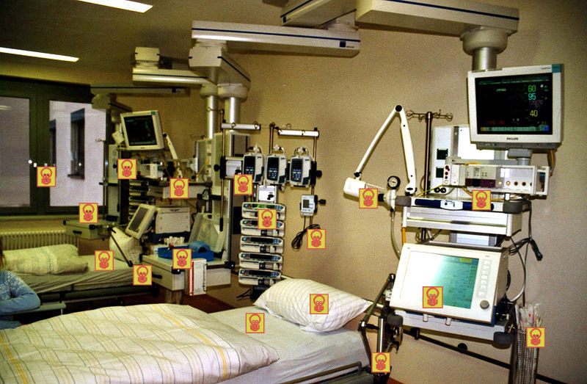
Q 1:
Do cleaner hospitals really mean safer hospitals?
13

Slide 14

Q 1:
Do cleaner hospitals really mean safer hospitals?
14
YES!

Slide 15

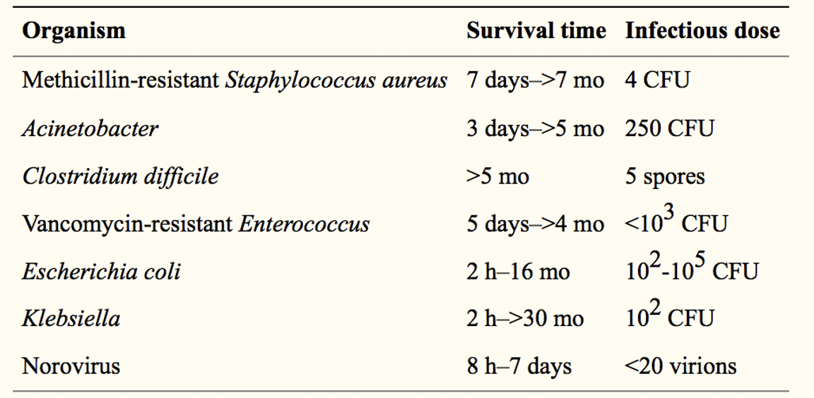
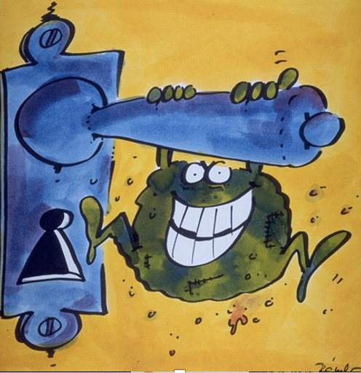
15
Survival times and infectious doses retrieved or extrapolated from published studies

Slide 16
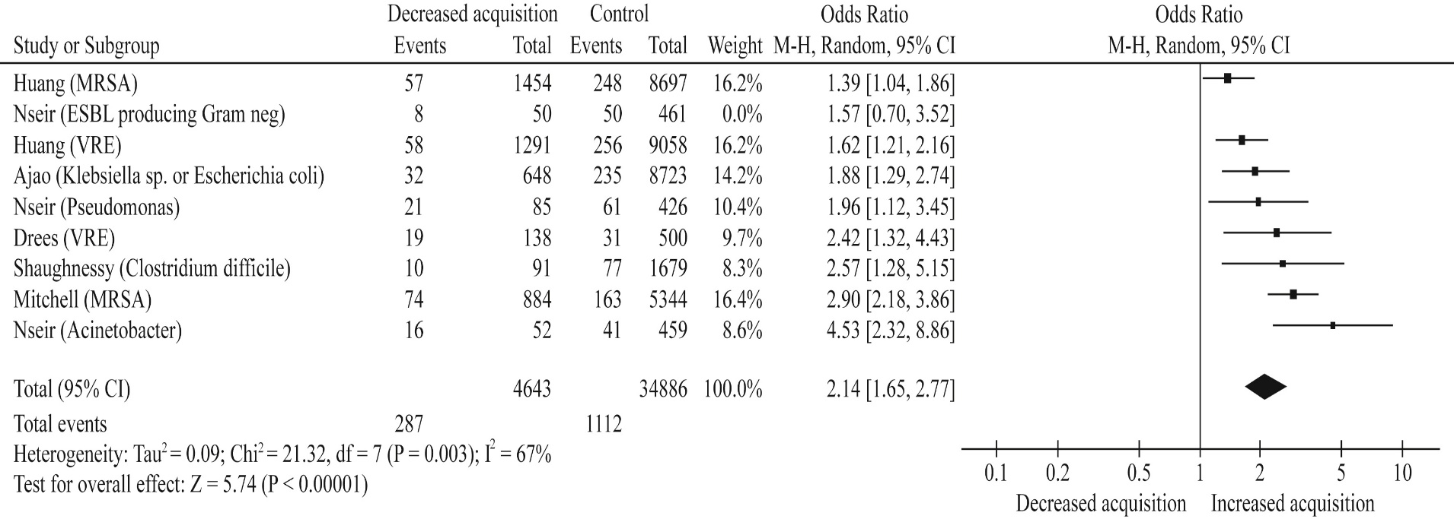

Risk of acquisition from prior room occupants by organism
16
Mitchell, B. G., Dancer, S. J., Anderson, M. & Dehn, E. Risk of organism acquisition from prior room occupants: a systematic review and meta-analysis. J. Hosp. Infect. 91, 211–217 (2015).

Slide 17
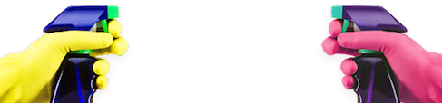
Q 2:
What is the difference between cleaning and disinfecting?
17

Slide 18
Cleaning vs. Disinfecting
18
Both reduce microbial contamination, but there is a difference in the amount of reduction
Cleaning- the process of the physical removal dust and dirt (which also removes some microbes)
    Ex. with surfactants or scrubbing
Disinfection- process of killing microbes through mechanical or chemical means
    Ex. with heat or alcohol

Slide 19


Q 3:
How is cleaning a hospital different than cleaning a hotel?
18

Slide 20
Why are hospitals different?
20
  Difference in vulnerability of population
  Difference in level of contamination from sick patients
  Pathogens in hospitals can differ from those in the community
  Difference in needed level of cleanliness (depending on zones)
  Range of specific environments
  Pathogen transmission patterns, host affinities, microbiological characteristics

Slide 21
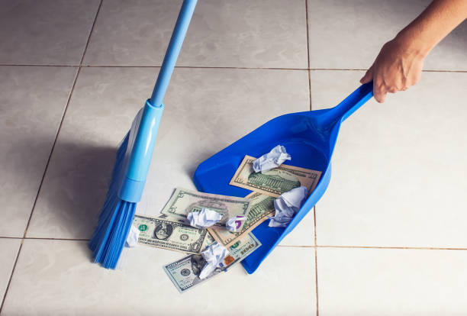
Q 4:
Does it make economic sense to invest in hospital cleaning programs?
21

Slide 22

Why is it so difficult to figure out?
Costs of not cleaning can affect numerous budgets within a hospital
Need to look at both expenditures and averted expenditures
(including patient days, opportunity costs, staff time, missed surgical revenue, averted infections)

Slide 23

The cost of hospital cleaning and disinfection
23
Hospitals usually think of environmental hygiene in terms of COST
They need to think in terms of VALUE
VS.

Slide 24

Return on Investment
24
For Hand Hygiene return on investment is up to 23x…
How much is return on investment for hospital environmental hygiene?
  Increased costs associated with antimicrobial resistance in healthcare-associated infections (some estimates over €85 trillion by 2050)
  A small outbreak with 40 individuals can cost over €1 million)
M Abbas et al. Conflicts of interest in infection prevention and control research. Intensive Care Med Press; 2108.
Pittet D, et al. Cost implications of successful hand hygiene promotion. Infect Control Hosp Epidemiol. 2004;25:264–266.
Graves Nicholas. Hand Hygiene. Hoboken, NJ, USA: John Wiley & Sons, Inc.; 2017. The Economic Impact of Improved Hand Hygiene; pp. 285–293.
Craig D, et al. Economic evaluations of interventions to prevent healthcare-associated infections literature review. 2017.

Slide 25


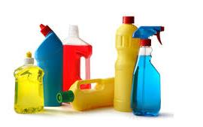
The real question is….
25
What is the cost of NOT cleaning?
Investing in quality is worth it

Slide 26
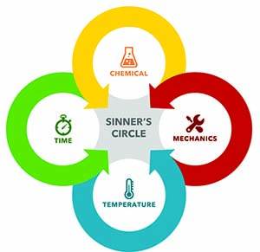
Q 5:
How can cleaning be a science?
26

Slide 27
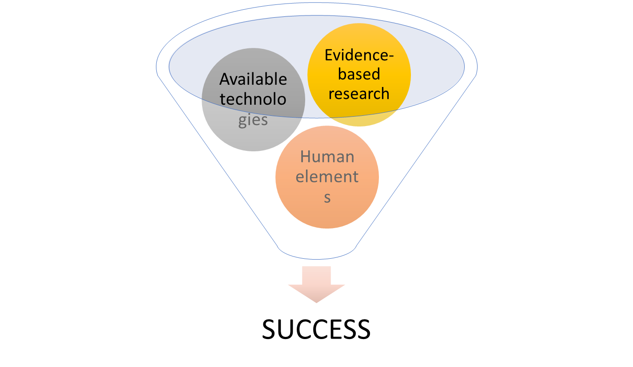
Environmental hygiene in healthcare is complex because:
27
+ High stakes

Slide 28
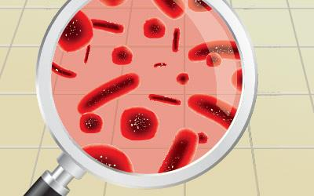
Q 6:
How do we make sure a surface is clean?
28
  First decide how clean you want that surface to be

Slide 29
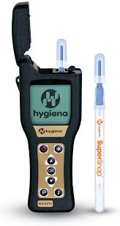

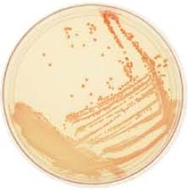
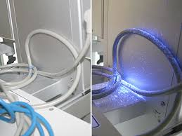
Ways of inspecting the healthcare environment
29
Visual inspection
Cultures
Fluorescent markers
ATP meters

Slide 30
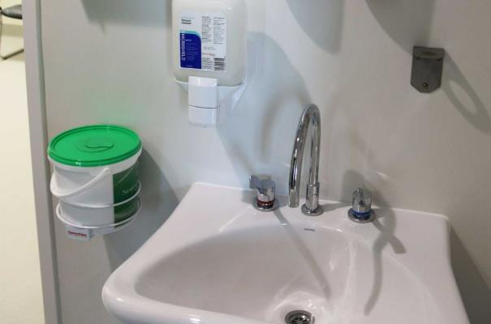
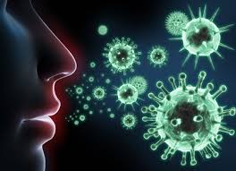
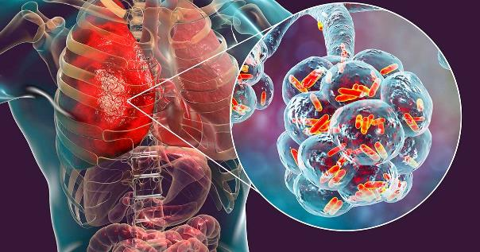
Q 7:
Do air and water quality matter for controlling infections?
30

Slide 31
Air and water
31
  Depends on:
  The microbe present and how it can be transmitted
    Ex. tuberculosis or Legionella spp. disease
  The vulnerability of the patient
  The need of a particular environment
    Ex. a patient room vs. an operating theater

Slide 32










Risk Zones at HUG
32
ZONE 1 – LOW Risk
Administrative rooms, entryways, hallways
ZONE 2 – MODERATE Risk
Patient rooms, daycare areas, laboratories
ZONE 3 – HIGH Risk
Intensive care rooms, post-anethesia care unit
ZONE 4 – VERY HIGH Risk
Rooms of transplant patients, operating theaters
ZONE 5 – CLEAN-ROOMS
ZONE 5
Salles blanches

Slide 33
Q 8:
Is it better to outsource cleaners or train them in house?
33

Slide 34
Q 8:
Is it better to outsource cleaners or train them in house?
?
34
Trick question:

Slide 35
Q 8:
Is it better to outsource cleaners or train them in house?
?
35
Trick question:
A: You get what you pay for

Slide 36

Outsourcing vs. In-house
36
Pros
  Can cost less
  More flexible workforce
  Generally ok for non-critical areas
Cons
  Not your workforce
  Little control over training
  Issues with quality management

Slide 37

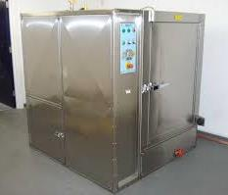
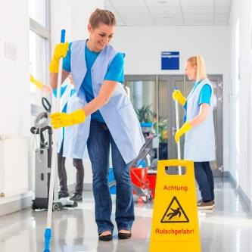
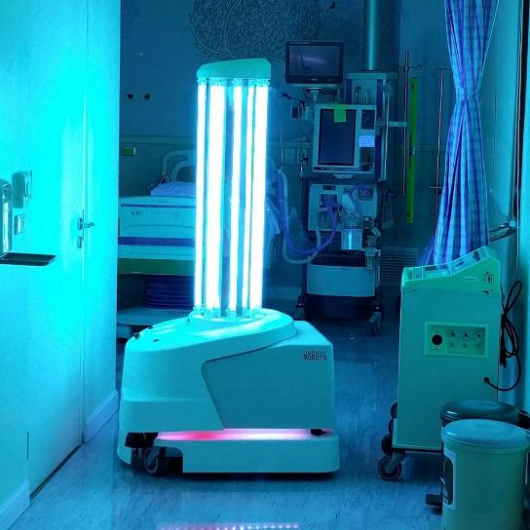
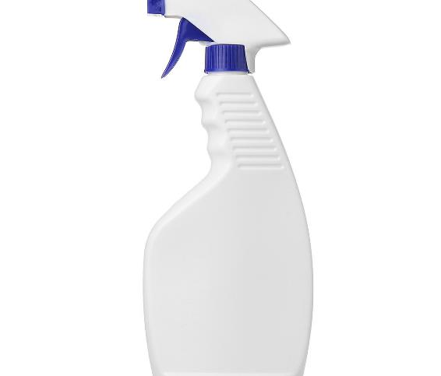
Q 9:
What element of healthcare environmental hygiene should my institution invest in first?
37

Slide 38
What should my institution invest in first?
38
  First training, and then good products
  A good cleaner can get better results with a simple detergent than spraying disinfectant on a soiled surface
  It is crucial the environmental services department work closely with infection prevention and control

Slide 39

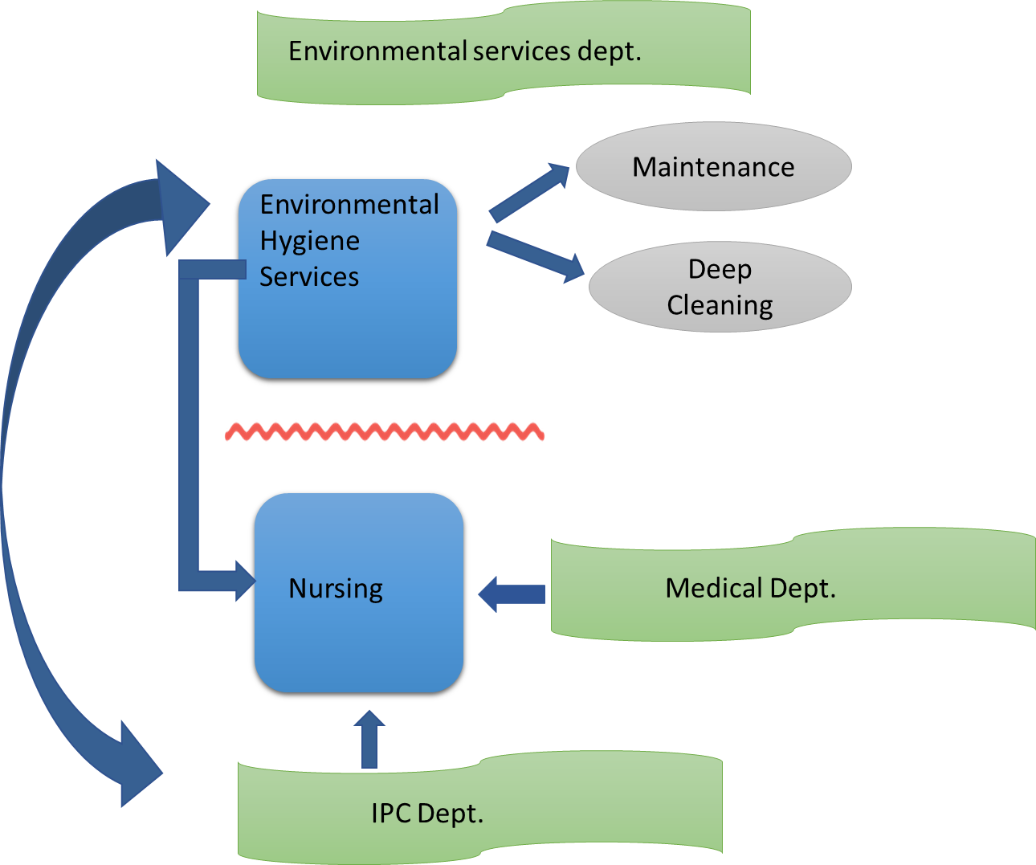
39
Education and training

Slide 40


Logistics of hospital cleaning
40
Nursing department
?
Infection Prevention and Control (IPC) department

Slide 41

Q 10:
How can hospitals save costs in environmental hygiene?
41

Slide 42
Key Elements
42
Decide which elements need which level of cleaning
Calculate the cost/benefit of HEH in their institution
Keep staff longer, educate and motivate them
Decide when fancy/high-tech machinery is necessary or not

Slide 43
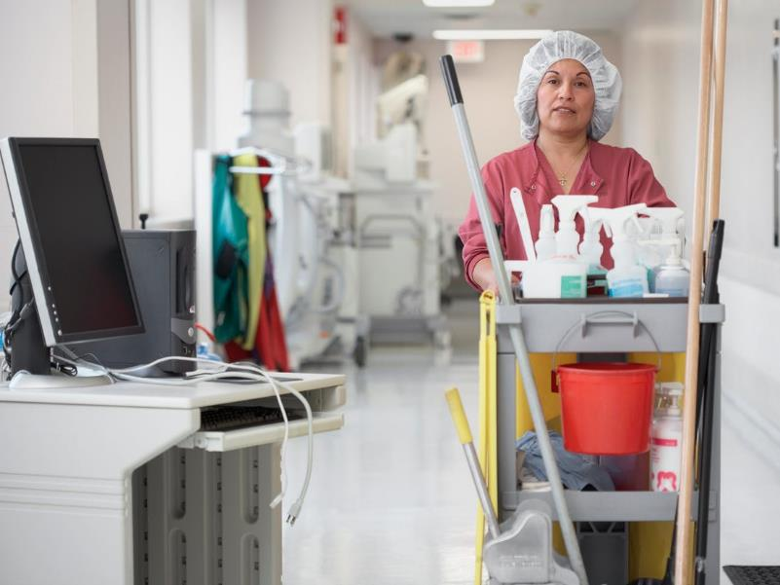
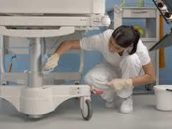
Q 11:
How can I improve team workflows between cleaners and nursing staff?
43
  .
Everyone needs to know their job, and everyone is crucial to the outcome. Social identities can be fostered by the institution

Slide 44
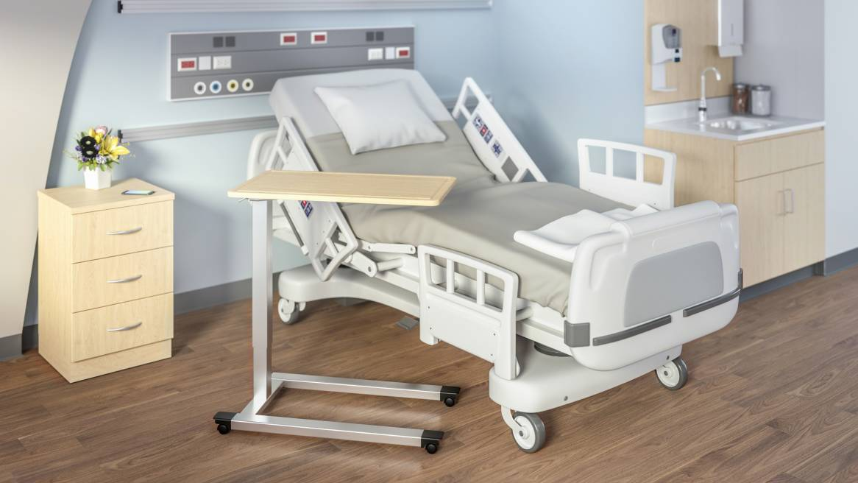
Who does what?
44

Slide 45
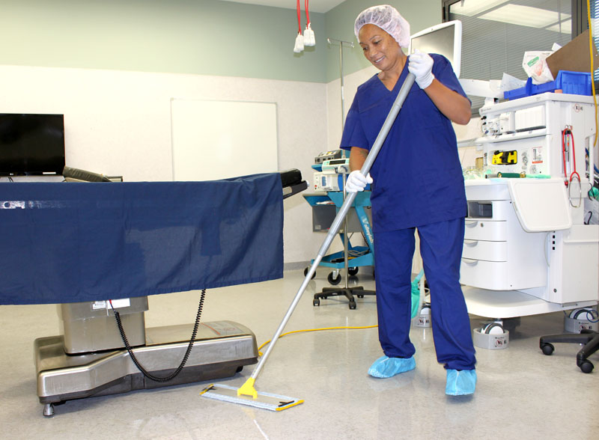

Optimizing HEH personnel performance
45
Good education
Clear protocols
Direct communication
Quality control
Constructive feedback
A humanistic approach
Important to remember that this is a stressful time for everyone, especially essential HCWs
Be sensitive to the concerns of stressed populations
Team cohesion and empowerment is more important than ever

Slide 46
Q 12:
Any more questions ?
?
  .
paul@webbertraining.com

Slide 47
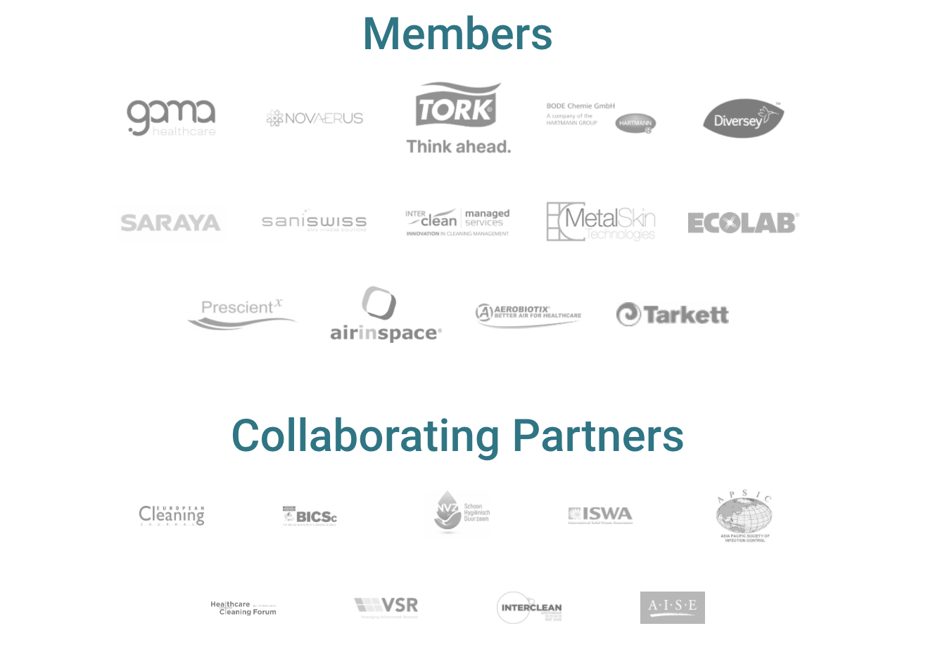

Thanks to our Clean Hospitals Members and Partners
www.CleanHospitals.com

Slide 48

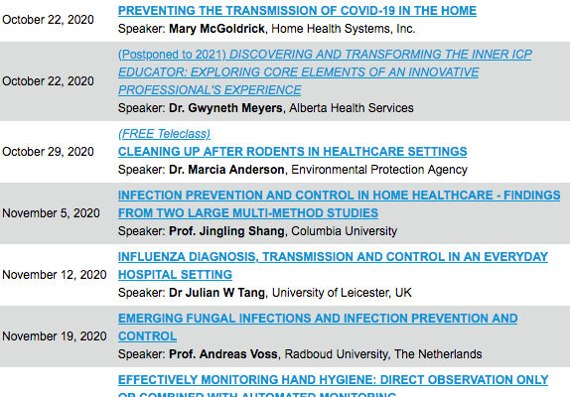

Slide 49


