Slide 1
AHEAD: Behavioral science framework for infection prevention
Prof. Dr. med. Hugo Sax
Dr. phil. Lauren Clack
University Hospital Zürich, Switzerland
Hosted by Martin Kiernan
martin@webbertraining.com
www.webbertraining.com
August 13, 2020

Slide 2



About us

Slide 3

Healthcare associated infections
35-55 % are preventable
Schreiber PW, Sax H, Wolfensberger A, Clack L, Kuster SP. The preventable proportion of healthcare-associated infections 2005–2016: Systematic review and meta-analysis. Infection Control & Hospital Epidemiology. 2018 Nov;39(11):1277-95.

Slide 4
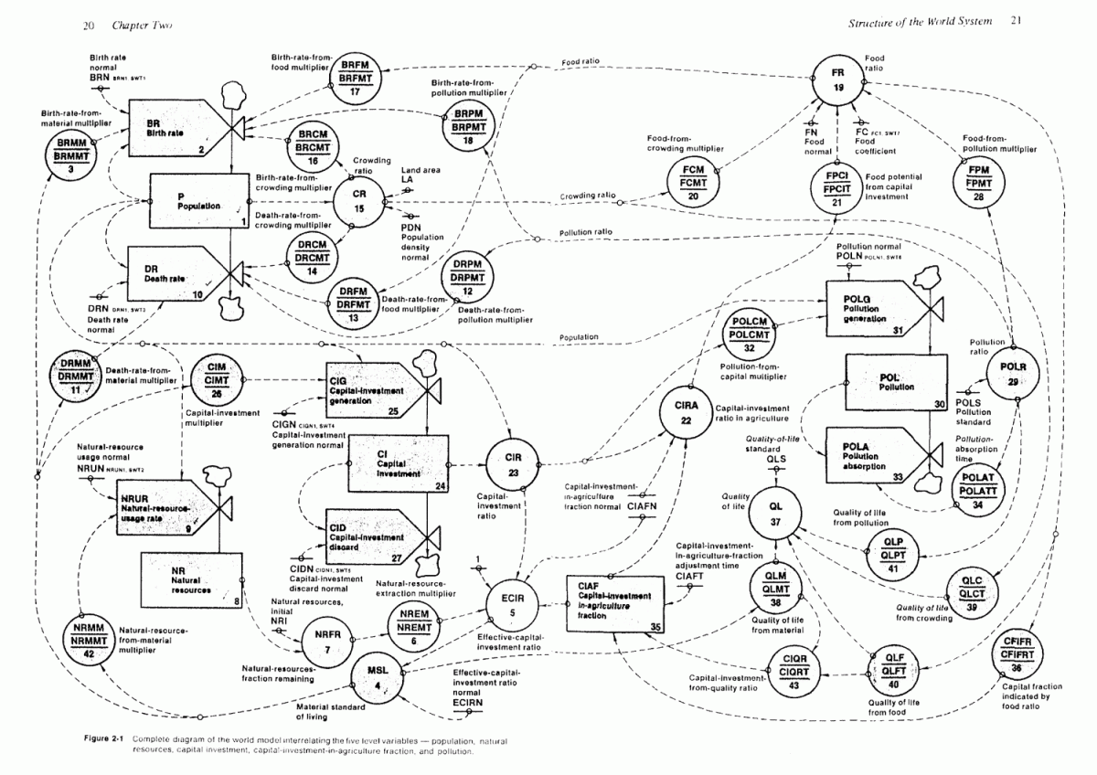
Complex systems dynamics
Forrester JW. World dynamics. Wright-Allen Press; 1971.

Slide 5
Human factors engineering
Human factors engineering is the scientific discipline concerned with the understanding of interactions among humans and other elements of a system, and the profession that applies theory, principles, data and methods to design in order to optimize human well-being and overall system performance.
- International Ergonomics Association (https://www.iea.cc)

Slide 6
Infection Risk Moments (IRM)

Slide 7
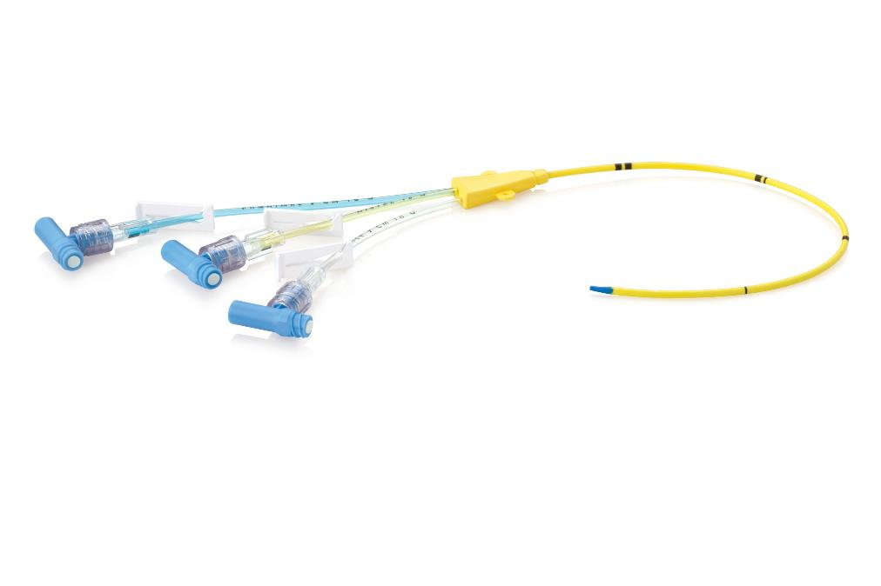
Infection prevention
High risk!

Slide 8

Also infection prevention
Low risk?

Slide 9
Defining «Risk»
likelihood x frequency = overall RISK
( infections per moment)
(moments per unit time)
( infections per unit time)

Slide 10

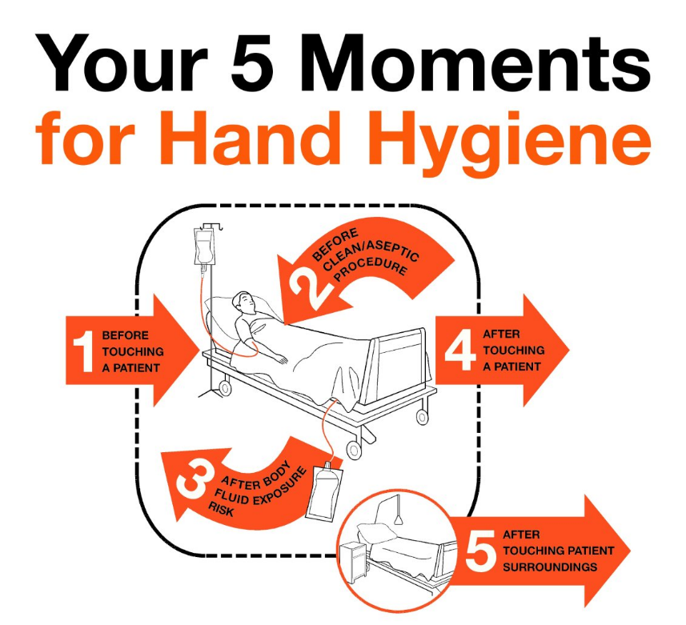





Hand hygiene

Slide 11
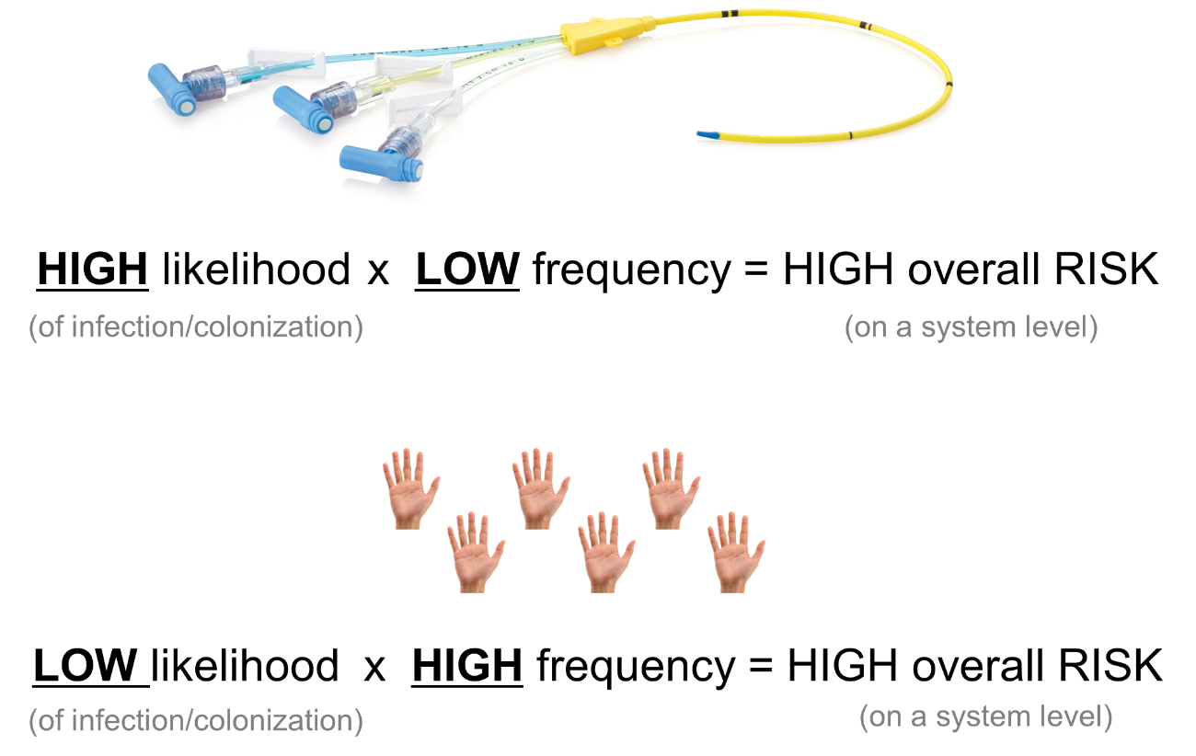
Risk

Slide 12
Limitations to current infection prevention approaches
Rule-based approach based on compliance with existing guidelines:
  Does not cover all potential risk behaviours
  Does not consider many “low likelihood” events
Under-utilisation of behavioural theory:
  Compliance remains low
  Over-reliance on education and guideline dissemination
  Fail to consider factors that influence behaviour before designing interventions

Slide 13
Behavioural Science Paradigm for infection prevention
Step 1)
Identify and define behaviours that need to change
Part 1: Which healthcare provider behaviours are relevant for transmission of pathogens?
Step 2)
Identify the barriers and enablers that should be addressed
Part 2: What are the factors that influence risk behaviours?
Step 3)
Based on evidence and theory, identify possible intervention solutions

Slide 14
Part 1: Identifying infectious risk behaviours

Slide 15
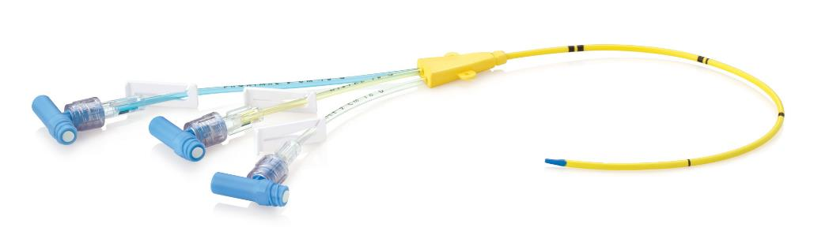

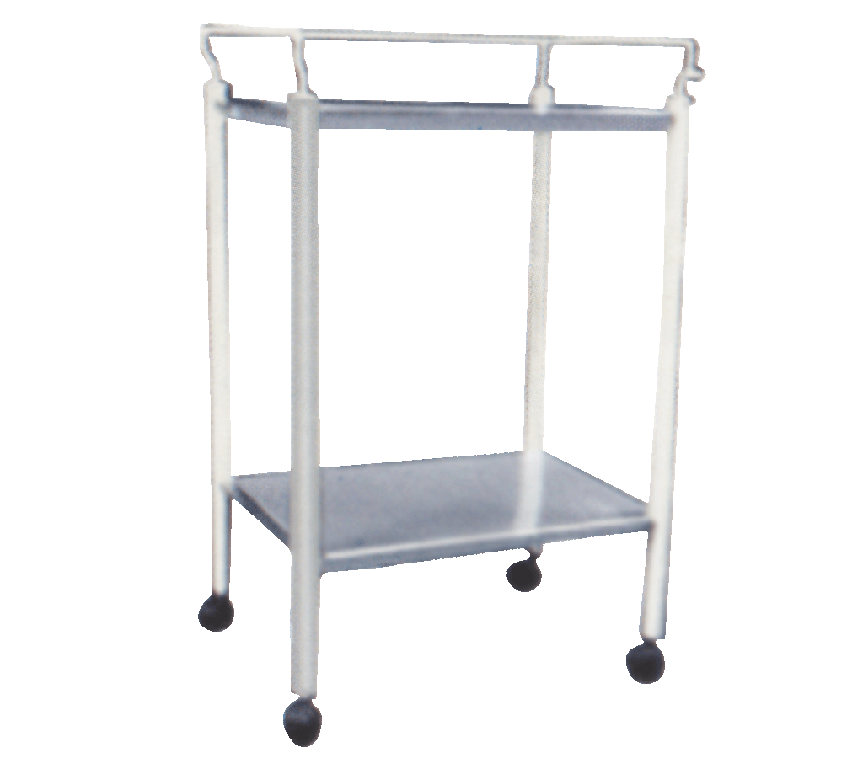
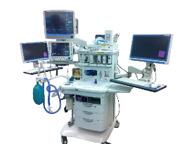


In addition to…
HIGH Likelihood X LOW Frequency
We also look at…
LOW likelihood X HIGH frequency

Slide 16


Infectious risk moments (IRM)
And beyond!

Slide 17
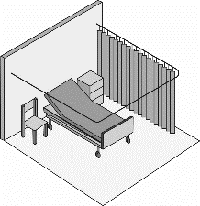












Infectious risk moments (IRM)– refining the concept
IRM Definition: seemingly innocuous, yet frequently occurring care manipulations potentially resulting in transfer of microorganisms to patients
Method: Exploratory observations
130 hours exploratory observations
Established INFORM (Infectious Risk Moment Classification Taxonomy)
Source
Vector
Endpoint
Non-critical sites
Critical sites
Clack, L., Schmutz, J., Manser, T., & Sax, H. (2014). Infectious risk moments: a novel, human factors-informed approach to infection prevention. Infect Control Hosp Epidemiol, 35(8), 1051-1055. doi:10.1086/677166
Clack, L., Passerini, S., Wolfensberger, A., Sax, H., & Manser, T. (2018). Frequency and Nature of Infectious Risk Moments During Acute Care Based on the INFORM Structured Classification Taxonomy. Infect Control Hosp Epidemiol, 39(3), 272-279.

Slide 18
INFORM - Infectious Risk Moment Classification Taxonomy
Clack, L., Passerini, S., Wolfensberger, A., Sax, H., & Manser, T. (2018). Frequency and Nature of Infectious Risk Moments During Acute Care Based on the INFORM Structured Classification Taxonomy. Infect Control Hosp Epidemiol, 39(3), 272-279.

Slide 19

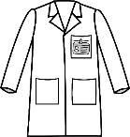
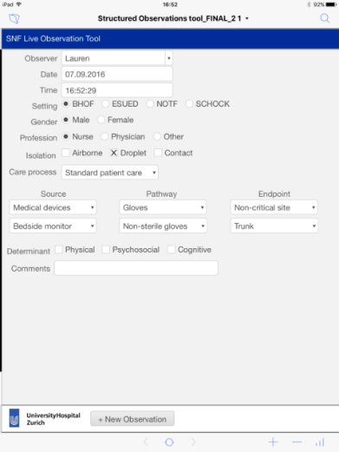




Infectious risk moments (IRM)
Method: Structured direct observations
53.77 observation hours (31.25 active care hours)
1’338 infectious risk moments (every 1.4 minutes)
25.8% concerned transfer to critical sites (higher risk!)
Comprehensive IRM inventory established
44.5%
34.2%
8.6%
7.6%
4%
1.1%
Clack, L., Passerini, S., Wolfensberger, A., Sax, H., & Manser, T. (2018). Frequency and Nature of Infectious Risk Moments During Acute Care Based on the INFORM Structured Classification Taxonomy. Infect Control Hosp Epidemiol, 39(3), 272-279.

Slide 20

Hand-to-surface exposures (HSE)
HSE definition: contact resulting in bi-directional exchange of microorganisms between hand and the touched surface
Method: Indirect observations of HSE using head-camera
Filmed and coded 300 minutes of care (8 nurses, 2 physicians) in ICU
4,222 hand-to-surface exposures (1 HSE every 4.2 seconds)
291 transitions from outside to inside the “patient zone”
      Microorganisms potentially transmitted via hands
      from outside to inside the patient’s direct
      environment once every 1.01 minutes
Clack, L.*, Scotoni, M.*, Wolfensberger, A., & Sax, H. (2017). "First-person view" of pathogen transmission and hand hygiene - use of a new head-mounted video capture and coding tool. Antimicrob Resist Infect Control, 6, 108
Photo: https://www.sealswatersports.com/snorkeling/gopro-headstrap-mount

Slide 21
Part 1 – Summary of Results
Study question: Which healthcare provider behaviours are relevant for transmission of pathogens?
Infectious Risk Moments (IRM)
Occur every 1.4 minutes
Involved the following vectors:
      hands
      gloves
      medical devices
      mobile objects
      invasive devices
      healthcare provider clothing and accessories
Hand-to-surface exposures (HSE)
1 HSE every 4.2 seconds
Colonising HSE occur every 1.01 minutes
The patient’s direct surroundings are likely contaminated with foreign microorganisms

Slide 22
Part 2: Understanding the factors that influence infectious risk behaviours

Slide 23
Part 2 – Three Methods
Study question: What are the factors that influence risk behaviours?
Method one: Concept mapping
    Card-sorting activity to reveal mental models
Method two: Video-reflexive ethnography
    Filming active patient care
    Reviewing care-film during a reflexive interview
Method three: Systematic Literature Review
    Reviewed published literature to identify barriers and enablers with established infection prevention guidelines

Slide 24
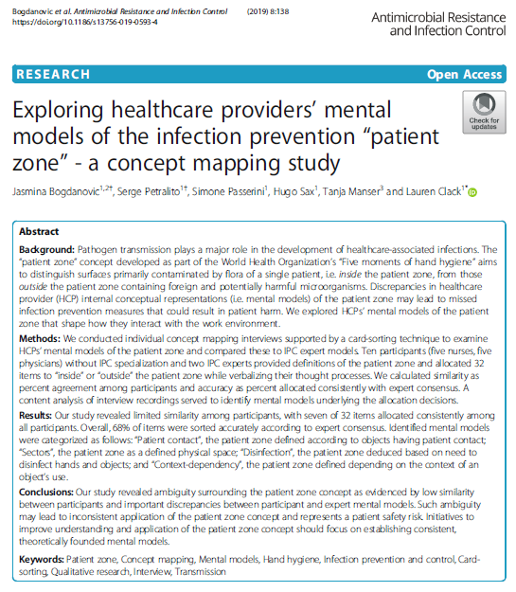
Concept mapping
Bogdanovic J, Petralito S, Passerini S, Sax H, Manser T, Clack L. Exploring healthcare providers’ mental models of the infection prevention “patient zone”-a concept mapping study. Antimicrobial Resistance & Infection Control. 2019 Dec 1;8(1):138.

Slide 25


Video reflexive ethnography - methods
Data collection: video-reflexive ethnography
      10’ active patient care filming
      30’ reflexive interview
    Guiding frameworks
      Consolidated Framework for Implementation Research (CFIR)
      Theoretical Domains Framework (TDF)
        incorporates constructs from 138 theories into 12 theoretical domains
Analysis
      Reflexive interviews recorded and transcribed verbatim
      Interviews coded deductively using TDF as coding framework
      Inductive thematic analysis to identify emerging themes

Slide 26

Video reflexive ethnography - results
    40 reflexive interviews (5 nurses and 5 physicians each, from four care settings)
    2’431 Utterances coded according to TDF
    TDF Domains of greatest relevant importance:
      Environmental context and resources
      Knowledge
      Beliefs about consequences

Slide 27
Video reflexive ethnography – results
Domain: Environmental context and resources
Theme 1: Lack of space
Barrier: Lack of space, and narrow work result in unintentional contact with people and surfaces
Theme 2: Availability and placement of materials
Facilitator: Convenient placement of materials (e.g. handrub, glove dispensers)
Barrier: lack of – or inconvenient placement of materials
Theme 3: Lack of time
Barrier: insufficient time to adhere to infection prevention
“You try to disinfect your hands but of course, it is always the time factor. It is additional work you have to carry out.” (Nurse, intensive care)

Slide 28
Video reflexive ethnography – results
Domain: Knowledge
Theme 1: Knowledge of rules and guidelines
“I do not know exactly when to wear gloves and when not. I mean, I know it is for every patient contact. But what does ‘ for every patient contact’ really mean? When do I have to change them?” (Physician, Trauma ward)
Theme 2: Knowledge/Awareness of contamination status
Barrier: lack of shared knowledge about what items are clean vs. dirty
Theme 3: Knowledge of evidence underlying guidelines
Barrier: perceived lack of evidence, or lack of knowledge about evidence
Facilitator: knowledge of evidence supporting guidelines

Slide 29
Video reflexive ethnography – results
Domain: Beliefs about consequences
Theme 1: Beliefs about patient consequences based on empiric observation
“Not really, to be honest, from all risks of germs […] these things are a bit overrated. It is more likely, that the patient catches something another way, gets the infection. Especially, a wound infection – I have never seen a wound infection in a patient at least not in our department, that came from the outside.” (Physician, Medical ward)
Theme 2: Belief in efficacy of preventative measure
Belief or disbelief in efficacy of measure to prevent infection
Theme 3: Self protection
Facilitator: when infection prevention behaviour aligned with self-protection measures, else barrier

Slide 30
Summary of part 2 results
Study question: What are the factors that influence risk behaviours?
Video-reflexive ethnography |  |  | Systematic Literature Review
Domain | Frequency | Themes | Domain | Frequency | Themes
11. Environmental Context and Resources | 416 | 7 | 11. Environmental Context and Resources | 61 | 16
1. Knowledge | 276 | 5 | 12. Social influences | 48 | 13
15. Nature of the behaviours | 244 | 5 | 1. Knowledge | 31 | 7
6. Beliefs about Consequences | 243 | 6 | 10. Memory, Attention and Decision Processes | 30 | 11
10. Memory, Attention and decision Processes | 154 | 6 | 3. Social/Professional Role and Identity | 29 | 12
12. Social influences | 99 | 6 | 6. Beliefs about Consequences | 25 | 8
Legend: domains that did not emerge as highly important in both studies are listed in grey.

Slide 31
Summary and implications

Slide 32
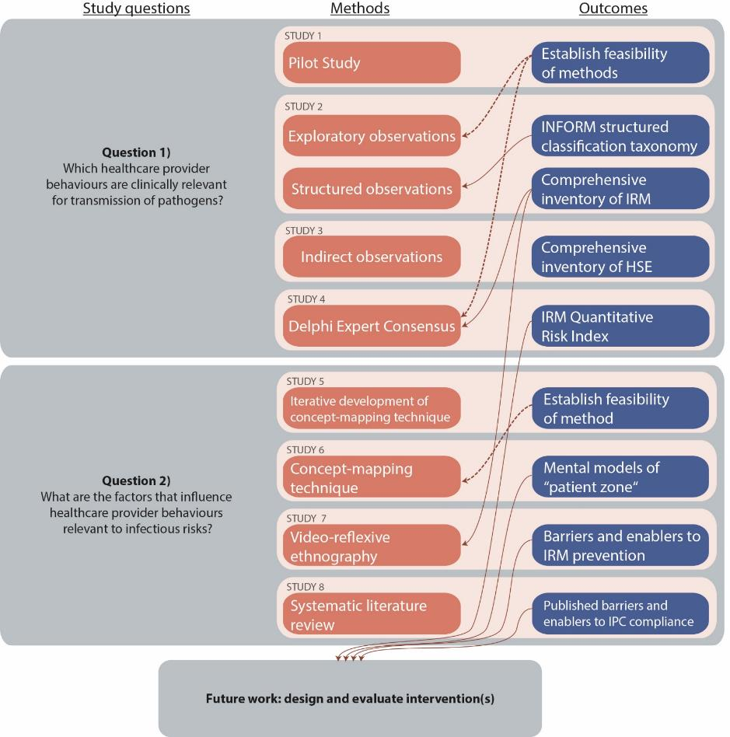

Slide 33
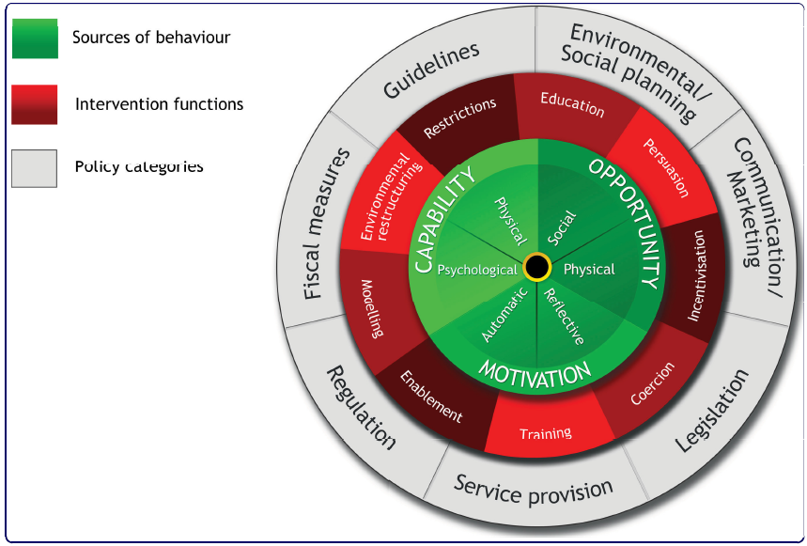
Intervention design
Mapping identified barriers and facilitators to intervention functions
Michie, S., van Stralen, M. M., & West, R. (2011). The behaviour change wheel: a new method for characterising and designing behaviour change interventions. Implement Sci, 6, 42. doi:10.1186/1748-5908-6-42

Slide 34
Intervention design
TDF Domain | Intervention functions
Environmental Context and Resources | Training Restriction Environmental restructuring Enablement
Knowledge | Education
Beliefs about Consequences | Education Persuasion Modelling

Slide 35
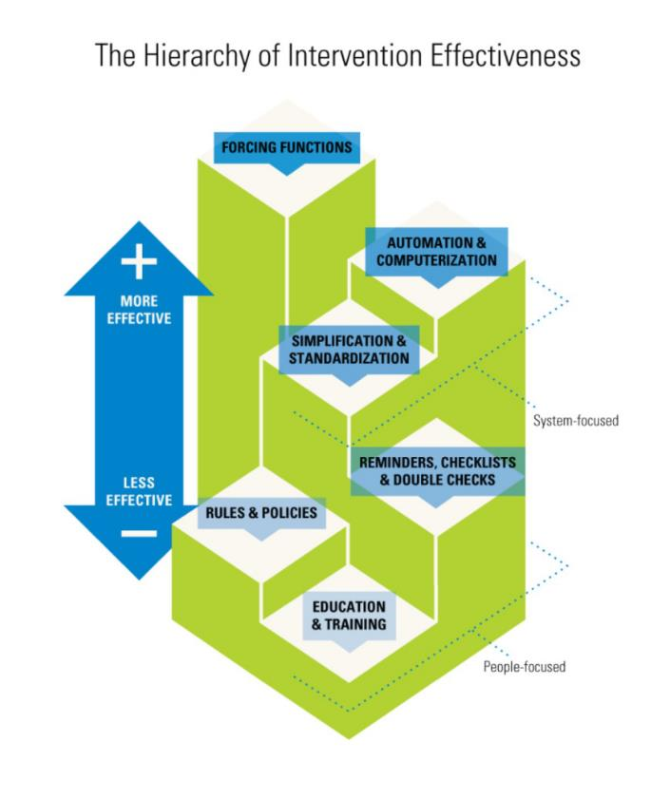
Hierarchy of intervention effectiveness
Cafazzo, J., & St-Cyr, O. (2012). From Discovery to Design: The Evolution of Human Factors in Healthcare. Healthcare Quarterly, 15, 24-29.

Slide 36
Conclusions
Part 1: Identifying infectious risk behaviours
Several low/medium-risk, high frequency behaviours identified
These include, but go beyond existing indications for hand hygiene
Part 2: Understanding behavioural determinants
Environmental context and factors beyond individual knowledge appear to be important influencers of behaviour
Social influences of
Part 3: Intervention design
INFORM observational taxonomy to identify most relevant local risks
Interventions should be designed with consideration of barriers and facilitators
Prioritise “theoretically coherent” intervention functions
      Environmental restructuring
Step 1)
Identify and define behaviours that need to change
Step 2)
Identify the barriers and enablers that should be addressed
Step 3)
Based on evidence and theory, identify possible intervention solutions

Slide 37
Thank you for your attention!

Slide 38

Acknowledgements
University Hospital Zürich
Simone Passerini
Jasmina Bogdanovic
Team Spitalhygiene
University of Zurich
Prof Urte Scholz
University of Applied Sciences North-western Switzerland
Prof Tanja Manser
ETHZ
Dr Jan Schmutz
University College London
Dr Fabiana Lorencatto
Prof Susan Michie

Slide 39

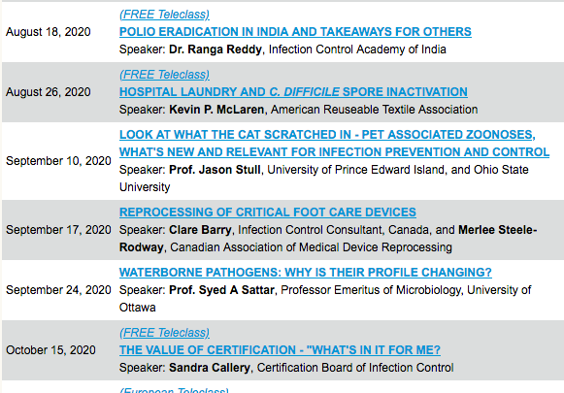

Slide 40


