Slide 1
Climate Change and Infectious Diseases
Mark Birch
Depts Infectious Diseases and General Medicine
Canterbury District Health Board, New Zealand
Hosted by Jane Barnett
jane@webbertraining.com
www.webbertraining.com
March 14, 2018

Slide 2
Overview
Overview of Climate Change
Green house gases
Mosquitoes
Diseases (malaria, dengue fever, zika, chikungunya)
NZ impact
US impact

Slide 3
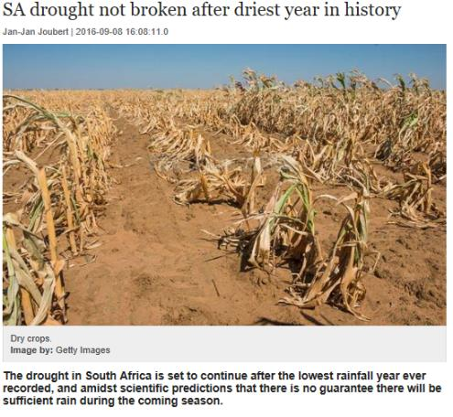
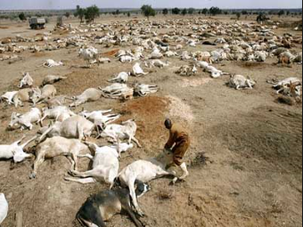
2016: The hottest year

Slide 4
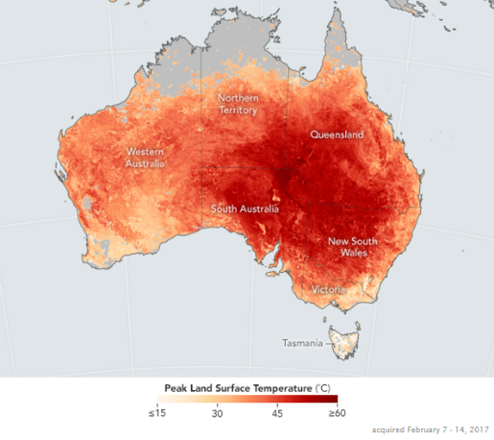
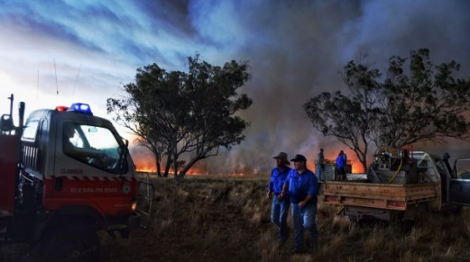
21 Feb 2017: Australia

Slide 5
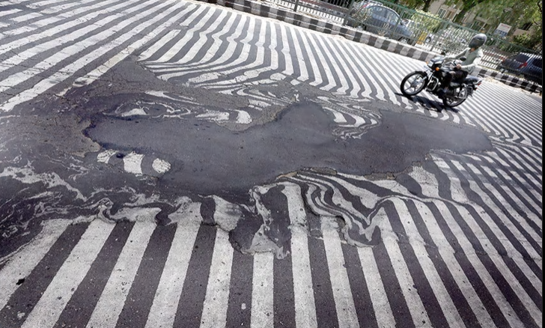
India's extreme heat wave. Asphalt melting in New Delhi. 1,400 deaths

Slide 6
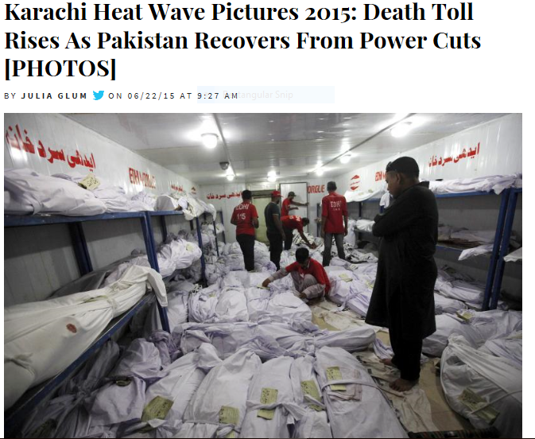

Slide 7
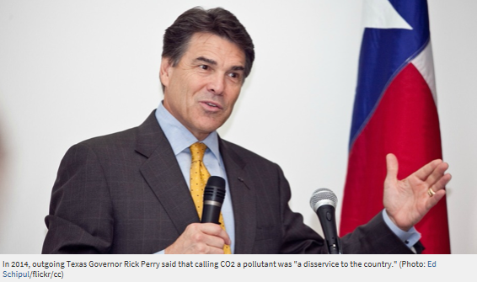


Slide 8
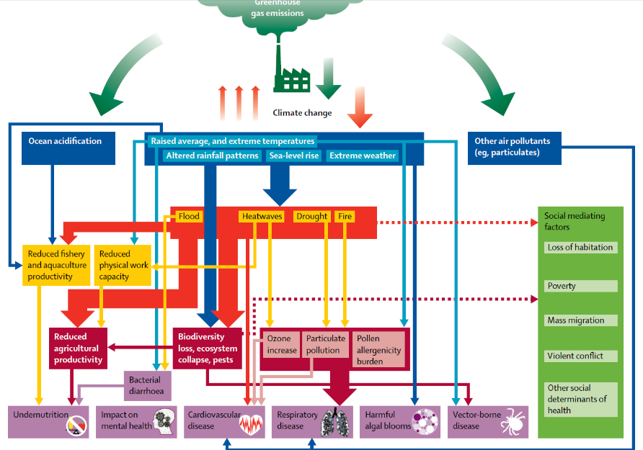

Slide 9
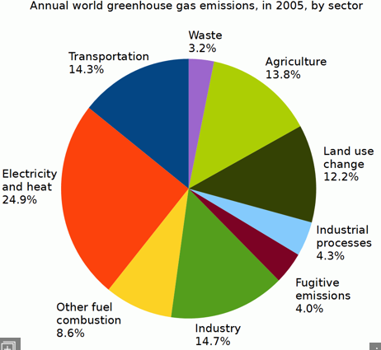
Greenhouse gases
Carbon dioxide (lasts thousands of yrs!)
Oxides of nitrogen
Methane
Chlorinated hydrocarbons (CFCs)
Fossil fuels (oil, coal, natural gas)
  Energy generation accounts for approx. 25% GHGs
Destruction of forests (15-20%), agriculture, industry and transportation

Slide 10
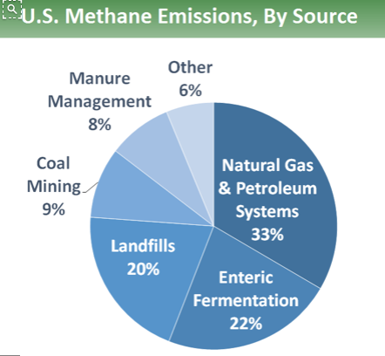
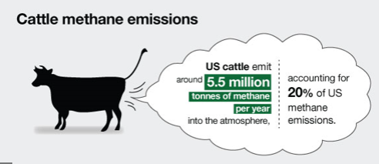
Methane

Slide 11
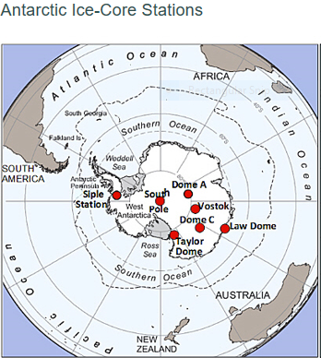
CO2 levels
Last 420,000 years = 180-280 ppm in troposphere
  Vostok ice core Antarctica
  Measure of 400,000 years
Now: 360 ppm!!

Slide 12
Weather Extremes
Warming of land surface intensifies monsoons
  Assoc with mossie and water borne diseases in Bangladesh and India
Flooding
  Increases in mossie breeding sites
  Water borne diseases eg cryptosporidium
  Increase in algal blooms (bad for birds, fish and mammals)

Slide 13
The Costs of Climate Change
Present day
  $1.2 trillion/year
  1.6% global GDP
By 2030
  3.2% global GDP
  Poorest countries = 11% GDP

Slide 14
Estimated deaths
Between 2030-2050: increased 250,000 deaths/yr
Malnutrition, malaria, diarrhea, heat stress
Low – middle income countries most affected
  Food and water insecurity
  Population displacement
  Increased diseases-vector borne, diarrheal, respiratory

Slide 15
Climate in Numbers
1.1°C global warming
2.0°C maximum warming Paris Climate Deal (Dec 2015)
2020 when annual emissions must peak for us to hit only 2°C
3.6°C likely warming on current government pledges

Slide 16
New Diseases since 1975
WHO reports > 30 new diseases
HIV
Ebola
Lyme disease
Legionnaires disease
Toxic E coli
Hanta virus

Slide 17
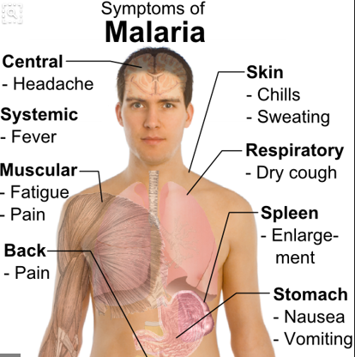
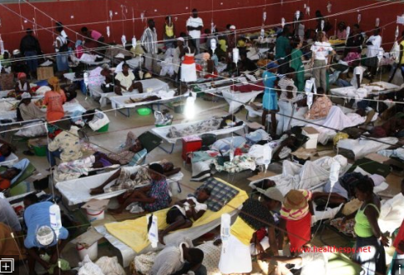
Resurgence of old diseases
Malaria
Cholera

Slide 18
Mosquito Borne Diseases
Protozoa eg malaria
Viral eg dengue, chikungunya, zika, yellow fever
Nematode eg filariasis

Slide 19
Malaria and climate change
Warmer temps increase mossie reproduction and biting
Anopheles survives in temps > 16°C
Increase rate of pathogen maturation
  20°C: Falciparum takes 26 days to incubate
  25°C: takes 13 days
Anopheles survive for approx. 3 weeks -> parasites mature quicker, transferred to host

Slide 20
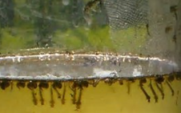
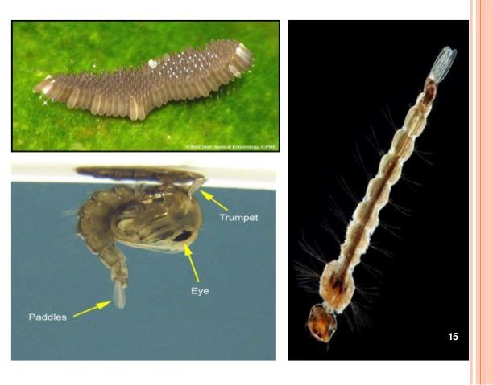
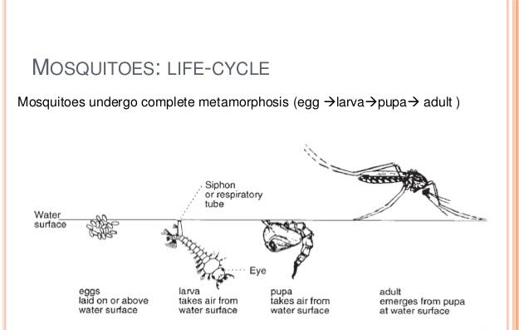
Mosquito life cycle

Slide 21
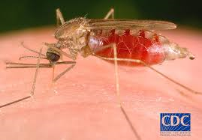
Anophelene mosquito

Slide 22
Spread of Anopheles
Anopheles in N America
1980s: transmission only in California
1990s: new outbreaks in Texas, Florida, New York, Toronto
Anopheles elsewhere causing malaria
  S Korea, southern Europe, S Africa
  Highland urban areas eg Nairobi
  Rural highland areas eg PNG
Not in NZ….yet!

Slide 23
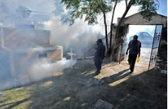
Impact of malaria
Today: 50% world’s population exposed
Impact of doubling of CO2: 60% exposed
Other factors
  Land clearing
  Population movement
  Drug and pesticide resistance

Slide 24
Dengue Fever and Yellow fever
Aedes aegypti survives > 10°C
Freezing kills
Warmer winters and warmer nights -> greater survival
Aedes limited by temp to 1,000m in elevation
Now found at 1,100m in Mexico and 2,200m in Colombian Andes

Slide 25
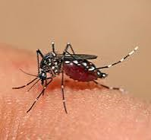
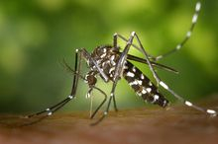
Aedes aegypti and albopictus

Slide 26
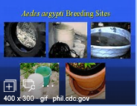
Aedes mosquitoes
Eggs withstand dessication (drying) for months
Very difficult to eradicate
Survive without water for several months
Hatch once exposed to water-rainfall in wet season
Humans provide great breeding sites
A aegypti in Australia
A albopictus-Australia free….but has been detected at airports, ie Sydney!!
Aedes not in NZ…yet

Slide 27
Dengue Fever
Most common arthropod borne viral diseases worldwide
Endemic in > 100 countries
  Africa, eastern Mediterranean, Americas, Asia, western Pacific, northern Australia
Main vectors Aedes widely spread in Asia and Pacific
In last 50 years estimated 30 fold increase in DF cases!
100 million clinically apparent cases/ year
Mortality 25,000/year

Slide 28
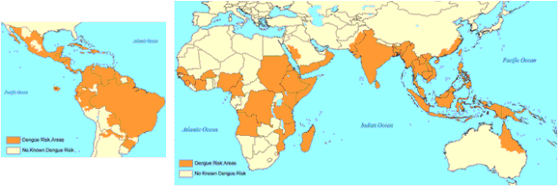
Dengue Fever Distribution

Slide 29
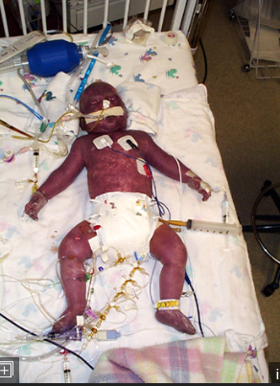
Dengue haemorrhagic fever
Epidemics DHF
Causes deaths, usually kids
Supportive care
Epidemics of DF in Pacific in 1970s, assoc with epidemics of DHF

Slide 30
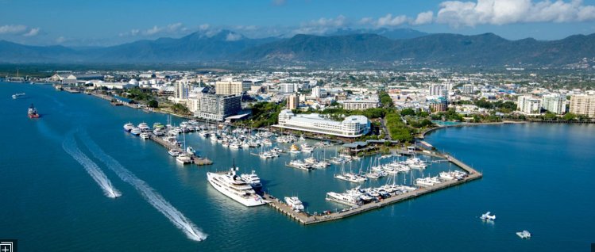


Slide 31
Dengue in northern Queensland
Outbreaks in Townsville and above since 1990s
Some deaths
Research into prevention of dengue
  Vaccination trials
  Infecting mosquitoes with Wolbachia bacteria

Slide 32
Zika Virus: Re-emerging Disease
1st picked up during Dengue surveillance in Uganda 1947
Later spread to India and SE Asia
Subsequent outbreaks
  Yap Is (Pacific) 2007
  French Polynesia 2013
  Brazil 2015

Slide 33
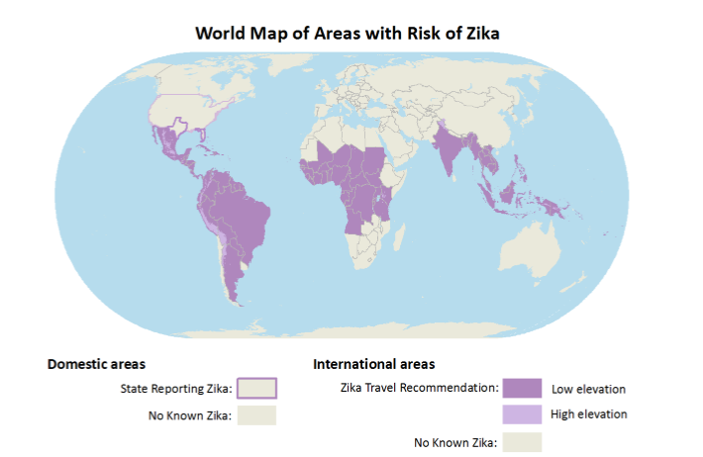

Slide 34
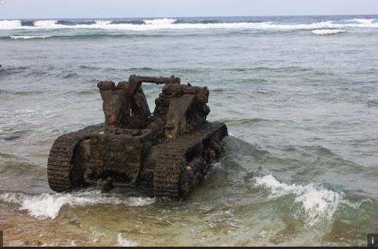
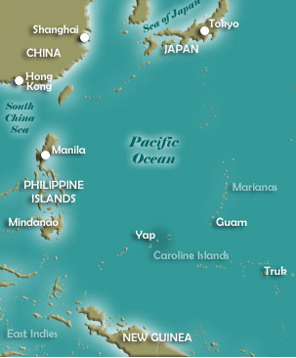
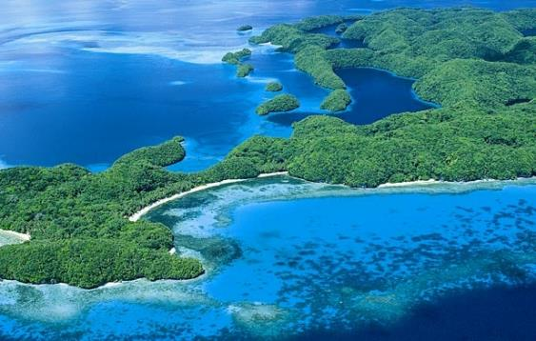
Yap Is

Slide 35
Zika transmission
Via Aedes mosquitoes
Modes of transmission
  Sex, even if asymptomatic at time-virus persists in semen for months
  Blood transfusion (Brazil)
  To fetus in pregnancy
Not transmitted via breast feeding
Australia 2016: approx. 100 cases
New Zealand: reported person to person/sexual transmission

Slide 36
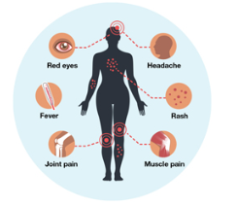
Symptoms
Usually mild illness
¾ cases asymptomatic
Several days to a week
Viraemia for 1 week
Similar symptoms to dengue and chikungunya

Slide 37
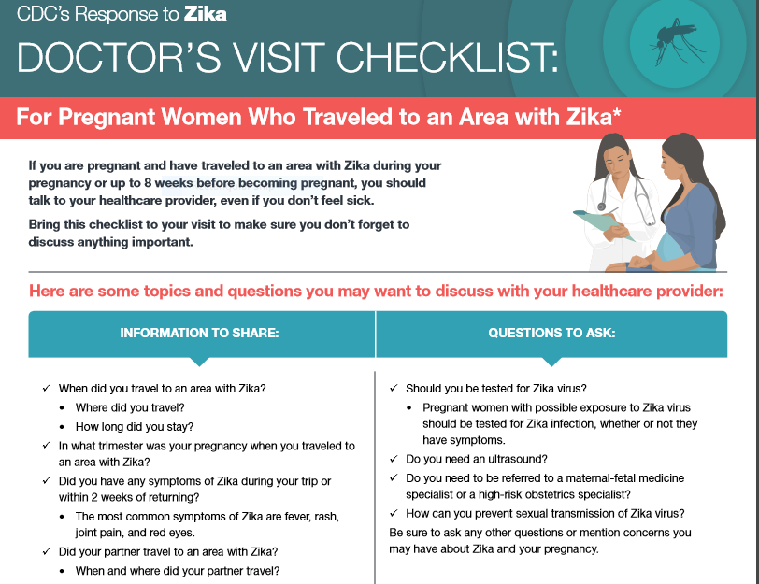

Slide 38
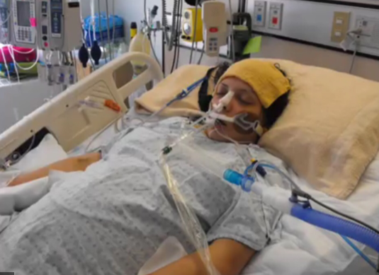
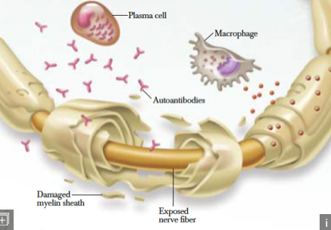
Complications of Zika
Guillain-Barre syndrome
Congenital Zika Syndrome

Slide 39
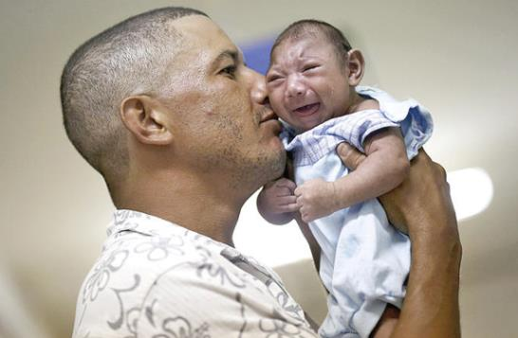
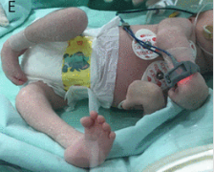
Congenital Zika
Microcephaly
Virus crosses blood brain barrier during 1st trimester
Decreases normal replication of neurons and astroglial cells
Small no. get abnormal limb development (arthrogryposis)

Slide 40
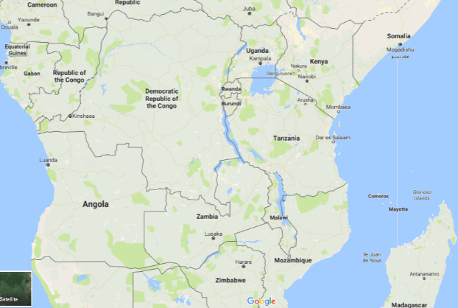
Chikungunya: Re-emerging disease
1952- 1st identified virus
Outbreaks in southern Tanzania, Makonde plateau
Derived from Makonde or Swahili word = “that which bends up”

Slide 41
Chikungunya: Re-emerging disease
Virus, circulates between mosquitoes and non-human primates
Aedes aegypti and albopictus
Thought to have originated in Africa
1954: 1st reported in Philippines
Before 2000: occasional outbreaks in Africa
Since 2000: increasing outbreaks
Spread to Asia via shipping

Slide 42
Subsequent Outbreaks
2004: epidemic in Kenya
2005-2006: outbreak in India
Oct 2013: in Saint Martin Island (Asian genotype)
Then transmission throughout Caribbean
Since Aug 2016: spread to Americas
  > 1 million suspected cases

Slide 43
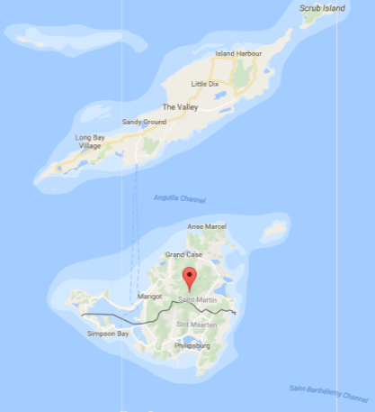
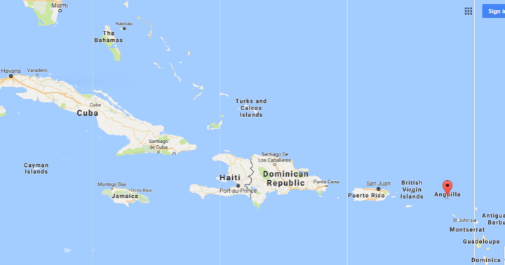
St Martin Is and Caribbean

Slide 44
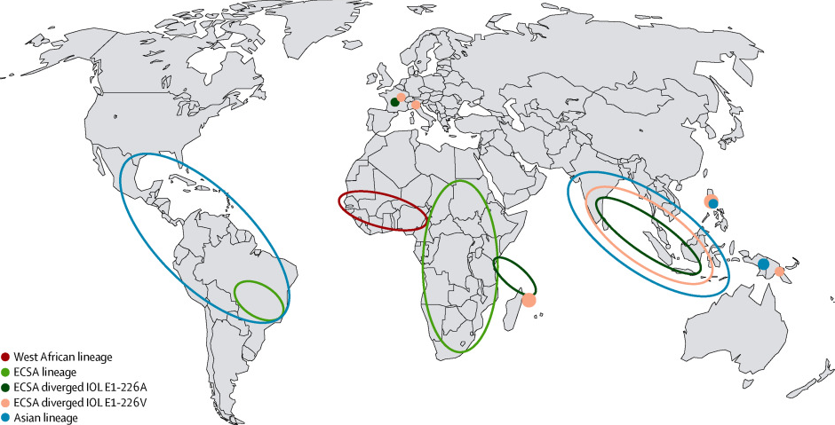
Chikungunya Distribution

Slide 45
Symptoms
Usually self limiting 7-10 days
Severe joint pain/swelling-any joints, especially small joints
Myalgias
Fever
Rash (up to 90%)
Some get prolonged disability-joint sympts for 3 years!

Slide 46
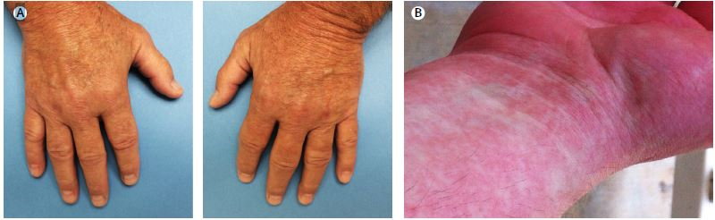
Arthritis and rash

Slide 47
Complications
Outbreaks in last 15 years seem to be associated with more severe disease
Myocarditis
Fulminant hepatitis
Encephalitis-seizures and paralysis
Fetal transmission
  Baby gets encephalopathy
  Microcephaly
  Cerebral palsy
Deaths < 1/1000

Slide 48
Treatment
Supportive care
No specific treatment
No vaccine

Slide 49
Guidelines for Travellers
Cover up
Insect repellents-containing DEET, picaridin, oil of lemon eucalyptus (OLE), and others
  Safe if pregnant
  Most can use on kids > 2 months old
  OLE Not kids < 3 years old
  Take enough for trip!
Permethrin treated clothing and gear
Mosquito net (espec if outdoors)
Screened rooms or air conditioning if possible

Slide 50
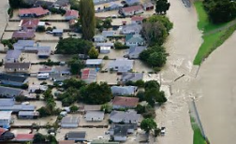
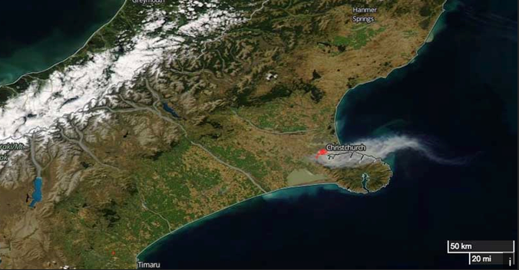
New Zealand Impact?
Increased extreme weather events
June 2015: flooding south Dunedin
2017: Edgecumbe floods
2017: Christchurch fires

Slide 51
NZ Impact: extreme temperatures
Above 25°C for 20-40 days/year
2100: With warming predicted to increase to 80 days
Heat related death rate when Temp > 20°C = 14 (ages over 65 yrs)
Predicted death rate with increase by 1°C = 28

Slide 52
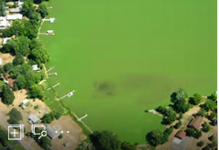
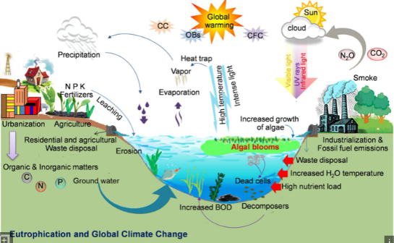
NZ Impact: Marine
Increased algal blooms (cyanobacteria)
Toxins
Effect on human health-contact or ingestion
Effect on commercial fishing and marine habitat
1998: warm water, algal blooms along east coast

Slide 53
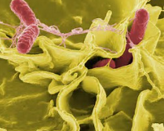
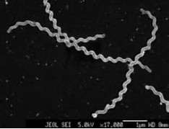
NZ Impact: Fresh Water
Microbial contamination
Salmonella and E coli in streams
Leptospirosis
Norovirus
Contamination of groundwater wells
Aug 2016: Campylobacter outbreak Havelock North

Slide 54
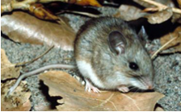
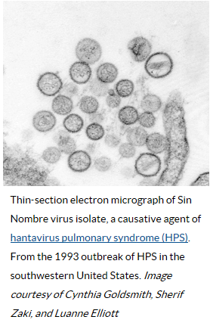
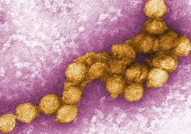

Emergence of new diseases in North America
Hanta virus
West Nile Virus

Slide 55
Hanta Pulmonary Syndrome (HPS)
1987-1992: prolonged drought in California and US southwest
Decreased predators (owls, eagles, falcons, hawks etc), coyotes, snakes
Increased rodent population
1993: intense rains-increase food for rodents
(grasshoppers and pinon nuts)
Emergence of rodent borne HPS
Now in Latin America

Slide 56
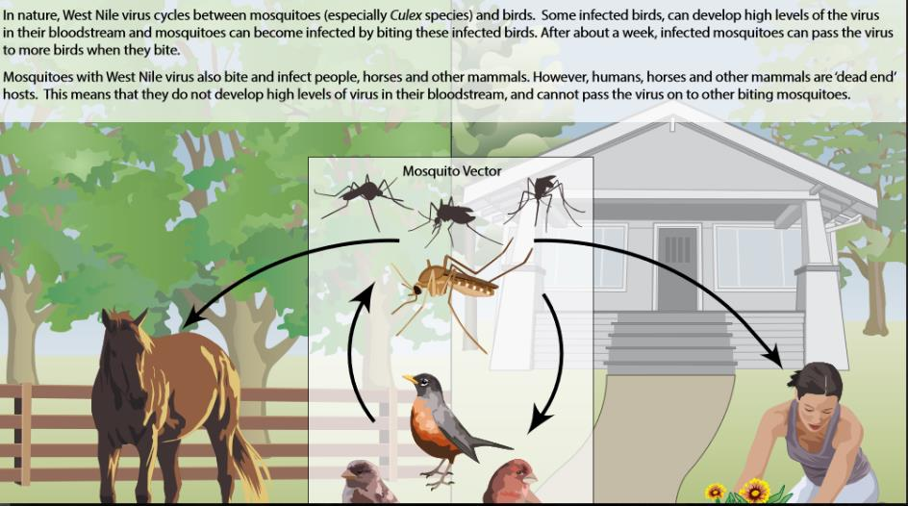
West Nile Virus (WNV) transmission

Slide 57

West Nile Virus
Sept 1999: small outbreak in New York city
Warmer winters, followed by summer drought
Increased cycling of WNV among birds, mossies-Culex pipiens (urban)
Encephalitis in humans
Mortality in birds

Slide 58
Take Home messages
Interplay between climate, environmental changes, population of humans and our impact on environment
Increasing outbreaks of serious illness across globe
  Malaria
  Arthropod borne disease-dengue, zika, chikungunya
Limited or no treatment for some illnesses
New Zealand not immune
Need to act urgently

Slide 59
References
Globalisation, Climate Change and Human Health. NEJM 2013;368(14), p1335-1343
Climate Change and Emerging Infectious Diseases. Microbes and Infection 2001, p747-754
Meeting report Climate Change and Infectious Diseases. International Journal of Medical Microbiology 302 (2012), p1-3
Chikungunya virus: an update. Lancet Infectious Diseases 2017;17:e107-17
Health and equity impacts of climate change in Aotearoa-NZ. New Zealand Med Journal 2014; vol 127, p16-23
Climate Change, health and the role of nurses. Nursing for Womens Health 2017; vol 21, p79-83

Slide 60




Slide 61


