Slide 1
Clinical Syndromes and Conditions Warranting Empiric Transmission Based Precautions
Dr. Jennifer Cole DrPH, MSN, RN, CIC, COHN-S, CENP
Hosted by paul Webber paul@webbertraining.com
www.webbertraining.com
January 27, 2022

Slide 2
Objectives:
Recognize the early signs and symptoms of potentially infectious patients when they first present
Describe when empiric transmission precautions should be utilized
Recall potential pathogens that patients could present with in your healthcare setting

Slide 3

High Risk Situations

Slide 4
3 Steps to a Safer Emergency Room
IDENTIFY- upon entry
ISOLATE - promptly
INFORM- a provider quickly

Slide 5

Communicable Diseases

Slide 6
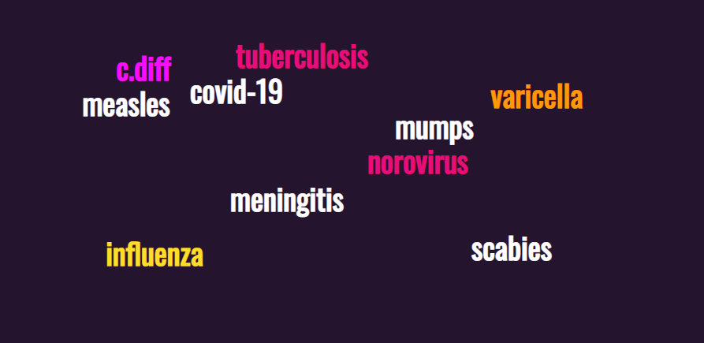
Emergency Room Exposures

Slide 7
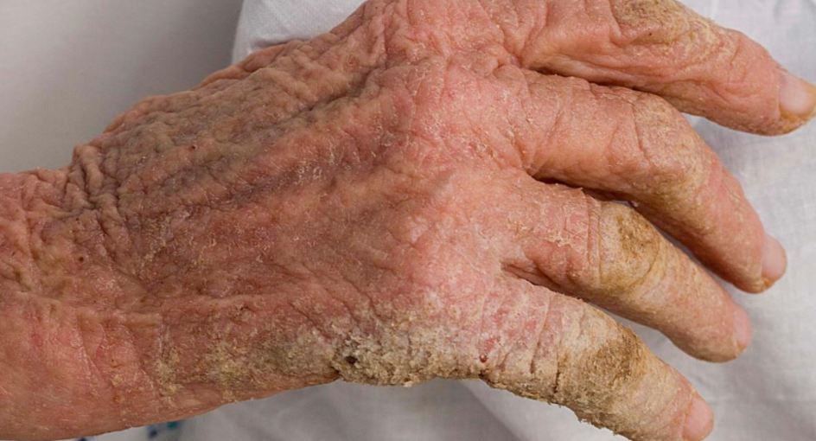
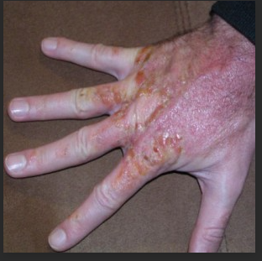
Diagnosis of Skin Conditions
Norwegian crusted scabies
versus
Psoriasis

Slide 8
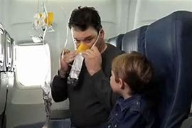

Protect Yourself First

Slide 9

Nurse Empowerment

Slide 10
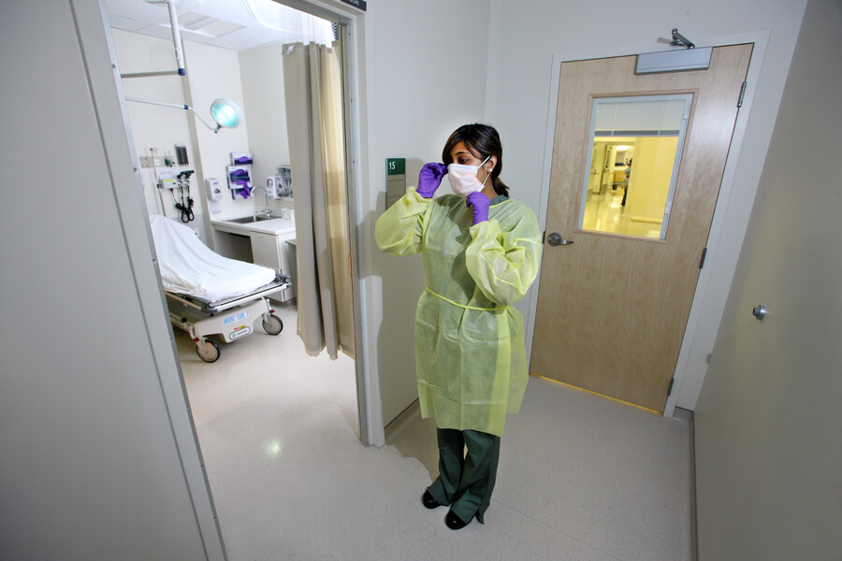
Isolation Rooms

Slide 11
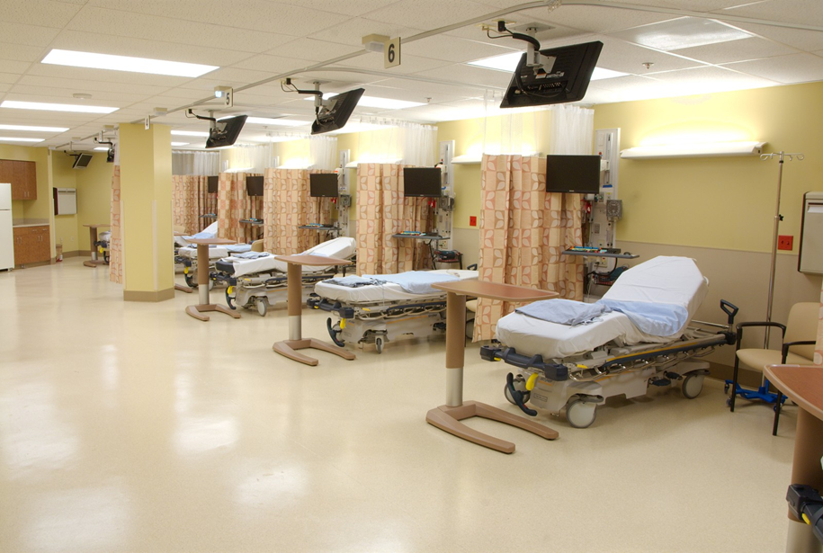
Isolation in the Emergency Room

Slide 12
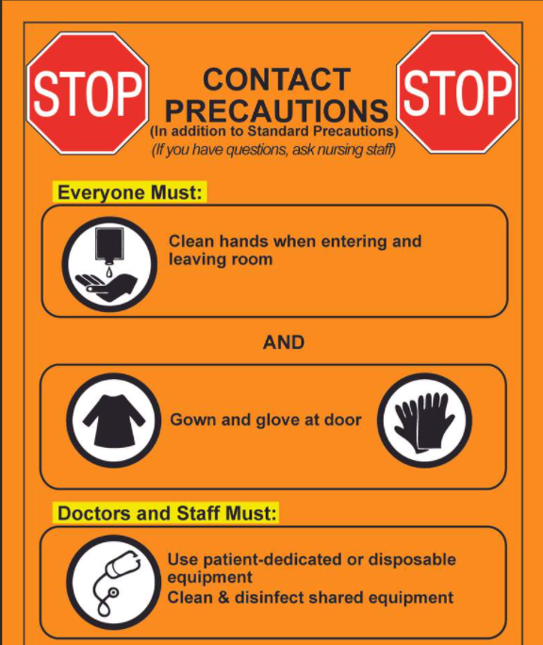
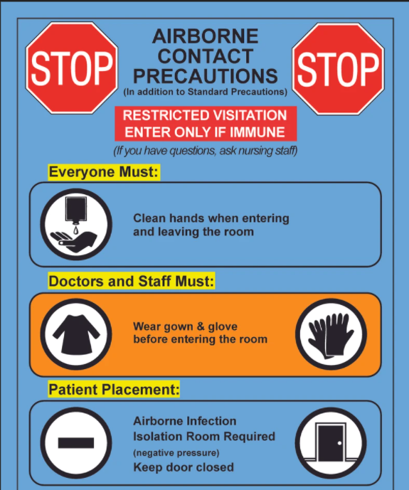
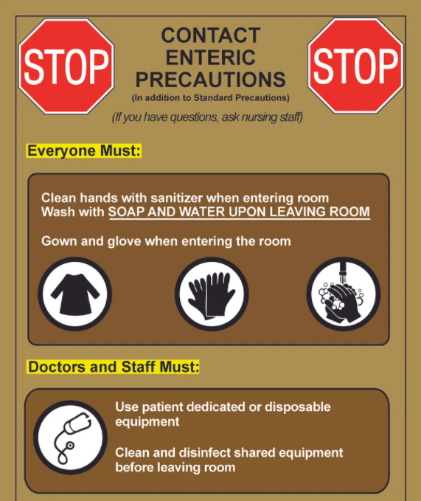
Isolation Signage

Slide 13
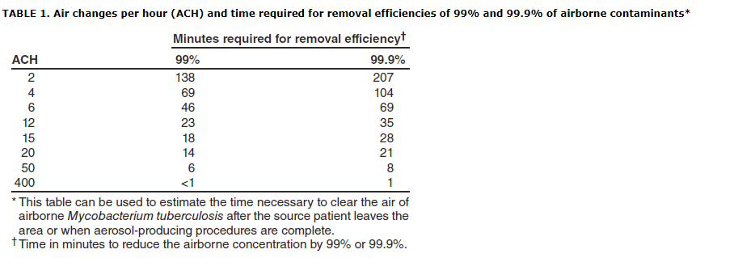
Air Exchanges

Slide 14
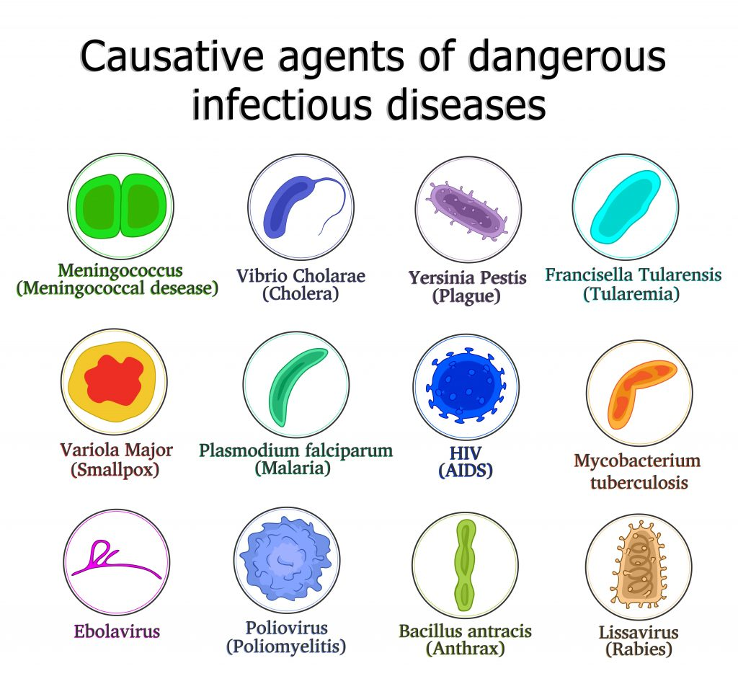
Nurse Education

Slide 15
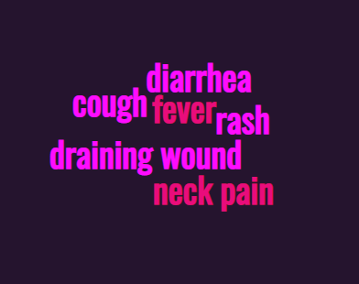
Recognize the early signs and symptoms of potentially infectious diseases

Slide 16
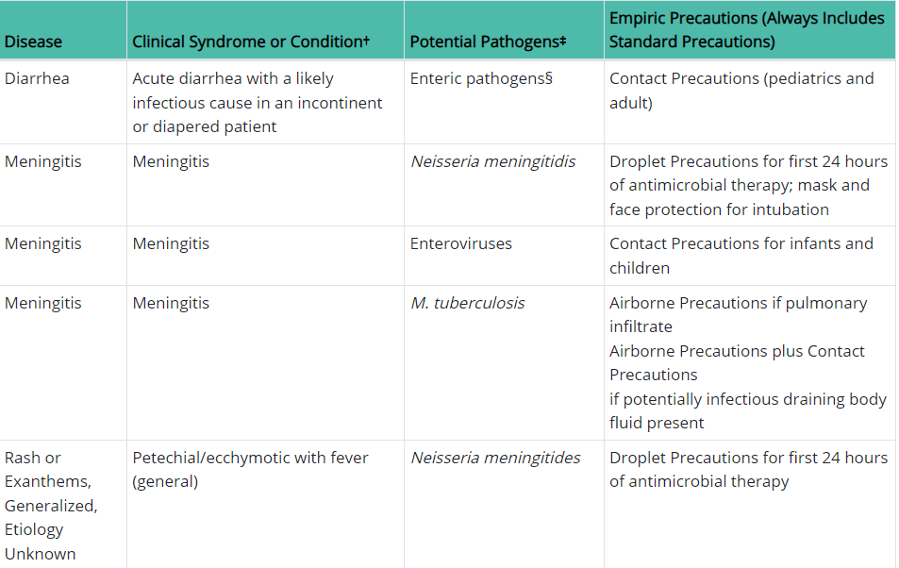
Empiric Isolation
Clinical Syndromes or Conditions Warranting Empiric Transmission-Based Precautions in Addition to Standard Precautions
Guideline for Isolation Precautions: Preventing Transmission of Infectious Agents in Healthcare Settings (2007)
Appendix A: Table 2
Transmission Precautions | Appendix A | Isolation Precautions | Guidelines Library | Infection Control | CDC

Slide 17
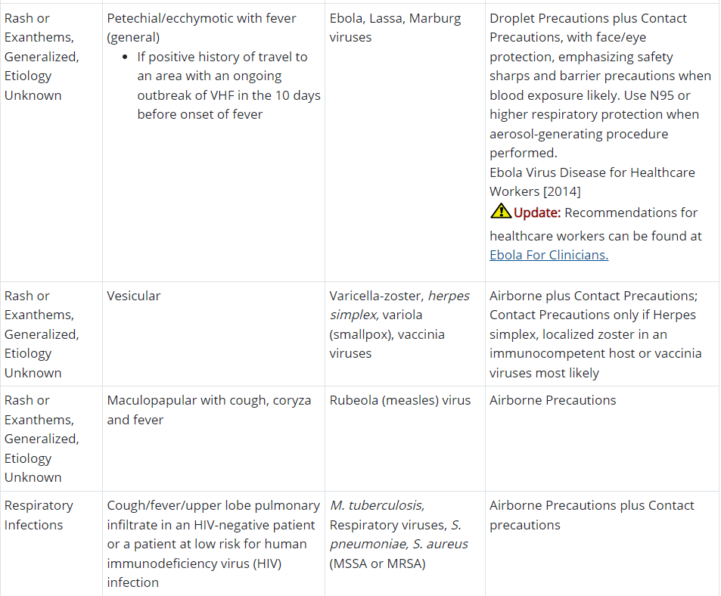
Empiric Isolation

Slide 18
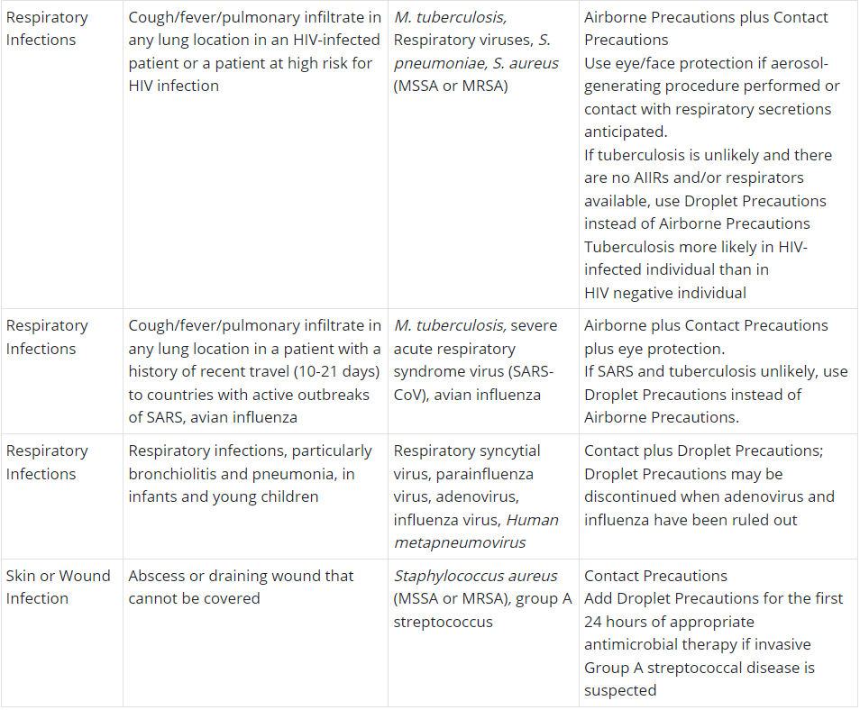
Empiric Isolation

Slide 19

When empiric transmission precautions should be utilized
Upon first assessment – Triage area

Slide 20
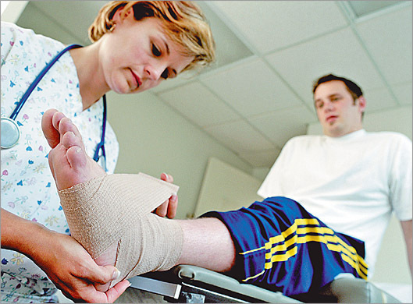
Primary complaint

Slide 21

Increased Awareness of Infectious Signs and Symptoms

Slide 22
CDC’s Isolation Recommendations
Guideline for Isolation Precautions: Preventing Transmission of Infectious Agents in Healthcare Settings (2007). Last updated July 2019.
Appendix A: Type and Duration of Precautions Recommended for Selected Infections and Conditions. Page 96 of 206
Isolation Precautions | Guidelines Library | Infection Control | CDC

Slide 23
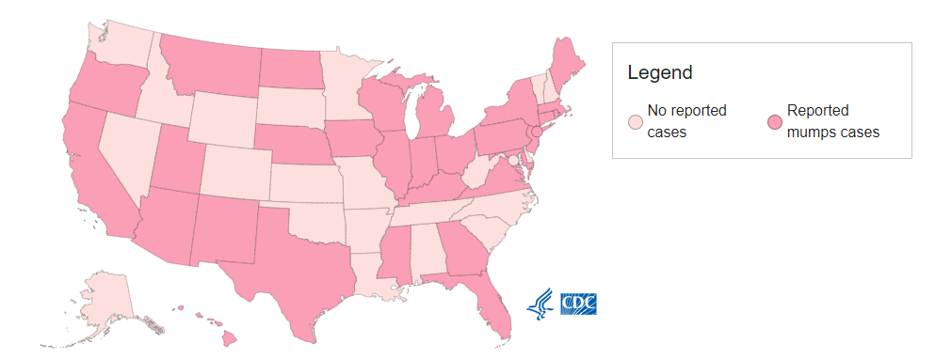
Reported US Mumps Cases by Jurisdiction and Year*
Reported Mumps Cases-2021

Slide 24
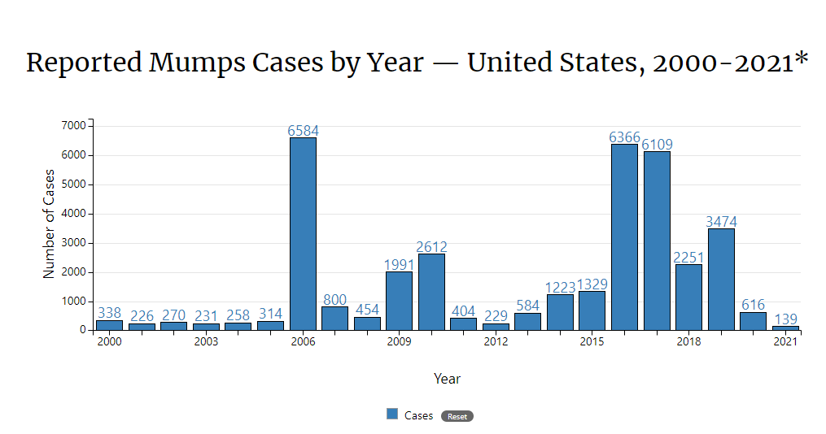
Incidence of Mumps

Slide 25
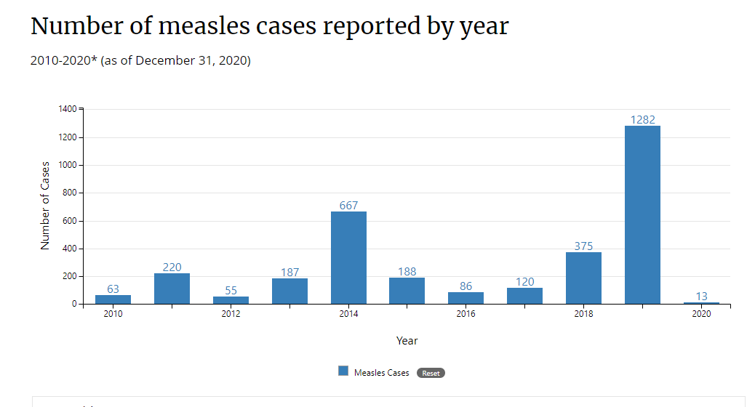
Measles cases in 2021
As of December 1, 2021, a total of 49 measles cases were reported by 5 jurisdictions in the United States. *

Slide 26
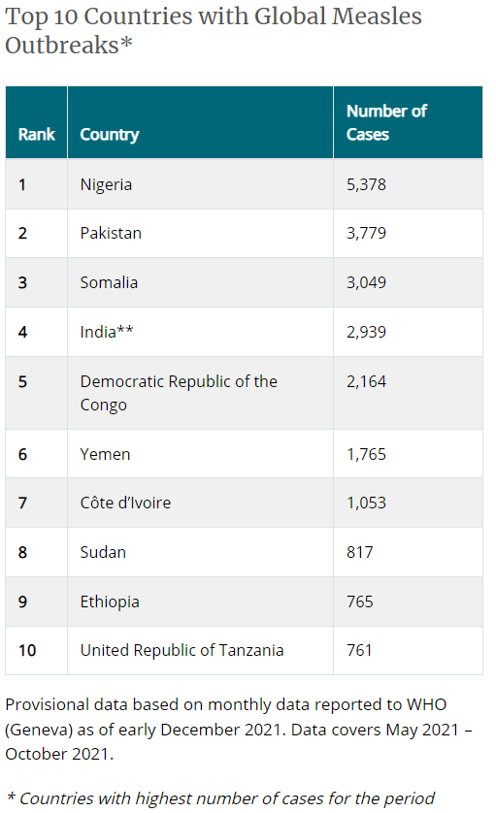
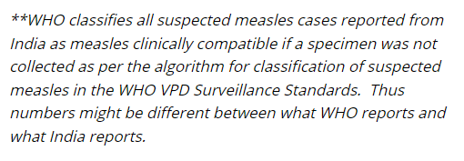
G Global Measles

Slide 27
Reduce Occupational Health Exposures to Airborne and Droplet Transmitted Diseases: An Improvement Project in a Northern Californian Emergency Room
Abstract
Background: Preventing respiratory infectious disease exposures is a performance improvement project to reduce the incidence of occupational health exposures among health care workers. This project encouraged registered nurses to quickly identify and isolate potentially infectious patients in the emergency room, to prevent exposures to airborne and droplet transmitted communicable diseases, including meningitis, tuberculosis, and measles.
Methods: This pre- and postintervention model implemented a quasi-experimental designed project in the emergency room (ER). The Centers for Disease Control's empiric transmission-based isolation precautions were implemented to prevent occupational health exposures. Eighty registered nurses (RN's) received education on the new intervention. The assumption of this project was, the new process will decrease occupational health exposures.
Results: Eight ER RNs reported an occupational health exposure, preintervention in quarter 2 of 2019, compared to zero occupational health exposures, postintervention in quarter 3 of 2019. A χ² independence test was used to determine if the categorical variables of the capstone intervention and disease exposure were related in the same RN population. An association between the capstone intervention and disease exposure was observed, X² (1) = 8.421, P = .004, indicating the result is statistically significant.
Conclusions: The preventing respiratory infectious disease exposures project effectively reduced occupational health exposures to airborne and droplet transmitted diseases in the emergency room by 100%. These results should encourage Infection Preventionists to adapt the Centers for Disease Control's empiric transmission isolation precautions in their emergency rooms and urgent cares to prevent airborne and droplet transmitted disease exposures.
Cole J, Gambone J, Barnard E. P.R.I.D.E.-preventing respiratory infectious disease exposures: An improvement project in a Northern Californian emergency room. Am J Infect Control. 2021 Feb;49(2):174-178. doi: 10.1016/j.ajic.2020.07.030. Epub 2020 Aug 6. PMID: 32768437; PMCID: PMC7406469

Slide 28
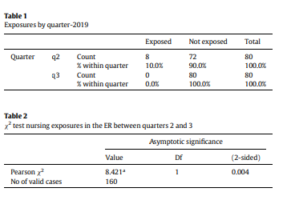
Data tables
Cole J, Gambone J, Barnard E. P.R.I.D.E.-preventing respiratory infectious disease exposures: An improvement project in a Northern Californian emergency room. Am J Infect Control. 2021 Feb;49(2):174-178. doi: 10.1016/j.ajic.2020.07.030. Epub 2020 Aug 6. PMID: 32768437; PMCID: PMC7406469

Slide 29
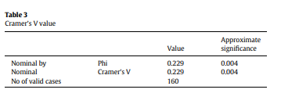
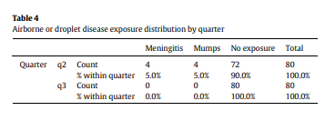
Data tables
Cole J, Gambone J, Barnard E. P.R.I.D.E.-preventing respiratory infectious disease exposures: An improvement project in a Northern Californian emergency room. Am J Infect Control. 2021 Feb;49(2):174-178. doi: 10.1016/j.ajic.2020.07.030. Epub 2020 Aug 6. PMID: 32768437; PMCID: PMC7406469

Slide 30
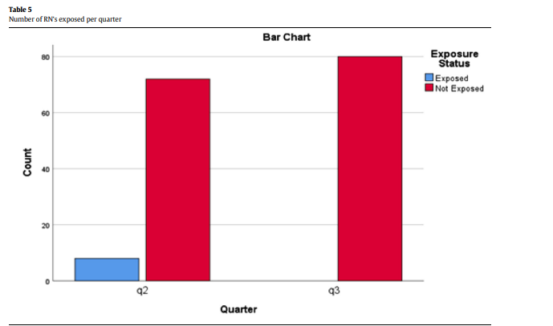
Data-Bar Chart

Slide 31
Case Scenario
Pre-intervention Post-intervention
39 year old male presents to the ER. Chief The patient advised to wear a mask upon
Complaint c/c of fatigue and facial/neck swelling. Identification of symptoms and report of
Patient reports recent exposure to a positive exposure to a known Mumps case. The
Mumps case. The patient remains unmasked patient is placed in Droplet isolation
And advised to wait in the general waiting area. Immediately.
Droplet isolation is ordered after being seen by the
ER physician after 1 hour has passed.

Slide 32
Case Scenario
Pre-intervention Post-intervention
Unvaccinated 3 year old female with generalized Patient is seen by triage nurse and is stable.
Rash- etiology unknown. Seen by triage nurse and Patient and parent are advised to wear a
Advised to wait in the general ER waiting area. Surgical mask and wait in their vehicle. An
Patient is seen by the ER physician 90 minutes airborne isolation room is identified and the
Later and placed in Airborne Isolation to r/o patient and parent are escorted to the room
Measles. For physician assessment.

Slide 33
Conclusion
The specific aim of this teleclass is to improve the ER RN’s ability to identify and isolate infectious patients promptly.
This change in practice can assist in preventing disease transmission and protecting the health of HCW’s and other hospitalized patients

Slide 34
References
CDC. (2015). Clinical Syndromes or Conditions Warranting Empiric Transmission-Based Precautions in Addition to Standard Precautions. https://www.cdc.gov/infectioncontrol/guidelines/isolation/appendix/transmission-precautions.html
CDC. (2021). Mumps | Cases and Outbreaks | CDC
CDC. (2021). Global Measles Outbreaks (cdc.gov)
CDC. (2016). Identify, Isolate, Inform: Emergency Department Evaluation and Management for Patients Under Investigation (PUIs) for Ebola Virus Disease (EVD) | Emergency Services | Clinicians | Ebola (Ebola Virus Disease) | CDC

Slide 35



Slide 36


