Slide 1
Complacency about diseases, anxiety about vaccines: The meningitis perspective
Liz Rodgers, Research Projects Manager
Meningitis Research Foundation
Hosted by Martin Kiernan martin@webbertraining.com
www.webbertraining.com
May 20, 2021

Slide 2
Outline
Importance of preventing meningitis: burden and impact of disease
Why some people don’t take up their life saving vaccines: defining the spectrum of vaccine hesitancy
The importance of advocacy and the patient perspective in building confidence for meningitis vaccines
Reviewing approaches to communicating with those who are hesitant

Slide 3
Importance of preventing meningitis: burden and impact of disease
Why some people don’t take up their life saving vaccines: defining the spectrum of vaccine hesitancy
The importance of advocacy and the patient perspective in building confidence for meningitis vaccines
Reviewing approaches to communicating with those who are hesitant

Slide 4
Burden of disease: meningitis and neonatal sepsis
https://www.meningitis.org/mpt

Slide 5
Burden of disease: meningitis

Slide 6
Impact of meningitis
In 2019, it was estimated that over 16 million years of healthy life were lost from meningitis worldwide

Slide 7
WHO Global Roadmap to Defeat Meningitis by 2030
Defeating meningitis by 2030 global road map (version 26 October 2020) available: https://www.who.int/publications/m/item/defeating-meningtis-by-2030-global-road-map-(version-20-october-2020)

Slide 8
Pillars of the Roadmap
Defeating meningitis by 2030 global road map (version 26 October 2020) available: https://www.who.int/publications/m/item/defeating-meningtis-by-2030-global-road-map-(version-20-october-2020)

Slide 9
Roadmap scope
“The roadmap on defeating meningitis sets out a plan to tackle the main causes of acute bacterial meningitis: meningococcus, pneumococcus, Haemophilus influenzae and group B Streptococcus.
This focus is based on: (i) evidence of the worldwide burden of disease due to these four organisms, which also cause sepsis and pneumonia and were responsible for over 50% of the 290 000 deaths from all-cause meningitis in 2017; (ii) the impact that this global strategy could have on diminishing the burden by 2030, since effective vaccines that protect against disease caused by all four organisms are currently available (or in development).
Although the focus of this road map is not on other important causes of meningitis, such as tuberculosis, Cryptococcus, enteric bacteria and viruses such as enterovirus, several goals aimed at reducing the burden of disease are applicable to all causes of meningitis.”

Slide 10
Pneumococcal infection
Streptococcus pneumoniae (pneumococcus) can cause: meningitis, septicaemia, severe pneumonia, as well as non-invasive, milder diseases
~90 serotypes identified, small number account for most invasive disease
Disease most common at the extremes of age: young children and elderly
Two conjugate vaccines exist (PCV13 and PCV1O), an additional 10 valent vaccine ‘Pneumosil’ is WHO pre-qualified. A polysaccharide vaccine (PPV23) is also available
Higher valency conjugate vaccines are currently in development and research is on-going into protein and alternative vaccine approaches

Slide 11
Haemophilus Influenzae infection
Six serotypes identified, of which type b (Hib) causes the vast majority disease, with the under-5’s being the most affected
Hib can cause: meningitis, septicaemia, pneumonia as well as milder diseases
Hib conjugate vaccine available since the 1980’s
HiA now causing a high burden of disease in some communities
Global Roadmap to Defeat Meningitis includes a milestone for a HiA vaccine to be licensed by 2028

Slide 12
WHO recommendation for PCV and Hib vaccines
In view of their demonstrated safety and efficacy, WHO recommends the inclusion of conjugate Hib vaccines in all infant immunization programmes
WHO also recommends the inclusion of PCVs in childhood immunization programmes worldwide
https://www.who.int/immunization/policy/position_papers/who_pp_pcv_2019_summary.pdf?ua=1
https://www.who.int/wer/2013/wer8839.pdf?ua=1

Slide 13
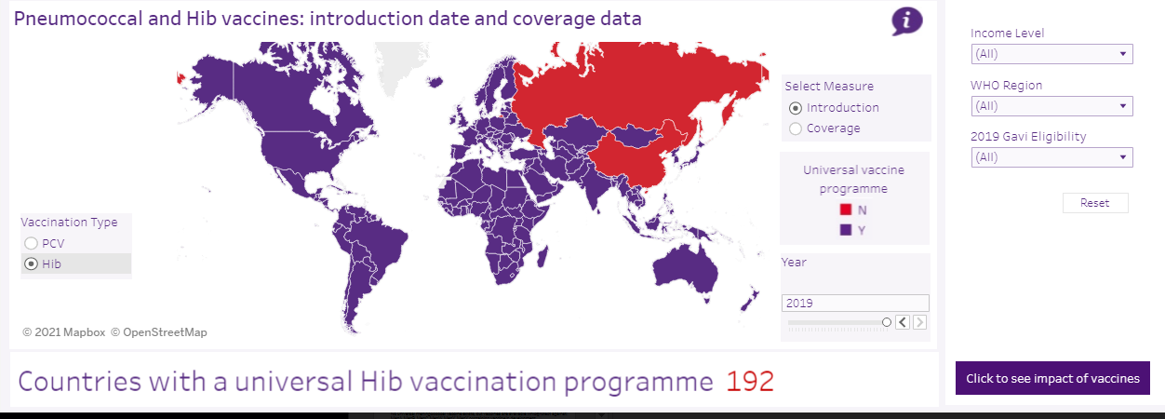

Slide 14
Declining rates of disease in relation to increased vaccine uptake

Slide 15
Meningococcal infection
Neisseria meningitidis (meningococcus)
12 serogroups identified - six (A, B, C, W, X and Y) responsible for the majority of invasive disease
Babies and under 5’s are the most at risk of disease, followed by a second peak in teenagers
Vaccines are available which protect against: MenA, MenB, MenC, MenW, MenY, MenX containing vaccine in development
No universal meningococcal vaccine exists

Slide 16
WHO recommendation for meningococcal vaccines
‘WHO recommends that countries with high (>10 cases/100 000 population/year) or intermediate endemic rates (2-10 cases/100 000 population/year) of IMD and countries with frequent epidemics, introduce appropriate large scale meningococcal vaccination programmes. In countries where the disease occurs less frequently (<2 cases per 100,0000 population/year), meningococcal vaccination is recommended for groups at known risk of meningococcal exposure ’
Meningococcal vaccines. A summary of the WHO position paper of 18 Nov 2011 https://www.who.int/immunization/position_papers/MC_summary_14_Nov_2011.pdf?ua=1

Slide 17
There are fewer countries with universal meningococcal programmes

Slide 18
GBS infection
Streptococcus agalactiae (Group B Streptococcal (GBS)) can cause: meningitis, neonatal sepsis, pneumonia
Leading cause of meningitis and sepsis in newborn babies
319,000 infant cases of GBS infection estimated to occur globally each year, resulting in 57,000 stillbirths and 90,000 infant deaths in 2015
Around 1 in 4 pregnant women carry GBS bacteria in gut and genital tract, and bacteria can be passed from mother to baby during birth
GBS disease can be early onset or late onset
No GBS vaccines available, so current GBS prevention focuses on giving antibiotics to women in labour, aiming to reduce disease in infants at delivery
Seale, A.C., Bianchi-Jassir, F., Russell, N.J., Kohli-Lynch, M., Tann, C.J., Hall, J., Madrid, L., Blencowe, H., Cousens, S., Baker, C.J. and Bartlett, L., 2017. Estimates of the burden of group B streptococcal disease worldwide for pregnant women, stillbirths, and children. Clinical infectious diseases, 65(suppl_2), pp.S200-S219.

Slide 19
Risk based approach vs universal screening
Risk factor based screening approach:
Involves offering prophylactic antibiotics to the mother in labour when the baby is at higher risk of developing the infection.
Risk factors for the UK setting include:
early labour (<37 weeks)
waters breaking too early
mother having a fever ( >38°C)
previous baby with GBS disease
GBS detected in the mother’s urine
This approach is imperfect: some babies are missed and many women with risk factors do not carry GBS but receive antibiotics unnecessarily
Seale, A. ed., 2017. The Burden of Group B Streptococcus Worldwide for Pregnant Women, Stillbirths, and Children. Oxford University Press.

Slide 20
Risk based approach vs universal screening
Universal screening approach:
Involves routinely swabbing all pregnant women for GBS prior to birth and offering prophylactic antibiotics to those found to be carrying GBS bacteria
Benefits to this approach include:
Women not carrying GBS are not given unnecessary antibiotics
Prevents babies whose mothers do not have risk factors, but do carry GBS developing early onset GBS
Results in fewer babies dying, or surviving with life altering after effects
But there are some drawbacks:
Costly especially for LMICS
Could result in many women being given antibiotics they do not need

Slide 21
GBS vaccine development
Number of GBS vaccines currently in development, intended for maternal use
Survey by the UK Charity Group B Strep Support suggest that a GBS vaccine would be well accepted
Many countries already recommend vaccination in pregnancy (e.g. influenza), so the concept is familiar and acceptable to most pregnant women
But in some areas maternal vaccination uptake is low
Research was conducted with pregnant women living in London, UK, to understand factors that influence vaccine acceptance during pregnancy

Slide 22
Improving maternal vaccination acceptance
The findings of this study and the recommendations based on them were divided into five broad themes:
Access
Healthcare rhetoric
Involving community and family influences on vaccination decisions
Health care professional’s views towards maternal vaccination
Patient-healthcare professional relationships
Wilson, R., Paterson, P. and Larson, H.J., 2019. Strategies to improve maternal vaccination acceptance. BMC Public Health, 19(1), pp.1-11.

Slide 23
Importance of preventing meningitis: burden and impact of disease
Why some people don’t take up their life saving vaccines: defining the spectrum of vaccine hesitancy
The importance of advocacy and the patient perspective in building confidence for meningitis vaccines
Reviewing approaches to communicating with those who are hesitant

Slide 24
The Global Roadmap recognises the importance of vaccine confidence
Defeating meningitis by 2030 global road map (version 26 October 2020) available: https://www.who.int/publications/m/item/defeating-meningtis-by-2030-global-road-map-(version-20-october-2020)

Slide 25
Defining vaccine hesitancy
“Vaccine hesitancy refers to delay in acceptance or refusal of vaccines despite availability of vaccine services. Vaccine hesitancy is complex and context specific, varying across time, place and vaccines. It is influenced by factors such as complacency, convenience and confidence.”
WHO-SAGE
SAGE Working Group, 2014. Report of the SAGE working group on vaccine hesitancy. Geneva: World Health Organization.

Slide 26
Parental positions towards vaccination
The unquestioning acceptor
The cautious acceptor
The
hesitant
The late or selective vaccinator
The
refuser
Leask, J., Kinnersley, P., Jackson, C., Cheater, F., Bedford, H. and Rowles, G., 2012. Communicating with parents about vaccination: a framework for health professionals. BMC pediatrics, 12(1), p.154.

Slide 27
3 C’s model of vaccine hesitancy
ac
COMPLACENCY
CONVENIENCE
CONFIDENCE
SAGE Working Group, 2014. Report of the SAGE working group on vaccine hesitancy. Geneva: World Health Organization.

Slide 28
What determines vaccine hesitancy?
Decisions surrounding vaccination, and reasons underpinning refusal are complex, determined by:
Contextual influences: media, environment, politics
Individual and group influences: arising from personal perception of the vaccine or influences of the social/peer environment
Vaccine/vaccination specific factors: directly related to the vaccine/vaccination, e.g. mode of administration, reliability and source of vaccine and knowledge base/attitude
SAGE Working Group, 2014. Report of the SAGE working group on vaccine hesitancy. Geneva: World Health Organization.

Slide 29
Global picture of vaccine hesitancy
Lane, S., MacDonald, N.E., Marti, M. and Dumolard, L., 2018. Vaccine hesitancy around the globe: Analysis of three years of WHO/UNICEF Joint Reporting Form data-2015–2017. Vaccine, 36(26), pp.3861-3867.

Slide 30
Top three determinants of vaccine hesitancy
Research has revealed the top three cited reasons for vaccine hesitancy globally are:
Risk-benefit (scientific evidence) e.g. vaccine safety concerns of fear of side effects
Lack of knowledge and awareness of vaccination and its importance
Religion, culture, gender and socioeconomic issues regarding vaccines
Lane, S., MacDonald, N.E., Marti, M. and Dumolard, L., 2018. Vaccine hesitancy around the globe: Analysis of three years of WHO/UNICEF Joint Reporting Form data-2015–2017. Vaccine, 36(26), pp.3861-3867.

Slide 31
COVID-19 vaccines and vaccine hesitancy

Slide 32
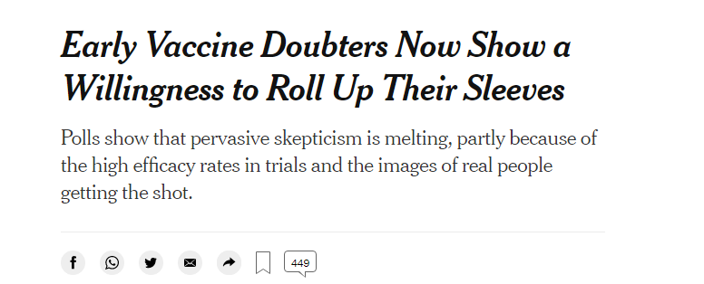

Slide 33
Importance of preventing meningitis: burden and impact of disease
Why some people don’t take up their life saving vaccines: defining the spectrum of vaccine hesitancy
The importance of advocacy and the patient perspective in combatting complacency, and building confidence for meningitis vaccines
Reviewing approaches to communicating with those who are hesitant

Slide 34
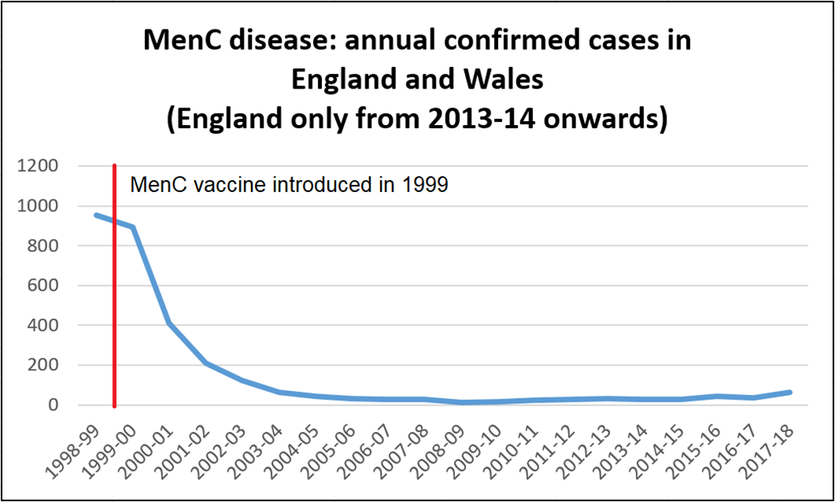
Vaccines reduce burden of disease, which can result in complacency, and hesitancy
Source: Public Health England, Meningococcal disease: laboratory confirmed cases in England
https://www.gov.uk/government/publications/meningococcal-disease-laboratory-confirmed-cases-in-england-and-wales

Slide 35
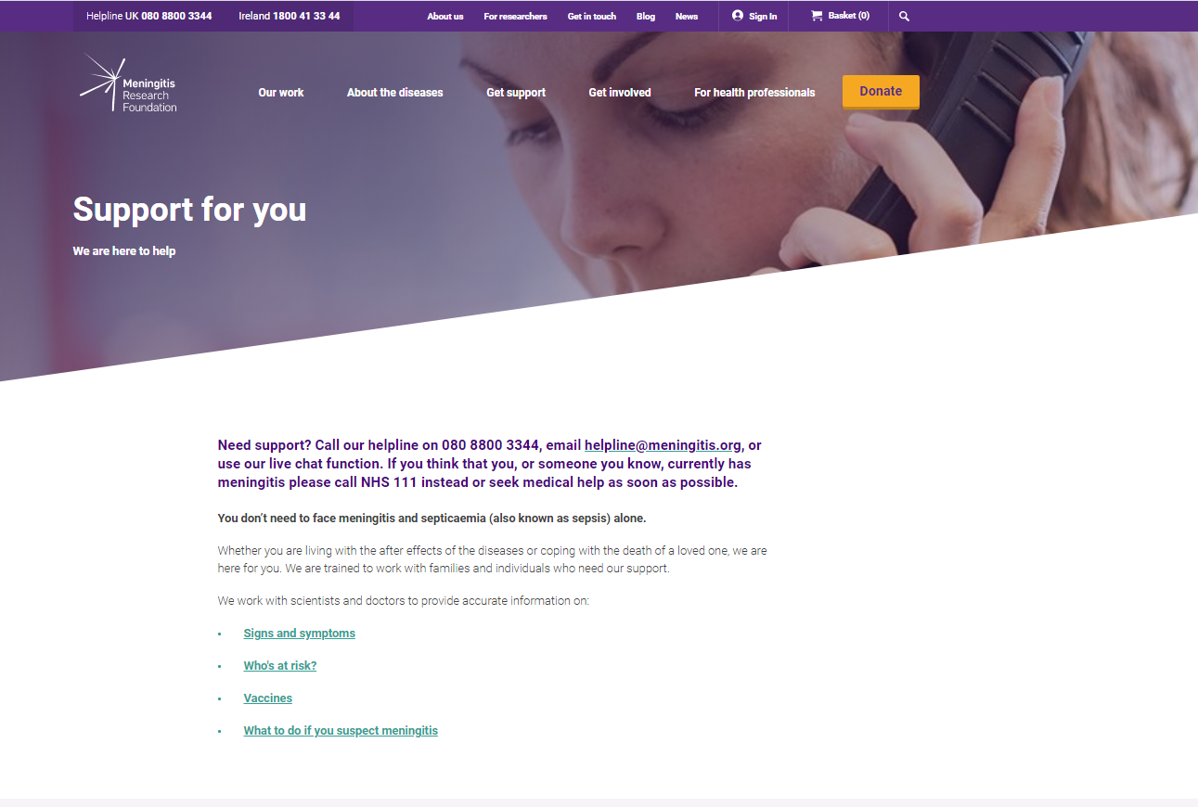
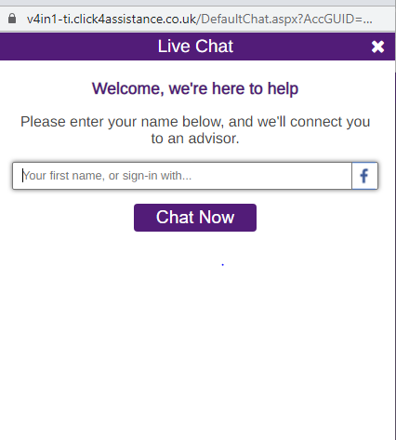
Meningitis stories shared: combatting complacency

Slide 36
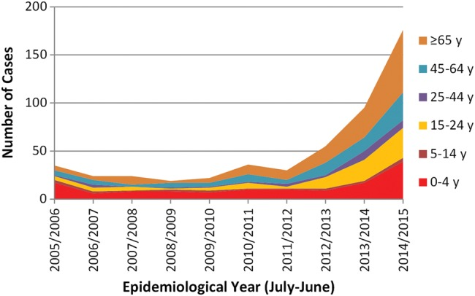
Increasing vaccine uptake after emergence of a new, virulent strain
From 2009, sharp increase seen in MenW disease
Affecting mainly healthy people, particularly teenagers
Unusual clinical presentation (gastric symptoms)
Higher case fatality rate (13% vs 5-10%)
Source: Ladhani SN, Ramsay M, Borrow R, Riordan A, Watson JM, Pollard AJ. Enter B and W: two new meningococcal vaccine programmes launched. Archives of disease in childhood. 2016 Jan 1;101(1):91-5.

Slide 37
Genomics revealed increase was due to MenW ST-11
https://pubmlst.org/bigsdb?db=pubmlst_neisseria_mrfgenomes

Slide 38
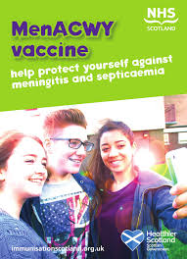
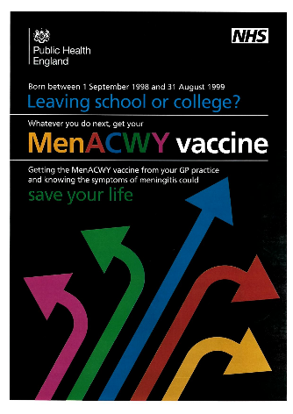
MenACWY introduction
In 2015, MenACWY was introduced for those aged 14 years
Catch up programme for older age groups, but uptake in this group was low
To help overcome this, MRF launched ‘Stop the Spread’ campaign, which in line with the 3 C model aimed to: combat complacency, ensure convenience and enhance confidence

Slide 39
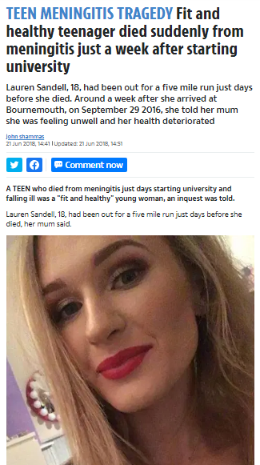
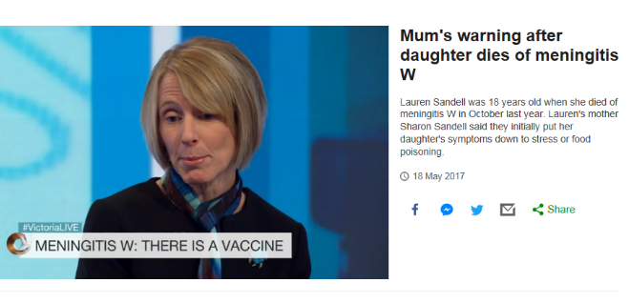
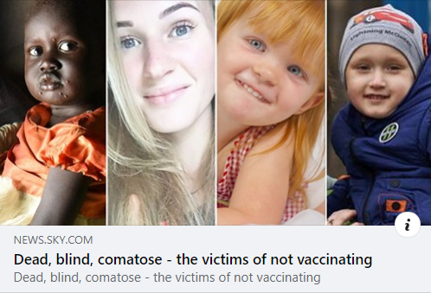
Combatting complacency
Target mothers -research shows they are the health keepers in families
Highlight the severity of the diseases using peer case studies

Slide 40
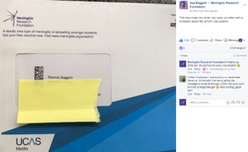
Enhancing confidence
MRF partnerships with trusted sources
Official letters from UCAS – (Universities and Colleges Admissions Service)

Slide 41
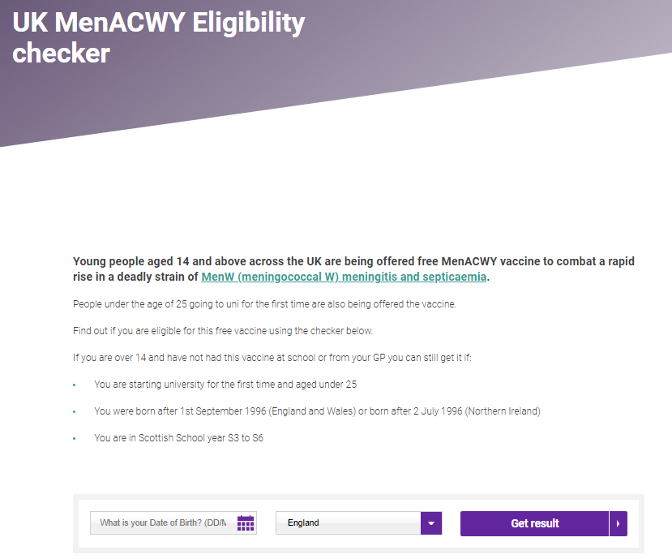
Ensuring Convenience
Created an online ‘eligibility checker’
Leveraged connections with academics to bring vaccinations to students
Attended freshers’ fairs
8,400 posters
41,000 leaflets

Slide 42
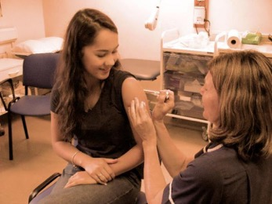
Impact
Universities with ‘sign up’ vaccination reaching 70% coverage
Around 70,000 additional vaccinations taking place, compared to the same period in 2016.
Rates of MenW had for the first time in years started to reduce in the age group eligible for the vaccine.
Image: NHS England South West. ‘Student Georgina Campbell gets the MeningitisACWY vaccine’.

Slide 43
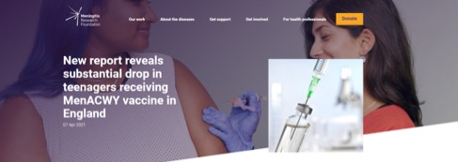
Impact of COVID-19 on meningitis cases and vaccine uptake
https://www.meningitis.org/news/drop-meningitis-cases-lockdown-england
https://www.gov.uk/government/publications/meningococcal-disease-laboratory-confirmed-cases-in-england-in-2019-to-2020

Slide 44
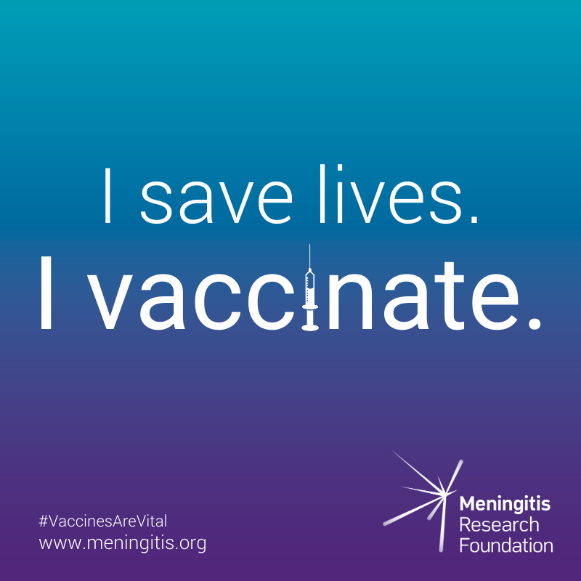
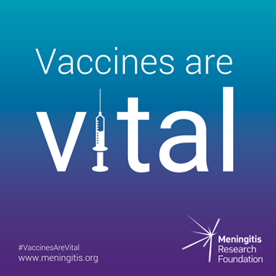
Vaccines are vital campaign
Launched to combat growing concern that the COVID-19 pandemic could threaten global immunisation uptake

Slide 45
Patient perspective: Why are vaccines vital to you?
"Vaccines save lives. If we had only known about the vaccines our son would probably have been alive today. Instead we are looking at the one year anniversary of his death." – Christine
“They save lives and futures. My future changed 10 years ago. My life got flipped on its head. No one should ever have to go through this when there is a vaccine out there. Cost of vaccine shouldn’t be thought about considering the amount I and many others have cost the NHS and other U.K. services and will keep costing for years to come.” – Lesley
“Vaccines are vital because they save lives. My mum lost my sister over 40 years ago to meningococcal septicaemia and we also almost lost our daughter to the same thing at 18mths old thankfully she’s now almost 14 and things have come a long way and we are so lucky to have the vaccines we do." - Justine
https://www.meningitis.org/blogs/why-vaccines-are-vital-to-you

Slide 46
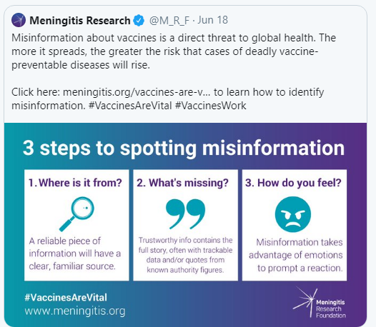
Spotting misinformation
The UK’s independent fact checking charity, Full Fact, recommends taking three steps to interrogate information

Slide 47
Importance of preventing meningitis: burden and impact of disease
Why some people don’t take up their life saving vaccines: defining the spectrum of vaccine hesitancy
The importance of advocacy and the patient perspective in building confidence for meningitis vaccines
Reviewing approaches to communicating with those who are hesitant

Slide 48
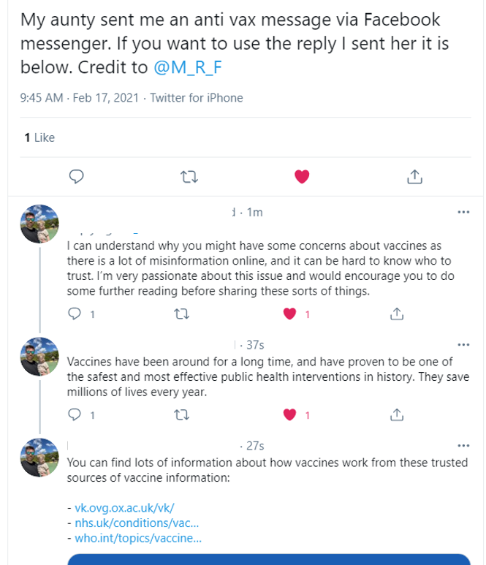
Responding to ‘anti-vax’ views
"Hello. I can understand why you might have some concerns about vaccines as there is a lot of misinformation online, and it can be hard to know who to trust. I’m very passionate about this issue and would encourage you to do some further reading before sharing these sorts of things. Vaccines have been around for a long time, and have proven to be one of the safest and most effective public health interventions in history. They save millions of lives every year. You can find lots of information about how vaccines work from these trusted sources of vaccine information: …..
https://www.meningitis.org/blogs/how-to-respond-to-anti-vaxxers

Slide 49
Why else might people not get vaccinated?

Slide 50
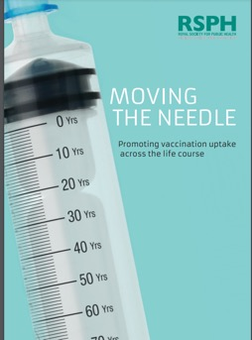
Access is an important determining factor
Report by the Royal Society of Public Health found that the most common barriers to getting vaccinated were:
Timing of appointments (49%)
Availability of appointments (46%)
Childcare duties (29%)
https://www.rsph.org.uk/static/uploaded/3b82db00-a7ef-494c-85451e78ce18a779.pdf

Slide 51
Overcoming barriers and increasing uptake (1)
Send invites and reminders
Check children are up to date
Check IT system flags when people have missed out
Record vaccinations with appropriate codes
Plan sufficient appointments
Speak confidently abut vaccines
https://publichealthmatters.blog.gov.uk/2019/05/16/increasing-vaccine-uptake-strategies-for-addressing-barriers-in-primary-care/

Slide 52
Overcoming barriers and increasing uptake (2)
7. Provide leaflets and posters
8. Create a call-back system
9. Signpost people to online resources
10. Offer additional and more flexible appointments
https://publichealthmatters.blog.gov.uk/2019/05/16/increasing-vaccine-uptake-strategies-for-addressing-barriers-in-primary-care/

Slide 53
Mandatory vaccination
While it is not the position held in the UK, some countries have chosen to make vaccines mandatory to try and increase vaccine uptake
In France, in December 2017, vaccination mandates were extended from 3 to the 11 vaccinations included in the routine immunisation schedule of children under 2 years old, because:
The coexistence in the schedule of both mandatory and recommended vaccines, created confusion among many parents, giving the false impression that the latter were less important or even optional
The growing vaccine hesitancy in the French population, leading to insufficient vaccine coverage for most recommended vaccines
This translated into an unacceptable burden of severe morbidity and mortality for some vaccine preventable diseases
Lévy-Bruhl D, Fonteneau L, Vaux S, Barret AS, Antona D, Bonmarin I, Che D, Quelet S, Coignard B. Assessment of the impact of the extension of vaccination mandates on vaccine coverage after 1 year, France, 2019. Eurosurveillance. 2019 Jun 27;24(26):1900301.

Slide 54
Impact of mandatory vaccination
Results so far are encouraging and the number of infants who received the first dose of the meningococcal C vaccine has increased
However, as discussed, making vaccination compulsory is not the only way to obtain high vaccination rates.
Without mandating vaccines, the UK has held a high uptake rate for many years with the vast majority of parents choosing to vaccinate their children.

Slide 55
Reminder of the wide reaching benefits of vaccines
Vaccinations have far reaching benefits beyond simply the health gained by preventing vaccine preventable disease in the immunised individual, such as but not limited to:
Increased patient contact with health services
Maximum protection of the unimmunised through herd protection
Reduction of antibiotic resistant organisms
Alleviating pressure on health systems through outbreak prevention
Reduction of health inequalities

Slide 56
Thank you for listening
elizabethr@meningitis.org

Slide 57
