Slide 1
Continuously Acting Disinfectants
Dr. Charles P Gerba Professor, WEST Center
University of Arizona
Hosted by Martin Kiernan ... martin@webbertraining.com
www.webbertraining.com
June 24, 2021

Slide 2
Charles P. Gerba - Disclosure
Crazy clean – advisory board
Apex Surface care – seminar speaker
Solid Care – Seminar speaker
Procter and Gamble – speaker, research grant
Rickett – research grant
Allied Bioscience – research grant
Corning Inc. - research grant
PPG – research grant
Boeing – research grant, consultant
Clean Remotes – research grant
PDI - advisory board
Behr – research grant
Waterlogic – research grant
Proshield – research grant

Slide 3
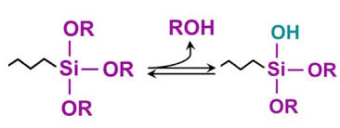
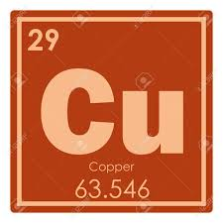
Next Generation Disinfectants
The pandemic has resulted in a rapid development of the next generation of anti-microbials (anti-viral products)coatings/surfaces
Our group aided industry with laboratory and “in-use” testing against SARS-CoV-2 and norovirus surrogate
Help provided the data for first approval for use of an “anti-viral” coating in the U.S.
The age of “continuously acting disinfectants” – CADs
Organo-silane quats – 2 to 90-day residual effects ( after wear testing)
Copper coatings – (can kill norovirus in less than a minute)

Slide 4
Continuously Acting Disinfectants
Coatings or surfaces that provide a disinfectant effect against microbes. Different than antimicrobial, which may only prevent the growth of bacteria/fungus.
Anti-fungal
Anti-bacterial
Anti-viral
Have been around a long time but claims against pathogens have been limited by the EPA
Not designed to replace regular cleaning and disinfecting, but and additional barrier

Slide 5
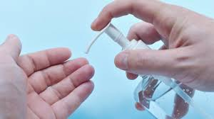
Persistent Antiviral Hand Sanitizers
Hand sanitizers with residual activity are possible
Development of a hand sanitizer effective against human norovirus for up to four hours (silinated quat)
Kugat et al 2019 Intranational. J. of Hygiene and Environment and Health

Slide 6
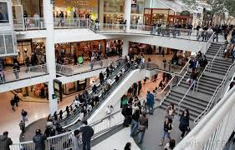
Life in the 21st Century
More people work in offices than ever before
We travel more than ever before
We spend less time cleaning than the last generation (50% less than 50 years ago)
We spend more time in public places (and larger ones)

Slide 7
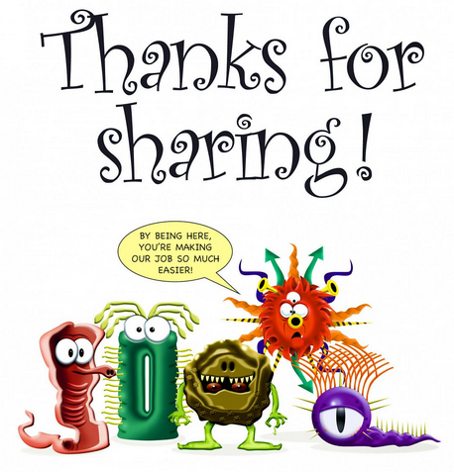
Life in the 21st Century
We share more common surfaces (fomites) with more different people than ever before in history
As a result, we share more germs with more people than at any time in history
The “perfect storm” for transmission of CoVid-19

Slide 8
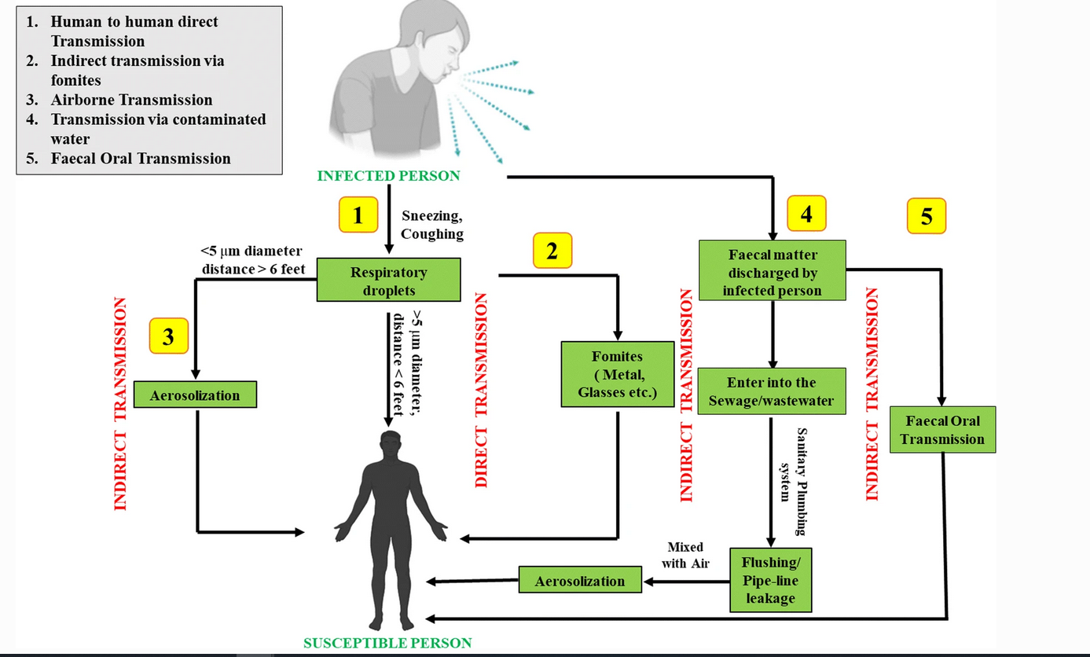

Slide 9
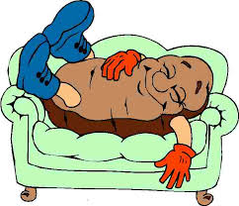
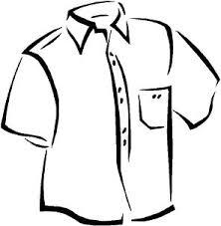
Dangers of being a Couch Potato Re-aerosolization of Pathogens
aerosol
Inhaled
Hand
Transfer
Transfer to Clothing
Hand Transfer

Slide 10
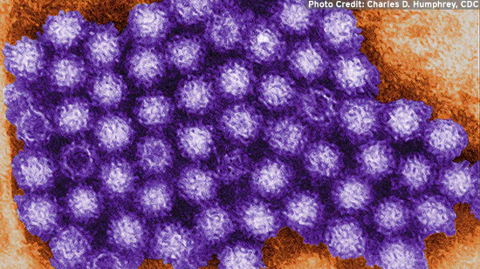
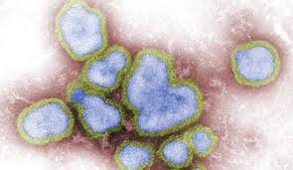
Viruses can survive for long periods of time on surfaces
Norovirus – 4 weeks
Hepatitis A – 2 weeks
Rotavirus – 2 weeks
Adenovirus 40 – 3-4 days
Influenza A – 1.5 days
Coronavirus 229E – 5 hours
Rhinovirus – 2 hours
From Bone and Gerba 2007 AEM 73:1687-1696.

Slide 12
How Fast does a virus move in an indoor environment vis fomites?
Add a bacterial virus to the entrance door handle of an office building with 80 persons
Collect samples after 2, 4 and 7 hours of fomites and hands

Slide 13
Next do an Intervention Hand Sanitizer plus Disinfectng wipes
+ hygiene education
52% of 80 employee’s agreed to participate

Slide 14
Impact of intervention on Occurrence of Virus on Employees’ Hands

Slide 15
Results
Viruses can spread rapidly in indoor environments via the hands
The number of people with viruses on their hands was reduced 80 to 50%.
The occurrence of viruses in communal work areas (fomites) was reduced by more than 80% after four hours and by 70%-100% after s
Repeat of studies in different indoor environments yielded the same results in
Nursing home
Out-patient clinic
Hotel
homes

Slide 16
Types of CAD
Querido et al 2019 colloids and surface Biointerfaces 178:8-21

Slide 17
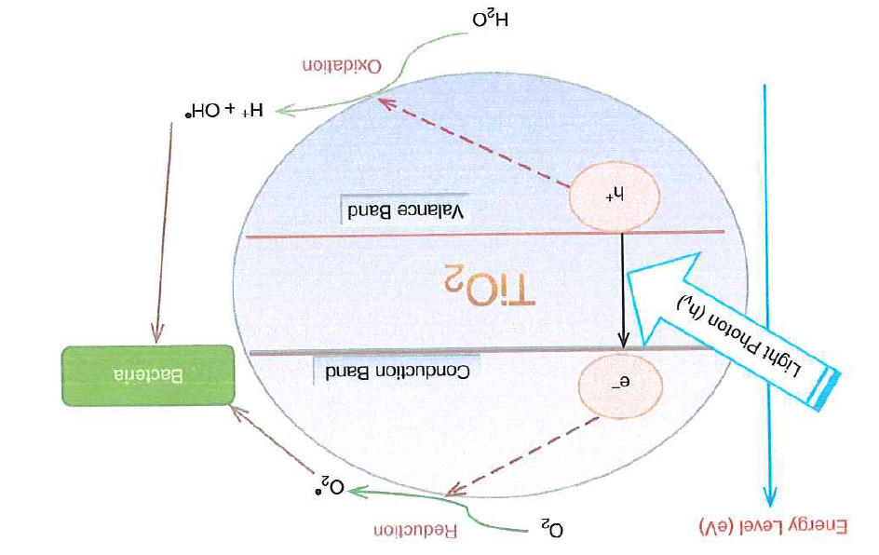
Titanium Dioxide – a photocatalyst

Slide 18
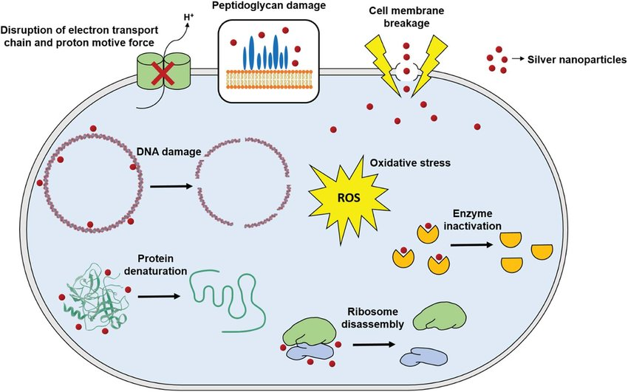
Silver and Copper

Slide 19
Silinated Quats
Have been around for 40 years (odor eater socks)
Combined with polymers and silicon allows them to sick to surfaces
Usually applied as spray or wipe
Advantage - a wide range of chemical formulations possible
Can persist for days to months once applied.

Slide 20
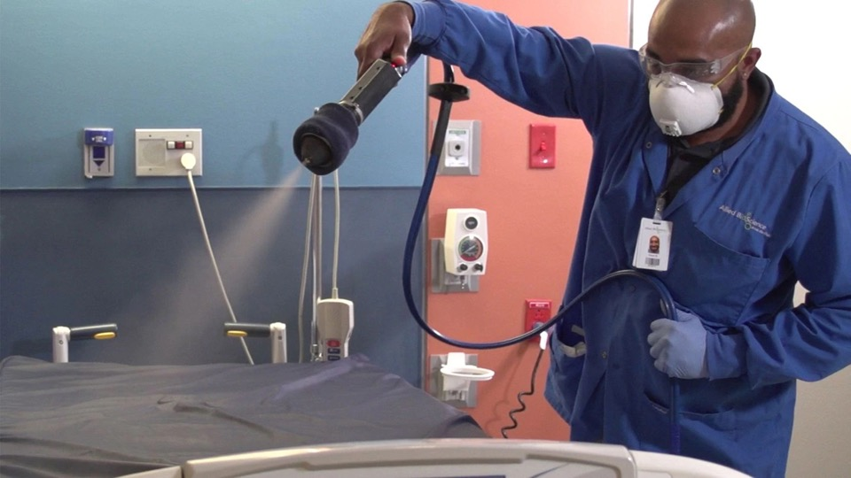

Slide 21
EPA Wear testing required for registration of CAD

Slide 22
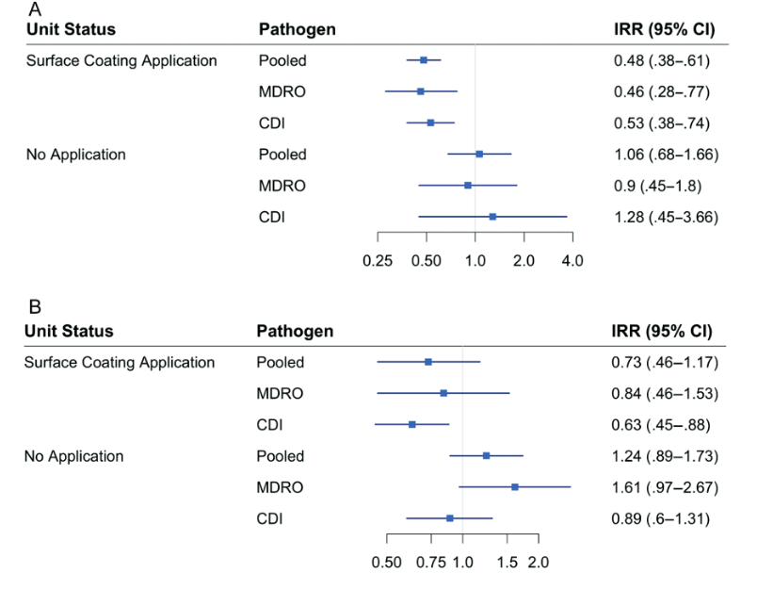
Incidence rate ratios of HAI Infections – before and after application of a silinated quat CAD in two Hospitals
MDRO = multi-resistance organisms
CDI –Clostridium difficille
Ellingson et al 71:1907-18013

Slide 23
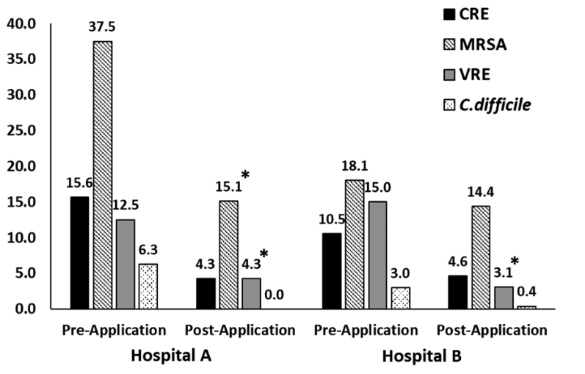
Percent Sites Positive for Clinically Relevant Pathogens (Polymer Silnated Quat) (Ellingson et al 2020)

Slide 24
Anti-viral Silinated Quat Coated Surfaces
 | HCoV 229E | SARS-CoV-2
Detection Limit (log₁₀) | <0.50 | <1.50
Log₁₀ reduction | >5.16 | >3.53
Percent Reduction | >99.9994% | >99.97%
Notes: Values are reduction in virus titer compared to untreated controls. Two-hour contact. Virus suspended in 5% fetal calf sera

Slide 25
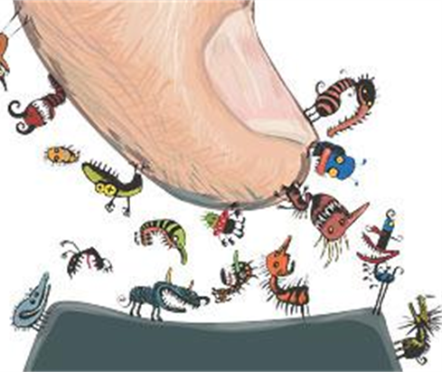
Transfer Efficiency of Human Coronavirus 229E from fomites to fingers
Fomite/Surface | Mean % Transfer to Finger
Stainless Steel | 0.46
Glass | 37
Glazed Porcelain | 49
Laminate | 7
Formica | 25

Slide 26
Transfer of Human Coronavirus 229E from CAD treated Porcelain to the finger 24 hours after treatment
Fomite/Surface Treatment | % of virus transferred to the finger
Control- no treatment | 49.0
Regular Quat wipe | 36.1
Silinated quat wipe | 4.1
Silinated quat spray | 0.1
Polymeric simulated quat coating | 0.05
Virus suspended in 5% fetal calf sera

Slide 27
Lessons Learned
Not all CADs are equal – even of the same basic anti-microbial composition
Anti-bacterial does not mean anti-viral
Highly effective against bacteria does not mean effective against viruses
Effectiveness may depend on environmental conditions
Relative humidity plays a role for metal surfaces
Presence of a dirt load may reduce effectiveness
Ability to stand up to wear testing
Time of contact is a factor
Different products may take a few minutes to two hours
Type of organism is a factor
Enveloped vs. non-enveloped viruses

Slide 28
Outlook and Effectiveness
Epidemiological studies suggest CADs can reduce hand transmitted infections
Epidemiological studies for some respiratory viruses suggest they are not as effective in healthcare
Impact outside of healthcare – crowded public environments
Day care – schools
Mass transport – buses, subways
Malls
Other high traffic areas
Areas were re-aerosolization may occur - fabrics

Slide 29
Questions
Charles P. Gerba
gerba@ag.Arizona.edu

