Slide 1
Cost Analysis of Universal Screening vs. Risk Factor-Based Screening for MRSA
Dr. Virginia Roth
The Ottawa Hospital
Hosted by Nicole Kenny
Virox Technologies Inc.
www.webbertraining.com
April 27, 2017

Slide 2

Methicillin-Resistant Staphylococcus aureus (MRSA)
Background
Compared to MSSA
  Increased cost ($3,700 per infection)
    Higher readmission, length of stay
  Increased mortality
  Fewer therapeutic options
Colonization precedes infection (10:1)
  Can persist for months – years
Emergence of community MRSA in 1998
Tansarli et al. Expert Rev Anti Infect Ther 2013; Nathwani J Infect 2009

Slide 3
Methicillin-Resistant Staphylococcus aureus (MRSA)
Control Measures
Spread by direct contact
Asymptomatic MRSA carriers → reservoir for transmission
Infection control strategies - variably effective:
  Screening
  Contact precautions
  Contact tracing
  Decolonization

Slide 4
Methicillin-Resistant Staphylococcus aureus (MRSA)
Admission Screening
Risk-Factor Based (Targeted) Screening
Screening based on pre-defined high-risk factors
Universal Screening
Screening all patients for MRSA upon admission
In past:
  Lack of agreement, inconclusive evidence
  Mandatory in certain jurisdictions
  Patient safety movement

Slide 5
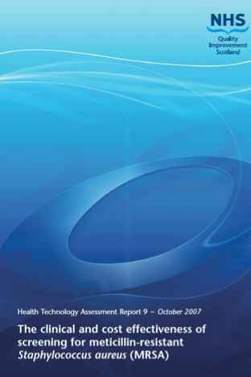
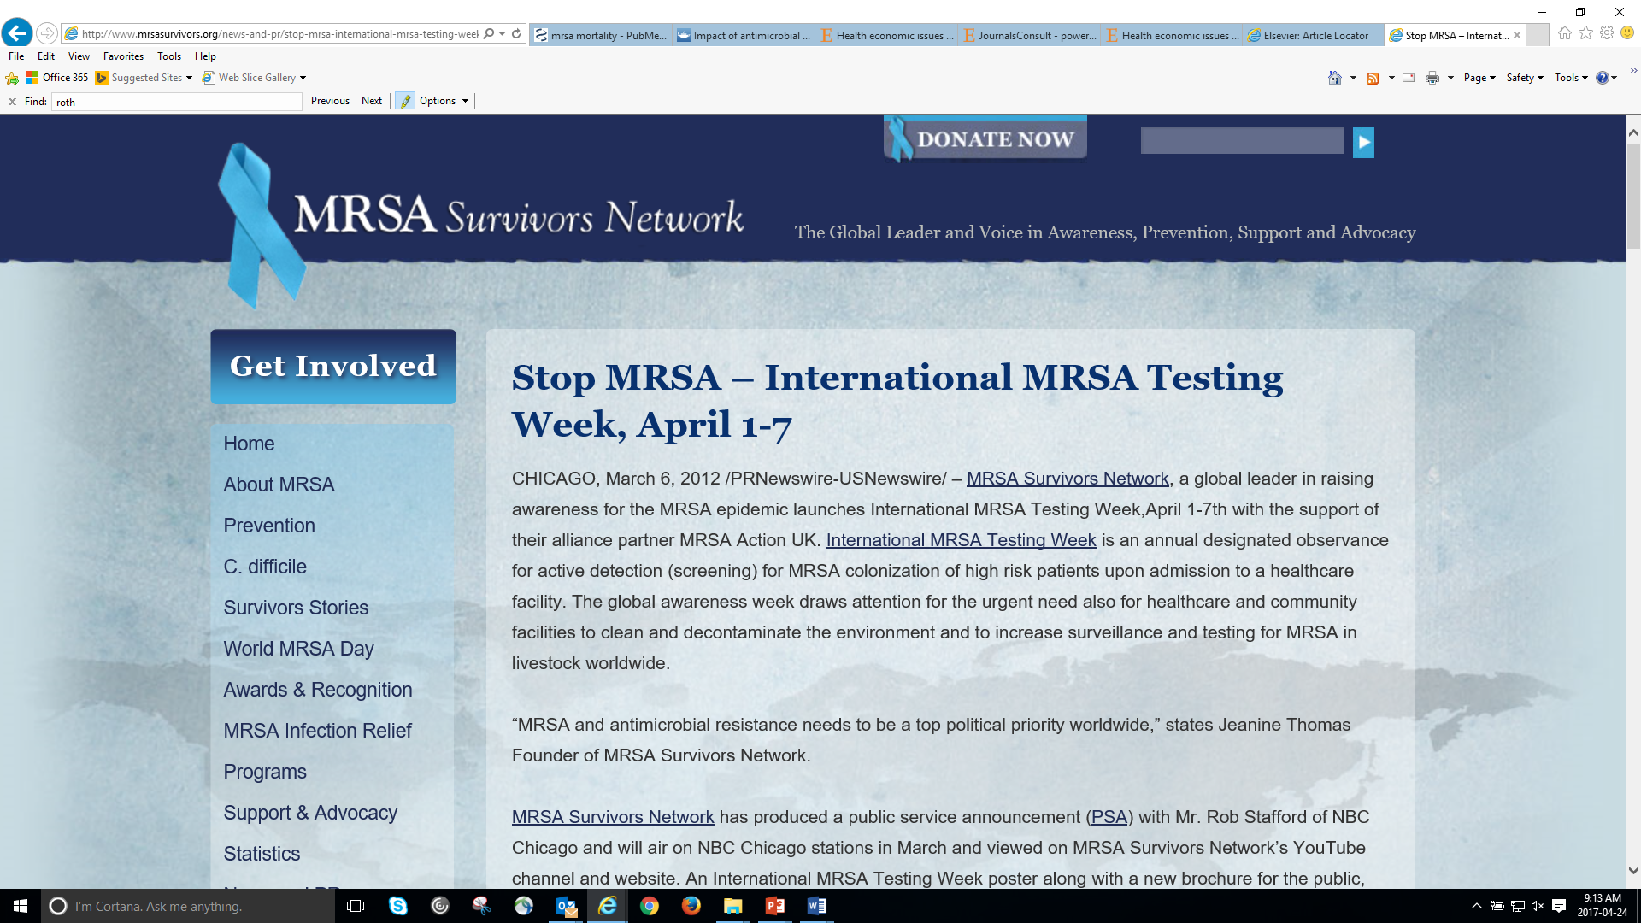

Slide 6
Methicillin-Resistant Staphylococcus aureus (MRSA)
Impact of Screening
Comparison | HCA-MRSA Acquisition | HCA-MRSA Infection
Universal vs No Screening |  | 45-70%
Universal vs Targeted Screening | NA | 0.12-52%
ICU Universal vs No Screening
Surgical Patients vs No Screening
Targeted vs No Screening
Glick et al. Am J Infect Control 2014

Slide 8
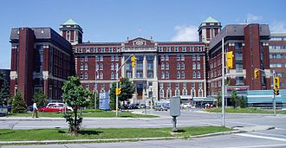
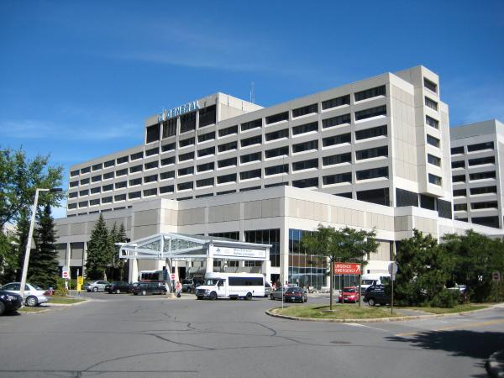
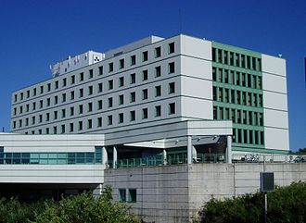
Setting
The Ottawa Hospital
  Multicenter tertiary care facility
  1,200 beds:
    med, surg, obstetrics, ICU, mental health, rehab
MRSA Control Measures:
  Targeted admission screening
  Contact Precautions: hand hygiene, gowns, gloves
  Contract screening, blocked beds
  Private room, bathroom
  Dedicated patient care equipment
  Decolonization not routinely performed

Slide 9
Staff at the Ottawa Hospital are Battling Outbreak of a Superbug
CJOH-TV
“Superbug” Hits
City Hospitals
The Ottawa Citizen
Hospital Battles Superbug
The Sun
Superbug Outbreak at the Ottawa Hospital, Civic Site
CJOH
Ottawa Hospital’s Civic Campus hit with Outbreak of Resistant Bacteria
CHRO

Slide 10
Our Burning Platform for Change
Risk-factor based (targeted) admission screening limited:
  Compliance 30 – 70%
  Missed Community MRSA
Economic models supported universal screening
  Projected > $400,000 annual savings
Recent switch to PCR testing
Lee et al. Infect Control Hosp Epidemiol 2010

Slide 11
Objectives
Assess the impact of universal admission screening on healthcare-associated MRSA rates
  All patients admitted through the ED
  All elective admissions
  All patients transferred from another institution
Compare the annual and per patient costs of universal versus risk factor-based MRSA screening

Slide 12
Study Design
Quasi-experimental
Risk Factor-Based Screening: 24 mo
Universal Screening: 20 mo
1º outcome: HCA-MRSA acquisition per 100,000 patient-days
Segmented regression analysis
2º outcomes (to account for threats to validity)
Incidence of HCA - C. difficile
Mupirocin use
Regional MRSA rates

Slide 13
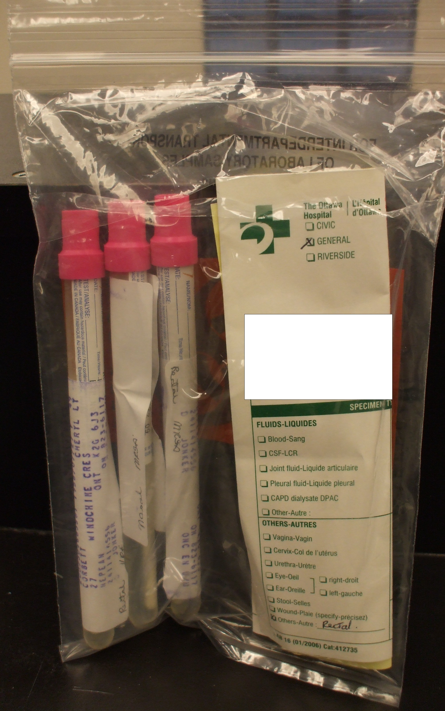
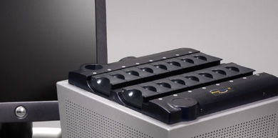
Lab Methods
Screening swabs from nares, rectum and open wounds
Incubated overnight in broth
Tested using RT-PCR
Culture confirmation of PCR positive
Results available within 24 hr

Slide 14
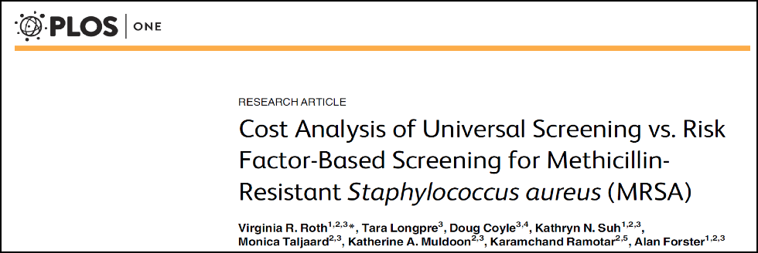
Cost Analysis
Operational costs of screening
  Specimen collection, lab costs
Costs of additional cases identified
  Infection control, contact precautions, housekeeping, private room
Cost savings of fewer nosocomial cases
  Healthcare costs of colonization & infection
Sensitivity analysis
2016

Slide 15
Methods – Decision Model

Slide 16
Results – Study Population
 | Risk-Factor Screening Jan 2006 – Dec 2007 | Universal Screening Jan 2008 – Aug 2009
Number of Admissions | 76,273 | 61,782
Number Screened (%) | 22,271 (29.2) | 51,815 (83.8)
Total MRSA positive cases on admission (% of admissions) | 745 (1.0) | 1,621 (2.6)
MRSA Detection Rate per 1,000 admissions | 9.8 | 26.2
Nosocomial MRSA Cases | 323 | 321
Nosocomial MRSA rate /100,000 pt days | 41.8 | 47.5
MRSA Bacteremia Cases | 14 | 14
MRSA Bacteremia rate /100,000 pt days | 1.8 | 2.1

Slide 17
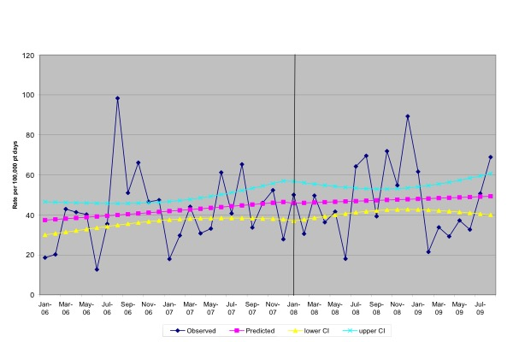
Healthcare-Associated MRSA Rates Pre- and Post-Intervention (Per 100,000 Patient Days)

Slide 18
Segmented regression modeling
 | MRSA Rates |  | CDI Rates |  | Mupirocin Prescription Rates |  | Regional MRSA Rates
 | Rate | p-value | Rate | p-value | Rate | p-value | Rate | p-value
Baseline rate per 100,000 pt-days | 46.79 |  | 41.01 |  | 76.22 |  | 7.39
Change in pre-intervention rate (24 month risk factor screening period) | 0.40 | 0.482 | -0.95 | 0.026 | 0.70 | 0.155 | 0.10 | 0.017
Change in pre-post rate (Immediate rate difference) | -1.11 | 0.923 | 12.52 | 0.142 | 3.93 | 0.694 | 0.83 | 0.316
Change in post-intervention rate (20 month universal screening period) | -0.21 | 0.826 | 0.24 | 0.753 | -0.78 | 0.331 | -0.20 | 0.004

Slide 19
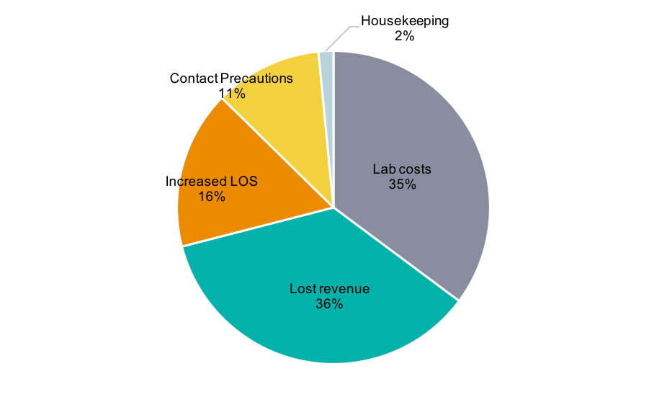
Cost Analysis of risk factor-based vs universal admission screening
 | % Patients Screened | Annual Cost | Cost per Patient
Risk Factor | 30 | $780,000 | $128.03
Universal | 83 | $1.94M | $145.79
Difference |  | $1.16M | $17.76
Universal Screening Costs

Slide 20
Sensitivity Analysis - Cost
Universal screening less costly when:
  MRSA prevalence is low (1-3%): $3.03 - $30.75 saved per patient screened
  Acquisition rates are very high (>60%): $0.74 saved per patient screened
Little impact:
  Probability of false negative, unknown
  Probability of MRSA acquisition, MRSA infection

Slide 21
Conclusions
Universal screening (vs Risk factor-based):
Improved MRSA detection 3-fold
Did not reduce MRSA acquisition
Did not impact MRSA bacteremia
Cost an additional $17.75 per patient

Slide 22
WHY didn’t it work?
Compliance with infection control practices <100%
Moderately low MRSA prevalence: 2.6%
84% admission screening compliance ≠ “universal”
Did not include impact of universal decolonization

Slide 23
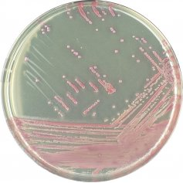
What’s An ICP to Do?
Screening
  Less costly rapid detection methods
  Risk-factor based (depending on local epidemiology):
    All patients admitted through ED
    All direct transfers
    All admissions to ICU and Rehab
Strict adherence to infection control measures
Consider universal decolonization
  May prevent 44% of colonization and 45% of infections
Gidengil et al. Infect Control Hosp Epidemiol 2015

Slide 24

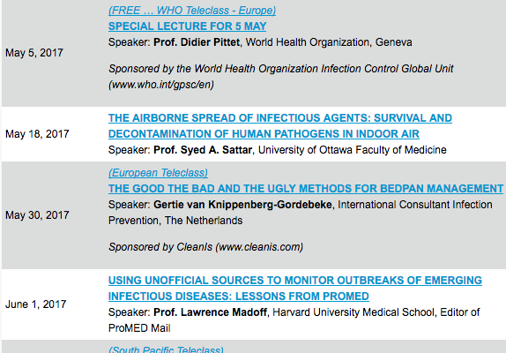

Slide 25


