Slide 1

COVID-19/SARS-CoV-2 PANDEMIC:
DRESS REHEARSAL FOR “DISEASE X”?
Stephen S. Morse
Professor, Epidemiology
ssm20@cumc.columbia.edu
Hosted by Paul Webber
paul@webbertraining.com
www.webbertraining.com
December 16, 2021

Slide 2

CONGRATULATIONS ON TELECLASS’ 20th ANNIVERSARY!

Slide 3
WHO 2018 Annual review of diseases prioritized under the R&D Blueprint
The second annual review occurred 6-7 February, 2018. Experts consider that given their potential to cause a public health emergency and the absence of efficacious drugs and/or vaccines, there is an urgent need for accelerated research and development for:
Crimean-Congo haemorrhagic fever (CCHF)
Ebola virus disease and Marburg virus disease
Lassa fever
Middle East respiratory syndrome coronavirus (MERS-CoV) and Severe Acute Respiratory Syndrome (SARS)
Nipah and henipaviral diseases
Rift Valley fever (RVF)
Zika
Disease X
Disease X represents the knowledge that a serious international epidemic could be caused by a pathogen currently unknown to cause human disease, and so the R&D Blueprint explicitly seeks to enable cross-cutting R&D preparedness that is also relevant for an unknown “Disease X” as far as possible

Slide 4
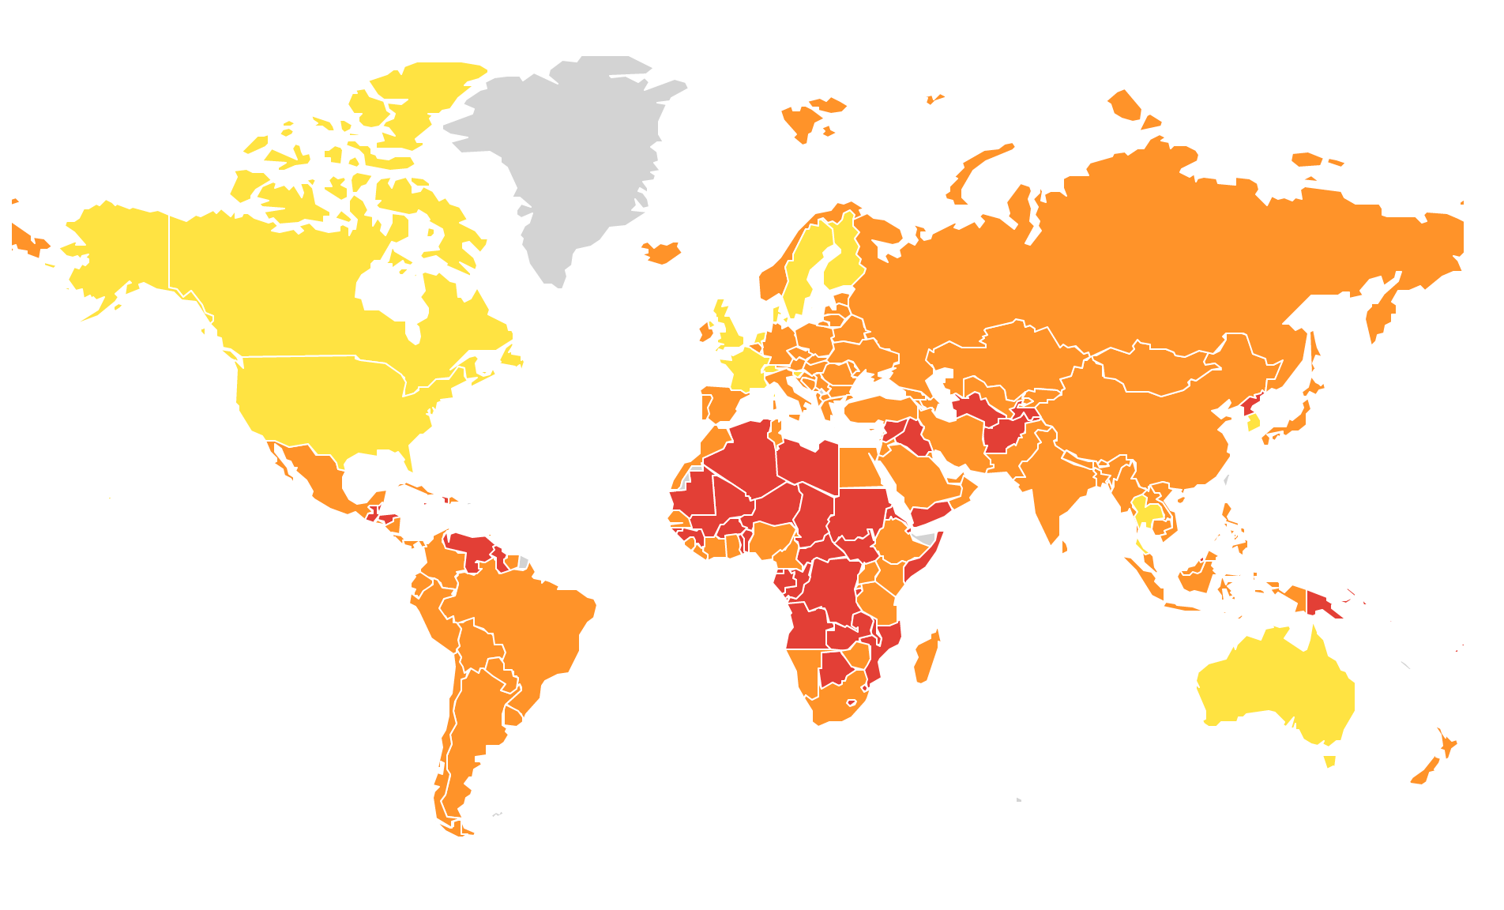
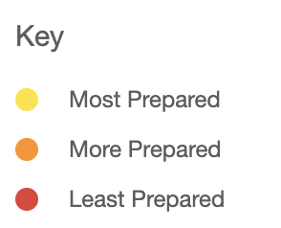
Global Health Security: Overall
Courtesy of Dr. Wilmot James
Source: https://www.ghsindex.org/

Slide 5
We had dress rehearsals for “Disease X”

Slide 6
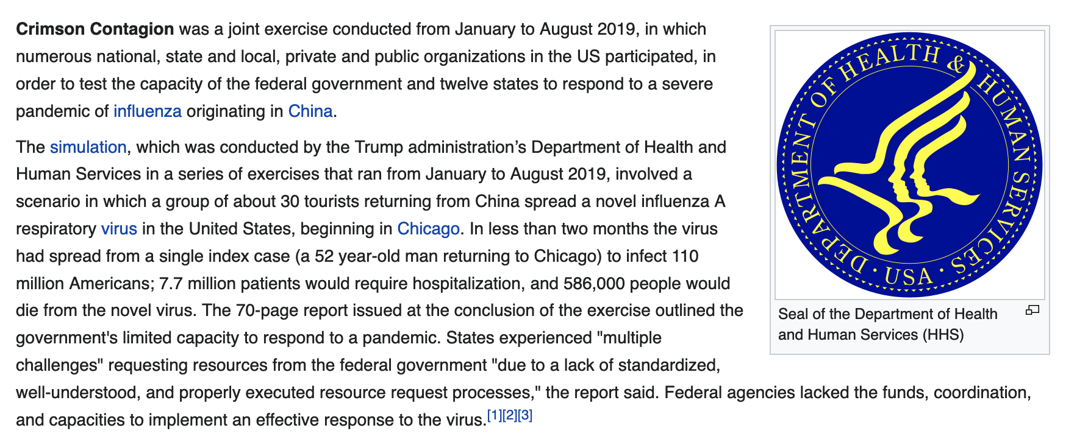
‘Crimson Contagion 2019’ Simulation Warned of Pandemic Implications in US
Wikipedia, https://en.wikipedia.org/wiki/Crimson_Contagion;
NY Times, March 19, 2020 (by David E. Sanger, Eric Lipton, Eileen Sullivan and Michael Crowley)

Slide 7
Event 201 (October, 2019) Johns Hopkins Center for Health Security
The Johns Hopkins Center for Health Security in partnership with the World Economic Forum and the Bill and Melinda Gates Foundation hosted Event 201, a high-level pandemic exercise on October 18, 2019, in New York, NY. The exercise illustrated areas where public/private partnerships will be necessary during the response to a severe pandemic in order to diminish large-scale economic and societal consequences.
The scenario ends at the 18-month point, with 65 million deaths. The pandemic is beginning to slow due to the decreasing number of susceptible people. The pandemic will continue at some rate until there is an effective vaccine or until 80-90 % of the global population has been exposed. From that point on, it is likely to be an endemic childhood disease.
https://www.centerforhealthsecurity.org/event201/

Slide 8

An interesting time to be an Epidemiologist!

Slide 9
“People ask me to predict the future, when all I want to do is prevent it.”
—Ray Bradbury

Slide 10
Emerging Infections
Those rapidly increasing in incidence (number of new cases) or geographic range
Often novel (a previously unrecognized disease)
Most are zoonotic (from other species)
Anthropogenic causes (such as land use change, agriculture, live animal markets) often important in emergence

Slide 11
Common Pathways for Emerging Infections
Wildlife contact
Hunting
Live animal markets and food handling
Healthcare settings (infection control)

Slide 12
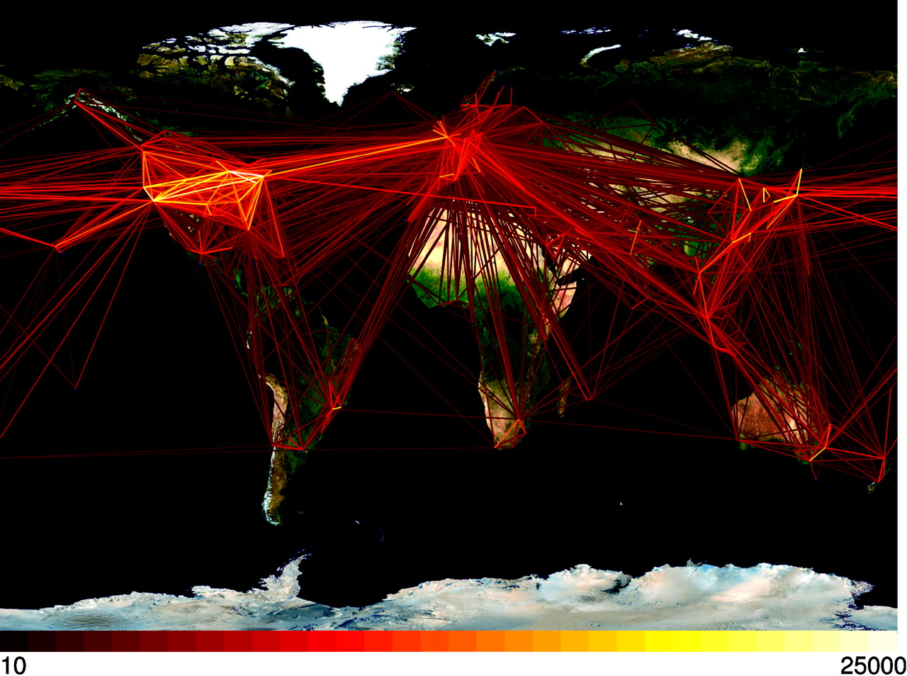
Global aviation network
Hufnagel, L. et al. (2004) Proc. Natl. Acad. Sci. USA 101, 15124-15129
Copyright ©2004 by the National Academy of Sciences

Slide 13
Zoonoses in disease emergence
1407 human pathogens
58% are zoonotic
130 of the 177 recently emerged pathogens zoonotic (RR=2.0)
Woolhouse ME, Gowtage-Sequeria S. Host range and emerging and reemerging pathogens. Emerg Infect Dis 2005; 11(12): 1842-7.

Slide 14
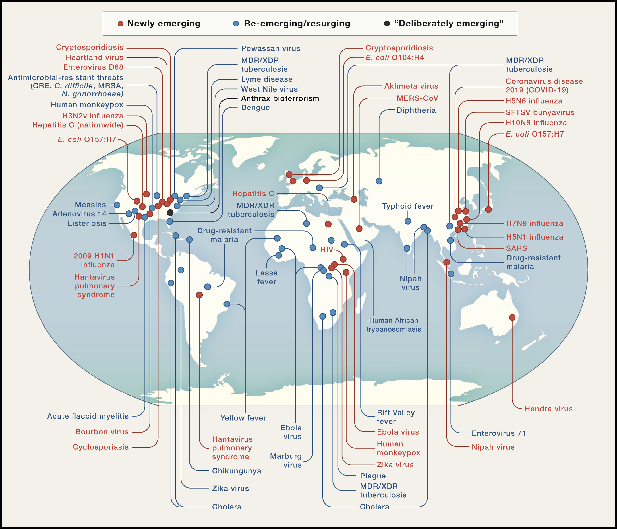
Global Examples of Emerging and Re-Emerging Infectious Diseases
Cell 2020 1821077-1092DOI: (10.1016/j.cell.2020.08.021)
David Morens and Anthony Fauci, NIAID
Copyright © 2020 Elsevier Inc.

Slide 15
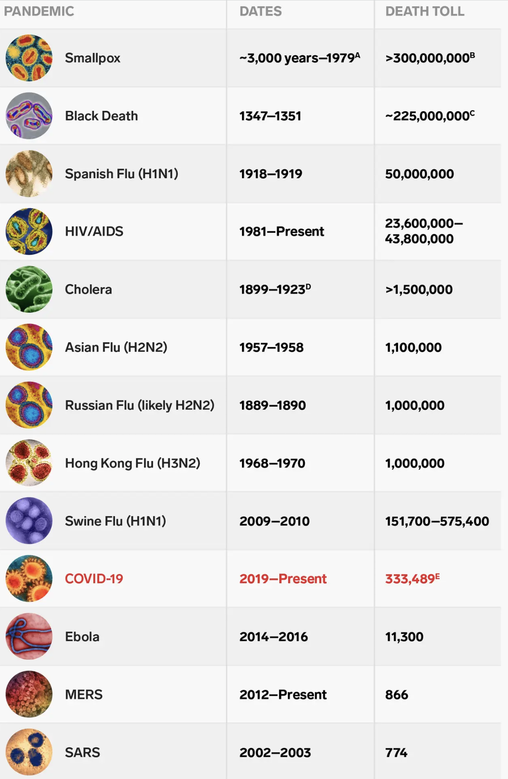
PANDEMICS IN HISTORY
Shayanne Gal/Business Insider, May 22, 2020
^{E:} COVID-19 deaths as of May, 2020; >5 M globally as of Dec. 12, 2021

Slide 16
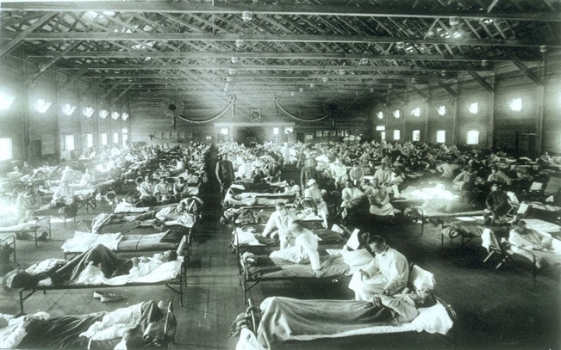
Influenza Pandemic 1918 at Camp Funston (Kansas)

Slide 17
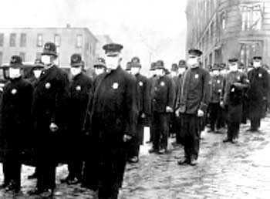
Influenza Pandemic, 1918

Slide 18
No pandemic or emerging infection has ever been predicted
--- Morse et al., Lancet 380: 1956–1965 (2012)
… and we can probably now say that
none has ever been stopped yet
18

Slide 19
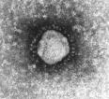
CORONAVIRUS

Slide 20
SARS
(Severe Acute Respiratory Syndrome)
2003

Slide 21
PNEUMONIA - CHINA (GUANGDONG): RFI
**********************************
A ProMED-mail post
<http://www.promedmail.org>
ProMED-mail is a program of the International Society for Infectious Diseases <http://www.isid.org>
[1]
Date: 10 Feb 2003
From: Stephen O. Cunnion, MD, PhD, MPH <cunnion@erols.com>
This morning I received this e-mail and then searched your archives and found nothing that pertained to it. Does anyone know anything about this problem?
"Have you heard of an epidemic in Guangzhou? An acquaintance of mine from a teacher's chat room lives there and reports that the hospitals there have been closed and people are dying.“
--
Stephen O. Cunnion, MD, PhD, MPH
International Consultants in Health, Inc
Member ASTM&H, ISTM
<cunnion@erols.com>

Slide 22
ProMED-mail: A Prototype Outbreak Reporting System
ProMED-mail: www.promedmail.org
Moderated listserv
Free to all
Started 1994
Approximately 70,000 subscribers in ≥185 countries

Slide 23
A Compliment?
"The popular ProMED-mail e-list offers a daily update on all the known disease outbreaks flaring up around the world, which surely makes it the most terrifying news source known to man."
– Steven Johnson
"The Ghost Map", p. 219
Riverhead Books/Penguin, 2006

Slide 24

Rhinolophus (“Horseshoe Bat”)
Natural host of SARS Coronavirus – and a number of other related coronaviruses
Sold in live animal markets in South China
EcoHealth Alliance

Slide 25
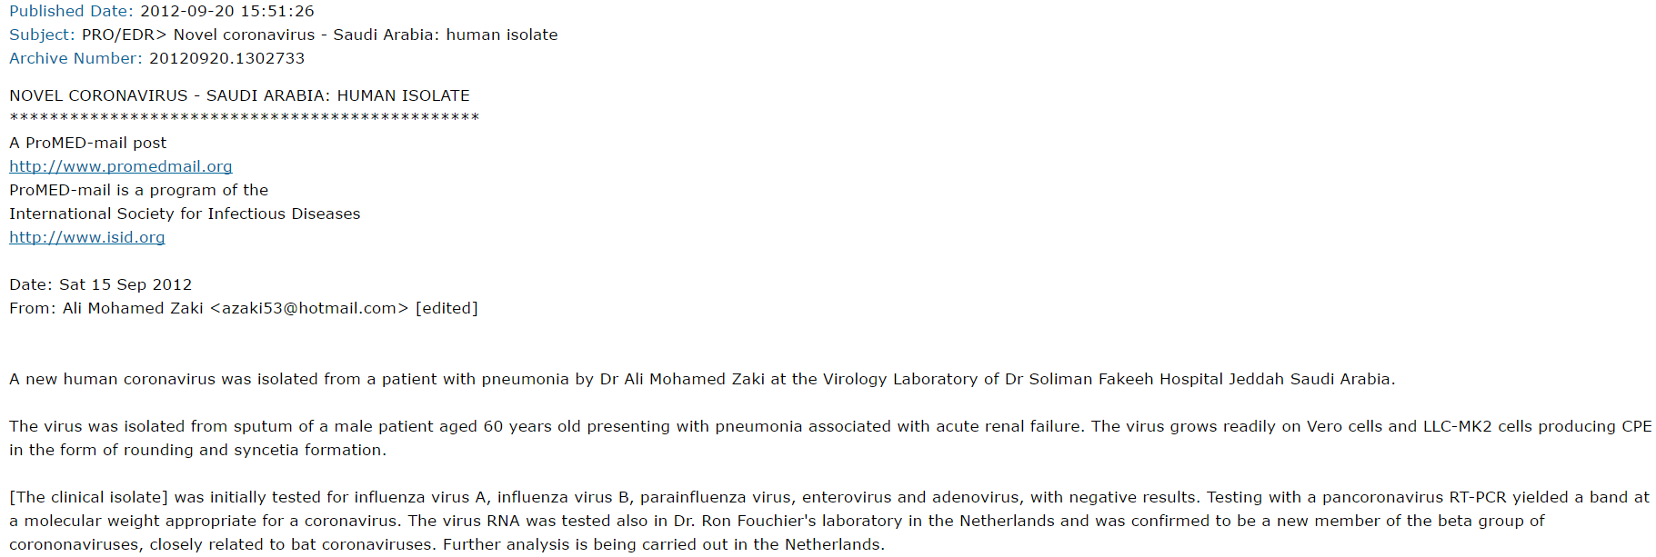

September 20, 2012
A ProMED Mail report details a novel human Coronavirus isolated from a 60 year old male patient in Jeddah, Saudi Arabia
25

Slide 26
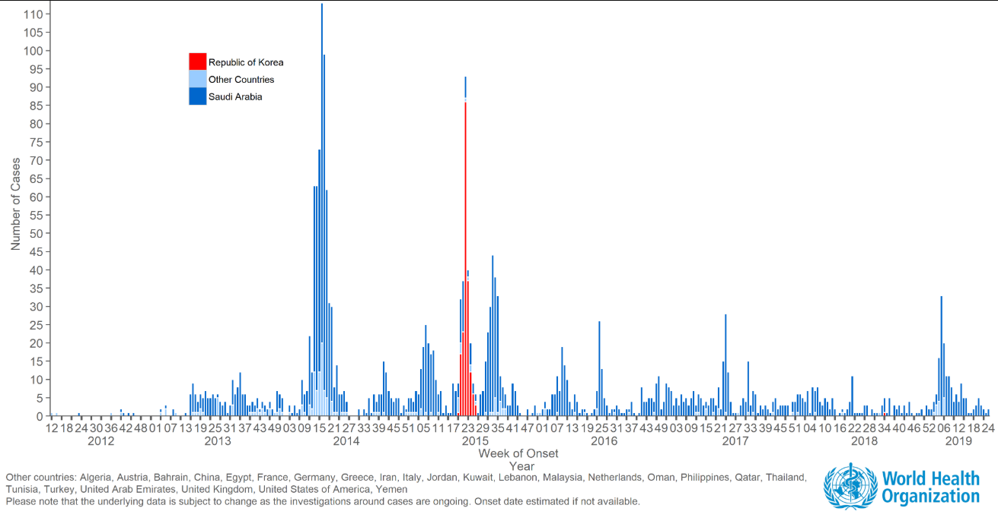
MERS Cases (total, to Dec. 2020): 2564
Deaths: 881 (case-fatality ratio 34.4%)
*Republic of Korea, May-June 2015:
185 cases (36 deaths)

Slide 27
… And now …
SARS-CoV-2
(COVID-19)

Slide 28
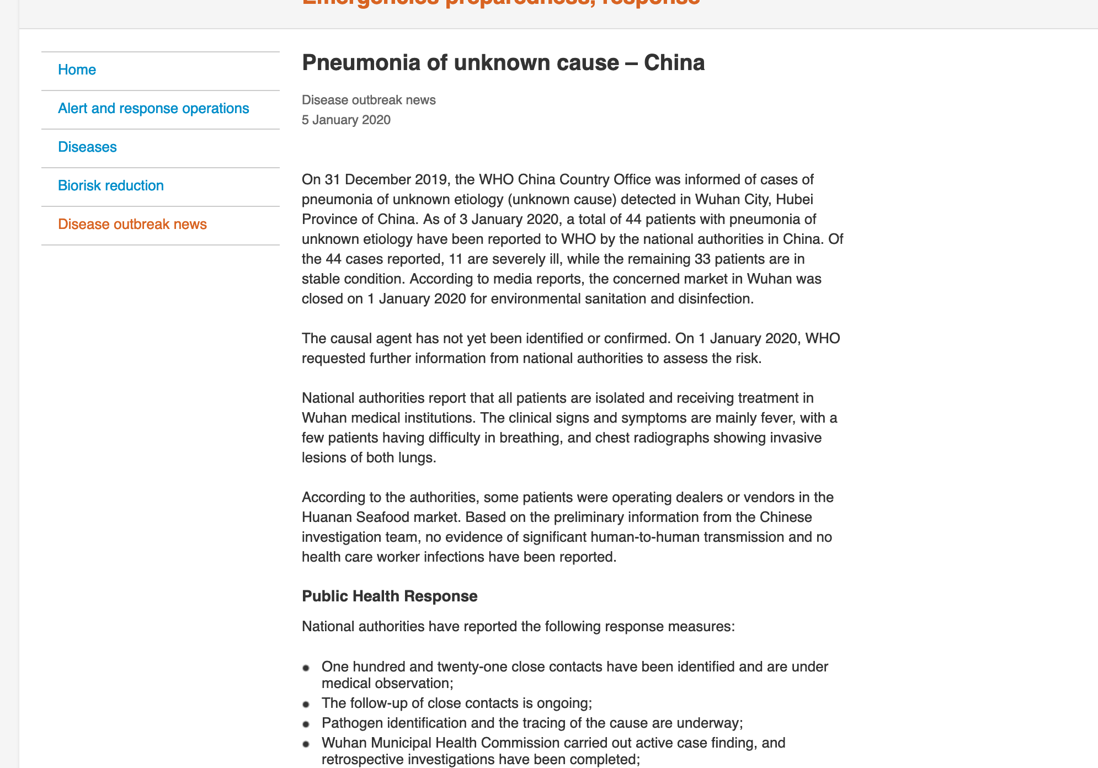
WHO

Slide 29
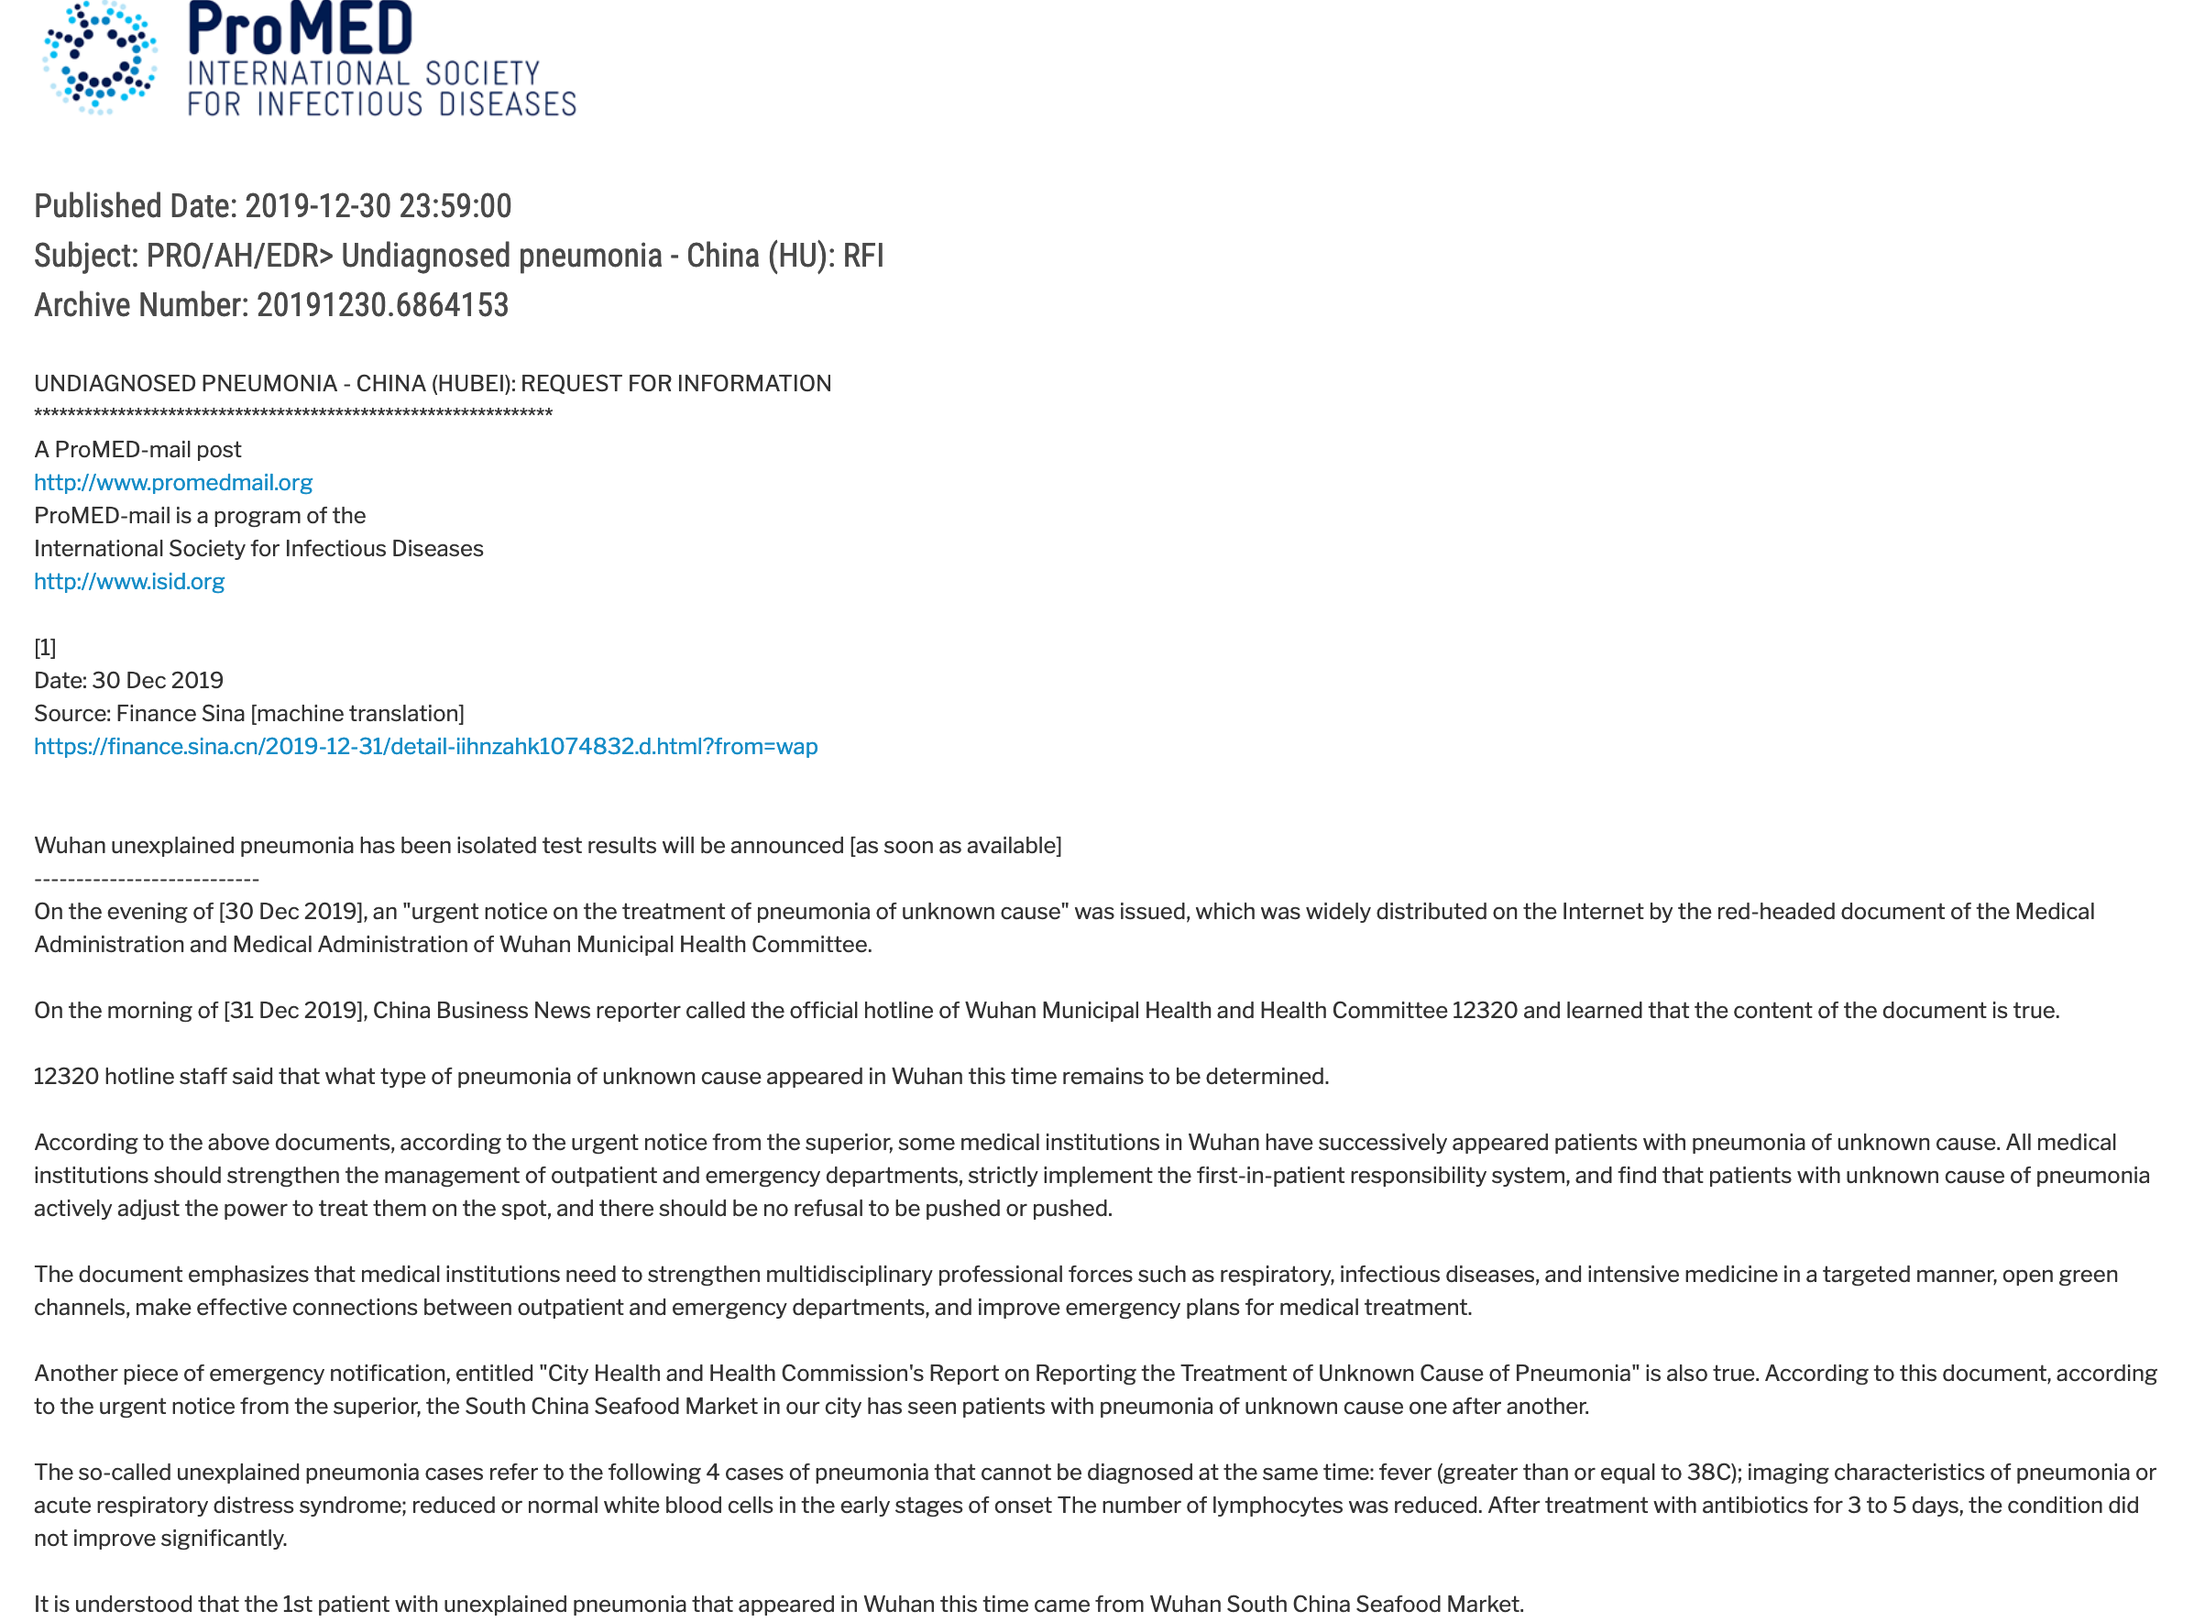

Slide 30
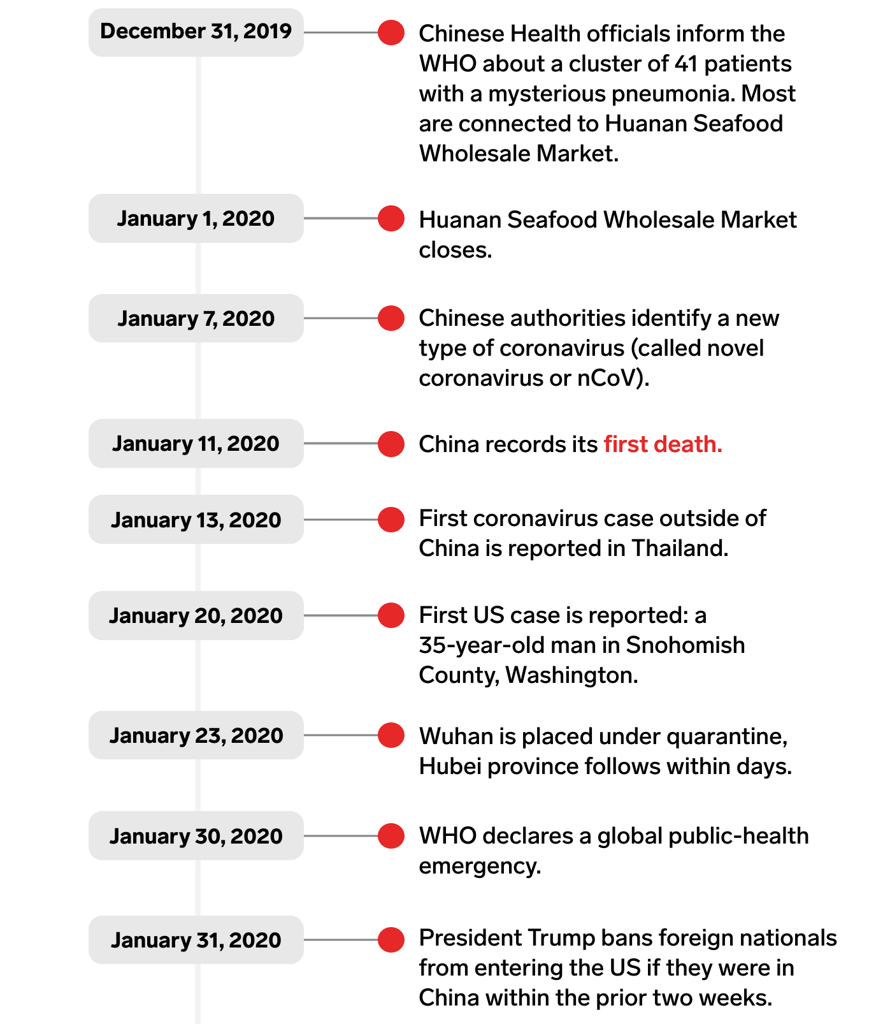
ProMED posting:
Dec. 30/31
Timeline
Business Insider

Slide 31
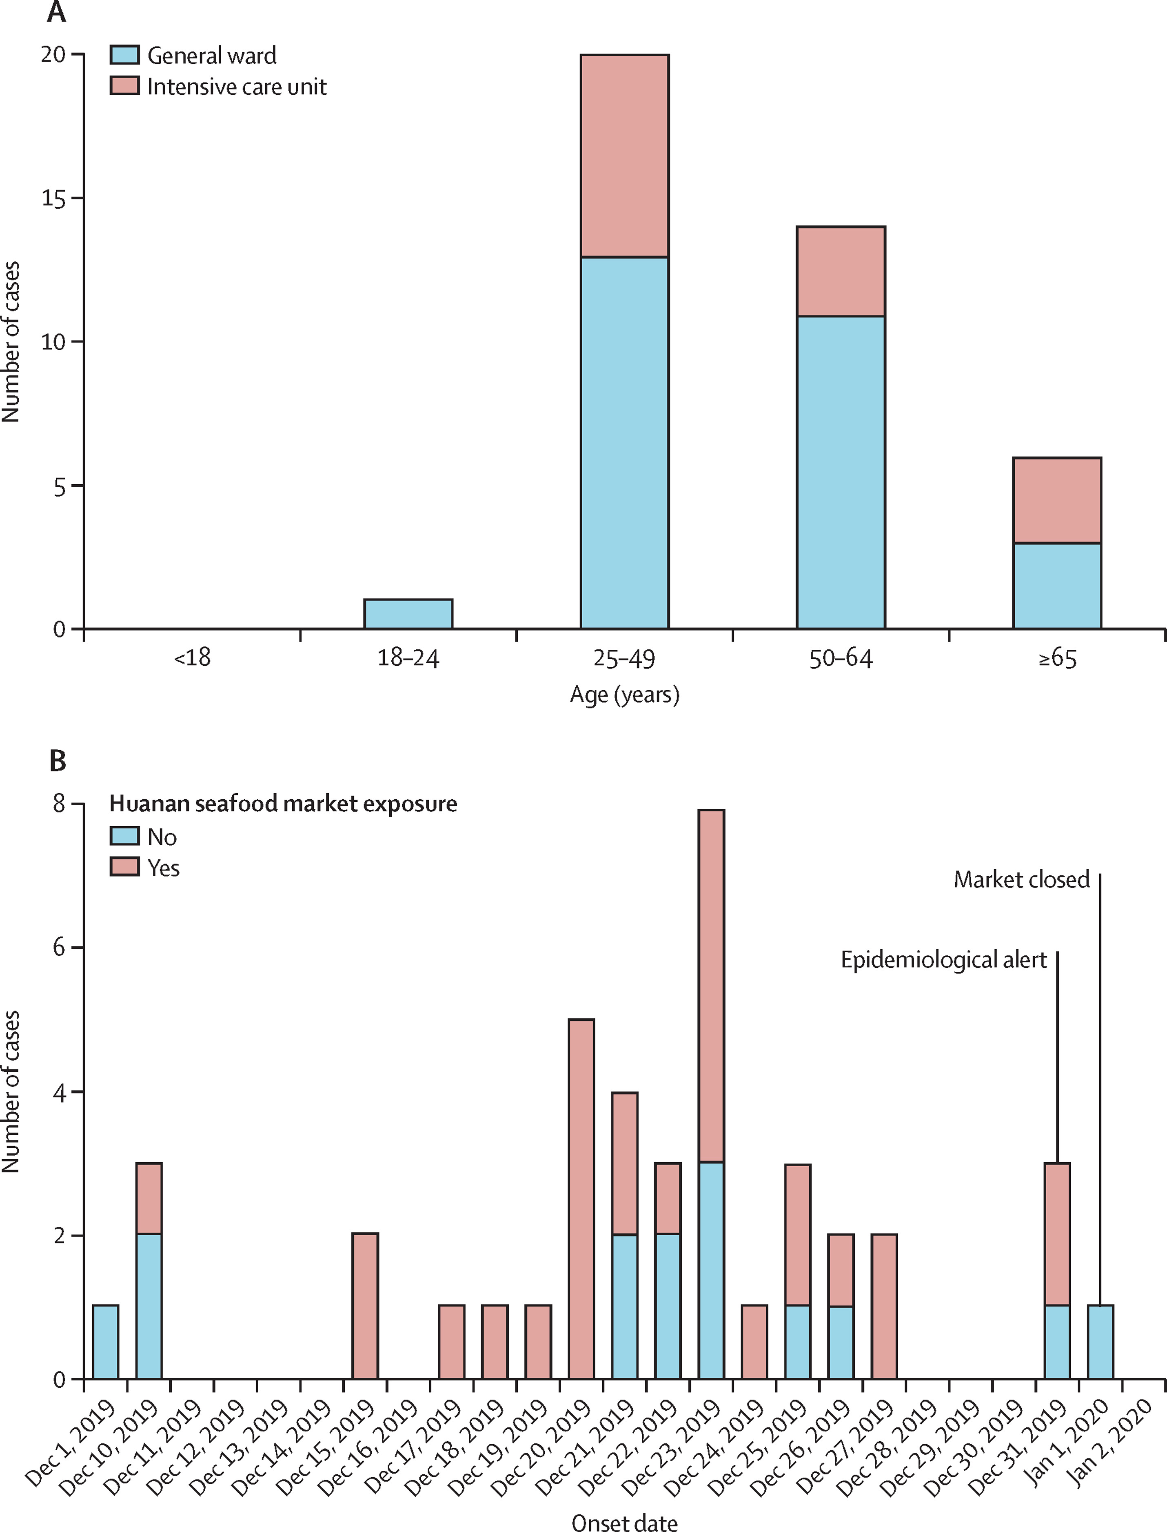

Figure 1
Date of illness onset and age distribution of patients with laboratory-confirmed 2019-nCoV infection
Huang C et al. Lancet Volume 395 Issue 10223 Pages 497-506 (February 2020)
DOI: 10.1016/S0140-6736(20)30183-5
31

Slide 32
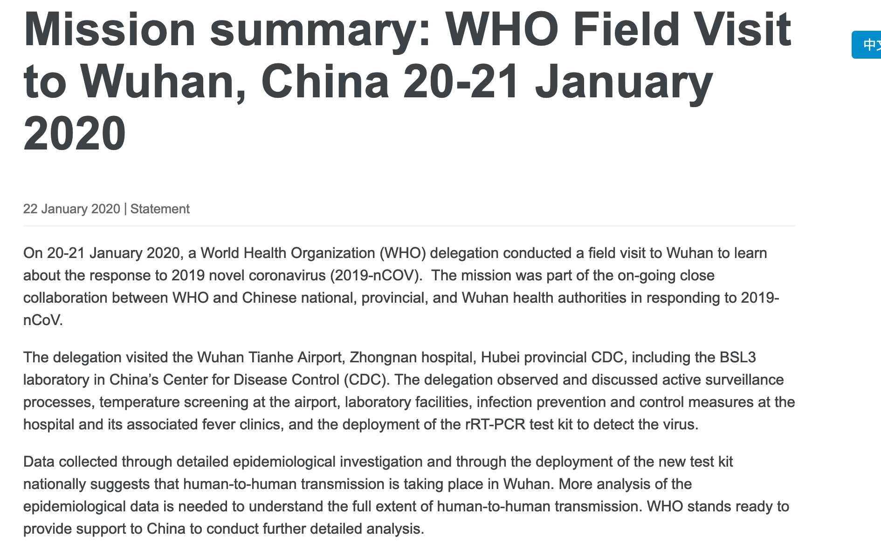
32

Slide 33
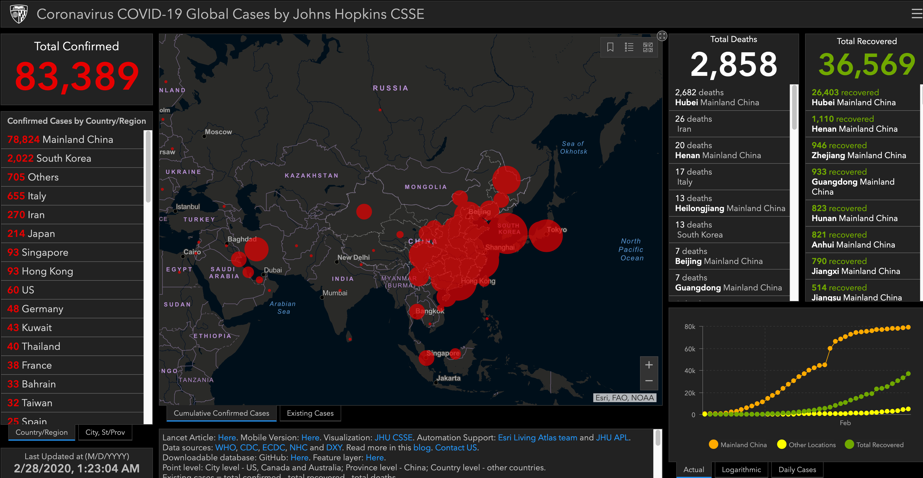
The situation as of Feb. 28, 2020
33

Slide 34
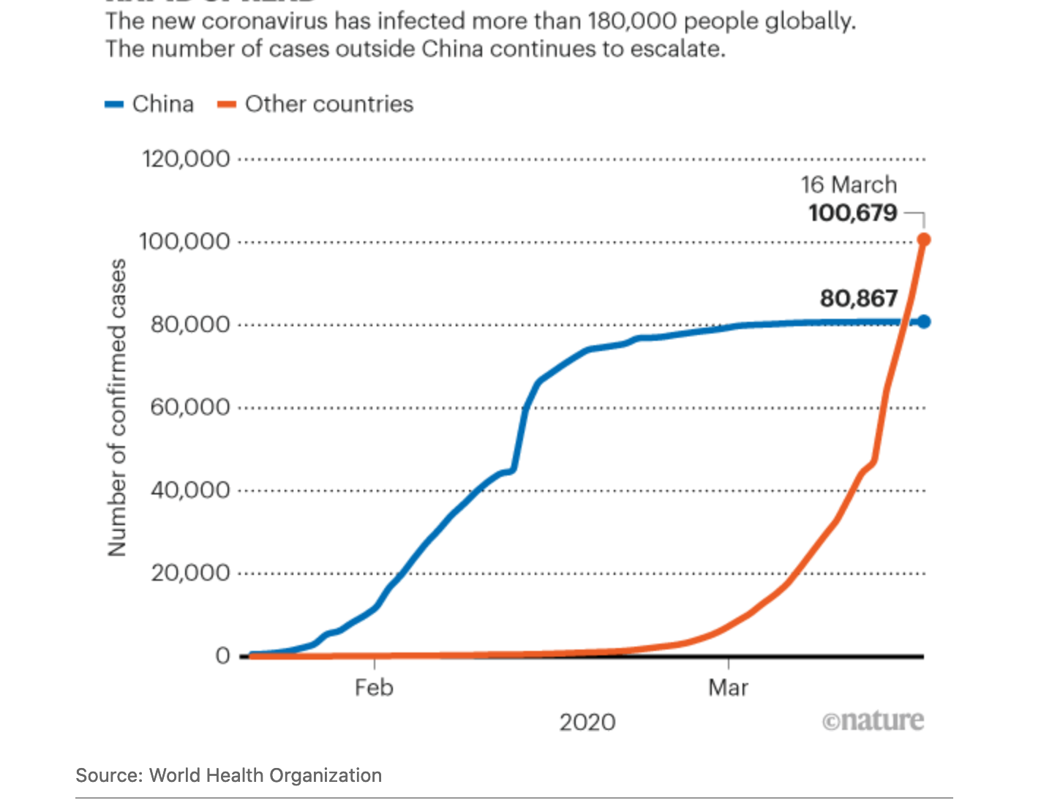
BY MARCH 2020

Slide 35
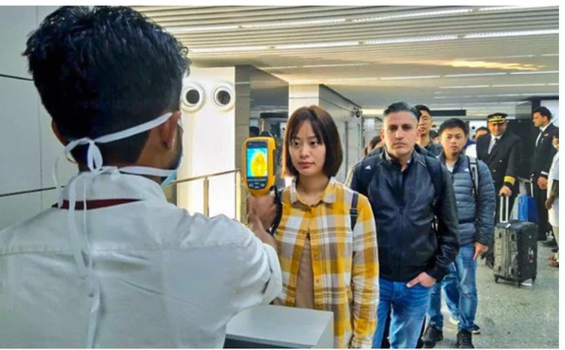
U.S. Begins Airport Screening from Wuhan Jan. 17
(For illustrative purposes; this is
actually Kolkata Airport)

Slide 36

International Arrivals at DFW Airport, Mar. 14, 2020
New York Times, Mar. 15, 2020

Slide 37
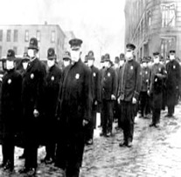
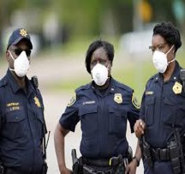
THEN AND NOW …
Influenza Pandemic, 1918
SARS-CoV-2 Pandemic, 2020

Slide 38
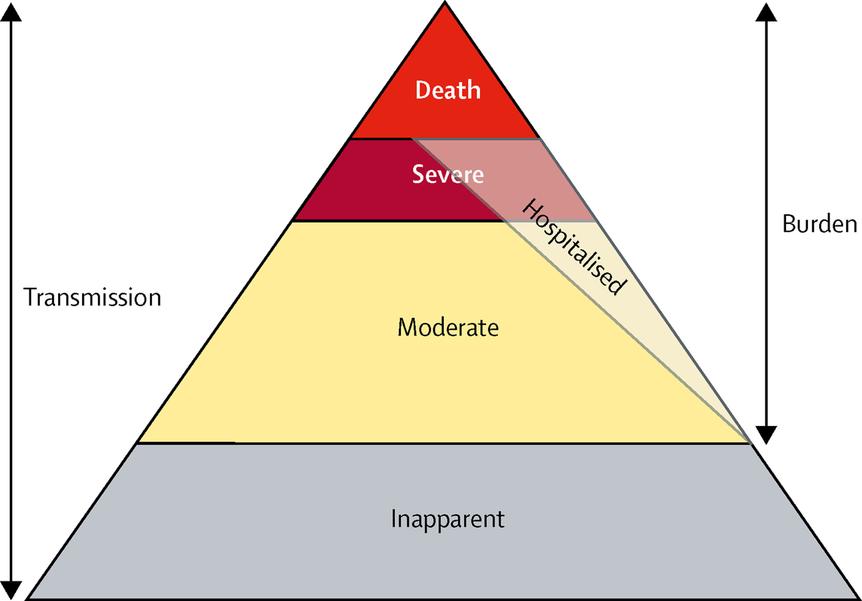
Figure 1
Copyright © 2019 The Author(s). Published by Elsevier Ltd. This is an Open Access article under the CC BY 4.0 license Terms and Conditions
The Lancet Respiratory Medicine 2019 769-89DOI: (10.1016/S2213-2600(18)30496-X)

Slide 39
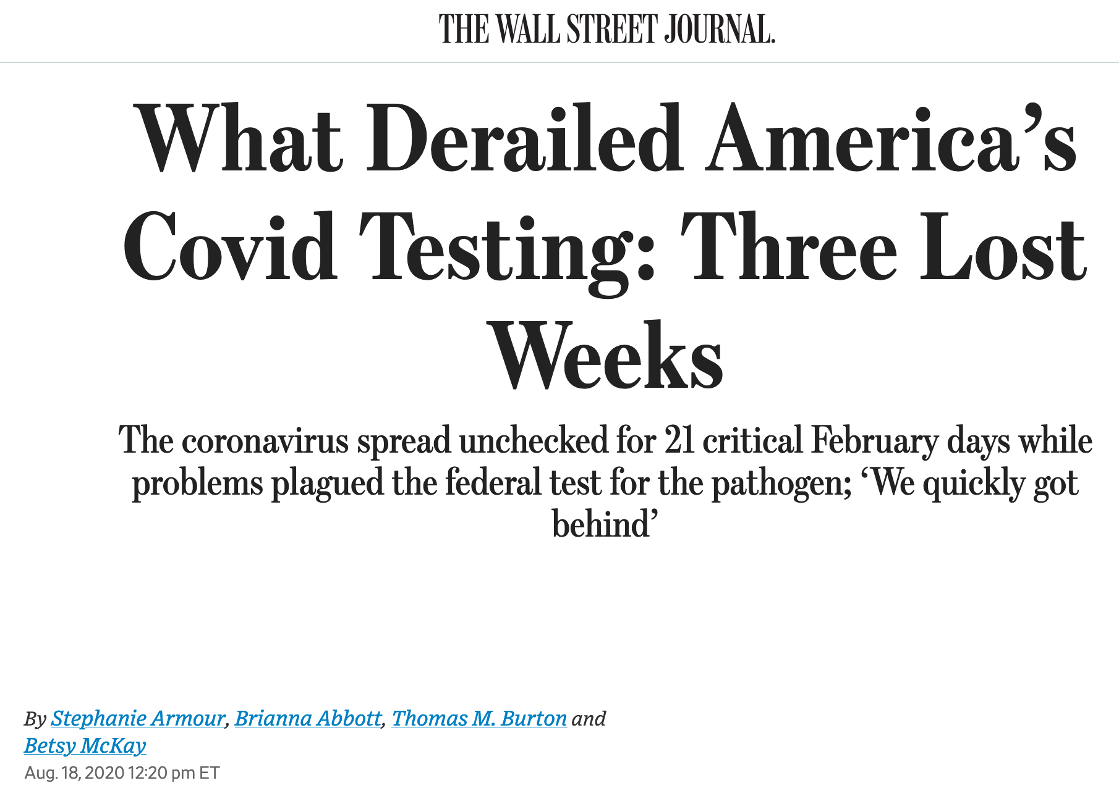

Slide 40
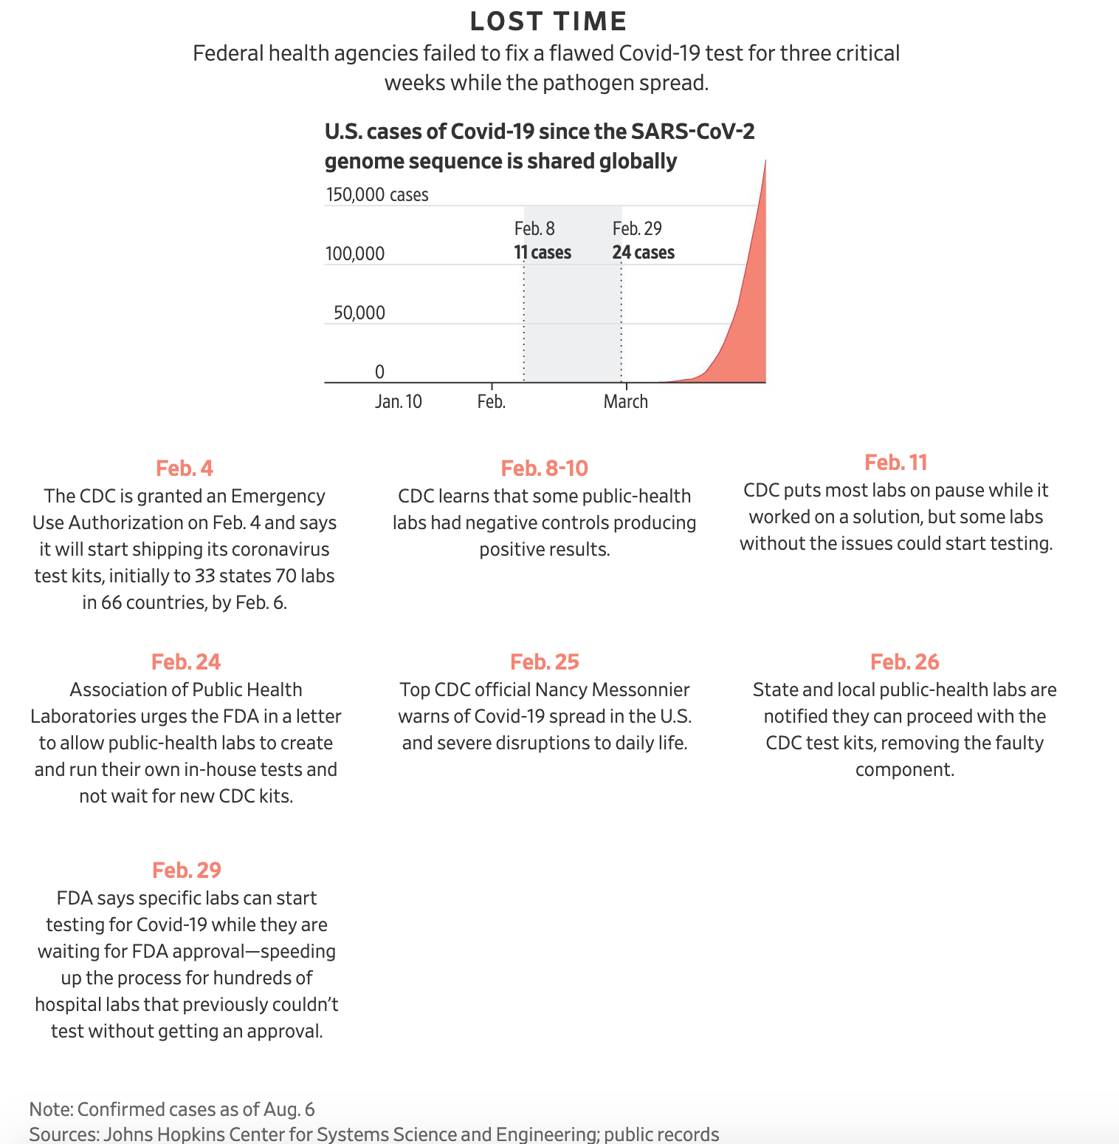
Wall Street Journal, Aug. 19, 2020

Slide 41

WHY WOULD A PANDEMIC BECOME A POLITICAL ISSUE?
Anti-Mask Demonstrations, Michigan State House, May 1, 2020

Slide 42
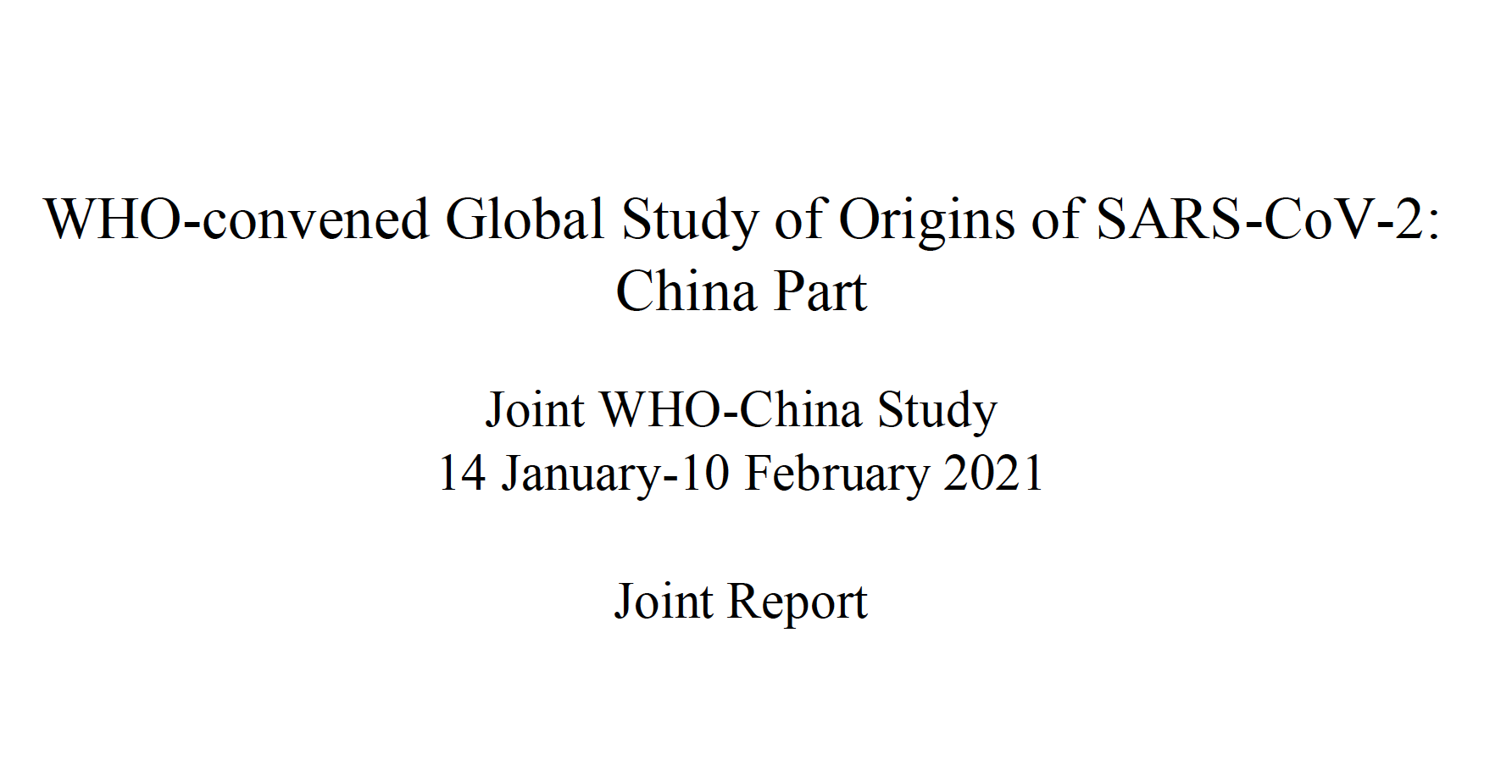

Slide 43
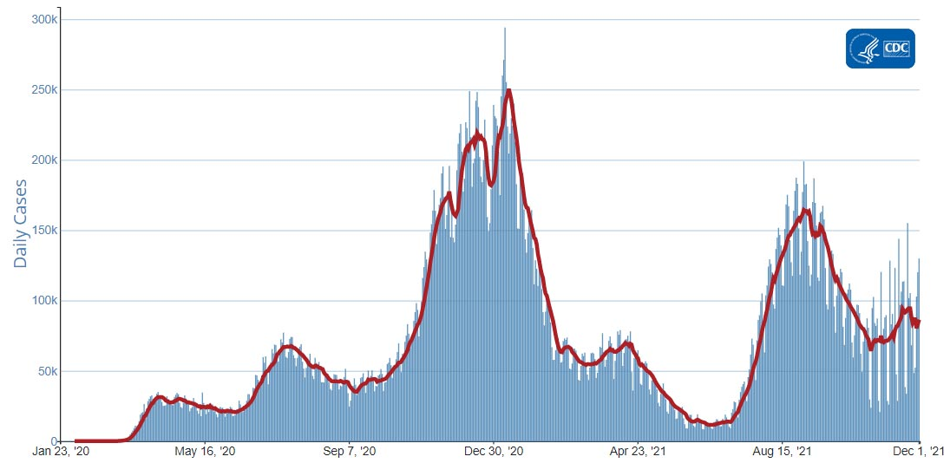
AVERAGE DAILY CASES IN U.S. (CDC)

Slide 44
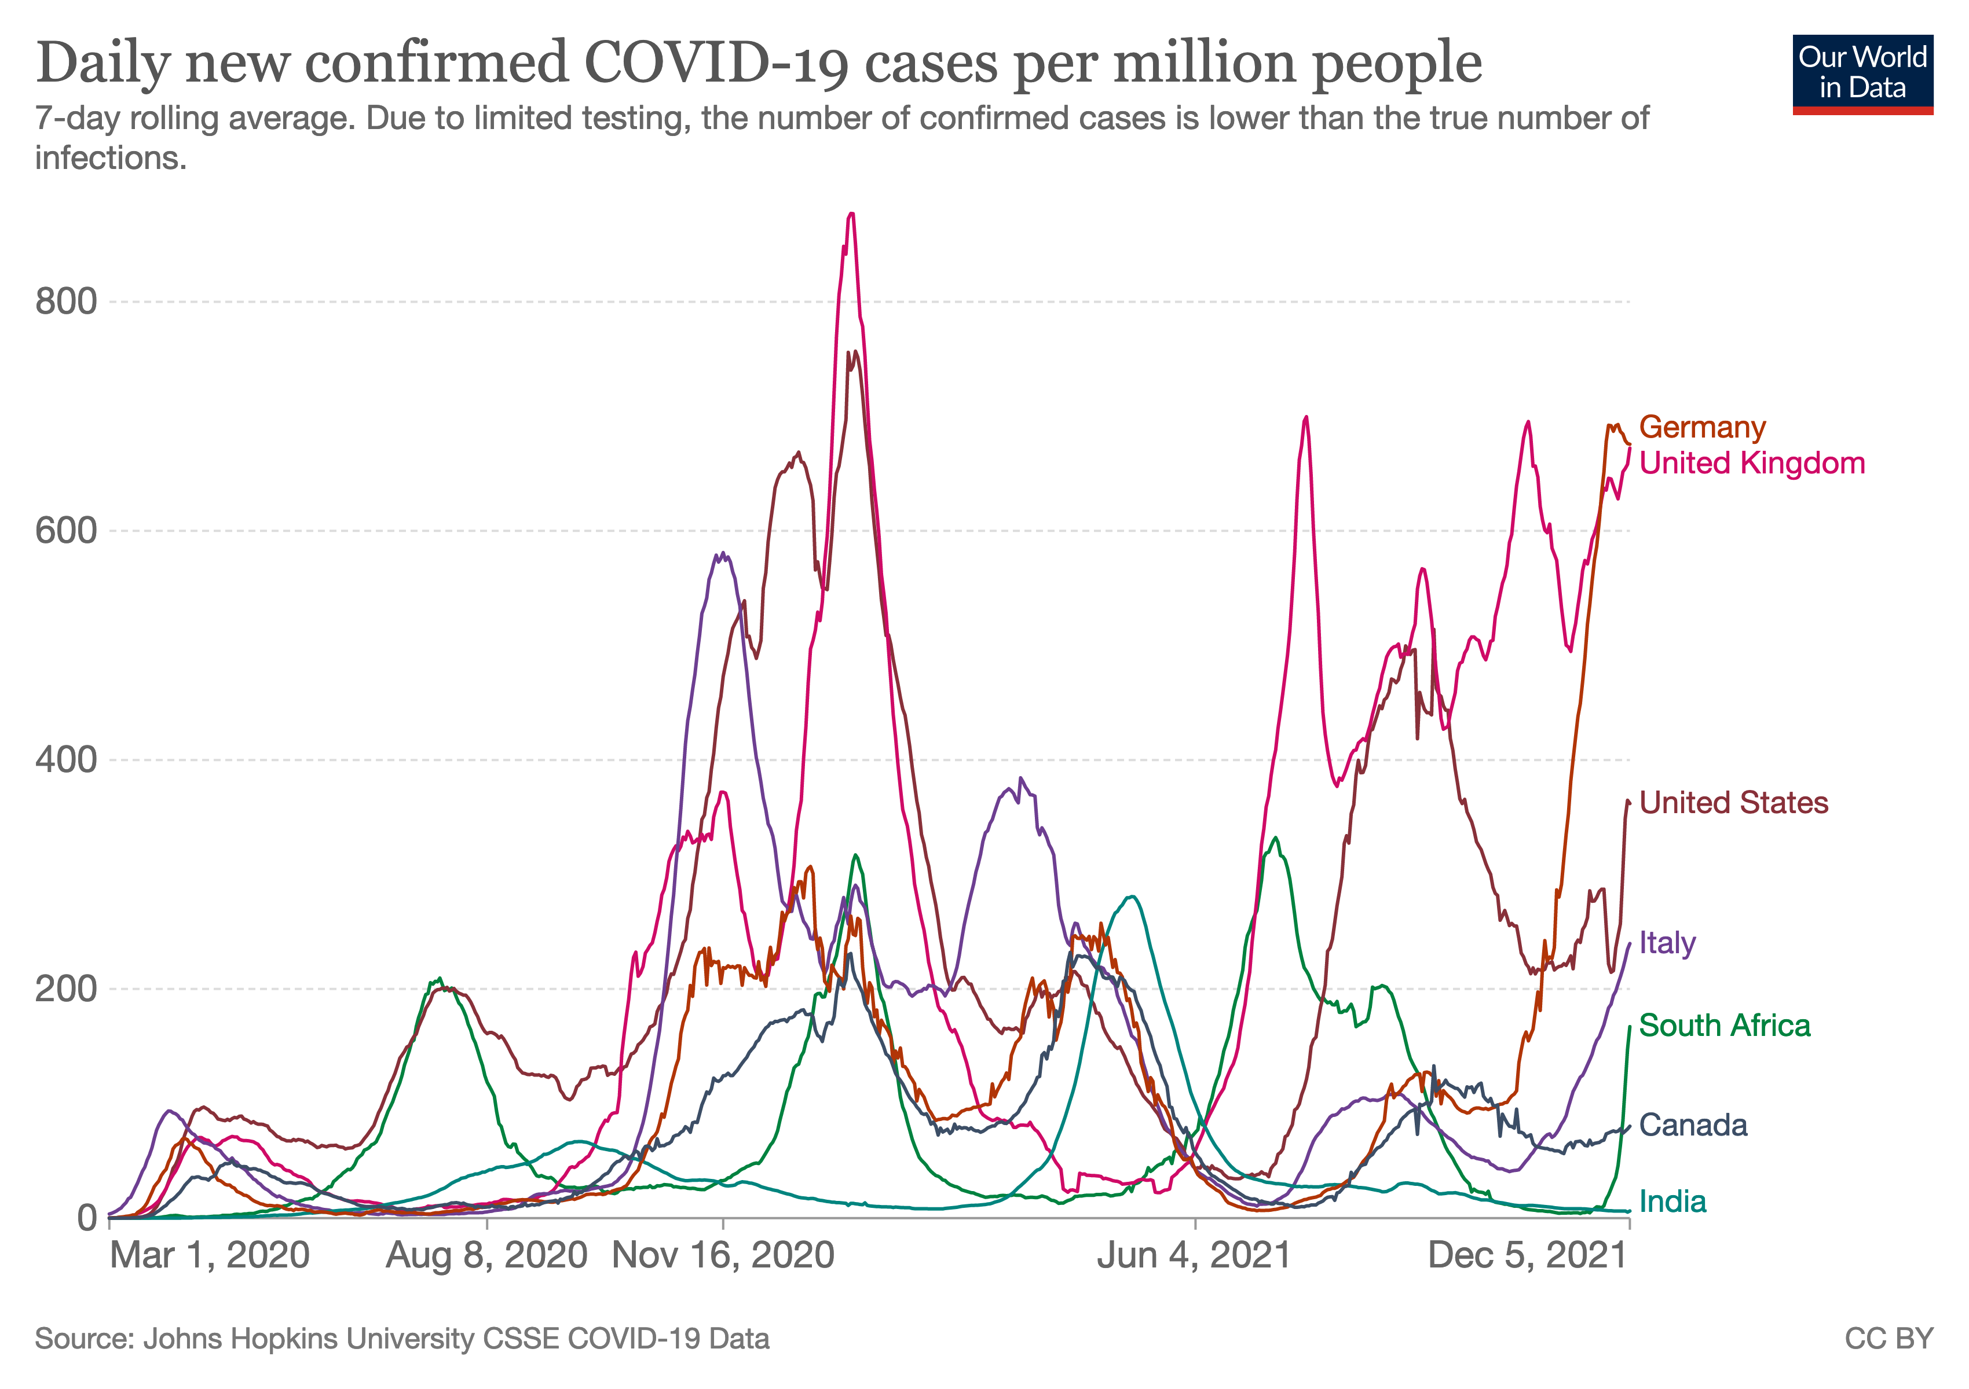

Slide 45
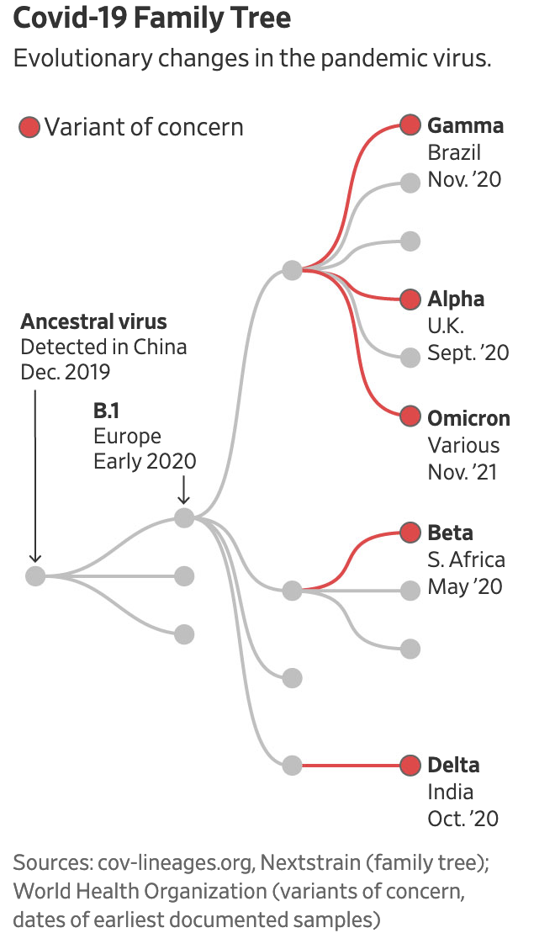
Wall Street Journal, Dec. 4, 2021

Slide 46










Measures to control transmission ultimately affect the rise and impact of viral variants
As RNA virus replicates, most or all progeny have mutations
With more virus, greater opportunity for variety of variants to evolve and spread
New opportunities for additional variants as this cycle repeats
Preventing infection and transmission slows the evolution of new variants, and their spread

Slide 47
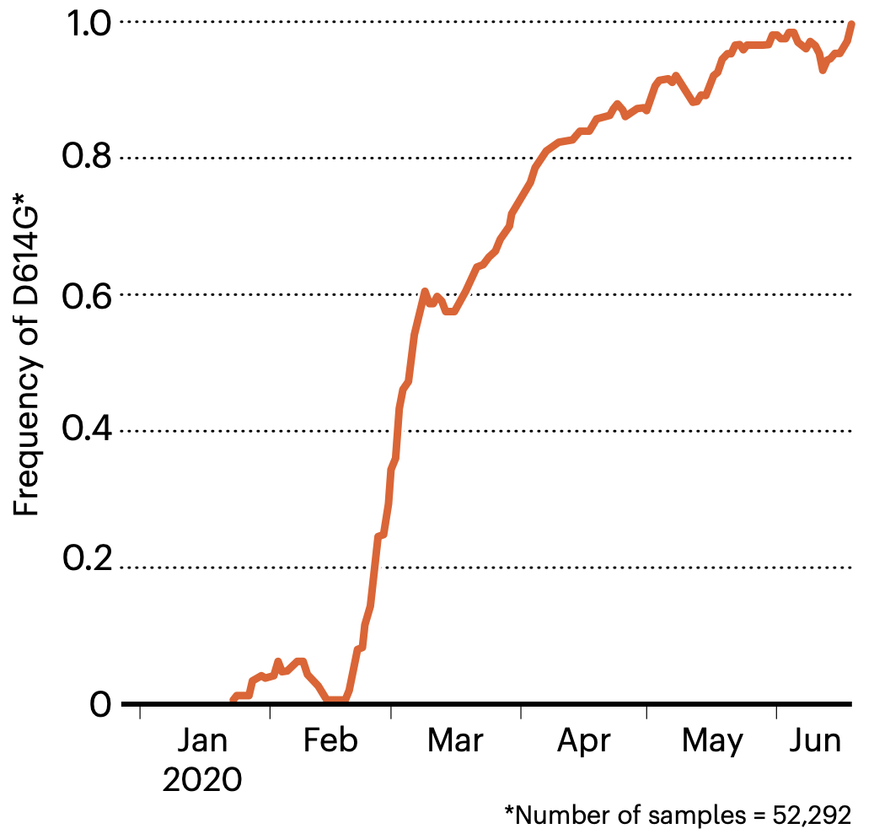
Global spread
By the end of June, the D614G mutation was found in almost all SARS-CoV-2 samples worldwide
Callaway E. Making Sense Of Coronavirus Mutations. Nature, Vol 585, 10 Sept 2020. https://media.nature.com/original/magazine-assets/d41586-020-02544-6/d41586-020-02544-6.pdf.
Accessed 9 Mar 2021. Data: Korber, B. et al. Cell 182, 812–827 (2020).
47

Slide 48
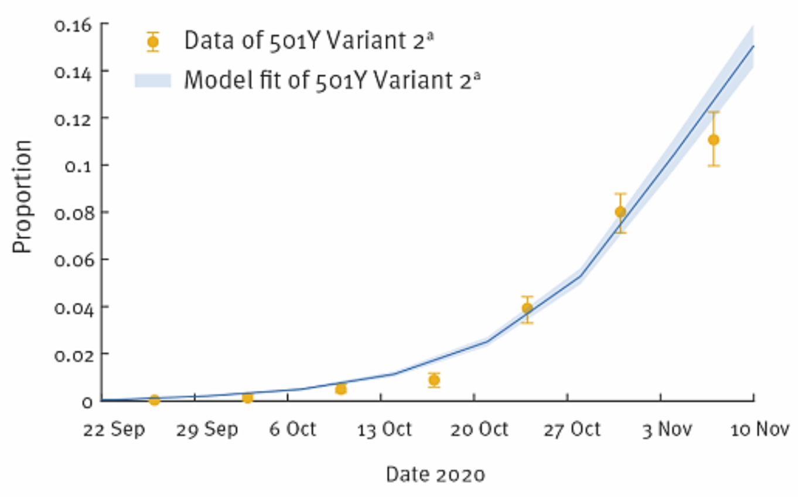
SARS-CoV-2 501Y variant 2 (B.1.1.7; Alpha) in U.K.
CDC, COVID-19 Science Update, Transmission. 22 Jan 2021, Ed. 73. https://www.cdc.gov/library/covid19/01222021_covidupdate.html Accessed 9 Mar 2021.

Slide 49
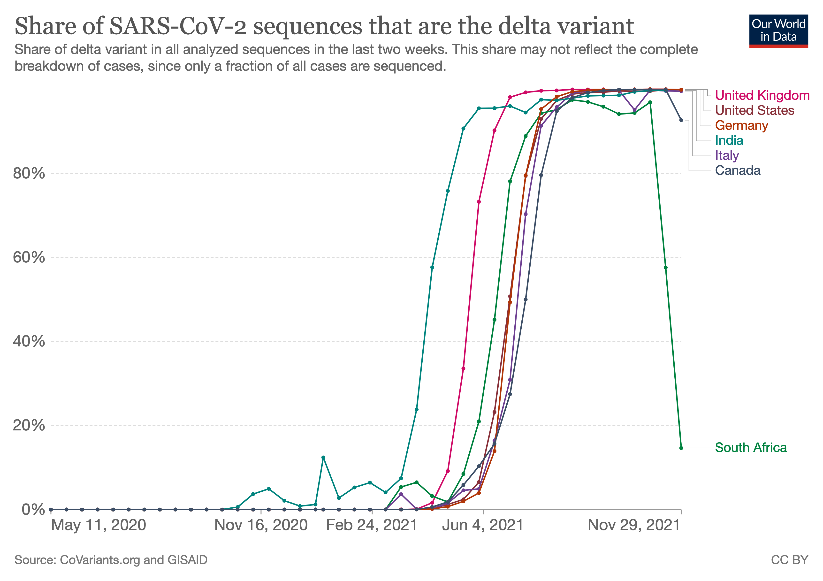

Slide 50
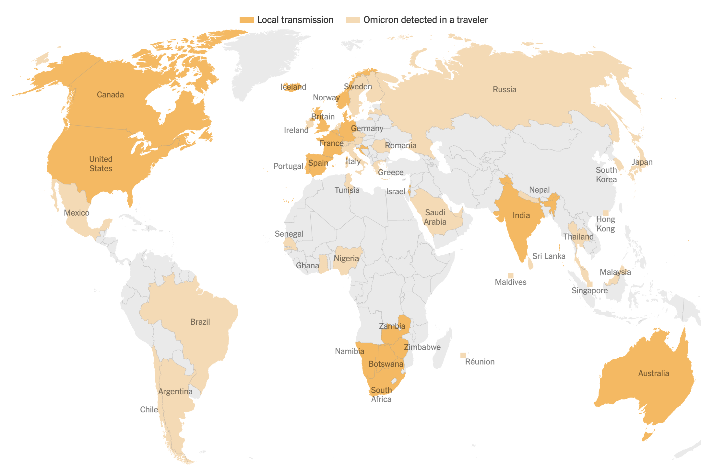
… and now Omicron
NY Times

Slide 51
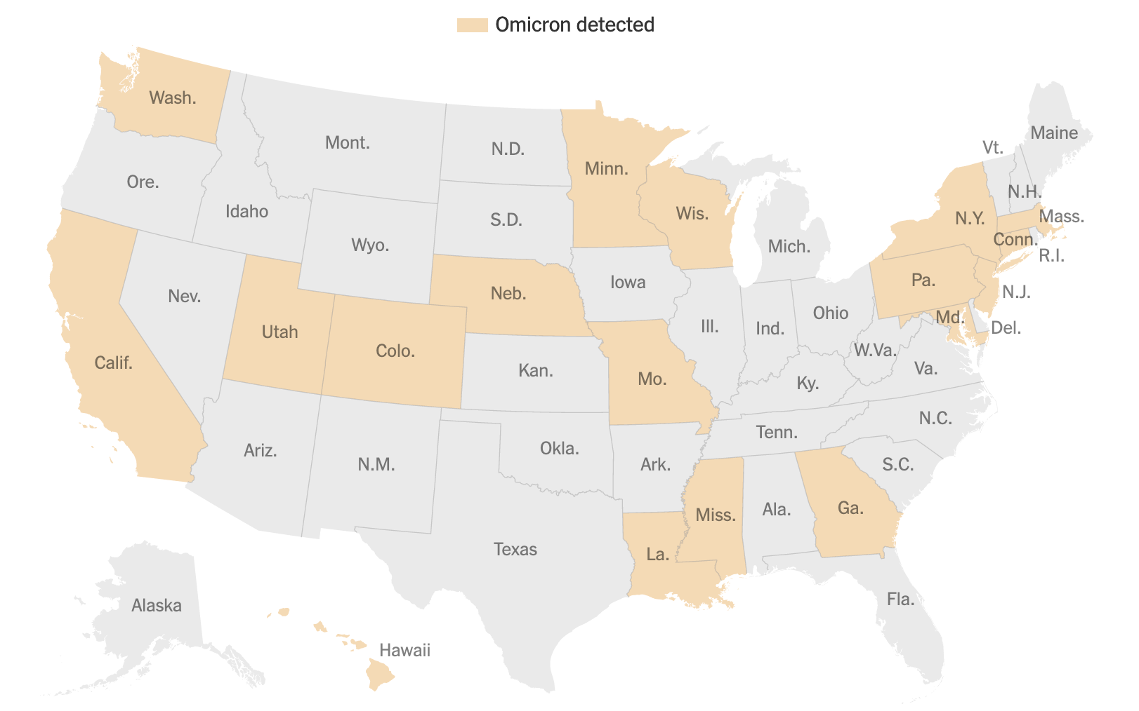
NY Times; Data: CDC

Slide 52
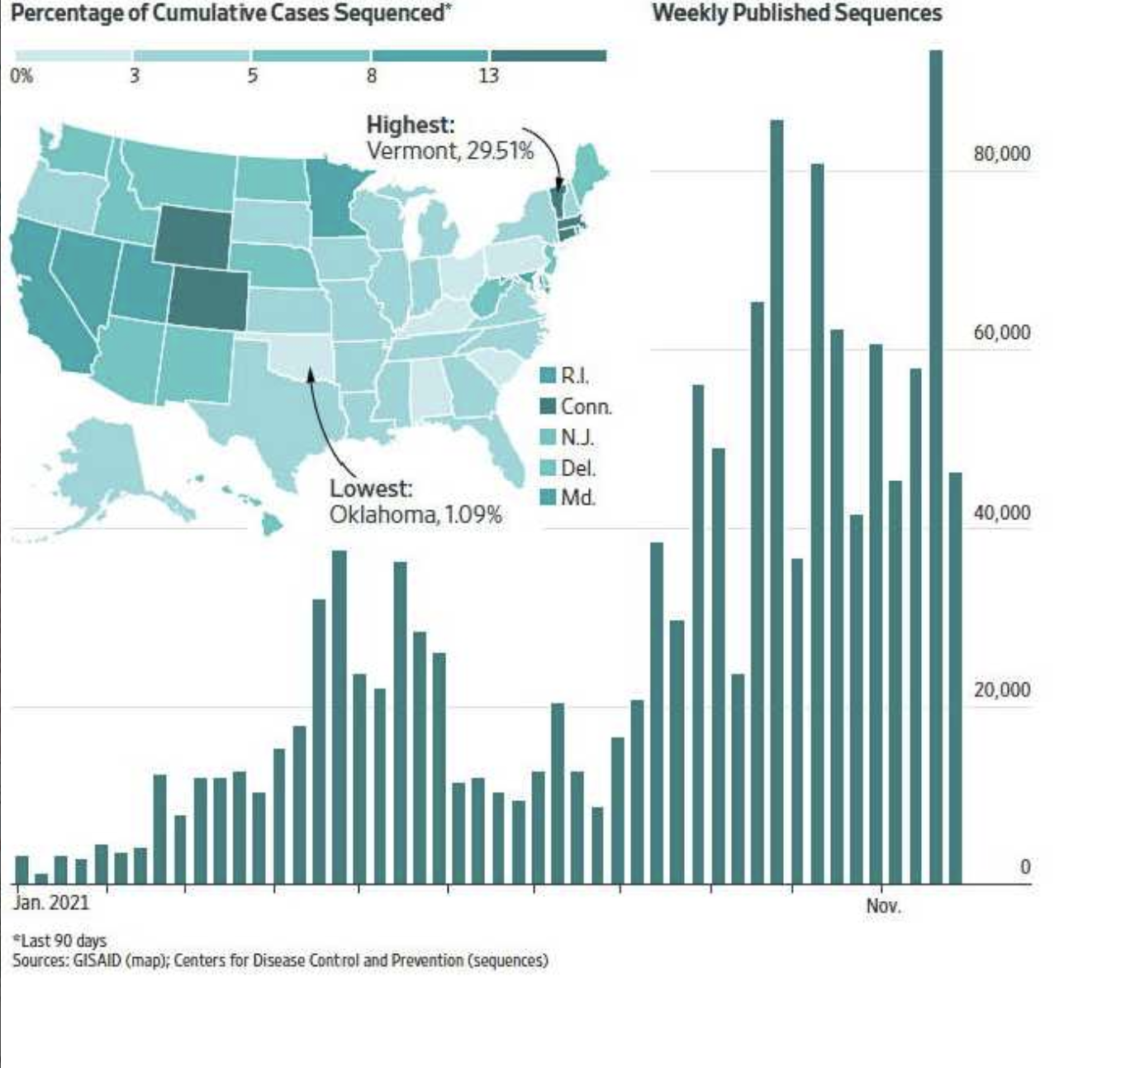
Wall Street Journal, 12/6/21, p. A6

Slide 53
Some Lessons from this Pandemic:
We Were Not Prepared!
Failed to recognize spread by asymptomatic individuals (unlike SARS but like many other coronaviruses)
Lack of global or regional coordination or strategic planning (WHO was mostly left out)
The “diagnostic gap”
Failure to implement systematic epidemiologic surveillance
Public health mostly sidelined
Shortages of essential supplies (like PPE)
Misinformation (“infodemic”)

Slide 54
READY FOR THE NEXT DISEASE X?
WHO 2020 Annual review of diseases prioritized under the R&D Blueprint
COVID-19
Crimean-Congo haemorrhagic fever
Ebola virus disease and Marburg virus disease
Lassa fever
Middle East respiratory syndrome coronavirus (MERS-CoV) and Severe Acute Respiratory Syndrome (SARS)
Nipah and henipaviral diseases
Rift Valley fever
Zika
“Disease X” *
* Disease X represents the knowledge that a serious international epidemic could be caused by a pathogen currently unknown to cause human disease. The R&D Blueprint explicitly seeks to enable early cross-cutting R&D preparedness that is also relevant for an unknown “Disease X”.

Slide 55
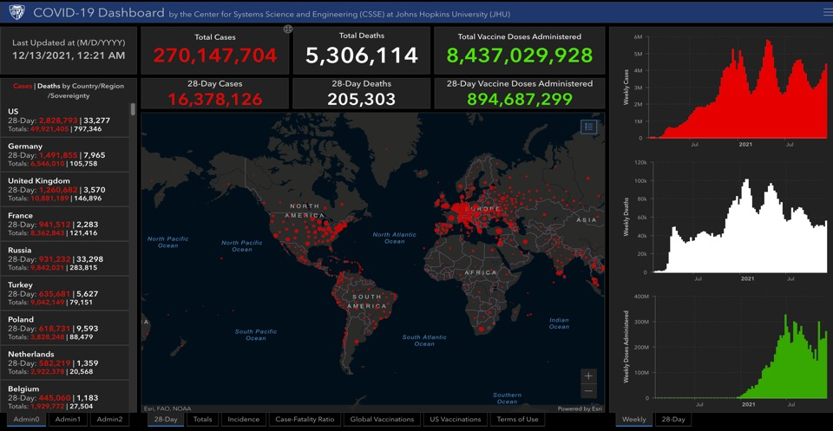
https://gisanddata.maps.arcgis.com/apps/dashboards/bda7594740fd40299423467b48e9ecf6

Slide 56


Thank You!
56

Slide 57
HAPPY HOLIDAYS

Slide 58

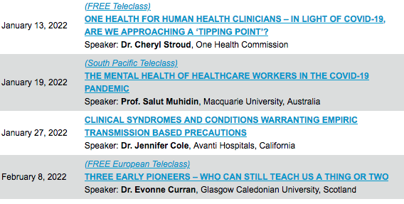

Slide 59


