Slide 1
Developing and implementing a personal protective equipment training programme for high consequence infectious disease preparedness
Ruth Barratt RN, BSc, MAdvPrac (Hons)
CNC Infection Prevention and Disease Control (Biopreparedness)
Hosted by Jane Barnett jane@webbertraining.com
www.webbertraining.com
February 19, 2020

Slide 2
Disclosure
I have no actual or potential conflict of interest in relation to this presentation

Slide 3
Acknowledgements
Dr Mary Wyer, Westmead Institute for Medical Research and WSLHD
State of Biopreparedness Committee, Westmead Hospital
Infection Prevention and Control Team WH
Westmead staff who trained in high-level PPE
Professor Lyn Gilbert, University of Sydney

Slide 4
Background
Using video-reflexive ethnography to improve PPE use
Invited to use VRE in high-level PPE training
IPC and educator expertise
Developed a comprehensive training programme for high-level PPE
Current roles are federal-funded positions for NSW biopreparedness

Slide 5
Key influential documents
Alison Sykes 2019: An International Review of High Level Isolation Units
Alberta Health Services & University of Calgary 2015: Human Factors Evaluation of Simulated Ebola Virus Disease Patient Scenarios: System Factors Associated with Donning and Doffing During Triage, Treatment and Transport
NETEC - The National Ebola Training and Education Center - https://netec.org/
Numerous research articles related to safe doffing and PPE

Slide 6
Outline of presentation
Introduction to HCID
What we have done so far to prepare for HCID
Hierarchy of controls
Facility
Policy
PPE
Developing and implementing the training programme

Slide 7
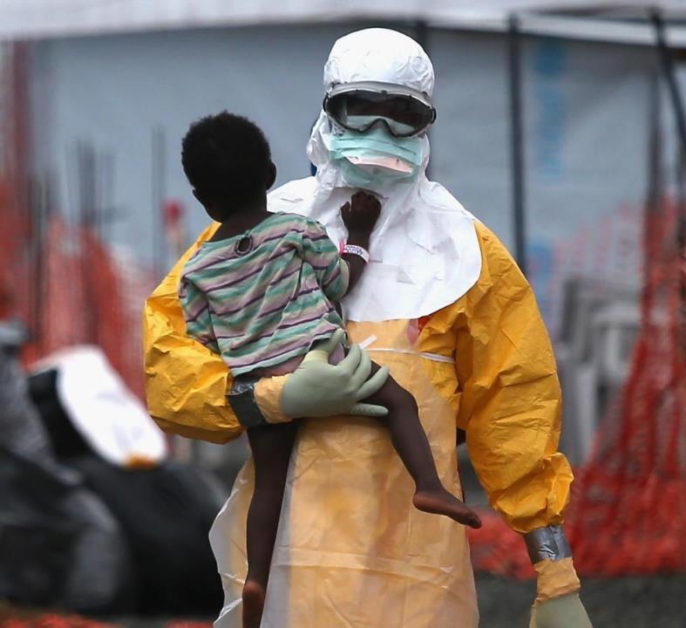
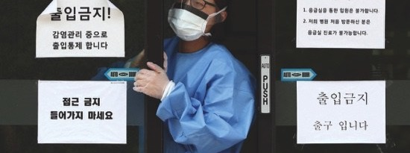
MSF worker-2019 Ebola DRC
iAfrica
South Korea - 2015 MERS outbreak
Korea Financial Times

Slide 8
High Consequence Infectious Diseases (HCID) ¹
Acute infectious disease
Typically has a high case-fatality rate
May not have effective prophylaxis or treatment
Often difficult to recognise and detect rapidly
Ability to spread in the community and within healthcare settings
Requires an enhanced individual, population and system response to ensure it is managed effectively, efficiently and safely
¹ UK Government 2019
Notes:
I have used the definition for the UK government to describe HCID

Slide 9
HCID
Contact transmission
Airborne transmission
Viral Haemorrhagic Fevers
Ebola virus disease (EVD)
Lassa fever
Marburg virus disease (MVD)
2019-nCoV acute respiratory disease
Avian influenza A
H5N1
Other novel human pathogenic influenza
Severe acute respiratory syndrome (SARS)
Middle East respiratory syndrome (MERS)
Monkeypox
Notes:
HCID can be broadly divided into two categories depending on the mode of transmission.

Slide 10
HCID threat
2014-2016: West Africa Ebola Zaire outbreak
28,616 people affected, 11,310 deaths
2014: MERS outbreaks
Middle East but also S Korea
Hospital transmission
2018 – present: EVD Democratic Republic of the Congo
Public Health Emergency of International Concern (WHO 2019)
3421 cases / 2242 deaths / 1154 survivors (as of 28/1/20)
2019 – present 2019-nCoV acute respiratory disease

Slide 11
Local HCID preparedness
Westmead Hospital in Sydney – state facility for NSW (adults)
Isolation facilities - existing and new
HCID policies and procedures
PPE
Staff training

Slide 12
Local HCID preparedness
Build on work done in 2014-2015 and with SOB project team
DRC outbreak renewed efforts to be prepared as the state facility
Training programme linked to other HCID preparedness activities e.g. policies revised
Appointment of small multi-disciplinary team

Slide 13
Preventing transmission – hierarchy of controls

Slide 14
Engineering controls
Europe - high level isolation units
4 in UK
USA - biocontainment units
10 regional
Australia – infectious disease units / biocontainment units
1 per state
NZ – I purpose built
Trexler isolator – Royal Free Hospital, UK
Notes:
Engineering control address the hospital design and physical environment

Slide 15
Westmead engineering controls
Current: 2 Q-class rooms for adults
Dedicated beds in the ICU
Anteroom, patient room with ensuite
Utility room A
Staff shower
Utility B for transfer of waste, blood samples etc.
New: state of the art biocontainment unit
Paediatric and adult beds

Slide 16
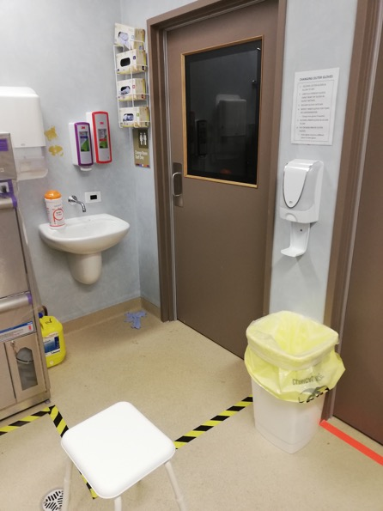
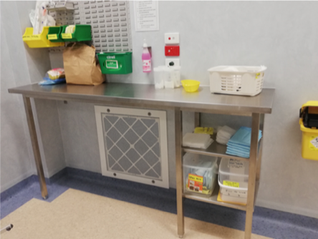
Q-class rooms

Slide 17
Engineering controls
Organisation of PPE supplies in donning area
Build upon existing dirty and clean zones
Tape on floor for doffing
Minimal equipment/supplies in room
Checklist with photos
Signage
Hands free ABHR dispenser
Cuff first gloves dispenser
Notes:
We made a number of engineering controls to the existing design and workflow of the Q-class suite

Slide 18
Administrative controls
Operational procedures to prevent/minimise exposure
Buddy system
Change in practice to minimise entries
↓ number of people exposed
↓ doffing risks
Clinical interventions – radiology, IV, dialysis
Waste
Environmental cleaning
Training
Donning and doffing PPE
Procedures
Notes:
Administrative controls is the next tier down and considers the operational and organisational requirements and aspects of caring for a HCID patient.

Slide 19
Operational procedures – doing the job
The safety of staff MUST take precedence over patient safety
BUT, the patient is a person
Confidence in PPE protection
Understanding transmission routes
Adapting IPC principles to the physical space
Using a Buddy

Slide 20
Buddy responsibilities
Being vigilant in spotting defects or breaches in PPE while HCWs are in the patient room
Observing HCWs for heat stress or fatigue related to PPE
Monitoring compliance with PPE protocols
Guiding, correcting, and assisting during donning and doffing
Adhering to the Call / Do / Respond method
Warning HCWs of potential risky actions (e.g., touching face)
Being informative, supportive and well-paced in issuing instructions or advice
Protecting themselves through proper PPE use during doffing
Anticipating and planning for risks

Slide 21
Specific procedures
Cleaning up a blood or body fluid spillage
Phlebotomy and preparing the samples for transport to the laboratory
Transferring waste bags from the dirty zones
Procedure for changing outer gloves

Slide 22
Training
Train specifically for knowledge and skills relating to:
Self-awareness of habitual behaviours and the importance of minimizing them
Hazard identification, awareness of where contamination may occur and knowledge of how to respond appropriately should contamination occur.
Familiarity with PPE, specifically how it will affect HCW mobility and dexterity, as well as how their body reacts to heat stress.
Procedural competency, repetitive training including appropriate technique for the motions associated with doffing PPE and checklist use.
Buddy roles that support HCW including the management of PPE breaches, minimising the spread of contamination, and avoiding high risk behaviours.

Slide 23
Personal Protective Equipment
PPE based models of delivery
Different PPE ensembles
No global consensus on individual PPE items
PPE is unfamiliar and constraining
High probability of error when doffing – self contamination

Slide 24
PPE checklists
Checklists used for both donning and doffing
Used video reflexivity to improve checklists and doffing procedures
Learn from healthcare workers
Buddy system used (trained observer)
Consider a third person if resources allow
CALL, DO, RESPOND method
Physically tick the check list
Include regular reassurance (doffing)
Minimise steps that require the Buddy to touch the HCW when doffing

Slide 25
Selection of PPE
Availability – currently / in global emergency
Gowns versus coveralls with mask or PAPR
Adequate coverage
Protection for mucous membranes
Ability to move and work in PPE
Ease in doffing – minimises breaches
Staff acceptance

Slide 26
Gowns & Coveralls
Gown
Coverall
Surgical gown
knitted cuffs
wrap around (coverage)
AAMI 4 level - whole gown
Weight - comfort
Length
Fit & sizing
Neck fastening (doffing)
Protection level
? Hood or no hood
Integral finger loops (middle finger)
No integral feet (trip hazard)
Covered zipper
Zipper cord
Additional plastic apron or gown?

Slide 27
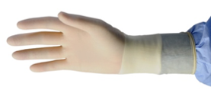
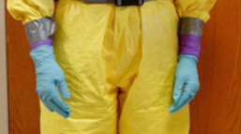
Gloves
Different colours for inner and outer
Long cuffs e.g. chemotherapy gloves
Thickness – dexterity
2 pairs or 3 pairs
Taping of gloves
ease of removing tape – no scissors
longitudinal or circumference
risk of tearing gown
Glove dispenser – cuff first

Slide 28
Face and head cover
Mask over or under hood
Goggles and/or face visor
Hood with shroud
Material
Fit
Availability
PAPR
Availability of suitable hood
Motor outside or concealed
Disposable versus reusable

Slide 29
Foot coverings
Plastic shoes
Colour coded for size
Easily disinfected
Booties
Long enough with gown
Non-slip sole
Ties versus elastic
2 sizes
Note: The booties are the trickiest item to remove

Slide 30
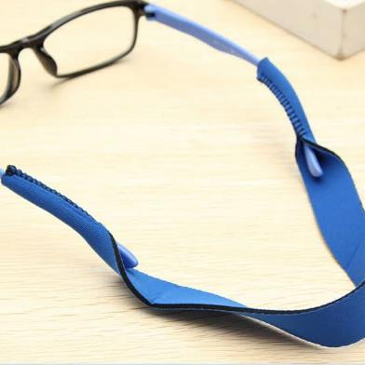
Other PPE items
Scrubs – disposable scrubs were transparent
Sports bands for personal glasses
Non-slip socks
Hair ties and clips
Anti-fog spray
Tape
Permanent marker

Slide 31
Training programme
Aims and learning outcomes
To equip participants with the ability to understand and demonstrate safe donning and doffing of high-level PPE
To give clinicians the experience of performing common procedures while wearing full PPE
To understand the role of the Buddy
Use of WSLHD lesson plans
Incorporate video-reflexive ethnography as a learning tool

Slide 32
Video reflexive ethnography
Video clinicians working in and doffing PPE
Show the footage to them individually or in groups for reflexive discussion
Makes explicit the complex reality of high-level PPE
Assists clinicians make sense of their own PPE practices and contexts – self-awareness
Leads to improvements in individual behaviour and procedures

Slide 33
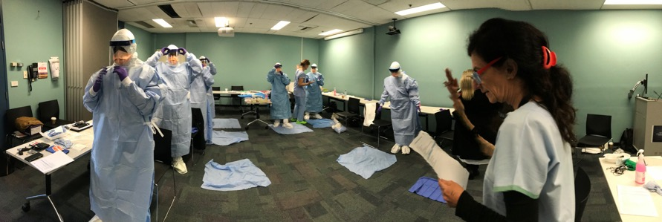
Planning
Attendees
Emergency Department
Infectious Diseases
Critical Care
Public Health
IPC
Content:
Theory
Classroom
Simulation
Debrief
Numbers limited by:
Space for demo and practical component in classroom
Opportunities in Q-class rooms
Expert feedback

Slide 34
Planning (cont.)
Training time:
Pre-training - watch video for safe glove removal methods
8 hours initial training day
4 hours credentialing session
1 hour 3-month refresher
Admin
Training day preparations
Data entry – PPE sizes, credentialing etc
Beak method of glove removal

Slide 35
8-hour day - morning
PPT intro – 1hr
PPE sizing and collection of items & brief tour of Q-class rooms
Demonstration of donning and doffing PPE then practice
Videos of procedures

Slide 36
Classroom demo and practice

Slide 37
8-hour day - afternoon
Practice donning and doffing in real space
Practice being a Buddy
Practice undertaking procedures in PPE
Debrief
Evaluation

Slide 38
4 hours for credentialing
Requires 5 practices
1 counted from 8-hour day
Don and doff 4 times
Assessed on final
Re-use gown, hood, visor and booties
Maximum 4 people
2 persons per session per Q-class room
2 assessors (experts)
Competency tool based on state but revised in-house
Include research follow up

Slide 39
Refresher training
3 month in normal time
More frequently if alert locally/nationally
Don and doff x 1
Act as doffing Buddy
Ideally 2 persons
In real space
Incorporate other procedures if time allows
Minimum 1 hour

Slide 40
Summary
>50 people have now completed the initial training, credentialing and 3-month refresher
Resource intensive – time!
Benefit by having a dedicated space always available
Inclusion of research useful and clinician opinion critical to confidence of staff in using PPE

Slide 41
Conclusion
Preparation for HCID is important for public health and protection
Training in routine and high level safe donning and doffing PPE is an essential component of preparedness
Planning should allow for resources and sustainability

Slide 42
A bit of fun – a pandemic limerick
There was an infectious disease
Which brought the whole world to its knees
When they sneezed and they coughed
We donned and we doffed
And survived with barely a sneeze

Slide 43
