Slide 1


Discovering and Transforming the Inner ICP Educator
Dr. Gwyneth Meyers
Education Clinical Practice Coordinator
Infection Prevention and Control
Alberta Health
https://ipac-canada.org/photos/custom/CJIC/CJIC_Spring2019_Meyers.pdf
Hosted by Colette Ouellet
Queensway Carleton Hospital, Ottawa
www.webbertraining.com
November 4, 2022

Slide 2
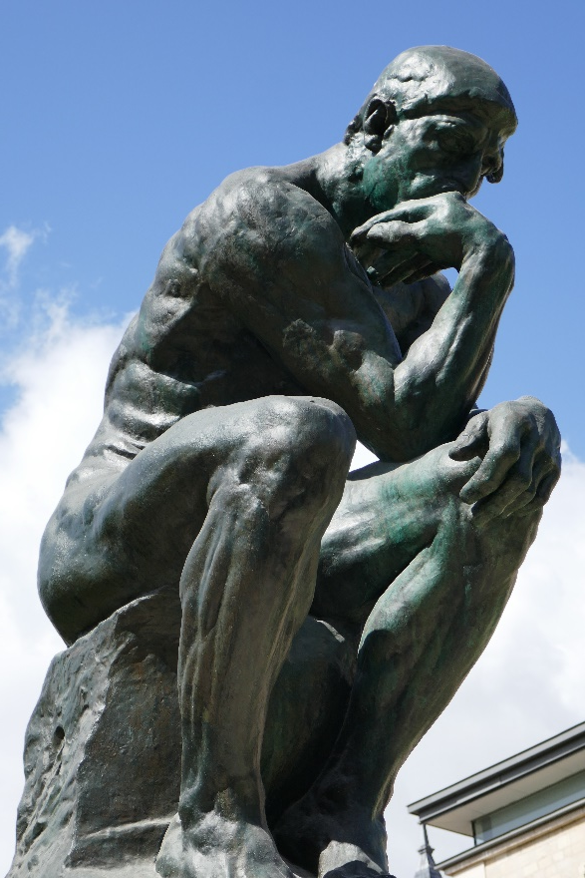

Slide 2
Outline
Why discover and transform the inner educator
Core principles of the professional development experience
Teaching and learning strategies used
Potential application of the design elements (So what – Now What)

Slide 3

Slide 3
The Rationale for Transforming ICP Educational Practice

Slide 4

Slide 4
Emerging Trends in:
Workplace learning
Online learning
Contemporary learning designs

Slide 5
Slide 5
Challenges:
What do we mean by education?
  Assumptions?
How we think influences what we do
Teach as we were taught
  Training and expertise

Slide 6
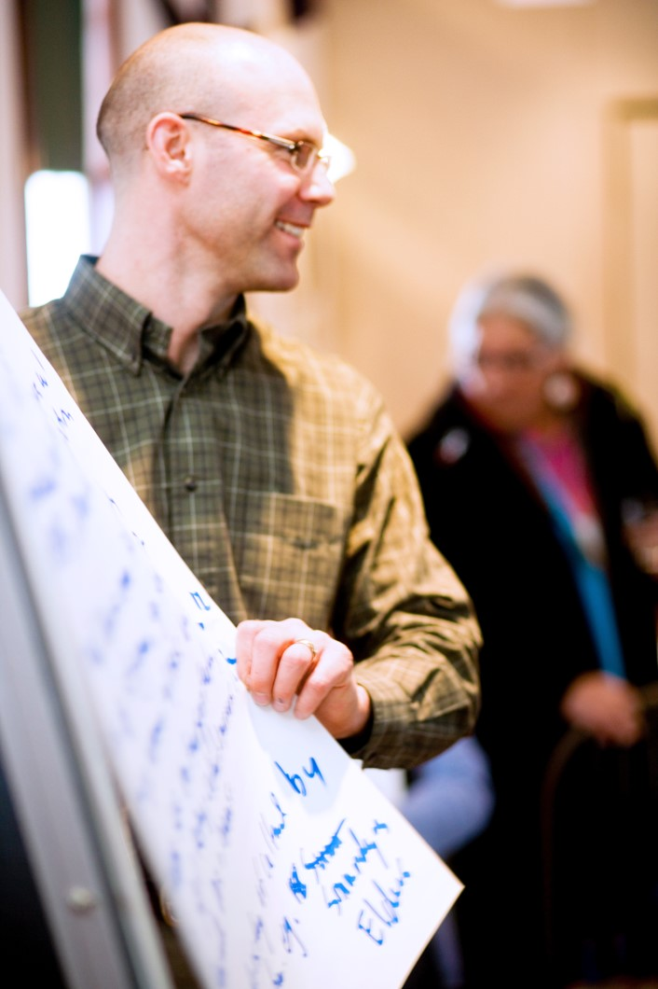
Slide 6
Core Elements of the Professional Development
Experience

Slide 7
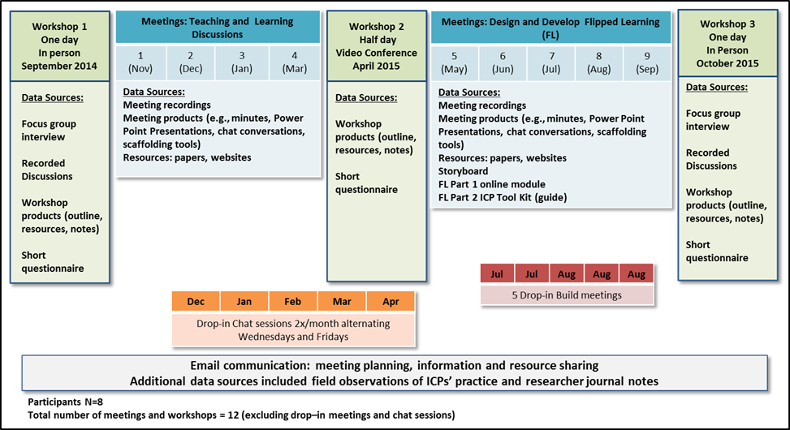
Slide 7

Slide 8
Slide 8
Core Elements of the Professional Development Experience
Understanding ICP Educational Practice
Building Pedagogical Knowledge
Cognitive
Presence
Social
Presence
Community of Learning
Teaching
Presence
Experiencing Different Teaching and Learning Strategies
Building Educator Identity

Slide 9
Slide 9
Core Elements of the Professional Development Experience
Community of Learning
Like a Community of Practice
Collaborative
Joint responsibility
Flexible
Presence
Social
Build group cohesion and relationships
Cognitive
Content grounded in theory, research and literature
Teaching
Learning from each other
Social
Presence
Cognitive
Presence
Community of Learning
Teaching
Presence

Slide 10
Slide 10
Core Elements of the Community of Learning (CoL)
Understanding ICP Educational Practice
Developing an awareness of practice
Making practice explicit
Identifying key gaps and issues
CoL
Key elements
Social
Presence
Cognitive
Presence
Community of Learning
Teaching
Presence

Slide 11
Slide 11
Core Elements of the Professional Development Experience
Building Pedagogical
Knowledge
Learning about teaching and learning concepts and strategies
Developing a vocabulary
Acquiring resources
Understanding ICP Educational Practice
Cognitive
Presence
Social
Presence
Community of Learning
Teaching
Presence

Slide 12
Slide 12
Core Elements of the Professional Development Experience
Understanding ICP Educational Practice
Building Pedagogical Knowledge
Cognitive
Presence
Social
Presence
Community of Learning
Experiencing Different Teaching and Learning Strategies
Moving theory into practice
Experience as learners, reflect as educators
Teaching
Presence

Slide 13
Slide 13
Core Elements of the Professional Development Experience
Understanding ICP Educational Practice
Building Pedagogical Knowledge
Cognitive
Presence
Social
Presence
Community of Learning
Experiencing Different Teaching and Learning Strategies
Moving theory into practice
Experience as learners, reflect as educators
Teaching
Presence
Building Educator Identity
Developing an awareness of role
Building Expertise
Changing practice

Slide 14
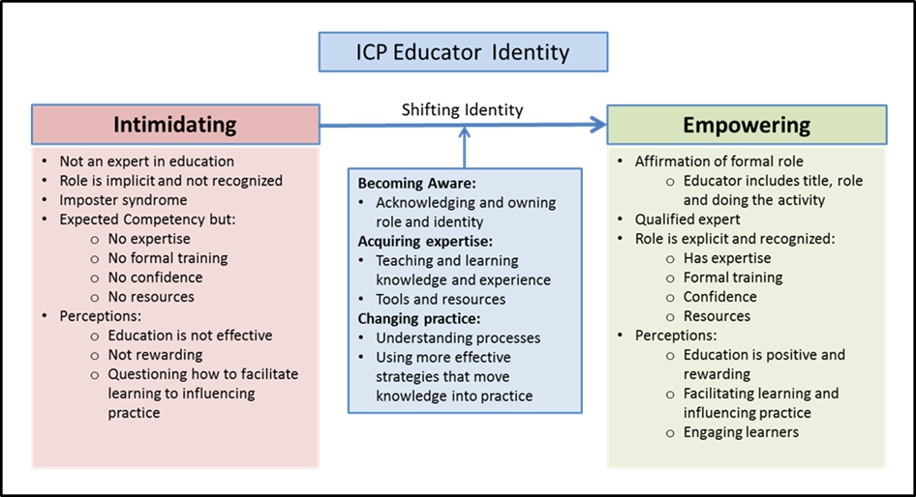
Slide 14
Core Elements of the Professional Development Experience

Slide 15
Slide 15
Teaching and Learning Strategies

Slide 16
Slide 16
Core Elements of the Professional Development Experience
Understanding ICP Educational Practice
Building Pedagogical Knowledge
Strategies
Research findings
Practice Reflection
Discussion
Cognitive
Presence
Social
Presence
Community of Learning
Teaching
Presence
Experiencing Different Teaching and Learning Strategies
Building Educator Identity

Slide 17
Slide 17
Core Elements of the Professional Development Experience
Understanding ICP Educational Practice
Building Pedagogical Knowledge
Strategies
Research findings
Practice Reflection
Discussion
Strategies
Content
Scaffolding
Sequencing
Role modeling
Cognitive
Presence
Social
Presence
Community of Learning
Teaching
Presence
Experiencing Different Teaching and Learning Strategies
Building Educator Identity

Slide 18
Slide 18
Core Elements of the Professional Development Experience
Understanding ICP Educational Practice
Building Pedagogical Knowledge
Strategies
Research findings
Practice Reflection
Discussion
Strategies
Content
Scaffolding
Sequencing
Role modeling
Cognitive
Presence
Social
Presence
Community of Learning
Teaching
Presence
Experiencing Different Teaching and Learning Strategies
Building Educator Identity
Strategies
Experience activities
Flipped Learning
Design, develop, implement
and evaluate a teaching
experience

Slide 19



Slide 19
https://flippedlearning.org/
Flips the use of the learning spaces
rearranges how time is spent in and out of a classroom setting
Shifts ownership of learning from educators to learners
Engages in active learning / deeper learning
Goal in the COL
Experience FL as a strategy
To explore application of design elements that facilitate learning
Design, implement and evaluate a FL experience that ICPs can use to teach
http://www.mclph.umn.edu/watersedge/

Slide 20
Slide 20
Core Elements of the Professional Development Experience
Understanding ICP Educational Practice
Building Pedagogical Knowledge
Strategies
Research findings
Practice Reflection
Discussion
Strategies
Content
Scaffolding
Sequencing
Role modeling
Cognitive
Presence
Social
Presence
Community of Learning
Teaching
Presence
Experiencing Different Teaching and Learning Strategies
Building Educator Identity
Strategies
Experience activities
Flipped Learning
Design, develop, implement
and evaluate a teaching
experience
Strategies
Acquire knowledge, experience, resources, language
Confidence, validation

Slide 21
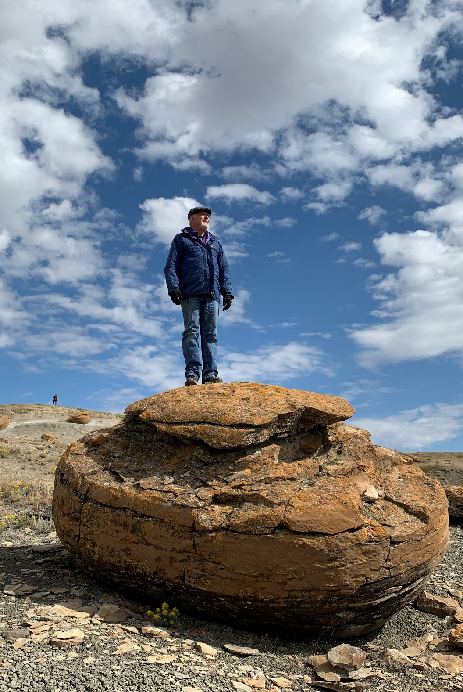
Slide 21
Application of core principles and design elements
(So What – Now What)

Slide 22

Slide 22
So what was learned?
Concepts and strategies
How to design for learning
Strategies supported by research
The value situating learning in activity and practice
Learned about learning
Learned about themselves as
educators and learners
Transformative change is disruptive

Slide 23

Slide 23
So what changed?
Identity
  Confidence and validation
Shift in perception
  Influenced thinking
  Practice
  Meaning of education
How to learn
  Continue to learn as a group
Changes
  Incremental

Slide 24

Slide 24
Now What?
Waking up ICP inner educator
Using guiding principles vs prescribed practices
Designing for transformative learning
Learning across not just within individuals
Situate learning
Learning Presence
Responsive and flexible

Slide 25
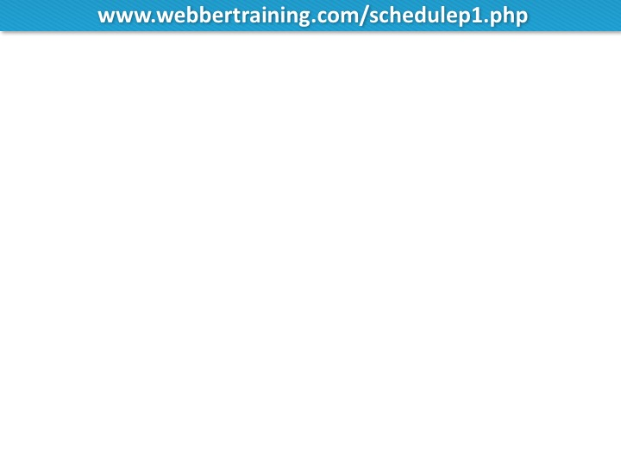
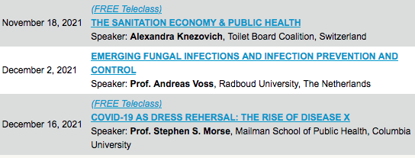

Slide 26


