Slide 1
Emerging Respiratory
Viruses: Are Healthcare
Workers Protected?
Virginia Roth, MD, FRCP, MBA
The Ottawa Hospital & University of Ottawa
Hosted by Paul Webber
paul@webbertraining.com
www.webbertraining.com
November 13, 2014

Slide 2
Outline
SARS 2003
Novel H1N1 2009
MERS CoV 2012
Ebola 2014
Lessons for Future Outbreaks

Slide 3

Severe Acute Respiratory Syndrome (SARS)
Feb 28:
Mar 7:
Mar 10:
Mar 11:
Mar 12:
Impact:
Identified in a Hanoi patient with
atypical pneumonia (Dr. Carlo Urbani)
First Canadian case admitted to hospital
22 HCW in Hanoi fall ill
Hospital outbreaks in Hong Kong
WHO alert issued
8,096 cases, 774 deaths

Slide 4
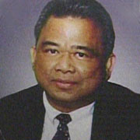
SARS: Vulnerability of Healthcare Workers
Dr Nestor Yanga
54 year old family physician, Toronto
Apr 1-2: examined 3 patients with undiagnosed SARS
Apr 4: fever, myalgia, diarrhea, cough
Apr 8: admitted to hospital
Apr 13: respiratory failure to ICU
BiPAP, difficult intubation
Aug 13: succumbed to SARS
Notes:
4

Slide 5
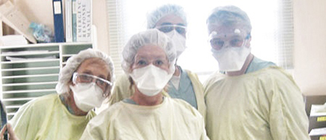
“Protected HCW” Get SARS
9 HCW caring for Dr. Yanga developed SARS
  6 present during intubation
Intubation: negative-pressure HEPA filtered room
All wore recommended PPE
  Gowns, gloves, PCM2000 mask, googles /face shield
Ofner et al. CCDR ‘03
Notes:
5

Slide 6
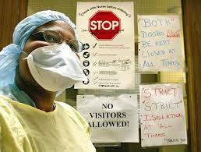
SARS in Protected HCW
Toronto, 2003
18 suspect / probable cases
Associated with high-risk procedures / patients
Incorrect use of PPE:
  Formal training before SARS assignment = 31%
  Inadequate eyewear = 67%
  Moist mask = 25%
  Failure to change b/w patients = 19%
Health Canada; Ofner et al. CCDR 2003
Notes:
6

Slide 7
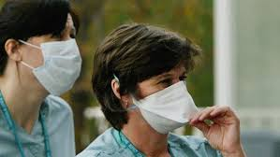
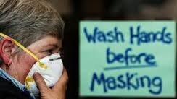
“Possibility of self-contamination”
Notes:
7

Slide 8
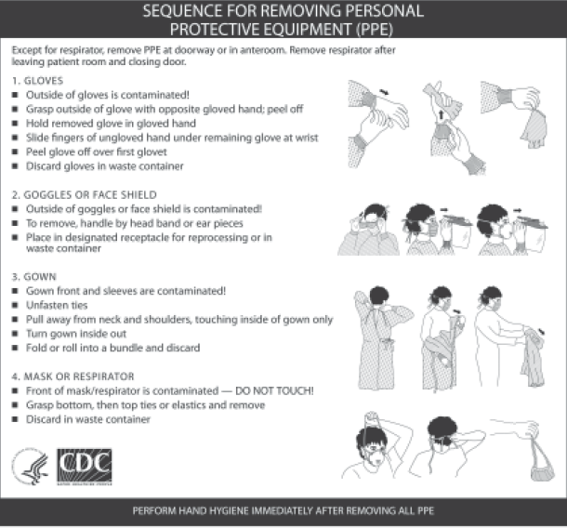
Virus Transfer from PPE to HCW Skin and Clothing
PPE contaminated with non-enveloped non-pathogenic RNA virus and glo-germ
10 volunteers took BP from mannequin
Instructed to remove PPE following CDC protocol
Casanova et al. Emerg Infect Dis 2008
Notes:
8

Slide 9
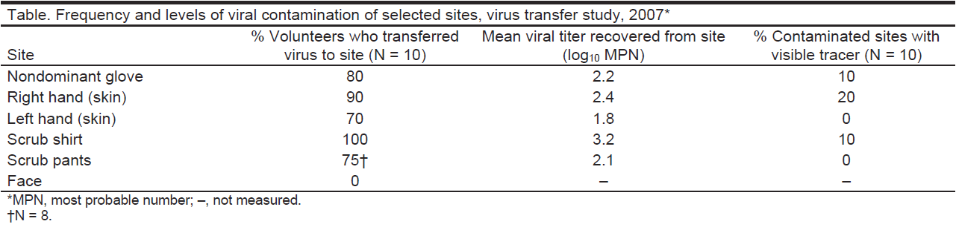
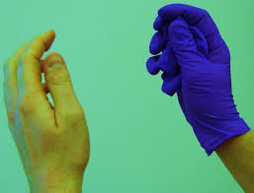
Conclusions:
Need altered protocols
Importance of hand hygiene between steps
Casanova et al. Emerg Infect Dis 2008
Notes:
9

Slide 10
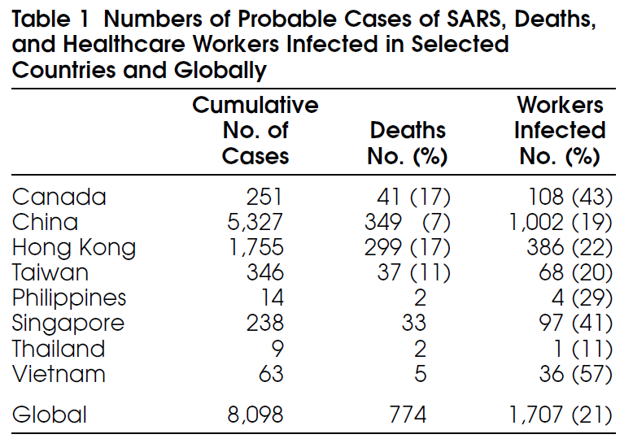
SARS in Healthcare Workers
Ontario: 45%
Hong Kong: 22%
Chan-Yeung Int J Occup Environ Health 2004
Notes:
10

Slide 11
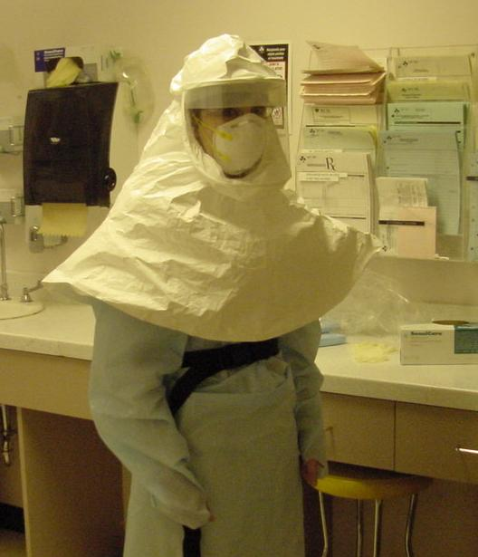
SARS Response
Changing directives
New equipment
Increased complexity
Difficult removal
Clinical challenges
Notes:
11

Slide 12
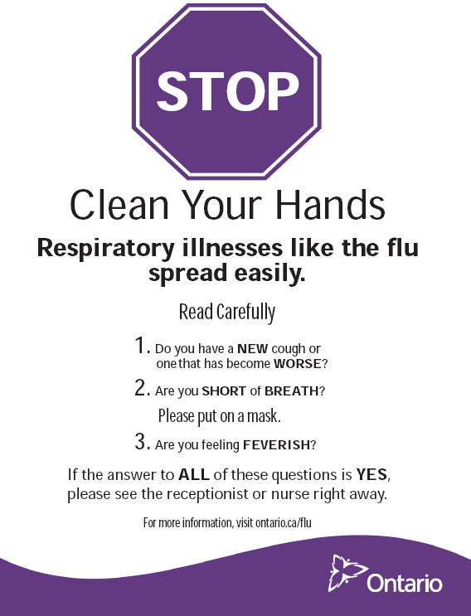
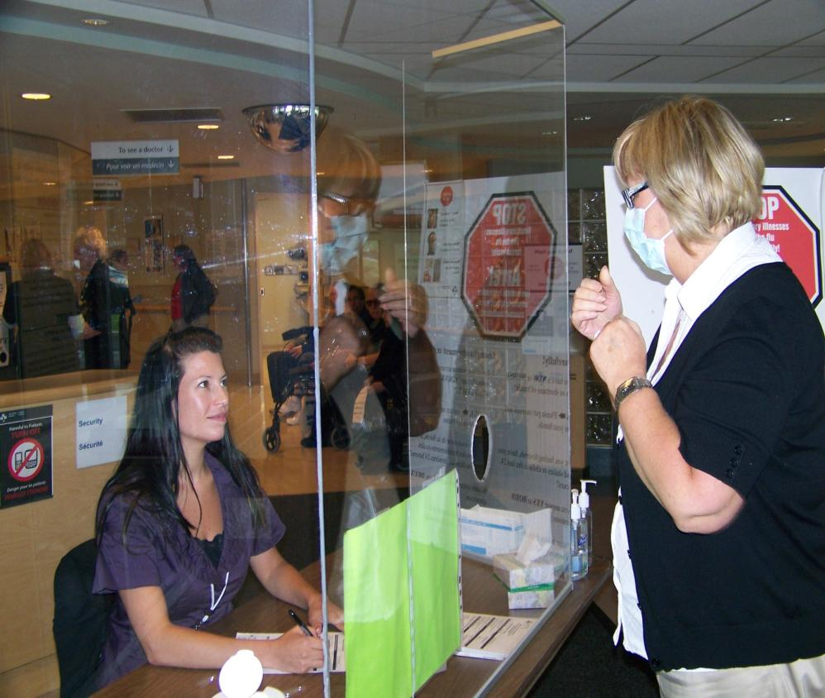

Slide 13
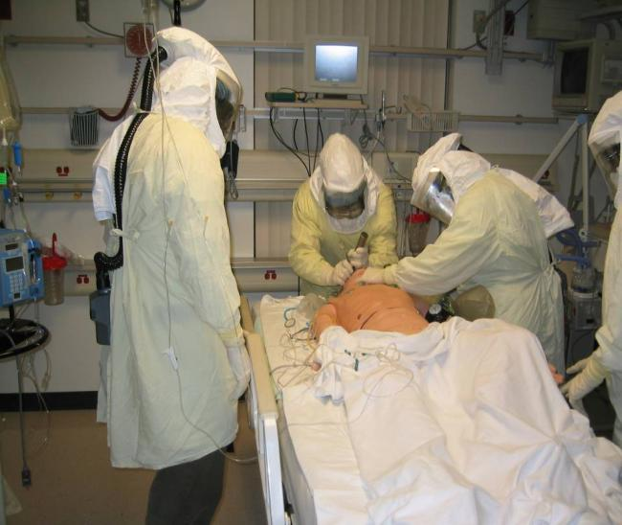
Protected Code Blue
“My 'problem' is that emergency physicians and nurses thrive in heroics and do this by nature. So we need evidence-based information and to clearly show them why they must not do that which they gravitate towards.”

Slide 14
Psychological Impact of SARS
Fear – unknown virus, sick colleagues
Anger – insufficient protection
Confusion – constant change in practice
Isolation – “work quarantine”, family separation
Ostracism – public prejudice
Exhaustion – added equipment, stress
Reduced human contact – barrier equipment
Notes:
14

Slide 15


Right to Refuse Work
Argument
Firefighters don’t get to select which fires to attend
Police don’t get to select which dark alleys they walk down
Counter Argument
We don’t expect firefighters to jump into a burning pit
We don’t expect police to jump in front of a bullet

Slide 16
Professional Organizations
Nurses’ Association: Nurses have a right to refuse to work where unsafe conditions exist and they cannot be adequately protected …
Medical Association: Physicians are not all required to be heroes, especially if they could do more good for patients by staying away from dangerous front-line situations.
Notes:
16

Slide 17

The Ethics of SARS
HCW have a duty to:
  care for the sick
  care for themselves in order to carry out duties
Institutions have duty to:
  support and protect HCW
  provide safe environment
Public / leaders have a duty to:
  recognize heroism of front-line medical workers
University of Toronto Joint Center for Bioethics
Notes:
17

Slide 18
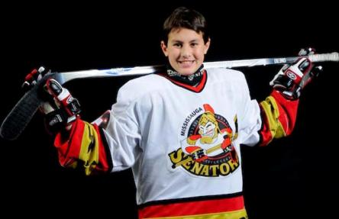
Novel Influenza A (pH1N1)
March 2009: First cases in Mexico and US
June 11, 2009: WHO declares global pandemic
Sept 2009: > 296,000 cases, ~ 3500 deaths worldwide
Affected children and young adults (median age = 18)
Ability to cause severe pneumonia
Higher risk of complications in pregnancy
Community exposure
Evan Frustaglio

Slide 19
Mitchell R, Roth V, Gravel D, et al. AJIC 2013
Physician Nurse Allied Health HSK
(n=53) (n=228) (n=42) (n=19)
Gloves 79% 88% 95% 95%
Gown 81% 82% 93% 79%
Eye Protection 26% 41% 33% 42%
Mask 79% 89% 88% 79%
Correct Removal 36% 56% 55% 78%

Slide 20
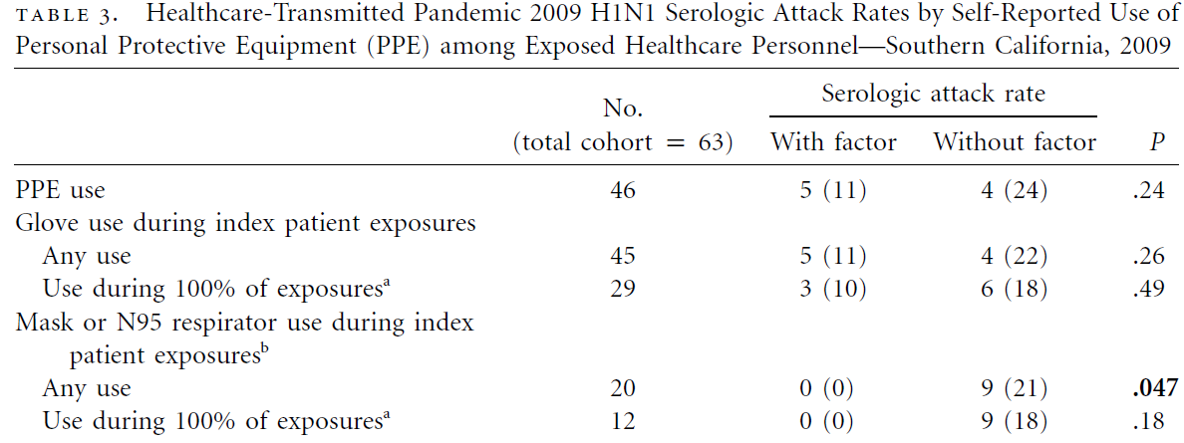
27% reported no PPE use

Slide 21
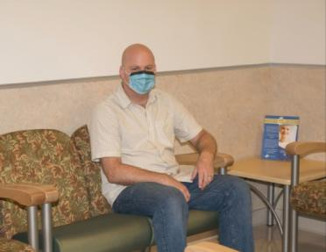
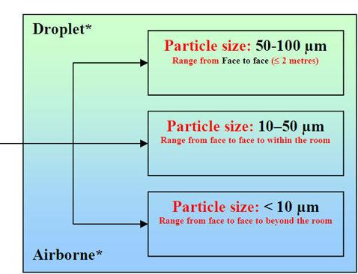
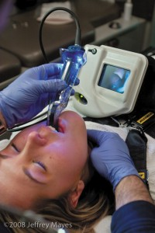
The Airborne Droplet Continuum

Slide 22

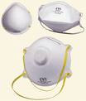
Novel Influenza A (H1N1)
Conflicting Guidelines Over Masks
Care of Pt with Confirmed or Suspected Novel H1N1
Regular mask <1 m of pt
N95 respirator to enter pt room
Regular mask <2 m of pt
N95 respirator <2 m of pt
Aerosol Generating Medical Procedures
N95 respirator
N95 respirator
N95 respirator
N95 respirator
WHO
CDC
PHAC
Ontario
“Current evidence supports handling H1N1 on the basis of droplet transmission consistent with recommended precautions for seasonal influenza.” Statement from Society for Healthcare Epidemiology of America (SHEA) June 2009
Notes:
22

Slide 23
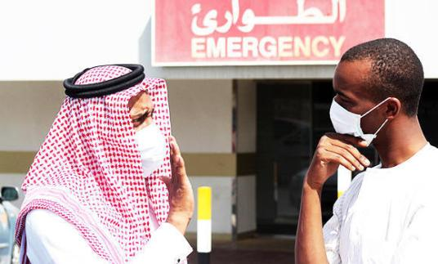
Middle East Respiratory Syndrome Coronavirus (MERS-CoV)
April 2012: severe acute respiratory illness of unknown etiology
By April 2014: 495 cases - Saudi Arabia, Qatar, Jordan, UAE
96 (19%) HCW
  66 (66%) in April 2014
>60% of 128 cases in Jeddah were nosocomial
  39 HCW
  6 required ICU or died
Notes:
23

Slide 24
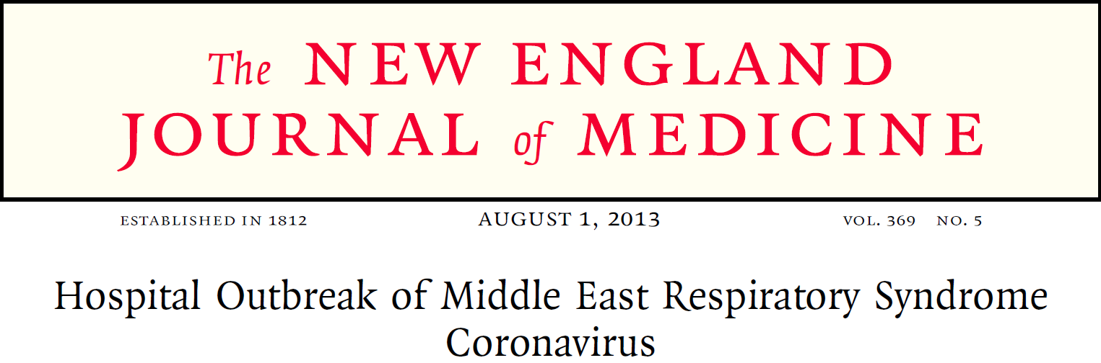
21 healthcare-related cases
  Person to person transmission: HCW and household contacts
  Many patients: no transmission
  Few patients: multiple infections (super-spreaders)

Slide 25
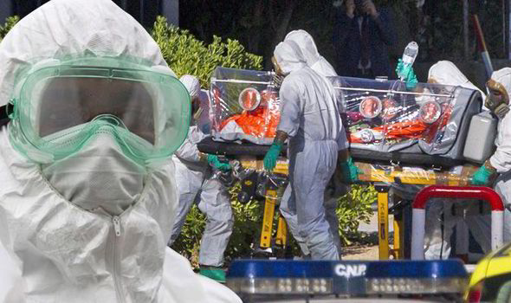
Ebola
Notes:
25

Slide 26
Ebola in Madrid
Oct 6: Nurse’s aid confirmed positive for Ebola
Treated 2 missionaries who died of Ebola Aug-Sep 2014
Followed protocol (touched her face with her gloves?)
Spokesperson – “Its obvious that the patient herself has recognized that she did not strictly follow the protocol.”
“We’re really angry” said one nurse. “She is the victim, and they are criminalizing her as if she was the one responsible for all that has happened”
Oct 12: Concerns about training and safety standards lead to work refusals

Slide 27
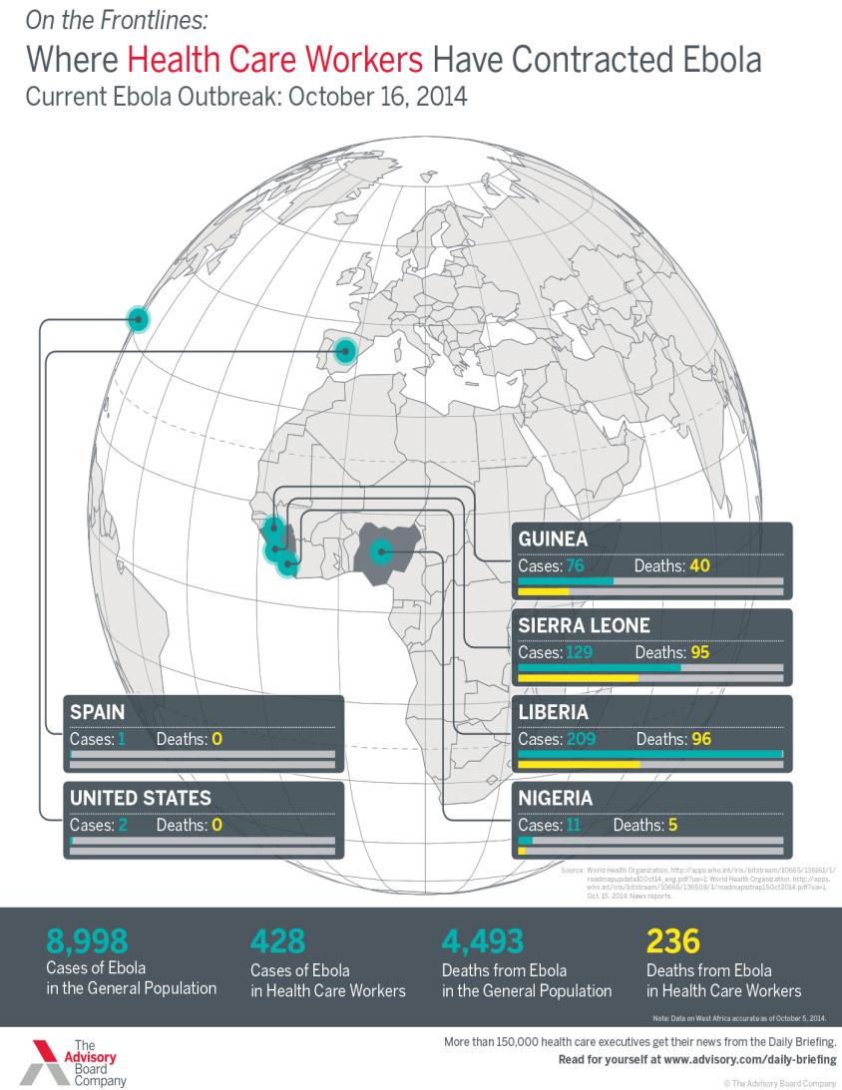

Slide 28
Ebola in US
Sep 20: Liberian man arrives in Dallas
Sep 24: Low-grade fever, abdominal pain, headache
Sep 26: Presents to ED - sent home
Sep 28: Worsens - return to ED and placed in isolation
Sep 30: Confirmed Ebola
  Moved to isolation unit, addition of PPE layers
Oct 8: Dies
Oct 10: Nurse develops low-grade fever
Oct 12: CDC confirmed Ebola positive
Oct 14: 2nd nurse confirmed positive

Slide 29
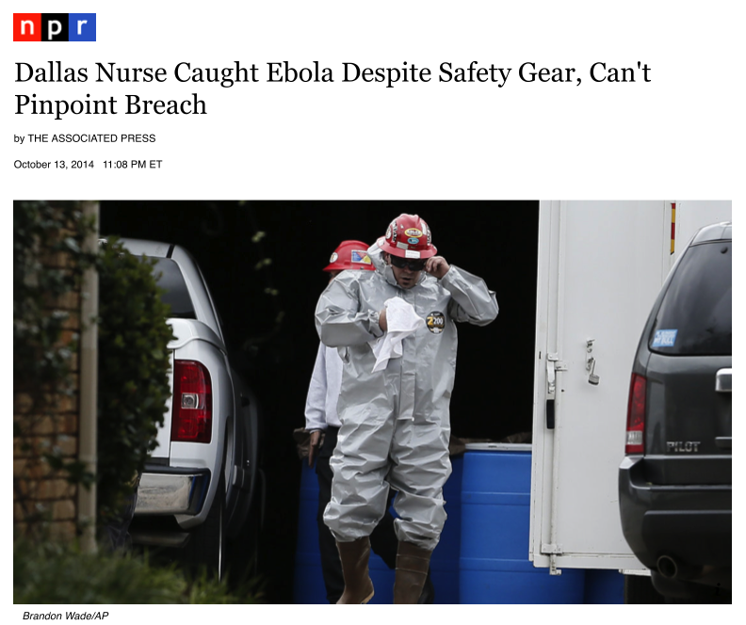
ED screening
Communication
High-risk procedures
Self-contamination
PPE removal without supervision
Variability in PPE
Conflicting recommendations

Slide 30
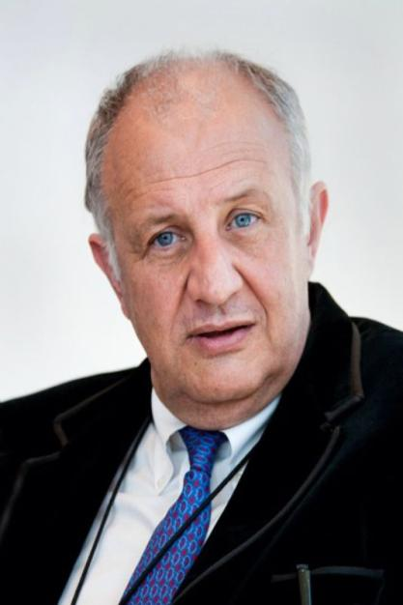
Why did Dallas Nurses get Infected?
Following recommendations
Responsive administration
Competent committed staff
Heroic measures (dialysis):
"We never recommend, in Africa, to do that type of thing … It's very risky and the likelihood of saving someone is very low. When every organ starts to fail, you're not going to save them."
Dr. Pierre Rollin CDC

Slide 31
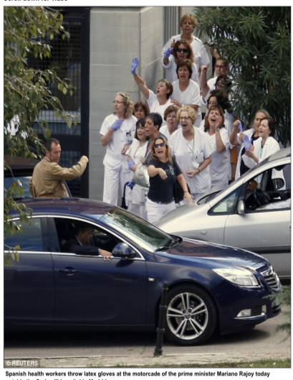
Nurses’ Perspective
US – National Nurses United
  Nurses “strongly feel unsupported, unprepared, lied to and deserted to handle their own situation”
Spain - Juan Jose Carlos, Satse nursing union
  “Their children aren't being invited to birthday parties and their friends are cancelling joint holiday plans”
  “They’ve become known as the Ebola nurses. And it’s not fair.”

Slide 32

Ebola cruise ship ‘in utter panic’ as Mexico and Belize refuse to let it dock
Bellevue hospital (NY)
More than a dozen employees report discrimination
Not welcomed at business or social events
Refused services
THE INDEPENDENT – October 24, 2014

Slide 33
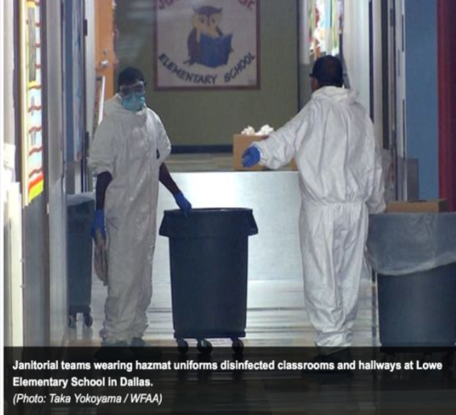
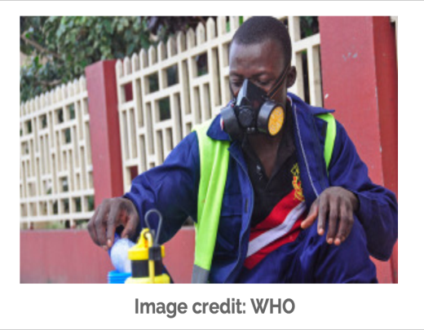
PPE Challenges

Slide 34
Are Healthcare Workers Protected?
Depends on…
Risk assessment
Availability of PPE
Proper use of PPE
Preventing self-contamination

Slide 35
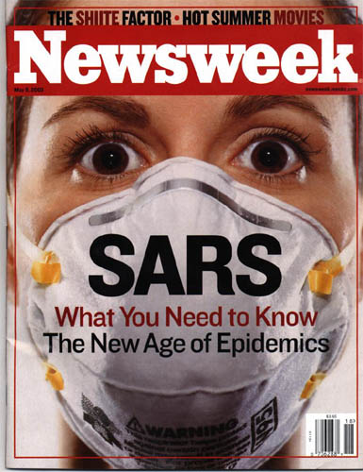
Lessons for Future Outbreaks
Screening
Thoughtful PPE selection
Minimize change
Training / retraining
Supervision
Minimize high risk procedures
Hospital /public responsibility

Slide 36

November 17 (FREE Teleclass - Broadcast Live from Healthcare Infection Society Conference)
AIRBORNE TRANSMISSION AND PRECAUTION - FACTS AND MYTHS
Prof. WH Seto, The University of Hong Kong, China
November 17 (FREE Teleclass - Broadcast Live from Healthcare Infection Society Conference)
NOROVIRUS - 2 LECTURES
Dr Ben Lopman, Centers for Disease Control & Prevention, USA,
Professor Marion Koopmans, Erasmus Medical Centre, The Netherlands
November 18 (FREE Teleclass - Broadcast Live from Healthcare Infection Society Conference)
DEBATE: HIGH-TECH DECONTAMINATION OF THE ENVIRONMENT
Professor Hilary Humphreys, The Royal College of Surgeons, Ireland, Professor Markus Dettenkofer, University of Freiburg, Germany,
Dr Philip Carling, Boston University School of Medicine,
Mr Peter Hoffman, Public Health England
November 20 THE ROLE OF COMPANION ANIMALS IN INFECTION TRANSMISSION

Slide 37


