Slide 1
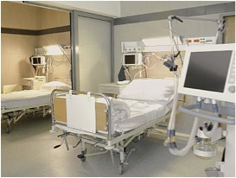
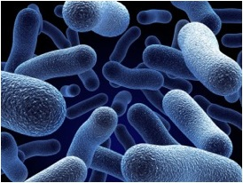
Environmental Cleaning in Healthcare:
Is Monitoring of Cleaning Compliance Really Needed?
Michelle J. Alfa, Ph.D., FCCM
Principal Investigator, St. Boniface Research Centre
Winnipeg, MB, Canada
Hosted by Paul Webber
paul@webbertraining.com
www.webbertraining.com
December 11, 2014

Slide 2

Acknowledgements:
Dr. Evelyn Lo; Co-investigator
IP&C staff at SBH(Adriana Cherewyk)
Nancy Olson and Brenda-Lee Murray; research lab staff at SBRC
Michelle MacRae Manager Housekeeping, SBH & Sean McCarthy; Director Facility Support, SBH
Louise Buelow-Smith; Clinical Advisor, SBH
Housekeeping staff at SBH
Nicole Kenny: Virox Inc.
Brenden Dufault: Biostatistician, U of Manitoba

Slide 3
Overview:
Importance of Environmental Cleaning/Disinfection
- Healthcare HAI transmission
Cleaning monitoring
- Guidelines; audit tools
- Published data
Prospective Manitoba study
Summary

Slide 4

Evidence of HAI Transmission related to Environment
PIDAC 2012 has excellent literature review
MRSA:
Patients in ICU who acquired MRSA had same strain as found in the ICU environment
(Hardy et al Infect Control Hosp Epidemiol 2006)
42% of 12 nurses contaminated gloves with MRSA by touching objects in room of patients with MRSA in wound or urine
(Boyce J Environmental contamination makes an important contribution to hospital infection J Hosp Infect 2007;65:50-54.)
Contact with items from the environment just as likely to contaminate caregiver hands with MRSA as direct contact with the Patient’s skin. (Steitel U et al ICHE 2011;32:185-7)
Copyright: Dr. M. Alfa

Slide 5
Evidence of HAI Transmission related to Environment
PIDAC 2012 has excellent literature review
MRSA & VRE:
Patients admitted to room previously occupied by patient with MRSA or VRE have significantly higher risk of acquiring these AROs
(Drees et al Clin Infect Dis 2008, Huang et al Arch Int Med 2006)
Copyright: Dr. M. Alfa

Slide 6


Best Practices for Environmental Cleaning for Prevention and Control of Infections: In All Health Care Settings
(PIDAC 2009, revised 2012 – free from website)
“Hotel Clean”:
Non-patient care areas
- cleaning only
“Hospital Clean”:
Patient-care areas:
- cleaning & disinfection
- high-touch surfaces
- frequency: risk stratification
Copyright: Dr. M. Alfa

Slide 7
Hospital-approved Liquid Disinfectants for Environmental Cleaning
[PIDAC 2012]
Alcohols: 70-90%
Chlorines: sodium hypochlorite or bleach
Hydrogen peroxides: (enhanced action formulations)
Quaternary ammonium compounds: QUATS
[limited bacterial killing ability]
Phenolics: not to be used in nurseries
Iodophors: non-antiseptic formulations
Be sure to ensure microbial killing claims are effective in < 3 minutes

Slide 8
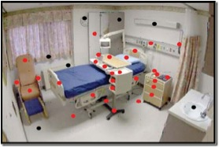
Environmental Cleaning Monitoring
PIDAC Recommendations:
- Process in place to assess quality of cleaning
- In addition to visual inspection use of an Audit tool
- Regular feedback to housekeeping staff
- Action plans when inadequate compliance detected
Audit Tools:
UV-visible Marker
ATP
Culture

Slide 9
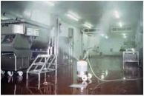
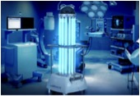
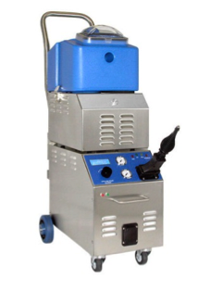
Novel Methods for Environment Disinfection:
CleanRoomTechnology website
Fogging:
- VHP,
- Ozone gas,
- super-oxidized water,
UV irradiation:
Steam:
Lightclean Website
Stambio website
Regardless of Disinfection method used, monitoring cleaning compliance is still needed

Slide 10
Cleaning criteria: | Compliance of Monitoring Method with cleaning criteria
 | UV-Marker | ATP | Culture | Visual Inspection
Surface was wiped | + | +* | +/- | -
Low Organic residuals | - | + | - | -
Low Microbial residuals | - | -** | + | -
No residual AROs | - | - | + | -
Low labour | + | + | - | +
Results available for immediate feedback | + | + | - | +
* Cutoff for adequate cleaning not yet defined (250 RLUs/site suggested)
** ATP lacks sensitivity to detect < 100 cfu/test
10

Slide 11
ATP levels (RLUs) do NOT correlate with viable count
Sciortino C et al Validation and comparison of three ATP luminometers for monitoring hospital surface sanitization: A Rosetta Stone for ATP testing. AJIC 2012;40:233-9
Shama G, Malik DJ. The uses and abuses of rapid bioluminescence-based ATP assays. Int.J.Hyg.Environ.Health 2013;216:115-25
Boyce JM et al Comparison of fluorescent marker systems with 2 quantitative methods of assessing terminal cleaning practices. ICHE 2011;32:1187-93.

Slide 12
Viable count versus RLUs for microbes dried onto a surface
Days dried: | E.faecalis 7.02 Log₁₀/site |  | P.aeruginosa 6.41 Log₁₀/site |  | C.albicans 6.55 Log₁₀/site
 | RLUs/site (Median) | Log₁₀ CFU/site | RLUs/site (Median) | Log₁₀ CFU/site | RLUs/site (Median) | Log₁₀ CFU/site
1 | 119,593 | 7.43 | 281,666 | 3.42 | 825,313 | 4.06
14 | 81,799 | 5.51 | 154,462 | < LD | 815,736 | < LD
29 | 82,405 | 4.08 | 182,144 | < LD | 795,052 | < LD
Alfa MJ et al Adenosine tri-phosphate (ATP)-based cleaning monitoring in healthcare: How rapidly does environmental ATP deteriorate? J Hosp Infect. 2015 (accepted; in press)

Slide 13
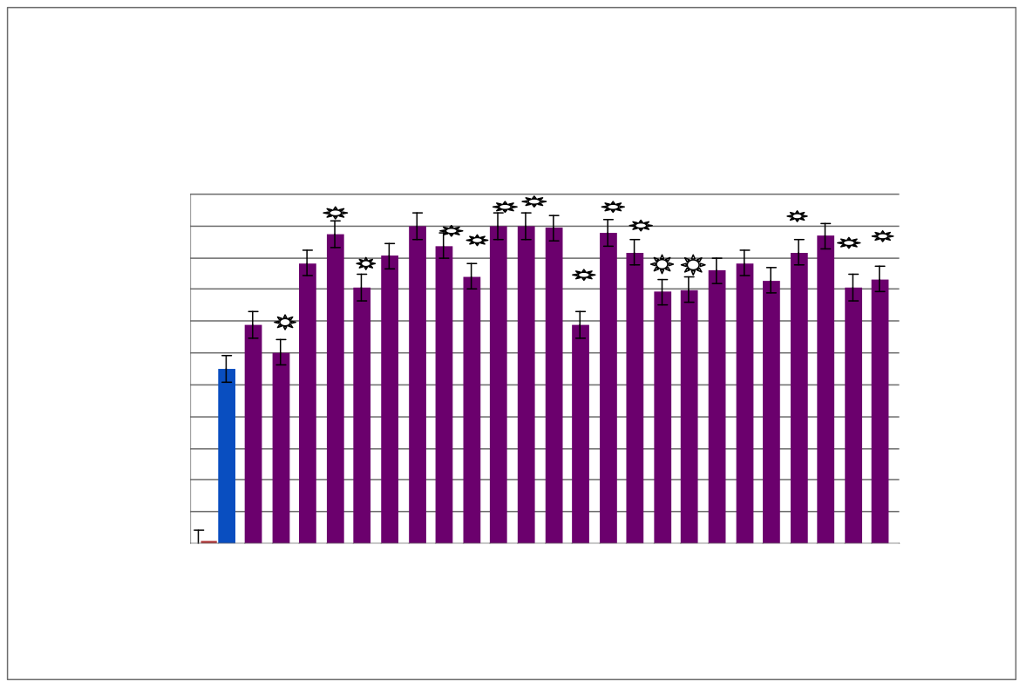
UV Marker Audits:
Impact of Feedback on Compliance
New Staff Training: Ensure Trainers meet compliance targets
Target of 80%
Feedback
Tratjman A et al Continuing performance feedback and use of the ultraviolet visible marker to assess cleaning compliance in the healthcare environment. J Hosp Infect 2013;84:166-172

Slide 14
ATP Monitoring of Cleaning Compliance
RLU cutoff for “clean” was 250 RLUs
Smith PW et al Impact of ATP detection and feedback on hospital room cleaning ICHE 2014;35:564-569

Slide 15
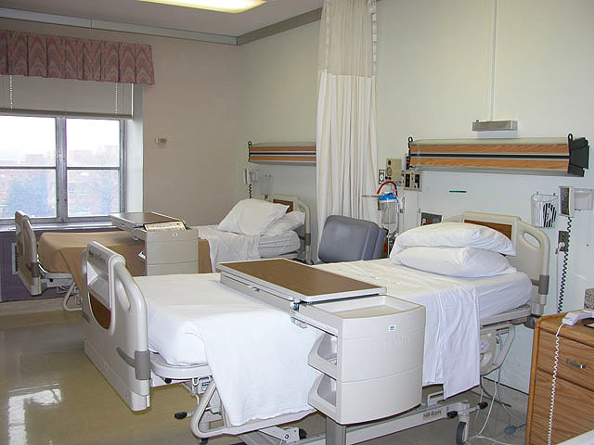
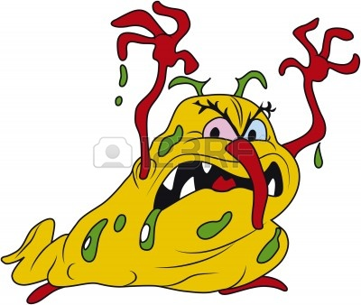
Can use of a disinfectant-cleaner combined with monitoring and feedback of cleaning compliance reduce HAIs?
Risk of ARO transmission is highest prior to ARO diagnosis when patient is not yet on isolation precautions
Important that daily cleaning-disinfection is effective

Slide 16

Key Study Parameters
Select a hospital grade disinfectant-cleaner that could be used daily (bleach alternative) that kills all AROs
Use this disinfectant-cleaner for routine daily disinfection of all high-touch areas (including curtains) for both isolation rooms and non-isolation rooms
Ensure compliance with surface application (monitor, feedback, re-clean)

Slide 17
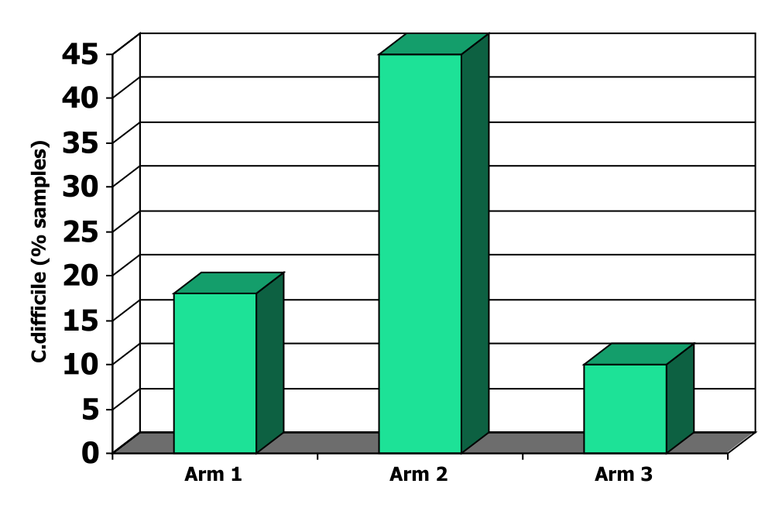
Use of Oxivir_{TB} (Accelerated Hydrogen Peroxide) as a bleach alternative
Alfa et al 2010; BMC Infectious Diseases [www.biomedcentral.com]
Arm 1: 50 patients, 133 samples
CDAD, twice daily cleaning, Oxivir_{TB}
Arm 2: 68 patients, 254 samples
CDAD, twice daily cleaning, PerDiem
Arm 3: 68 patients, 179 samples
Diarrhea, once daily cleaning, PerDiem

Slide 18

Study Protocol: Nov 2012- Oct 2013
TARGET: General Daily Cleaning/Disinfection
ALL Patient-care areas hospital-wide:
- use Oxivir_{TB} wipes for ALL High-touch surfaces
(NOTE: Company alternate name: “Accel Intervention”)
- All staff trained in use of container/wipes
UV-Marker: Audit housekeeping compliance
- 2 rooms/study ward/week
- 10-15 sites/room (bathroom & patient room)
- > 80% compliance considered acceptable
- re-clean sites that have residual marker
Document impact on HAI rates

Slide 19
Wards included in Study
Program/wards Included in Study:
Cardiac Program: - A5CM - CR4C - ICCS - ICMS
Surgical Program: - A4S (includes Step-down) - A7SO - A7WE
Medicine Program: - A6ME - B5ME - E4GM - E6ME - E5ME
Women & Child - B3MC - B4GY - LDRP - NICU
Areas that also used Oxivir_{TB} but not included in study of HAIs

Slide 20
VRE
(Nov 1 to Oct 31 each year)
[2011 CNISP benchmark: 9.4 cases/10,000 PDs]
3
287
338
223
186
CASES/year
*
**
Cases/10,000 Patient days
* p = 0.0358
** p = < 0.0001

Slide 21
MRSA
(Nov 1 to Oct 31 each year)
[2011 CNISP benchmark: 11.43 cases/10,000 PDs]
59
41
63
51
33
CASES/year
*
**
Cases/10,000 Patient days
*p = 0.5239
**p = 0.0071

Slide 22
C.difficile
(Nov 1 to Oct 31 each year)
[2011 CNISP benchmark: 6.04 cases/10,000 PDs]
78
67
66
54
39
CASES/year
*
Cases/10,000 Patient days
**
*p = 0.4277
**p = 0.005

Slide 23
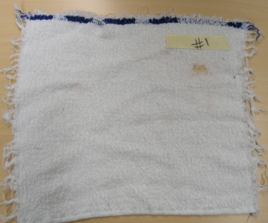
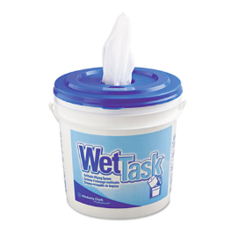
Fluid transfer for Wipes versus Rags as cleaning cloths
Overbed table & bedrail wiped | Cloths tested
Condition tested (5 replicates): | Accel Wipes | Cotton Rags
Liquid absorbed: Avg. grams (SD) | 15.34 (0.86) | 60.22 (18.05)
Liquid released: Avg. grams (SD) | 3.46 (0.38) | 2.46 (0.36)
Dry time: Table Avg. mins (SD) | 8.78 (2.23) | 3.13 (1.12)
Dry time: Bedrail Avg. mins (SD) | 1.95 (0.21) | 1.21 (0.31)

Slide 24

Key Study Conclusions:
HAI rates reduced for VRE, MRSA & C.difficile
Three key components:
Training of Housekeepers:
- required to demonstrate competency
Monitoring cleaning compliance:
- minimal acceptable compliance of 80%
- same-day feedback (re-clean required)
Effective disinfectant agent:
- wide range of kill in < 1min
- container-wipe application system

Slide 25

BATTLEFRONT: INFECTION
Housekeeper 007
HOUSEKEEPING IS THE FRONT LINE IN THE
“BATTLE OF THE BUGS”!
BE SURE YOU HAVE OPTIMIZED YOUR DEFENCES!
TRAINING
OPTIMAL KILLING AGENT
FEEDBACK ON COMPLIANCE
Housekeeper
007
Infectious Disease
Picture from Google Images

Slide 26


Slide 27


