Slide 1
Evaluating IPC Education in the Workplace
To do
Remind delegates that eval works best in Chrome
Pia
Dates for next year
Invoice asap
Ask Kevin when quality forum isS
Next year:
Dates!
Screen location and size (can go right up to ceiling?)
Lose 1/3 of stage; put screens closer to stage?
If screens right under airwalls that will take care of lighting issues.
Videotape all
This computer:
Download Citrix
Get product key for MS Office
Update Chrome, IE, Adobe Flash
Conference notes
Millennials – resilience to change because they grew up with changing technology
What about us?
Goldman sachs – 30% of millennials don’t own car, don’t want to
Dopamine allows your brain to work
21 days: 3 things you’re grateful for
Liz
Masters student study: Aerodynamics of pathogen movement in toilet plume
Jim Gauthier
Font size on labels
MARTIN KIERNAN
VISITING CLINICAL FELLOW UNIVERSITY OF WEST LONDON
CLINICAL DIRECTOR, GAMA HEALTHCARE
Hosted by Paul Webber
paul@webbertraining.com
www.webbertraining.com
March 9, 2017

Slide 2
Content
The evidence for the effectiveness of education in reducing Healthcare-associated Infections
The importance of evaluation
Evaluation strategies
Use of questionnaires
Use of the Kirkpatrick model of Evaluation
Education and compliance with practice
What does training do for your organisation

Slide 3
Introduction
Staff education and training is widely regarded as a pivotal measure to reduce the risk of healthcare-associated infection
Zingg et al, Lancet (2015)
Quality of evidence on education and training
2 of 10 key components of hosp-level IPC
Healthcare providers provide in-service education and training on IPC to their new and existing staff in varying degrees and through various methods
Typically has limited or no link to formal tertiary education structures
Although IPC programmes and practitioners devote much time and effort to teach HCWs, how effective is this?

Slide 4
What does the literature say about effectiveness of IPC education?
It’s not good..
Ward DJ. The role of education in the prevention and control of infection: a review of the literature. Nurse Education Today (2011) 31(1):9-17
Review of 39 studies
no clear evidence of sustained positive effect on compliance with IPC precautions
unclear whether education alone has a significant and sustained effect on infection rates, whether it needs to be combined with other interventions or even if education has any role to play at all
questionable whether knowledge increase improves practice
There is no rigorous and convincing evidence that education improves compliance with infection control precautions or reduces rates of infection, particularly in the long-term

Slide 5
Education does not work?
Effectiveness of educational interventions to reduce use of carbapenems
Prospective 17-month three-phase study
8-month pre-intervention period; one-month intervention period (intensive education and awareness campaign); 8-month post-intervention period
Shashikala, N. (2016) J Hosp Infect 94(2): 130-131
Nothing changed
Intervention was meetings (content not disclosed); Focus group discussions (no detail); Dissemination of published papers (did anyone read them?)
All ‘one off’ events over one month
Conclusion:
short education programmes are ineffective
Never evaluated the programme – went straight to outcome

Slide 6
Education does not work?
Hand hygiene teaching does not improve compliance
Dorsey S, et al 1996. Is handwashing teachable? Academic Emergency Medicine 3 (4), 360–5
After two weeks, brightly colored signs with CDC recommendations for handwashing were posted at all sinks and a copy of a related publication on handwashing by medical personnel was distributed to all staff
No formal teaching was provided
Was this ‘teaching’?

Slide 7
Effective outcomes
Effectiveness of training to improve central line care
Perez-Granda, M. Jet al (2015). "Effectiveness of a training program in compliance with recommendations for venous lines care." BMC Infect Dis 15: 296
Data from 2 point prevalence documentation reviews a year apart
Reduction in inappropriate catheterisation (subjective)
Improved documentation of insertion and dressing change
Non-significant reduction in infection rate (p=0.52) and the population in the second part of the study were significantly younger
Programme: interactive on-line teaching component and distribution of pocket leaflets and posters with recommendations on VL care
Not compulsory, compliance or completion rates not recorded
Never evaluated

Slide 8
Industry does evaluation of training
Invests millions in training to gain a competitive advantage
Training investment is increasing because learning creates knowledge which differentiates between those companies and employees who are successful and those who are not
Makes large investments in training and education and view training as a strategy to be successful
They expect outcomes or benefits to be measurable
Evaluation provides data to demonstrate that training does provide benefit

Slide 9
What some think about training
“If we train them they will leave”
Perhaps more worrying is what happens if we don’t and they stay..
Train people well enough so they can leave, treat them well enough so they don't want to
Richard Branson

Slide 10
Education vs. Training
Education
provides HCWs with a knowledge base and insight that act as a driving force behind future activities
There is a hugely motivational aspect to this
Training
task-orientated within a specific working environment
helps staff to acquire skills to complete a procedure to a set standard
Clinical and non-clinical

Slide 11
“Good news, It’s Mandatory Training Day”

Slide 12
Confession Time
I delivered around 1000 in-house training sessions in my NHS Career
I have no idea if they were effective
People seemed to like them
So that’s OK then
Did it change anything?
I have no clue
Or do I?

Slide 13
Evaluations
Student rating is a traditional approach to the evaluation of education programmes
Educators should instead use self, peer, and mentor rating scales in addition to student rating scales to obtain a range of perspectives
Berk, R.A. (2013) Medical Teacher, 35:15-26.
These ratings will only give partial information

Slide 14
Student ratings vs. multiple sources of evidence
In healthcare education, ratings have not received the same level of research attention as other fields
There are many behaviours and skills defining teaching effectiveness which students are NOT qualified to rate
Tutor’s knowledge and content expertise
Teaching methods
Use of technology
Course materials
Assessment instruments
Grading practices

Slide 15
Questionnaires
Questionnaires do not replace speaking to people and do not replace qualitative methods
If you need to ask why they answered a question in that way, you probably are using the wrong method
The person filling in the form is disinterested, not paying attention, and will rush through it
Anything that can go wrong….
So the design is important

Slide 16
Questionnaires 1
Question order matters (a lot)
Ask the most important question first
In one word, how would you describe the session?
Limit the number, eventually ‘question fatigue’ will sink in and answers will become erratic
too weak.
Yes/no
only when it is an easy ‘yes/no’ question
Ask questions from top to bottom
Columns from left to right lead to confusion, vertical responses seem to be better
Dillman DA. Mail and telephone surveys: the total design method. New York: John Wiley & Sons, Inc; 1978

Slide 17
Some guidelines for questionnaires 2
All questions on a 5 (or odd) point scale and symmetrical
Best scale (Likert)
Strongly agree, agree, Neither agree nor disagree, Disagree, Strongly disagree
An alternate is Excellent, Very Good, Good, Fair, Poor (For ratings)
Question specific 5 point scale
How is the tea in Yorkshire?
Much too strong, A little to strong, About right, A little too weak, Much too weak
Don’t ask extra questions just because you can, ask only questions you will act on
“Now we would like to move on to Q. 618 concerning the health of your pet fish...”

Slide 18
Bias in questionnaire design Choi B., Pak A. Prev Chronic Dis. 2005;2(1):1-13
Ambiguous question
lead respondents to understand the question differently than was intended and so to answer a different question than was intended
Double-barrelled question
made up of two or more questions makes it difficult
for the respondent to know which part of the question to answer
for the investigator to know which part of the question the respondent actually answered
Short question
may not be as accurately answered as questions that are longer

Slide 19
How to cheat
Manipulate
Get an answer you want by putting it after a question that has the desired answer in it
Bias towards an answer you want by using a 6 point scale
If there is an even number, people will deviate towards the positive
Phrasing is important
People may say "yes” if you ask the question this way
Do think hand hygiene is important?
But probably will say "no" if you ask the question this way:
Is hand hygiene a problem for you?

Slide 20
Analysis
Don’t be depressed if everyone doesn’t ‘strongly agree’ that the training was ‘excellent’
Respondents usually avoid ends of scales, try to be conservative and be towards the middle
Foddy W. Constructing questions for interviews and questionnaires: theory and practice in social research. Cambridge (United Kingdom): Cambridge University Press; 1993
Respondents are more likely to check “Agree” or “Disagree” than “Strongly agree” or “Strongly disagree
Aday LA. Designing and conducting health surveys. 2nd ed. San Francisco (CA): Jossey-Bass; 1996

Slide 21
Donald Kirkpatrick
Kirkpatrick developed a model of training evaluation in 1959
Arguably the most widely used approach
Simple, Flexible and Complete
4-level model

Slide 22
Why Evaluate?
Should the program be continued?
How can the program be improved?
How can we ensure regulatory compliance?
How can we maximise training effectiveness?
How can we be sure training is aligned with strategy?
How can we demonstrate the value of training?

Slide 23
Model of Evaluation Kirkpatrick (1967)
Industry expects good outputs from sales and manufacturing however make no effort to discover whether training depts are effective
Proposed 4 levels of outcome evaluation
Level 1 – Reaction
Level 2 – Learning
Level 3 – Behaviour
Level 4 – Results
Assumption that each level will affect the subsequent level
Has been criticised for not distinguishing between education (learning) and training (skill)
Can be overcome by the selection of appropriate tools

Slide 24
Kirkpatrick Level 1 - Reaction
A participant satisfaction measure
Were the participants pleased with the program
Perception of if they learned anything
Likelihood of applying the content
Effectiveness of particular strategies and the packaging of the course
Measures participants reactions to the training program, including:
reactions to the overall program (outcomes)
“To what extent did you find the training useful?”
reactions to specific components of the program (processes) e.g.,
What aspect(s) did you most appreciate and find useful and what did you least appreciate and feel is most in need of improvement?
Consider looking for delayed reactions

Slide 25
Example of Level One
How much did you know about this subject before taking this training?
Nothing Some A lot
1 2 3 4 5
How much do you know about this subject after this training?
Nothing Some A lot
1 2 3 4 5
Measures intent
The question does not assess actual learning, it assesses perceived learning

Slide 26
More Level One
How likely are you to use some or all of the skills taught in this training in your work?
Not Very Likely Likely Very Likely
1 2 3 4 5
Intent
Determine participants perceived relevance of the training
May correlate with the satisfaction learners feel

Slide 27
Reaction: Relationship to Other Levels
Positive - can ask trainees if they:
Will use new skill(s) or information (Level II)
Plan to change behavior (Level III)
Expect improvements in results (Level IV)
Negative - does not:
Measure what was learned (Level II)
Guarantee behavioural change (Level III)
Quantify results from learning (Level IV)

Slide 28
Level 2 - Learning
Measures what participants have learned from involvement in the program
What is measured needs to relate to what was covered in the program, e.g., learning objectives
Typically covers knowledge, skills, or attitudes
Needs to include both rating scales & open-ended questions
Can include self-report & tests of actual knowledge
Use a control group if possible

Slide 29
Level Two Alternative Strategies
Consider using scenarios, case studies, sample project evaluations, etc, rather than test questions
What would you do if.. Etc
Develop a rubric of desired responses
Develop between 3 and 10 questions or scenarios for each main objective.

Slide 30
Learning: Relationships to Other Levels
Positive - people who learn can:
Experience pride (Level I)
Experiment with new behaviors (Level III)
Achieve better results (Level IV)
Negative - It does not ensure that they:
Liked training program (Level I)
Will behave differently (Level III)
Will get expected results (Level IV)

Slide 31
Level 3 - Behaviour
Measures transfer of knowledge, skills & attitudes from the training context to in-vivo or real-life contexts
Evaluate both before & after the program if practical
Can use survey, focus groups, interviews with students, mentors, staff
Survey is a practical method
Self and peer are both valid

Slide 32
Evaluating Behaviour
Measure on a before/after basis
Otherwise how will you know if a change has taken place?
Use a control group if practical
Allow time for behaviour change to take place & embed
Survey or interview those who are in the best position to see change
Participant/learner
Supervisor/mentor
Subordinates or peers
Others familiar with the participants actions

Slide 33
Behavior: Relationships with Other Levels
Positive - Can determine:
Degree to which learning transfers to the post-training environment (Level II)
Negative - Cannot determine whether:
Participants like the training (Level I)
Participants understand (Level II)
Behaviors accomplish results (Level IV)

Slide 34
Measurement of Intent
Comparison of the perception of safety culture and intention to comply with IPC guidelines in professionals who were required by their supervisors to take the course, and those who did so voluntarily
Yassi, A et al Can J Infect Dis Med Microbiol 2009;20(1):15-19
Those required to take the course had a significantly better perception of the institutional safety climate (P<0.001), and had a higher reported intention to comply with infection control guidelines (P=0.040) than those who took the course voluntarily

Slide 35
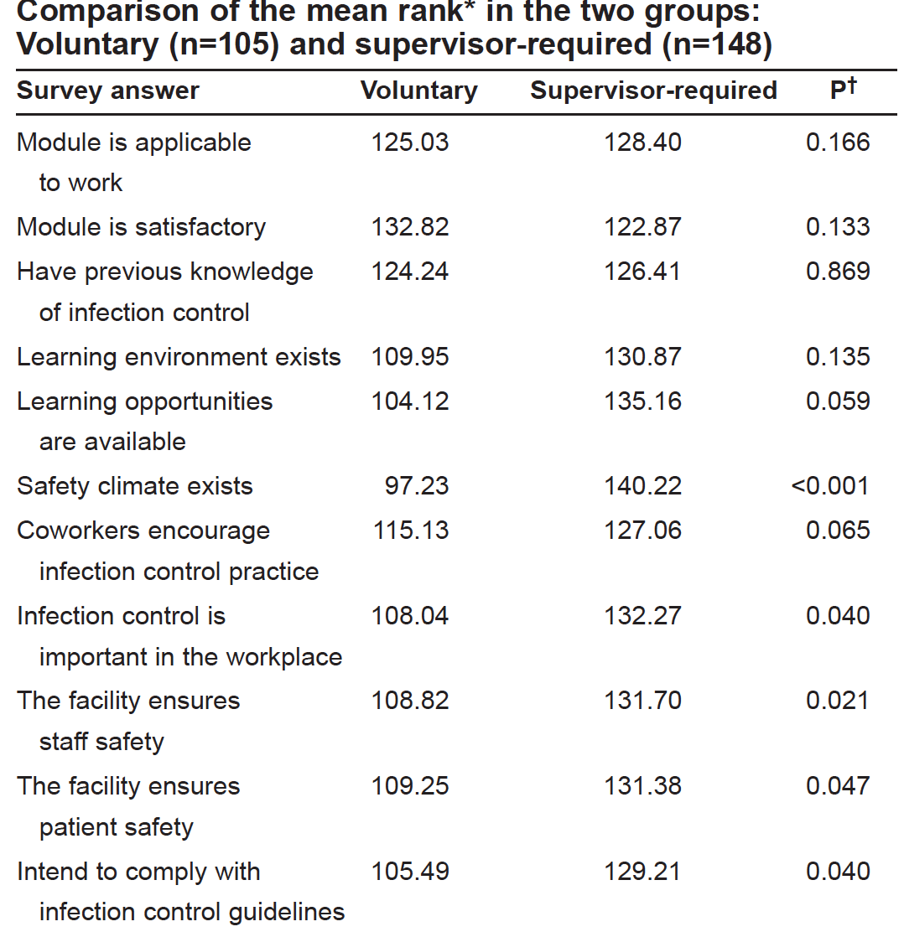

Slide 36
Level 4 - Results
Nirvana – but not easy
Measures “return-on-investment”, or the extent to which the training/education has produced results
Some examples include –
Hard outcomes
Hard data for what was addressed during the training
Soft outcomes
Staff job satisfaction
Staff self-reporting of behaviour change

Slide 37
Measurement of Effectiveness
Outcome measures
Infection rates
(CLABSI, SSI, Transmissions etc etc)
Product usage (more or less)
Reduced (or increased) costs
Cleanliness assessment via quantitative methods
Process measures
Adherence to standards; Compliance with interventions (and bundle)
Many studies report these as positive following educational interventions
Majority do not look at whether this was sustained

Slide 38
Results: Relationship to Other Levels
Positive
Positive Levels 1, 2, 3 evaluations results can provide positive Level 4 evidence.
Negative - Does not:
Tell if participants liked training (Level I)
Prove trainees understand (Level II)
Prove use of preferred behaviors (Level III)
Positive results at Level Four does not always directly correlate to desired behaviours. It can be easy to attribute ‘success’ to your efforts but check for other/external factors

Slide 39
Summary of Tools to Purpose
 | Level 1 | Level 2 | Level 3 | Level 4
Continue the programme | X |  | X
Improve the programme | X | X | X
Ensure compliance |  | X
Enhance effectiveness of training |  |  | X
Align training with strategy |  |  | X | X
Demonstrate the value of training | X | X | X | X

Slide 40
Evaluation Techniques
 | Evaluation Levels
Methods | 1 Reaction | 2 Learning | 3 Behaviour | 4 Results
Survey | ● | ● | ● | ●
Questionnaire/Interview | ● | ● | ● | ●
Focus Group | ● | ● | ● | ●
Knowledge Test/Check |  | ●
Skills Observation |  | ● | ●
Presentations |  | ● | ●
Action Planning |  | ● | ● | ●
Action Learning |  |  | ●
Key organisational Metrics |  |  |  | ●

Slide 41
Criticism of Kirkpatrick
Assumption of growing significance from the first to the last level
Oversimplification of relevant influences on training success
Unclear cause–effect relations between levels
Bates, R. A. (2004), ‘A critical analysis of evaluation practice: the Kirkpatrick model and the principle of beneficence’, Evaluation and Program Planning, 27, 341–7

Slide 42
Is Evaluation Linked to Transfer of Training?
Study relationship between training evaluation and the transfer of training
Saks, A. M. and L. A. Burke (2012) "An investigation into the relationship between training evaluation and the transfer of training" International Journal of Training and Development 16(2): 118-127
Organisations reporting evaluation of training programs more often have a higher rate of transfer of training
Relationship between training evaluation and transfer stronger immediately after training than 6 months and 1 year after training

Slide 43
Does teaching increase compliance?
Effectiveness of a nursing IPC educational program presented to nursing students before graduation
Al-Hussami M, Darawad M. (2012) AJIC 41(4) 332-6
Students randomly assigned to receive defined IPC education
All had received some basic IPC in medical and surgical sessions
Pretest scores 12.45/30 (range 4-16)
Hypotheses
When compared with a control group, nursing students who complete an infection prevention educational program will demonstrate
Increased knowledge of IPC precautions
better attitudes toward IPC precautions
increased compliance with IPC precautions

Slide 44
Does teaching increase compliance?
Knowledge
Assessed by test
9 true/false and 21 multi-choice questions
Attitude
11 questions measuring attitudes toward choosing personal protective equipment (PPE), donning PPE and high-risk procedures
Responses used a 5-point Likert scale, ranging from 1, “strongly disagree” to 5, “strongly agree”
Results
Participants in the experimental group demonstrated significantly better knowledge (t = 19.15; df = 95; P = .000) and attitude scores (t = 2.29; df = 46; P = .04) than in the control group

Slide 45
Does teaching increase compliance? – 2
Compliance
cross-sectional survey was conducted to investigate the nurses’ knowledge of and compliance with Universal Precautions (UP) in an acute hospital in Hong Kong
Chan R et al.. Int J Nurs Stud 2002;39:157-63
Self-evaluated using a tool containing 15 items scored on a 4-point Likert scale, ranging from 1 “never,” to 4 “always”, with higher scores indicating better compliance with standard precautions
areas related to the use of PPE, disposal of sharps, disposal of waste, decontamination, prevention of cross infection
no significant relationships between the nurses’ knowledge and compliance with UP
Spot the flaw?

Slide 46
Sustainability
“He that complies against his will, Is of his own opinion still; Which he may adhere to, yet disown, For reasons to himself best known”
‘Hudibras’ (1678) poem by Samuel Butler (1612-80)
Trying to find out why the opinion has not changed is vital

Slide 47
Competency-based training Salaripour & Perl (2013) CJIC 28(1) 13-16
Evaluation of mandatory training
Random professionals from various occupations and a mixture of hospital units
Pre and post-training short questionnaires
new employees before and after IPC orientation sessions
Examined knowledge retention, included elements that captured knowledge, practice of and attitude to IPC
retention questionnaire given to staff employed at least one year and up to three years from initial employment
Both surveys included five multiple-choice questions
Each question was given one point
Points were added to give a maximum score of five

Slide 48
Results
86% of hospital staff trained by Sept 2007
207 pre-test and 244 post-test surveys were completed
93 retention surveys
Correct answers to all questions
Pre-test 32.8%
Post-test 53.6%
A significant difference between the knowledge level of the two stages of the surveys taken before and after the workshop was identified (P< 0.0001)
Sustained?
Knowledge at one year was actually lower than pre-testing
Retention test 0.03%

Slide 49
Discussion
Knowledge gained was very short-term
retention drop in health workers that were tested at least a year after initial training is suggestive of the need for re-education at shorter intervals
Nurses find that educational modules are more effective when nurses’ needs are included in structuring their components
Cheng SM, et al Can J Infc Control, (2008) 23(3): 165-71

Slide 50
Effect of Training
Ineffective (or no) training
Effective training
Organisational
Poor job performance
Low job satisfaction
Safety hazards and injuries
Lower patient satisfaction
Legal repercussions
Waste of resources
For IPC
Infections
Transmission
Increased length of stay
Increased cost
Organisational
Improved Quality of Work
Better Team Performance
Increased Productivity
Improved employee health and Org. safety record
Increased patient satistaction
Don’t forget patient ‘choice’
Staff Retention
Increased morale
And some for IPC..

Slide 51
Maybe the tide is turning
Hours of infection prevention education received significantly associated with student nurses’ self-reported ability to comply with infection prevention practices
Carter, E. J. et al Nurse Education Today (2017) In Press doi:10.1016/j.nedt.2017.02.021
Unevaluated, but related to the amount of time exposed to IPC education
Quality vs. quantity argument still must be addressed

Slide 52
Don’t be afraid to evaluate!
You may be pleasantly surprised
You will never be the worst evaluated part of Mandatory Training
That is the role of ‘Data Protection’ and others
You will be able to demonstrate the value of training and of your team
and maybe it will help you argue for more access to training
All training provided in the organisation should be evaluated in some form
that includes training provided by external providers

