Slide 1
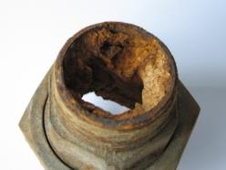
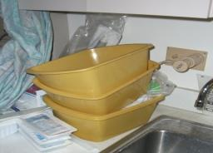

Evidence vs. Tradition: Examining the science on bathing critically ill patients
Kathleen M. Vollman MSN, RN, CCNS, FCCM, FAAN
Clinical Nurse Specialist / Educator / Consultant
ADVANCING NURSING
kvollman@comcast.net
Northville Michigan
www.vollman.com
Sponsored by
www.sage.com
Hosted by Paul Webber
paul@webbertraining.com
© ADVANCING NURSING LLC 2013
www.webbertraining.com
September 24, 2015

Slide 2
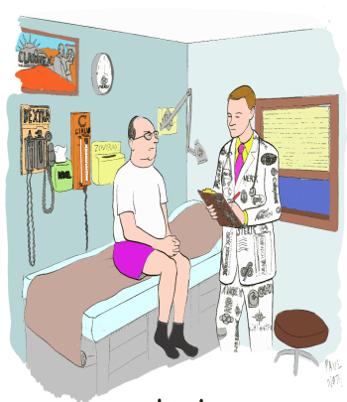
Disclosures
    Sage Products Speaker Bureau & Consultant
    Eloquest Healthcare Speaker Bureau & Consultant
    Hill-Rom Speaker Bureau & Consultant
2

Slide 3
Session Objectives
Create the link of patient advocacy to the basic nursing care
Define key fundamental evidence based nursing care practice of bathing to reduce harm/infection
Discuss strategies to overcome barriers

Slide 4
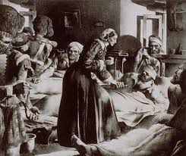
Notes on Hospitals: 1859
“It may seem a strange principle to enunciate as the very first requirement in a Hospital that it should do the sick no harm.”
Florence Nightingale
Advocacy = Safety

Slide 5

Protect The Patient From Bad Things Happening on Your Watch
Implement
Interventional Patient Hygiene

Slide 6
Interventional Patient Hygiene
Hygiene…the science and practice of the establishment and maintenance of health
Interventional Patient Hygiene….nursing action plan directly focused on fortifying the patients host defense through proactive use of evidence based hygiene care strategies
Catheter
Care
Hand Hygiene
Bathing &
Assessment
Comprehensive
Oral Care Plan
Pressure Ulcer Prevention
Incontinence Associated Dermatitis Prevention Program

Slide 7
INTERVENTIONAL PATIENT HYGIENE (IPH)
VAP/HAP
Oral Care/ Mobility
HAND
Patient
HYGIENE
Skin Care/ Bathing/Mobility
Catheter Care
CA-UTI
CA-BSI
SSI
HASI
Vollman KM. Australian Crit Care, 2009;22(4): 152-154

Slide 8

Achieving the Use of the Evidence
Skills & Knowledge
Resources & System
Factors Impacting the
ability to Achieve Quality
Nursing Outcomes
at the Point of Care
Vollman KM. Intensive Crit Care Nurs, 2013;22(4): 152-154
Attitude
&
Accountability
Value

Slide 9

Rank Order of
Error Reduction Strategies
Forcing functions and constraints
Automation and computerization
Standardization and protocols
Checklists and double check systems
Rules and policies
Education / Information
Be more careful, be vigilant
Notes:
9

Slide 10
Why HAI's?
Protecting Patients From Harm
Estimates: 183 Hospitals in 10 States
HAI: | 722,000/year
HAI-related deaths: | 75,000/year
Hospitalized patients develop infection: | 1 out of 25 (4%)
Death due to sepsis/septic shock: | 700/day
Money spent: | $45 billion/year
Increase risk of readmission: | 27days vs. 59 days
Magill SS, et al. New England Journal of Med, 2014;370:1198-208

Slide 11
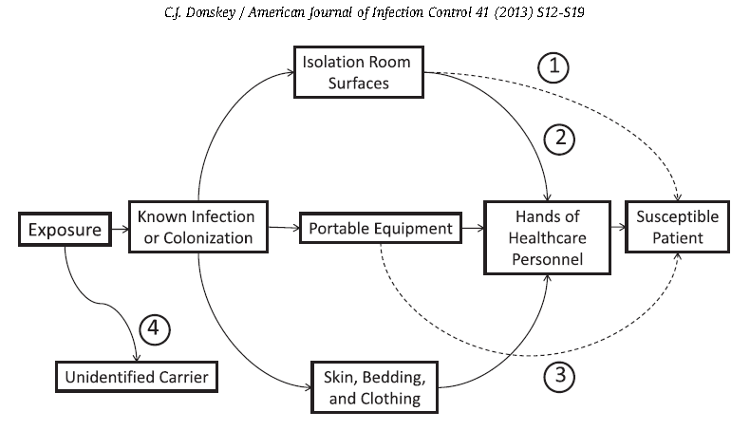
Common Routes of Transmission

Slide 12
Reducing MDRO’s
Hand hygiene (Electronic versus direct observation more accurate in measuring compliance)¹
Decontamination of environment and equipment
Ultraviolet–C to kill pathogens.^{2,3}
  After 45 minutes of use, C. difficile spores were reduced by up to 99 percent.
  15 minutes for non-spore forming bacteria
Decontamination of the patient⁴
Practice the device bundles (VAP,BSI, UTI)⁵
¹Morgan DJ, et al. AJIC, 2012;40:955-959
²Nerandzic MM, et al. BMC Infect Dis 2010 Jul 8;10:197
³Havill NL et al. Infect Control Hosp Epidemiol, 2012;33:507-512
⁴Huang SS, et al. New Engl J of Med, 2013;368(24):2255-65
⁵www.ihi.org

Slide 13

Patients At Risk
Multi-Drug Resistant Organisms
  Immunodeficiencies
  Breaks in skin integrity related to
  invasive devices
  Co-morbidities
  Hand transmission
  Equipment contamination/Hospital environment
Damaging the Natural Barriers to Infection…the Skin
  Bathing techniques
  Soaps
  Wash cloths
Bonten MJM. Am J Respir Crit Care Med. 2011;184:991-993
Popovich KJ, et al. Infect control and Hosp Epidemiol, 2012;33:889-896
Weber DS, et al. Am J of Infect control, 2010;38:S25-33.
13
Used with Permission Advancing Nursing LLC Copyright 2013 AACN and Advancing Nursing LLC

Slide 14

The Bath: The First Line Of Defense
Nurse!!!
Early Detection of Skin Injury
Reducing Microorganism spread
Efficiency & Effectiveness
Health/Social Well Being

Slide 15
Optimal Hygiene
pH balanced (4-6.8)
  Stable pH discourages colonization of bacteria & ↓ risk of infection
  Bar soaps may harbor pathogenic bacteria
  Skin pH requires 45 minutes to return to normal following a ordinary washing
Excessive washing/use of soap compromises the water holding capacity of the skin
Non-drying, lotion applied
Multiple steps can lead to large process variation
Voegel D. J WOCN, 2008;35(1):84-90
Byers P, et al. WOCN. 1995; 22:187-192.
Hill M. Skin Disorders. St Louis: Mosby; 1994.
Fiers SA. Ostomy Wound Managment.1996; 42:32-40.
Kabara JJ. et. al. J Environ Pathol Toxicol Oncol. 1984;5:1-14

Slide 16
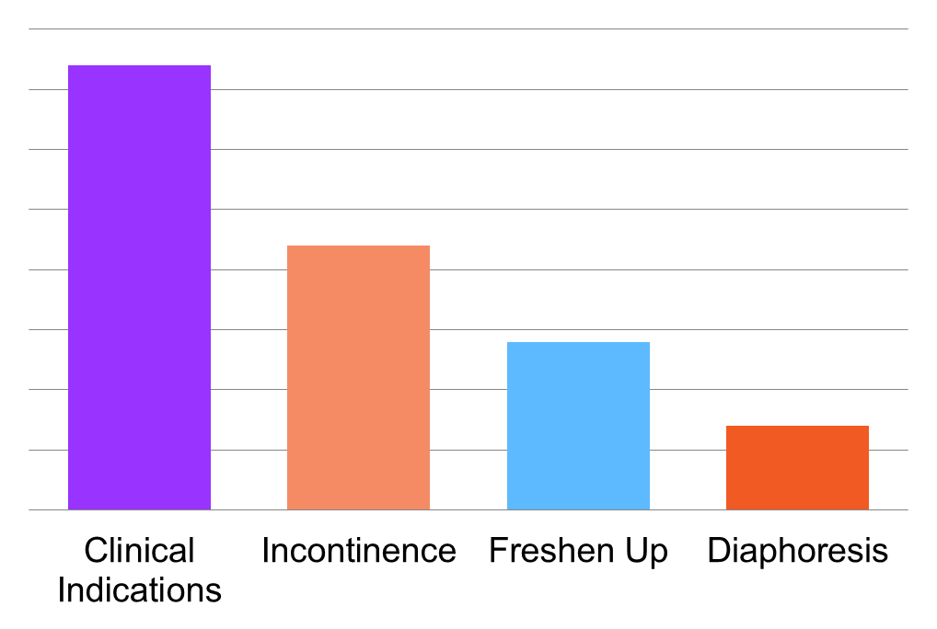
The Evidence: Reasons for Bathing
  37%
  22%
  14%
  7%
Coyer FM, et al. Aust Crit Care. 2011;24(3):198-209.
16
Used with Permission Advancing Nursing LLC Copyright © 2013 AACN and Advancing Nursing LLC

Slide 17

Timing of Bath
40% baths occur 2400 – 0600
Timing for bathing varies globally
Consider patient need for sleep
and energy reserves.
Avoid:
  Nurse preference
  Organizational factors
  Unit norms
Coyer FM, et al. Aust Crit Care. 2001;24:198-209
Celik S, et al. J Clin Nurs. 2004;14:102-106
Tamburri LM, et al. Am J Crit Care. 2004;392:102-113
17
Used with Permission Advancing Nursing LLC Copyright 2013 AACN and Advancing Nursing LLC

Slide 18
Traditional Bathing
nurWse!
Why are there so many bugs in here?
Soap and water basin bath was an independent predictor for the development of a CLABSI
Bleasdale SC, e tal. Arch Intern Med. 2007;167(19):2073-2079

Slide 19
Environmental Contamination as a
Source of Health Care Acquired Pathogens
Pathogen | Survival | Data | Transmission Settings
C. difficile | Months | 3+ | Healthcare facilities
MRSA | d-weeks | 3+ | Burn units
VRE | d-weeks | 3+ | Healthcare facilities
Acinetobacter | 33 d | 2/3+ | ICUs
P. aeruginosa | 7 h | 1+ | Wet environments
Hands equally become contaminated from commonly examined skin sites & environmental surfaces
Hota B, Clin Inf Dis 2004; 39(8):1182-9
Stiefel U et al. Infect control & Hosp Epidemiol 2011;32:185-187.
19

Slide 20

The Evidence: Bath Basins
Potential Source of Infection
Multicenter Sample Study to Identify and Quantify Bacteria in Basins
Enterococci 54%
  Gram negative 32%
  S. aureus 23%
  VRE 13%
Less than 10% growth rates
  MRSA 8%
  P. aeruginosa 5%
  Candida albicans 3%
  E. coli 2%
98% grew bacteria
Johnson D, et al. Am J Crit Care, 2009;18(1):31-40, 41.
20
Used with Permission Advancing Nursing LLC Copyright © 2013 AACN and Advancing Nursing LLC

Slide 21




Bath Basins
Potential Source of Infection
Large multi-center study evaluates presence of multi-drug resistant organisms
62%
45%
Total hospitals: 88
Total basins: 1103
Contaminated
686 basins/88 Hospital
Gram negative bacilli
495 basins/86 hospitals
3%
35%
Colonized w/ VRE
385 basins/80 hospitals
MRSA
36 basins/28 hospitals
Marchaim D, et al. Am J of Infect Control. 2012;40(6):562-564
21
Used with Permission Advancing Nursing LLC Copyright 2013 AACN and Advancing Nursing LLC

Slide 22


Mechanisms of Contamination
Skin flora
Multiple-use basins
  Incontinence cleansing
  Emesis
  Product storage
Bacterial biofilm from tap water
Shannon RJ, et al. J Health Care Safety Compliance Infect Control. 1999;3:180-184.
Larson EL, et al. J Clin Microbiol. 1986;23(3):604-608.
Johnson D, et al. Am J Crit Care, 2009;18(1):31-38, 41.
Marchaim D, et al. Am J Infect Control. 2012;40(6):562-564.
22
Used with Permission Advancing Nursing LLC Copyright © 2013 AACN and Advancing Nursing LLC

Slide 23

Waterborne Infection
Hospital Tap Water
Most overlooked source for pathogens
29 studies demonstrate an association with HAIs and outbreaks
Transmission:
  Drinking
  Bathing
  Rinsing items
  Contaminated environmental surfaces
Immunocompromised patients at greatest risk
Anaissie EJ, et al. Arch Intern Med. 2002;162(13):1483-1492.
Cervia JS, et al. Arch Intern Med, 2007;167:92-93
Trautmann M, et al. Am J of Infect Control, 2005;33(5):S41-S49,
23
Used with Permission Advancing Nursing LLC Copyright © 2013 AACN and Advancing Nursing LLC

Slide 24
Prepackaged Disposable Bathing
Studies show
Prepackaged disposable bathing cloths result in…
 | Nurse satisfaction Improved skin condition
 | 78% fewer UTIs Amount of product used Time spent Cost Variation in bathing process
Larson E. et al. AJCC. 2004; 13(3):235-41
McGuckin M, et al Am J Infect Control. 2008 Feb;36(1):59-62
Shepard CM, et al. J of Gerontol Nurs. 2003;49:36-45
Birch S, et al. Ostomy Wound Manage. 2003;49:64-67
24
Used with Permission Advancing Nursing LLC Copyright 2013 AACN and Advancing Nursing LLC

Slide 25
Antisepsis Bathing
Prospective sequential group single arm clinical trial
1787 patients bathed
  Period 1: soap & water
  Period 2: CHG basinless cloth bath
  Period 3: non-medicated basinless cloth bath
Veron MO et al. Archives Internal Med 2006;166:306-312

Slide 26
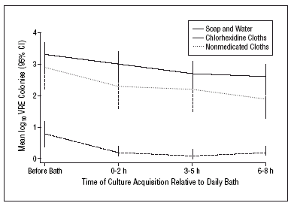
26 colonization's with VRE per 1000 patients days vs. 9 colonization's per 1000 patient days with CHG bath
Veron MO et al. Archives Internal Med 2006;166:306-312

Slide 27
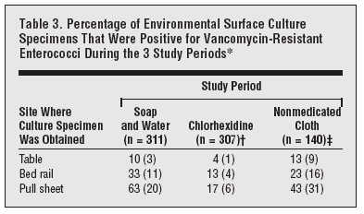
Veron MO et al. Archives Internal Med 2006;166:306-312

Slide 28
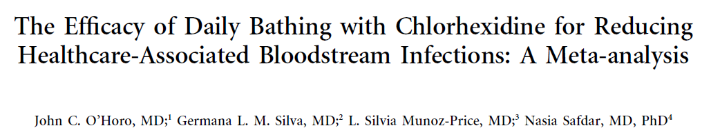
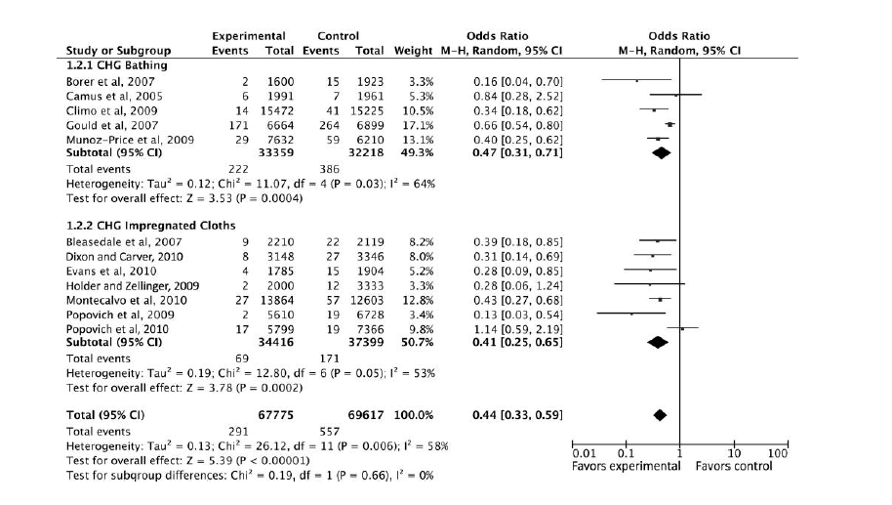


Slide 29
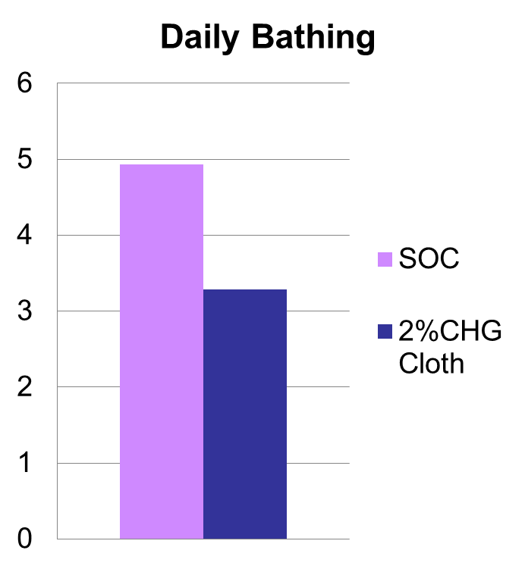
Antisepsis Bathing: SCRUB Trial
Critically Ill Children
Cluster-randomized 2-period cross over trail
>2 months of age
6 month
4947 admissions
  SOC: basin less bathing or soap & H₂O
  CHG: 2% CHG cloth
Demographics similar
Outcomes:
  Primary bacteremia-36% reduction
  12 pts withdrew because of skin irritations (1%)
  CHG-associated skin reactions-1-2 per 1000 pt days
36% Reduction
4.93
3.28
Bacteremia per 1000 days
Milstone AM, et al. 2013; 381(9872):1099-106

Slide 30
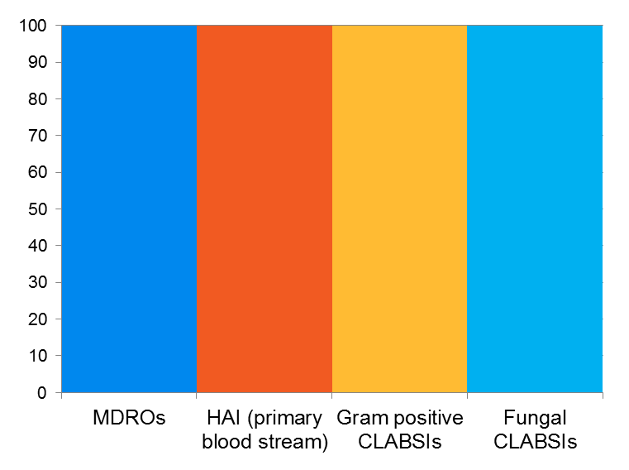
The Evidence: Impact of Antisepsis Bathing
Evaluate effect of daily bathing with CHG on acquisition of MDRO’s and incidence of CLABSI
9ICU’s & Bone Marrow Transplant unit
Randomly assigned 7727 patient:
  No-rinse, 2% CHG impregnated washcloths
  Non-antimicrobial,
  no-rinse bath cloths
  Results of 2% CHG bathing
  23% reduction
  28% reduction
  50% reduction
  90%
  reduction
30
Climo, M et al, N Engl J Med, 2013;368:533-542

Slide 31
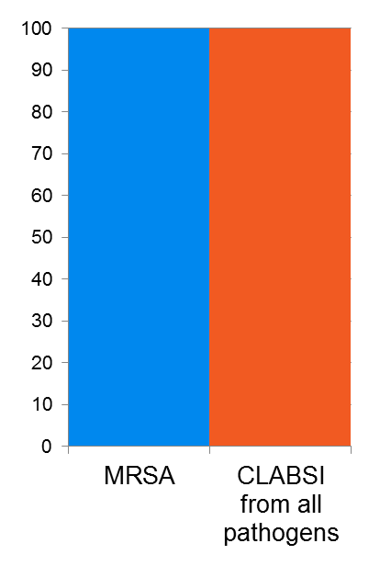
Impact of Antisepsis Bathing
Study to determine the best method for reducing spread of MRSA & MDROs
3 protocols tested:
Swab for MRSA on admission to ICU
  Isolate if positive
Swab for MRSA on admission to ICU
  Isolate if positive
  Nasal mucopiricin x 5 days
  2% CHG cloth bathing for entire ICU stay
No swab
  Nasal mucopiricin x 5 days
  2% CHG bath cloth for entire ICU stay
  Results: No Swab Group
  Universal Decolonization
  Demonstrated
  37% reduction
  44% reduction
Huang SS, et al. New England Journal of Med, 2013; May 30th online.
31

Slide 32
Single Center CHG Bathing Study
A pragmatic cluster randomized, crossover study of 9340 patients admitted to 5 adult intensive care units of a tertiary medical center in Nashville, Tennessee, from July 2012 through July 2013.
Units performed once-daily bathing of all patients with disposable cloths impregnated with 2%chlorhexidine or non-antimicrobial cloths as a control
Bathing treatments were performed for a 10-week period followed by a 2-week washout period during which patients were bathed with non-antimicrobial disposable cloths, before crossover to the alternate bathing treatment for 10 weeks….3x
Results
  No difference in CLABSI’s, CAUTI’s, VAP & c-diff infections were seen
Noto MJ, et al. JAMA, published online 01/20/2015

Slide 33
Limitations:
Adherence to care practice was not monitored
Intracluster correlation nor sequence of randomization was consider in the analysis
Used outcomes measures beyond previous studies
Active surveillance was not perform to detect cross over transmission of MDRO’s
Wasn’t registered on the clinical trials site
Pittet D, et al. JAMA, published online 01/20/2015

Slide 34
Recommendations and Implementation Strategies
Bath patients daily in ICU with CHG (determine if exclusion criteria)
Patient-centered bath times
Evaluate clinical stability and patient preference.
Avoid bathing between 2400 -0600.
Evaluate workloads on all shifts.
  Adjust distribution of care practices.
Avoid reusable bath basins and use of washcloths
  Remove soaps and creams from the unit stock.
  Replace basin with better strategies for containing emesis
  and keeping supplies.
  Reduce par levels of washcloths.
Avoid tap water for any component of bathing ICU patients
Use a no-rinse pH-balanced cleanser for facial cleansing
34

Slide 35
Recommendations and Implementation Strategies
6. Procedure:
  After routine washing of face and hair, remove one batch of CHG cloths (three bundled packages of two cloths each = six cloths).
  Warming is for patient comfort, it is not required.
  Cloths should be used to bathe the skin with firm massage.
  Do not use CHG above the jawline
  CHG should be used for incontinence care, or for any other reasons for additional cleaning
    If incontinence occurs, rinse the affected area with water and clean with chux. Then clean skin with CHG cloths.
  Use CHG-compatible barrier products if needed
  Do not rinse with water or wipe off
Universal ICU Decolonization: An Enhanced Protocol: Appendix F. Chlorhexidine Bathing Skills Assessment. September 2013. Agency for Healthcare Research and Quality, Rockville, MD. http://www.ahrq.gov/professionals/systems/hospital/universal_icu_decolonization/universal-icu-apf.html

Slide 36
For Successful Banning of Basins for Patient Care
We need to provide alternatives for the other functions:
Current | New
Emesis | Emebags being installed in every adult and ped pt. room, ACU, PACU
Storage of patient items | Clear plastic “baggies” Trial of “Concierge List” to decrease waste of unused/unneeded products
Foot soaks | Shampoo caps, prepackaged
Shampoo patient’s hair | Shampoo caps par’d on all units
24 hour urine, ice | Store some basins in lab to be dispensed with each 24 hour jug.
Bath cloths with no insulation, cold halfway through bath. | Bath cloths with insulation to stay warm longer

Slide 37
General Implementation Strategies
Educate patients and families about new bathing technologies
  Improves condition of the skin
  Reduces the spread of microorganisms
  Should not be rinsed off
Monitor compliance
  Assess estimated number of baths given
  Compare to use of bathing products used.
37
Copyright 2013 AACN and Advancing Nursing LLC

Slide 38

Strategies for Successful Implementation
Baseline measurement of HAI’s
Build the Will
Reduce process variation
Cost-benefit analysis
Place resources at point of care
Monitor compliance

Slide 39

It is not enough to do your best; you must know what to do, and THEN do your best.
~ W. Edwards Deming
Used with Permission Advancing Nursing LLC Copyright 2013 AACN and Advancing Nursing LLC

Slide 40

September 28 (Free British Teleclass ... Broadcast live from the 2015 IPS conference)
WHAT DID THE ROMANS EVER DO FOR US?
Carole Fry, Healthcare Infection Society
September 29 (Free British Teleclass ... Broadcast live from the 2015 IPS conference)
FAECAL TRANSPLANT TO TREAT CLOSTRIDIUM DIFFICILE DISEASE
Dr. Jonathan Sutton, Betsi Cadwaladr University Health Board, Wales
September 29 (Free British Teleclass ... Broadcast live from the 2015 IPS conference)
DEBATE – SELECTIVE DECONTAMINATION OF THE GUT
Dr. Cliff McDonald, Division of Healthcare Quality Promotion, USA, and
Professor Jan Kluytmans, St Elisabeth Hospital, The Netherlands
September 30 (Free British Teleclass ... Broadcast live from the 2015 IPS conference)
THE EMERGENCE OF MERS: FROM ANIMAL TO HUMAN TO HUMAN
Professor Ziad Memish, Prince Mohammed Bin Abdulaziz Hospital, Saudi Arabia
October 14 (FREE WHO Teleclass - Europe)
THE USE OF SOCIAL MEDIA IN SUPPORT OF GLOBAL INFECTION
PREVENTION AND CONTROL

Slide 41


