Slide 1
Feces Management: Time to Address the Risks
Jim Gauthier MLT, CIC
Providence Care
Kingston, Ontario, Canada
Teleclass Broadcast Sponsored by
Hosted by Bruce Gamage Provincial Infection Control Network of Vancouver
www.meiko.de
www.webbertraining.com
April 9, 2015

Slide 2
Disclaimer
Jim has been hired as a consultant or has been sponsored as a speaker by the following companies:
Meiko
Steven’s
ArjoHuntleigh
Virox
Diversey
3M
Ecolab

Slide 3
Disclaimer
None of these companies have had any influence on the content of this presentation

Slide 4
Objectives
Review mode of transmission and portal of entry related to multi-drug resistant organisms (MDRO)
Discuss areas in healthcare that need more attention
Propose ideas for discussion

Slide 5
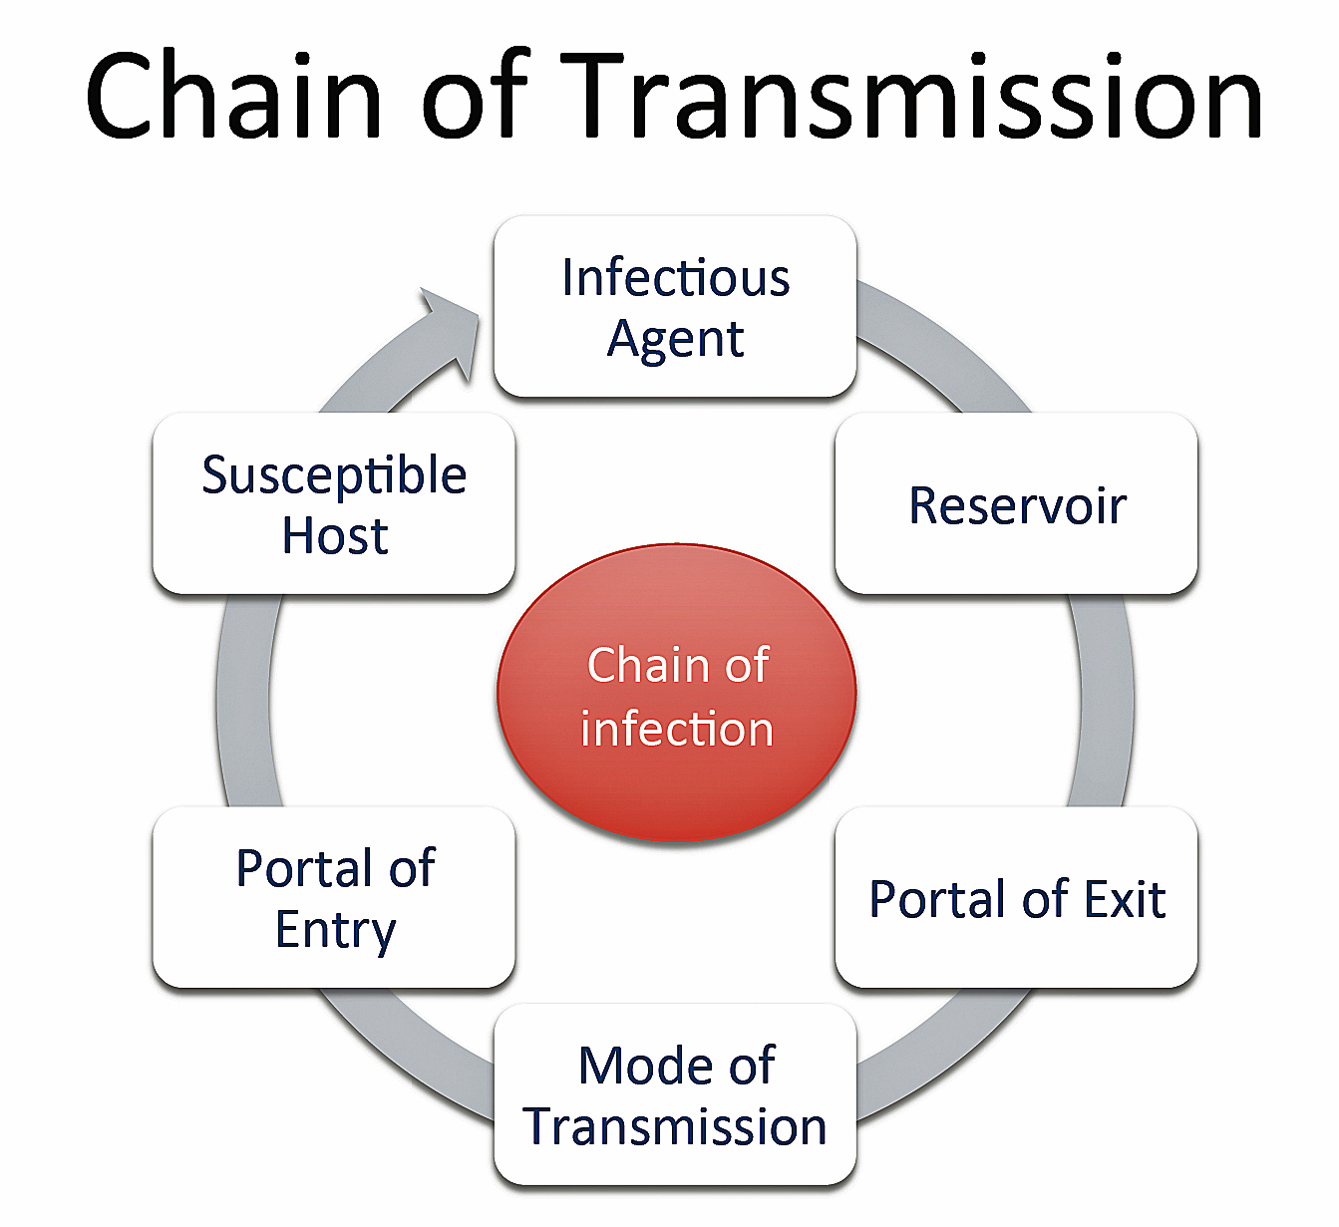
http://diseasedetectives.wikia.com/wiki/Chain_of_Transmission

Slide 6
Infectious Agent
Vancomycin Resistant Enterococci (VRE)
Extended Spectrum Beta Lactamase (ESBL)
Carbapenemase-producing Enterobacteriaceae (CPE)
Clostridium difficile (CD)
Not truly an MDRO

Slide 7
Infectious Agent
Methicillin Resistant Staphylococcus aureus
Yes, that bug…
Ebola
Yes, I know it is not an MDRO by definition

Slide 8
http://diseasedetectives.wikia.com/wiki/Chain_of_Transmission

Slide 9
Reservoir
Feces
fe‧ces fi siz/ [fee-seez]
–noun (used with a plural verb )
1. Waste matter discharged from the intestines through the anus; excrement.
2. Also, especially British, faeces.
Origin 1425-75; late middle English from Latin faecēs – grounds, dregs, sediment
*www.dictionary.com
Dictionary.com unabridged V1.0.1

Slide 10
Reservoir
Urine
Colonization common
Especially elderly patients
Catheterized patients

Slide 11
Reservoir
Sputum
Common in elderly, intubated (Garcia 2005)
Not applicable to this presentation

Slide 12
http://diseasedetectives.wikia.com/wiki/Chain_of_Transmission

Slide 13
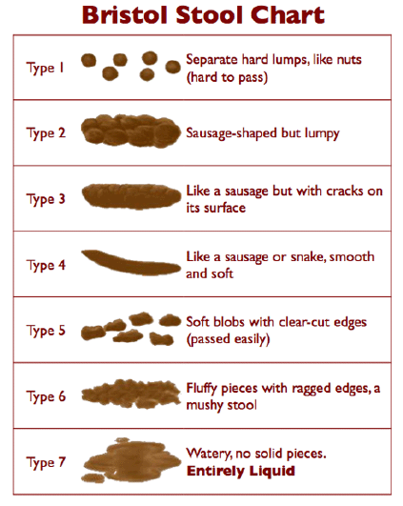
Portal of Exit
Defecation
Formed, soft, loose
www.continence.org.au
(O’Donnell 1990)
Urination

Slide 14
http://diseasedetectives.wikia.com/wiki/Chain_of_Transmission

Slide 15
Mode of Transmission
Equipment
Bedpans, commode buckets, urinals, bed rails, toilet high touch surfaces
Hands
Staff
Patients
Aerosols?

Slide 16
http://diseasedetectives.wikia.com/wiki/Chain_of_Transmission

Slide 17
Portal of Entry
Rectum, mouth, non-intact skin
Fecal – oral
Who puts this into the patient’s mouth or rectum?
Rectum – endoscopes, gloved hands
Mouth – endoscopes, hands

Slide 18
http://diseasedetectives.wikia.com/wiki/Chain_of_Transmission

Slide 19
Susceptible Host
Our patients
CDI
Proton pump inhibitors, antibiotics, hemodialysis, HIV, numerous hospital admissions (Bengualid 2011)
CRE
International travel (Tängdén 2010)
Unrecognized colonized patient (Borgia 2012)

Slide 20
Control Measures
www.qualitysystems.com

Slide 21
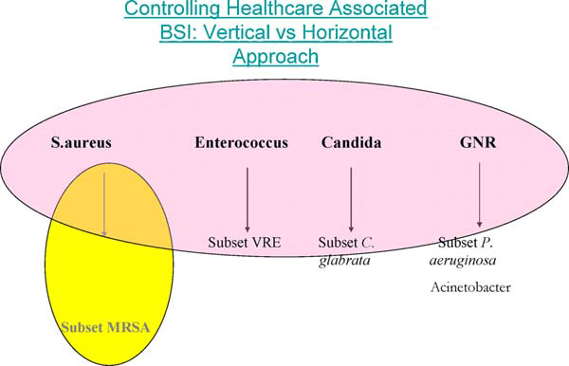
Horizontal vs Vertical Infection Control
Wenzel 2010

Slide 22
Horizontal
Reduce rates of all infections for all pathogens
Hand hygiene program
Decolonization therapies (Chlorhexidine bathing)
Board to ward (Nat Audit Office 2009)
Antibiotic Stewardship Programs
Cleaning and disinfection

Slide 23
Horizontal vs Vertical Infection Control
Wenzel 2010

Slide 24
Vertical
Focus on a single pathogen or anatomic site
Pathogen specific
MRSA
VRE
ESBL
CRE
Acinetobacter
Candida

Slide 25
Modern Vertical Semmelweis
Death by Group A Streptococcal puerperal sepsis
Screen for Group A only?
Only use an agent effective against gram positive cocci?
Only wash hands if in morgue?

Slide 27
VRE in the Environment
Grabsch 2006
Colonized and past colonized VRE patients
Structured exam, hemodialysis sessions
Chairs positive in 36% outpatient, 58% hemodialysis
Couch positive 48% OP, 42% radiology,

Slide 28
NDM-1 Environment
Walsh 2011- New Delhi
12 of 171 seepage samples grew
2 of 50 water samples grew
11 species in which NDM-1 not previously reported
Some resistance to meropenem seen in isolates

Slide 29
Survival - CRE
Havill 2014
Looked at K. pneumoniae and C. freundii
Can be shed into the environment and survive
Because in GI tract, could be shed with high inoculum
 | Water | TSB
K. pneumoniae | 19 days | 40 days
C. freundii | 12 days | 40 days

Slide 30
Clostridium difficile
Fekety 1980
Hands and fecally contaminated items
Low infective dose in hamsters in presence of antibiotics
Over 1000 cfu orally did not colonize nor infect unchallenged hamsters
Looked at relationship with Lactobacilli and other gut flora

Slide 31
C. difficile
Deep cleaning
“…breaking the cycle of faecal-oral spread.”
Included deep cleaning (emptying ward) (Cartmill 1994)
Floor Contamination
Especially washrooms, sluice rooms
Moved by feet hypothesized
High rate of colonization in Geriatrics
(McCoubrey 2003)

Slide 32
C. difficile Colonization
Alasmari 2014 14% on admission
Toxigenic, no relation to previous admission
Galdys 2014 Review article
Strong evidence suggests that CD-colonized individuals are a reservoir for CD infection
Donskey 2014 Review article
As above.
Sporicidal in all rooms potential to reduce transmission

Slide 33
MRSA diarrhea
Stools for CD testing cultured for MRSA
Diarrhea and MRSA colonization of stool (Case)
MRSA + patients, negative stool (Control)
10 surfaces in patient’s room
59% of case surfaces contaminated
23% of control surfaces contaminated
Boyce 2007

Slide 34
Ebola
2-4 litres of liquid stool per day
Lyon 2014

Slide 36
Control Measures
www.qualitysystems.com

Slide 37
Patient Hand Hygiene
Savage 2011
36 hour observation session
Patients: 151 opportunities
Zero used soap or ABHR
Visitors: 121 opportunities
4% soap or ABHR

Slide 39
Does it Work?
Could not get rates down
4 full time and 4 part time attendants hired
Met patients and visiting relatives at door
Verbal and pamphlet
Encourage to clean hands at least twice per day
Used 70% with 0.5% Chlorhexidine

Slide 40
Results Impressive
 | 2002-3 | 2003-4 | Reduction
MRSA Infections per 1000 Admissions | 10.6 | 5.2 | 51%
MRSA BSI | 1.3 | 0.2 | 85%
MRSA Resp | 4.9 | 1.5 | 69%
Ratio MRSA BSI / MSSA BSI | 59% (13/22) | 14% (2/14) | 76%
MRSA Mortality | 0.7 | 0.2 | 71%

Slide 41
Projected Savings
$688,843!
May have prevented 51 infections
MRSA infection ~ $14,360
MRSA BSI ~ $27,083
Staffing was $170,000

Slide 42
MRSA Infections per 1000 Patient Admissions
04-05 | 05-06 | 06-07 | 07-08 | 08-09 | 09-10 | 10-11 | 11-12 | 12-13
2.3 | 1.0 | 0.6 | 0.6 | 0.7 | 0.5 | 0.3 | 0.2 | 0
Personal Communication 2013

Slide 43
Hand Sanitizer Bottle Label
FOR PATIENT USE
Keep on overbed table
If necessary, please ask for
assistance to use this product

Slide 45
Patient Moments
Landers 2012 (review)
1. After using the toilet, bedpan, or commode
2. When returning to room after test or procedure
3. Before eating, drinking, taking medicine, or putting anything in your mouth

Slide 46
Patient Moments
4. When visibly dirty
5. Before touching any breaks in the skin (wounds, dressing, tubes) or any care procedure (dialysis, IV drug administration, injections)
6. Before dialysis, contact with IV lines or other tubes

Slide 47
Patient Moments
7. After coughing, sneezing, or touching nose or mouth
8. Before interacting with visitors and after they leave
9. When there is concern about whether hand are clean

Slide 48
Jim’s Additional Moments
Leaving a wheelchair
- New pamphlet for patients
After pet therapy (Lefebvre 2006)

Slide 49
C. difficile
APIC 2013 – Guide to preventing CDI
Patient hand hygiene is mentioned
Single use bedpan or single patient bedpan
“Disposal of excreta and cleaning of the bedpan or commode should be preplanned”
“An alternate is to use a single patient–use bedpan that can be cleaned with a bleach-based disinfectant after each use”

Slide 50
Preventative Measures
Palmore 2013 - CRE
Patients use gloves and gowns
Double clean
Hand hygiene (staff)
Chlorhexidine baths (ICU)
Adherence monitoring

Slide 51
Preventative Measures
Bed cleaning
Sink drains
Room vapor disinfection
No mention of patient hand hygiene

Slide 52
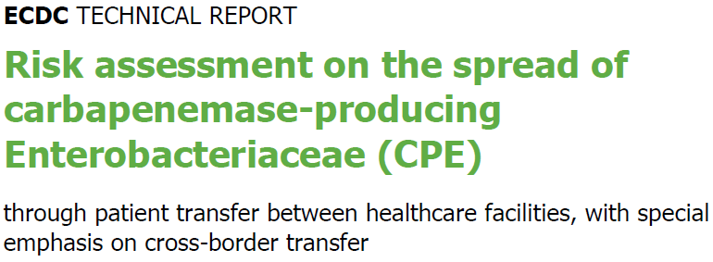
Guidelines
ECDC 2011

Slide 53
European Center for Disease Control
Prior antimicrobial use
Length of stay (time at risk)
Severity of illness
Mechanical ventilation
Admission to the ICU
High procedure score
Presence of wounds
Positive culture from a blood isolate
Transfer between hospital units within the same hospital
Prior surgery
Prior hospital stay
Presence of a biliary catheter and recent transplantation

Slide 54
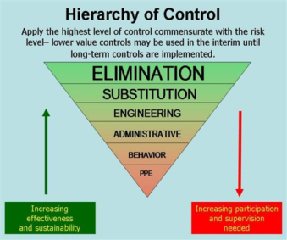
ECDC – Low Grade Evidence
…consistently supports the effectiveness of early, active surveillance for CPE carriage by rectal screening
Additional precautions for the care of CPE-positive patients,
wearing disposable gloves and gown
cohort nursing by a separate, dedicated team

Slide 55
ECDC – Other Measures
Long Term Healthcare Facilities
Israel uses contact precautions if:
Patient incontinent
On antimicrobials
Notes:
Note This!

Slide 56
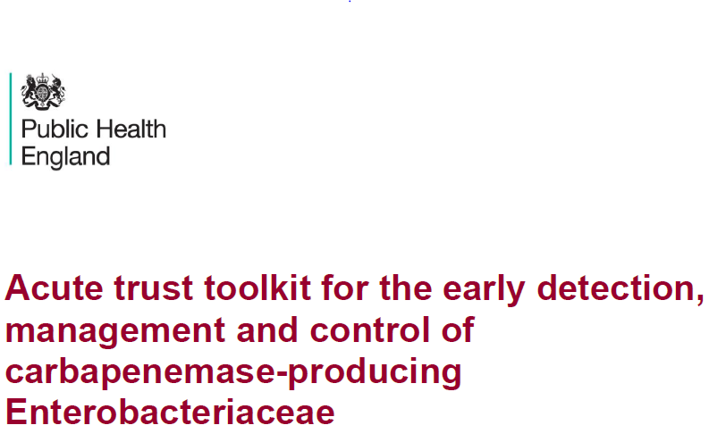
2013

Slide 57
Public Health England

Slide 58
PHE
Early Screening
Early Isolation
Reinforce Strict Standard Precautions

Slide 59
PHE
No words such as
Bedpan
Does have language for
Diarrhoea (around hand hygiene)
Toilet (that patient will have a private en suite)
Environment (cleaning)
Commode (if no toilet)
Disinfection (high touch, mattresses, endoscope, etc.)

Slide 60
PHE
Other close-patient contact equipment and items
pulse oximeters, blood pressure cuffs, stethoscopes and thermometers, privacy curtains, unused wrapped single-use items in the patient’s immediate vicinity, tubes of ointment and lubricant

Slide 62
CDC
Hand Hygiene
Contact Precautions (colonized or infected)
Patient and staff cohorting
Minimize use of invasive devices
Antimicrobial Stewardship
Screening

Slide 63
CDC
LTC settings high risk residents
totally dependent upon healthcare personnel for activities of daily living
ventilator-dependent
incontinent of stool
wounds whose drainage is difficult to control
high-risk settings (e.g., ventilator unit)

Slide 64
CDC
No words such as
Diarrhea, Toilet, Environment, Bedpan, Commode, Disinfect, patient hand hygiene
Does recognize that incontinent patients in LTC should have
Private room
Possibly chlorhexidine bathing

Slide 65
http://www.apic.org/For-Consumers/Monthly-alerts-for-consumers/Article?id=cre-the-nightmare-bacteria

Slide 66
Spread of CRE infection
To get a CRE infection, a person must be exposed to CRE bacteria.
CRE bacteria are most often spread person-to-person in healthcare settings specifically through contact with:
infected or colonized people
contact with wounds or stool

Slide 67
What You Can Do Now
8. When you are in a healthcare facility, insist that everyone who takes care of you clean their hands with soap and water or an alcohol-based hand rub before touching you! And remind them to wash their hands again as they leave your room!

Slide 68
CRE Guidelines
Curran 2014
Confusion on terms like Standard Precautions
Ensure guidelines writers understand the front line

Slide 69
Curran 2014
5 Fronts:
SP for all and additional transmission based precautions for CRE
Hand washing basins free of CRE
Safe injection and endoscopy practices
Prepare for outbreaks
Antimicrobial stewardship

Slide 70
So, What do I Suggest?
Monitor, or know, how many patients are incontinent
Or using briefs, diapers, assistive devices
Cochard 2014 – ESBL carriage nursing homes
Significantly associated with
Malignancy
Urinary AND fecal incontinence

Slide 71
Control Measures
www.qualitysystems.com

Slide 72
Suggestions
Manage feces and urine better than our great grandfathers
Mandate NO manual cleaning
Thermal disinfection
Macerators
Liners
Disposable

Slide 73
Suggestions
When we publish, list how feces and urine is managed and by what percentage
Brief
Toilet
Commode
Thermal disinfection
Macerator
Liner

Slide 74
Suggestion
Mandatory gown use for any contact or potential contact with feces
All the time
Horizontal program
Sporicidal agent for all terminal cleans of washrooms (Bengualid 2011, Galdys 2014)

Slide 75
Suggestions
Isolate patients with diarrhea
Benjamin 2014
Any soiling of the environment with feces is an issue!

Slide 76
Suggestions – Clean!
Nseir 2011
Acquisition if in bed from previous patient
Siani 2011
Wipes moved spores around
Issue with “sporicidal” claims
Sattar 2013
Need better control of wipe use and testing
Loo 2015
Clean environment and patient’s hands

Slide 77
Suggestions – Clean!
Zoutman 2013
40% of ICP’s felt hospital was NOT clean enough
Frequent consultation between IPAC and Environmental Services before cleaning changes – lower CDI rates

Slide 78
Suggestions – Clean!
Zoutman 2014
Less than 50% of ES managers felt they had enough staff
Over 1/3 did no auditing

Slide 79
Suggestions
Lids on toilets/hoppers
Aerosols around toilets from flushing has been studied (Gerba 1975, Barker 2005, Johnson 2013)
C. difficile was in droplets around toilets with no lids (Best 2012, Roberts 2008)
Viral spread (Verani 2014)

Slide 80
Ebola
Feces and vomit have virus
(Shieffelin 2014, Chertow 2014)
Dallas family
No illness
Dallas hospital
2 infected
Wet Phase
2-4 litres of liquid stool per day

Slide 81
WARNING!!
This patient has:
Skin!
Feces!
Mucous Membranes!
PERFORM HAND HYGIENE AFTER CONTACT WITH THIS PATIENT OR THEIR ENVIRONMENT!

Slide 83
Comments? Questions?

Slide 84
References
Alasmari F, Sieler SM, Hink T, et al. Prevalence and risk factors for asymptomatic Clostridium difficile carriage. Clin Infect Dis 2014;59(2):216-22
American Practitioners in Infection Control and Epidemiology. http://www.apic.org/For-Consumers/Monthly-alerts-for-consumers/Article?id=cre-the-nightmare-bacteria. Accessed November 2, 2014
American Practitioners in Infection Control and Epidemiology. http://www.apic.org/For-Media/News-Releases/Article?id=2122443e-6d22-46ae-aecc-e9512e98e1cb Accessed November 10, 2014
Barker J, Jones MV. The potential spread of infection caused by aerosol contamination of surfaces after flushing a domestic toilet. J Appl Microbiol 2005;99:339-347

Slide 85
References
Benjamin A, Rogers BA, Havers SM, Harris-Brown TM, Paterson DL. Predictors of use of infection control precautions for multiresistant gram-negative bacilli in Australian hospitals: Analysis of a national survey. AJIC 2014;42:963-9
Best EL, Sandoe JAT, Wilcox MH. Potential for aerosolization of Clostridium difficile after flushing toilets: the role of toilet lids in reducing environmental contamination risk. J Hosp Infect 2012;80:1-5
Bengualid V, Umesh KC, Alapati J, Berger J. Clostridium difficile at a community hospital in the Bronx, New York: Incidence prevalence and risk factors from 2006 to 2008. AJIC 2011;39:183-7
Borgia S, Lastovetska O, Richardson D, Eshaghi A, et al. Outbreak of carbapenem-resistant Enterobacteriaceae containing blaNDM-1, Ontario, Canada. Clin Infect Dis. 2012 Dec;55(11):e109-17. doi: 10.1093/cid/cis737. Epub 2012 Sep 20.

Slide 86
References
Boyce JM, Havill NL, Otter JA, Adams NMT. Widespread environmental contamination associated with patients with diarrhea and methicillin-resistant Staphylococcus aureus colonization of the gastrointestinal tract. ICHE2007;28(10):1142-7
Cartmill TDI, et al. Management and control of a large outbreak of diarrhoea due to Clostridium difficile. J Hosp Infect 1994;27:1-15
Center for Disease Control and Prevention. Guidance for control of carbapenem-resistant Enterobacteriaceae (CRE). 2012 http://www.cdc.gov/hai/organisms/cre/cre-toolkit/index.html Accessed November 10, 2014
Chertow DS, Kleine C, Edwards JK, Scaini R, et al. Ebola virus disease in West Africa – clinical manifestations and management. NEJM 2014 Nov 5, 2014

Slide 87
References
Cochard H, Aubier B, Quentin R, van der Mee-Marquet N. Extended-spectrum beta lactamase-producing Enterobacteriaceae in French nursing homes: an association between high carriage rate among residents, environmental contamination, poor conformity with good hygiene practice, and putative resident-to-resident transmission. ICHE 2014;35(4):384-9
Curran ET, Otter JA. Outbreak column 15: Carbapenemase-producing Enterobacteriaceae. J Infect Prevent 2014;15:193-198
Donskey CJ, Kundrapu S, Deshpande A. Colonization versus carriage of Clostridium difficile. Infect Dis Clin N Am 2015;29:13–28
European Centre for Disease Prevention and Control. Risk assessment on the spread of carbapenemase-producing Enterobacteriaceae (CPE) through patient transfer between healthcare facilities, with special emphasis on cross-border transfer. Stockholm: ECDC;2011

Slide 88
References
Fekety R, et al. Studies on the epidemiology of antibiotic-associated Clostridium difficile colitis. Am J Clin Nutr 1980;33:2527-32
Gagné D, Bédard G, Maziade PJ. Systematic patients’ hand disinfection: impact on meticillin resistant Staphylococcus aureus infection rates in a community hospital. J Hosp Infect 2010;75:269-72
Galdys AL, Curry SR, Harrison LH. Asymptomatic Clostridium difficile colonization as a reservoir for Clostridium difficile infection. Expert Rev Anti Infect Ther 2014;12:967–80
Garcia R. A review of the possible role of oral and dental colonization of the occurrence of health care-associated pneumonia: underappreciated risk and a call for interventions. Am J Infect Control 2005;33(9):527-40
Gerba CP, Wallis C, Melnick JL. Microbiological hazards of household toilets: droplet production and the fate of residual organisms. Appl Microbiol 1975;30(2):229-237

Slide 89
References
Grabsch EA, Burrell LJ, Padiglione A, O’Keefe JM, et al. Risk of environmental and healthcare worker contamination with vancomycin resistant enterococci during outpatient procedures and hemodialysis. Infect Control Hosp Epidemiol 2006;27:287-93
Havill NL, Boyce JM, Otter JA. Extended survival of carbapenem-resistant Enterobacteriaceae on dry surfaces. ICHE 2014;35(4)445-7
Johnson DL, Mead KR, Lynch RA, Hirst DVL. Lifting the lid on toilet plume aerosol: A literature review with suggestions for future research. AJIC 2013;41:254-8
Landers T, Abusalem S, Coty MB, Bingham J. Patient-centered hand hygiene: the next step in infection prevention. AJIC 2012;40:S11-S17

Slide 90
References
Loo VG. Environmental interventions to control Clostridium difficile. Infect Dis Clin N Am 2015;29:83–91
Lyon GM, Mehta AK, Varkey JB, Brantly K, et al. Clinical care of two patients with Ebola virus disease in the United States. NEJM 2014 DOI: 10.1056/NEJMoa1409838 McCoubrey J, et al. Clostridium difficile in a geriatric unit: a prospective epidemiological study employing a novel S-layer typing method. J.Med Micro 2003;52:573-8
National Audit Office. Reducing healthcare associated infections in hospitals in England. Report by the Comptroller and Auditor General. HC 560 Session 2008-2009; 2009. National Audit office; London, UK

Slide 91
References
Nseir S, Blazejewski C, Lubret R, Wallet F, et al. Risk of acquiring multidrug-resistant gram-negative bacilli from prior room occupants in the intensive care unit. Clin Microbiol Infect 2011;17:1201–1208
O’Donnell LJD, Virjee J, Heaton KW. Detection of pseudodiarrhea by simple clinical assessment of intestinal transit rate. BMJ 1990; 300(6772):439-40
Palmore TN, Henderson DK. Managing transmission for carbapenem-resistant Enterobacteriaceae in healthcare settings: a view from the trenches. Clin Infect Disease 2013;57(11):1593-9
Public Health England Working Group. Acute trust tooklit for the early detection, management and control of carbapenemase producing Enterobacteriaceae. 2013 PHE: London.

Slide 92
References
Roberts K, Smith FC, Snelling AM, Kerr KG, et al. Aerial dissemination of Clostridium difficile spores. BMC Infect Dis 2008;8:7
Sattar S, Maillard JY. The crucial role of wiping in decontamination of high-touch environmental surfaces: Review of current status and directions for the future. Am J Infect Control 2013;41:S97-S104
Savage J, Fuller C, Besser S, Stone S. Use of alcohol hand rub (AHR) at ward entrances and use of soap and AHR by patients and visitors: a study in 27 wards in 9 acute NHS trusts. J Infect Prev 2011;12:54-8
Schieffelin JS, Shaffer JG, Gova A, Gbaki M, et al. Clinical illness and outcomes in patients with Ebola in Sierra Leone. NEJM.org Oct 29 2014. DOI: 10.1056/NEJMoa1411680

Slide 93
References
Siani G, Cooper C, Maillard JY. Efficacy of “sporicidal” wipes against Clostridium difficile. Am J Infect Control 2011;39:212-8
Tängdén T, Cars O, Melhus A, Löwdin E. Foreign travel is a major risk factor for colonization with Escherichia coli producing CTX-M-type extended-spectrum beta-lactamases: a prospective study with Swedish volunteers. Antimicrob Agents Chemother 2010; 54:3564–8 Verani M, Bigazzi R, Carducci A. Viral contamination of aerosol and surfaces through toilet use in health care and other settings. AJIC 2014;42:758-62
Walsh TR, Weeks J, Livermore DM, Toleman MA. Dissemination of NDM-1 positive bacteria in the New Delhi environment and its implications for human health: an environmental point prevalence study. The Lancet Infect Dis 2011;11:355-62

Slide 94
References
Wenzel RP, Edmond MB. Infection control: the case for horizontal rather than vertical interventional programs. Int J Infect Dis 2010;14(supp 4);S3-S5
Zoutman DE, Ford BD, Sopha K. Working relationships of infection prevention and control programs and environmental services and associations with antibiotic-resistant organisms in Canadian acute care hospitals. AJIC 2014;42:349-52
Zoutman DE, Ford BD, Sopha K. Environmental cleaning resources and activities in Canadian acute care hospitals. AJIC 2014;42:490-494

Slide 95
April 14 (British Teleclass) SURGICAL SITE INFECTION: A SURGEON’S PERSPECTIVE Prof. David Leaper, University of Huddersfield, UK
April 16 A PRAGMATIC APPROACH TO INFECTION PREVENTION AND CONTROL GUIDELINES IN AN AMBULATORY CARE SETTING Jessica Ng, Women’s College Hospital, Toronto April 22 (South Pacific Teleclass) COMING UP ROSES – A SUSTAINABLE COLUTION TO CONTINENCE PRODUCT DISPOSAL Julianne Munroe, Christchurch Women’s Hospital, New Zealand April 30 ARE WIPES (TOWELETTES) EFFECTIVE FOR SURFACE
DECONTAMINATION IN HEALTHCARE SETTINGS? Prof. Jean-Yves Maillard, Cardiff University, Wales

