Slide 1
Gastrointestinal Endoscopes:
A Need to Shift from Disinfection to Sterilization
William A. Rutala, Ph.D., M.P.H.
Director, Hospital Epidemiology, Occupational Health and Safety Program, UNC Health Care; Research Professor of Medicine, Director, Statewide Program for Infection Control and Epidemiology, University of North Carolina (UNC) at Chapel Hill, NC, USA
Hosted by Prof. Jean-Yves Maillard
University of Cardiff, UK
www.webbertraining.com
July 23, 2015

Slide 2
Gastrointestinal Endoscopes:
A Need to Shift from Disinfection to Sterilization
Review the CRE/MDR outbreaks associated with ERCP procedures
Evaluate the cause of endoscope-related outbreaks
Discuss the alternatives exist today that might improve the safety margin associated with duodenoscope reprocessing
Describe how to prevent future outbreaks associated with duodenoscopes and other GI endoscopes
2

Slide 3
Gastrointestinal Endoscopes:
A Need to Shift from Disinfection to Sterilization
Review the CRE/MDR outbreaks associated with ERCP procedures
Evaluate the cause of endoscope-related outbreaks
Discuss the alternatives exist today that might improve the safety margin associated with duodenoscope reprocessing
Describe how to prevent future outbreaks associated with duodenoscopes and other GI endoscopes
3

Slide 4
“Superbug” Outbreaks
Cedars-Sinai Medical Center, UCLA Ronald Reagan Medical Center, University of Pittsburgh Medical Center, Virginia Mason Medical Center, tertiary care facility in NE Illinois, Wisconsin medical center
ABC, CBS, NBC, CNN, New York Times, LA Times
Lawmakers asked Congress why the FDA “didn’t move more quickly and aggressively to ensure patient safety”
4

Slide 5
Recent Outbreaks When Manufacturer’s Instructions and Professional Guidelines Followed
Epstein et al. JAMA 2014;312:1447-1455 (NE IL)
Wendorf et al. ICHE 2015 (Seattle)
At least four other CRE outbreaks related to ERCP
  UCLA Ronald Reagan Medical Center
  Cedar Sinai Medical Center
  Univ of Pittsburgh Medical Center
  Wisconsin medical facility
5

Slide 6
GI ENDOSCOPES
Widely used diagnostic and therapeutic procedure (~20 million GI procedures annually in the US)
GI endoscope contamination during use (10⁷⁻¹⁰ in/10⁵ out)
Semicritical items require high-level disinfection minimally
Inappropriate cleaning and disinfection has lead to cross-transmission
In the inanimate environment, although the incidence remains very low, endoscopes represent a significant risk of disease transmission. In fact, more outbreaks of infection associated with endoscopes than any reusable medical device in healthcare.
6

Slide 7
Transmission of Infection by Endoscopy
Kovaleva et al. Clin Microbiol Rev 2013. 26:231-254
Scope | Outbreaks | Micro (primary) | Pts Contaminated | Pts Infected | Cause (primary)
Upper GI | 19 | Pa, H. pylori, Salmonella | 169 | 56 | Cleaning/Dis-infection (C/D)
Sigmoid/Colonoscopy | 5 | Salmonella, HCV | 14 | 6 | Cleaning/Dis-infection
ERCP | 23 | Pa | 152 | 89 | C/D, water bottle, AER
Bronchoscopy | 51 | Pa, Mtb, Mycobacteria | 778 | 98 | C/D, AER, water
Totals | 98 |  | 1113 | 249
Based on outbreak data, if eliminated deficiencies associated with cleaning, disinfection, AER , contaminated water and drying would eliminate about 85% of the outbreaks.
7

Slide 8
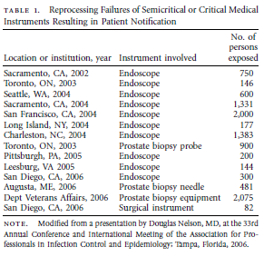
Reprocesssing Failures Have Led to Patient Notifications and Bloodborne Pathogens Testing
Rutala WA, Weber DJ. Infect Control Hosp Epidemiol 2007;28:146-155
8

Slide 9
Nosocomial Infections via GI Endoscopes
Infections traced to deficient practices
  Inadequate cleaning (clean all channels)
  Inappropriate/ineffective disinfection (time exposure, perfuse channels, test concentration, ineffective disinfectant, inappropriate disinfectant)
  Failure to follow recommended disinfection practices (tapwater rinse)
  Flaws and complexity in design of endoscopes or AERs
9

Slide 10

Endemic Transmission of Infections Associated with GI Endoscopes May Go Unrecognized
CRE and ESBLs
Inadequate surveillance of outpatient procedures for healthcare-associated infections
Long lag time between colonization and infection
Low frequency of infection
Pathogens “usual” enteric flora
Risk of some procedures might be lower than others (colonoscopy versus ERCP where normally sterile areas are contaminated in the latter)
10

Slide 11
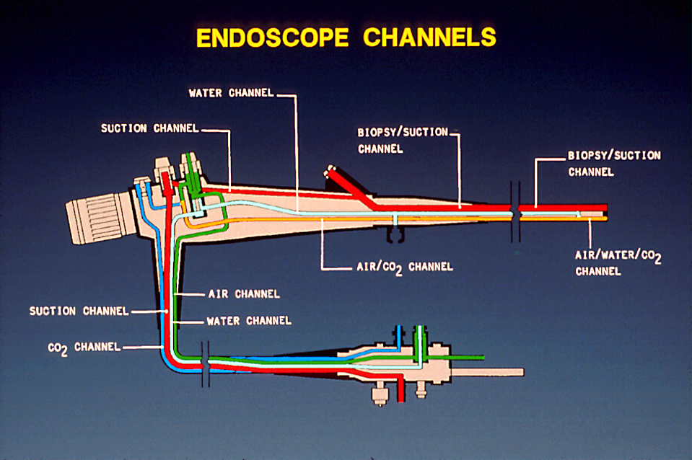
ENDOSCOPE REPROCESSING
11

Slide 12
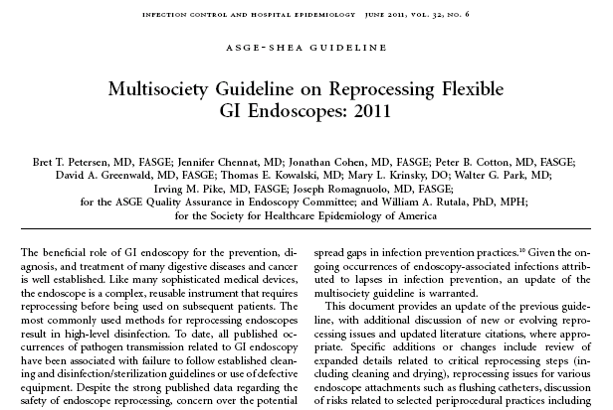
MULTISOCIETY GUIDELINE ON REPROCESSING GI ENDOSCOPES, 2011
Petersen et al. ICHE. 2011;32:527
12

Slide 13
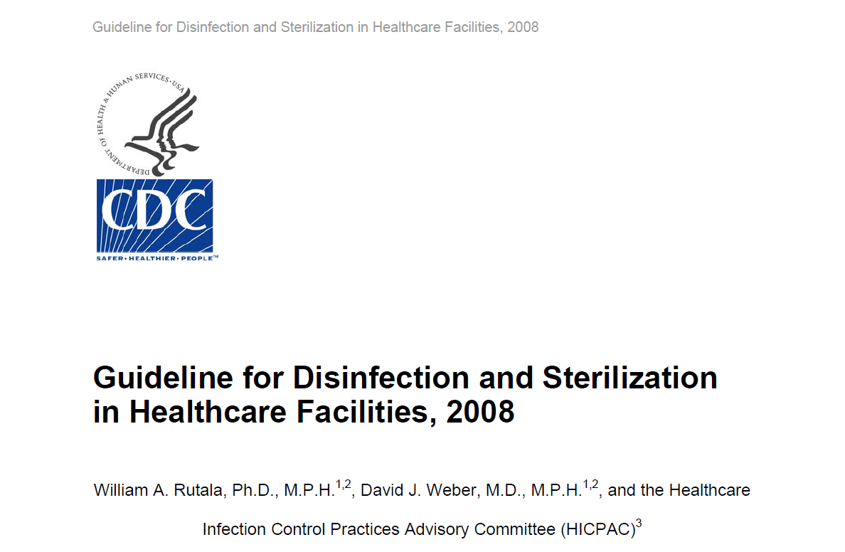
CDC Guideline for Disinfection and Sterilization
Rutala, Weber, HICPAC. November 2008. www.cdc.gov
13

Slide 14
ENDOSCOPE REPROCESSING
CDC 2008: Multi-Society Guideline on Endoscope Reprocessing, 2011
PRECLEAN-point-of-use (bedside) remove debris by wiping exterior and aspiration of detergent through air/water and biopsy channels; leak test
CLEAN-mechanically cleaned with water and enzymatic cleaner
HLD/STERILIZE-immerse scope and perfuse HLD/sterilant through all channels for exposure time (>2% glut at 20m at 20ºC). If AER used, review model-specific reprocessing protocols from both the endoscope and AER manufacturer
RINSE-scope and channels rinsed with sterile water, filtered water, or tap water. Flush channels with alcohol and dry
DRY-use forced air to dry insertion tube and channels
STORE-hang in vertical position to facilitate drying; stored in a manner to protect from contamination
14

Slide 15
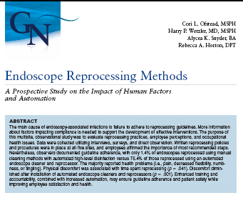
Endoscope Reprocessing Methods
Ofstead , Wetzler, Snyder, Horton, Gastro Nursing 2010; 33:204
15

Slide 16
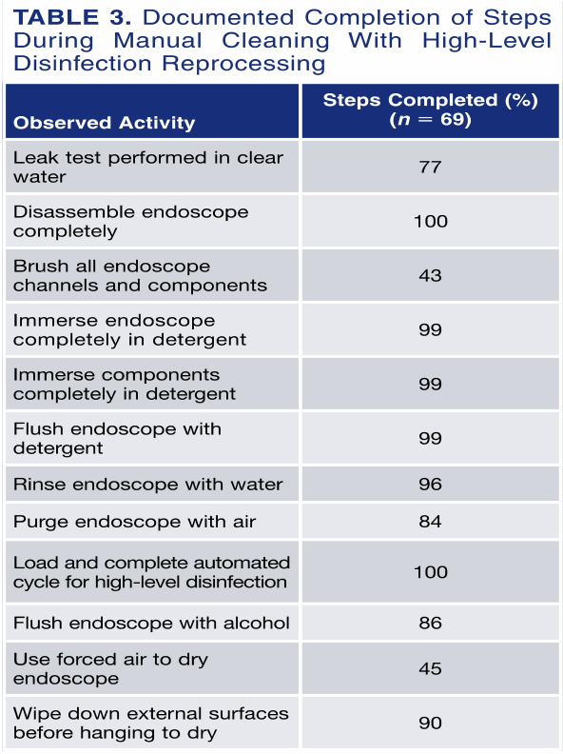
Endoscope Reprocessing Methods
Ofstead , Wetzler, Snyder, Horton, Gastro Nursing 2010; 33:204
Performed all 12 steps with only 1.4% of endoscopes using manual versus 75.4% of those processed using AER
16

Slide 17
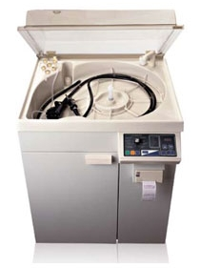
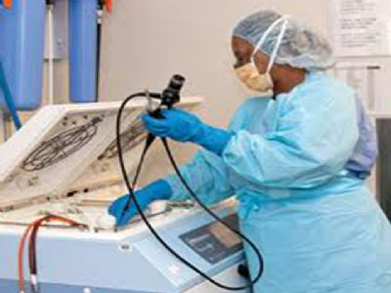
Automated Endoscope Reprocessors
AERs automate and standardize endoscope reprocessing steps
17

Slide 18
Transmission of Infection by Endoscopy
Kovaleva et al. Clin Microbiol Rev 2013. 26:231-254
Scope | Outbreaks | Micro (primary) | Pts Contaminated | Pts Infected | Cause (primary)
Upper GI | 19 | Pa, H. pylori, Salmonella | 169 | 56 | Cleaning/Dis-infection (C/D)
Sigmoid/Colonoscopy | 5 | Salmonella, HCV | 14 | 6 | Cleaning/Dis-infection
ERCP | 23 | Pa | 152 | 89 | C/D, water bottle, AER
Bronchoscopy | 51 | Pa, Mtb, Mycobacteria | 778 | 98 | C/D, AER, water
Totals | 98 |  | 1113 | 249
Based on outbreak data, if eliminated deficiencies associated with cleaning, disinfection, AER , contaminated water and drying would eliminate about 85% of the outbreaks.
18

Slide 19
Gastrointestinal Endoscopes:
A Need to Shift from Disinfection to Sterilization
Review the CRE/MDR outbreaks associated with ERCP procedures
Evaluate the cause of endoscope-related outbreaks
Discuss the alternatives exist today that might improve the safety margin associated with duodenoscope reprocessing
Describe how to prevent future outbreaks associated with duodenoscopes and other GI endoscopes
19

Slide 20
Reason for Endoscope-Related Outbreaks
Rutala WA, Weber DJ. Infect Control Hosp Epidemiol 2015;36:643-648
Margin of safety with endoscope reprocessing minimal or non-existent for two reasons:
Microbial load
    GI endoscopes contain 10⁷⁻¹⁰
    Cleaning results in 2-6 log₁₀ reduction
    High-level disinfection results in 4-6 log₁₀ reduction
    Results in a total 6-12 log₁₀ reduction of microbes
Complexity of endoscope
20

Slide 21
ENDOSCOPE REPROCESSING
21

Slide 22
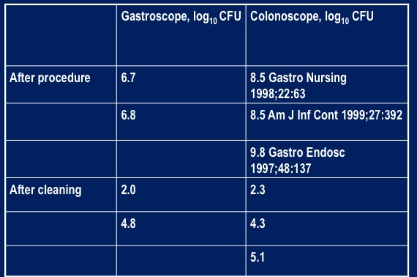
Bacterial Bioburden Associated with Endoscopes
22

Slide 23
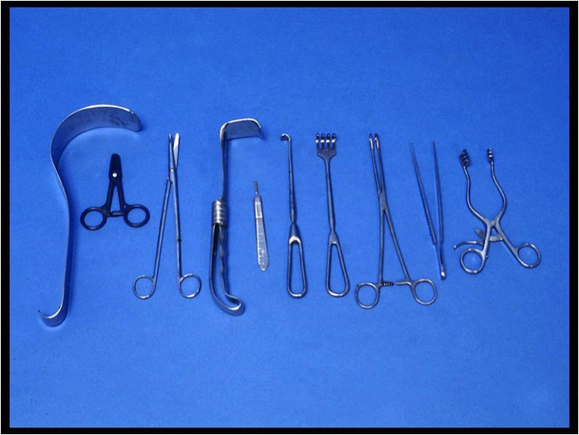

Slide 24
Bioburden on Surgical Devices
Non-lumen Surgical Instruments Carry a Low Microbial Load
Bioburden on instruments used in surgery (Nystrom, J Hosp Infect 1981)
  62% contaminated with <10¹
  82% contaminated with <10²
  91% contaminated with <10³
Bioburden on surgical instruments (Rutala, Am J Infect Control 1997)
  72% contained <10¹
  86% contained <10²
Bioburden on surgical instruments (50) submitted to CP (Rutala, AJIC 2014)
  58% contained <10
  20% contained < 10²
  16% contained <5x10²
  6% contained <10³
24

Slide 25
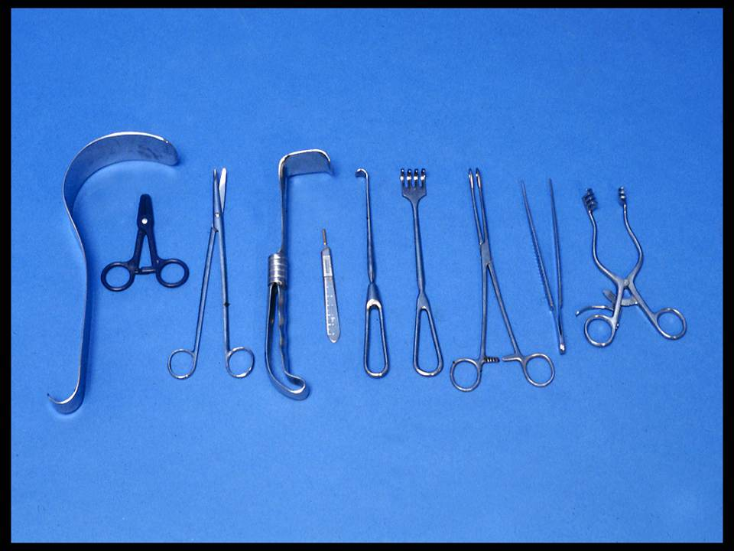
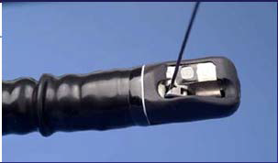
ENDOSCOPE REPROCESSING: CHALLENGES
Surgical instruments –
<10² bacteria
Complex [elevator channel] -
10⁷⁻¹⁰ bacteria
25

Slide 26
ENDOSCOPE REPROCESSING: CHALLENGES
NDM-Producing E. coli Associated ERCP
MMWR 2014;62:1051; Epstein et al. JAMA 2014;312:1447-1455
NDM-producing E.coli recovered from elevator channel (elevator channel orients catheters, guide wires and accessories into the endoscope visual field; crevices difficult to access with cleaning brush and may impede effective reprocessing)
26

Slide 27
Reason for Endoscope-Related Outbreaks
Rutala WA, Weber DJ. Infect Control Hosp Epidemiol 2015;36:643-648
Margin of safety with endoscope reprocessing minimal or non-existent for two reasons:
Microbial load
    GI endoscopes contain 10⁷⁻¹⁰
    Cleaning results in 2-6 log₁₀ reduction
    High-level disinfection results in 4-6 log₁₀ reduction
    Results in a total 6-12 log₁₀ reduction of microbes
    Level of contamination after processing: 4 log₁₀ (maximum contamination, minimal cleaning/HLD)
Complexity of endoscope
27

Slide 28
FEATURES OF ENDOSCOPES THAT PREDISPOSE TO DISINFECTION FAILURES
Heat labile
Long, narrow lumens
Right angle bends
Rough or pitted surfaces
Springs and valves
Damaged channels may impede microbial exposure to HLD
Heavily contaminated with pathogens, 10⁷⁻¹⁰
Cleaning (2-6 log₁₀ reduction) and HLD (4-6 log₁₀ reduction) essential for patient safe instrument
28

Slide 29
Reason for Endoscope-Related Outbreaks
Rutala WA, Weber DJ. Infect Control Hosp Epidemiol 2015;36:643-648
Margin of safety with endoscope reprocessing minimal or non-existent for at least two reasons:
Microbial load
    GI endoscopes contain 10⁷⁻¹⁰
    Cleaning results in 2-6 log₁₀ reduction
    High-level disinfection results in 4-6 log₁₀ reduction
    Results in a total 6-12 log₁₀ reduction of microbes
    Level of contamination after processing: 4log₁₀ (maximum contamination, minimal cleaning/HLD)
Complexity of endoscope
Biofilms-unclear if contribute to failure of endoscope reprocessing
29

Slide 30
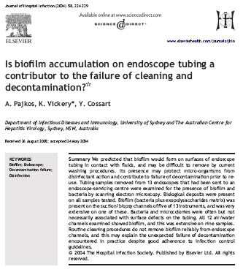
BIOFILMS
Pajkos, Vickery, Cossart. J Hosp Infect 2004;58:224
30

Slide 31
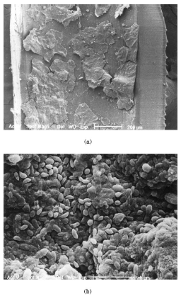
BIOFILMS
(Multi-Layered Bacteria Plus Exopolysaccharides That Cement Cell to Surface; Develop in Wet Environments)
31

Slide 32
BIOFILMS
Bacteria residing within biofilms are many times more resistant to chemical inactivation than bacteria in suspension
Does formation of biofilms within endoscopic channels contribute to failure of decontamination process? Not known
In addition to complexity and microbial load, a biofilm could contribute to failure of adequate HLD processes but if reprocessing performed promptly after use and endoscope dry the opportunity for biofilm formation is minimal
32

Slide 33
Why CRE/MDR? Why now? Why ERCP?
33

Slide 34
Carbapenemase-Resistant Enterobacteriaceae (CRE) and Multidrug Resistant Organisms (MDRO)
Microbes that are difficult to treat because they have a high level of resistant to antibiotics
Klebsiella, Enterobacter and E. coli are examples of Enteriobacteriaceae, a normal part of enteric microbes, that have become resistant to carbapenem
Healthy people usually do not get CRE infections
Infections with CRE and MDROs are very difficult to treat and can be deadly
Likely that MDR pathogens are acting as a “marker” or ‘indicator” organism for ineffective reprocessing of duodenoscopes
34

Slide 35
Recent Outbreaks When Manufacturer’s Instructions and Professional Guidelines Followed
Presence of an unusual pathogen that resulted in an investigation and recognition that duodenoscopes were the source of the outbreak
  Epstein et al. JAMA 2014;312:1447-1455 (NE IL)
  Wendorf et al. ICHE 2015 (Seattle)
  At least four other CRE outbreaks related to ERCP
    UCLA Ronald Reagan Medical Center
    Cedar Sinai Medical Center
    Univ of Pittsburgh Medical Center
    Wisconsin medical facility
35

Slide 36
Why ERCP (Endoscopic Retrograde
Cholangiopancreatography)?
More than 500,000 ERCP procedures using duodenoscopes are performed in the US annually
Procedure is the least invasive way of draining fluids from the pancreatic and biliary ducts blocked by cancerous tumors, gallstones or other conditions
Complex design of duodenoscopes causes challenges for cleaning and HLD. Some parts of the scope are extremely difficult to assess and effective cleaning of all areas of the duodenoscope may not be possible.
36

Slide 37
ERCP-Related Outbreaks
No clear breaches in reprocessing the duodenoscopes were identified by hospital staff, CDC field team and/or manufacturer of the endoscope or AER
Hospitals adhered to manufacturer’s duodenoscope and AER service schedule
No defects or improper functioning of the duodenoscope or AER identified by the manufacturer
37

Slide 38
Gastrointestinal Endoscopes:
A Need to Shift from Disinfection to Sterilization
Rutala WA, Weber DJ. Infect Control Hosp Epidemiol 2015;36:643-648
Review the CRE/MDR outbreaks associated with ERCP procedures
Evaluate the cause of endoscope-related outbreaks
Discuss the alternatives exist today that might improve the safety margin associated with duodenoscope reprocessing
Describe how to prevent future outbreaks associated with duodenoscopes and other GI endoscopes
38

Slide 39
What Should We Do Now?
39

Slide 40
How Can We Prevent ERCP-Related Infections?
No single, simple and proven technology or prevention strategy that hospitals can use to guarantee patient safety
Of course, must continue to emphasize the enforcement of evidenced-based practices, including equipment maintenance and routine audits with at least yearly competency testing of reprocessing staff
Must do more or additional outbreaks will continue
40

Slide 41
Current Enhanced Methods for
Reprocessing Duodenoscopes
Rutala WA, Weber DJ. Infect Control Hosp Epidemiol 2015;36:643-648
Hospitals performing ERCPs should do one of the following (priority ranked). Doing nothing is not an option:
Ethylene oxide sterilization after high level disinfection with periodic microbiologic surveillance (UNC Hospitals)
Double high-level disinfection with periodic microbiologic surveillance
High-level disinfection with scope quarantine until negative culture
Liquid chemical sterilant processing system using peracetic acid (rinsed with extensively treated potable water) with periodic microbiologic surveillance
High-level disinfection with periodic microbiologic surveillance
41

Slide 42
Summary of Advantages and Disadvantages of HLD and Sterilization Enhancements for Reprocessing Duodenoscopes
Rutala WA, Weber DJ. Infect Control Hosp Epidemiol 2015;36:643-648
Method | Advantages | Disadvantages
HLD with ETO, Microbiologic surveillance | Major endoscope manufacturer offers ETO as sterilization option Should be used after standard high-level disinfection Some data demonstrate reduced infection risk with HLD followed by ETO Single-dose cartridge and negative- pressure chamber minimizes the potential for gas leak and ETO exposure Simple to operate and monitor Compatible with most medical materials | Requires aeration time to remove ETO residue Only 20% of US hospitals have ETO on-site Lengthy cycle/aeration time No microbicidal efficacy data proving SAL 10⁻⁶ achieved Studies question microbicidal activity in presence of organic matter/salt ETO is toxic, a carcinogen, flammable May damage endoscope
42

Slide 43
Summary of Advantages and Disadvantages of HLD and Sterilization Enhancements for Reprocessing Duodenoscopes
Rutala WA, Weber DJ. Infect Control Hosp Epidemiol 2015;36:643-648
Method | Advantages | Disadvantages
Double HLD, Microbiologic surveillance | HLD inactivate MDR organisms including CREs Wide availability of HLD A second HLD cycle may reduce or eliminate microbial contaminants remaining from first cycle | Based on recent ERCP outbreaks, infection risk related to device complexity and microbial load Some HLD (e.g., aldehydes) may cross-link proteins
43

Slide 44
Summary of Advantages and Disadvantages of HLD and Sterilization Enhancements for Reprocessing Duodenoscopes
Rutala WA, Weber DJ. Infect Control Hosp Epidemiol 2015;36:643-648
Method | Advantages | Disadvantages
HLD with scope quarantine until negative culture | HLD inactivate MDR organisms including CREs Microbiologic surveillance offered as supplement by CDC Data demonstrate reduced infection risk | Based on recent ERCP outbreaks, infection risk related to device complexity and microbial load Sensitivity of microbiologic surveillance unknown 48-72 hours before culture results known No cutoff to define effective disinfection
44

Slide 45
Summary of Advantages and Disadvantages of HLD and Sterilization Enhancements for Reprocessing Duodenoscopes
Rutala WA, Weber DJ. Infect Control Hosp Epidemiol 2015;36:643-648
Method | Advantages | Disadvantages
Liquid Chemical Sterilant Processing System using Peracetic Acid, rinsed with extensively treated potable water, Microbiologic surveillance | HLD/chemical sterilant inactivate MDR organisms including CREs Offered as liquid chemical sterilant processing option | Based on recent ERCP outbreaks, infection risk related to device complexity and microbial load Not considered sterile as not a terminal sterilization process and scope rinsed with extensively treated water Unclear if peracetic acid will penetrate crevices in elevator channel and inactivate pathogens
45

Slide 46
Summary of Advantages and Disadvantages of HLD and Sterilization Enhancements for Reprocessing Duodenoscopes
Rutala WA, Weber DJ. Infect Control Hosp Epidemiol 2015;36:643-648
Method | Advantages | Disadvantages
HLD, Microbiologic surveillance | HLD inactivate MDR organisms including CREs Microbiologic surveillance offered as supplement by CDC | Based on recent ERCP outbreaks, infection risk related to device complexity and microbial load No data demonstrating reduced infection risk Sensitivity of microbiologic surveillance unknown 48-72 hours before culture results known No consensus regarding sampling scheme, 100% or 10% of scopes per week/per month? No cutoff to define effective disinfection (0 GNR?)
46

Slide 47
Summary of Advantages and Disadvantages of HLD and Sterilization Enhancements for Reprocessing Duodenoscopes
Rutala WA, Weber DJ. Infect Control Hosp Epidemiol 2015;36:643-648
Method | Advantages | Disadvantages
HLD only (not listed as an enhanced method for reprocessing endoscope) | HLD inactivate MDR organisms including CREs Current standard of care Wide availability | Based on recent ERCP outbreaks, infection risk related to device complexity and microbial load No enhancement to reduce infection risk associated with ERCP scopes Some HLD (e.g., aldehydes) may cross-link proteins
47

Slide 48
Summary of Advantages and Disadvantages of HLD and Sterilization Enhancements for Reprocessing Duodenoscopes
Rutala WA, Weber DJ. Infect Control Hosp Epidemiol 2015;36:643-648
Method | Advantages | Disadvantages
HLD, ATP only (not listed as an enhanced method for reprocessing endoscope) | HLD inactivate MDR organisms including CREs Real-time monitoring tool Simple to conduct Detects organic residue | Based on recent ERCP outbreaks, infection risk related to device complexity and microbial load No data demonstrating reduced infection risk Does not detect microbial contamination ATP not validated as risk factor for patient-to-patient transmission Unknown cut-off level to assure safety
48

Slide 49
UNC Hospitals
Interim Response to ERCP Outbreaks
Ensure endoscopes are reprocessed in compliance with national guidelines (CDC, ASGE, etc)
Evaluate CRE culture-positive patients for ERCP exposure
In the short term, enhance reprocessing of ERCP scopes; reprocess ERCP scopes by HLD followed for ETO sterilization
Microbiologic surveillance, 5-10% of scopes monthly
When new recommendations are available from ASGE, CDC, FDA, etc. comply
49

Slide 50
Surveillance for Bacterial Contamination of Duodenoscopes after Reprocessing www.cdc.gov
No requirement to perform regular surveillance cultures as part of their response to the issue
Method intended to culture bacteria from reprocessed duodenoscopes (after drying) specifically from the distal end and instrument channel
Samples should be collected by personnel familiar with the instrument
ASM recommends that routine duodenoscope cultures not be performed in a clinical diagnostic laboratory
50

Slide 51
Surveillance for Bacterial Contamination of Duodenoscopes after Reprocessing
Questions
What cutoff should be used to define proper disinfection (0 CFUs?)
Should there be a separate cutoff based on relatively nonvirulent pathogens
If a hospital cultures 2 duodenoscopes of 4 and 1 is positive, do they reprocess all 4 duodenoscopes as 50% positive
If a hospital does periodic microbiologic culturing and 20% of sampled endoscopes are positive, what actions should be undertaken (e.g., patient notification with an offer of BBP testing, stool exam for CRE)
Trigger based on level of contamination or frequency of contamination
Answer: Until evidence-based guidelines, hospitals should base their decisions on best available information (e.g., clinical risk) and what is feasible.
51

Slide 52
Adenosine Triphosphate (ATP) Validation
Alfa et al. Am J Infect Control 2013;41:245
Validated as a monitoring tool for assessing cleaning because it detects organic residuals
ATP is not a good indicator of microbial contamination and has not been validated as a method to assess the risk of patient-to-patient transmission
ATP <200 RLU benchmark for clean, equates to <4 log₁₀ CFUs/cm² or 10⁶ CFUs per endoscope
Thus, an endoscope assessed as clean using ATP could still have a significant microbial load (e.g., 10⁶)
52

Slide 53
Gastrointestinal Endoscopes:
A Need to Shift from Disinfection to Sterilization
Review the CRE/MDR outbreaks associated with ERCP procedures
Evaluate the cause of endoscope-related outbreaks
Discuss the alternatives exist today that might improve the safety margin associated with duodenoscope reprocessing
Describe how to prevent future outbreaks associated with duodenoscopes and other GI endoscopes
53

Slide 54
To protect the public health we (FDA, industry, professional organizations) must shift endoscope reprocessing from HLD to sterilization. FDA should mandate that duodenoscopes (preferably all GI scopes) used in healthcare facilities be sterile.
54

Slide 55
What Is the Public Health Benefit?
No ERCP-Related Infections
Margin of Safety-currently nonexistent; sterilization will provide a safety margin (~6 log₁₀). To prevent infections, all duodenoscopes should be devoid of microbial contamination.
HLD (6 log₁₀ reduction)
vs
Sterilization (12 log₁₀ reduction=SAL 10⁻⁶)
55

Slide 56
FDA Panel, May 2015, Recommended Sterilization of Duodenoscopes
56

Slide 57
Potential future methods to prevent GI-endoscope-related infections?
57

Slide 58
Potential Future Methods to Prevent
GI-Endoscope Related Outbreaks
Rutala WA, Weber DJ. Infect Control Hosp Epidemiol 2015;36:643-648
Steam sterilization of GI endoscopes
New low temperature sterilization methods proving SAL 10⁻⁶ achieved
Disposable sterile GI endoscopes
Improved GI endoscope design (to reduce or eliminate challenges listed earlier)
Use of non-endoscope methods to diagnosis or treat disease (e.g., capsule endoscopy, blood tests to detect GI cancer, stool DNA test)
58

Slide 59
Some Potential Sterilization Technologies for Duodenoscopes
Rutala WA, Weber DJ. Infect Control Hosp Epidemiol 2015;36:643-648
Optimize existing low-temperature sterilization technology
  Hydrogen peroxide gas plasma
  Vaporized hydrogen peroxide
  Ethylene oxide
Potential new low-temperature sterilization technology
  Ozone plus hydrogen peroxide vapor
  Nitrogen dioxide
  Supercritical CO₂
  Peracetic acid vapor
Steam sterilization for heat-resistant endoscopes
59

Slide 60
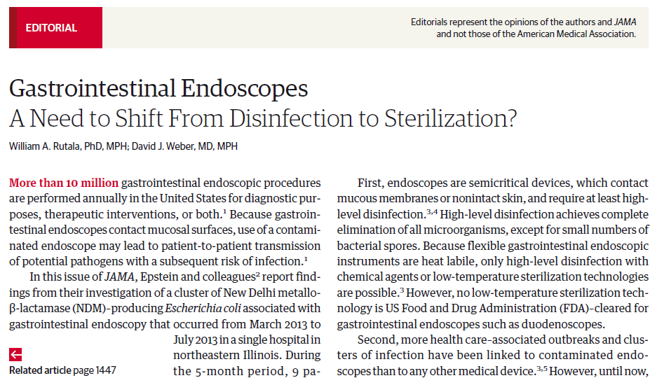
GI Endoscopes:
Shift from Disinfection to Sterilization
Rutala, Weber. JAMA 2014. 312:1405-1406

Slide 61
FDA, in collaboration with industry and infection prevention clinicians, must develop future success from past failures and pursue new prevention strategies with urgency and laser-like focus
61

Slide 62
FDA must mandate dramatic change as it did in 1992
62

Slide 63
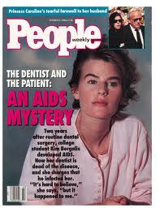
HIV Transmission in Dental Settings
First case of dentist to patient transmission; removed molars in 1987, AIDS in 1990, died in 1991
FDA recommends that reusable dental handpieces and related instruments be heat sterilized between each patient use. September 1992
63

Slide 64
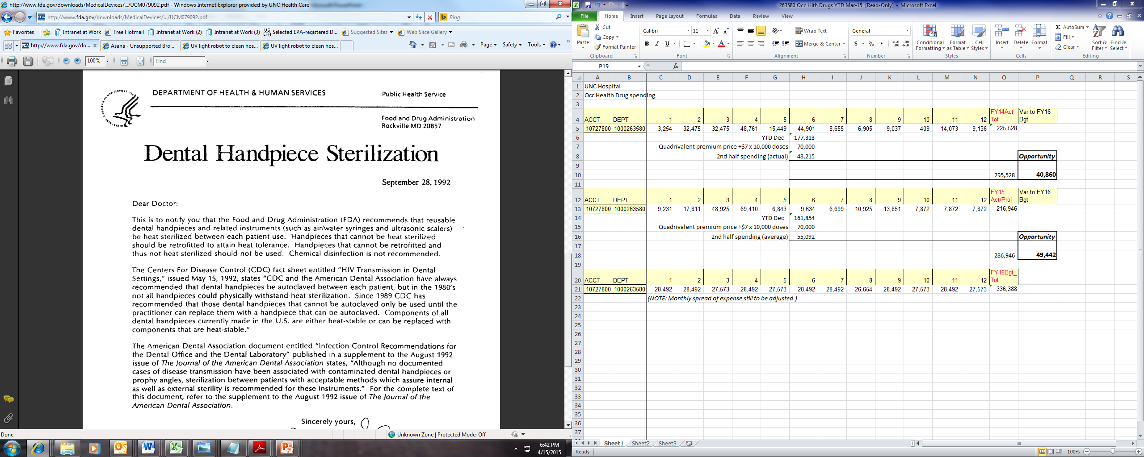
Mandate for Sterilization
64

Slide 65
Gastrointestinal Endoscopes:
A Need to Shift from Disinfection to Sterilization
Review the CRE/MDR outbreaks associated with ERCP procedures
Evaluate the cause of endoscope-related outbreaks
Discuss the alternatives exist today that might improve the safety margin associated with duodenoscope reprocessing
Describe how to prevent future outbreaks associated with duodenoscopes and other GI endoscopes
65

Slide 66
Conclusions
Endoscopes represent a nosocomial hazard. Narrow margin of safety associated with high-level disinfection of semicritical items. Endoscope reprocessing guidelines must be strictly followed.
AERs can enhance efficiency and reliability of HLD of endoscopes
For hospitals performing ERCPs, implement 1 or 5 enhanced methods for reprocessing duodenoscopes. For infection prevention and medical-legal reasons, doing nothing is not an option.
Only when we implement new technologies (LTST proving SAL 10⁻⁶ achieved, steam-sterilization of GI endoscopes, disposable sterile GI endoscopes, non-endoscopic methods) will we eliminate the risk of infection.
66

Slide 67

THANK YOU! www.disinfectionandsterilization.org
67

Slide 68

August 13 ASSESSING THE IMPACT OF AN EDUCATIONAL INTERVENTION ON
VENTILATOR-ASSOCIATED PNEUMONIA
Prof. Arti Kapil, All India Institute of Medical Sciences, New Delhi, India
September 3 (Free South Pacific Teleclass – Broadcast live from the 2015 IPCNC New Zealand
Conference)
IS MANDATORY INFLUENZA FOR HEALTHCARE WORKERS THE
BEST WAY TO PROTECT OUR PATIENTS?
Dr. Michael Gardam, University Health Network, Toronto
Sponsored by Johnson & Johnson (www.jnjnz.co.nz)
September 17 CAN ENERGY MANAGEMENT BENEFIT INFECTION PREVENTION?
Andrew Streifel, University of Minnesota
September 28 (Free British Teleclass ... Broadcast live from the 2015 IPS conference)
E.M. COTTRELL LECTURE
Carole Fry, Healthcare Infection Society

Slide 69


