Slide 1
Hand hygiene – reloaded
Prof Dr med Hugo Sax | Bern University Hospital and University of Bern, Switzerland | sax.health.design.AG
Hosted by Martin Kiernan | martin@webbertraining.com
www.webbertraining.com
October 28, 2021

Slide 3
Content
Learn about the origins of the 5 moments of hand hygiene
Critically analysing the (theoretical) effect of hand hygiene on infectious risks
Discussing some unconventional hand hygiene studies
Hand hygiene quo vadis?

Slide 4
The making of the 5 Moments.

Slide 5
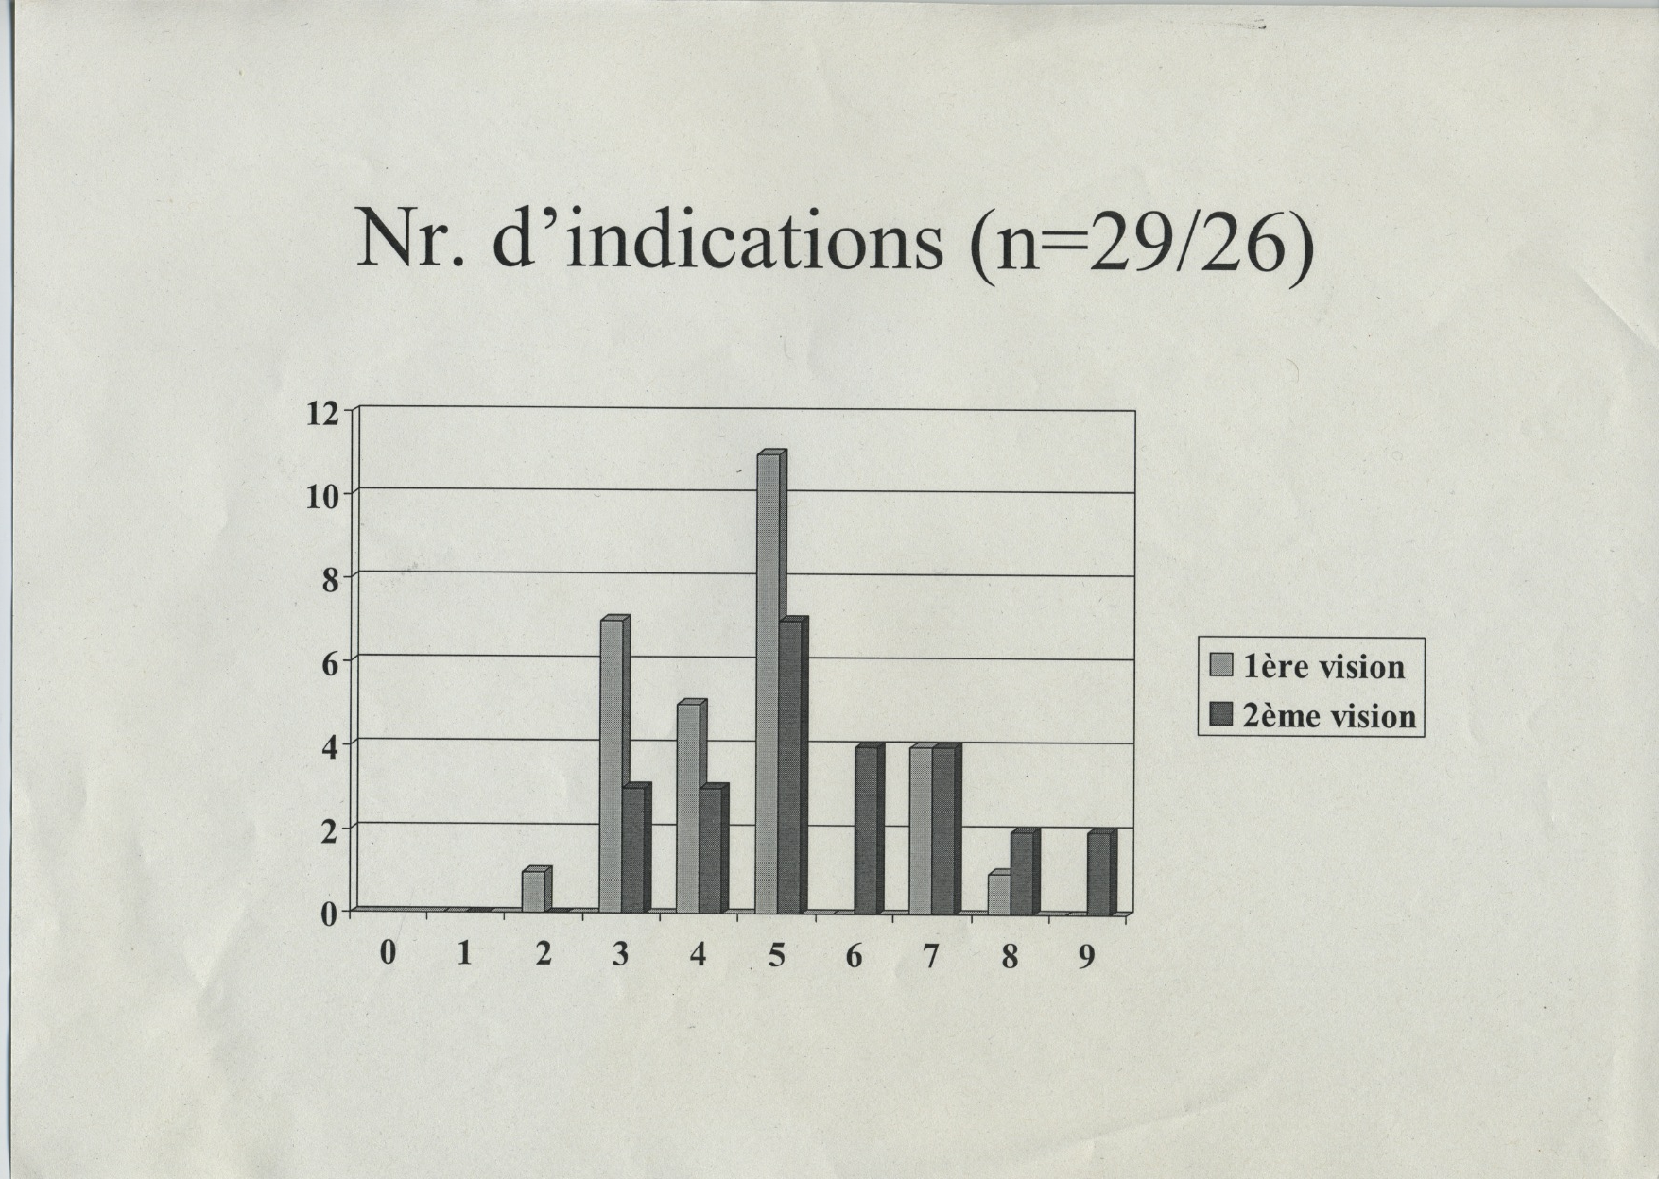
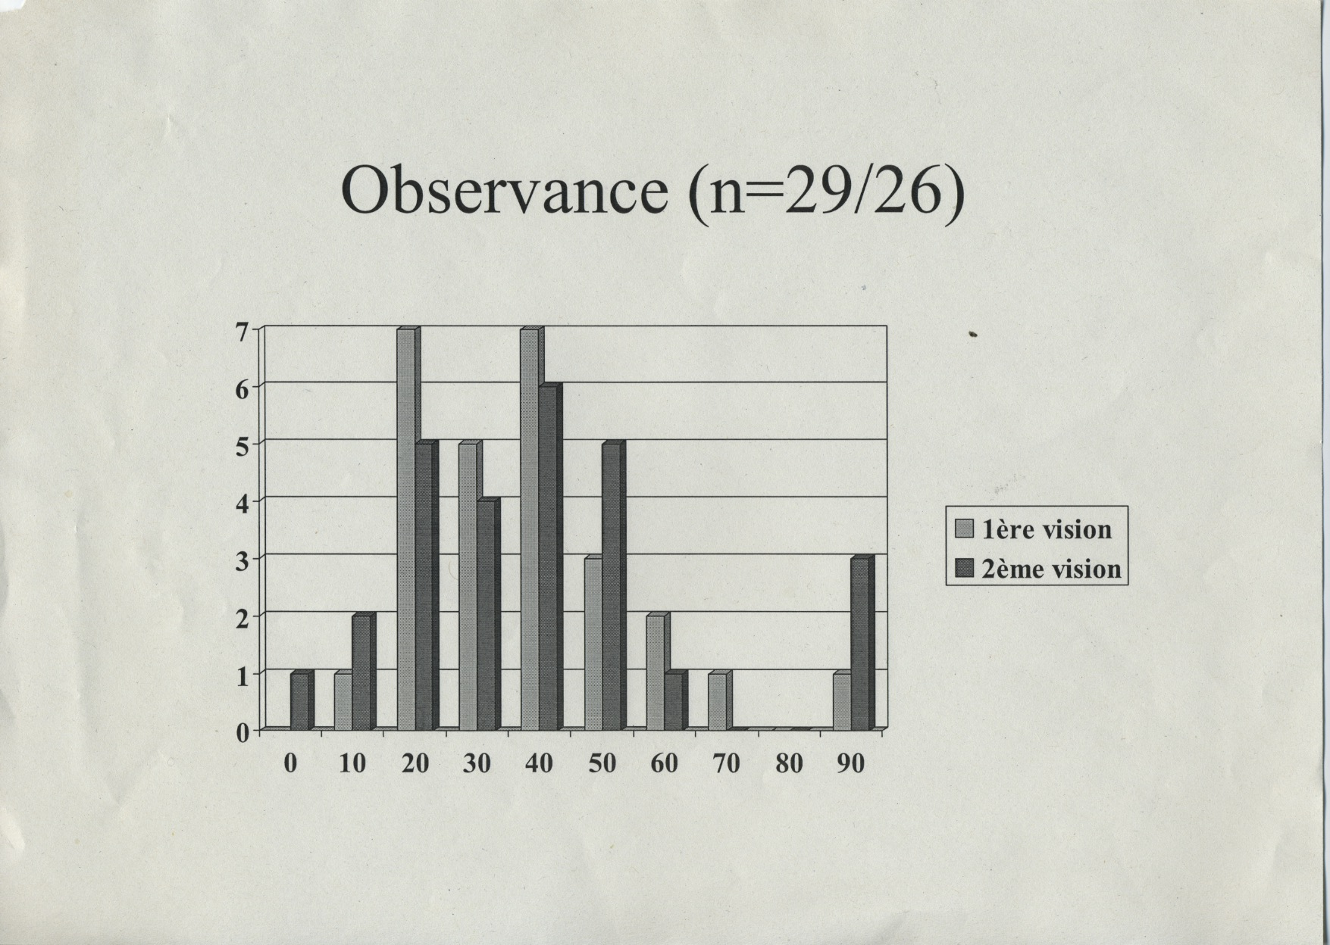

Slide 6
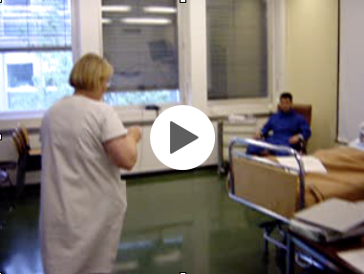

Slide 7
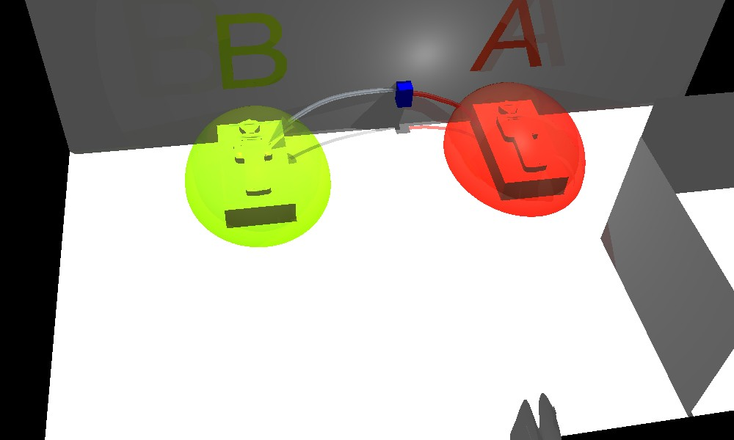
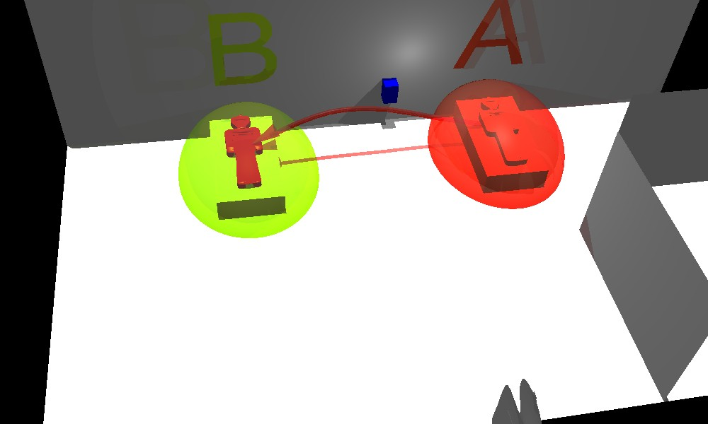

Slide 8
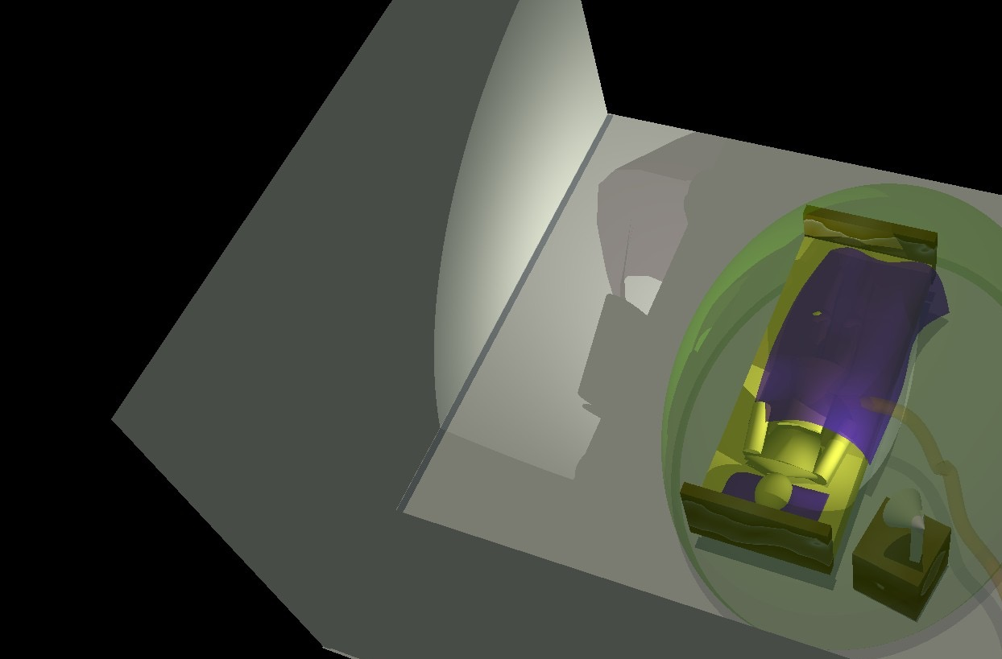

Slide 9
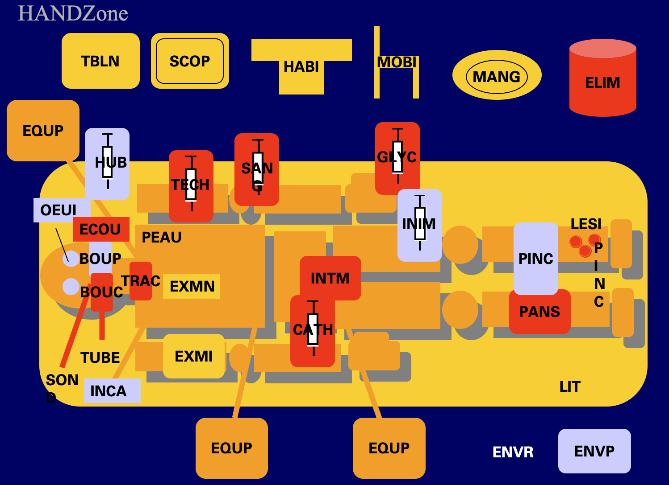
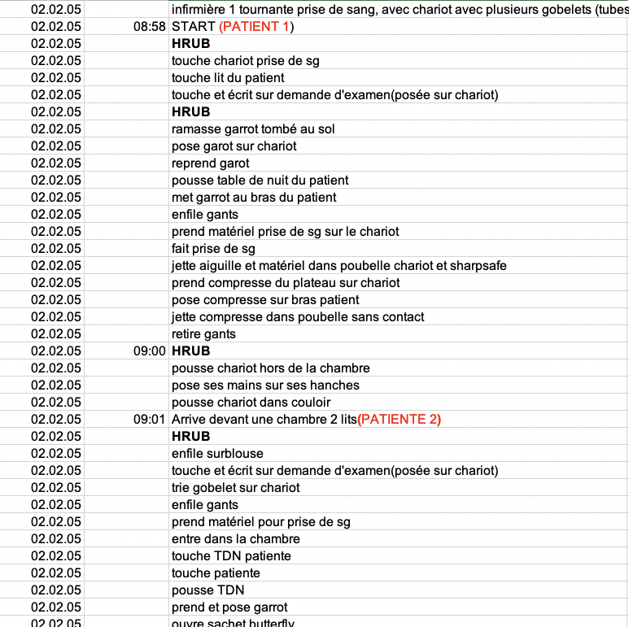

Slide 10
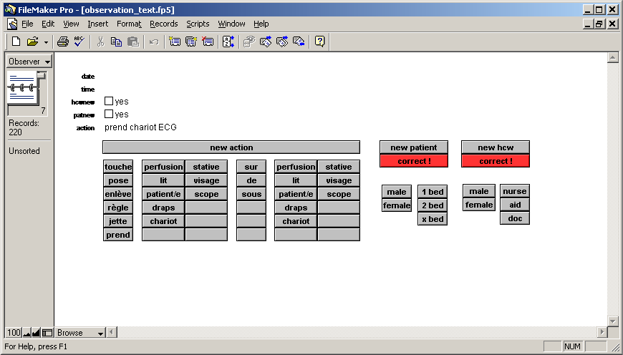
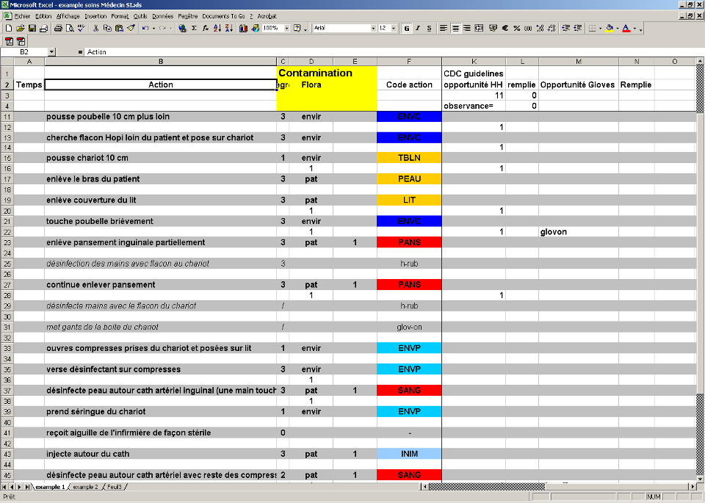

Slide 12
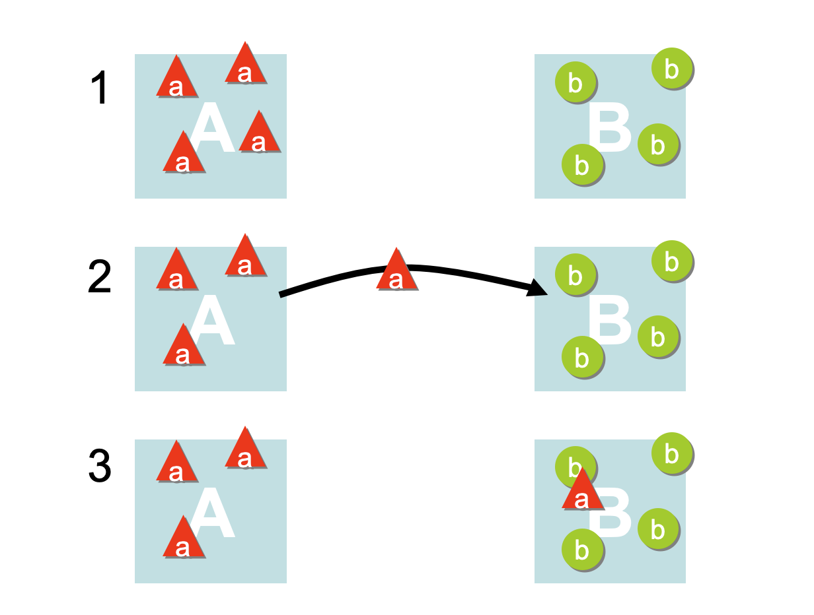

Slide 14
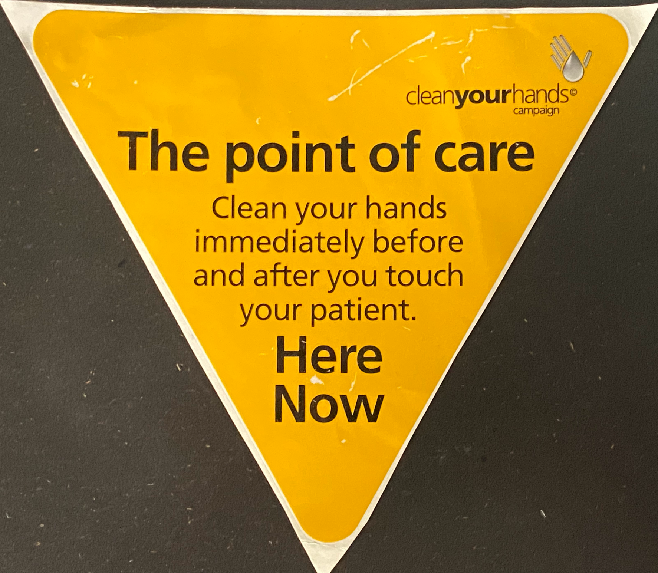

Slide 15
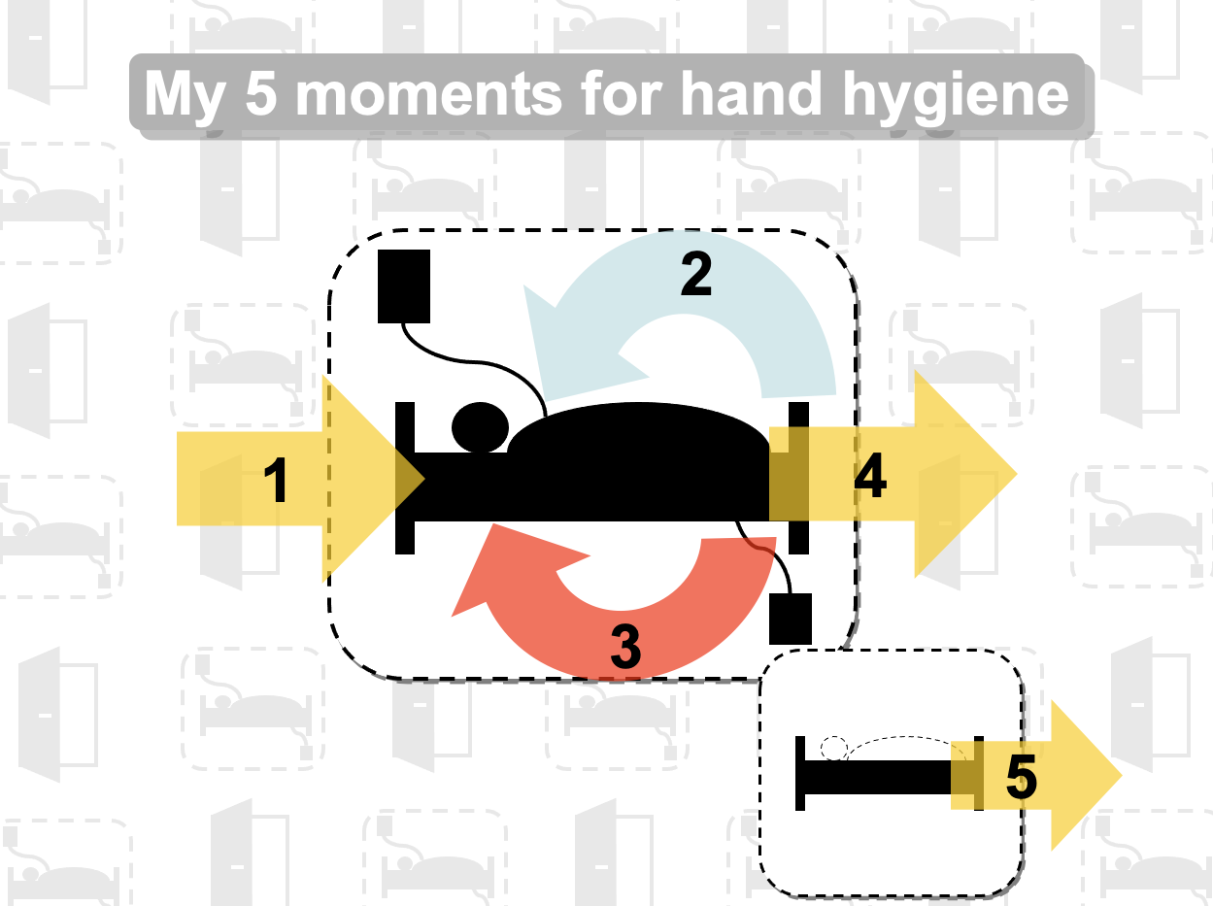

Slide 16
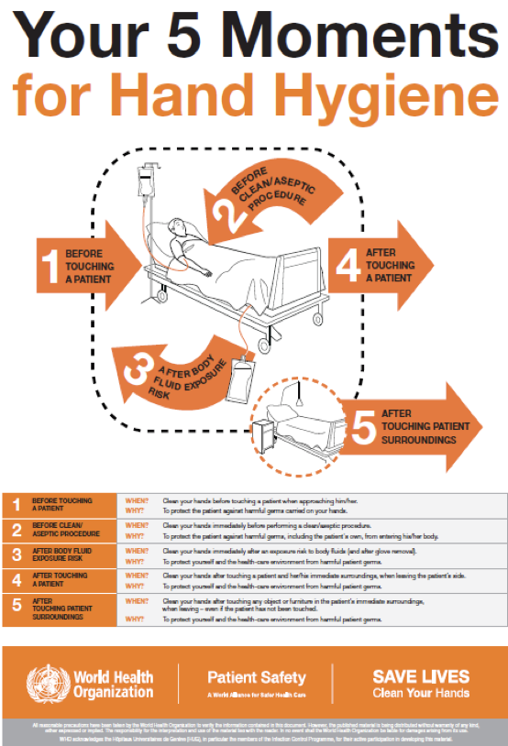
Sax H, Allegranzi B, Uckay I, Larson E, Boyce J, Pittet D. “My five moments for hand hygiene”: a user-centred design approach to understand, train, monitor and report hand hygiene. Journal of Hospital Infection 67, 9–21 (2007).

Slide 17
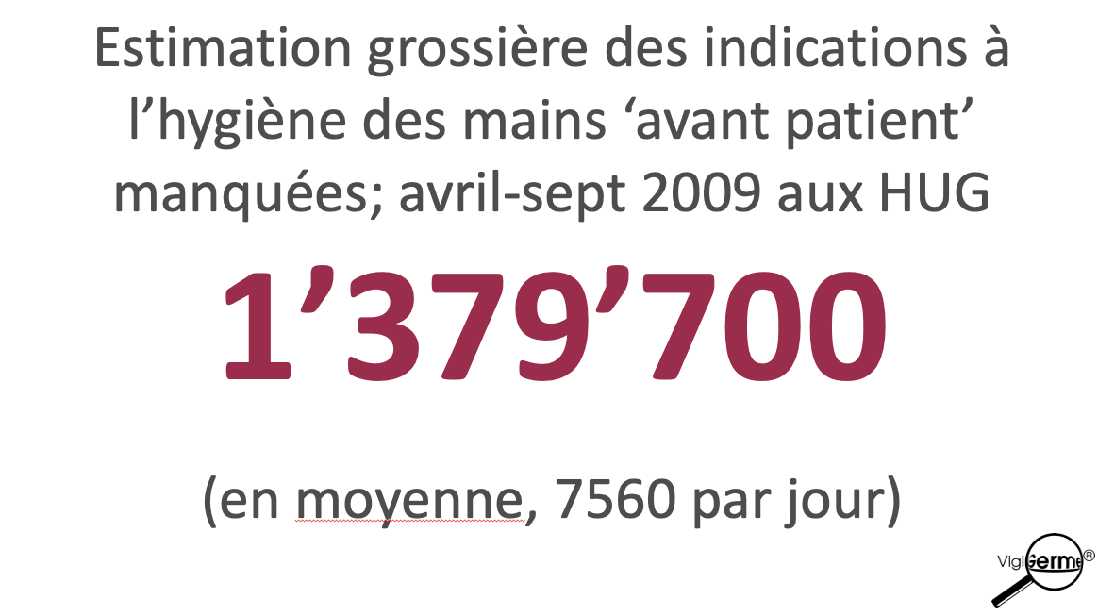

Slide 18
events/outcome
human behaviour
leverage for sustainable change
system structure

Slide 19
Monitoring hand hygiene.

Slide 20
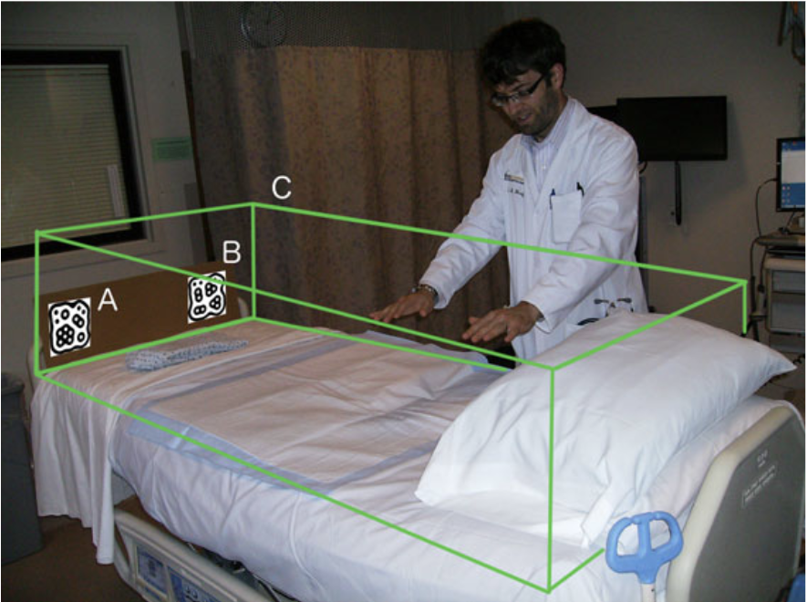
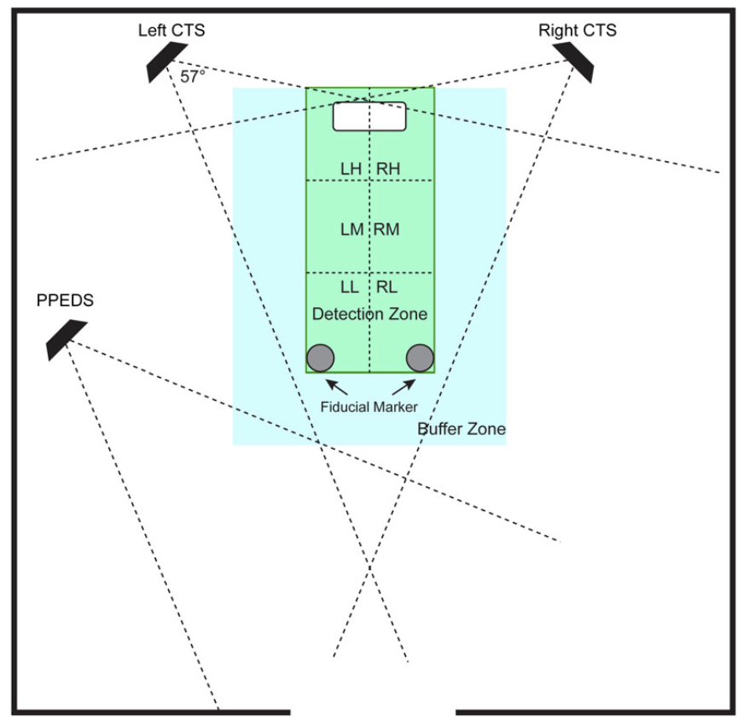
Computer vision and depth sensing can estimate potential HH opportunities and adherence to PPE.
Method
Microsoft Kinekt and inbuilt and additional software:
Color video camera & depth sensor
Track 6 skeleton representations (2 with 20 points)
Fiducial markers to ‘know’ the position of the bed
Privacy protecting millisecond existence of videos
Evaluation of touch, gown, mask, glove against human observation in video from an additional video camera
Chen, J., Cremer, J. F., Zarei, K., Segre, A. M. & Polgreen, P. M. Using Computer Vision and Depth Sensing to Measure Healthcare Worker-Patient Contacts and Personal Protective Equipment Adherence Within Hospital Rooms. Open Forum Infect Dis 3, ofv200 (2016). https://academic.oup.com/ofid/article/3/1/ofv200/2460557

Slide 21
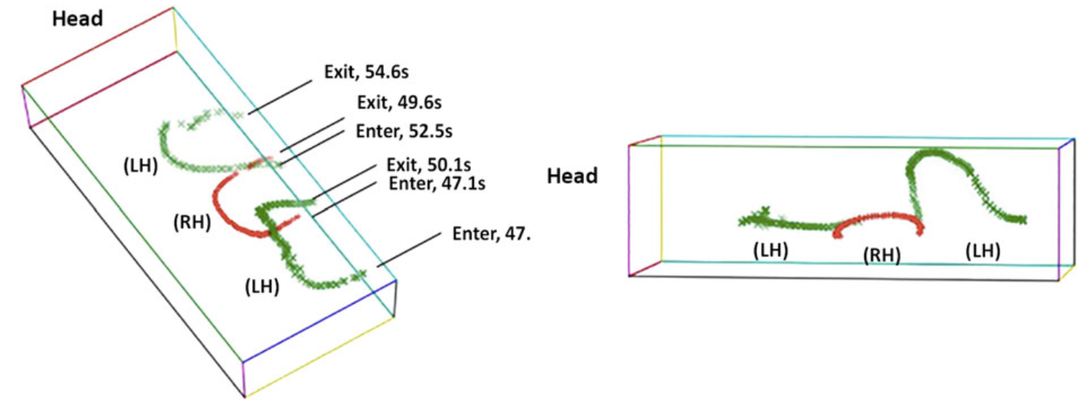
Computer vision and depth sensing can estimate potential HH opportunities and adherence to PPE.
Results
Average ‘contact’ was 3 seconds
Touch detection:
Sensitivity: 99.7%
Specificity: 98.7%
Gown detection:
Sensitivity: 100.0%
Specificity: 98.2%
Mask detection:
Sensitivity: 100.0%
Specificity: 98.8%
Glove detection:
Sensitivity: 100.0%
Specificity: 98.8%
Chen, J., Cremer, J. F., Zarei, K., Segre, A. M. & Polgreen, P. M. Using Computer Vision and Depth Sensing to Measure Healthcare Worker-Patient Contacts and Personal Protective Equipment Adherence Within Hospital Rooms. Open Forum Infect Dis 3, ofv200 (2016). https://academic.oup.com/ofid/article/3/1/ofv200/2460557

Slide 22
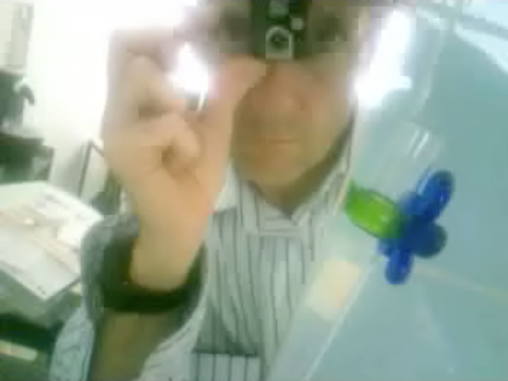

Slide 23
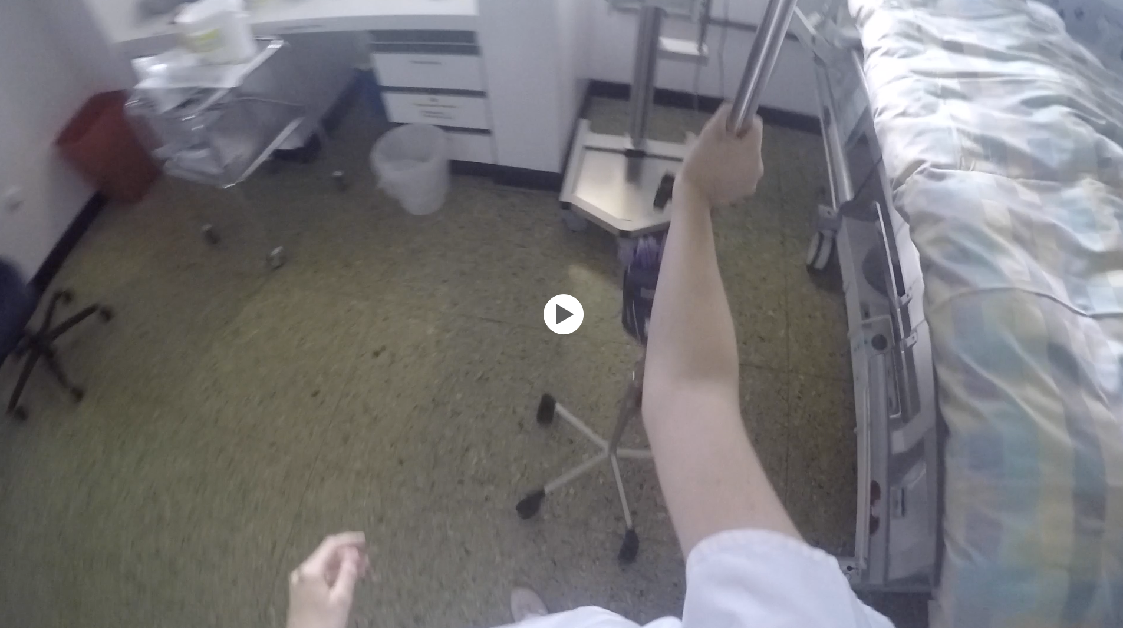

Slide 24
Hand hygiene reality check
Filming real ICU care with a head camera
296.5 min, 8 nurses, 2 physicians
4222 hand-to-surface exposures (one per 4.2”; mean duration 7.4”), gloved 21%
 | Outside patient zone | Inside patient zone 42% | Overall
Mobile objects | 61% | 78% | 61%
Immobile objects | 16% | 12% | 13%
Patient intactskin | — | 10% | 4%
Patient critical sites | — | 28% | 12%
HCP own body | 23% | — | 10%
Clack, L., Scotoni, M., Wolfensberger, A. & Sax, H. “First-person view” of pathogen transmission and hand hygiene - use of a new head-mounted video capture and coding tool. Antimicrob Resist Infect Control 6, 108 (2017). https://aricjournal.biomedcentral.com/articles/10.1186/s13756-017-0267-z

Slide 25
Hand hygiene reality check
Filming real ICU care with a head camera
 | Occurrence; n | Hand hygiene action; n (%)
Infectious risk moments | 508 | 17 (3.3%)
Patient colonisation events | 291 | 14 (4.8%)
Patient infection events | 217 | 3 (1.4%)
Clack, L., Scotoni, M., Wolfensberger, A. & Sax, H. “First-person view” of pathogen transmission and hand hygiene - use of a new head-mounted video capture and coding tool. Antimicrob Resist Infect Control 6, 108 (2017). https://doi.org/10.1186/s13756-017-0267-z
Clack, L., Scotoni, M., Wolfensberger, A. & Sax, H. “First-person view” of pathogen transmission and hand hygiene - use of a new head-mounted video capture and coding tool. Antimicrob Resist Infect Control 6, 108 (2017).

Slide 26
How do hands … infect?

Slide 27
Exogenous infection

Slide 28
Endogenous infection

Slide 29
Are HAI transmissible?
5 ICUs, 18 months, genetic typing of all strains of 10 pathogens, daily chart review, 9-day time window for same strains between patients = transmission
28,498 patient days, 278 (431) infections, 41 (14.5%) associated with transmission
Grundmann H, Bärwolff S, Tami A, et al. How many infections are caused by patient-to-patient transmission in intensive care units? Crit Care Med 2005, 33:946–951. https://journals.lww.com/ccmjournal/fulltext/2005/05000/how_many_infections_are_caused_by.5.aspx

Slide 30
bloodstream infections
pneumonia
surgical site infections
urinary tract infections
~85% of all healthcare-associated infections

Slide 31
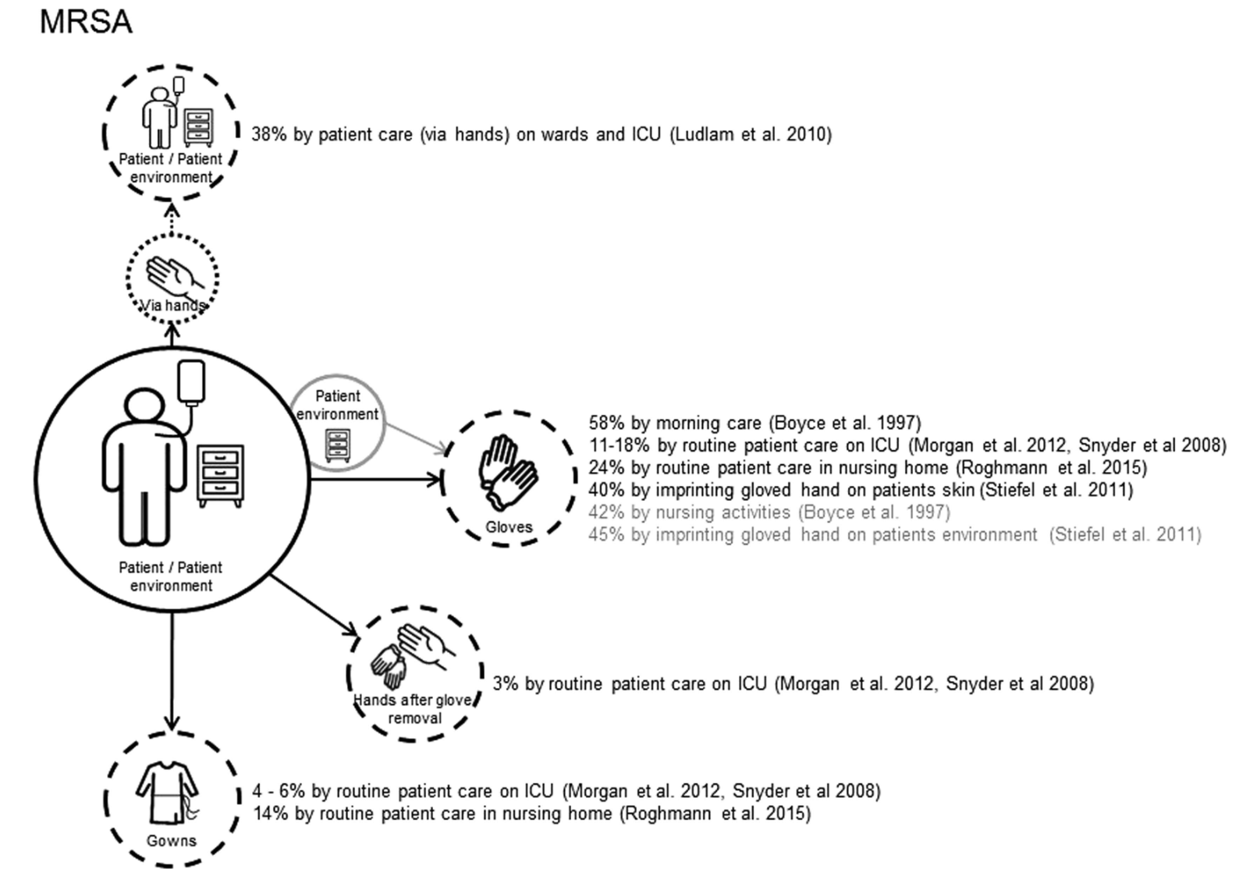
How and how often do pathogens travel?
A systematic literature review 2018
32 of 13,121 articles included
84% examined transfer from patients
Transfer frequency to hands 33%, gloves 30%, gowns 10%
Only 2 studies transfer to patients
Risk: moist body sites (n=7), longer duration of care (n=5), and care of patients with an invasive device (n=3).
Wolfensberger, A. Clack L, Kuster SP, Passerini S, Mody L Chopra V, Mann J, Sax H. Transfer of pathogens to and from patients, healthcare providers, and medical devices during care activity-a systematic review and meta-analysis. Infect Control Hosp Epidemiology 39, 1–15 (2018). https://doi.org/10.1017/ice.2018.156

Slide 32
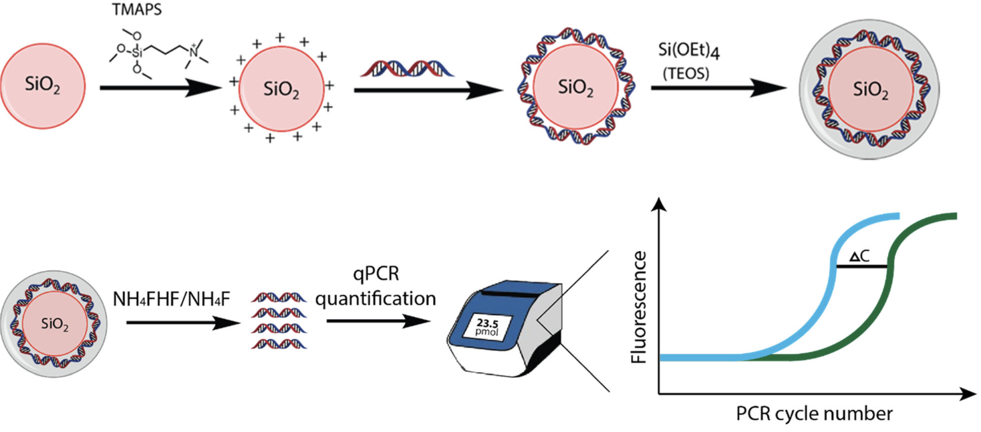
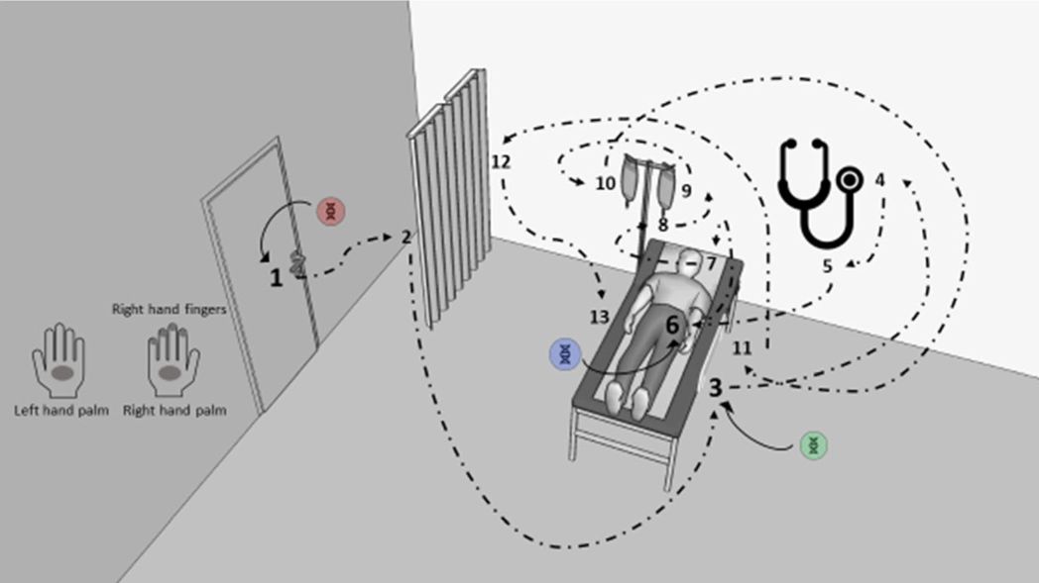
How and how often do pathogens travel?
Silica nanoparticles with encapsulated DNA (SPED)
Scotoni M, Koch J, Clack, L, PItal AK, Wolfensberger A, Grass R, Sax H. Silica nanoparticles with encapsulated DNA (SPED) – a novel surrogate tracer for microbial transmission in healthcare. Antimicrob Resist Infect Control 9, 152 (2020). https://doi.org/10.1186/s13756-020-00813-7

Slide 33
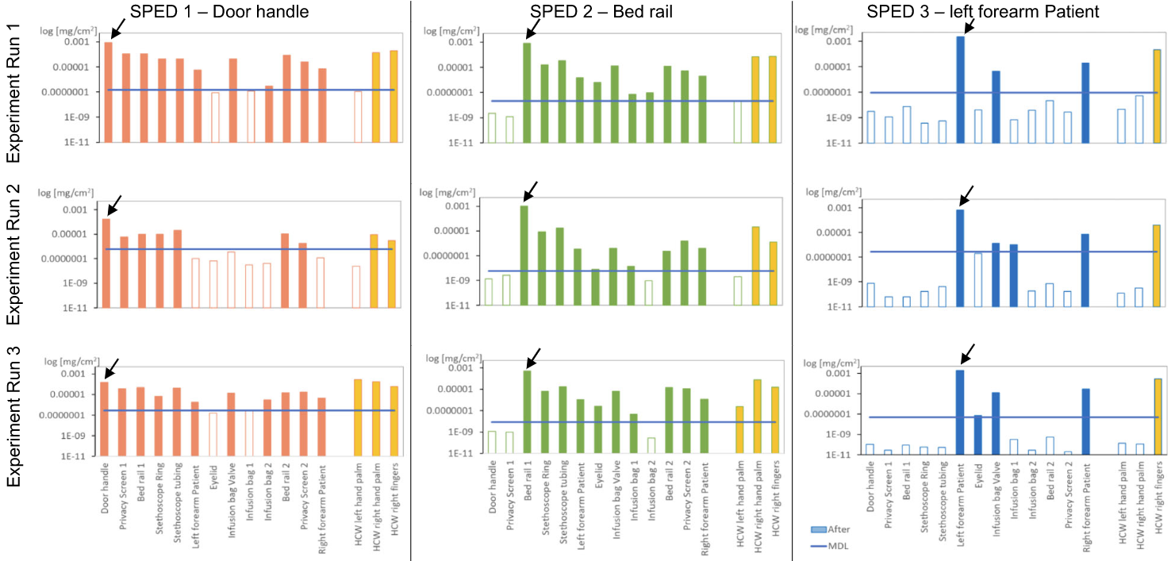
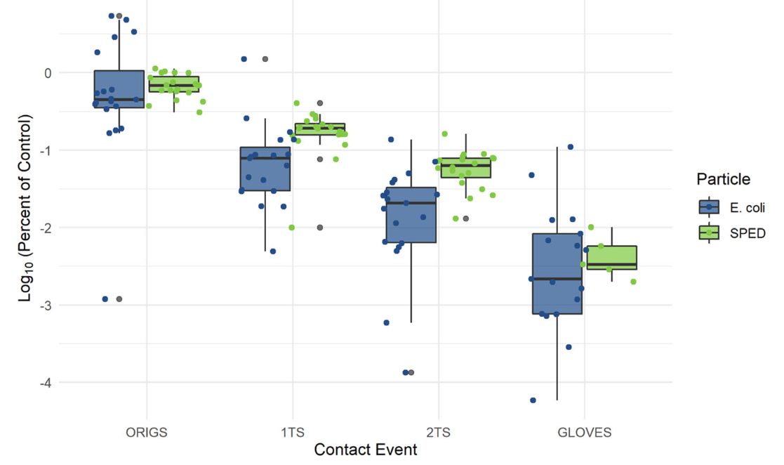
How and how often do pathogens travel?
Silica nanoparticles with encapsulated DNA (SPED)
Scotoni M, Koch J, Clack, L, PItal AK, Wolfensberger A, Grass R, Sax H. Silica nanoparticles with encapsulated DNA (SPED) – a novel surrogate tracer for microbial transmission in healthcare. Antimicrob Resist Infect Control 9, 152 (2020). https://doi.org/10.1186/s13756-020-00813-7

Slide 34
Quo vadis?

Slide 35
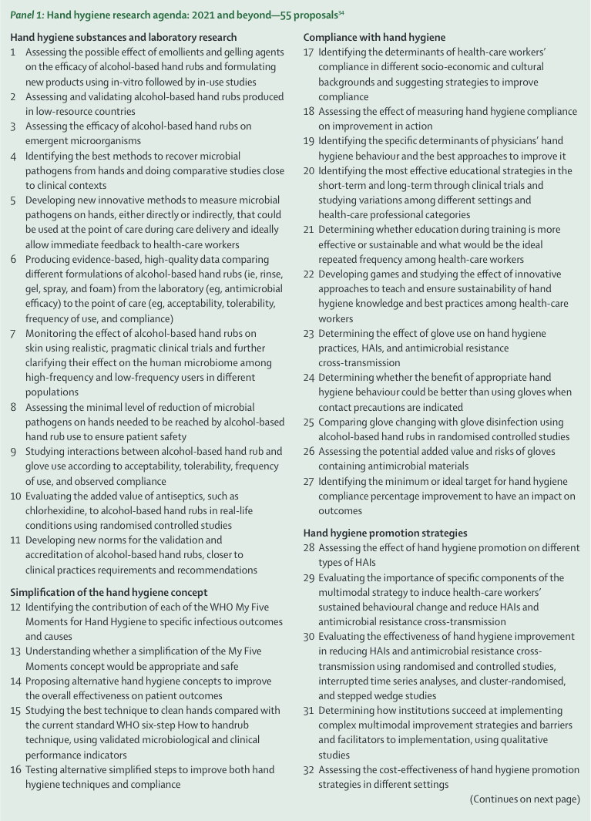
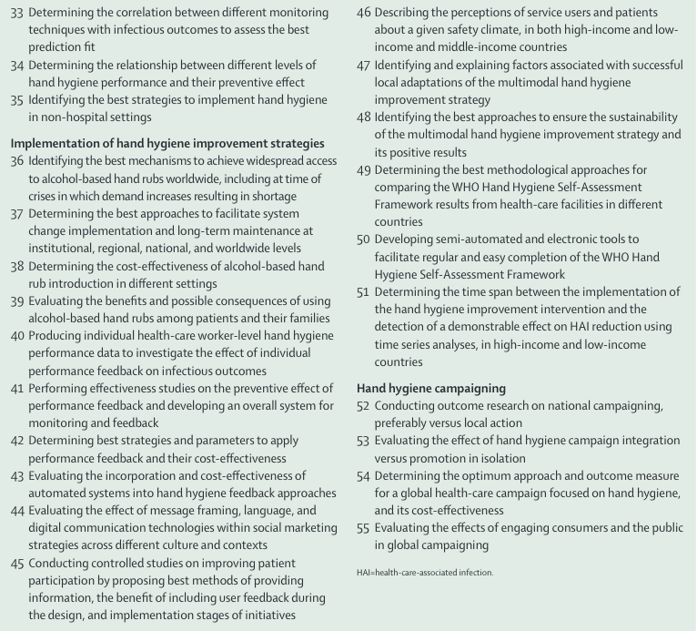
4 Identifying the best methods to recover microbial pathogens from hands and doing comparative studies close to clinical contexts
5 Developing new innovative methods to measure microbial pathogens on hands, either directly or indirectly, that could be used at the point of care during care delivery and ideally allow immediate feedback to health-care workers
…
12 Identifying the contribution of each of the WHO My Five Moments for Hand Hygiene to specific infectious outcomes and causes
13 Understanding whether a simplification of the My Five Moments concept would be appropriate and safe
14 Proposing alternative hand hygiene concepts to improve the overall effectiveness on patient outcomes
Lotfinejad N, Peters A, Tartari E, Fankhauser-Rodrigez C, Pires D, Pittet D. Hand hygiene in health care: 20 years of ongoing advances and perspectives. Lancet Infect Dis 21, e209–e221 (2021).

Slide 36
In conclusion…
The idea behind the ‘Five Moments’ was to create a simple and robust mental model - it clearly needs systems design for a successful implementation.
The exact contribution and pathway of hand transmission to infection needs more investigation.
Detailed accounts of hand-to-surface exposures could help to better understand transmission.
Utopia: precision infection prevention would tell healthcare providers when a transmission is (very likely) going to happen, which would decrease need for general hand hygiene and increase adherence.

Slide 37
Credits
Benedetta Allegranzi
Lauren Clack
Robert Grass
Pascale Herrault
Claire Kilpatrick
Julian Koch
Stefan Kuster
Lona Modi
Simone Passerini
Didier Pittet
Manuela Scotoni
Jules Storr
Ilker Uckay
Cinzia Ullrich
Aline Wolfensberger

Slide 38
