Slide 1

Healthcare Infection Control and Recent Public Health Responses
Live broadcast from ...
Dr. Ryan Fagan, MD, MPH&TM
Division of Healthcare Quality Promotion
Centers for Disease Control and Prevention
NO DISCLOSURES
The findings and conclusions in this report are those of the author and do not necessarily represent the official position of the Centers for Disease Control and Prevention.
National Center for Emerging and Zoonotic Infectious Diseases
Division of Healthcare Quality Promotion
www.webbertraining.com
June 28, 2015

Slide 2
Outline
Why outbreak investigations are important and brief overview of resources and recent CDC HAI outbreak activities and resources
Examples
  Ebola
  MERS
  Fungal meningitis
  Unsafe injection practices
  Duodenoscopes
What CDC is doing
Major questions and open issues for healthcare infection control

Slide 3
Why Outbreak Investigations Are Important
Prevent additional cases and future outbreaks
Advance understanding of infection control gaps and challenges
  May be ‘sentinel events’ that indicate broader underlying problems
  New diseases
  Something new about an old disease
  Unintended consequences
Help shape both educational and policy efforts to improve patient safety
Reassure public
Minimize economic and social disruption

Slide 4
Challenge: How to Recognize an HAI (or Any) Outbreak?
Most public health jurisdictions require reporting of outbreaks:
  “An outbreak or unusual number or clustering of diseases or other conditions of public health importance”
But the definition of ‘unusual’ can vary:
  Any case of a very rare or serious communicable disease
  Unusual syndromes or patient populations
  Illnesses involving organisms that are not normally pathogenic
Many Challenges
  Baseline surveillance data may be limited
  Linking illnesses among patients who may be evaluated across different providers, departments, facilities, health jurisdictions
  Outbreaks involving common pathogens may be harder to recognize
  Most facilities have limited resources to recognize and investigate possible outbreaks
http://www.epi.alaska.gov/pubs/conditions/ConditionsReportablePg06.pdf

Slide 5
Surveillance Pyramid
Cases reported to health department
Laboratory-
confirmed cases
Lab tested
Specimen obtained
Person seeks care
Person becomes ill
Exposures in the general population

Slide 6
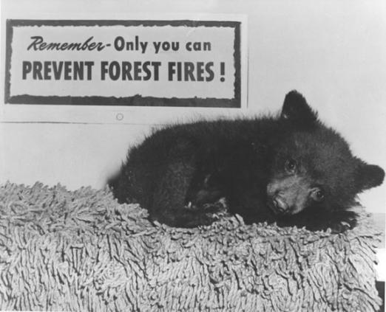
Who’s in Position to Recognize HAI Outbreaks?
Often, IPs are! But unlike what Smokey says about fires, not just you (IPs)
It helps us to hear from you about possible outbreaks
We can’t learn from outbreaks if we don’t know about them

Slide 7
Healthcare Associated Infection (HAI) Outbreaks: CDC 2014 Annual Highlights
CDC (DHQP) participated in 88 response activities
  Variety of settings
    Acute care (40)
    Ambulatory care (34)
    Long-term care (6)
  31 different states, including 3 multistate activities
  6 foreign countries (Guinea, Kingdom of Saudi Arabia, Liberia, Nigeria, Switzerland and the United Arab Emirates)
  12 Epi-Aids

Slide 8
HAI Outbreaks: CDC 2014 Annual Highlights
Wide variety of organisms
  Bacterial (38)
    Gram negative (18) – 13 unique genera
    CRE (9)
    NTM (5)
  Viral (34)
    HCV (13)
    HBV (11)
    Ebola (4)
  Fungal (5)
    Aspergillus spp (2)
    Rhizopus spp (1)

Slide 9
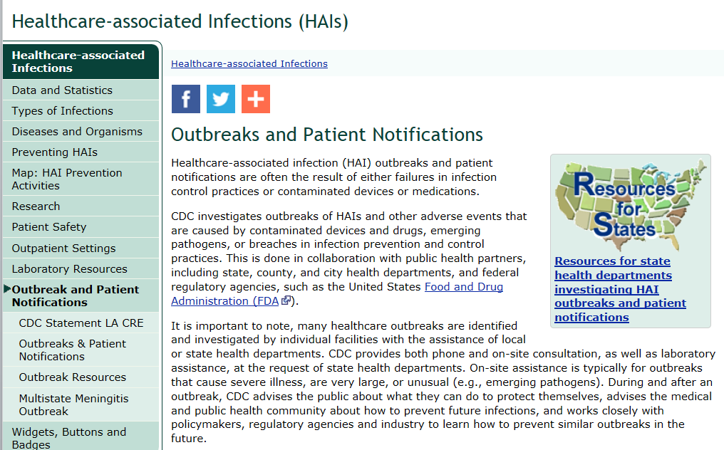
http://www.cdc.gov/hai/outbreaks/index.html

Slide 10
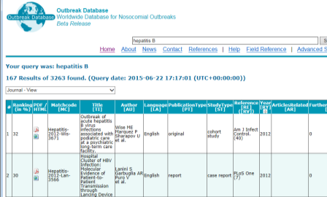
Free and Public Resources
CDC HAI Outbreak Investigation Toolkit
http://www.cdc.gov/hai/outbreaks/outbreaktoolkit.html
  Video presentation about outbreak investigation in healthcare settings
  Outbreak investigation abstraction form with users guide
Outbreak Database (worldwide) http://www.outbreak-database.com/Home.aspx

Slide 11
TRAVEL AND COMMUNICABLE DISEASES
Travel Medicine and Infectious Disease (2015) 13, 3e5

Slide 12
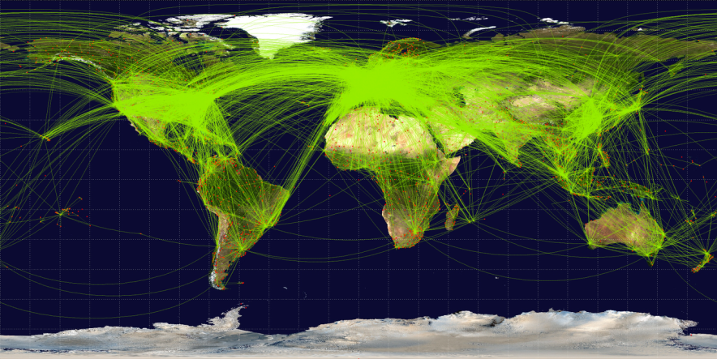
World Airline Route Map*
*"World-airline-routemap-2009" by Jpatokal - Own work. Licensed under CC BY-SA 3.0 via Wikimedia Commons - https://commons.wikimedia.org/wiki/File:World-airline-routemap-2009.png#/media/File:World-airline-routemap-2009.png

Slide 13
Air travels remains a major contributor to the spread of communicable diseases
Control measures are resource intensive and effectiveness is largely dependent on (and frequently limited by) behavior of individuals
  Entry & exit screening
  Traveler information
  Quarantine, isolation, health monitoring
  Contact tracing
  Hygiene measures (face masks, hand hygiene, etc)
  Travel restrictions
  Animal
  Vector control
  Contaminated materials
Travel Medicine and Infectious Disease (2015) 13, 19e30

Slide 14
Implications for Healthcare Infection Control
Healthcare providers remain critical to controlling the spread of communicable diseases
Travel histories should be routinely sought from patients to facilitate early detection of possible communicable diseases in travelers
  Avoid missed opportunity to implement appropriate isolation and infection control measures, as well as potential life saving treatment for ill traveler
  Healthcare personnel (HCP) and patients are at risk
  These events are increasingly common and will likely continue to occur
  Note that many HCP volunteer overseas

Slide 15
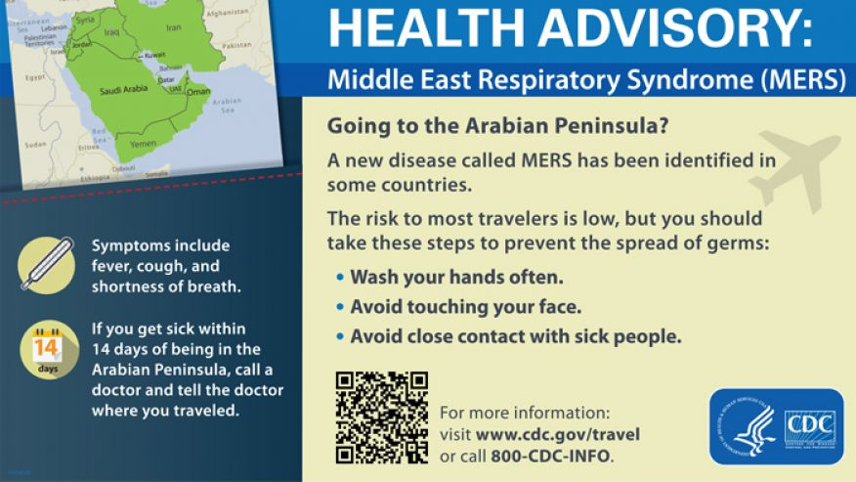

Slide 16
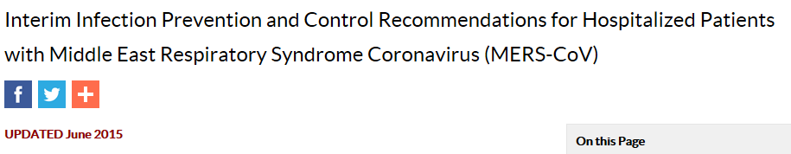
Middle East Respiratory Syndrome (MERS)
May 2014, 2 unlinked imported cases to the U.S.*
  Indiana
  Florida
Both cases were among HCP who lived and worked in Saudi Arabia
Both hospitalized in the U.S. and recovered
http://www.cdc.gov/coronavirus/mers/infection-prevention-control.html
*http://www.cdc.gov/coronavirus/mers/us.html

Slide 17
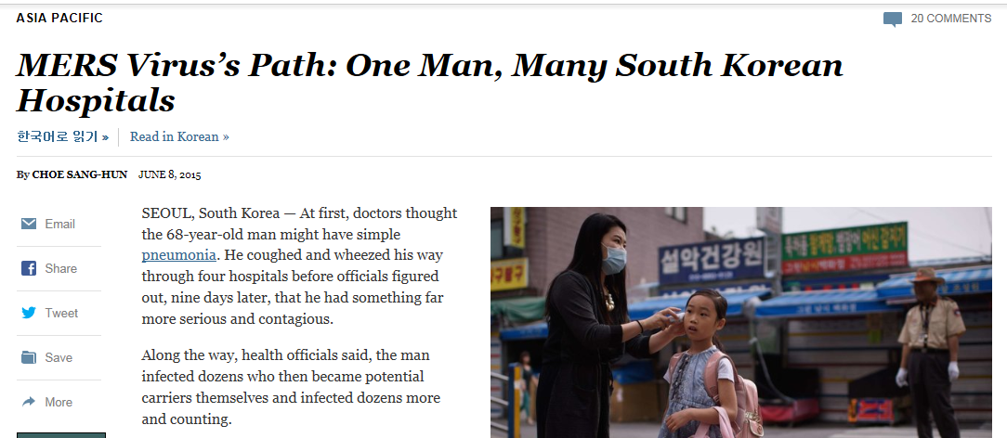
http://www.nytimes.com/2015/06/09/world/asia/mers-viruss-path-one-man-many-south-korean-hospitals.html
“The original diagnosis that missed what became South Korea’s first case of Middle East respiratory syndrome, or MERS, was possibly caused by incomplete information from the patient about his travels”
South Korea outbreak summary, WHO*
  126 cases (including 10 HCP) and 11 deaths
  Single transmission chain involving 44(!) hospitals where transmission occurred or confirmed patient visited before diagnostic confirmation
  >3,600 contacts
*http://www.who.int/csr/don/12-june-2015-mers-korea/en/

Slide 18
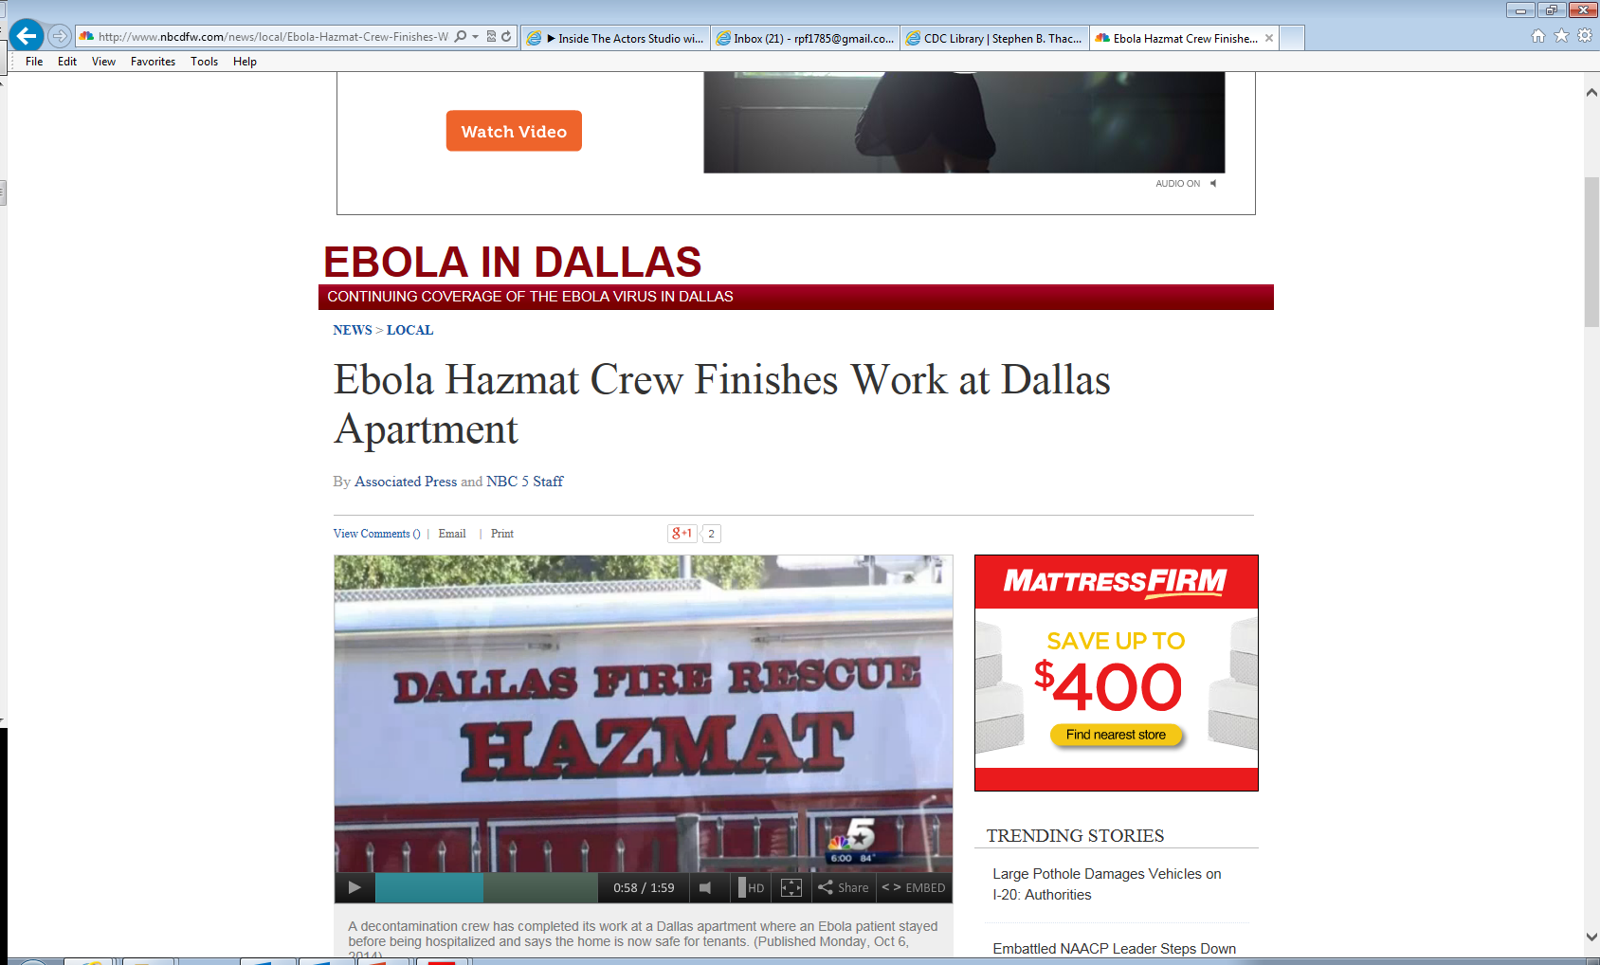

Ebola: Dallas Experience, September-October 2014
First ever Ebola Case diagnosed in US
  Index patient was a traveler from Liberia
  Two nurses who cared for the index patient subsequently became infected
Healthcare associated transmission had major disruptive impact on hospital and community
http://www.nbcdfw.com/news/local/Ebola-Hazmat-Crew-Finishes-Work-at-Dallas-Apartment-278267921.html

Slide 19
Dallas Experience, September-October 2014
Key CDC Investigation Findings
  No specific exposures that led to transmission were identified
  Hypothesis that transmission of Ebola virus occurred in the early part of the index patient’s MICU stay
    Index patient had a high viral load and copious diarrhea during this period
    Use of unconventional and unfamiliar PPE
    Consistent with typical incubation period of 9-12 days
  Absence of infection among others who cared for the index patient is noteworthy
    Standard practice
    Unconventional practice

Slide 20
Insights
  Sense of fear
    Unorthodox use of PPE may paradoxically increase risk of transmission.
  In emotionally charged situations where fear is a factor, there may be advantages to providing guidance that is more prescriptive, minimizes potential for error and self contamination, increases confidence, and allays fear among healthcare workers
    Including trained observers to alert healthcare worker to possible contamination during care, and ensure safe donning and doffing

Slide 21
Dallas Experience, Summary and Conclusions
Decisions on guidance must be based on science and experience
  Must be prepared to adapt as experience changes
The Dallas experience provided lessons that prompted important updates in guidance and approach
More permissive, less prescriptive
More structured, prescriptive
Uniform approach to patient management
across all healthcare facilities
Tiered approach to management

Slide 22
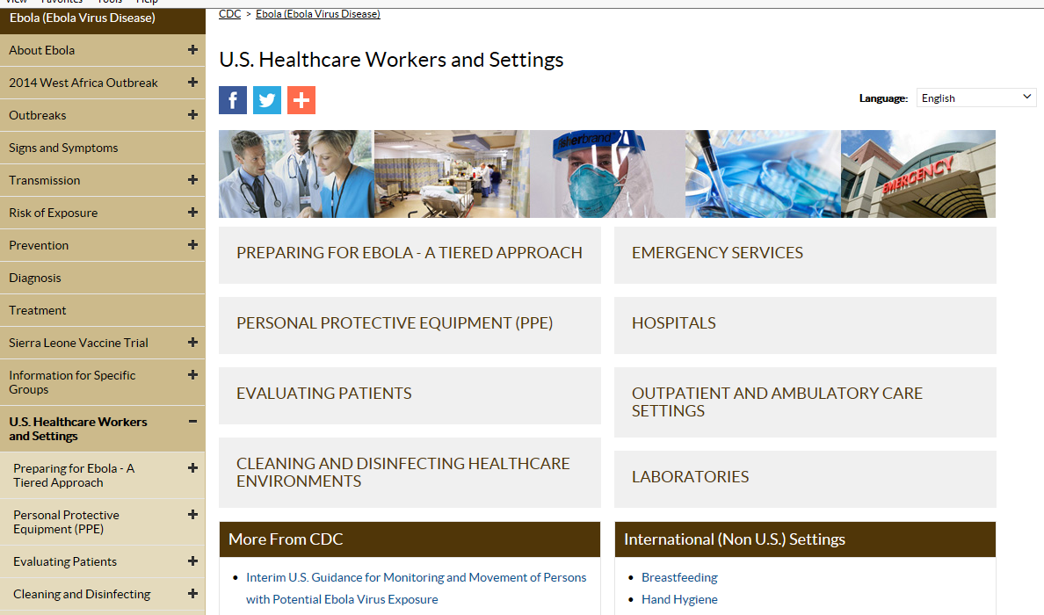

Slide 23
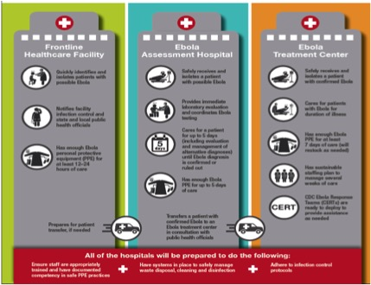
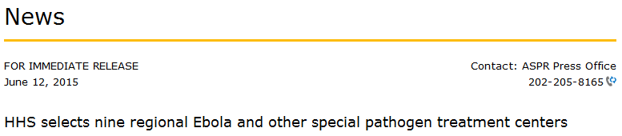
http://www.cdc.gov/vhf/ebola/healthcare-us/preparing/hospitals.html

Slide 24
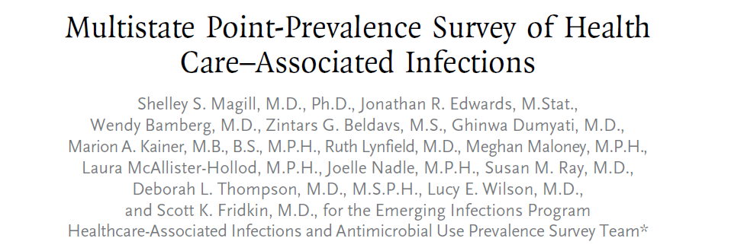
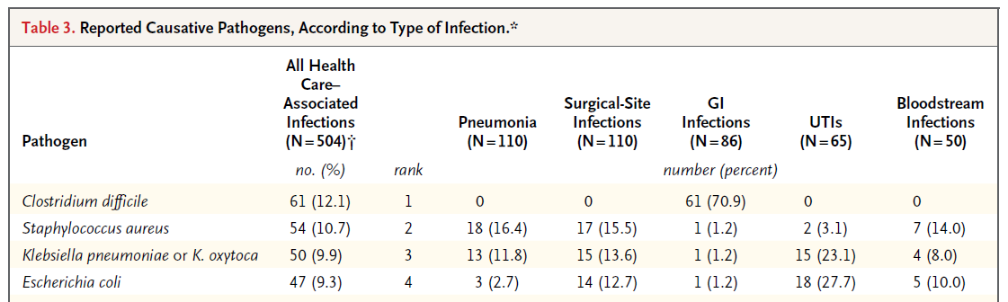
What Do Our Experiences with Ebola Preparedness Say about Transmission of Common HAI Pathogens?
Estimated 720,000 HAIs in U.S. hospitals in 2011*
  75,000 related deaths
  Role of healthcare personnel (HCP) and unrecognized contamination (hands, surfaces, equipment) during patient care
Common HAI pathogens typically don’t cause illness among HCP but can be silently transferred via contaminated hands or equipment
*N Engl J Med 370;13 nejm.org march 27, 2014

Slide 25
UNSAFE INJECTION PRACTICES AS UNINTENDED CONSEQUENCES
Mishandling of Medications
Reuse of Syringes

Slide 26
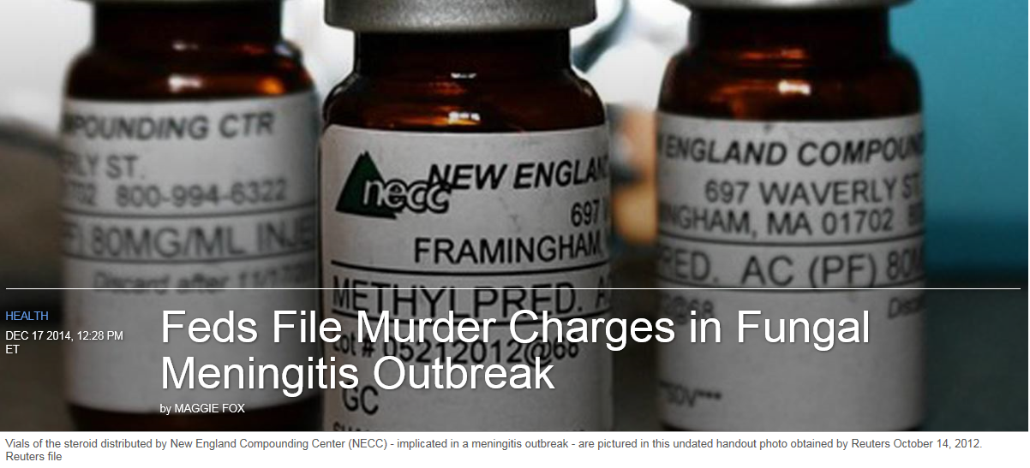
“The 2012 outbreak shocked Americans and set off investigations by Congress and the Food and Drug Administration. The FDA's since overhauled how it manages so-called compounding pharmacies - which the law and regulations had treated as mom-and-pop operations, but which often act more like large-scale pharmaceutical manufacturers.”
http://www.nbcnews.com/health/health-news/feds-file-murder-charges-fungal-meningitis-outbreak-n270106

Slide 27
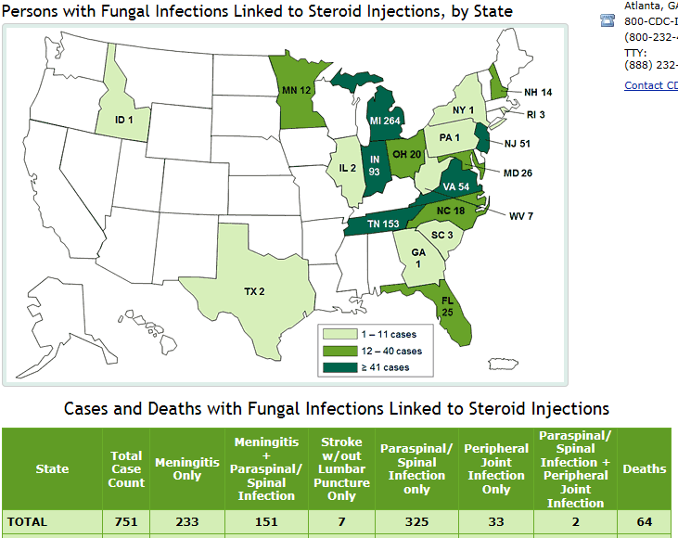
Fungal Meningitis
http://www.cdc.gov/hai/outbreaks/meningitis-map-large.html#casecount_table

Slide 28
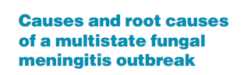
Public health investigation triggered by reporting of initial cases by individual facilities to local health depts (TN, then MI, VA, OH, IN, others) and subsequently to CDC and FDA
Favorable market for large scale sterile compounding
  Small hospitals and clinics unable to support industry standards for sterile compounding
  Problems with drug shortages from other sources
“Over a period of a few weeks following the report of the first case … the source of the outbreak was determined, new cases were averted, and a proactive approach to early case identification and treatment was initiated. The precise and rapid means by which this outbreak was abrogated represents one of the more important achievements of the public health community in recent years.”
Curr Opin Infect Dis 2013, 26:545–550; J Am Pharm Assoc (2003). 2015 Mar-Apr;55(2):118

Slide 29
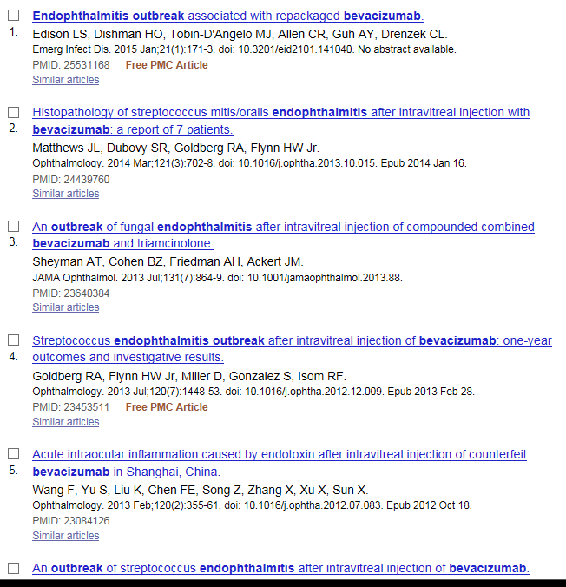
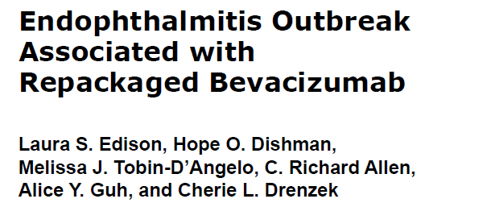
Financial Pressure, Single-Use Vials and Repackaging: Endophthalmitis Example
March 2013 outbreak in Georgia and Indiana
  Serious infection with potential permanent vision loss
  Rare organisms: Granulicatella adiacens (human oral flora) and Abiotrophia
  Contamination during compounding pharmacy repackaging of single use, 4-mL vials of bevacizumab ($550 each!)
  Numerous prior outbreaks worldwide →
Emerging Infectious Diseases • www.cdc.gov/eid • Vol. 21, No. 1, January 2015

Slide 30
Hemodialysis Center Example
Financial pressure
  Single-use 1-mL vials of epoetin alfa ($85 each)
  Single-use can lead to the waste of $1.1 million worth of medication annually, for a facility serving 150 patients, for which no reimbursement is received
  ‘There is concern that with constraints on reimbursement and increasing privatization, dialysis providers are motivated to control costs, sometimes to the detriment of patient care.’
Contamination occurred after single-use vials were punctured more than once
N Engl J Med. 2001 May 17;344(20):1491-7.

Slide 31
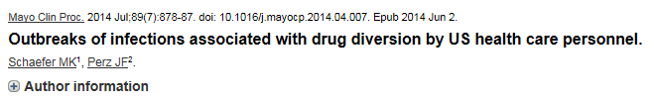

Tampering with injectable controlled substances
Unauthorized access to drugs can be an unintended consequence of processes designed to improve efficiency (e.g., prefilled labeled syringes, extra supplies for procedures)
Outbreaks reveal gaps in prevention, detection, and response to drug diversion in U.S. healthcare facilities
Highlight need for:
  Security measures
  Active monitoring systems
  Response that includes assessment of harm to patients, notification to public health as well as enforcement agencies
http://www.newsweek.com/2015/06/26/traveler-one-junkies-harrowing-journey-across-america-344125.html

Slide 32
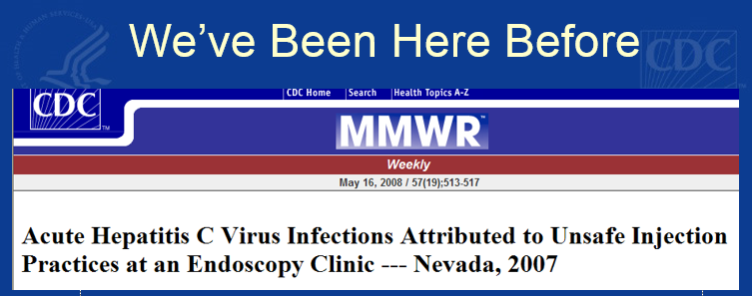
Unsafe Injection Practices: We’ve Been Here Before (Again)
  Slide from CDC (Arjun Srinivasan) Presentation at APIC 2009 →
Outbreaks are reflections of the intense financial pressures that are a reality in healthcare
Keep these ‘hidden costs’ in mind as we think about issues related to improving healthcare, patient safety, and medication safety

Slide 33
ANOTHER EXAMPLE: PARENTERAL NUTRITION

Slide 34
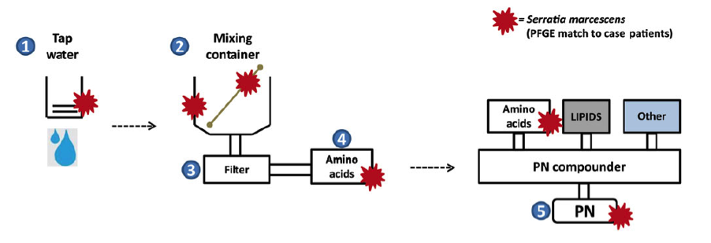
19 patients, 6 healthcare facilities, 9 deaths
43% of surveyed US hospitals >600 beds outsource nutrition support preparations
Outbreak associated with compounding of nonsterile amino acid components initiated due to manufacturer shortage combined with failure to follow recommended compounding standards
Clinical Infectious Diseases 2014;59(1):1–8

Slide 35
ENDOSCOPES & CHALLENGES POSED BY NEW TECHNOLOGIES

Slide 36
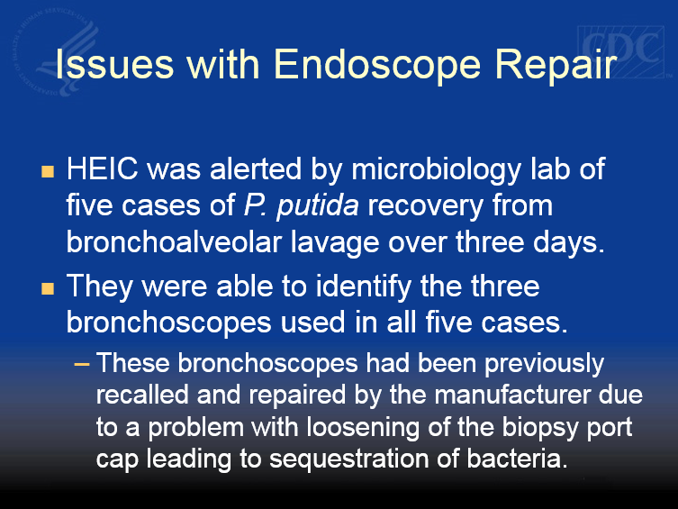
We’ve Been Here Before, Too
Another slide from APIC 2009 →

Slide 37
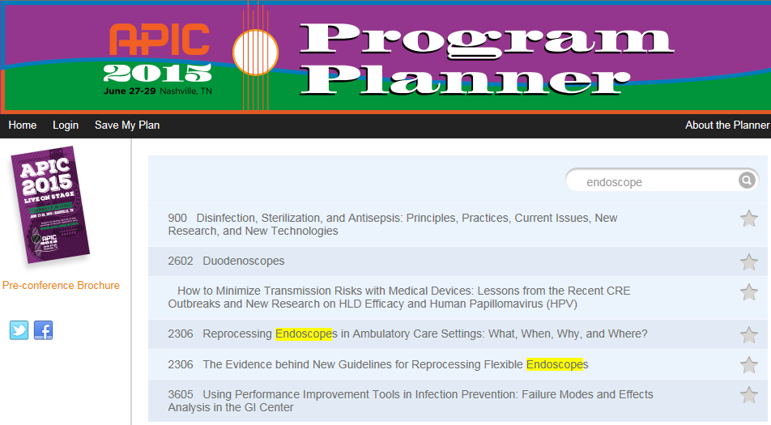
… And It’s a Hot Topic at APIC 2015
(So I’ll Keep it Brief)

Slide 38

Cleaning and Disinfecting Duodenoscopes
Even when the devices are cleaned strictly in accordance with manufacturers' FDA-approved guidelines, "they have a lot of intricate mechanisms and pieces that are very difficult to disinfect," says Alex Kallen, an infectious-disease physician at the CDC who helped direct the investigation. "There definitely is a risk of (disease) transmission with these scopes."
http://www.usatoday.com/story/news/2015/01/21/bacteria-deadly-endoscope-contamination/22119329/

Slide 39
Recent Duodenoscope Clusters
Notification Dates | Manufacturer | Organism
July 2013 | Pentax | NDM-Producing E. coli
November 2013 | Olympus | NDM-producing E. coli
November 2013 | Olympus | Plasmid AmpC-producing E. coli
May 2014 | FujiFilm | KPC-producing K. pneumoniae
June 2014 | Olympus | KPC-producing K. pneumoniae
February 2015 | Olympus | OXA-48-type-producing K. pneumonia
March 2015 | Olympus | KPC-producing K. pneumoniae
March 2015 | Olympus | ESBL-producing E. coli

Slide 40
Common Themes from CDC Duodenoscope Investigations
Clusters detected due to presence of very unusual organisms
  No reason CDC aware of that these organisms would be more likely to persist than other organisms
Duodenoscopes linked to transmission have been of variable ages (weeks old to years old)
  Have involved open and closed elevator wire endoscopes although closed more common
Facilities often perceived problems removing debris with what they felt was recommended procedures
  Employed other brushes or steps
Many facilities had some deviations from recommended practice
  Additional brushes
  Detergents or disinfectants not on manufacturers list
Cultures positive months after last use

Slide 41
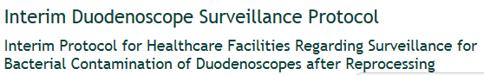
Highlights of CDC protocol:
Timing: Minimum of every 4 weeks or 60 procedures for each duodenoscope
  Other options including after each procedure or weekly (on Friday)
  Holding duodenoscopes prior to culture results an option
Organisms: Defines high-concern and low-concern organisms
  High-concern – more often associated with disease
  Low-concern - less often associated with disease; potentially a result of contamination during collection
Areas to target (minimum)
  Area around elevator mechanism
  Instrument channel
http://www.cdc.gov/hai/organisms/cre/cre-duodenoscope-surveillance-protocol.html

Slide 42
Surveillance Cultures: Caveats
Short-term option – Not a recommendation or requirement
  May not be feasible everywhere
Protocol is needed for clusters (outbreaks)
Not a substitute for good reprocessing practices
Many challenges, requires discussion at facility level to identify solutions
Has been used in outbreaks but not a validated protocol
  Sensitivity unknown – these results alone should not rule out transmission
* Citations, references, and credits – Myriad Pro, 11pt

Slide 43
Potential Long-term Solutions
Duodenoscope redesign
  Removable distal end caps
  Single-use parts
New or modified reprocessing
  Validated high-level disinfection instructions
    What should be required before instructions approved
  Sterilization
  Use of forced air drying cabinets
Improved/ validated reprocessing assessment
  ATP or other non-culture methods
    Some of these best for cleaning – do not asses entire process
  Surveillance cultures

Slide 44
WHAT ELSE IS CDC DOING?

Slide 45
Supplemental Funding to Improve Healthcare Infection Control Assessment and Response Activities
2-3 year cooperative agreements between CDC and state and local health departments
Infection control assessment programs
  Expanded state HAI plans and advisory groups
  Inventory of healthcare settings in state
  Ebola assessment hospitals
  Outbreak reporting and response in healthcare facilities
Targeted healthcare infection prevention programs
  Expand infection control assessments
  Infection control training
  Enhance surveillance capacity
http://www.federalgrants.com/Domestic-Ebola-Supplement-to-Epidemiology-and-Laboratory-Capacity-for-Infectious-Diseases-ELC-Building-and-Strengthening-Epidemiology-Laboratory-and-Health-Information-Systems-Capacity-in-State-and-Local-Health-Departments-49276.html

Slide 46
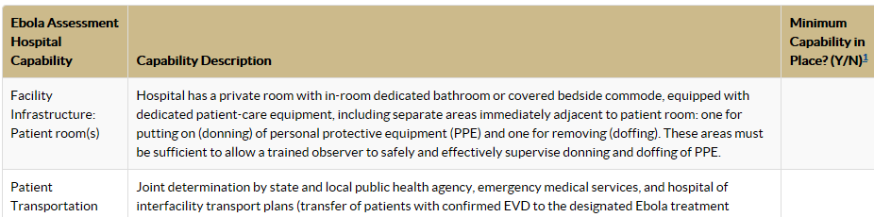
Project Status
Ebola assessment hospital work continues
Setting-specific, expanded infection control assessment tools are under development
CDC is partnering with APIC and many other groups to discuss future training, outbreak reporting and response, and surveillance activities – STAY TUNED!
http://www.cdc.gov/vhf/ebola/healthcare-us/preparing/assessment-hospitals.html

Slide 47
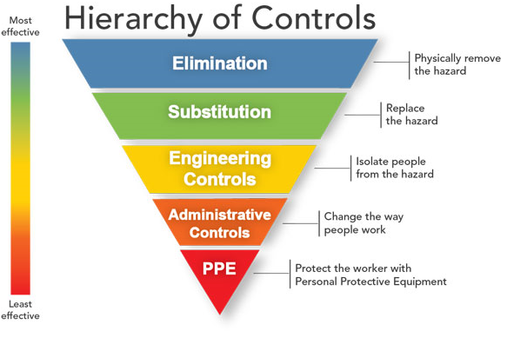
CDC, NIOSH Hierarchy of Controls
It’s NOT just about PPE - note where PPE sits in this hierarchy! →
http://www.cdc.gov/niosh/topics/hierarchy/

Slide 48
Other Questions and Open Issues
Higher frequency of routine cleaning of the patient care environment?
How can facilities be better engineered for infection control?
  One way flow
  Sinks, drains (P traps), and splashes
  On-site waste management (autoclave)
What is the role of newer technologies for disinfection?
  UV light, vaporized hydrogen peroxide
Why aren’t PPE donning and doffing (components, sequence) standardized for ALL patient care situations?
  Simulating patient care (e.g., procedures) while wearing PPE
Why aren’t ALL HCP formally trained in the minimum infection prevention practices necessary to adhere to standard precautions?
How to develop more timely and appropriate lab tests / diagnostics?

Slide 49
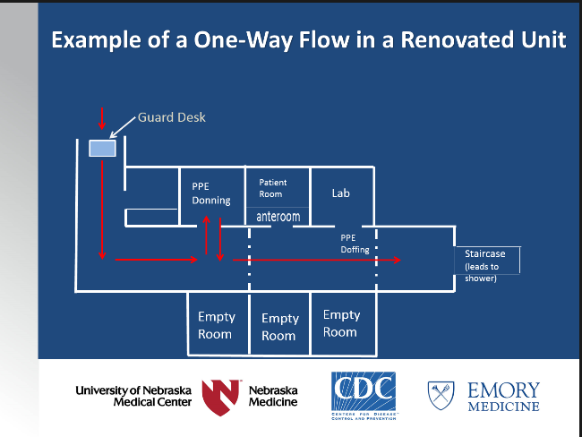

Slide 50
Final Thoughts
IPs often in position to recognize potential outbreaks
Your job - infection prevention and control – is very important – and difficult
  Reporting requirements
  Constantly evolving threats from emerging diseases and unintended consequences of financial pressures and advancing technologies
  Antimicrobial resistance, evolution of electronic health records to aid epidemiologic work, continued shift of care to outpatient settings, research needs
  IPs can’t do it alone, and there are new opportunities to partner more closely with local health jurisdictions
APIC and CDC continue to partner to improve guidance and identify potential solutions to gaps in outbreak detection, routine surveillance, infection control training

Slide 51
Special Thanks to Lots of People at DHQP, CDC Including:
Mike Bell
Denise Cardo
Bryan Christensen
Jeff Hageman
John Jernigan
Alex Kallen
David Kuhar
Shelley Magill
Joe Perz
Arjun Srinivasan
And, to the Many IPs, Other HCP, Health Depts, and Federal Agencies Who Help Us Recognize and Respond to Outbreaks

Slide 52
Discussion
Ryan Fagan, MD, MPH&TM
Division of Healthcare Quality Promotion
Centers for Disease Control and Prevention
Atlanta, Georgia, USA
National Center for Emerging and Zoonotic Infectious Diseases
Division of Healthcare Quality Promotion

Slide 53
