Slide 1
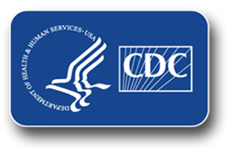
Healthcare Textiles: Factors That Impact Cleanliness
Lynne M. Sehulster, PhD, M(ASCP)
Health Scientist National Center for Emerging and Zoonotic Infectious Diseases Division of Healthcare Quality Promotion
Hosted by Paul Webber paul@webbertraining.com
www.webbertraining.com
October 16, 2014

Slide 2
Topics for Today
Healthcare laundry basics:
Some observations
Basic steps of the laundry process
Antimicrobial activity in the wash cycle
Key observations from the report of the 2009 mucormycosis outbreak
Assess the holding/transport/storage stage for contamination opportunities
Fungi (and bacteria) as agents of textile biodegradation
Strategies to minimize environmental contamination of hygienically clean healthcare textiles (HCTs)
Antimicrobial treatment of textiles

Slide 3
Laundry and Infectious Diseases
Textiles contaminated with body substances can contain large numbers of microorganisms (10⁶ – 10⁸ cfu/100 cm² fabric)
Few reports in the literature link laundry to disease transmission when proper procedures are followed
Annual estimates for volume of laundry processed in U.S. health care: several billion lbs. higher than the 5 billion lbs. in the late 1980s
Continue current infection prevention practices

Slide 4
Observations from a Recent Study
135 personnel (45% physicians, 55% nurses) in surgical depts. (60%) and medical depts. (40%)
Nonpathogenic skin organisms isolated from all attire tested
Rate of contamination with pathogens higher in attire changed every 2 days compared to that for daily changes (p <.05)
Isolated pathogenic bacteria:
Acinetobacter spp. 37% (89/238 cultures)
Staphylococcus aureus 13% (32/238 cultures)
Enterobacteriaceae 8% (18/238 cultures)
Pseudomonas aeruginosa 3% (8/238 cultures)
Only skin bacteria isolated from 4 uniforms cultured immediately after receipt from the hospital laundry
Bacterial loads significantly lower than on uniforms being worn
Wiener-Well Y, et al. Am J Infect Control 2011; 39: 555-9

Slide 5
Current Healthcare Textiles Standard in the U.S.
Standard for reusable textiles: Hygienically clean
Not quantified for microorganisms, but assume textiles are generally rendered free of vegetative pathogens
Through a combination of soil removal, pathogen removal, pathogen inactivation, contaminated laundry is rendered hygienically clean
Carries negligible risk to healthcare workers and patients, provided that the clean textiles are not inadvertently contaminated before use
Sensory attributes: visual, tactile, olfactory
Reusable surgical textiles: Sterilized
CDC Guidelines for Environmental Infection Control in
Health-Care Facilities, 2003:
http://www.cdc.gov/hicpac/pdf/guidelines/eic_in_HCF_03.pdf
ANSI/AAMI ST79:2010 and A1; ANSI/AAMI ST65:2008

Slide 6
AAMI: Hygienically Clean
Definition: “Free of pathogens in sufficient numbers to cause human illness.” (ANSI/AAMI ST 65:2008)
No one has ever defined what “sufficient numbers” means
Underlying medical conditions may increase risk of infection by opportunistic pathogens

Slide 7
Main Steps of Healthcare Laundry Processing
Collection of soiled textiles at point of use
Transport to laundry
Wash cycle:
Flush, main wash, bleaching, rinsing, souring
Dried and pressed
Packaged, loaded into carts
Delivery back to the hospital

Slide 8
Conventional Laundering: Log Reductions in Bioburden
In the wash, rinse cycles:
Agitation: ~3 log unit reductions
Addition of bleach: ~ 3 log unit reductions
In the dry cycle:
~ 1 – 2 log unit reductions
From: Blaser MJ, et al. 1984; J Infect Dis 149: 48-57.
Post wash microbial burden ~10 – 100 CFU/cm²
Predominantly Gram-positive organisms

Slide 9
Alternatives to Hot-water Laundry
In-house laundries consume an average of 50% - 70% of the facility’s hot water (10% - 15% of the total energy used)
Water temperature may be regulated locally
Lower temperature (e.g., 22° – 50° C) wash cycles can be used with appropriate detergents and laundry additives
New detergents and processes (e.g., oxidative products) are being evaluated in Europe
Current problems associated with bleach use:
Not all fibers and fabrics are compatible with bleach
Chlorine + residual chlorhexidine gluconate (CHG) = brown stains

Slide 10
The Laundry Process: Log Reductions
Process | Gram Positive LR* | Gram Negative LR*
Pre –wash at 35° C | 0.73 – 2.47 | 0.70 – 1.16
Main wash at 45° C w/o pre-wash | 0.97 – 2.58 | 1.11 – 2.66
Main wash at 60° C w/o pre-wash | 1.34 - >5.56 | 3.71 - >5.6
E60 + 35: pre-wash at 35° C, main wash at 60° C | 1.91 - >7.68 | >5.6 - >7.76
Completed main wash at 75° C | >5.56 - >7.88 | >5.6 - >7.76
Disinfecting only at 75° C | >5.56 - >7.88 | >5.6 - >7.76
Complete 3-step cycle (with disinfection at 80° C) | >5.56 - >7.88 | >5.6 - >7.76
Detergent was mix of anionic and nonionic surfactants, phosphates
Bleach: H₂O₂ agent; Disinfecting agent was peroxyacetic acid, H₂O₂, acetic acid
Starting inocula: 10⁶ – 10⁷ CFU in 1 square cm
The disinfecting step by itself could not remove stains
E. faecium had the greatest survival; Gram positive > Gram negative
* LR = log reduction
Fijan S, et al. Diag Microbiol Infect Dis 2007; 57: 251-257
Notes:
10

Slide 11
U.S. EPA: Laundry Sanitizers and Disinfectants
OCSPP 810.2400: Fabrics and Textiles – efficacy data recommendations
Efficacy testing for antimicrobial pesticides intended to be used on fabrics and textiles, and which bear label claims as disinfectants or sanitizers
Sanitizers used on fabrics: 3 log₁₀ reduction
Disinfectants used in laundry facility: > 59 carriers out of 60 – no growth (carriers inoculated with > 10⁶ microbes)

Slide 12
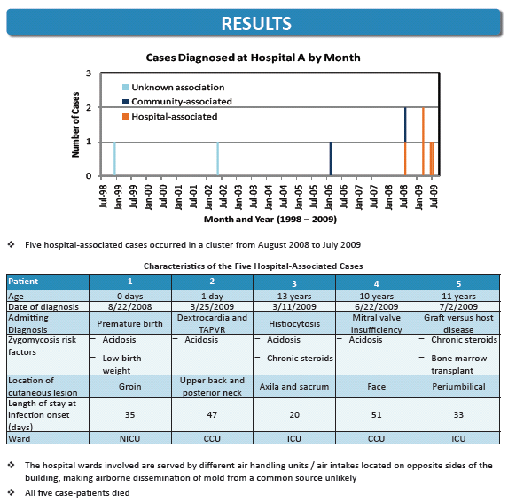
Duffy, J et al. Mucormycosis outbreak associated with hospital linens. Pediatr Infect Dis J 2014;33:472-476.

Slide 13
HACCP: An Assessment Tool for Infection Prevention
HACCP
Hazard Analysis and Critical Control Points
Used extensively in the food service industry to help maintain product quality
Look critically at the laundry facility and the laundry process to identify possible points at which contamination could be introduced, diminishing textile hygienic quality
Helps to identify quality control strategies to prevent contamination of the product

Slide 14
HACCP Analysis for Possible Opportunities for Environmental Contamination
Laundry Contractor A:
Facility was not climate controlled, ventilated with unfiltered outdoor air
Clean HCTs in uncovered bins, exposed to outdoor air before loading into trucks
Bins not lined with plastic that could be tied shut
Hospital A:
Bins with clean HCTs held inside the loading dock receiving area for unspecified time
HCTs placed on shelves in Central storage area
Construction near the loading dock for the last 5 months of the epidemic period
Duffy, J et al. Mucormycosis outbreak associated with hospital linens. Pediatr Infect Dis J 2014;33:472-476.

Slide 15
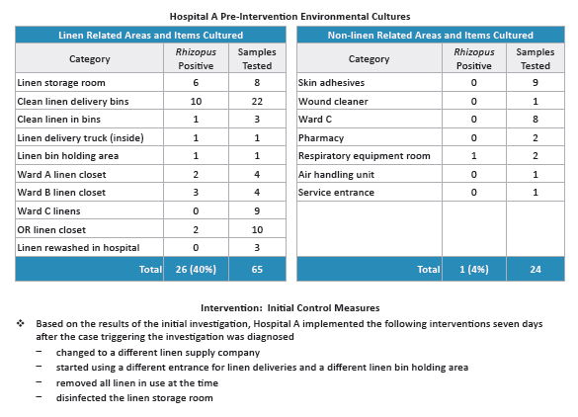
Duffy, J et al. Mucormycosis outbreak associated with hospital linens. Pediatr Infect Dis J 2014;33:472-476.

Slide 16
Conclusions From the Outbreak Investigation
HCTs were the most likely vehicle to have brought Rhizopus in contact with the patients
Genetic subtyping of fungal isolates supported this epidemiologic hypothesis
Contamination of clean HCTs with Rhizopus happened repeatedly, but might have been intermittent
HCTs should be laundered, shipped, and stored in a manner that minimizes exposure to environmental contaminants Duffy, J et al. Mucormycosis outbreak associated with hospital linens. Pediatr Infect Dis J 2014;33:472-476.

Slide 17
Chain of Infection (COI)
Virulent pathogen:
Bacteria, fungi, viruses, parasites, prions
Sufficient number of pathogen:
Infectious dose
Mode of transmission:
Contact, droplet, airborne
Portal of entry:
Broken skin, mucous membrane, respiratory tract, ingestion
Susceptible host:
Age, immunity, medical conditions
Other possible links include reservoir, portal of exit
Notes:
17
17

Slide 18
Questions Raised
Customers are beginning to question the standard
Is hygienically clean good enough? Should we be doing something different?
Should we be incorporating more antimicrobials into the laundry process on a routine basis?
Reports of customers asking laundry operators to do ATP sampling of laundry facility surfaces, cleaned textiles
What does this mean?
Should microbial sampling of clean textiles be implemented?
Use of ATP monitoring of hard surfaces in a HACCP approach

Slide 19
Outbreaks Attributed to Laundered Healthcare Textiles (HCTs)
12 outbreaks in 43 years worldwide attributed to laundered, clean HCTs
U.S. – 3, U.K. – 5, Japan – 3, Singapore – 1
> 353 patients affected
Pathogens identified:
Aspergillus flavus
Bacillus cereus (7/12, 58% of the outbreaks)
MRSA
Streptococcus pyogenes
Rhizopus delemare
Clostridium difficile
Root causes included environmental contamination during transport, dust, improper storage conditions, washing machine malfunctions, inadequate drying, construction dust, recycled water in wash and rinse

Slide 20
Outbreaks Attributed to Soiled Healthcare Textiles (HCTs)
5 outbreaks of occupationally-acquired infections or exposure to hazardous pharmaceuticals in 43 years
148 – 248 workers affected
Pathogens/chemicals identified:
Scabies
Microsporis canis
Salmonella hadar
Hepatitis A virus
Antineoplastic pharmaceuticals
Breach of infection prevention practices identified
Improper handling created aerosols
Failure to use appropriate PPE
Exposures to fecal and other body substance contamination

Slide 21
Four Key Observations: Infections and HCTs
Patient-to-patient transmission of infection has not as yet been reported in association with hygienically-clean HCTs
Laundry processes carried out in accordance with recommended industry operational specifications for water quality, cycle parameters, proper laundry chemical selection and use, and proper equipment maintenance
Outbreaks involve environmental contamination and failure to maintain HCT cleanliness after washing and drying
Root causes identified and corrected
Problems with storage are most frequently identified
Occupational infection or chemical exposure involve failure to use PPE and follow standard infection prevention procedures when handling soiled HCTs
Rare events, but is underreporting at work here?

Slide 22
Biodegradation of Textiles
Textiles, especially those containing natural fibers, are readily attacked by microbes
Some processing and finishing agents (e.g., dyes) are also vulnerable
Over time loss of strength, discoloration, change of appearance, odor
Fungi are the most important microbial class associated with biodegradation
Three things necessary for fungal growth:
Food source (e.g., cellulose)
Moisture
Favorable environmental conditions (e.g., temperature, humidity)
Szostak-Kotowa J. Biodeterioration of textiles. Int Biodeterioration Biodegradation 2004; 53: 165-170.

Slide 23
Biodegradation of Textiles
There are two main ways to control and/or prevent biodegradation of HCTs:
Control of environmental and physical conditions of clean HCTs, or
Use antimicrobial treatments
Szostak-Kotowa J. Biodeterioration of textiles. Int Biodeterioration Biodegradation 2004; 53: 165-170.

Slide 24
Laundry Holding/Transport / Storage
Controlling the environmental conditions is considered to be the best means of protecting textiles
Clean HCTs touch clean surfaces
That includes clean hands and worker uniforms
HCTs should be as dry as practical prior to bundling or packaging
Unwrapped HCTs should be stored and transported using strategies to prevent inadvertent contamination by soil or body substances
Covered containment, either bins, carts, or shelves
Notes:
24

Slide 25
Laundry Transport / Storage
Separate clean textiles from contaminated textiles when transporting in a vehicle
Physical barriers and/or space separation
Clean, unwrapped textiles can be stored in a clean location for short periods of time
Unwrapped textiles should be stored so to prevent inadvertent contamination by soil or body substances
This is the part of the overall process that is most vulnerable to outside contamination

Slide 26
Climate Control via Ventilation: Key Engineering Specifications
Clean HCT Storage:
Temperature: 72 - 78° F
Relative humidity (RH): NR*
Air changes/hour (ACH): 2
Airflow direction: Positive
Surgical Pack Room Storage:
Temperature: < 78° F
Relative humidity: < 70%
Air changes/hour (ACH): 2
Airflow direction: Positive
Hold/Staging at the Laundry:
?
Why this is important:
Fungi grow rapidly at RH > 80%
Keeping the ventilation parameters consistent helps to minimize microbial growth
Trapped excess moisture due to packaging may create opportunities for growth when RH fluctuates
May cause pockets of high humidity within the HCT bundle that may be RH >80%
This increase can be as much as 20% over ambient humidity
Higher temperatures encourage fungal growth
FGI. Guidelines for Design & Construction of Hospitals & Outpatient Facilities. 2014 Ed. FGI, Dallas, TX
ANSI/ASHRAE/ASHE Standard 170-2013. Ventilation of Health Care Facilities. 2013. ASHRAE, Atlanta, GA
HLAC Accreditation Standards for Processing Reusable Textiles for Use in Healthcare Facilities, 2011. Plainfield, IL
ANSI/AAMI ST65:2008 (R2013). Processing of Reusable Surgical Textiles for Use in Healthcare Facilities, 2009. Arlington, VA
Montegut D, Indictor N, Koestler RJ. Fungal deterioration of cellulosic textiles: a review. Int Biodeterioration 1991; 28:209-226

Slide 27
Laundry Holding/Transport / Storage: Area Cleanliness and Dust Control
Evaluate HCT storage area in the hospital for ways to minimize dust intrusion
Self-closing doors help to maintain positive pressurization
Location of HCT storage room relative to the loading dock and other services
Amount of traffic through the room
Establish hospital policy for regular cleaning and disinfection of the room’s storage surfaces
Where are clean HCTs unloaded in the hospital?
Visual inspection of outermost bundle surfaces

Slide 28
Antimicrobial Chemical Treatments
Different approaches to adding chemical treatments:
Impregnation of the fiber (e.g., copper)
Treatment of the fabric before final garment/item construction
Treatment of the garment/item (e.g., add/recharge an antimicrobial residual)
Function of the antimicrobial treatment
Protection of the fabric/garment to maintain textile function
Hygienic treatment
Antimicrobial treatments for hygienic purposes:
Low toxicity to humans, minimize skin irritation
Should not leach from the fabric (e.g., when moistened by sweat)
Should not interfere with proper function of the textile
Low cost, withstand repeated washings
Szostak-Kotowa J. Bioterioration of textiles. Int Biodeterioration Biodegradation. 2004; 53:165-170.

Slide 29
A Short List of Antimicrobial Chemicals for Textiles
Quaternary ammonium compounds plus acrylic copolymer fluid repellent
Chitosans and chitooligosaccharides
Quaternary ammonium compounds plus organosilane (forming a silicon-nitrogen carbon polymer)
Hydrophobic N-alkyl plus benzophenone containing polyethylenimine
Silver (Ag) nanoparticles
Copper (Cu) nanoparticles
Gold (Au) nanoparticles
Siloxane sulfipropylbetaine (SSPB)
Titanium dioxide (TiO₂)
Ag nanocomposite with TiO₂ and citric acid as a crosslinker
Triclosan

Slide 30
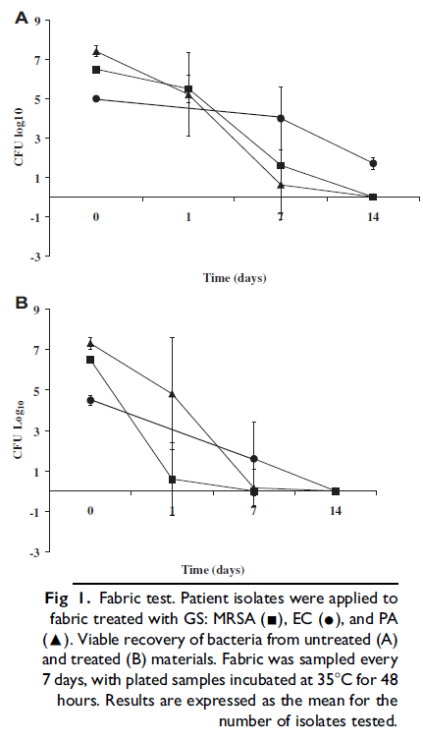
Treatment of Fabric with Quaternary Ammonium/Organo-silane During the Wash Process
From: Baxa D, et al. Am J Infect Control 2011; 39: 483-7

Slide 31
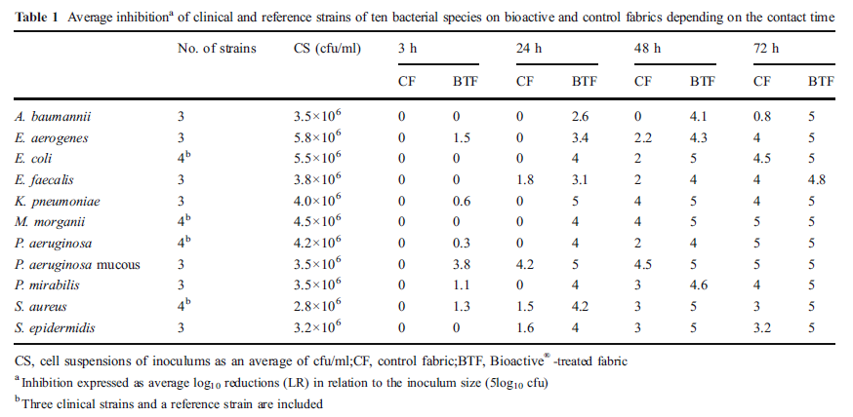
Log Reductions on Untreated Fabric (Control) and Silver Treated Fabric
Mariscal A, et al. Eur J Clin Microbiol Infect Dis 2011; 30: 227-32

Slide 32
Dermatophyte Susceptibility to Selected Antimicrobial Textiles
Growth inhibition of the Trichophyton species assessed as follows:
0 = no growth visible to the naked eye
1 = no growth visible to the naked eye, but visible under the microscope
2 = 25% growth compared to the negative control
3 = 50% growth compared to the negative control
4 = > 50% growth compared to the negative control
5 = growth comparable to the negative control
Inhibition of Candida albicans shown as log₁₀ reductions. Standard deviation shown in parentheses.
Key: DDAC = didecyldimethylammonium chloride
PHMB = poly-hexamethylenbiguanide
AgCl = silver chloride
Cu = copper
From: Hammer TR, et al. Dermatophyte susceptibility varies toward antimicrobial textiles. Mycoses 2012; 55: 344-351.

Slide 33
Chitosans and Chitooligosaccharides Antimicrobial Activity - Candida albicans
Figure 3. Effects (Average + Standard Deviation) of Different MW Chitosans and COS Upon Candida albicans
Panel A: 1 hour exposure Panel B: 4 hour exposure
Black bars: incubated in Müller-Hinton broth White bars: incubated in cotton fabric
From: Fernandes JC et al. J Microbiol Biotechnol 2010; 20: 311-318.

Slide 34
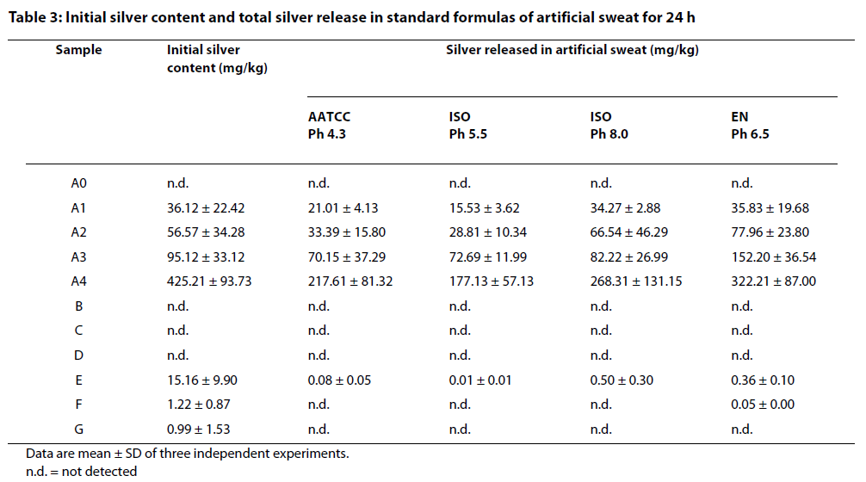
Effect of Artificial Sweat on Silver Leaching from Treated Fabrics
From: Kulthong K, et al. Part Fib Toxicol 2010; 7: 8-16

Slide 35
EPA: Treated Article Exemption
According to FIFRA, “treated articles” refer to articles or products that are treated with an antimicrobial pesticide to protect the article or product themselves.
Treated Articles Exemption:
An article or substance treated with or containing a pesticide to protect the article or substance, if the pesticide is registered for such use
The Treated Articles Exemption is available only for the protection of the product and not for public health uses
Odor control, prevention of deterioration
Products bearing a public health claim must be registered in addition to the registration of the antimicrobial pesticide
http://www.epa.gov/pesticides/factsheets/treatart.htm

Slide 36
Quality Issues for Consideration
Conduct risk-benefit analysis
Potential toxicologic and allergic side effects
Does exposure alter the microbial ecology of the skin, skin integrity?
Potential selection for resistant microorganisms with long-term use
Potential environmental issues
Biodegradability, toxicity to plants, marine life
Persistence of the antimicrobial effect
Is recharge needed, or is another treatment necessary?
Can consistent adherence to existing infection prevention practices achieve similar results?
Need to document an impact on healthcare-associated infection (HAI) rates while using antimicrobial treatment of textiles

Slide 37
Resources for More Information
CDC:
Guidelines for Environmental Infection Control in Health-Care Facilities: http://www.cdc.gov/hicpac/pdf/guidelines/eic_in_HCF_03.pdf
Guidelines for Disinfection and Sterilization in Healthcare Facilities: http://www.cdc.gov/hicpac/pdf/guidelines/Disinfection_Nov_2008.pdf
HAI Prevention Tool Kit: http://www.cdc.gov/HAI/prevent/prevention_tools.html
Options for Evaluating Environmental Cleaning
Appendices to the Conceptual Program Model for Environmental Evaluation
CDC Environmental Checklist for Monitoring Terminal Cleaning
CDC Environmental Checklist
Environmental Cleaning Evaluation Worksheet (Excel format)
CDI Prevention Tool Kit
EPA:
Selected EPA-Registered Disinfectants: http://www.epa.gov/oppad001/chemregindex.htm
Pesticide Product Label System: http://www.epa.gov/pesticides/pestlabels/index.htm

Slide 38
Thank You!
“Protect patients, protect healthcare personnel, and promote safety, quality, and value in the healthcare delivery system.”
The findings and conclusions in this report are those of the authors and do not necessarily represent the official position of the Centers for Disease Control and Prevention.
National Center for Emerging and Zoonotic Infectious Diseases

Slide 39
October 23 INFECTION PREVENTION IN OUTPATIENT ONCOLOGY SETTINGS Dr. Alice Guh, Division of Healthcare Quality Promotion, Centers for Disease Control and Prevention November 5 (Free WHO Teleclass – Europe) PUBLIC REPORTING AND DISCLOSURE OF HAI RATES:
POSITIVE IMPACT OR CONFUSION? Dr. Michael Borg, St. Luke’s Hospital, Malta Sponsored by the World Health Organization
November 6 (Free Teleclass) CBIC IS MAKING THE CERTIFICATION PROCESS WORK FOR ALL ! Craig H Gilliam and Lita Jo Henman, Certification Board of Infection Control November 13 EMERGING RESPIRATORY VIRUSES: ARE HEALTHCARE WORKERS PROTECTED? Dr. Virginia Roth, The Ottawa Hospital

