Slide 1

How do we imagine our future?
The Infection Prevention Crystal Ball Initiative
Prof Dr Hugo Sax | Bern University Hospital and University of Bern | sax.health.design | Switzerland
Hosted by Martin Kiernan martin@webbertraining.com
www.webbertraining.com
April 28, 2022

Slide 2
        “It is difficult to make predictions, especially about the future.“
Danish Parliament 1937-1938

Slide 3

Content
Why care about the future?
Crystal Ball Initiative
Futures Studies
First survey
Looking ahead

Slide 4
Why care about the future?

Slide 5
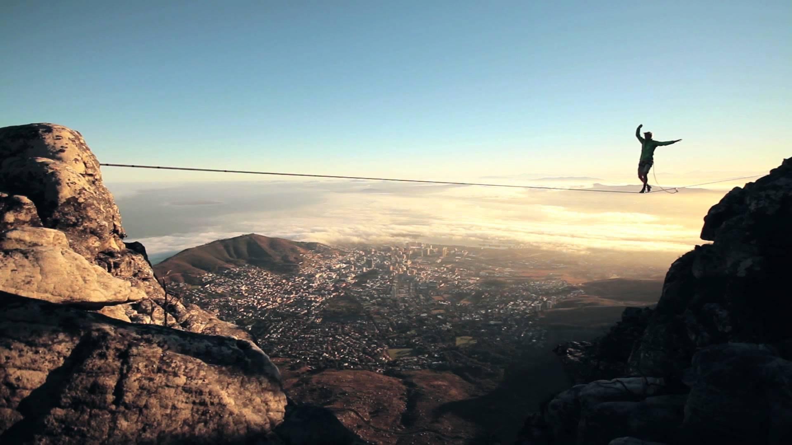
5

Slide 6
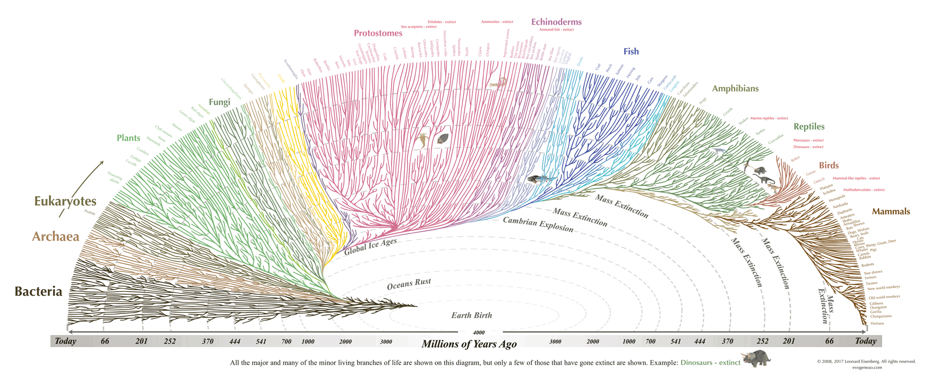

Slide 7
Humans

Slide 8
The IPC Crystal Ball Initiative

Slide 9
Vision?

Slide 10
Used future.

Slide 11
First round of an international crystal ball ‘exercise’ in 2019.

Slide 12
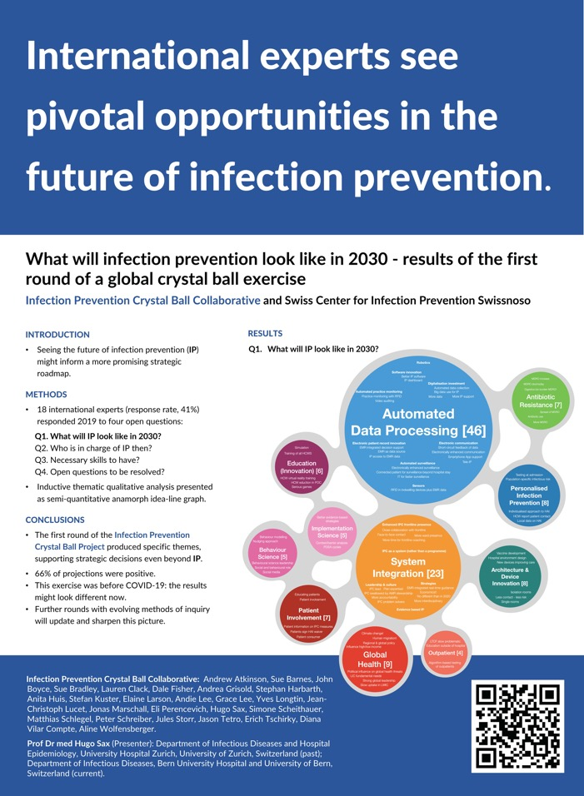
Collaborative 2019 -
Andrew Atkinson, Sue Barnes, John Boyce, Sue Bradley, Lauren Clack, Dale Fisher, Andrea Grisold, Stephan Harbarth, Anita Huis, Stefan Kuster, Elaine Larson, Andie Lee, Grace Lee, Yves Longtin, Jean-Christoph Lucet, Jonas Marschall, Eli Perencevich, Hugo Sax, Simone Scheithauer, Matthias Schlegel, Peter Schreiber, Jules Storr, Jason Tetro, Erich Tschirky, Diana Vilar Compte, Aline Wolfensberger.

Slide 13

“Futures Studies”

Slide 14
Futures Studies - Birth of a science
Inayatullah 2002, Masini 1983
conservative
Trying to predict the future as it will be.
Strategic planning to control the near future.
“The future is influenced by how one anticipates the future.”
The move from the future to several alternative futures.
Association of Professional Futurists - founded in 2002.
Evolution
disruptive

Slide 15
“Futures studies creates alternative futures by making basic assumptions problematic.
Through questioning the future, emerging issues analysis, and scenarios, the intention is to move out of the present and create the possibility for new futures.”
Sohail Inayatullah

Slide 16
Horizon 1
Horizon 2
Horizon 3
present
5-20 years
20-30 years

Slide 17
Policy making
Futures studies
Ways to include the possibility of discontinuous change, of forecasting trends before they emerge?
Notes:
Interest in finding ways to include the possibility of discontinuous change, of forecasting trends before they emerge, has been a natural progression in the evolution of the policy sciences.
is longer-term, from five to fifty years (even 1 000 years) instead of one to five years;
links horizon three (20–30 years) with horizon two (5–20) and horizon one (the present to five years);
is committed to authentic alternative futures where each scenario is fundamentally different from the other. When planners and economic forecasters use scenarios, they are often mere deviations from each other;
is committed to multiple interpretations of reality (legitimating the role of the unconscious, of mythology, of the spiritual, for example, instead of only views of reality for which empirical data exists);
is more participatory, in that it attempts to include all types of stakeholders instead of only powerbrokers;
consciously uses different ways of knowing, from drama or postcards from the future to various games (for example, the Sarkar game [Hayward and Voros 2006], or the CLA game);
is more concerned with the futures process, which is as important as the elegance of the strategic plan itself, if not more so;
although a technique, is also very much action-oriented, more concerned with creating the future than simply predicting it; and
is as much an academic field as it is a participatory social movement.

Slide 18
Futures Studies - “Six pillars”
Inayatullah 2008
Commonly used techniques
Mapping the future “Futures triangle”
Anticipating the future “Emerging issues analysis”
Timing the future “Micro-, meso-, and macro-history”
Deepening the future “Causal layers analysis” (CLA)
Creating alternatives “Scenario planning”
Transforming the future “Visioning”, “Backcasting”
Notes:
Futures research is done in workshops using certain techniques.

Slide 19
1. Mapping the Future

Slide 20
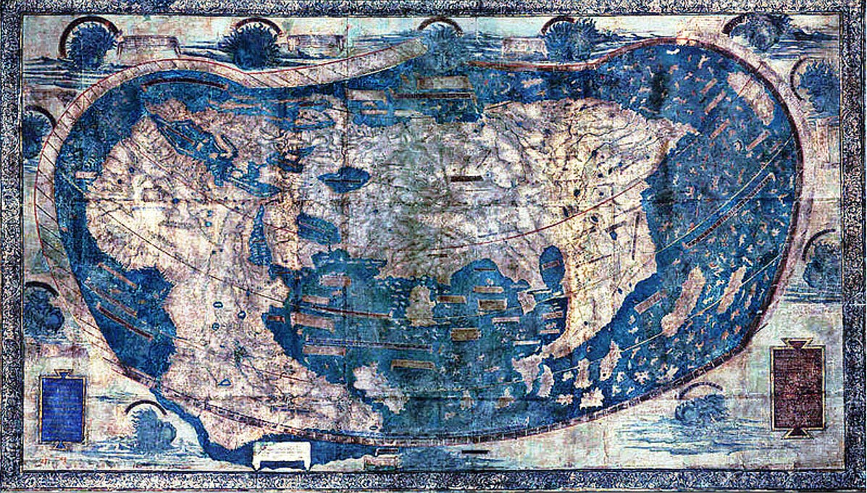
https://news.yale.edu/2015/06/11/hidden-secrets-yale-s-1491-world-map-revealed-multispectral-imaging
Henricus Martellus, Florence, Italy, late 15th century
Mapping | Anticipation | Timing | Deepening | Alternatives | Transforming
Notes:
https://news.yale.edu/2015/06/11/hidden-secrets-yale-s-1491-world-map-revealed-multispectral-imaging
Henricus Martellus, a German cartographer working in Florence in the late 15th century, produced a highly detailed map of the known world. According to experts, there is strong evidence that Christopher Columbus studied this map and that it influenced his thinking before his fateful voyage.

Slide 21
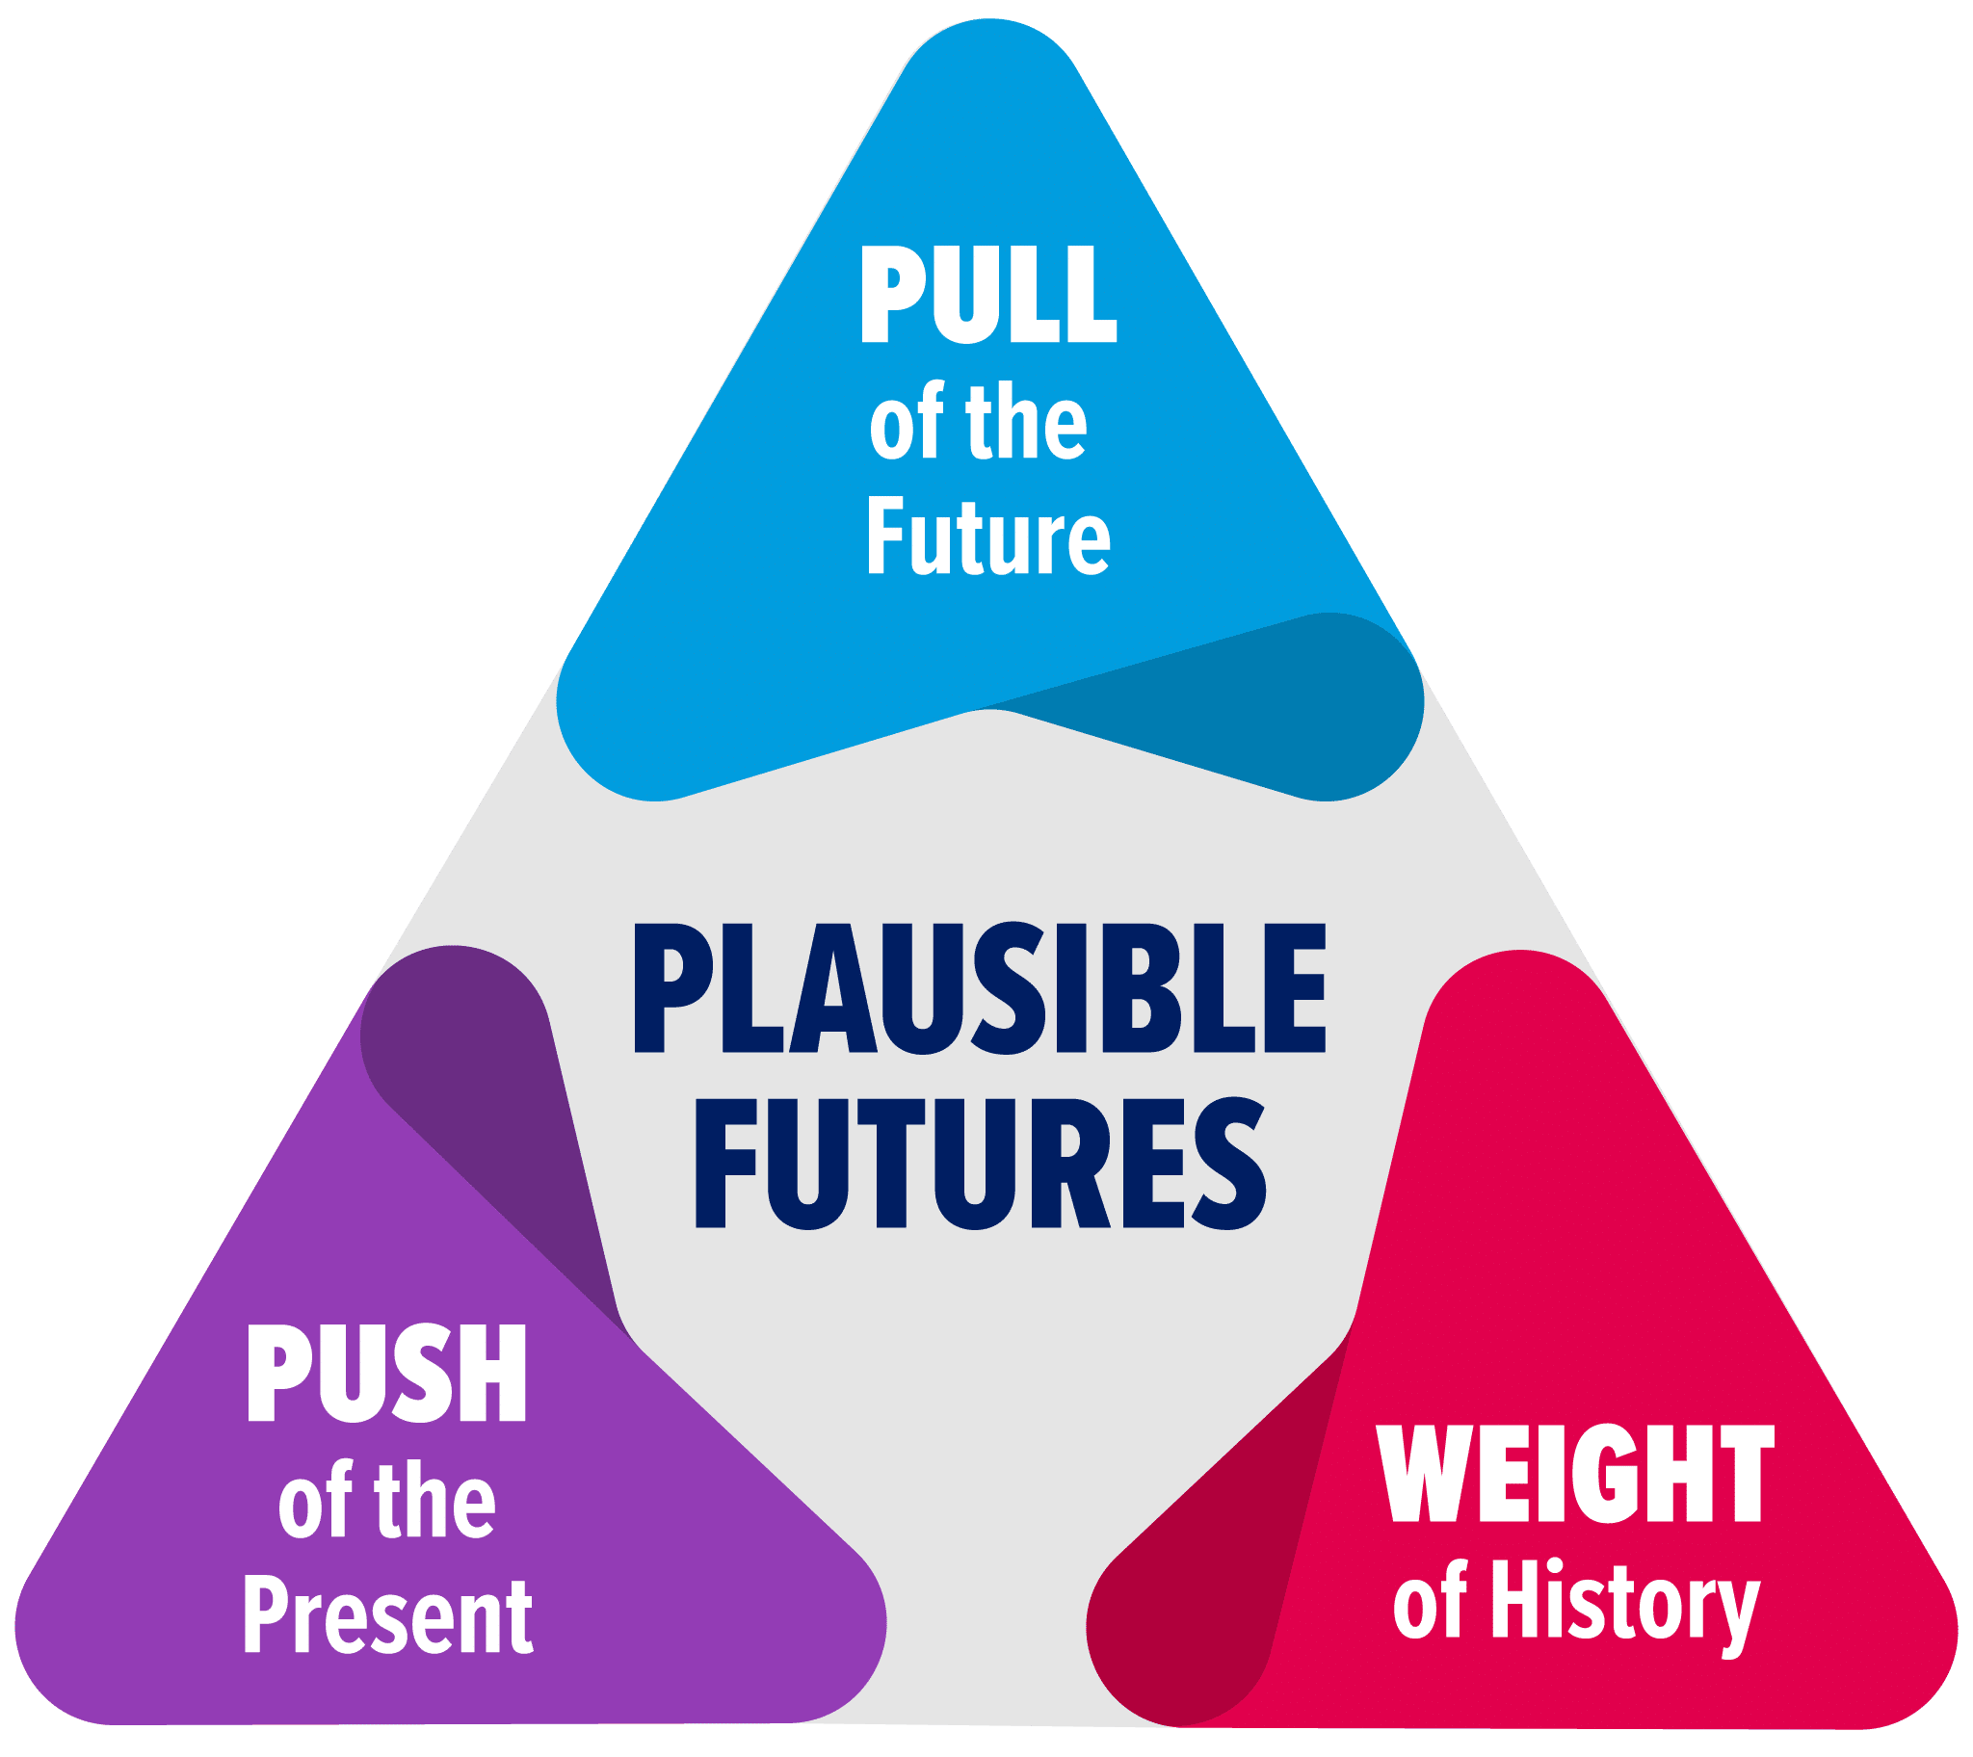
Futures triangle
What drivers of change are pulling us towards particular futures?
What are the compelling images of the future, those we can’t overlook?
Are there competing images of the future?
What drivers of change are pushing us towards particular futures?
What quantitative drivers of change are changing the future?
What is happening now? What is popular now?
What is holding us back or getting in our way?
What are the barriers to change?
What are the deep structures that resist change?
Maria Crabtree, https://knowledgeworks.org/resources/futures-thinking-now-drivers-change-futures-triangle/
Mapping | Anticipation | Timing | Deepening | Alternatives | Transforming
Notes:
https://thesystemsthinker.com/learning-about-connection-circles/

Slide 22
2. Anticipating the Future

Slide 23
Emerging issues analysis
Problems / issues
Trends
Emergency issues / weak signals
Unknown
Known
Mapping | Anticipation | Timing | Deepening | Alternatives | Transforming

Slide 24
3. Timing the future

Slide 25
Emerging issues analysis
The future is linear
The future is cyclical
The future is spiral
The future is disruptive
The future displays hinge periods
Mapping | Anticipation | Timing | Deepening | Alternatives | Transforming

Slide 26
4. Deepening the Future

Slide 27

Causal Layered Analysis (CLA)
Litany
Now
IPC is not well integrated.
Systemic cause
Years
Medicine is organ-oriented.
Worldview
Decennials
Medicine fixes sick human beings.
Myth / metaphor
Centuries
Causality is linear. Newton.
Mapping | Anticipation | Timing | Deepening | Alternatives | Transforming
Mapping ● Anticipation ● Timing ● Deepening ● Alternatives ● Transforming

Slide 28
5. Creating Alternatives

Slide 29
Scenario planning
Double variable method
Preferred
Centralised
Disowned
Hostile politics
No political inference
Scenario models
Integrated
Decentralised
Outlier
Mapping | Anticipation | Timing | Deepening | Alternatives | Transforming

Slide 30
6. Transforming the Future

Slide 31
Visualising
What happens when you wake up?
What does your home look like?
Who do you live with?
Do you go to work?
If yes, what does work look like?
What do you eat?
What can you see, smell, hear, touch, taste?
Mapping | Anticipation | Timing | Deepening | Alternatives | Transforming

Slide 32
Backcasting
now
Forecasting
Presence
Future
“now”
Backcasting
Presence
Future
Mapping | Anticipation | Timing | Deepening | Alternatives | Transforming

Slide 33

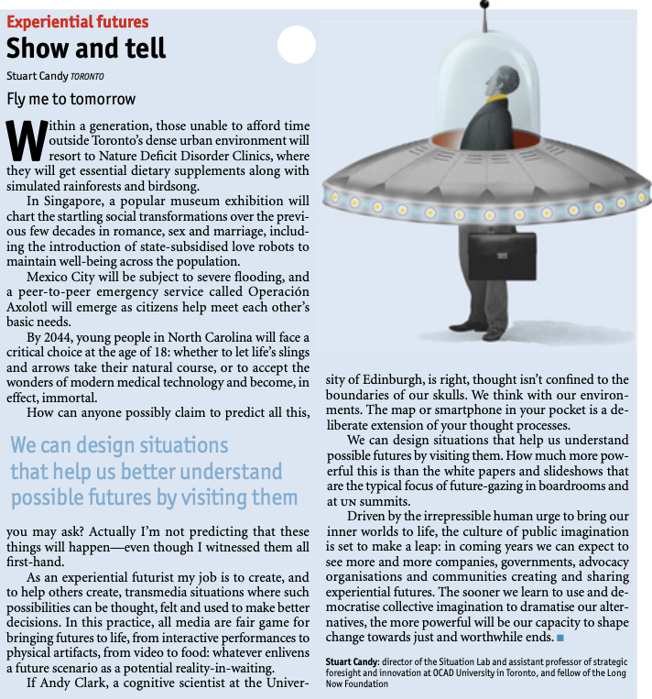
“We can design situations
that help us better understand
possible futures by visiting them.”
Stuart Candy, The Economist, November 2015
Mapping | Anticipation | Timing | Deepening | Alternatives | Transforming

Slide 34

First crystal ball survey

Slide 35
Scopes
Harvest the vision of senior infection prevention experts around the globe
Extract possible and desired futures
Invite participants as authors by contributing to next methods and evolution
Establish a platform

Slide 36
Method
Online self-administered survey of open-ended questions
Purposively chosen participants (innovative style) according to web, conference, and science publication contributions
Four main questions
Two-step inductive qualitative analysis:
per-case: codes —> themes
cross-case: leitmotifs

Slide 37
Questions
What will Infection Prevention and Control (IPC) look like in 2030?
In whose hands will IPC in healthcare settings lay in 2030? Who will be responsible?
What skills and knowledge will be necessary to execute IPC in healthcare settings successfully in 2030?
What are the most burning (research) questions regarding IPC in healthcare settings that should/will be answered by 2030?

Slide 38
Participants
18 of 44 (41%) responded
Profession: physicians (14), nurses (3), manager (1)
Geography: USA (6), Canada (2), Switzerland (2), Australia (1), France (1), Germany (1), Mexico (1), The Netherlands (1), Singapore (1), United Kingdom (1)

Slide 39
Results
Question 1 - Mood analysis

Slide 40
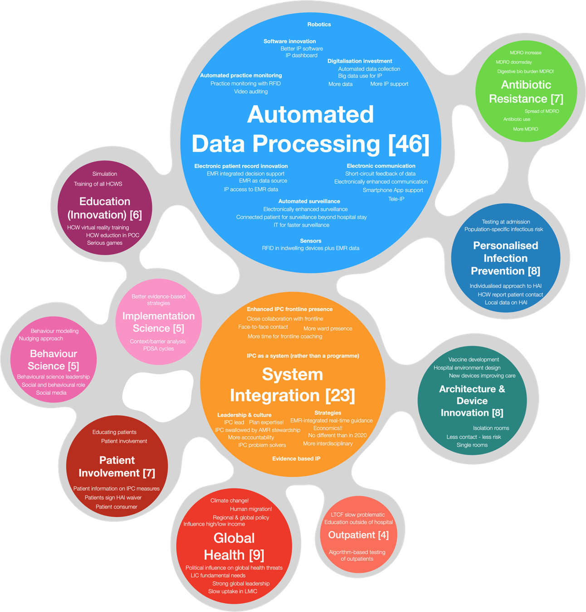
Results
Question 1 - Themes

Slide 41
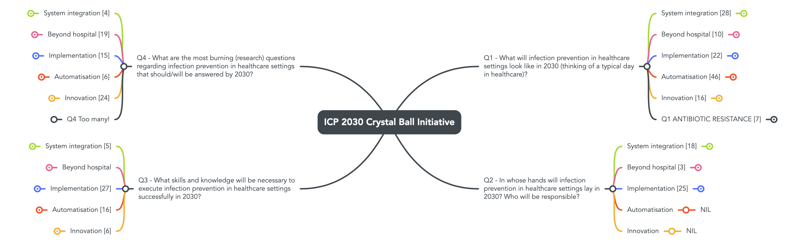

Slide 42
Results
“Leitmotifs” - cross-case analysis
“System integration”
“Beyond the hospital”
“Implementation”
“Automatisation - digitalisation”
“Innovation”
Quote: “I think the infection prevention and control/hospital epidemiology field will need to rethink the skill sets needed on the team to optimise success of programs.”
Quote: “IPC does not yet “own” the LMIC space.”
Quote: “How are we prepared to deal with public health and national or international emergencies?”
Quote: “Quality/patient safety departments may gain importance in hierarchy, but the need for special expertise in epidemiology, surveillance, prevention measures and implementation science, and outbreak investigations will persist.”
Quote: “Familiarity and expertise in data management, statistical analysis of data, epidemiological principles, use of artificial intelligence, methods for recognition and investigation of clusters or outbreaks of healthcare-associated infections, knowledge of antimicrobial resistance patterns of pathogens.”
Quote: “What is the role of the microbiome and immunologic host factors in risk of HAI and how can these be 'manipulated' or included in prevention of infections.”

Slide 43
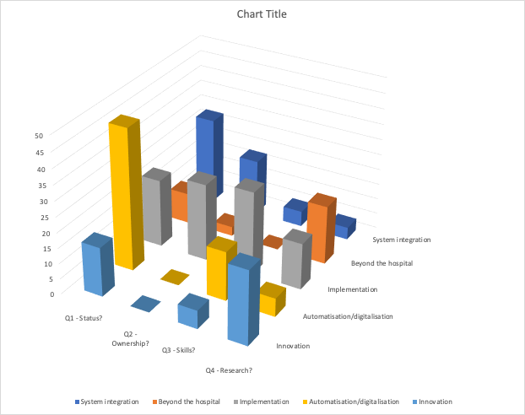
Results
Semiquantitative Questions x Leitmotifs

Slide 44
Conclusions
The survey gave rich picture(s) of the potential future
Most answers corresponded to ‘desired futures’ (positive mood);
except MDRO and take-over by administration / QI
Surprise: “System integration” and “Beyond the hospital”
Potential benefit of using a more structured, experiential “Futures” approach to create multiple futures?

Slide 45
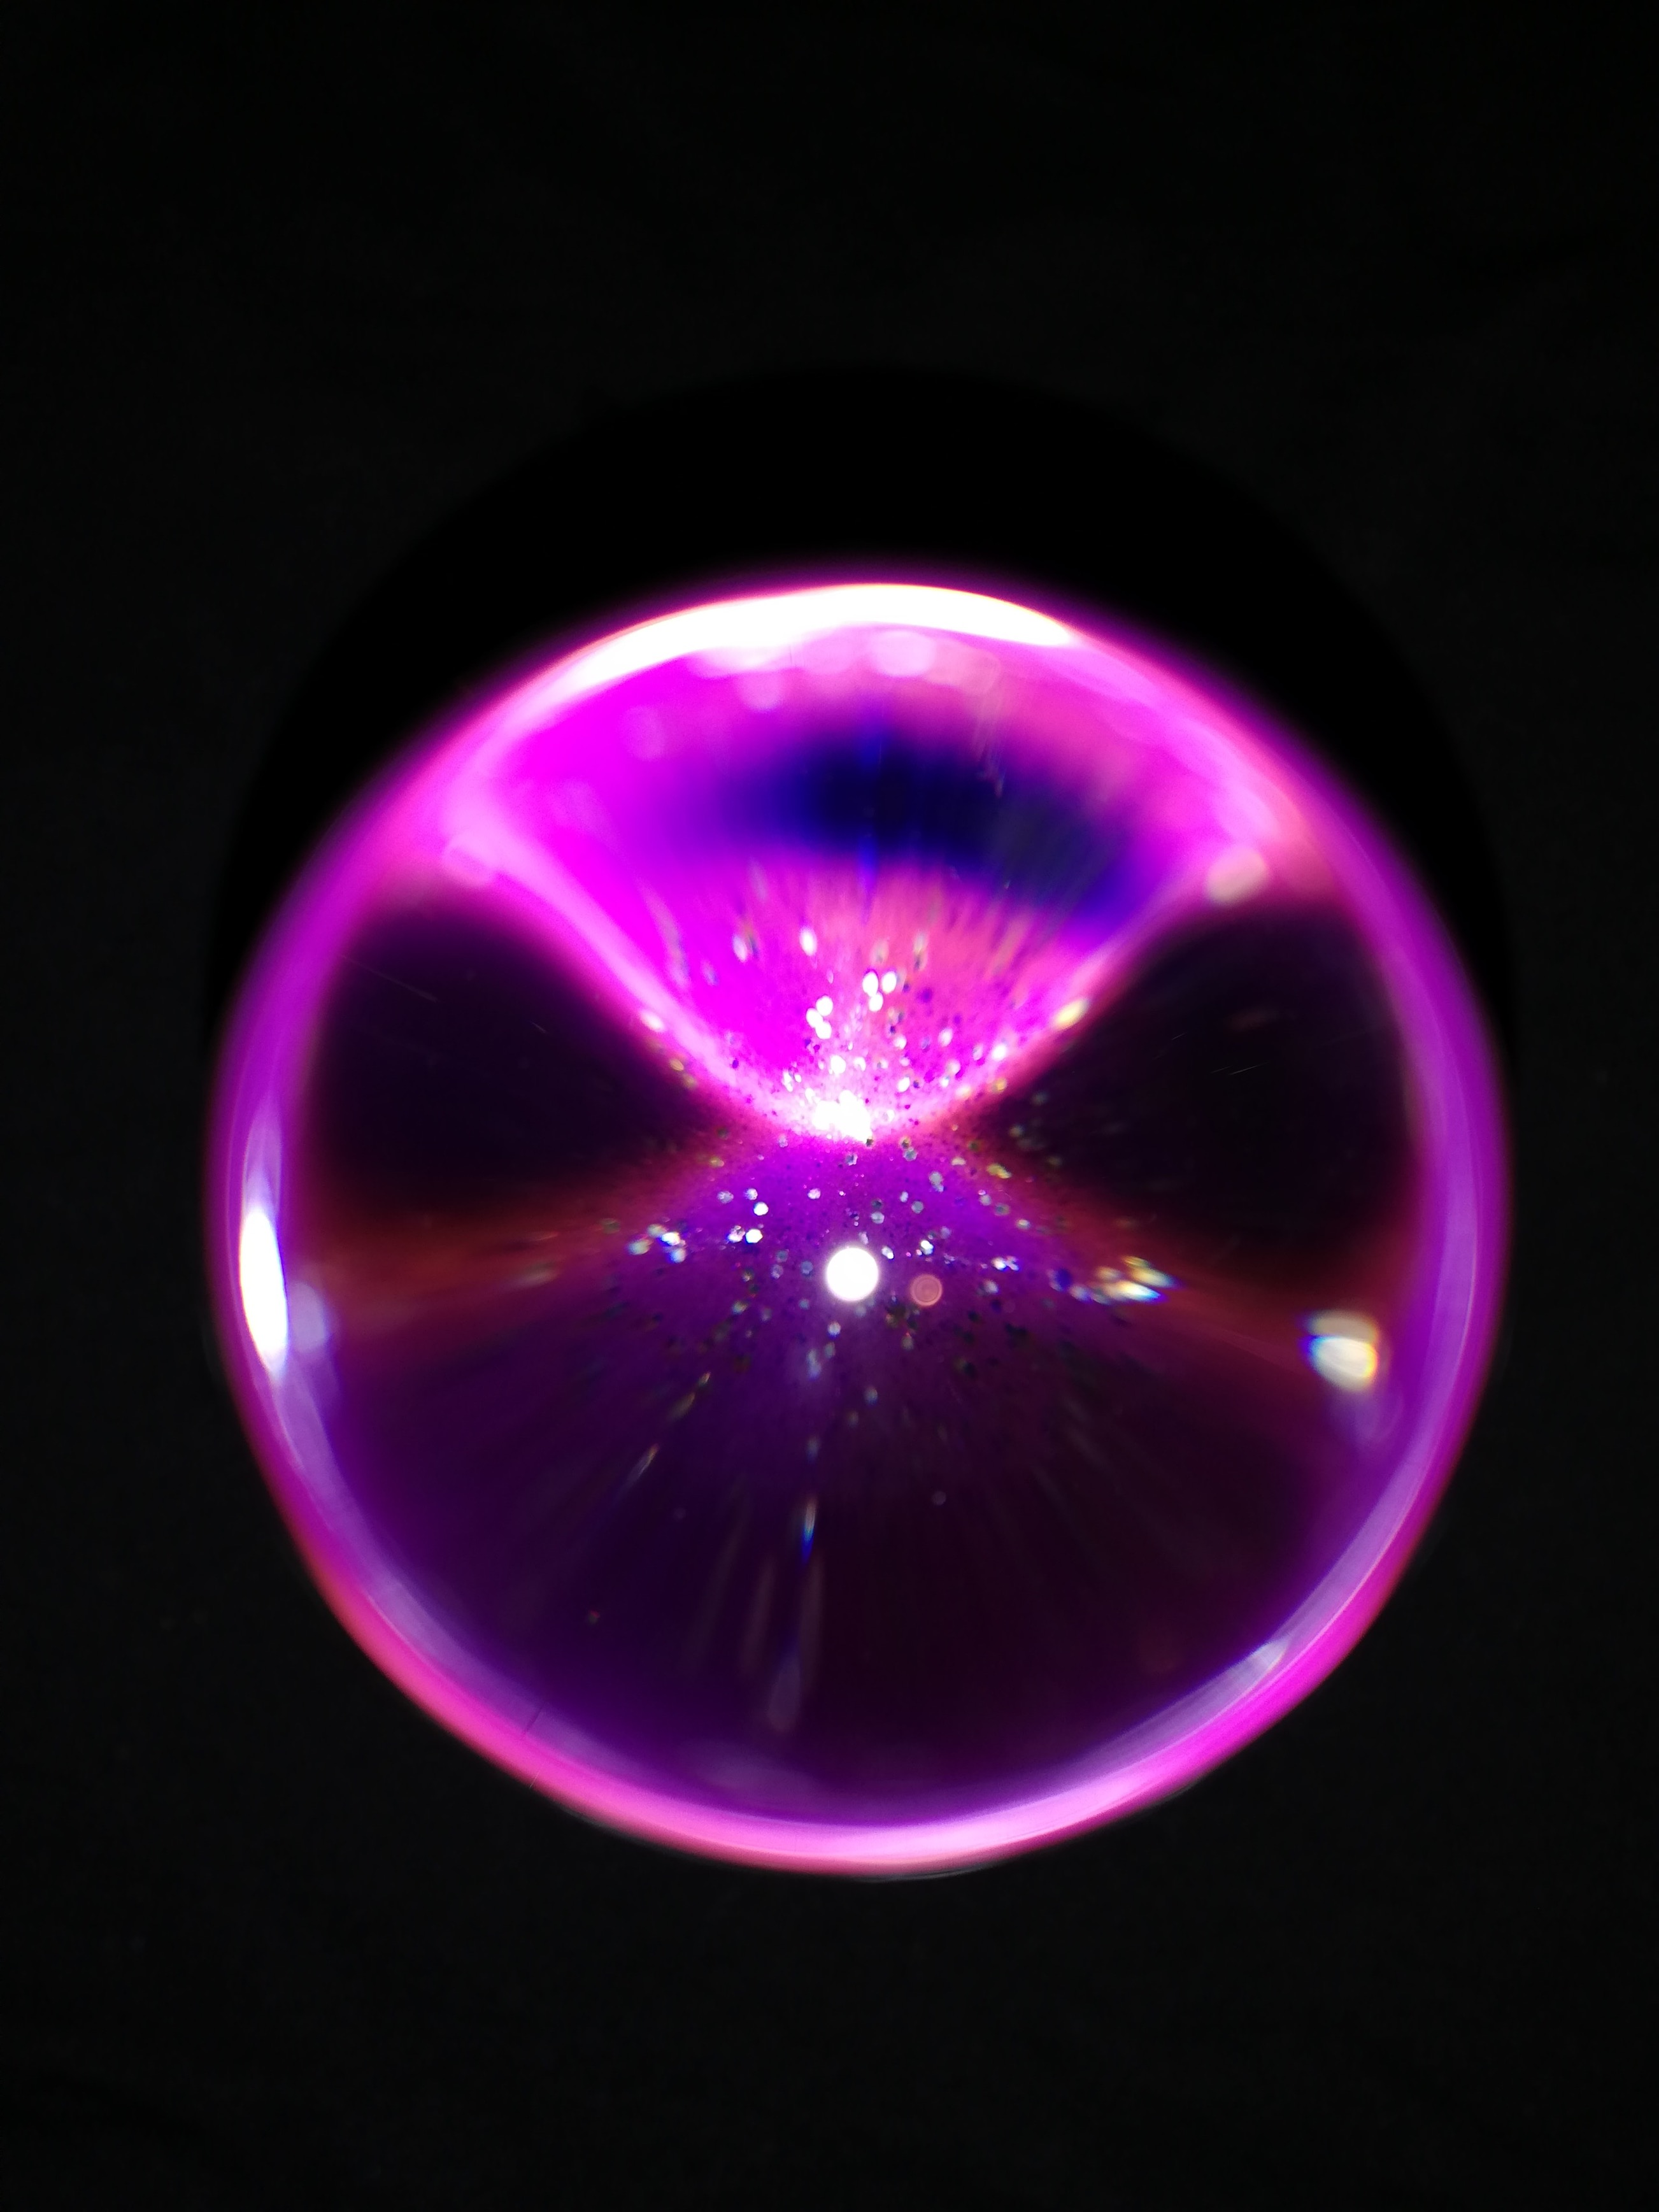
Looking ahead

Slide 46
Potential futures :)
Deepening by interviews?
IPC function in healthcare institutions?
Futures workshop?
Collaboration with other think tanks?

Slide 47

Infection Prevention Crystal Ball Initiative
Would you like to participate?
https://www.saxhealthdesign.com/crystal-ball

Slide 48
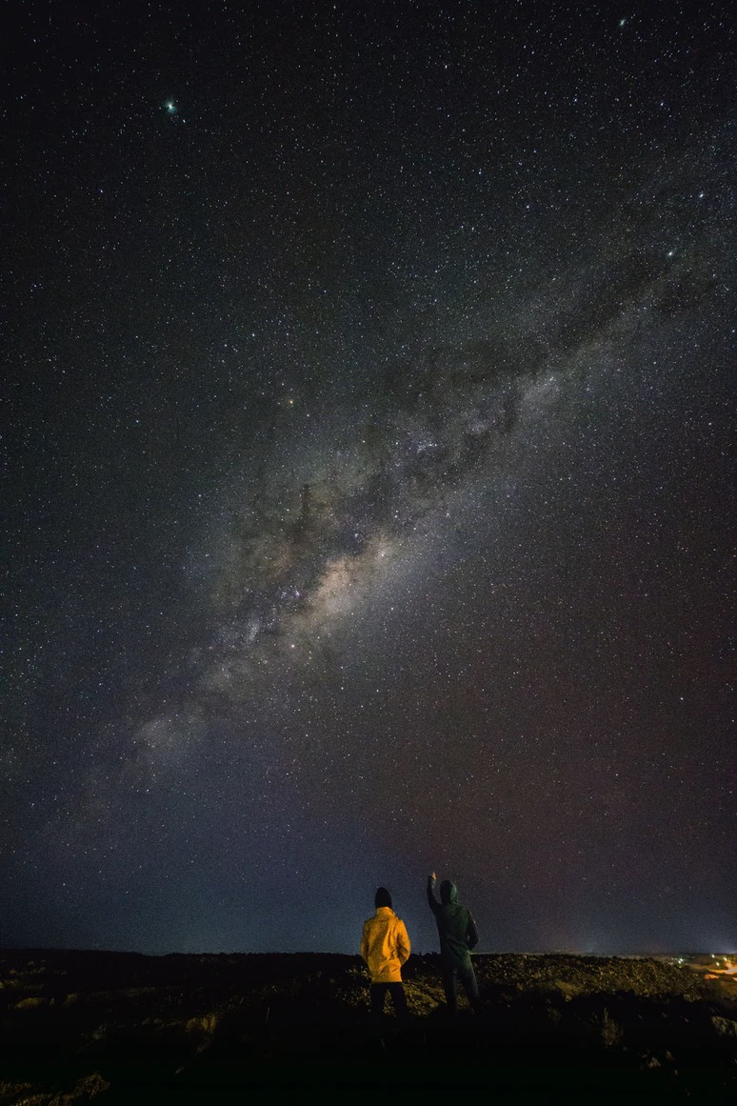
        “We will have the future we deserve.”
Albert Einstein

Slide 49
