Slide 1
How to Become Certified Without Becoming Certifiable
Susan Cooper MLT CIC
Team Lead- IPAC Regional Support
Public Health Ontario
Hosted by Paul Webber paul@webbertraining.com
www.webbertraining.com
March 16, 2017

Slide 2
Objectives
Discuss why certification is important
Review the practice analysis
Review eligibility requirements for certification
Discuss how to certify & when to re-certify
Review the resources recommended to help prepare for certification
Introduce you to the certification process
Describe recent changes in the exam process

Slide 3
Why Certify?
Recognized internationally, Certification valid for five years
Allows successful candidate to use “CIC” designation
The only standardized measurement of essential knowledge, skills, and abilities expected of infection prevention and control professionals
Provides an objective measure of competence
Recognized by APIC and IPAC-Canada as the standard for certification in infection control
Note: CBIC exam is only way to get CIC . No other course or program qualifies you to use the designation CIC

Slide 4
Independent organization, not connected to APIC, IPAC-Canada
Multidisciplinary, international board of Directors
Develops and administers the certification examination process for infection control professionals
CBIC’s certification program is accredited by the National Commission for Certifying Agencies (NCCA)

Slide 6
2014 Practise Analysis
Required every 4-5 yrs. by National Commission for Certifying Agencies
Identifies tasks and knowledge important to the current work performed by ICPs
Data collected guides development of test specifications and future exams
Survey distributed to membership and organizations

Slide 7
Practice Analysis
Most recent survey completed in June 2014
Task force reviewed current domains, tasks, knowledge and developed survey
Survey distributed to members and organizations
2819 responses used to develop new content outline and test content

Slide 8
Certification
Initial certification:
Must complete the proctored computer based examination (CBT)
Administered via computer in Prometric test centers throughout the United States , Canada and other international sites
Certification remains valid for 5 years
French version of exam now available (2016)

Slide 9
Re- Certification
Required every 5 years
Computer based exam not available for recertification (2016)
SARE not available in French until 2021
Recertification Exam ( formerly called SARE)
similar in content to the Computer-Based Test -150 multiple choice items; 15 questions under evaluation, not included in scoring
practice oriented and challenging questions geared to ICP with at minimum, five (5) to seven (7) years experience in infection prevention and control
Individuals who are currently certified are automatically eligible for re-certification every 5 years

Slide 10
Are You Eligible for CIC?
Eligibility Requirements
You are accountable for the infection prevention and control activities/program in your setting and this is reflected in your current job description.
AND
You have a post-secondary degree (e.g. associates’ (diploma in Canada )or baccalaureate degree ). AND
You have had sufficient experience (recommended: two years) in infection prevention and control which includes all three (3) of the following: 1. Identification of infectious disease processes 2. Surveillance and epidemiologic investigation 3. Preventing & controlling the transmission of infectious agents

Slide 11
Are You Eligible for CIC?
And
at least two (2) of the remaining five (5) components: 1. Employee/occupational health 2. Management and communication 3. Education and research 4. Environment of care 5. Cleaning, sterilization, disinfection, and asepsis

Slide 12
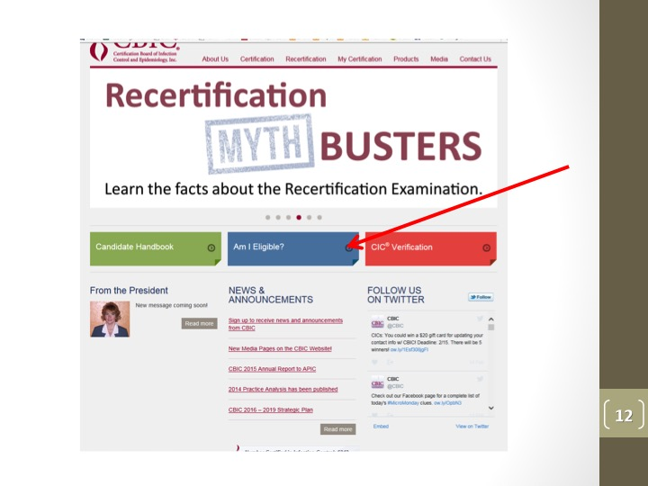

Slide 13
Exam Registration
Application process on-line or on paper application
Cost $350 US ( SARE $325 US)
Supporting documentation required
Proof of diploma/degree or transcripts
Supervisor signed attestation
Current job description
CV/resume, , if self employed 3 references
After your application has been approved, you have 90 days to schedule and take the exam
Complete instructions in candidate handbook

Slide 15
Taking the test
Computerized exam
3 hours to write-receive a “pass” or “fail” notice as soon as exam is finished
“pass” may use CIC designation- valid for 5 yrs.
“fail” – can re-write up to 4 times per year (every 90 days)
Recertification Exam
can be ordered as early as January, deadline to order Dec 1st
Can access as often as desired until submitted
Must be submitted by 11:59pm on Dec 30 of recertifying year.
Immediate “pass or fail”- detailed results sent via mail in 2-3 weeks

Slide 16
Taking the Exam
You will be given the opportunity to practice taking an examination on the computer to familiarize yourself with the testing software. The time used is not counted as part of the examination time.
You will have 3 hours to complete the exam.

Slide 17
Questions
Bank of approx. 1300 questions
150 multiple choice questions, 135 scored + 15 questions being evaluated
All questions fit into a category on the Content Outline
All questions have answers reference in CBIC approved references
No negative wording, exclusionary words (all, never…) or multiple answers (A+B, A+C, A+B+C, B+D)
All nation-specific references had been removed

Slide 18
Passing Score
Individual responses for each question analyzed and adjusted
Cut scores are adjusted taking into account levels of difficulty
Cut score is slightly different for each version of the test
Pass rate varies by degree of difficulty of exam
Percentage of correct answers to pass ~ 75%

Slide 19
Types of Exam Questions
Recall (20%)
Recognize or recall a fact, memorization
Analysis (20%)
Minimal interpretation: explain or differentiate, understand
Application (60%)
Judgement or decision making, transfer of learning

Slide 20
Example: Recall
Serum that is positive for HBeAg indicates
An increased likelihood of infectivity
The presence of the delta agent
Immunity to Hepatitis B
Prior receipt of the hepatitis B vaccine

Slide 21
Example: Recall
Serum that is positive for HBeAg indicates
An increased likelihood of infectivity
The presence of the delta agent
Immunity to Hepatitis B
Prior receipt of the hepatitis B vaccine

Slide 22
Example: Application
A 65 year old patient presents with jaundice and elevated liver enzymes. Blood for viral hepatitis screen with the following results:
Hepatitis A: Anti-HAV, IgG negative; IgM positive
Hepatitis B: HBsAG negative, anti HBc negative, antiHBs positive
Hepatitis C: Anti HCV negative
Which of the following is the most likely cause of the symptoms?
Hepatitis A
Hepatitis B
Hepatitis C
Delta hepatitis

Slide 23
Example: Application
A 65 year old patient presents with jaundice and elevated liver enzymes. Blood for viral hepatitis screen with the following results:
Hepatitis A: Anti-HAV, IgG negative; IgM positive
Hepatitis B: HBsAG negative, anti HBc negative, antiHBs positive
Hepatitis C: Anti HCV negative
Which of the following is the most likely cause of the symptoms?
Hepatitis A
Hepatitis B
Hepatitis C
Delta hepatitis

Slide 24
Example: Analysis
A previously healthy 70 year old presents with dyspnea and a productive cough. Which of the following diagnostic test results would be consistent with a diagnosis of community-acquired pneumonia?
Sputum gram stain: moderate white blood cells seen; moderate growth of Pseudomonas aeruginosa
Sputum gram stain: few white blood cells seen; light growth of Staphylococcus aureus and Acinetobacter baumannii
Total white blood cell count =12,000; Streptococcus pneumoniae isolated from 2 sets of blood cultures
Chest radiograph: diffuse infiltrate in the upper left lobe; sputum gram stain; no white blood cells seen; moderate growth of Klebsiella pneumoniae

Slide 25
Example: Analysis
A previously healthy 70 year old presents with dyspnea and a productive cough. Which of the following diagnostic test results would be consistent with a diagnosis of community-acquired pneumonia?
Sputum gram stain: moderate white blood cells seen; moderate growth of Pseudomonas aeruginosa
Sputum gram stain: few white blood cells seen; light growth of Staphylococcus aureus and Acinetobacter baumannii
Total white blood cell count =12,000; Streptococcus pneumoniae isolated from 2 sets of blood cultures
Chest radiograph: diffuse infiltrate in the upper left lobe; sputum gram stain; no white blood cells seen; moderate growth of Klebsiella pneumoniae

Slide 26
What’s on the Exam?
1) Identification of Infectious Disease Processes (22)
2) Surveillance and Epidemiologic Investigation (24)
3) Preventing/Controlling the Transmission of Infectious Agents (25)
4) Employee/Occupational Health (11)
5) Management and Communication (13)
6) Education and Research (11)
7) Environment of Care (14)
8) Cleaning, Sterilization, Disinfection, Asepsis (15)

Slide 29
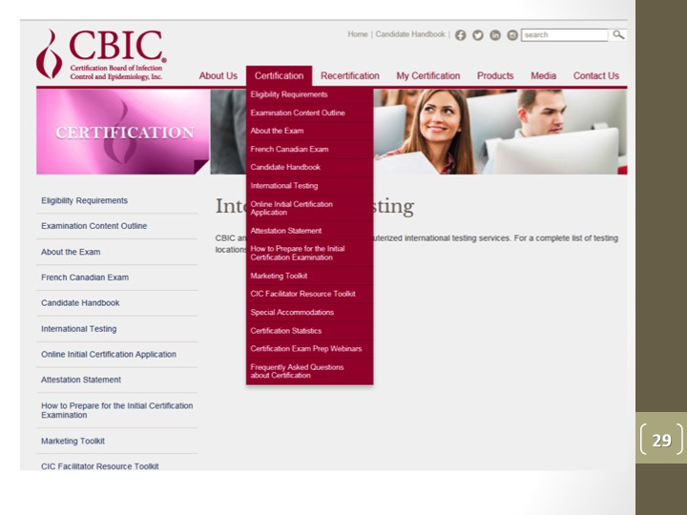

Slide 32
Secondary References
Current Recommendations of the Advisory Committee on Immunization Practices (ACIP).
Current guidelines, standards, and recommendations from CDC, APIC, SHEA, and Public Health Agency of Canada.
Pickering, Larry K, ed. Red Book, 30th ed., Elk Grove Village, IL: American Academy of Pediatrics; 2015.

Slide 36
Infection Prevention Certification Review Course- APIC
The course includes nine modules corresponding to the content areas of the certification exam, one general chapter about taking the exam, and a practice test module.
On-line course- 18hrs in length
Cost: Members: $350 / Non-members: $425
Recently audited and enhanced to reflect current standards and regulations

Slide 38
Study Group
Set up a study group
Helps improve grasp of the material by hearing the answers to questions from fellow students
interacting with the other group members can make studying enjoyable and be source of encouragement

Slide 39
Helpful Hints
Don’t write before you are ready
Exam STILL based on knowledge gained with 2 yrs experience
If possible, spend some time with an ICP in a different practice setting
Employer support vital

Slide 40
Exam tips
Book your exam, set out your study schedule and prepare.
Combination of group and independent review works best for many.
Don’t tell anyone when you have booked your exam…just let them know when you have been successful
Exam Day
Arrive early- don’t be in a rush
Be comfortable with the computer prior to start of 3hr timed period
Re-read the questions to ensure you understand
Try to relate the question to your work situation
Don’t change answers! First instinct is usually correct

Slide 42
