Slide 1

How to publish in the journals
Elaine Larson
Editor, American Journal of Infection Control
Hosted by Chingiz Amirov
Editor, Canadian Journal
of Infection Control
www.webbertraining.com
September 28, 2017

Slide 2
Objectives
Identify the value of publication to the development and advancement of a professional discipline and specialty
Describe the process of preparing, submitting, and revising a manuscript
Discuss major reasons for manuscript rejection and tips to avoid them from the perspectives of an author and an editor

Slide 3
The purpose of publishing is to influence, persuade and convince

Slide 4
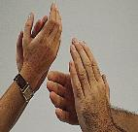
Why plan dissemination strategies?
Sharing is a professional responsibility
Too many communications (presentations and publications) are poorly done
If you don’t tell, people won’t know
Therefore, change cannot occur

Slide 5
Communicating Effectively
It builds self-awareness, clarity of thought, and resilience
It allows others to learn from what you have learned
It shapes your legacy to the profession

Slide 6

First, determine your goals
Audience: Internal, external, administration, practitioners, policy makers
Scope of Influence: Information only, change practice, change policy
Format: verbal, written or both (presentations or publications)

Slide 7
Questions to Ask
What do I have to say?(“So What” test)
Is the paper worth writing?
Has such a paper already been written?
What is the right format for my message?
Who is the audience?(“Who Cares” test)
What is the right journal for the paper?

Slide 8



Then, select your medium
Presentations
Publications
Often, several

Slide 9

Finding what’s already out there
National Library of Medicine website available worldwide
Largest biomedical library
Major products
  Index Medicus
  MEDLINE
  PubMed

Slide 10

Bibliographic Retrieval
Index Medicus started in 1879
Medline: 11 million journal citations back to 1964
Indexes >4,300 journals from US and 70 other countries
88% of citations are in English
Updated weekly with ~7,300 new citations
PubMed is web access to Medline

Slide 11
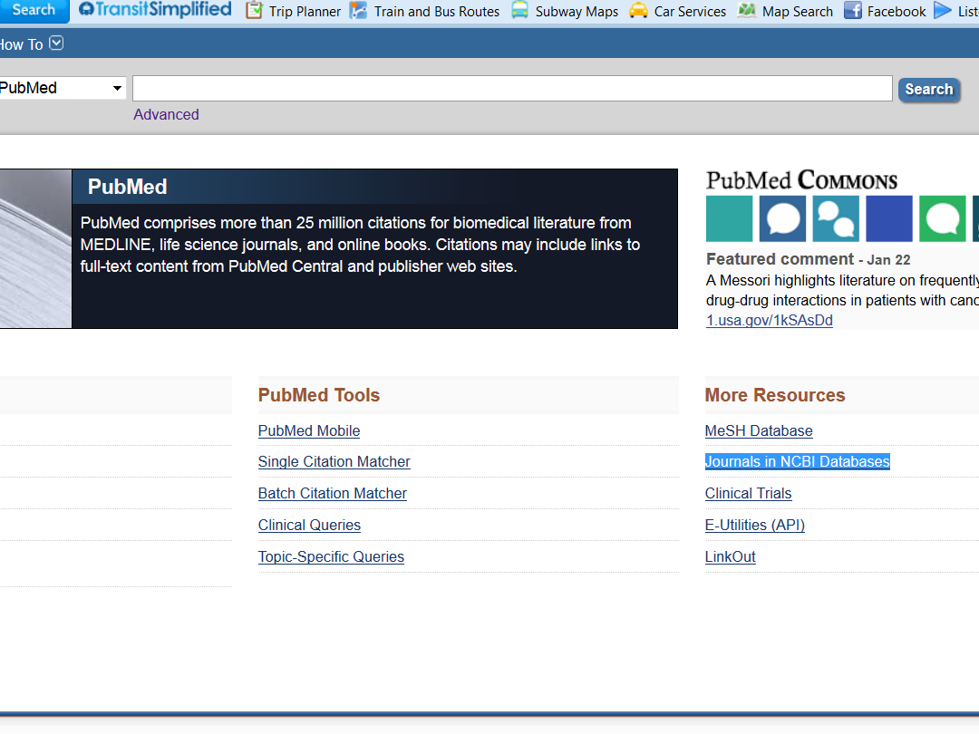

Slide 12
Which Journal? Format & Audience
Information for authors
Review some issues of the journal
Contact the editor?
Who are the subscribers?
Impact factors: Journal Citation Reports

Slide 13
Find your audience
Who would be most interested in your findings?
Which groups can make use of the results?
Resource: jane.biosemantics.org

Slide 14
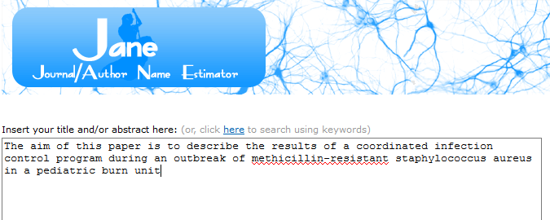
Resource: jane.biosemantics.org

Slide 15
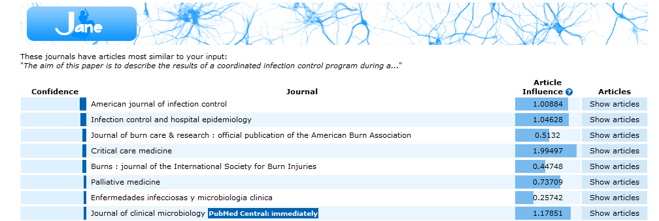

Slide 16
Predatory Publishing and
“Eminent researchers like you”
Used with permission from Dr. Amanda Hessels

Slide 17
The Problem
Losing copyright to your project data/manuscript
Forced to pay a large fee (hundreds - thousands)
Credibility of scientific community
Misinformation – “nonexperts doing online research will have trouble distinguishing credible research from junk” - Gina Kolata
Kolata G. Scientific Articles Accepted (Personal Checks, Too). The New York Times. 2013. http://www.nytimes.com/2013/04/08/health/for-scientists-an-exploding-world-of-pseudo-academia.html?_r=2&pagewanted=all&.

Slide 18
Characteristics of a Predatory Publications
Promise, but do not provide adequate or any peer review
Promise fast publication
High-cost publication, or full fees may not disclosed until after manuscript submission
Falsely claiming to have higher credentials (e.g., impact factor) than they have

Slide 19
Characteristics of a Predatory Publications
Publish fake content
Ransom (“withdrawal” fees)
Names purposely sound similar to legitimate journals / conferences
    Ex. “Journal of Advanced Practice Nursing” vs. “Journal of Advanced Practices in Nursing”
    Ex. “Entomology-2013” conference vs. “Entomology 2013” conference

Slide 20
“Fees” and “Open Access”
Open access model increases accessibility of science, particularly to resource scarce settings
Does not define predatory journals (e.g. PlOS ONE, BMJ Open)
But may be characteristics of predatory journals

Slide 21
Warning signs
Typos in emails or website
Limited publication history on website
Boastful language i.e., "leading publisher“, although startup or new organization
Publisher hides or does not reveal its location, and/or limited contact info.
A “Fleet" - a new publisher suddenly launched a large number of new journals, dozens - hundreds of titles all at once
Notes:
“Greetings for the Day”

Slide 22
Invitation to Submit: Predatory?
Dear Dr. Amanda J Hessels,
Greetings from SciFed.
Recognizing your very busy schedule, As we haven't received your response yet, We are sending you this note as a reminder to remind you that, We SciFed Journal of Immunology invites you to submit a paper in the area of your research, academic or professional interest related to any of the topics included in the Immunology journal.
Kindly avail this opportunity to share your scientific excellences and be a part of our esteemed organization.
Would you please have your assistant drop us a note. If you require further information.
We are sincerely looking forward to receiving your acceptance.

Slide 23
Example: One of the Worst
Dear Dr. Larson Elaine L,
I expect this email finds you good. I Just want to follow up on the submission of manuscript owed towards our Journal. In fact I am waiting for your article but I haven't received your article and I certainly understand your hectic commitments but having affirmative belief on you, we are trying to assemble next issue by 20th of September. Perhaps we are enthusiastic to have your active participation in this upcoming issue with any kind of article, so please be initiative and provide your promising words on submission.
I adore working with you and I have always been there in assessing any problems you might have. Predict to receive your acknowledgement in next 48 hrs.

Slide 24
Invitation to Submit: Predatory?
Dear Researcher,
Warm greetings from
We are glad to mail an eminent researcher like you.
Being aware of your eminence in the area, we with an immense interest would like to invite a few eminent researchers like you for your valuable contribution for our next issue. You can submit Research or Review article, may also submit Short Communication based on your previous article or a case report or an Opinion article or Commentary or Editorial or Image Article or Conference proceedings as per your expertise.
The journal intends to include the below topics but not limited to:
Epidemiology and Medicine, Public Health, Clinical Studies, Surveillance, Community Health, Infectious Diseases, Health Care, Antibiotic Resistance, Chronic Diseases, Oral Health, Nutrition, Mental Health, Aging Epidemiology, Genomic Research, Sociology, Environmental Health….etc

Slide 25
Tips to Avoid Predatory Journals
Does it have an ISSN?
“the assigned ISSN is only duly registered in the ISSN International Register once the first issue is received”
“regarding scholarly open access publications, 5 articles are considered as a minimum for making a complete issue.”
“The ISSN role is to identify a publication.
It is a digital code without any intrinsic meaning:
it does not include any information about the origin or contents of the publication,
it does not guarantee the quality or validity of the contents.”

Slide 26
Tips to Avoid Predatory Journals
Editor and Staff
No single editor listed for any journal
Editorial board
  No or limited to a few (2-3) individuals
  Same editorial board for multiple journals: http://oap-lifescience.org/
  Editor or review board do not have academic qualifications or affiliations
  Cannot find the individuals on the board elsewhere online!
  Little or no geographical diversity editorial board members, especially for international journals
  No women on ed. Board
Lacks retraction policy or does not publish corrections or clarifications and does not have a policy for these issues

Slide 27
Resources & References
Directory of Open Access Journals: https://doaj.org/
SERPHA/RoMEO: http://www.sherpa.ac.uk/romeo/search.php
Beall J. Criteria for Determining Predatory Open-Access Publishers. 2015.. http://pasca.uns.ac.id/wp-content/uploads/2017/01/criteria-2015.pdf. International Standard Serial Number. What is an ISSN? http://www.issn.org/understanding-the-issn/what-is-an-issn/ Accessed 06.06.2017
Stratton SJ. Another “Dear Esteemed Colleague” Journal Email Invitation? https://www.cambridge.org/core/services/aop-cambridge-core/content/view/1A2FB37ECA400894649580BE07A415AA/S1049023X16001370a.pdf/div-class-title-another-dear-esteemed-colleague-journal-email-invitation-div.pdf Accessed 06.06.2017
Oermann MH, et al. Study of Predatory Open Access Nursing Journals. Journal of nursing scholarship. 2016;48(6):624-32

Slide 28

Instructions to Authors
All journals have them, and they vary considerably
Follow them to the letter
  reference style
  format of paper
  permissions

Slide 29
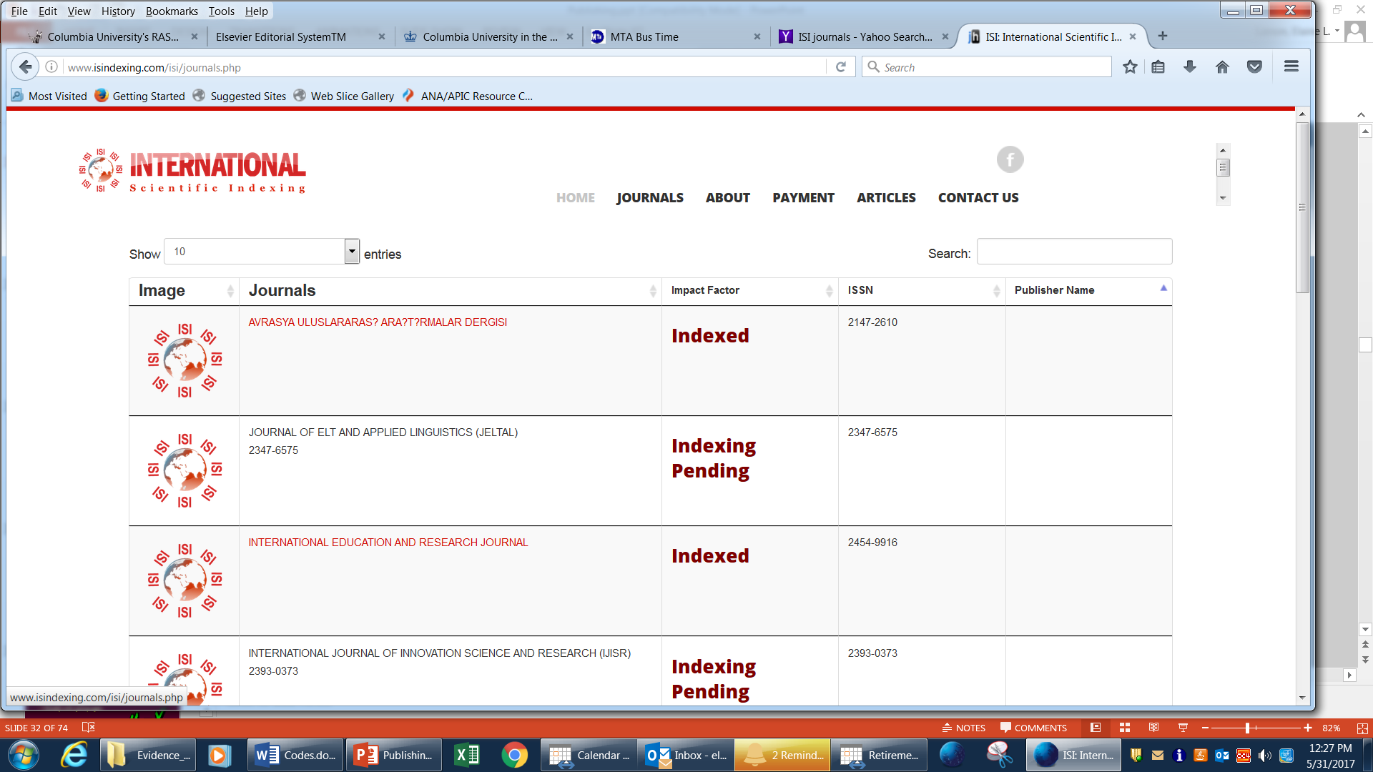

Slide 30
Open Access?
Often faster publication, BUT
Often costs money ($500-3,000)
Be sure journal is cited in PubMed
So check it out carefully!

Slide 31
Manuscript Types*
  Major Articles
  Brief Reports
  Commentary
  Correspondence
  Practice Forum
  *Examples from AJIC

Slide 32
Major Articles
Results of original research
~12-15 double-spaced, typed pages
4 illustrations
3 tables
15 references (often more these days)
Structured abstract of 150-200 words
  Background, Methods, Results, Conclusions

Slide 33
Brief Reports
1000 words or less
2 illustrations or tables
Maximum 10-15 references
Summary abstract (non-structured) of ≤100 words

Slide 34
Commentary
Opinions, philosophy, or comments related to IP practice
Sent to Editor for review
Brief
Referenced as appropriate

Slide 35
Correspondence
(Letters to the Editor)
Letters pertaining to articles previously published or other discussion items
Sent to Editor
Subject to review and/or responses by authors of referenced article

Slide 36
Practice Forum
Reports of IP practices and related applications of epidemiology
2-5 double-spaced, typed pages
Referenced as appropriate
Summary abstract (non-structured) of 50-75 words

Slide 37

ABSTRACT
Brief summary of why, who, how, what
Usually about 150-250 words

Slide 38
INTRODUCTION
Statement of purpose and background
Answers “so what?”
Usually a few paragraphs

Slide 39
METHODS
Study design
Setting
Sample, sample size
Procedures/definitions
Instruments
Analysis

Slide 40
RESULTS
Presents raw data first, then statistical analyses
Specifically addresses each research question
NO interpretation or discussion
Usually 1-2 pages

Slide 41
DISCUSSION
Author’s interpretation of results
Comparison with other studies
Possible explanations of findings
Strengths and limitations
Implications for practice and research
Recommendations and conclusions
Usually 2-4 pages

Slide 42
Formatting References
Sunkesula, V. C., et al. "Four moments for patient hand hygiene: a patient-centered, provider-facilitated model to improve patient hand hygiene." Infection Control & Hospital Epidemiology 36.8 (2015): 986-989.
Sunkesula, V. C., Knighton, S., Zabarsky, T. F., Kundrapu, S., Higgins, P. A., & Donskey, C. J. (2015). Four moments for patient hand hygiene: a patient-centered, provider-facilitated model to improve patient hand hygiene. Infection Control & Hospital Epidemiology, 36(8), 986-989.
Sunkesula, V.C., Knighton, S., Zabarsky, T.F., Kundrapu, S., Higgins, P.A. and Donskey, C.J., 2015. Four moments for patient hand hygiene: a patient-centered, provider-facilitated model to improve patient hand hygiene. Infection Control & Hospital Epidemiology, 36(8), pp.986-989.
Sunkesula VC, Knighton S, Zabarsky TF, Kundrapu S, Higgins PA, Donskey CJ. Four moments for patient hand hygiene: a patient-centered, provider-facilitated model to improve patient hand hygiene. Infection Control & Hospital Epidemiology. 2015 Aug 1;36(8):986-9.
MLA
APA
Harvard
Vancouver

Slide 43
Acute Fulminating Jargonitis
Loss of basic verbs:
  Utilizing, using
  Facilitating, helping
  Implementing, doing
  Optimizing, making the best of things

Slide 44
Noun clusters and chains
  Support system network
  Communication facilitation skills development intervention
Loss of objects
  People cope (with what?)
  Relate (to whom?)
  Share (what?)

Slide 45
“Fancy” talk
  Walk=ambulate
  Talk=verbalize
  Methods=methodology
Other jargon
  “Getting published”

Slide 46
Scholarly Writing Is Not Fiction
Inappropriate
  Allegory
  Alliteration
  Poetic expression
  Cliches
  Jargon
  Lengthy embellishments
  Dull and lifeless style
Appropriate
  Clarity
  Precision
  Honesty
  Brevity
  Completeness
  Objectivity

Slide 47

The Five “C’s”
Coherence
Clarity
Consistency
Conciseness
Conviction

Slide 48

Typical Review Process
Initial screening by Editor
Selection of two or more reviewers
Manuscript “blinded”
Decision: reject, undetermined, accept with revisions, accept
Comments from both reviewers and Editor sent to authors

Slide 49
What do editors look for?
Research that is going to change thinking
Interest to a wide audience
Ethically sound
Robust methods
Reported fully

Slide 50
What do editors look for?
Research that is going to change thinking
‘This is the largest study to identify that patients may be at significant risk of acquiring an infection with an organism from a patient who had previously occupied the same room’

Slide 51
What do editors look for?
Research that adds knowledge and is of interest and relevance to the journal’s readers
‘The results of this study emphasize the need for attention to glove donning and doffing practices
because glove use did not prevent contamination of the hands.’

Slide 52
What do editors look for?
Research that is ethically sound
‘The institutional review board at each facility approved the study.’

Slide 53

Criteria for Manuscript Review
Appropriateness
Originality
Importance
Documentation of conclusions
Presentation of data
Adequacy of references

Slide 54
Helpful Don’ts:
How to Get Your Paper Rejected
Don’t follow author’s guidelines
Don’t explain why the study is important
Don’t be concise or make a logical argument
Don’t say anything new, just repeat what is already known

Slide 55
Top 8 reasons for rejection
It fails the technical screening.
It does not fall within the Aims and Scope.
It's incomplete.
The procedures and/or analysis of the data is defective.
The conclusions cannot be justified on the basis of the rest of the paper.
It's is simply a small extension of a different paper often from the same authors.
It's incomprehensible.
It's boring.
Adopted from Thrower (2012)

Slide 56
Top Reasons for Editorial rejection
Ineffective study question and/or design (338; 92%);
Suboptimal data collection process (180; 49%);
Weak discussion and/or conclusions (139; 37%);
Unimportant or irrelevant topic to journal’s mission (137; 37%);
Weak data analysis and/or presentation of results (120; 33%);
Text difficult to follow or understand (89; 24%);
Inadequate or incomplete introduction (67; 18%);
Other publishing considerations (42; 11%); and
Issues with scientific conduct (20; 5%).
Manuscripts had, on average, three or more reasons
Meyer HS, et al. Acad Med 2017; doi: 10.1097/ACM.0000000000001860

Slide 57
Top 8 reasons for acceptance
It provides insight into an important issue.
The insight is useful to people who make decisions.
The insight is used to develop a framework or theory.
The insight stimulates new, important questions.
Methods used to explore the issue are appropriate.
The methods used are applied rigorously and explain why and how the data support the conclusions.
Connections to prior work in the field or from other fields are made and are clear
Tells a good story
Adapted from Pieper (2013)

Slide 58

Bugaboos
Misuse of references
Missing methods
  Unable to assess for bias
  Unable to replicate
  Operational definitions
  Intervention details
Illogical or unorganized presentation
  Writing that wanders
  Long background
  Information repeated in detail in both text and table

Slide 59

Rejected Manuscript?
Don’t be discouraged
Set it aside BRIEFLY
Carefully review critique
Don’t get defensive; weigh comments carefully
Revise before submitting it elsewhere

Slide 60
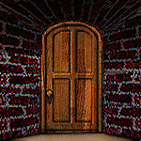
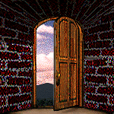
If manuscript is rejected…..
Review the critique, revise as indicated, turn it around quickly, do not let it sit

Slide 61
Appeals
  Editorial decisions are not infallible
  Indicate why the editors may not have appreciated the importance of your paper
  Provide evidence to refute reviewers
  Demonstrate how your paper will influence practice

Slide 62
Sample Helpful Web Sites
http://www.scribaltraditions.com/resources/tools.htm
http://sportsci.org/jour/9901/wghstyle.html
http://abacus.bates.edu/~ganderso/biology/resources/writing/HTWgeneral.html
http://www.sci.sdsu.edu/~smaloy/MicrobialGenetics/topics/scientific-writing.pdf
https://www.equator-network.org/library/guidance-on-scientific-writing/

Slide 63

Parting Thoughts on Publication
Perseverance
Don’t get discouraged
Celebrate your success

Slide 64
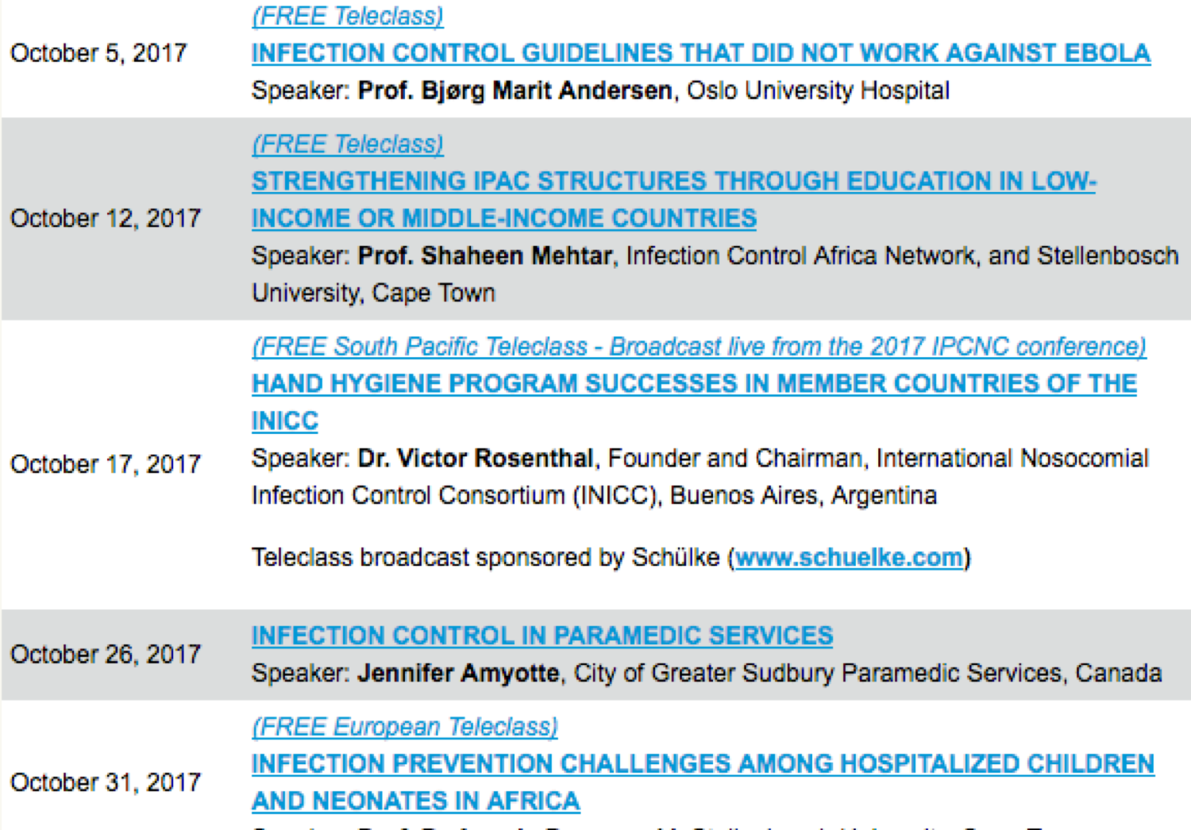

Slide 65


