Slide 1
Implementation of Clinical Indication for Dwell Time: Check the Patient, Not the Clock
Michelle DeVries, MPH CIC
Senior Infection Control Officer
Methodist Hospitals, Gary, Indiana
mdevries@methodisthospitals.org
Hosted by Paul Webber
paul@webbertraining.com
www.webbertraining.com
May 26, 2017

Slide 2
Objectives
Review current recommendations regarding peripheral IV dwell time
Discuss framework for launching protected clinical indication as part of a comprehensive infection prevention program
Propose process and outcome surveillance measures to evaluate the success of interventions in the context of a hospital who has achieved success with this policy change

Slide 3
CDC Recommendations
There is no need to replace peripheral catheters more frequently than every 72-96 hours to reduce risk of infection and phlebitis in adults. Category 1B
No recommendation is made regarding replacement of peripheral catheters in adults only when clinically indicated. Unresolved issue
Replace peripheral catheters in children only when clinically indicated. Category 1B
Some studies have suggested that planned removal at 72 hours vs. removing as needed resulted in similar rates of phlebitis and catheter failure. However, these studies did not address the issue of CRBSI, and the risk of CRBSIs with this strategy is not well studied.
http://www.cdc.gov/hicpac/pdf/guidelines/bsi-guidelines-2011.pdf
Accessed April 20, 2016

Slide 4
INS Standards 2016
Remove the short peripheral catheter if it is no longer included in the plan of care or has not been used for 24 hours of more
Remove short peripheral and midline catheters in pediatric and adult patients when clinically indicated, based on findings from site assessment and/or clinical signs and symptoms of systemic complications.

Slide 5
INS Standards 2016
Use the venous site most likely to last the full length of the prescribed therapy, using the forearm to increase dwell time, decrease pain during dwell time, promote self-care and prevention accidental removal and occlusions.
Use a new pair of disposable, nonsterile gloves in conjunction with a “no-touch” technique for peripheral IV insertion, meaning that the insertion site is not palpated after skin antisepsis
Dressing changes are performed… every 5-7 days and immediately if the dressing integrity becomes damp, loosened, or visibly soiled, or if moisture, drained or blood are present under the dressing.
Consider increased attention to aseptic technique, including strict attention to skin antisepsis and the use of sterile gloves, when placing short peripheral catheters… contamination of nonsterile gloves is documented
Consider monitoring bloodstream infection rates for peripheral catheters, or vascular catheter associated infections (peripheral) regularly
Make no more than 2 attempts at short peripheral intravenous access per clinician, and limit total attempts to no more than 4
Consider the use of maximal sterile barrier precautions with midline catheter insertion
For peripheral catheters, consider two options for catheter stabilization: (1) in integrated stabilization feature on the catheter hub combined with a bordered polyurethane securement dressing or (2) a standard round hub peripheral catheter in combination with an adhesive ESD.

Slide 6
Framing the discussion…
Most commonly used invasive device in hospitals
Up to 70% of patients receive one at some point during their hospitalization
Device utilization estimation is 20-30% of patient days
High failure rate reported
Mean across studies is 46%
60% of first attempts are unsuccessful
27% of patients endure 3 or more attempts

Slide 7
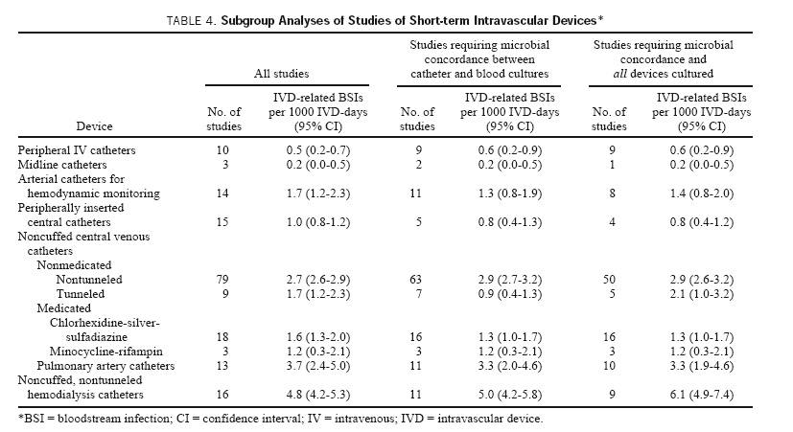
Maki DG et al., Mayo Clinic Proc 2006;81:1159-1171.

Slide 8
State HAI reporting in Pennsylvania
Hospitals are required to report ALL laboratory confirmed bloodstream infections (LCBI)
Not just CLABSI
In 2011 there were 2479 LCBI reported to the state
1540 were CLABSI
Which means 939 (38%) did not have a central line in place
How many of these may be related to peripheral lines?
What else could be contributing?
Several studies have shown around 20% of all LCBI may be from PVC
The 2014 HAI report disclosed:
2163 bloodstream infections
1140 CLABSIs
This leaves 1023 with no central line (47%)

Slide 9
Peripheral Venous Catheter-Related Staphylococcus aureus Bacteremia
24 S. aureus bacteremias
12% of all device related S. aureus bacteremias were caused by PVCs
Average treatment in this study was 19 days
Serious complications noted:
Two patient deaths and one transfer to hospice
Two I&D of local site
One DVT from PICC line placed to treat PVC-BSI
Ten events that would be reportable in to CMS (USA government mandate) under current regulations
8 MRSA bacteremias
2 C. diff

Slide 10
More to the S. aureus story…
Further analysis of the Pennsylvania data
Included all non-central line related BSI from 2011 and 2012
Based on pathogen analysis and infection onset, they speculate that “it is likely that the majority of acute care primary BSIs in Pennsylvania are due to PVCRI”
Additionally, they use S. aureus as an indicator for PVCRI and note that there is a substantial spike after 72 hours

Slide 11
Agency for Healthcare Research and Quality: Morbidity and Mortality Rounds on the Web
Case study of 75 year old man with history of CAD and CHF admitted for CHF exacerbation.
After PIV in for four days, RN requested orders to leave IV in an additional day or two because placement (given edema) would be difficult.
On day 6 patient developed erythema at the IV site and later that day developed fever and chills.
Blood cultures grew MRSA.
Subsequently, patient complained of back pain. MRI of the spine revealed epidural abscess.
Aspiration grew MRSA
Treatment required 6 weeks of antibiotics and is estimated to have cost hundreds of thousands of collars

Slide 12
Bundling for success
Insertion:
CHG skin prep
Sterile gloves if repalpating the site
Alcohol caps for intraluminal protection
Chlorhexidine impregnated sponge dressing for extraluminal protection
Updated catheter – integrated extension set
Integrated securement dressing
Neutral connectors
Maintenance:
Careful assessment – check the patient, not the box
Remove when clinically indicated, with dressing change at 7 days (or sooner if dressing compromised)
Re-prep when redressing the site
Ongoing surveillance of process and outcomes
Review any infections with floor staff in “real time” to discuss missed opportunities for prevention

Slide 13
What does the data show?
After 12 months of clinical indication policy:
38% statistically significant reduction in primary bacteremia (sustained at 24 months)
19% reduction in PIV associated bloodstream infections (with 6% further reduction at 24 months)
35% of PIVs now lasting more than 5 days
Average dwell time 4.2 days
48% decrease in IV start kits
75% decrease in ICU CLABSI (sustained at 24 months)
24% increase in patient satisfaction scores for patients hospitalized at least 5 days

Slide 14
It’s not just about infections…
Fewer sticks by reducing arbitrary restarts can impact¹:
Patient satisfaction
Vessel preservation
Supply costs
Nursing time
Expanding interventions beyond just central lines *may* also benefit CLABSI rates²
Anyway you look at it, making an investment in safely implementing an approach to address peripheral IVs there is much to be gained

Slide 15
What about midlines?
In an effort to reduce CLABSI incidence many hospitals are looking increasingly to midline catheters as part of their solution.
Midlines are considered peripheral catheters per INS standards and CDC definitions regarding tip termination.
How are you protecting your patients with these lines?
Insertion? INS says consider maximum sterile barriers.
Protection? These lines may dwell for up to 29 days
How are you measuring success?
Decrease in central line days?
Decrease in CLABSI?
Material costs and time savings?
Incidence of Midline associated bloodstream infection?

Slide 16
Planning for safety
Engaging all involved disciplines in the development of a new policy for extending dwell time
Addressing any product changes to assist with objectives of increased dwell time
Reviewing staff training/competencies
Understanding measures of success
Process measures
Outcome measures

Slide 17
Knowing your own data…
How do you know it’s not a problem if you aren’t looking?
NHSN definitions are for laboratory confirmed bloodstream infections
“Become” Central line associated (CLABSI) by the presence of a central line
Same reasoning can be applied BSI with no source other than Peripheral venous access
Process data is as important as outcome data
Take advantage of value added offerings from vendors to help leverage your data
Consider product and practice interventions for all intravascular devices, not just central lines.

Slide 18
June 2 ARE YOUR CLEANING WIPES SAFE? EVIDENCE SUPPORTING THE “ONE ROOM – ONE WIPE” APPROACH IN HEALTHCARE SETTINGS Dr. Laura Gavaldà, Hospital Universitari de Bellbitge, Barcelona, Spain June 9 CONTROLLING THE SPREAD OF VRE: IS ACTIVE SURVEILLANCE WORTHWHILE? Prof. Hilary Humphreys, Royal College of Surgeons in Ireland June 13 (FREE Teleclass - Broadcast live from the 2016 APIC conference) BRIDGING THE GAP BETWEEN RESEARCH AND PRACTICE IN LONG- TERM CARE: AN INNOVATIVE MODEL FOR SUCCESS Sharon Bradley, Pennsylvania Patient Safety Authority June 13 (FREE Teleclass - Broadcast live from the 2016 APIC conference) BEING HEARD: THE INFECTION PREVENTIONIST AND THE ORGANIZATIONAL STRUCTURE Sharon Glowicz, Texas Health Resources, Presbyterian Hospital of Denton, Texas

