Slide 1
Improving the knowledge and receptiveness of medical students towards hand hygiene:
Exploring new approaches
Rajneesh Kaur
Lowy Cancer Research Centre
Prince of Wales Clinical School
University of New South Wales
Australia
Hosted by Jane Barnett
jane@webbertraining.com
www.webbertraining.com
February 21, 2018

Slide 2
BACKGROUND
Research conducted to date, has documented hand hygiene (HH) compliance rates for medical students ranging between 8% and 52%.
While compliance rates have increased in recent years for medical students, they are still well below the ideal levels.
The audit data by hand hygiene Australia indicate that currently hand hygiene of medical students in Australia is around 80%.
To date, most studies have focused on trained hospital healthcare workers (HCWs) and have underestimated the role that students also have on infection control as future HCWs.
AIMS
Develop and evaluate a new learning/teaching approach for undergraduate medical students around HH
2

Slide 3
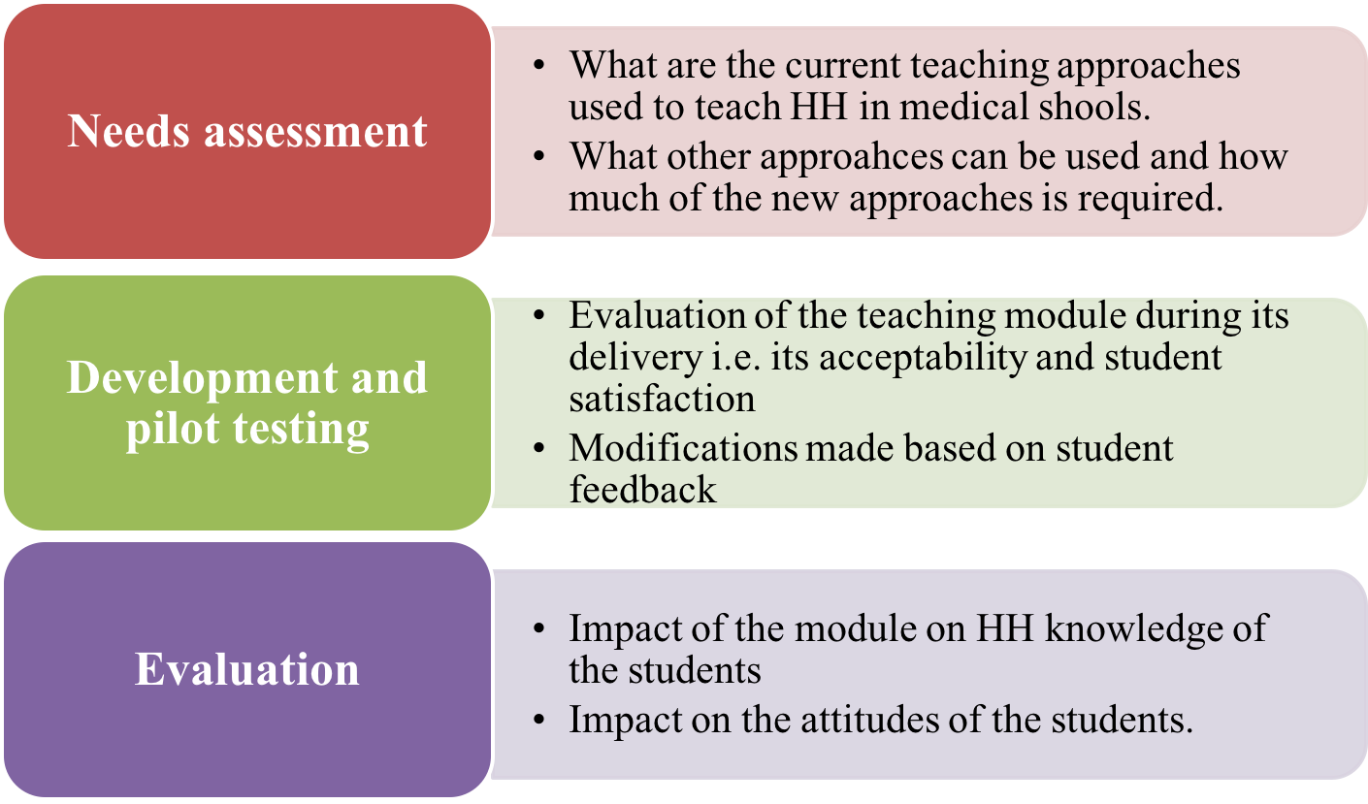
Study process
3

Slide 4
Needs Assessment
Three components
Literature review
Qualitative in depth interviews with medical students and academics at UNSW, Sydney
Survey of Deans of Medical Education of Australian medical schools
4

Slide 5
Literature review
Burden of HAIs
most common microorganisms responsible for causing HAIs
Healthcare workers’ hands and transmission of pathogens causing HAIs
‘My five moments of hand hygiene’
Hand hygiene compliance amongst HCWs
Measuring hand hygiene compliance
5

Slide 6
Literature review contd.
HCWs’ HH compliance worldwide and in Australia
HH compliance of medical students: worldwide and in Australia
Facilitators and barriers of HH compliance for all HCWs
The knowledge, attitudes and practices of medical students towards HH
Interventions aimed at improving compliance
Theoretical concepts: Social cognitive models
Adult learning theories
6

Slide 7
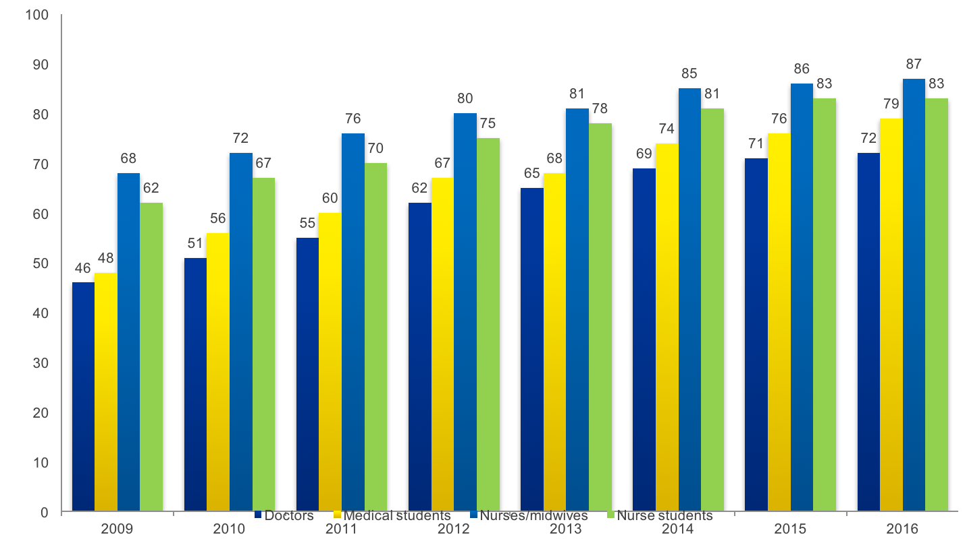
HH Compliance amongst medical students in Australia
7
Adapted from data by Hand Hygiene Australia (HHA)

Slide 8
Qualitative study
Key stakeholder interviews (n=17)
Key members of the undergraduate medical teaching
team (including faculty staff members and clinical supervisors)
Medical students from the UNSW
8

Slide 9
9

Slide 10
Selective forgetfulness
“I can’t recall any lectures on infection control or HH.......So if we were taught it, there was not much emphasis on it”. (Medical student)
This failure to remember any teaching around HH by medical students is ‘selective forgetfulness it happens to the concepts not considered important by students”(Academic)
10

Slide 11
Not important
‘Monkey see monkey do’, in that medical students go onto the ward, fail to see staff complying with HH and perhaps start to feel that while it is ideal to do it, it is ‘not really necessary”.
11

Slide 12
Inconvenient
‘It takes you away from what you’re doing, it distracts you, and it’s another process you need to remember, so I think there are multiple ways in which people justify to themselves that this is inconvenient’.
12

Slide 13
Role models
“In most cases, we just do what the consultants do. When they perform HH they actually encourage us to do the same thing…. We might do it for a day or two afterwards, but then the effect wanes off because we don’t see the same consultant for a while.”
13

Slide 14
Hidden curriculum
“The hidden curriculum is basically what the students see being done…. For example, if they see clinicians not changing their communication style... students will start doing the same thing”.
14

Slide 15
Scenario Based Learning
“Through a scenario whereby students can see the impact of poor infection control practices and think about what they would be and what the outcomes can be and so forth then I think there is some possibility of engaging them around”.
15

Slide 16
Assessment
“I don’t think I would like to be assessed but I think that would be the best way to learn”.
16

Slide 17
Campus based teaching
‘Campus based teaching should provide the theory, the scientific rationale... and then in a clinical setting it is more about reinforcing that message and the practical applications.’
17

Slide 18
3. Survey of Australian medical school
A questionnaire was sent to all medical schools across Australia (n=17)
18

Slide 19
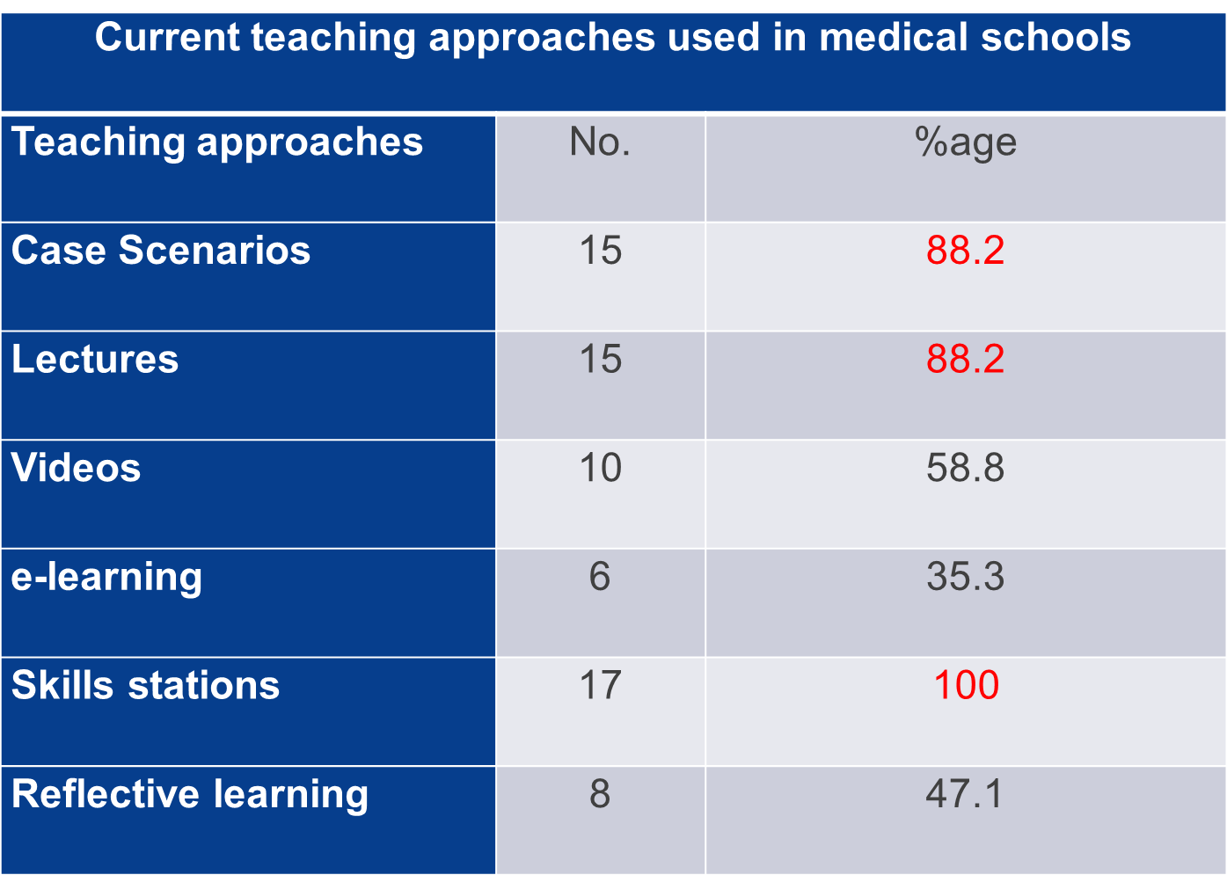
19

Slide 20
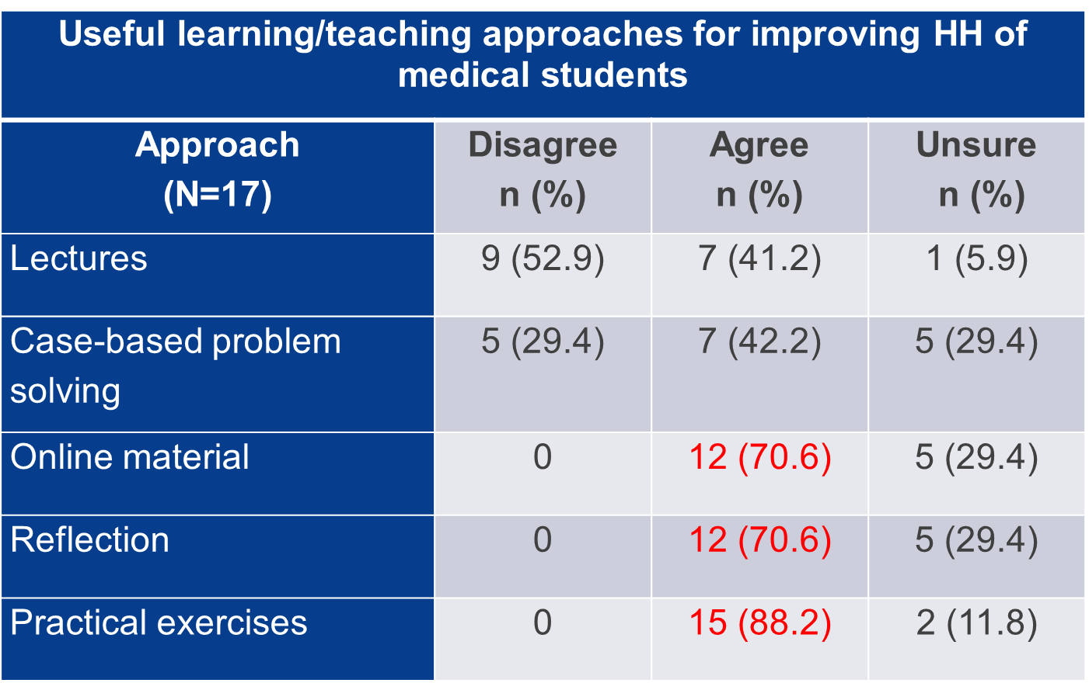
20

Slide 21
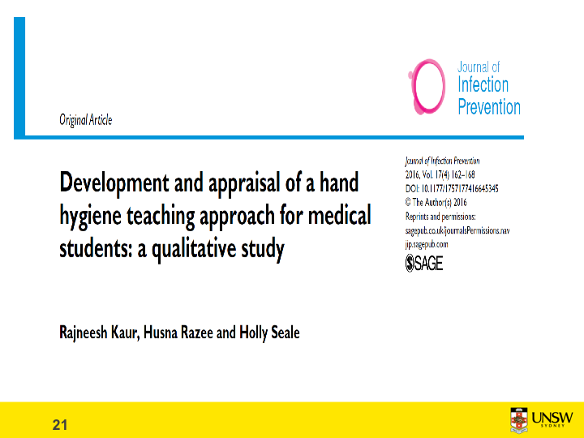
21

Slide 22
Development and pilot testing of the prototype
Qualitative group interviews (8 groups)
28 students from year 1 to 5
HH module prototype
PowerPoint presentation
Practical demonstration
Scenario based learning activity
Interview activity
22

Slide 23
Contents of the final HH teaching tool
23

Slide 24
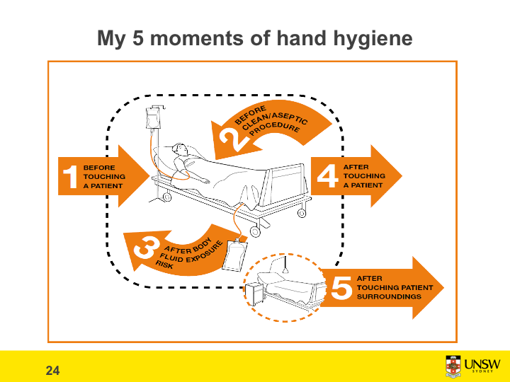

Slide 25
Phase 3: Implementing and evaluating the developed approach
25

Slide 26
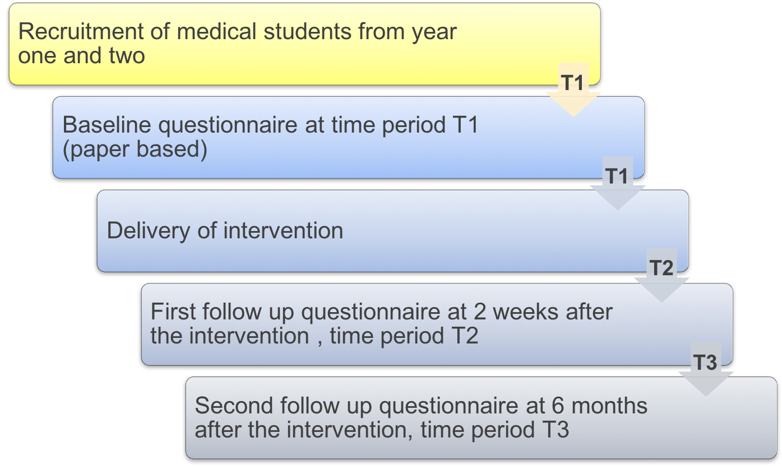
Study process
26

Slide 27
Results: Knowledge and attitude variable mean scores over three periods of time
27

Slide 28
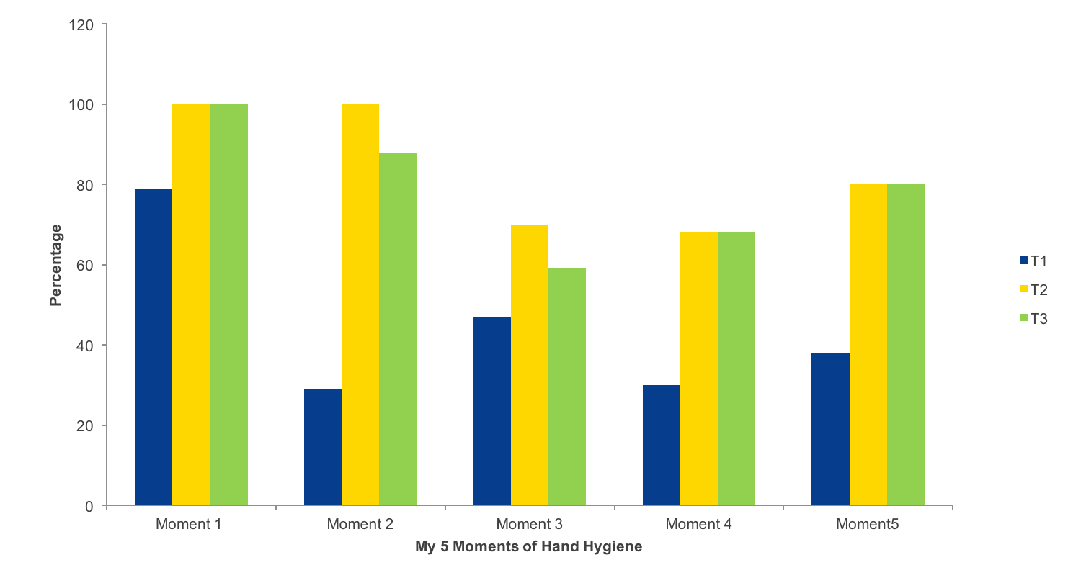
Student knowledge of ‘My 5 moments of HH’
28

Slide 29
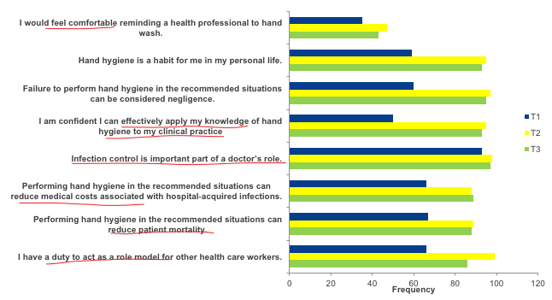
Attitudes of medical students to HH over three time periods
29

Slide 30
Student feedback on the HH teaching session done at first follow up survey at time-period 2 (T2)
30

Slide 31
Limitations
Generalisability
Uncontrolled design
Self reports vs actual practices
No long term follow up
Transition away from the university
Future directions
Use reflection and assessment
Check actual compliance
Use control group/RCTs
Empowerment
31

Slide 32




Acknowledgments
All academics and medical students who participated in four different studies
Dr Holly Seale Dr Husna Razee Dr Rachel Thompson Dr Chinthaka Balasooriya
32

Slide 33

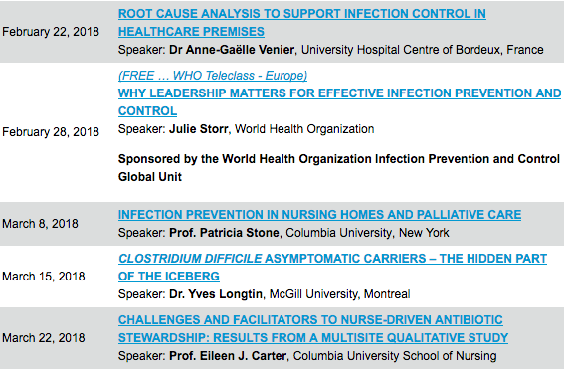

Slide 34


