Slide 1

Infection Control and Prevention in
Long-Term Care Facilities and
Healthcare Laundry
Handling, Storing, and Transporting Healthcare Textiles in Long-Term Care Facilities
John Scherberger, FAHE, CMIP, T-CSCT, VPEI
Healthcare Risk Mitigation
Past-President, HLAC
Spartanburg, SC
864-208-5750
"What is done is important, but more important is how it is done.”
- John Scherberger
Hosted by Dr. Lynne Sehulster
Environmental Infection Prevention, LLC
www.webbertraining.com
October 7, 2021

Slide 2

HAI’s, MRDO’s, Fungi, Mold, Pollution

Slide 3

Reduce the . . .

Slide 4
Proper Processes = Proper Results
Infection Prevention and Control (IPC) –
IPC is a practical multidiscipline, multimodal, evidence and science-based approach to mitigating and removing the opportunities for patients and health workers to be harmed by avoidable infectious microbial pathogens. The goal is the elimination of opportunistic infections through the vigilant application of personal and environmental infection prevention practices.

Slide 5
Proper Processes = Proper Results
Laundry Management -
Laundry management is intended to ensure:
A sufficient par level of hygienic healthcare textiles (HCTs)is maintained that will meet the needs of residents.
All hygienic HCTs are handled and maintained in ways to maintain the hygienic state and to minimize the opportunities contamination of clean HCTs
Soiled HCTs are handled in ways that minimize harm to residents and staff
Ensure that cross-contamination of HCTs does not happen.
– CDC Guidelines for Environmental Infection Control in Healthcare Facilities 2003

Slide 6
Proper Processes = Proper Results
Hygienically clean laundry carries negligible risk to health-care workers and residents, provided that the clean textiles, fabric, and clothing are not inadvertently contaminated before use.

Slide 7
Infections and Mortality
Infections account for up to half of all nursing home resident transfers to the hospital and cost between$670 million to $2 billion to treat each year. When a resident is hospitalized with a primary diagnosis of infection, the mortality rate can reach as high as 40 percent.
The top three infections to nursing home residents are urinary tract, respiratory and skin/soft tissue.
F441 §485.65 Infection Control, CMS Manual System, Publication 100-07 State Operations Provider Certification, Department of Health & Human Services, Centers for Medicare & Medicaid Services, Transmittal 55: December 2, 2009.

Slide 8
Infections and Mortality
The overall infection rate in LTCFs for endemic infections ranges from 1.8 to 13.5 infections per 1000 resident-care days. *
For epidemics, good estimates are difficult to ascertain, but the literature suggests that several thousand outbreaks may occur in US LTCFs each year.*
33% of overall endemic infections is thought to be preventable just by maintaining infection surveillance**
These rates no not reflect the realities of the COVID-19 pandemic
*Strausbaugh LJ, Joseph CL. The burden of infection in long-term care. Infect Control Hosp Epidemiol 2000;21:674-9.
**https://journals.lww.com/journaloftraumanursing/Citation/2020/07000/The_Need_for_Actions_to_Protect_Our_Geriatrics_and.2.aspx

Slide 9
CMS State Operations Manual
Appendix PP - Guidance to Surveyors for Long Term Care Facilities
§483.65 Infection Control
§483.65(a) Infection Control Program
§483.65(b) Preventing Spread of Infection
§483.65(c) Linens

Slide 10
The Challenges
Long-Term Care Facilities (LTCFs) are:
Low-technology settings
Length of stay is measured in months and years rather than days
LTCF are typically viewed as communities, not patient rooms
Residents are more mobile than patients
Payment systems are significantly different
(See next slide)

Slide 11
Inadequate Payment/Reimbursement
Section 4432(a) of the Balanced Budget Act (BBA) of 1997 modified how payment is made for Medicare skilled nursing facility (SNF) services. Effective with cost reporting periods beginning on or after July 1, 1998, SNFs are no longer paid on a reasonable cost basis or through low volume prospectively determined rates, but rather on the basis of a prospective payment system (PPS). The PPS payment rates are adjusted for case mix and geographic variation in wages and cover all costs of furnishing covered SNF services (routine, ancillary, and capital-related costs).

Slide 12
The Challenges
Staffing – cannot be accomplished by taking EVS staff from patient areas to operate
  ”Robbing Peter to pay Paul” is a Ponzi scheme
Facility space is inadequate
Machines - wrong type, age, maintenance
Education – Operating an on-premises laundry requires effort, time, investment
  Training
Insufficient interest on the part of owners

Slide 13
Challenges
F441
§483.65 Infection Control
The facility must establish and maintain an infection control program designed to provide a safe, sanitary, and comfortable environment and to help prevent the development and transmission of disease and infection.

Slide 14
§ 483.65(a) Infection Control Program
The facility must establish and maintain an infection prevention and control program designed to provide a safe, sanitary, and comfortable environment and to help prevent the development and transmission of communicable disease and infection.
§483.65(a) Infection Control Program
The facility must establish an infection control program under which it–
  (1) Investigates, controls, and prevents infections in the facility;
  (2) Decides what procedures, such as isolation should be applied to an individual resident; and
  (3) Maintains a record of incidents and corrective actions related to infections.

Slide 15
§ 483.65(b) Preventing Spread of Infection
F442
(1) When the infection control program determines that a resident needs isolation to prevent the spread of infection, the facility must isolate the resident.

Slide 16
§ 483.65(b)(2) Preventing Spread of Infection
F443
§483.65(b)(2) The facility must prohibit employees with a communicable disease or infected skin lesions from direct contact with residents or their food, if direct contact will transmit the disease.

Slide 17
§ 483.65(b)(3) Preventing Spread of Infection
F444
§483.65(b)(3) The facility must require staff to wash their hands after each direct resident contact for which handwashing is indicated by accepted professional practice.

Slide 18
§ 483.65(b) Infection control
(b) Infection preventionist. The facility must designate one or more individual(s) as the infection preventionist(s) (IPs) who are responsible for the facility's IPCP. The IP must:
  (1) Have primary professional training in nursing, medical technology, microbiology, epidemiology, or other related field;
  (2) Be qualified by education, training, experience or certification;
  (3) Work at least part-time at the facility; and
  (4) Have completed specialized training in infection prevention and control.
(c) IP participation on quality assessment and assurance committee. The individual designated as the IP, or at least one of the individuals if there is more than one IP, must be a member of the facility's quality assessment and assurance committee and report to the committee on the IPCP on a regular basis.

Slide 19
§483.65(c) Linens
F445
§483.65(c) Linens
Personnel must handle, store, process, and transport linens so as to prevent the spread of infection
Intent: §483.65(c)
The intent of this regulation is to prevent the spread of infection through linens.
Interpretive Guidelines: §483.65(c)
Soiled linens should be handled to contain and to minimize aerosolization and exposure to any waste products. Soiled linen storage areas should be well ventilated and maintained under a relative negative air pressure. The laundry should be designed to eliminate crossing of soiled and clean linen.

Slide 20
The Challenges
Most long-term care laundry facilities are not accredited or certified for adhering to established, CMS F Tag, CDC Guideline, OSHA Regulations, HLAC Standards, of TRSA Hygienically Clean Certification
CMS F Tag, CDC Guideline, OSHA are mandatory, HLAC and TRSA are voluntary

Slide 21
Infection Control Today
March 8, 2011
“Of all the surfaces in a hospital, a patient will
have the greatest degree of contact with his
gown and the bed linens.”
Lynne M. Sehulster, PhD, M(ASCP) (retired)
Prevention and Response Branch
Division of Healthcare Quality Promotion
Centers for Disease Control and Prevention
Atlanta, GA 30329-4027

Slide 22
Interpretive Guidelines: §483.65(c)
There are clear Standards and guidelines for handling contaminated HCTs, but nothing regarding the handling, storage, and distribution of hygienically clean HCTs.
How do facilities carry out those directives without standardized and accepted processes?
Left to their own devices, facilities will institute appropriate processes, over-zealous processes, impotent processes, or no processes at all leaving residents, patients and staff exposed.

Slide 23
Multimodal and Multidisciplinary Integration of Infection Prevention Processes, Including Textiles
What’s Missing:
  Communication, Cooperation, Collaboration
Between:
  Owners
  Administration
  Nursing leadership
  Infection Preventionist – if there is one
  Risk Management
  Quality Management
  Front-Line Staff

Slide 24
Healthcare Textiles (HCTs) Handling
CMS 483.65(c) states: “Personnel must handle, store, process and transport linen so as to prevent the spread of infection.”
Applicable to contaminated and hygienically clean HCTs. Unfortunately, too many facilities interpret this requirement as applicable to contaminated HCTs only, not hygienically clean HCTs.

Slide 25
Microorganism Survival on Clothing and Uniforms
Neely and Maley: J Clin Microbiol 2000; 38: 724-726
Neely and Orloff: J Clin Microbiol 2001; 39: 3360-3361
Perry C, et al. J Hosp Infect 2001; 48:238-241
Takashima M, et al. Am J Infect Control 2004; 32: 27-30
Wiener-Well Y, et al. Am J Infect Control 2011; 39: 555-9

Slide 26
Sources of Infectious Microbes
Patients
Staff
Hands and Environmental surfaces are the main transmitters of healthcare-associated infections.
Followed by work clothing and other inanimate objects.
Bacteria, fungi and viruses, which only transiently colonize on the skin, are easily taken up and passed on, either through direct contact – from the skin to the skin – or through indirect contact – from surfaces, objects, equipment and shared medical devices.
F441 §485.65 Infection Control, CMS Manual System, Publication 100-07 State Operations Provider Certification, Department of Health & Human Services, Centers for Medicare & Medicaid Services, Transmittal 55: December 2, 2009.

Slide 27
Trust, but Verify
  ENVIRONMENTAL SERVICES
  LAUNDRY MANAGEMENT
  INFECTION PREVENTION
  RISK MANAGEMENT
  QUALITY MANAGEMENT
Each has a responsibility to visit the healthcare laundry facility, whether contracted or in-house, to review processes and cleanliness.

Slide 28
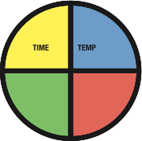
MECHANICAL
ACTION
PRODUCT
CONCENTRATION

Slide 29
Industry Observation
“Washing of the linen is only one part of the process of providing clean linens for storage. Each stage in the linen flow cycle from wash, finishing, transport, storage and point of use involves various opportunities for contamination of linen if proper training, cleaning and processes are not enforced.”
    Carrie Armstrong, Ecolab, Eagan, MN

Slide 30
Best Practice
Every surface that touches the healthcare textile must be as hygienically clean as the textile itself.

Slide 31
HLAC Standards
Incorporates regulations from OSHA, FDA, and EPA
Evidence-based, peer-reviewed best practices and recommendations for infection prevention and laundry procedures from federal agencies such as the CDC and professional entities such as:
  Association for the Advancement of Medical Instrumentation (AAMI),
  Association of periOperative Registered Nurses (AORN),
  Association for Professionals in Infection Control and Epidemiology (APIC),
  Facilities Guidelines Institute (FGI)
  Free Standards Download: HLACnet.org

Slide 32
By the way . . .
HCTs include Environmental Services infection prevention textiles commonly referred to as rags, mops, and dusters.
These essential infection prevention textiles are often processed in facilities or in ways that do not produce hygienically clean HCTs.
  The potential exists for introduction of new pathogens into a patient care environment and or exposure to the Environmental Services staff to contaminated infection prevention textiles.

Slide 33
Transportation, Distribution, and Storage of HCTs
Facilities to institute Policy & Procedures to properly address the transportation, distribution, and storage of hygienically clean HCTs.
Facilities to train staff in the proper processes to be followed in the transportation, distribution, and storage of hygienically clean HCTs.

Slide 34
Processes for Handling Hygienically Clean HCTs
All contact with clean HCTs and the isolation gown needs to be above waist level*
There is the possibility of contact with contaminated surfaces and the garment in the thigh and hip areas.
*NOTE: For the staff person making the bed in an occupied room

Slide 35
Processes for Handling Hygienically Clean HCTs
  Due to the proliferation of pathogens on uniforms, staff should never hug HCTs to their uniform.
    Unloading from laundry bins/trucks onto racks in a clean linen storage area;
    Moving HCTs from storage area to carts;
    Removing from linen carts to a patient room;
    When HCTs are being used to make the patient bed.

Slide 36
Processes for Handling Hygienically Clean HCTs
All clean HCT storage racks or carts must be covered with commercially available covers to prevent the contamination of hygienically clean textiles from airborne dust, dirt, and pathogens.
Storage of clean HCT carts must always be secured in closets or rooms to prevent patients, family members and all other personnel from handling the textiles without taking proper contact precautions.

Slide 37
Processes for Handling Hygienically Clean
If HCTs must be left unattended either in carts in the corridors or at a charting workstation, the cart and workstation should be cleaned, disinfected and capable of being locked so as to ensure the hygienic integrity of the HCTs.

Slide 38
Processes for Handling Hygienically Clean
HCTs should not be stored in patient rooms to minimize excess laundering expenses.
All HCTs placed in the patient's room shall be considered reserved for use for that patient and shall not be transferred to another patient's room without laundering prior to use).

Slide 39
Considerations
Do a Value Cost Analysis of having a commercial healthcare laundry launder all HCT’s – not resident personal clothing
Ensuring all Environmental Services (EVS)/Housekeeping staff trained by an outside organization to learn Best Practices and Industry Standards
Do away with rags and cotton string mops in EVS and use Healthcare Grade Ultra-Microfiber (HGUM) wipers, mops, and high-dusters supplied by a rental company that launders the according to CDC Laundry Guidelines
Incorporate the Association for the Healthcare Environment training certification classes for EVS
If the facility continues to launder HCTs on site, download the HLAC Standards for FREE at HLACnet.org and incorporate as many of the Standards as possible

Slide 40

The Art of Proper Linen Management

Slide 41
Managing Linens and Laundry
Use Standard Precautions.
Observe hand hygiene practices.
Fold or roll heavily soiled laundry.
Avoid airborne particulates – do not shake.
Hold soiled linen away from your clothes.
Remove large amounts of solid waste first.
Place soiled laundry into bag in patient room.

Slide 42
Clean Linen
Clean linen shall be stored in enclosed closet or covered carts.
Clean linen shall be covered while being transported in dedicated carts.
Clean linen supplies shall be spatially separated from soiled linen.
Linen placed in a patient room is to be used to meet an immediate need. It is not to be stocked in the room.
Upon discharge, the linen is considered contaminated and must be handled as such.

Slide 43
Mobile Clean Linen Carts
Small mobile linen carts may be filled and used during a work shift.
Linen carts are to be covered at all times.
Linen carts are to contain only clean linen.
No items are to be stored on top of a cart.
All linen storage carts must have a cart cover and a solid bottom.

Slide 44
Comply With State or Province Regulations
Soiled linen shall be kept in closed or covered containers while being collected, transported or stored.
Shall be separate from clean linens
Soiled linen shall be neither sorted nor rinsed in patient rooms.
Proper storage facilities shall be provided for keeping clean linen in sanitary condition prior to use.
Clean linen shall be transported in closed conveyance used only for transporting clean linen.
Used or soiled linen is considered contaminated
Used, soiled or contaminated linen is identified as linen in a unique colored linen bag
Soiled linen shall be covered (or be in closed bags) while collected, transported or stored.
Shall be handled as little as possible
During removal or bagging, soiled linens should not be shaken, manipulated or carried against the clothing

Slide 45

Use leak-resistant bags for linens contaminated with blood or body substances.
Bags containing contaminated laundry must be clearly identified with color-coding.
Handle contaminated linens with minimum agitation to avoid contamination of air, surfaces, and persons.
Do not sort or pre-rinse contaminated linens in patient-care areas.

Slide 46

Freestanding Hampers
Freestanding hampers with lids or covers may be used for holding single linen bags to be filled during a work shift.
When filled, the bags should be removed, closed and placed in the large storage container in a soiled utility room.
Hamper covers must be closed while holding soiled linens.

Slide 47
Soiled linen
Shall be bagged at the point of use.
Shall be single bagged in approved linen bags.
Linen bags should be no more than 1/2 - 2/3 full so the bag can close completely and not cause bodily injury.
Shall be double bagged if the outside of the single bag is contaminated with fluids or solids.
Shall be double bagged if the linen is blood-soaked and may cause soak-through.

Slide 48
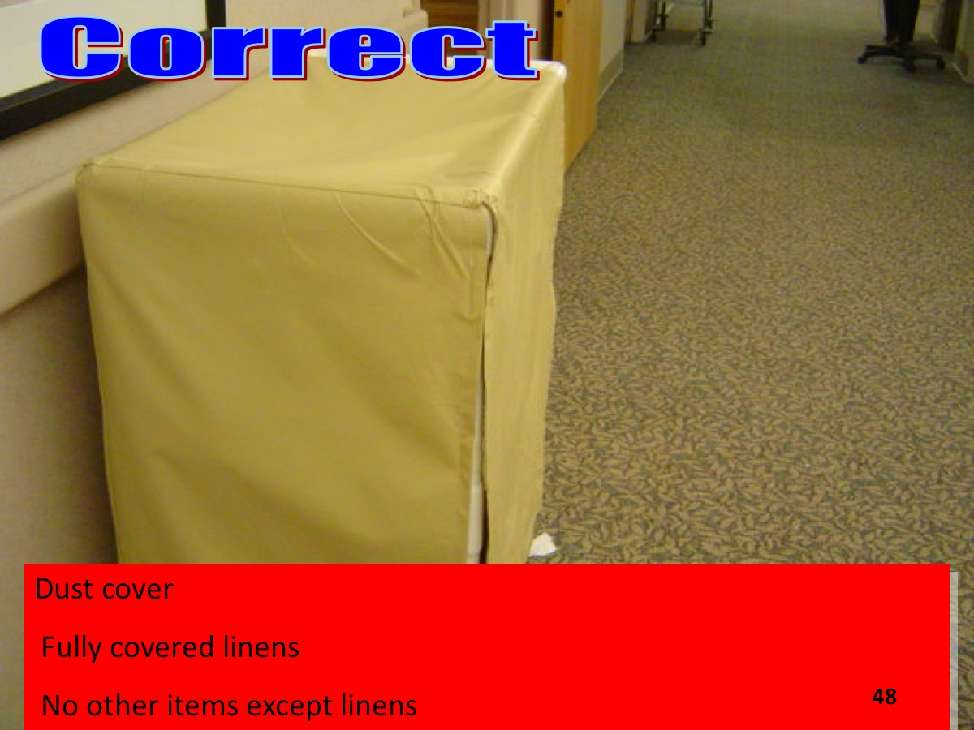

Slide 49
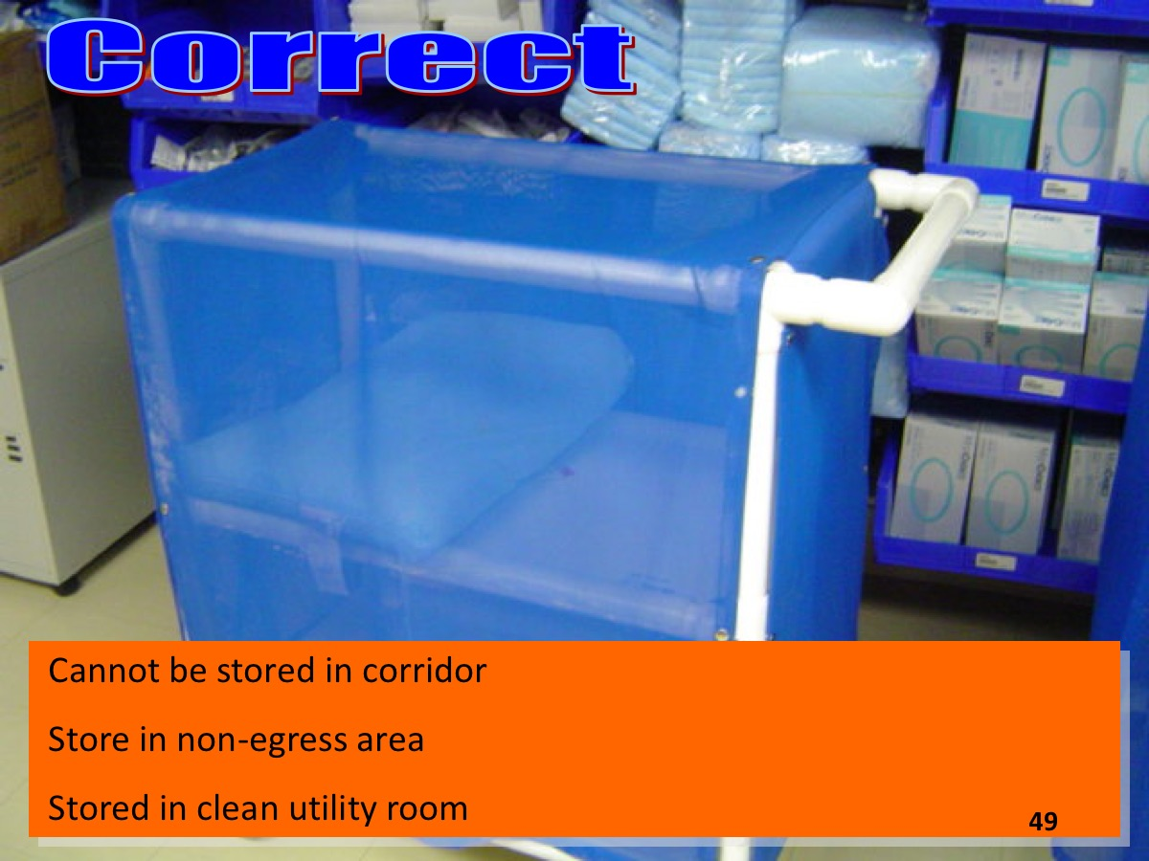

Slide 50
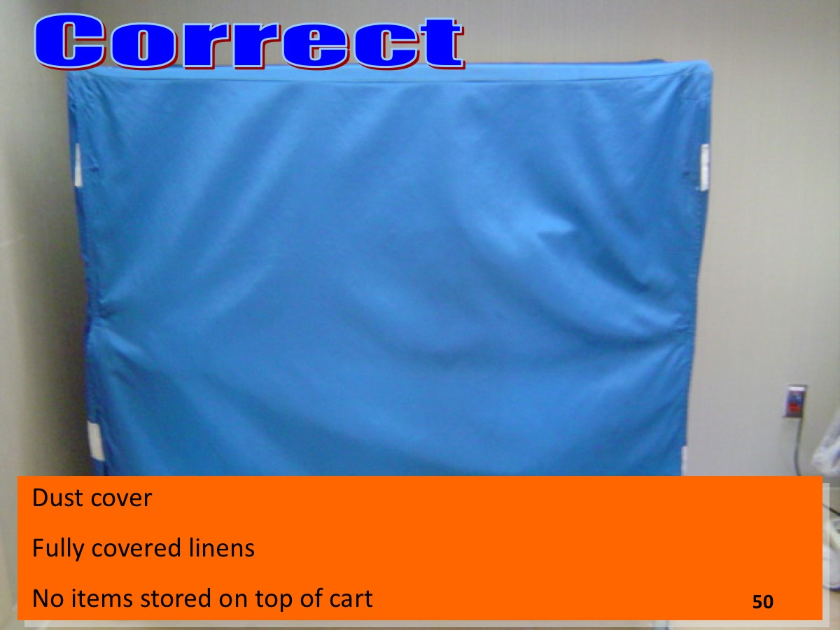

Slide 51
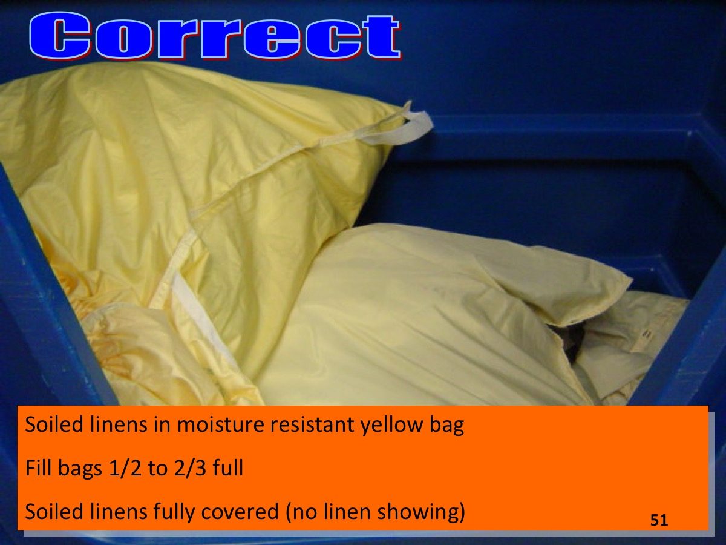

Slide 52
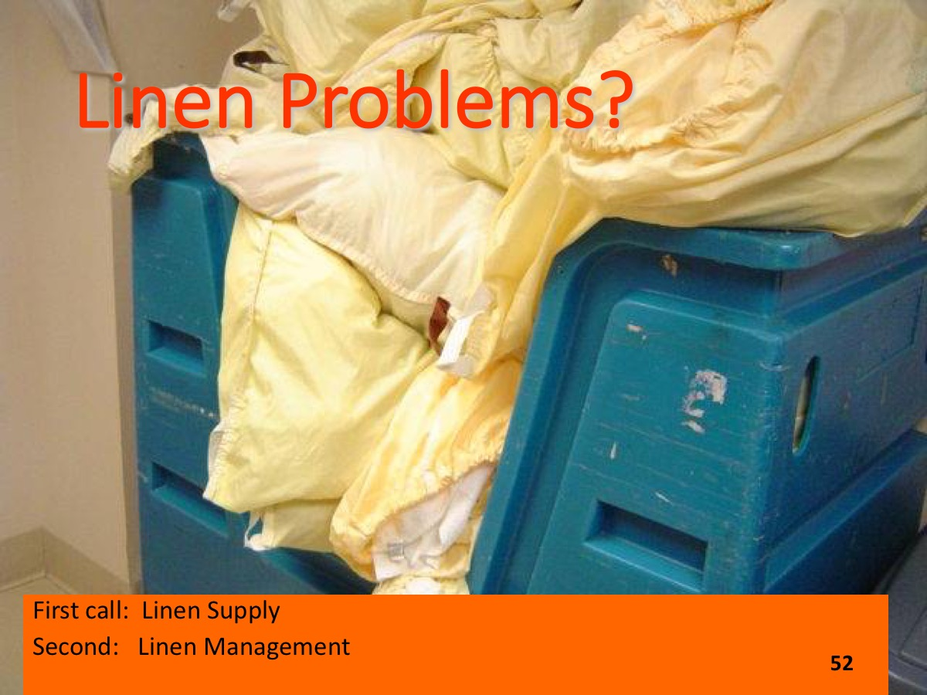

Slide 53
Review the following slides and identify all violations

Slide 54
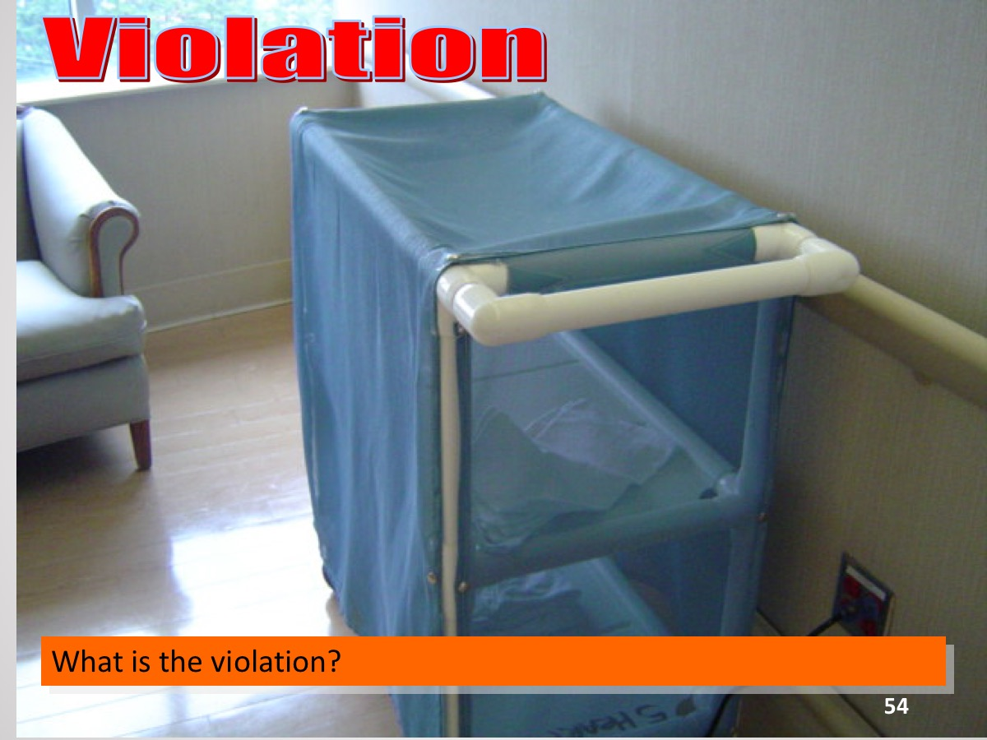

Slide 55
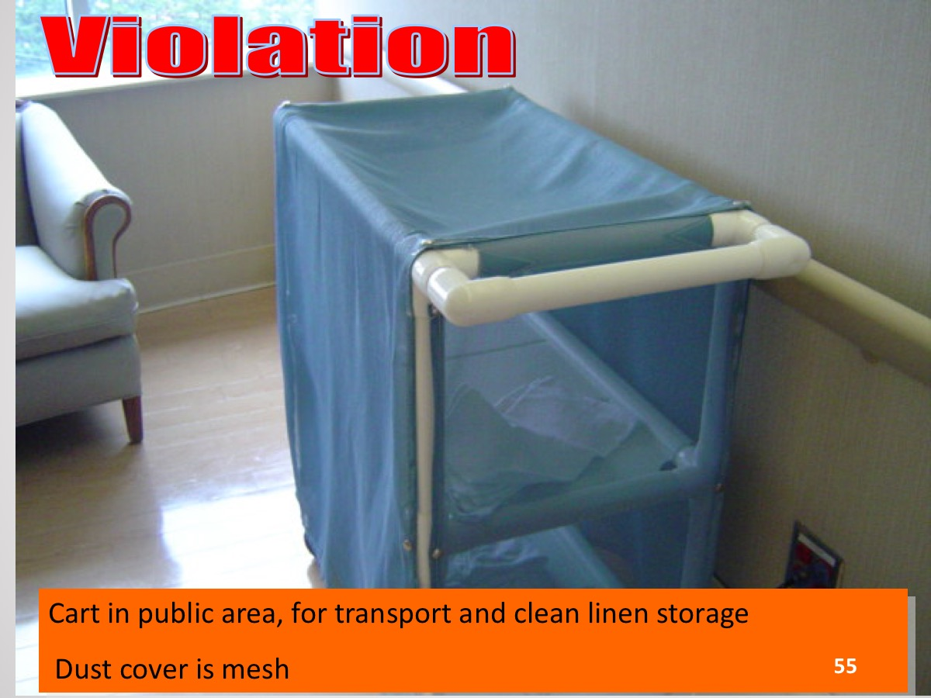

Slide 56
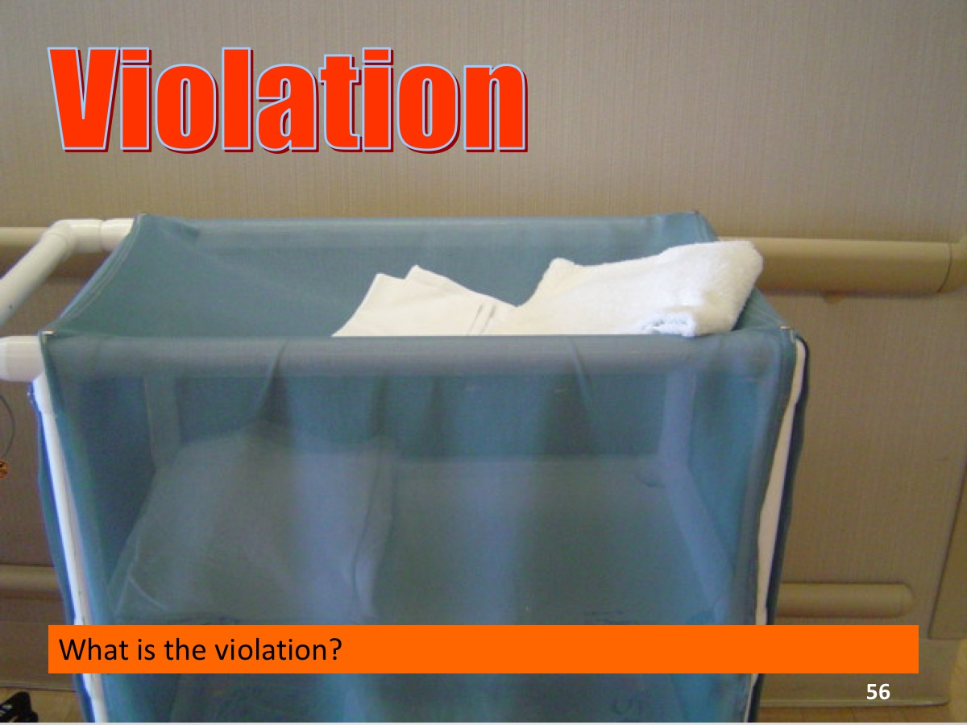

Slide 57
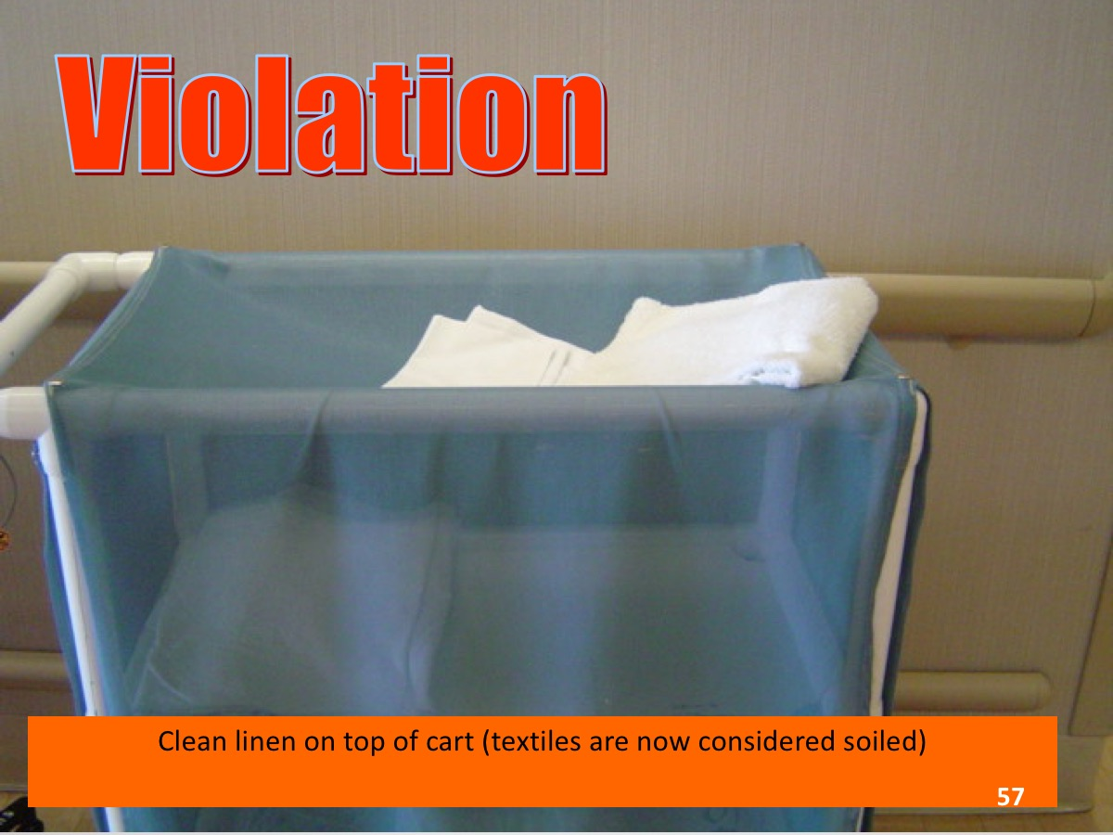

Slide 58
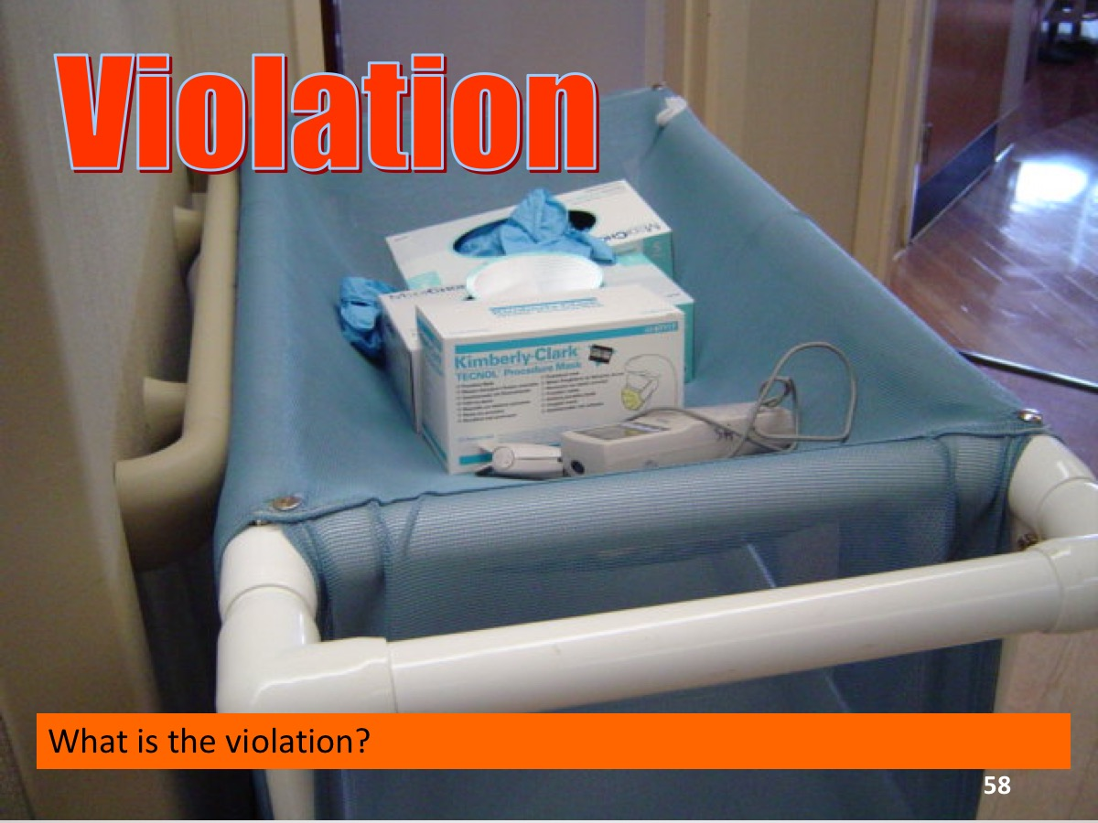

Slide 59
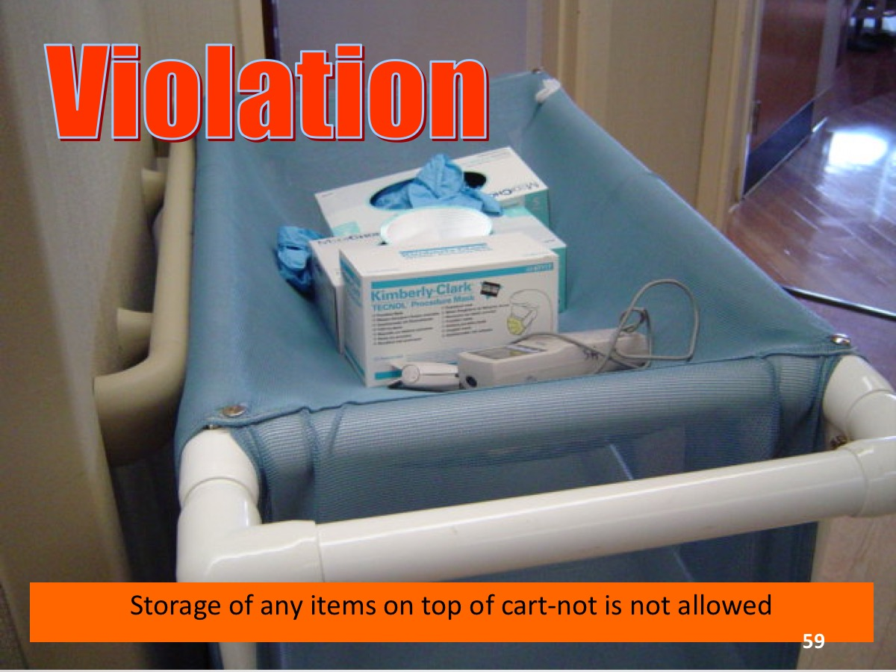

Slide 60
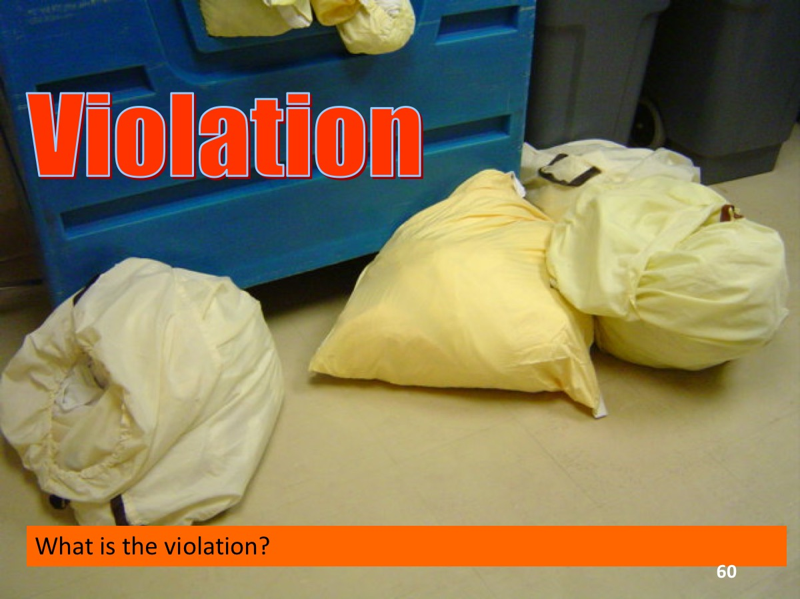

Slide 61
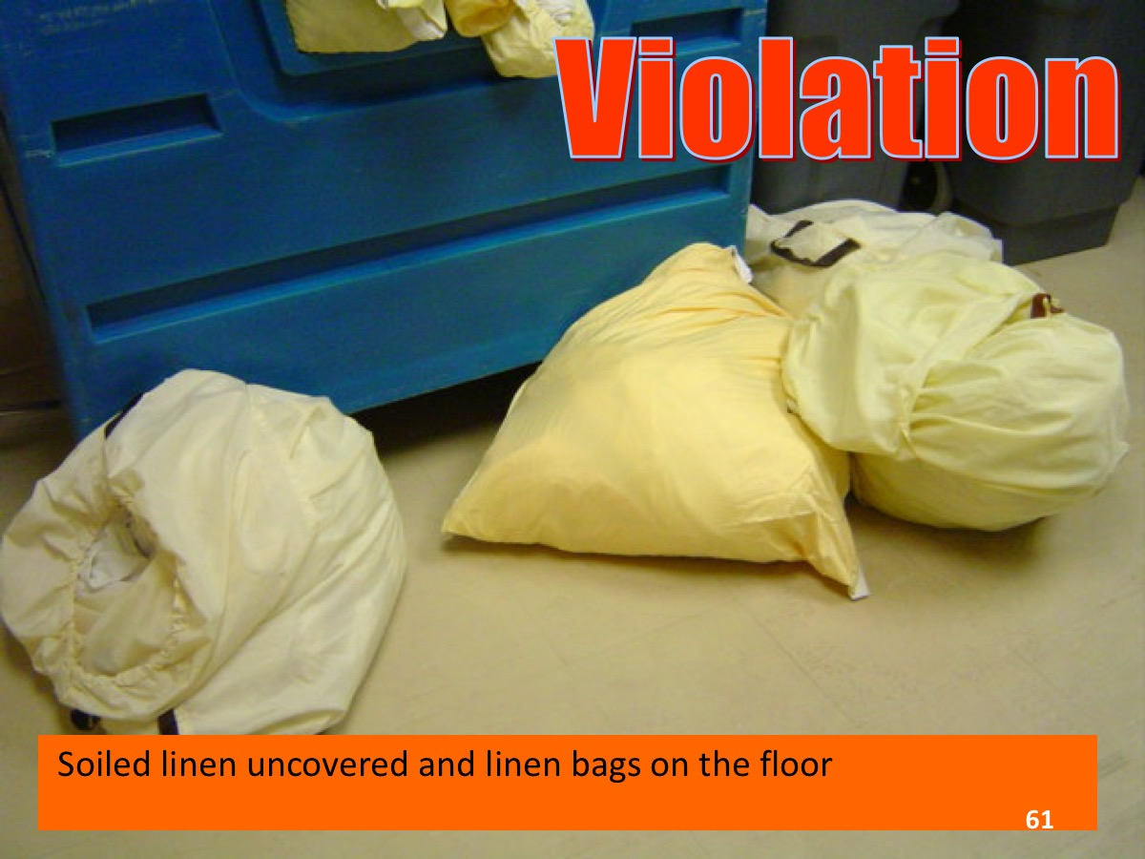

Slide 62
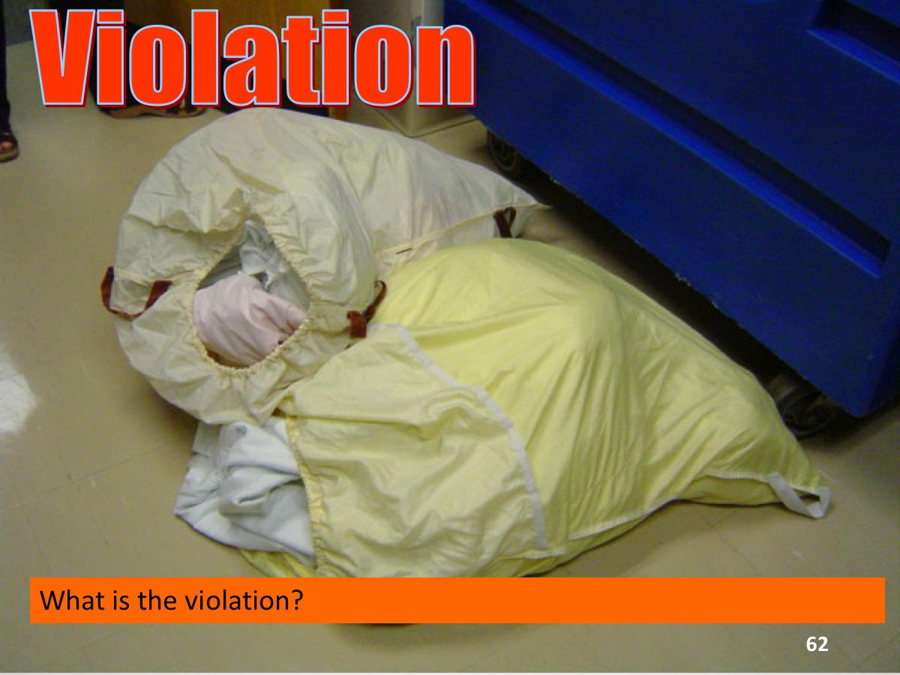

Slide 63
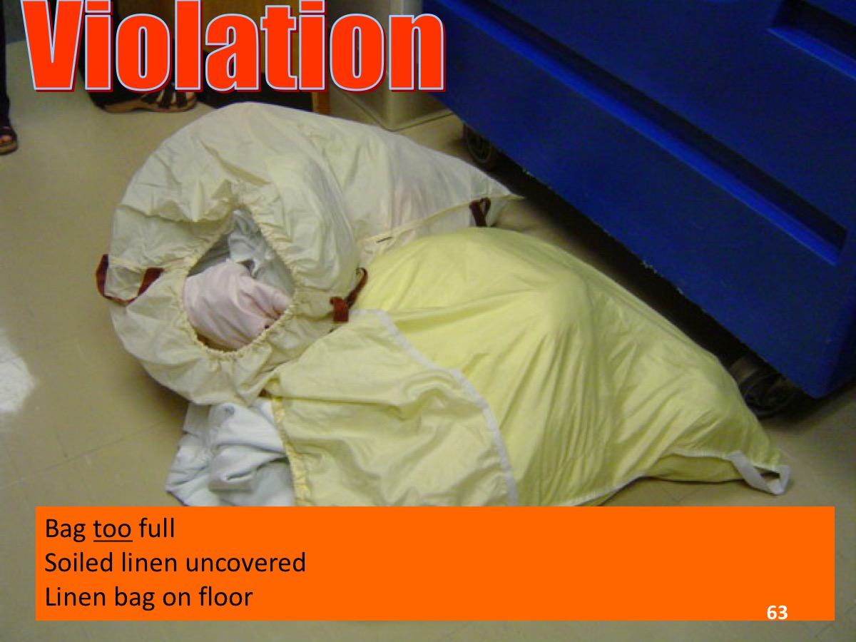

Slide 64
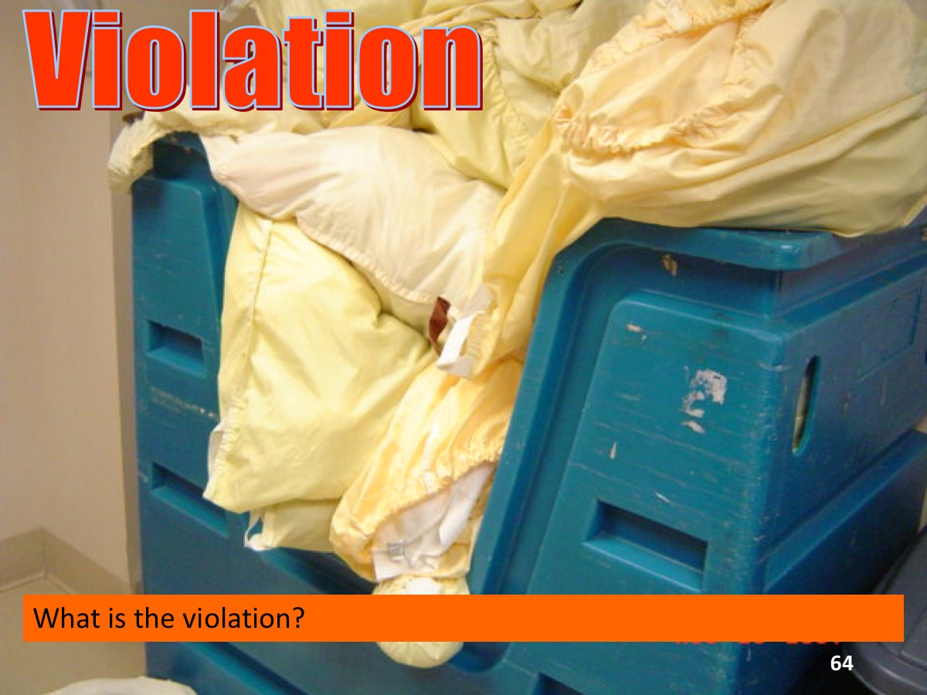

Slide 65
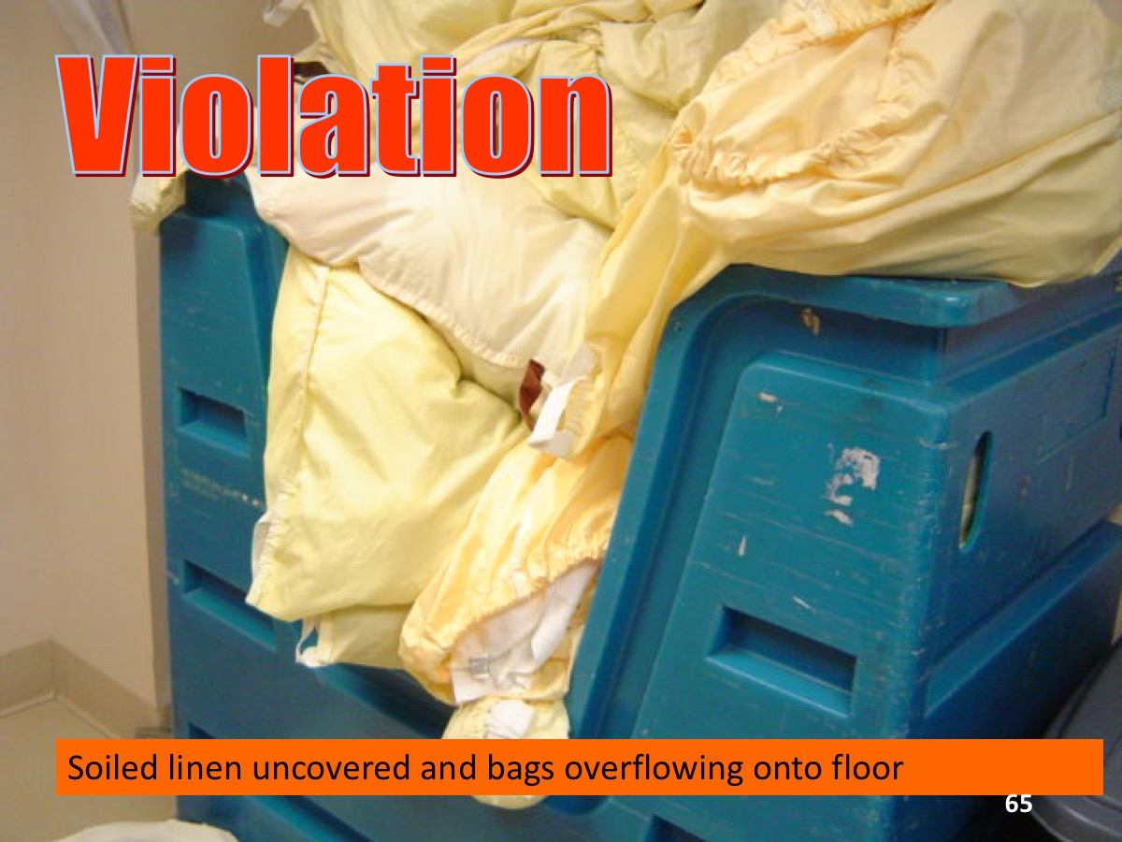

Slide 66
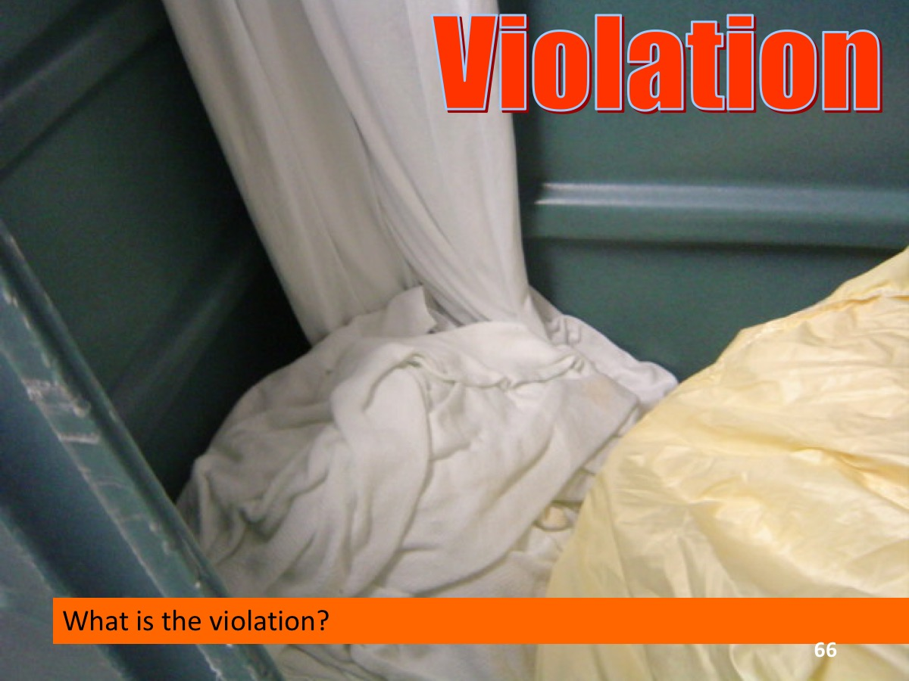

Slide 67
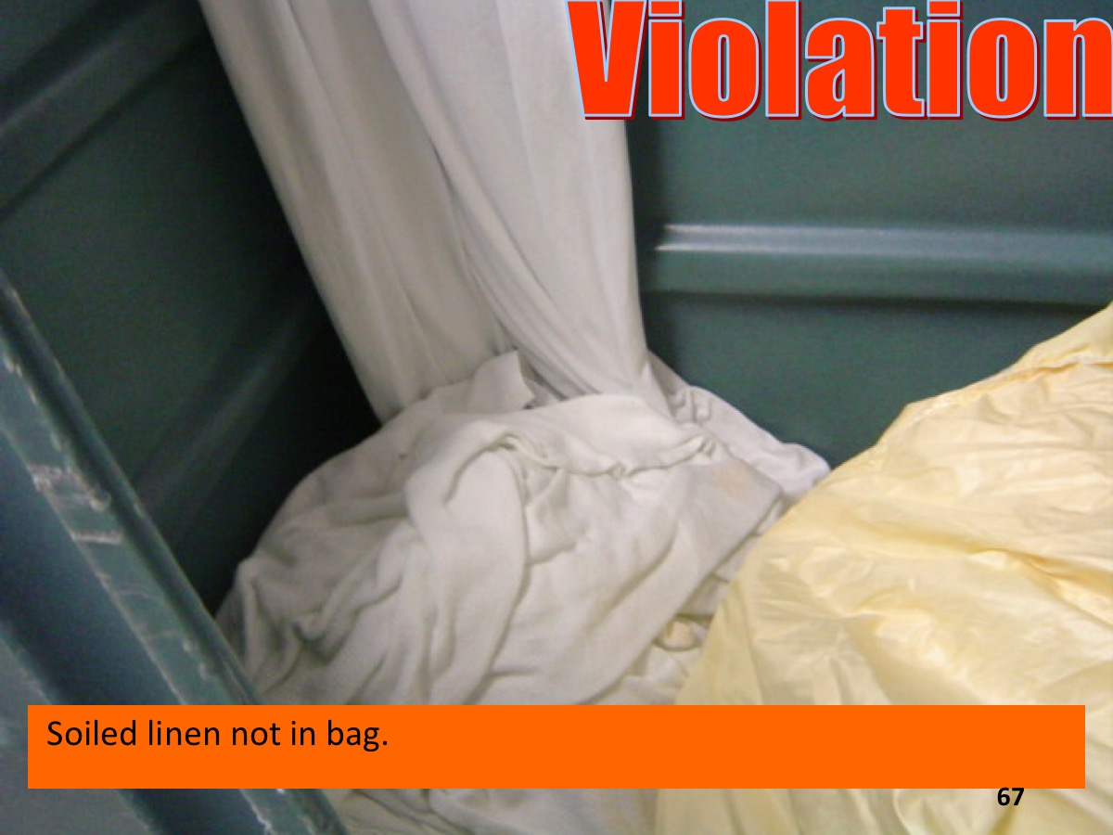

Slide 68

Thank you for keeping residents safe!

Slide 69
References
www.osha.gov/SLTC/etools/hospital/laundry/laundry.html#ContaminatedLaundry
www.osha.gov/SLTC/etools/hospital/housekeeping/housekeeping.html#ContaminatedLaundry
www.cdc.gov/HAI/prevent/laundry.html
www.hlacnet.org/standards.php
www.ndhealth.gov/disease/hai/Docs/WebEx/NDHCFLaundry11162011.pdf
shea.confex.com/shea/2010/webprogram/Paper2072.html
www.chnola.org/Images/Interior/pdfs/mucormycosis%20pages/mucormycosis_outbreak_associated_with_hospital.98032.pdf
F441 §485.65 Infection Control, CMS Manual System, Publication 100-07 State Operations Provider Certification, Department of Health & Human Services, Centers for Medicare & Medicaid Services, Transmittal 55: December 2, 2009
Economic Burden of Healthcare-Associated Infection in US Acute Care Hospitals – Societal Perspective
Albert Marchetti; Richard Rossiter doi: 10.3111/13696998.2013.842922

Slide 70
For more Information
John Scherberger, FAHE, CHESP, CMIP, T-CSCT, VPEI
Healthcare Risk Mitigation
Past-President, HLAC
Spartanburg, SC
864-208-5750
"What is done is important, but more importantly is how it is done.”
- John Scherberger
Thank you for investing your time viewing this presentation.

Slide 71
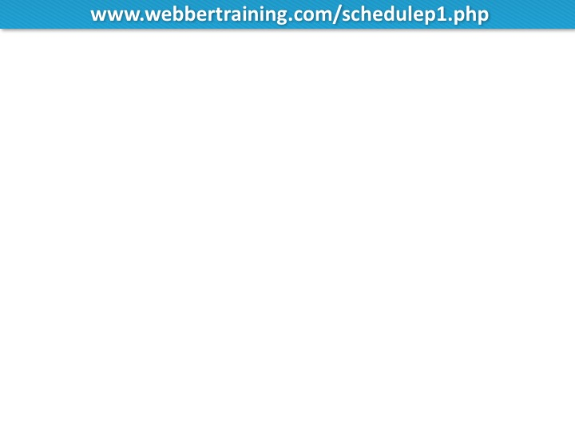


Slide 72


